Slide 1
WARM UP
PLAY GAME :
SLAP THE BOARD

Slide 2
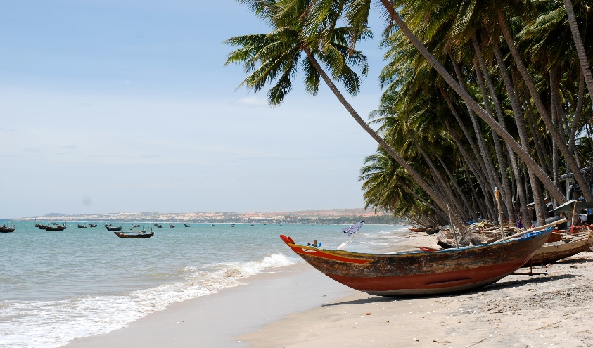

Slide 3
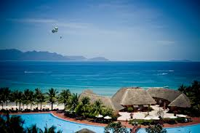

Slide 4
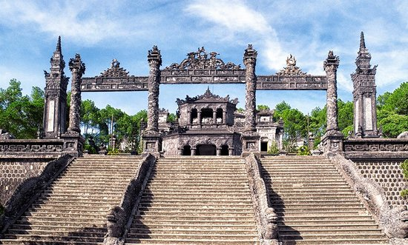

Slide 5
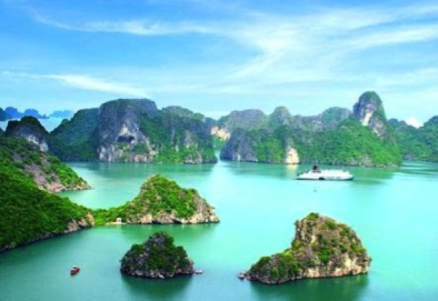

Slide 6
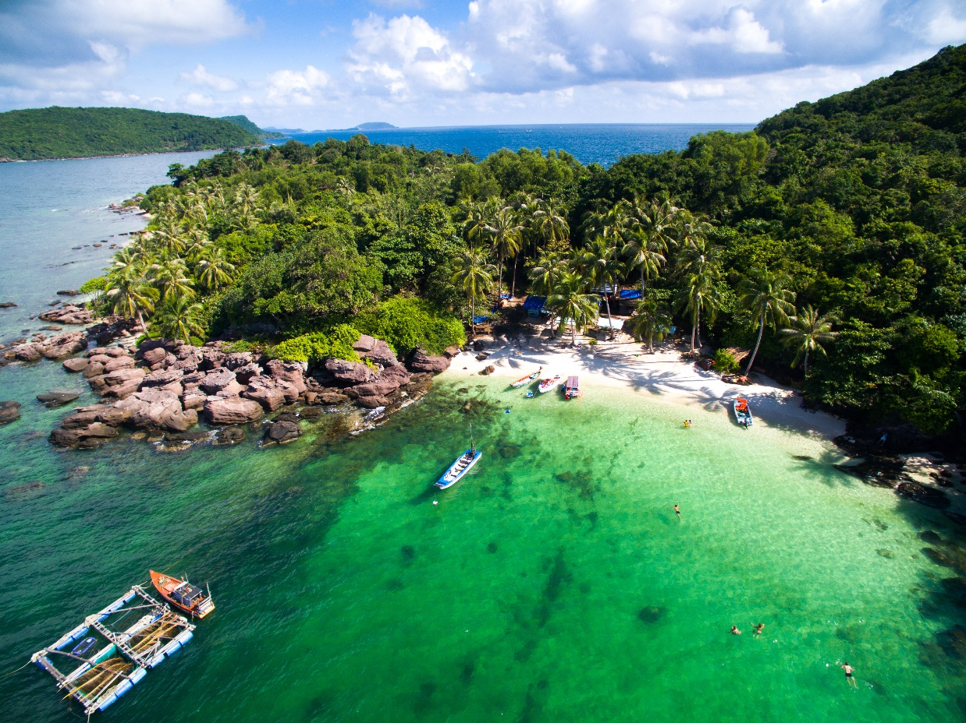

Slide 7
Unit 5: NATURAL WONDERS OF VIETNAM Period 40/Lesson : SKILLS2

Slide 8
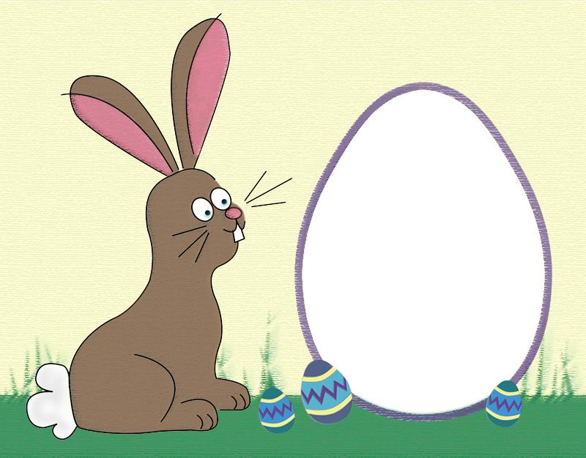
I.Listening

Slide 9
Work in groups. Discuss the question.
What do you know about Phu Quoc Island?
Beautiful island
In Kien Giang
PHU QUOC ISLAND
Listen to the talk and check your answers
Friendly people
Delicious seafood

Slide 10
Listen again and tick () T (True) or F (False).
 |  | T | F
1. | Phu Quoc is a very beautiful island in Viet Nam.
2. | There are no green forests in Phu Quoc.
3. | Tourists can visit fishing villages and national parks there.
4. | You cannot play water sports in Phu Quoc.
5. | People sell interesting things at the markets.





Audio script

Slide 11
II.Writing

Slide 12
Fill each blank in the network with the information about a travel attraction you know.
(2) Where is it?
(3) How can you go there?
(1) Name of the attraction
(5) What can you do there?
(4) What is special about it?

Slide 13
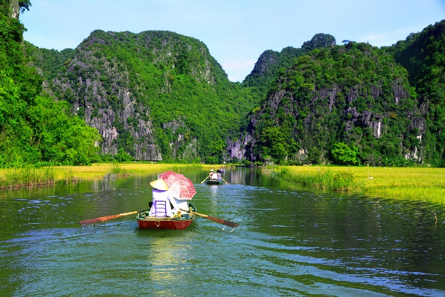
Use the notes in 3 to write a paragraph of about 50 words.
I am writing about
It is in

Slide 14
HOMEWORK
- Redo exercises
- Prepare the new lesson: Unit 5: Looking back and project

