Slide 1
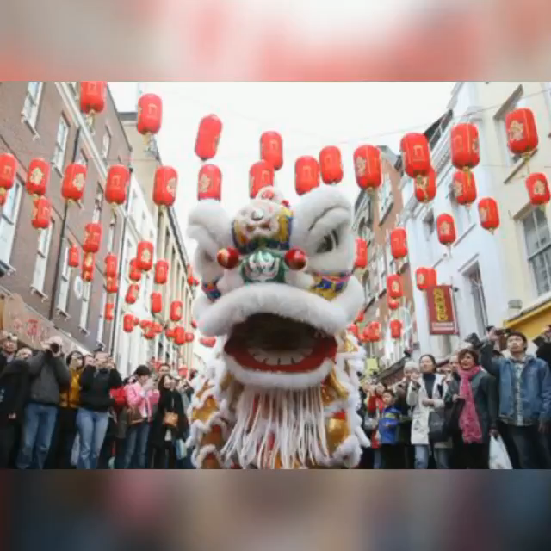
WARM-UP
WATCHING A VIDEO CLIP

Slide 2


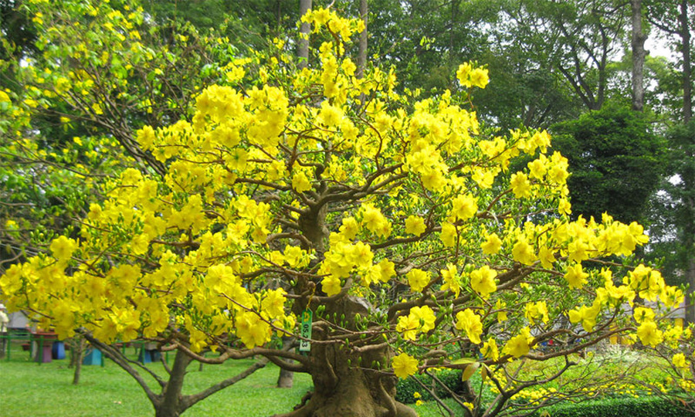
UNIT 6: OUR TET HOLIDAY
Period 42/ Lesson 1: Getting started
HAPPY NEW YEAR!

Slide 3
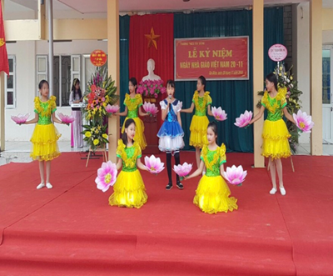
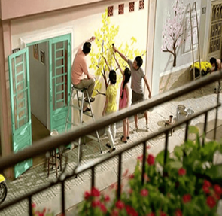
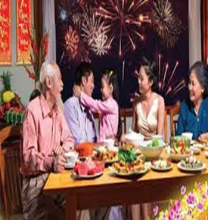
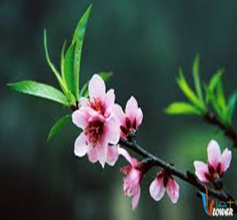
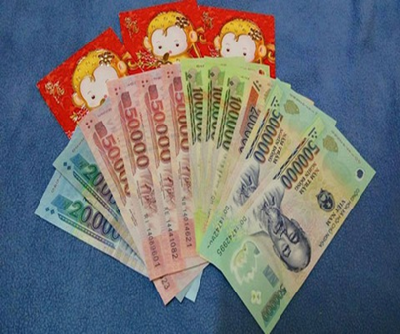
I.VOCABULARY
- Celebrate (v):
làm kỉ niệm
- Decorate (v):
trang trí
- Family gatherings(N.phr):
sum họp gia đình
- Peach flowers (n):
hoa đào
- Lucky money (n):
tiền lì xì

Slide 4




Check vocabulary
lucky money
1. We always have a lot of…………….. at Tet
decorate
2. She will………….her house before Tet
peach flowers
3. My mother often buys ………….
family gatherings
4. Tet is a time for……………………
celebrates
5. My school usually………….. Vietnamese teachers' day on November 20

Slide 5

II.PRACTICE
1.LISTEN AND READ
Linda: Phong, does Viet Nam celebrate New Years?
Phong: Yes, we do. We have Tet.
Linda: When is Tet?
Phong: At different times. This year, it’s in January.
Linda: What do you do at Tet?
Phong: We clean our homes and decorate them with ﬂowers.
Linda: Is Tet a time for family gatherings?
Phong: Yes. It’s a happy time for everybody.
Linda: Great.
Phong: Yes, and another good thing about Tet is that children get lucky money.
Linda: That sounds interesting. Is there anything special people should do?
Phong: We should say “Happy New Year” when we meet people, and we shouldn’t break anything.

Slide 6


What are Linda and Phong talking about?
A.
New Years in the world
B.
Tet in Viet Nam
C.
What to eat and wear during tet

Slide 7






Complete the sentences about Tet with the information from the conversation in 1.
1.
January
.
This year Tet is in
.
2.
We decorate our
homes
.
.
3.
Tet is a time for family
gatherings
.
.
4.
Children get
lucky money
.
.
5.
People shouldn’t
break
anything.
anything.

Slide 8

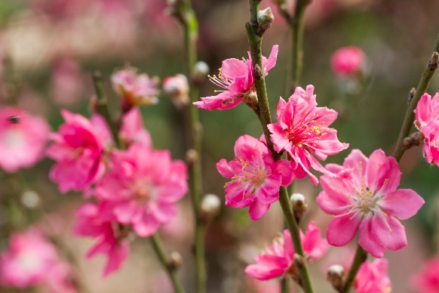
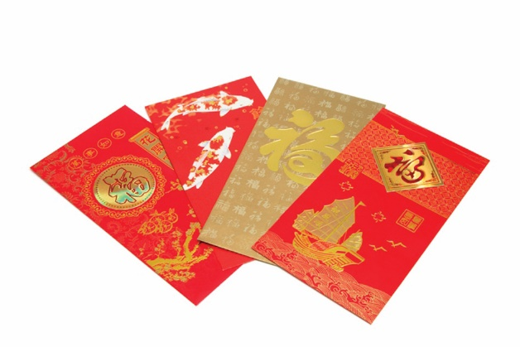
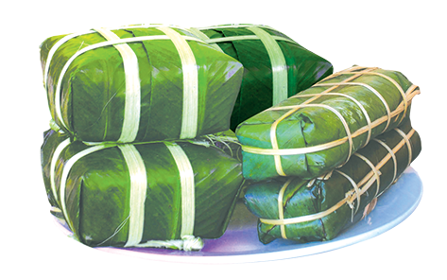
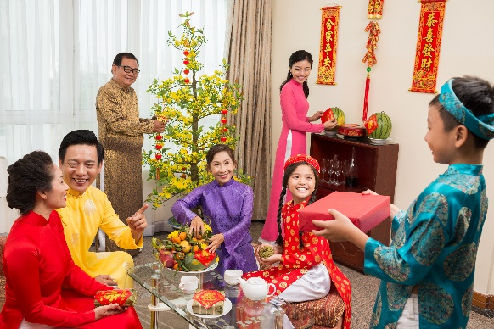
Match the words / phrases in the box with the pictures.
a. lucky money
a. lucky money
c. banh chung and banh tet
c. banh chung and banh tet
b. peach flowers
b. peach flowers
d. family gathering
d. family gathering
1
2
b. peach flowers
a. lucky money
3
4
c. banh chung and banh tet
d. family gathering

Slide 9
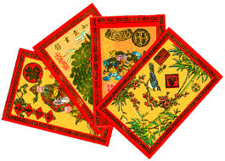
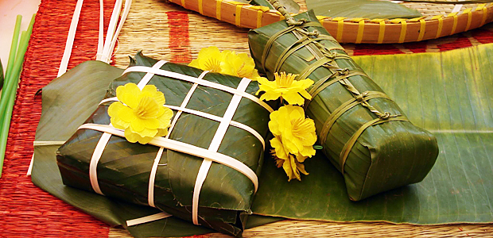
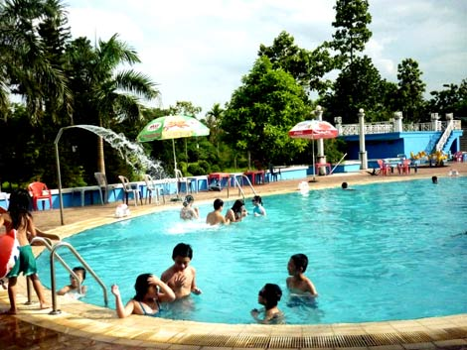
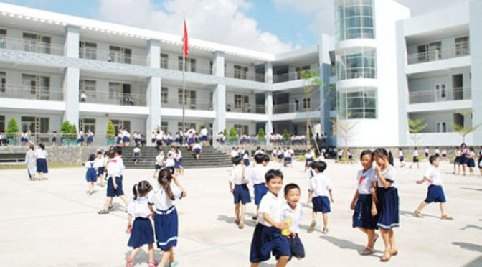

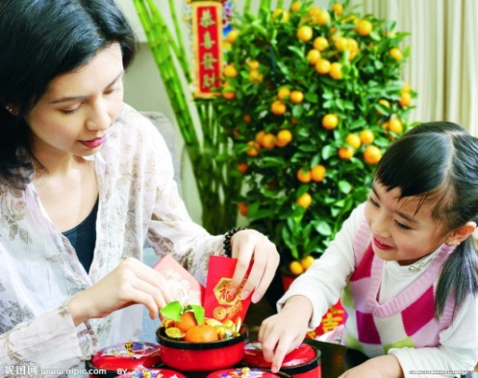
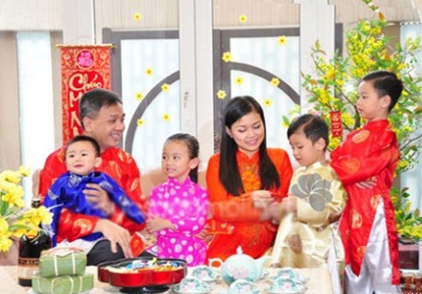
Look at the pictures . Which pictures do you think are related to Tet.
1……….…………...
2……….………..…..
3……………….……..
4………………..……..
5……….…………..
6……………………..
7……………...……..
8……………….……..

Slide 10

Unit 6: OUR TET HOLIDAY
Period 42: Getting started
HOME WORK
- Learnt new words by heart.
- Read the text again.
- Prepare: Unit 6 A Closer look 1

Slide 11







