Slide 1


Slide 2
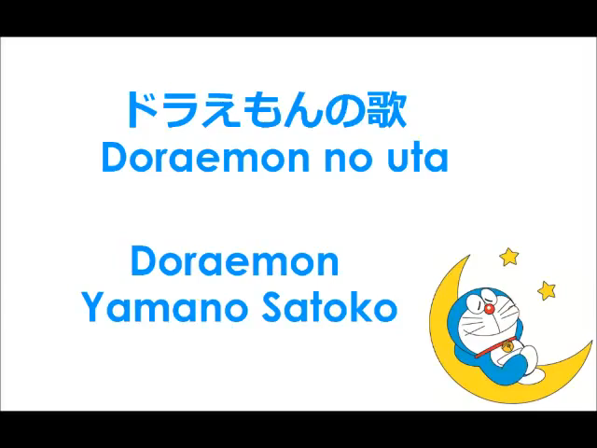
Do you like watching film?
You listen to music and tell the name of the film.

Slide 3
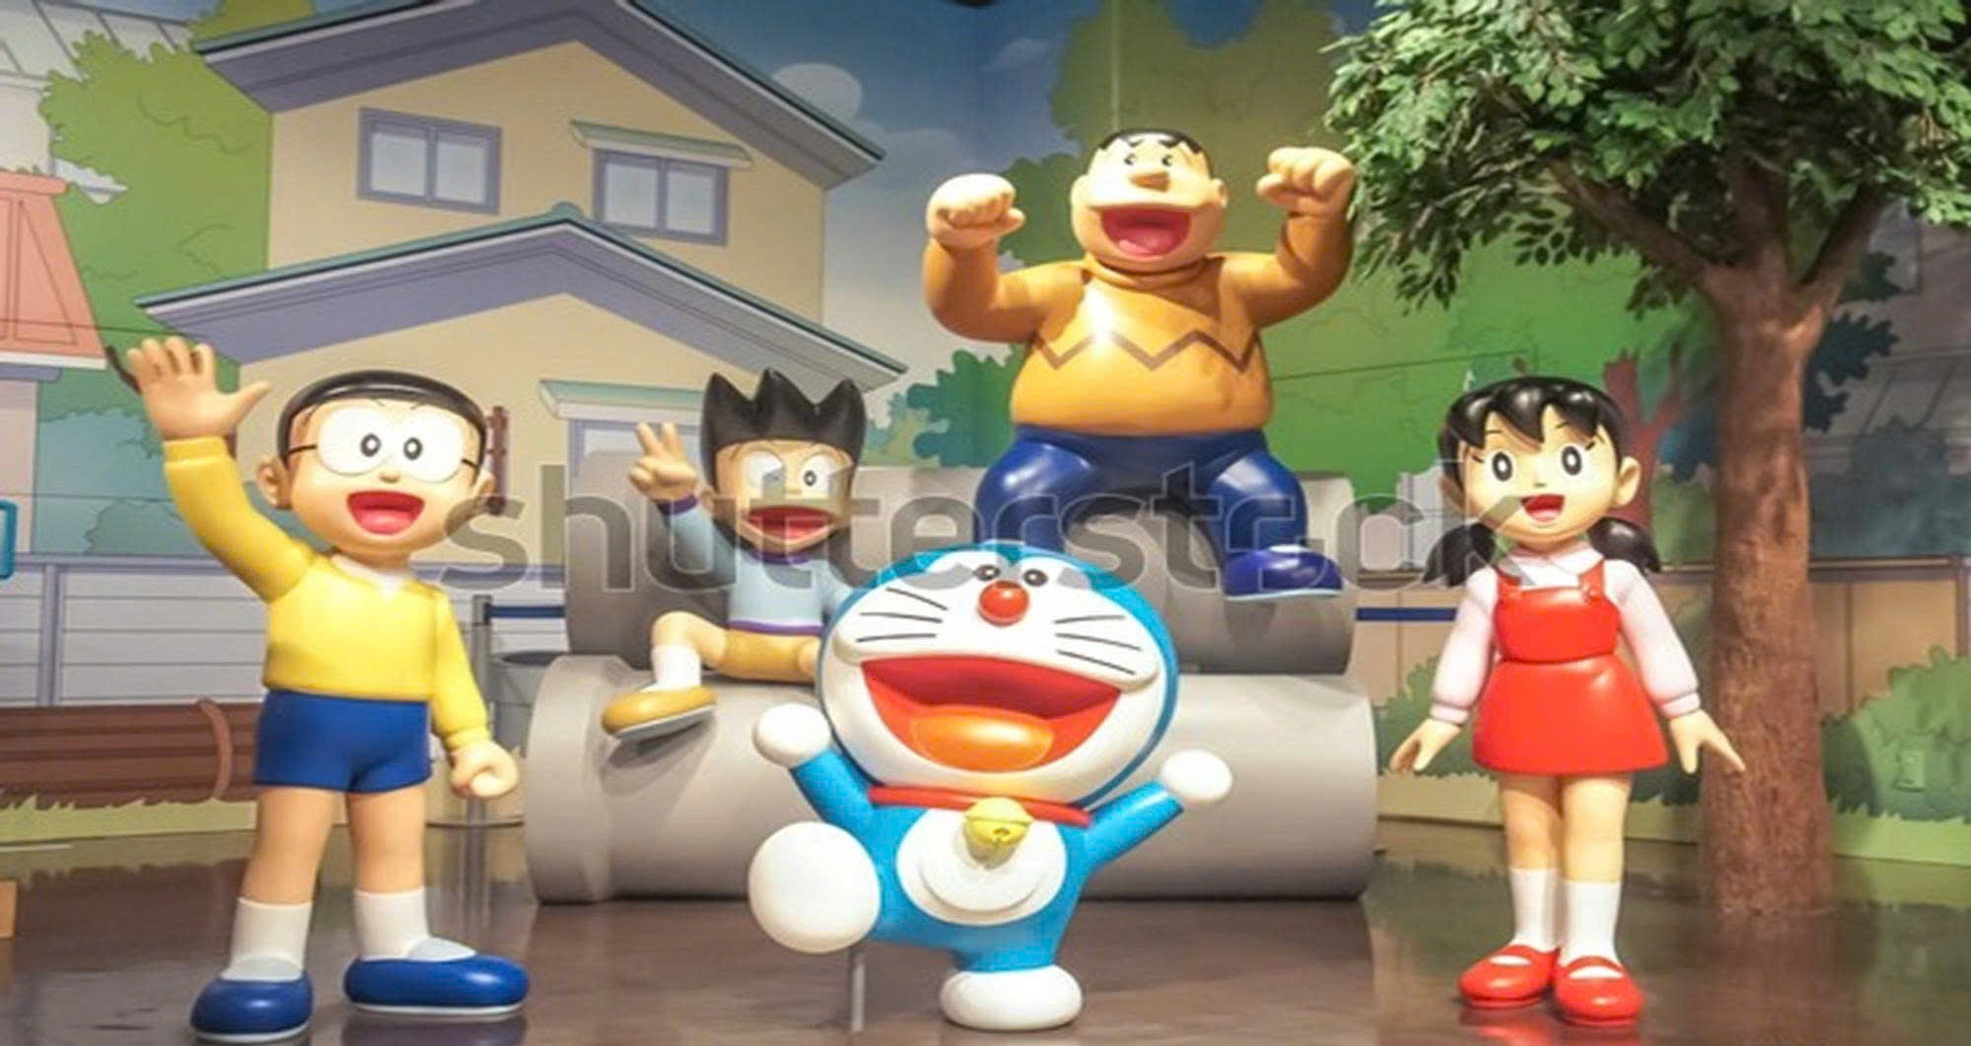
Who are they ?
ID: 238876258

Slide 4


Unit
3
MY FRIENDS
LESSON 2: A CLOSER LOOK 1
1

Slide 5
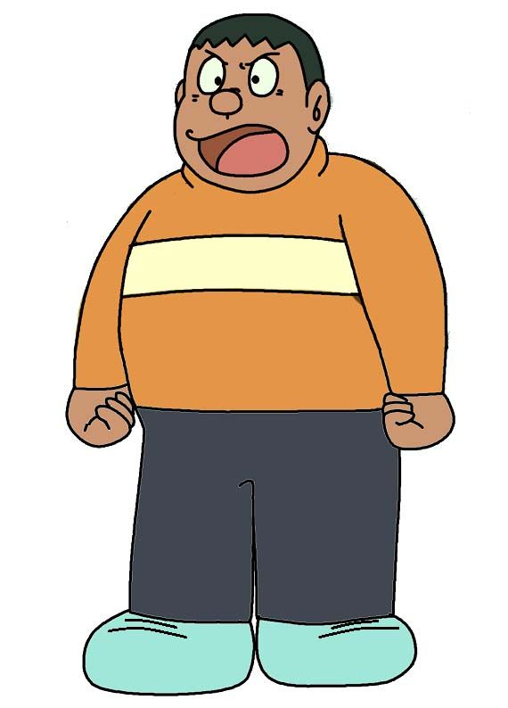
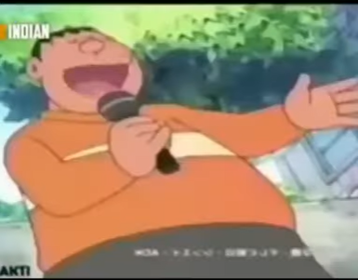

I. Vocabulary:
Gian is big and strong.
Sometimes, he makes people laugh. He sings very bad but he is confident
confident
tự tin

Slide 6
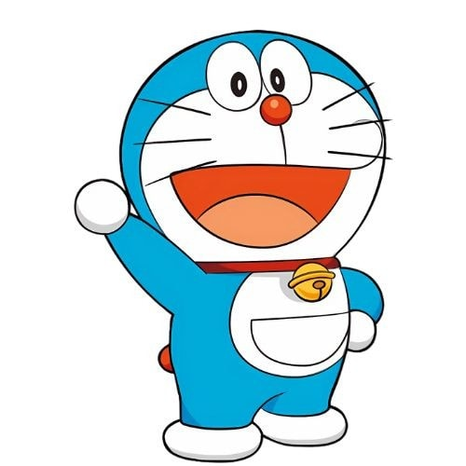
I. Vocabulary:
Doremon always helps other people.
caring
quan tâm
He is careful.
careful
cẩn thận

Slide 7
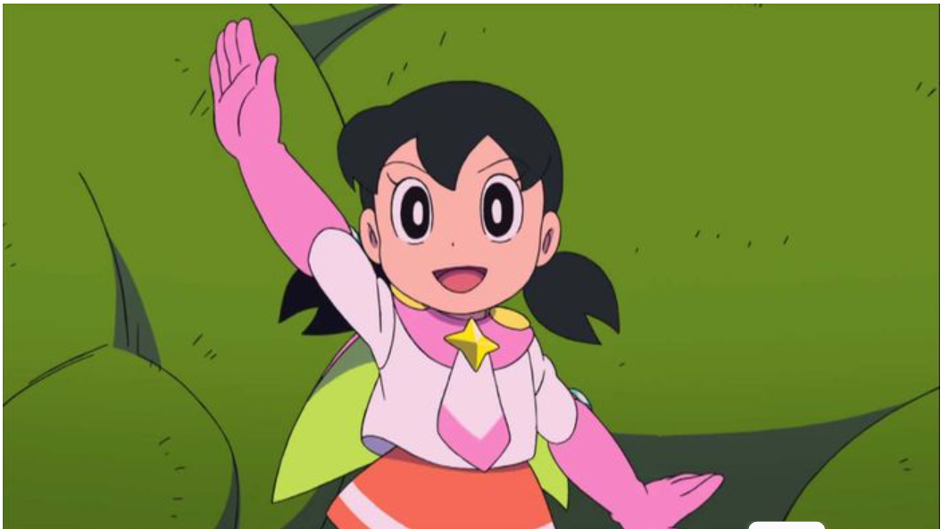
I. Vocabulary:
active
Shizuka is not lazy. She is active.
năng động
Shizuka is also nice to other people.
kind
tử tế, tốt bụng

Slide 8
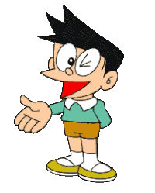
I. Vocabulary:
creative
Suneo is good at drawing and making things. He is creative and clever.
sáng tạo
clever
thông minh

Slide 9
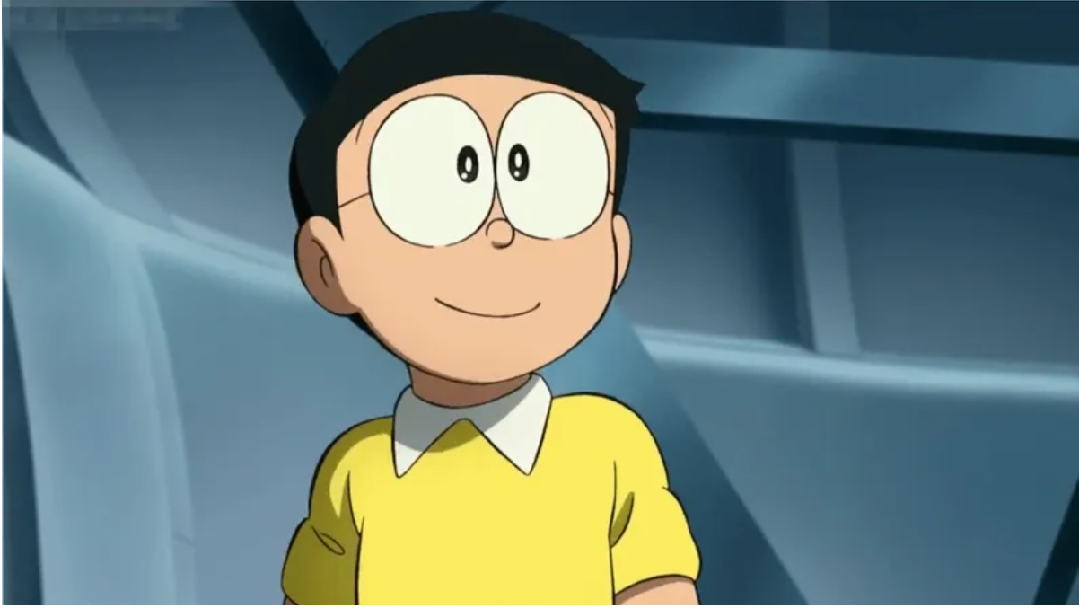
I. Vocabulary:
Nobita doesn’t like studying and working. He is shy.
shy
He is shy
nhút nhát

Slide 10
VOCABULARY
New words | Pronunciation | Meaning
1. confident (adj) | /ˈkɒnfɪd(ə)nt/ | tự tin
2. caring (adj) | /ˈkeərɪŋ/ | quan tâm
3. active (adj) | /ˈæktɪv/ | năng động
4. careful (adj) | /ˈkeəfl/ | cẩn thận
5. creative (adj) | /kriˈeɪtɪv/ | sáng tạo
6. shy (adj) | /ʃaɪ/ | nhút nhát
7. kind (adj) | /kaɪnd/ | tốt bụng
8. clever (adj) | /ˈklevə(r)/ | thông minh

Slide 11
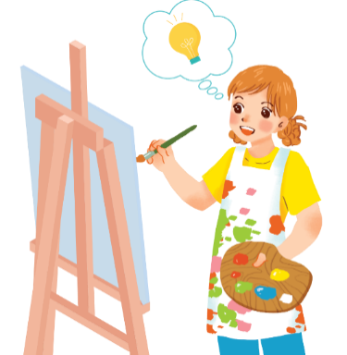
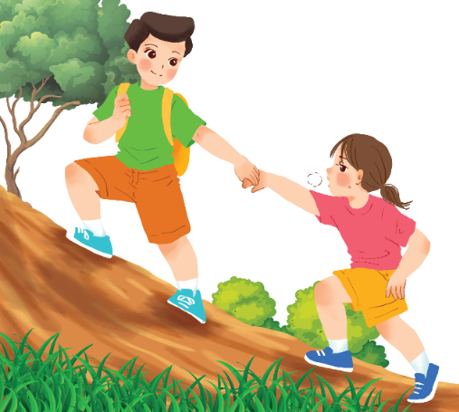
VOCABULARY
2
Use the adjectives in the box to complete the sentences.
Pay attention to the highlighted words / phrases.
careful
clever
shy
kind
creative
friendly
1.
Mina is very _______ . She likes drawing pictures. She always has lots of new ideas.
creative
kind
2.
Nam is _____ .
He likes helping his friends.

Slide 12
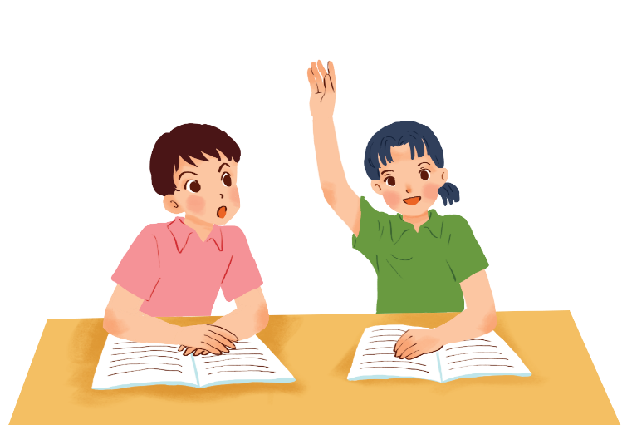
F
T
T
T
VOCABULARY
F
2
Use the adjectives in the box to complete the sentences.
Pay attention to the highlighted words / phrases.
careful
clever
shy
kind
creative
friendly
Mai is ______ .
She learns things quickly and easily.
5.
clever

Slide 13


VOCABULARY
3
  Friendship ﬂower.
Work in groups. Write two personality adjectives for each group member.
Minh: kind funny

Slide 14
II. PRONUNCIATION
4
Listen and circle the words you hear. Then repeat.
 | /b/ | /p/
1. | big | pig
2. | bear | pear
3. | buy | pie
4. | robe | rope

Slide 15

II. PRONUNCIATION
5
Listen. Then practise the chant. Notice the rhyme.
We’re having a picnic
We’re having a picnic
Fun! Fun! Fun!
We’re bringing some biscuits
We’re bringing some biscuits
Yum! Yum! Yum!
We’re playing together
We’re playing together
Hurrah! Hurrah! Hurrah!

Slide 16


LUCKY NUMBERS
1
2
3
4
5
6
7
8
GA
2
4
6
8
10
12
14
GB
2
4
6
8
10
12
14

Slide 17

LUCKY NUMBER!
you get 2 plus points

Slide 18
LUCKY NUMBER!
you get 2 plus points

Slide 19

UNLUCKY NUMBER

Slide 20
Fill in each blank.
What is Doreamon …… ?
like
He is useful and friendly

Slide 21
Fill in each blank.
What … Nobita like?
is
He is very kind but a little lazy.

Slide 22
Answer the question.
1
What is your best friend like?
She/ He is …kind and helful…

Slide 23
Answer the question.
1
What is your father like?
He is ……kind…….

Slide 24
1
Answer the question.
What is your English teacher like?
She is ……friendly…….

Slide 25

CONSOLIDATION
1
Wrap-up
What have we learnt in this lesson?
use lexical items related to body parts, appearance and personality
correctly pronounce the sound /p/ and /b/ in isolation and in context

Slide 26

CONSOLIDATION
2
Homework
Do the exercises in the workbook.
Prepare: A closer look 2.

Slide 27


Thank you!
Goodbye!

