Slide 1
Welcome to our class!

Slide 2
UNIT 8: SHOPPING
Period 63:
Lesson 2: A closer look 1

Slide 3
VOCABULARY
PRONUNCIATION

Slide 4
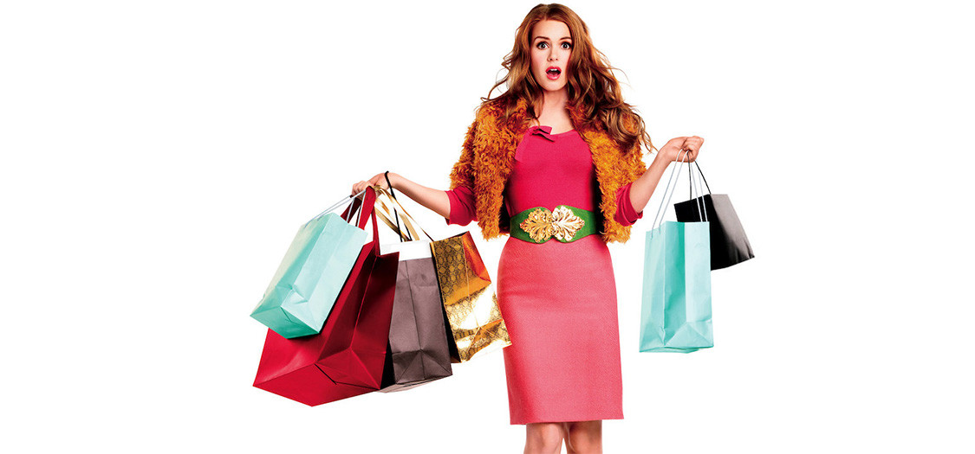
shopaholic (n) /ˌʃɒpəˈhɒlɪk/
người nghiện mua sắm

Slide 5
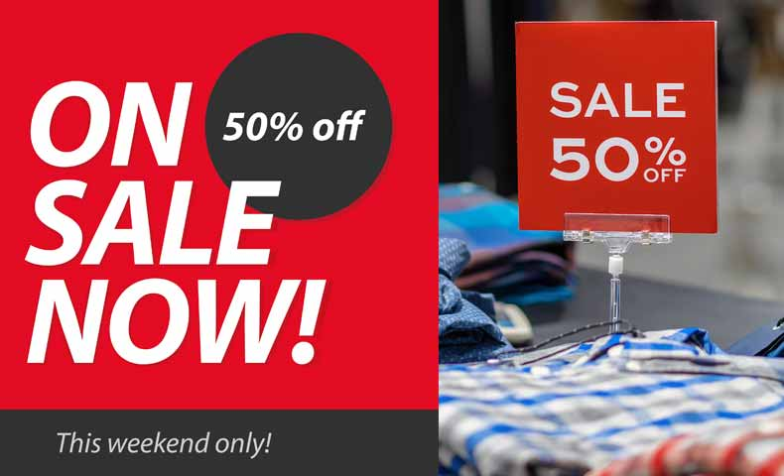
on sale (adv) /ɒn seɪl/
đang (được bán) hạ giá

Slide 6

discount shop (n) /ˈdɪskaʊnt ʃɒp/
cửa hàng hạ giá

Slide 7
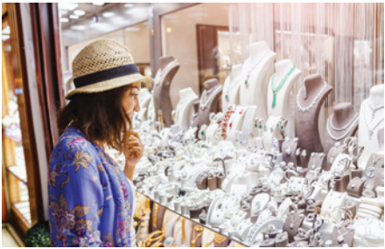
browse (v)
xem lướt qua
/braʊz/

Slide 8
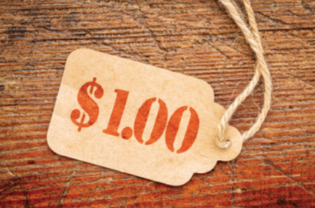
price tag (n)
/ prais tæg/
nhãn ghi giá 1 mặt hàng

Slide 9
New words | Pronunciation | Meaning
1. shopaholic (n) | /ˌʃɒpəˈhɒlɪk/ | người nghiện mua sắm
2. on-sale (adv) | /ɒn seɪl/ | đang (được bán) hạ giá
3. discount shop (n) | /ˈdɪskaʊnt ʃɒp/ | cửa hàng hạ giá
4. browse (v) | /braʊz/ | xem lướt qua
5. price tag (n) | / prais tæg/ | nhãn giá 1 mặt hàng

Slide 10
PRACTICE

Slide 11
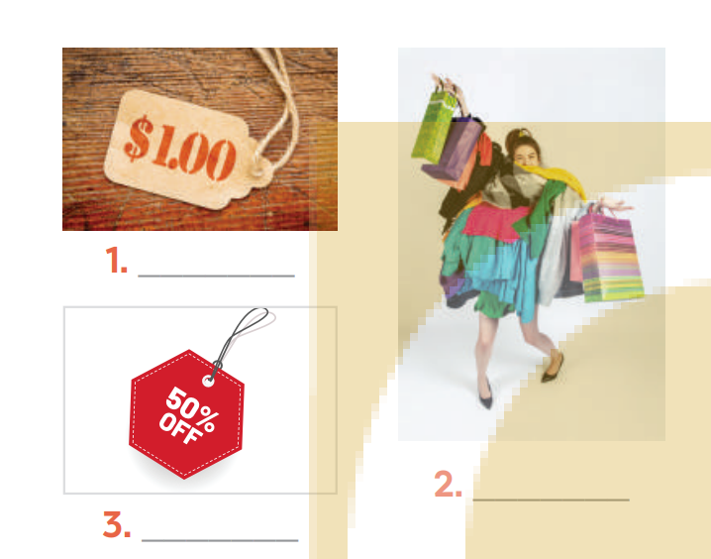
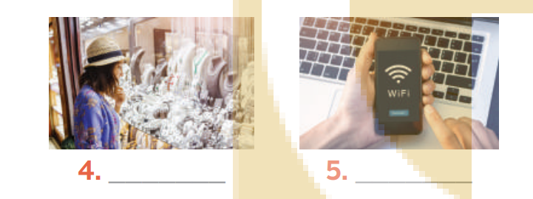
II.PRACTICE
1
Write the words and phrases under the correct pictures
shopaholic
browsing
price tag
Internet access
on sale

Slide 12
PRACTICE
2
Match the shopping places with their characteristics.
1. a speciality shop | a. It offers lower prices on all products.
2. a discount shop | b. It uses the Internet to sell goods and services.
3. a supermarket | c. It is often outdoor and offers a wide range of goods. Buyers can bargain.
4. an online shop | d. It is a large indoor shopping place with mixed prices for all the items offered.
5. an open-air market | e. It offers one or two specific kinds of goods.

Slide 13
I. VOCABULARY
PRACTICE
3
Complete the sentences with the words and phrases from the box.
shopaholic
bargain
speciality shops
browsing
range of products
There are many _______________in a shopping centre.
I spent the whole morning just __________ online for clothes, but I didn’t buy anything.
Alice doesn’t know how to _________ , so she paid too much for her T-shirt.
Both online and offline supermarkets offer a wide________________.
She’s a ___________ . She spends too much time and money shopping.

Slide 14
PRONUNCIATION

Slide 15

III. PRONUNCIATION
4
Listen and repeat the words. Pay attention to the sounds /sp/ and /st/.
/sp/ | /st/
spend
stall
speciality
staff
space
outstand
respect
honest
slasp
waste

Slide 16
III. PRONUNCIATION
PRACTICE
5
Listen and repeat the sentences. Pay attention to the underlined words.
There is a three-storey sports centre in my neighbourhood.
The assistant at her shop always gives us special attention.
The shop owner treats his customers with a lot of respect.
The food at that restaurant is too spicy for me.
Tom spent half of his savings in that music store.

Slide 17
Choose the correct answers:
1. I enjoy ______________ through different online stores to see what's available.
A. browsing B. scanning C. downloading D. connecting
2 . Online shopping offers a wide ________ of products to choose from.
A. area B. range C. field D. collection
3. Having reliable internet ______________ is essential for a seamless online shopping experience.
A. contact B. entry C. access D. admission
4. Many items are on ______________ right now, so it's a perfect time to shop for discounts.
A. purchase B. business C. market D. sale
5. When I checked the price ______________ on the dress, I was pleasantly surprised to see it was on sale for half its original price.
A. button B. badge C. tag D. label

Slide 18

CONSOLIDATION
What have we learnt in this lesson?
Shopping places and their characteristics.
2 sounds /sp/ vs /st/

Slide 19
* Homework:
Learn the new words by heart.
Redo the exercises in the textbook.
Do the exercises in the part A (workbook)
Prepare : A closer look 2 ( Adverbs of frequency)

Slide 20
THANK YOU FOR YOUR ATTENTION

