Slide 1
Matching game
Look at the picture.
Match the pictures with the correct words/phrases.
2 minutes

Slide 2
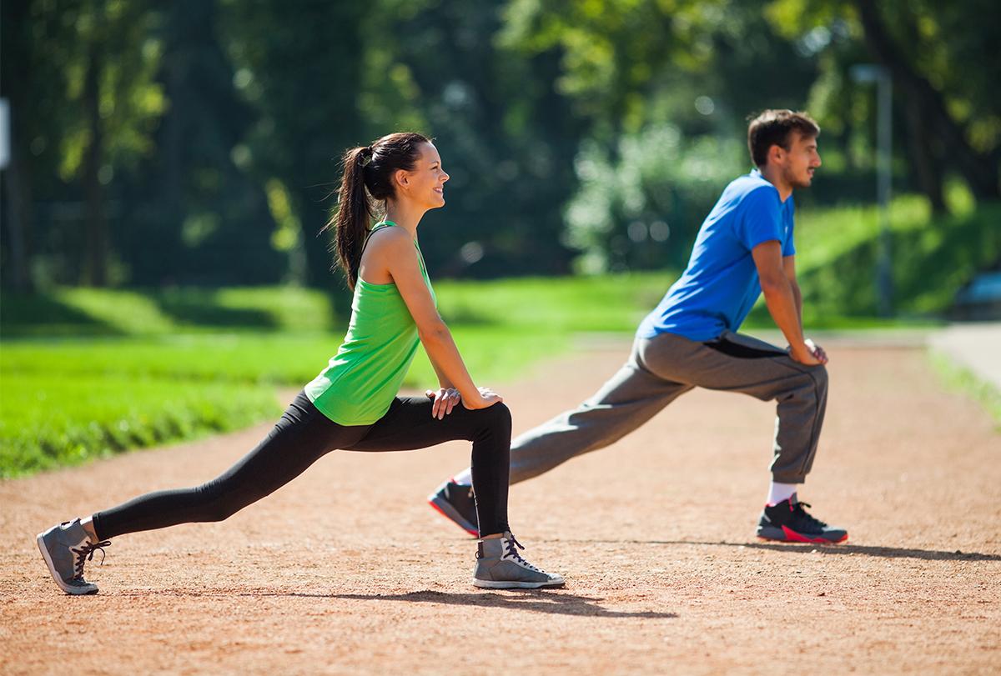
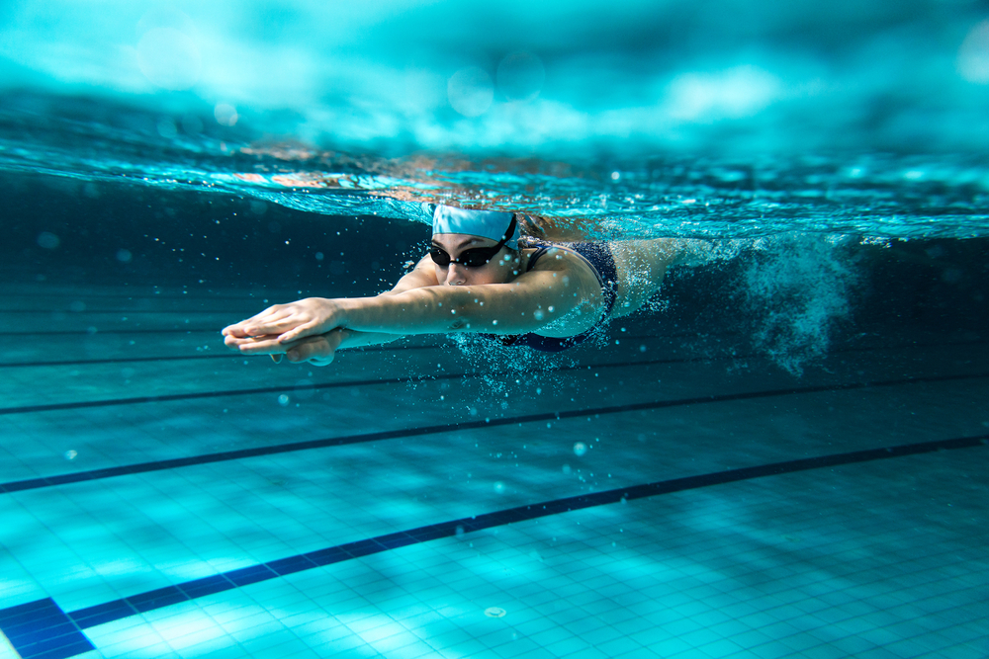
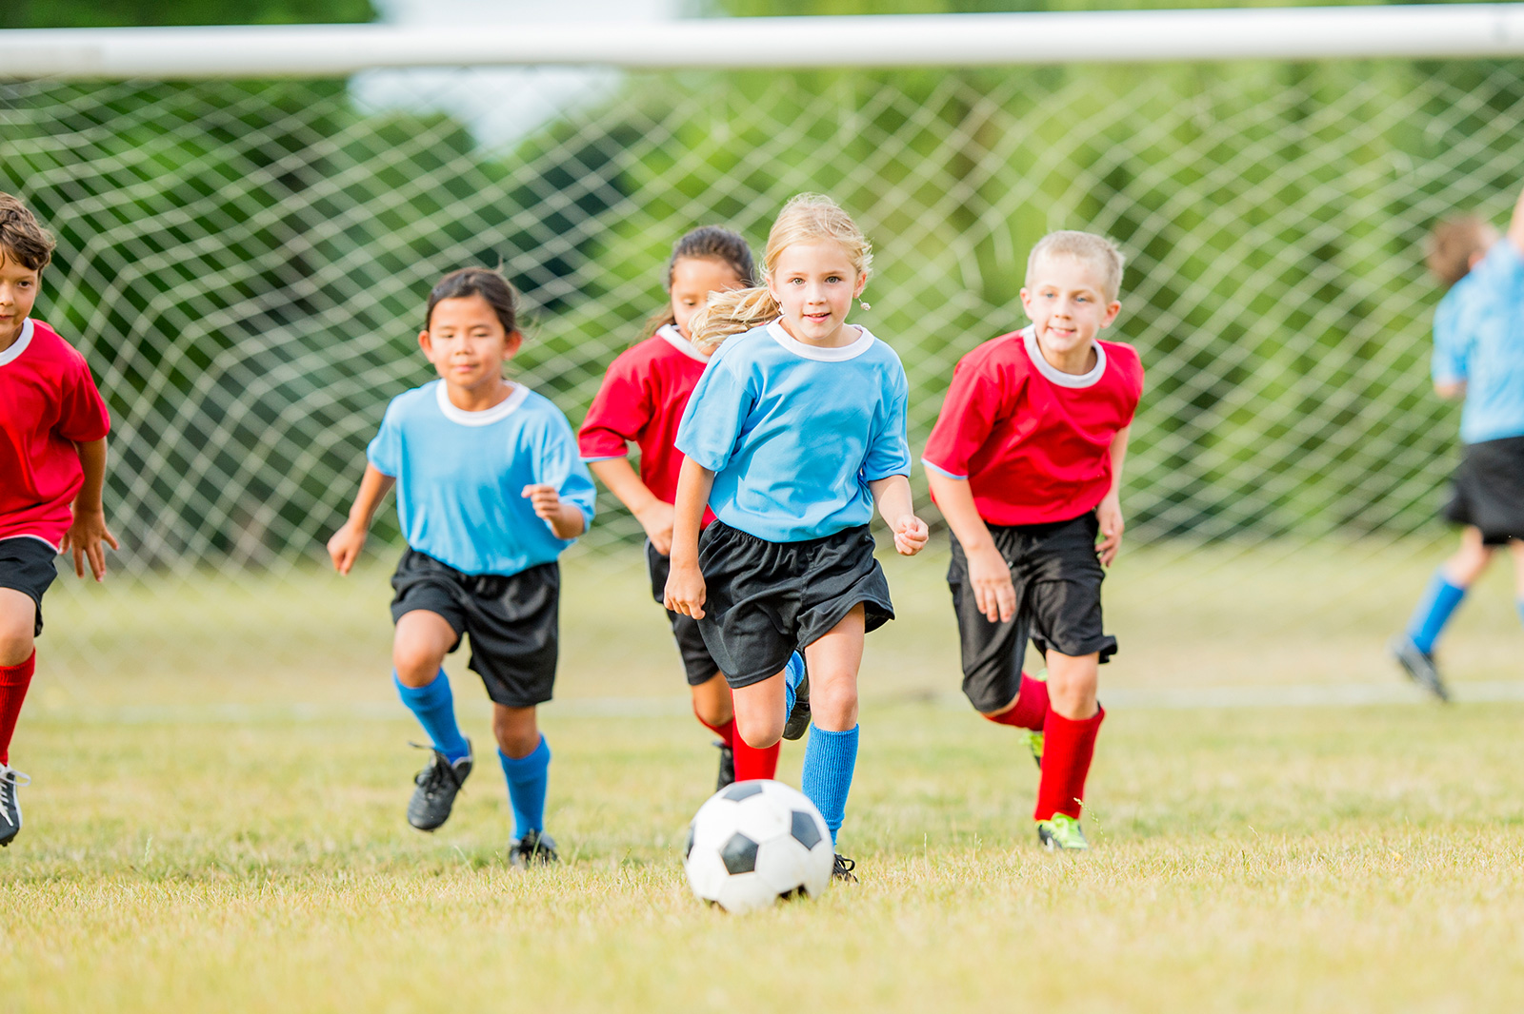
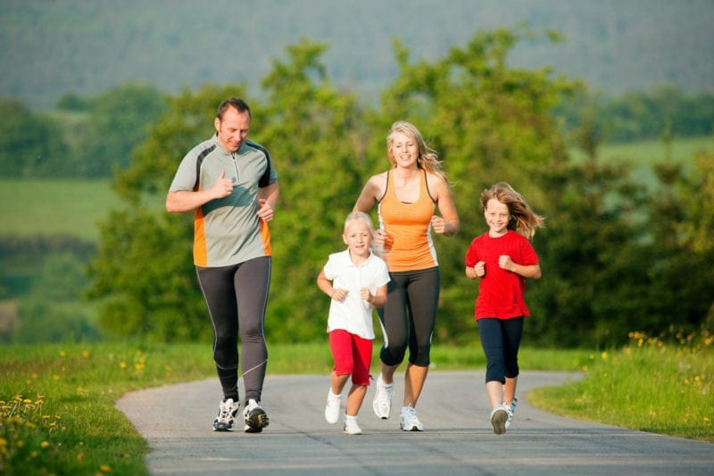
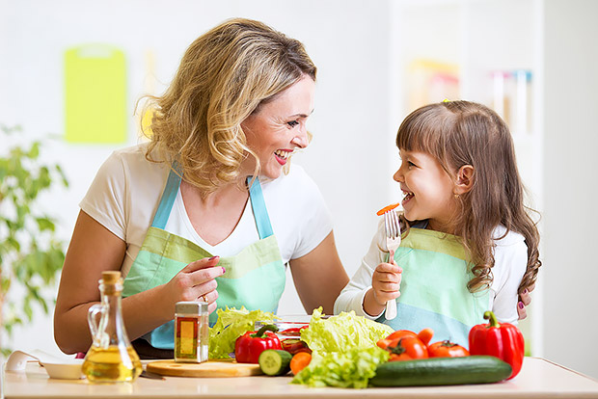
What is it?
doing exercise
swimming
playing sports
playing sports
doing exercise
eating fruits and vegetables
swimming
jogging
eating fruits and vegetables
jogging

Slide 3
Can you guess the topic?

Slide 4
Unit 2:
Healthy living
Lesson 1: Getting started

Slide 5
OBJECTIVES
Use the lexical items related to the topic Healthy living
Identify and talk about the daily activities and decide if they are good or bad for health

Slide 6
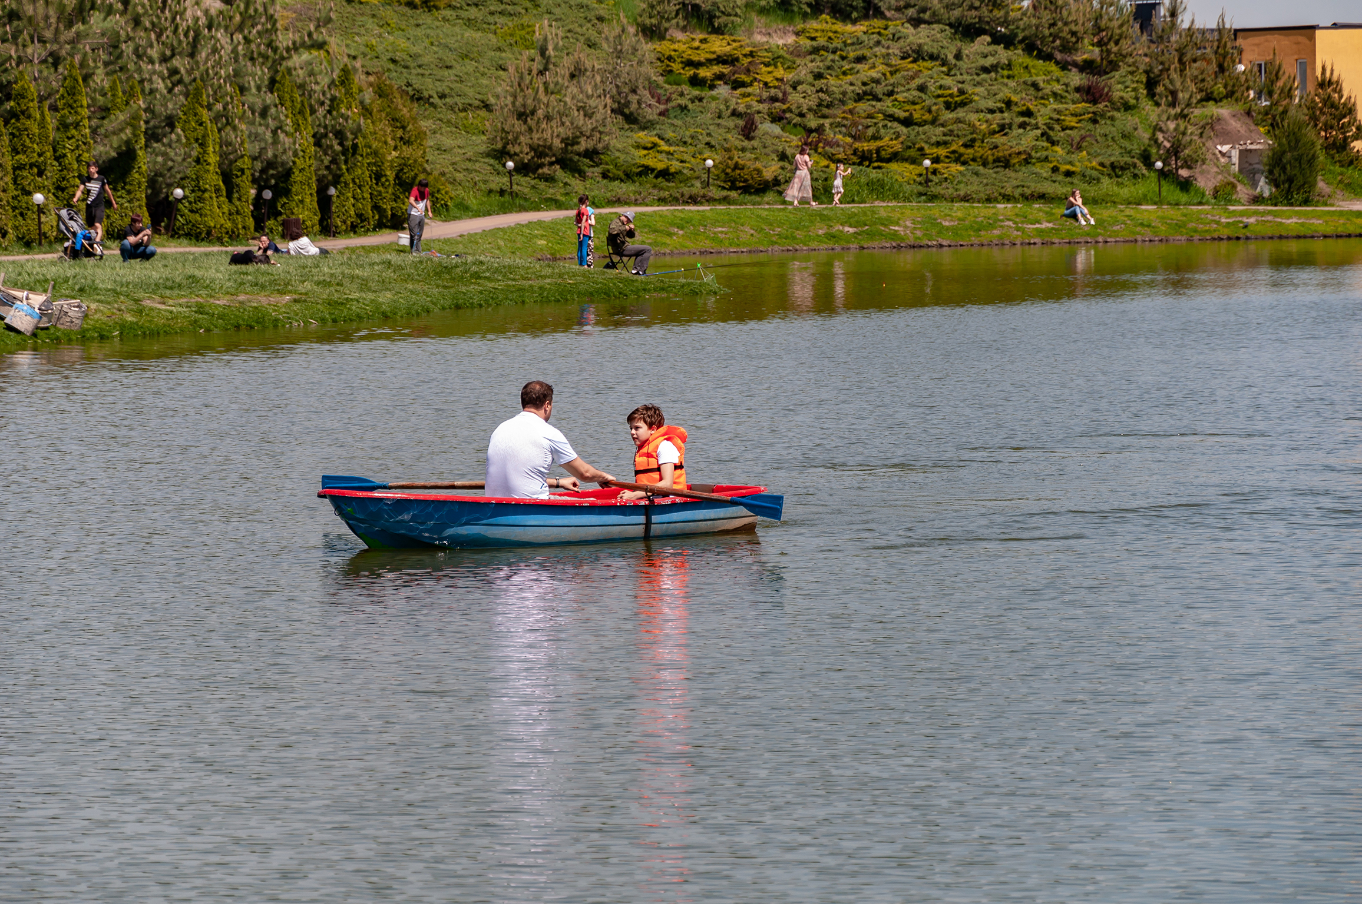
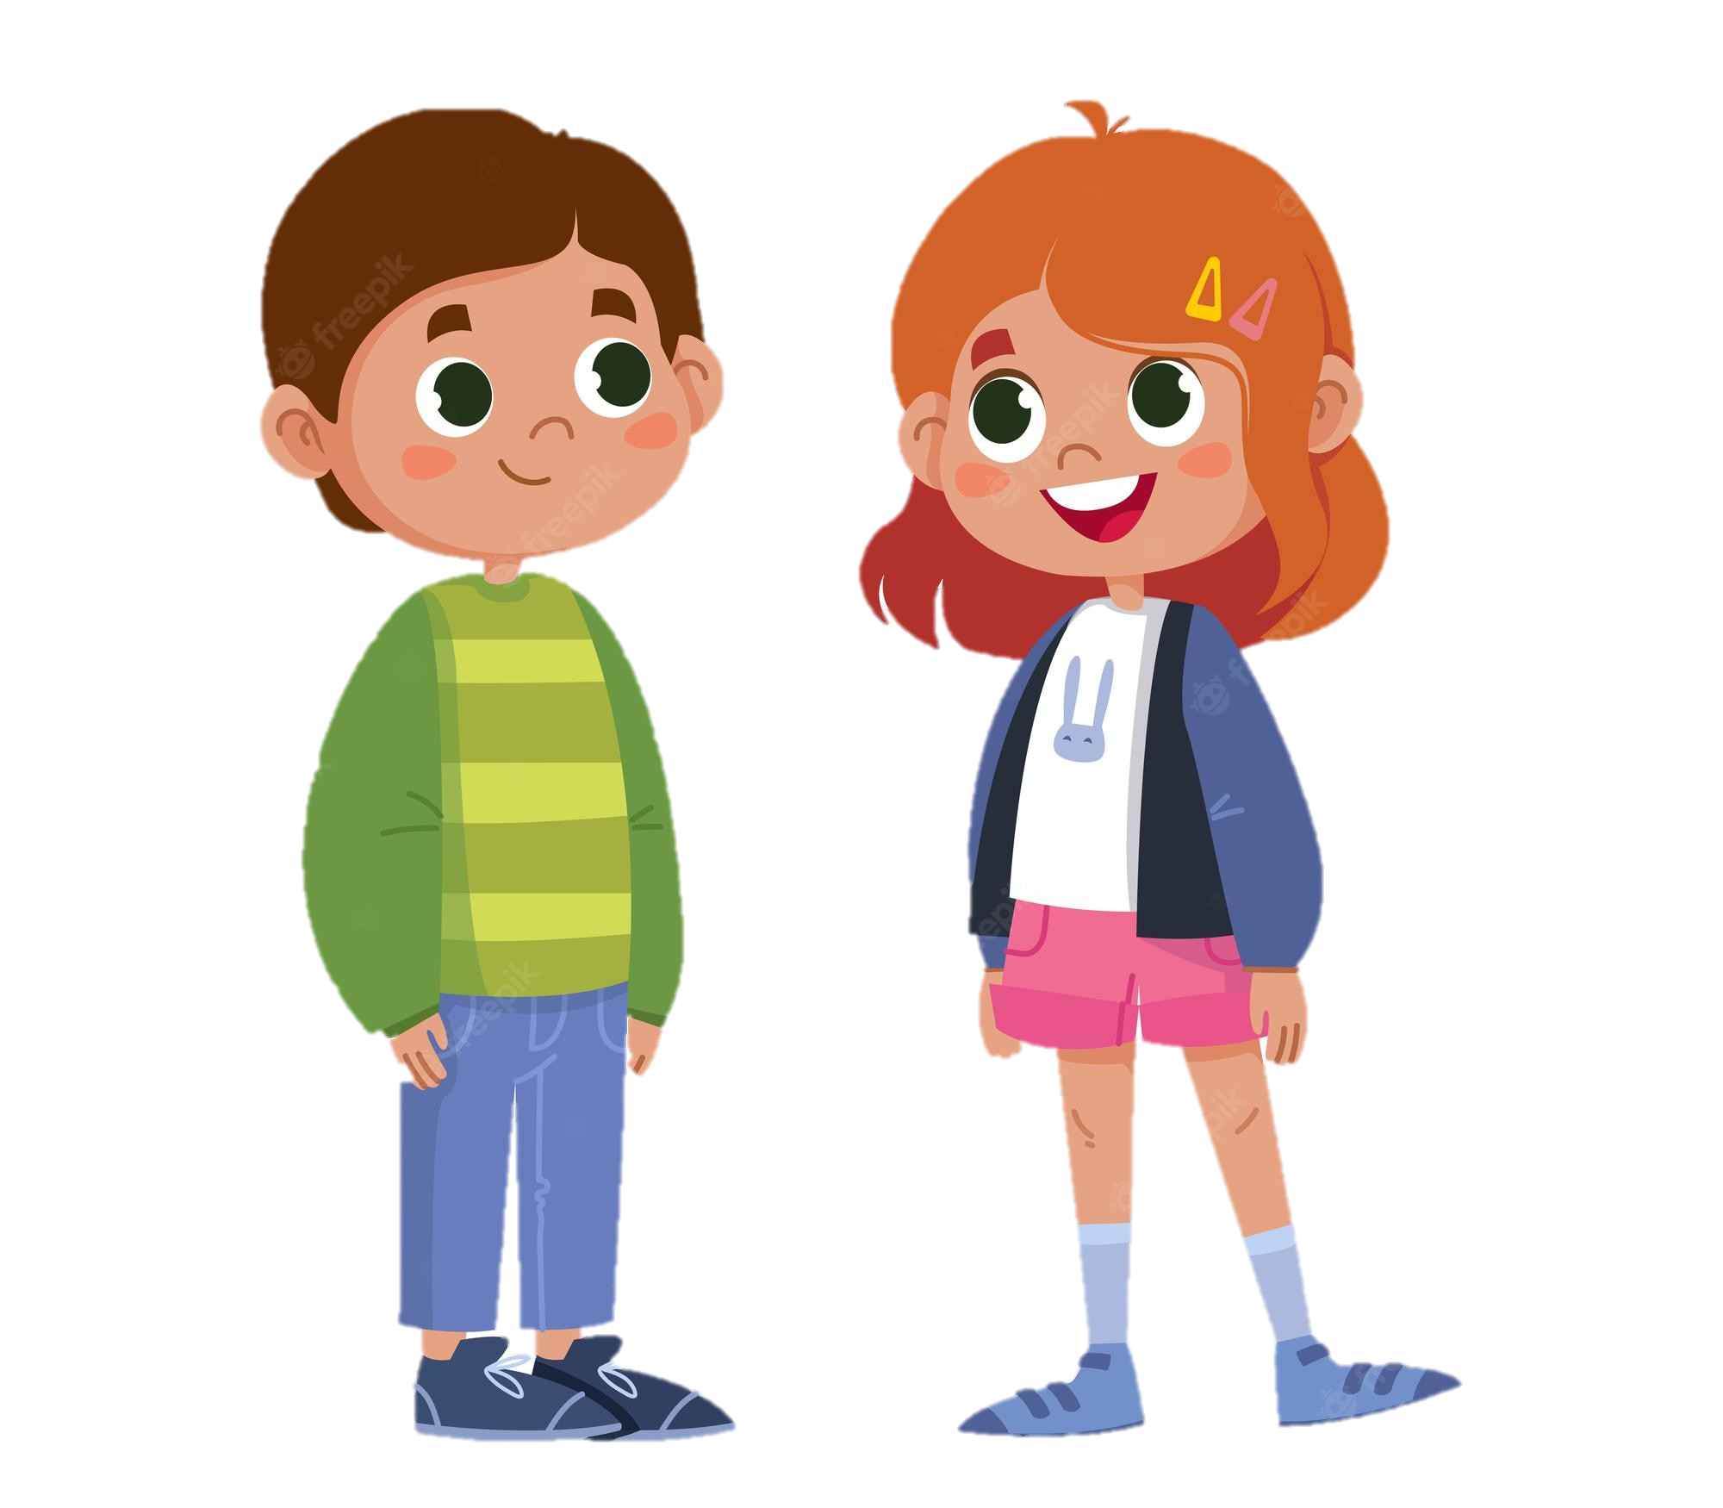

1. Listen and check.
Look and answer.
1. Who are talking?
Mark and Mi
2. Who are in the picture ?
Mark and his father
3. What are they doing?
They are boating.
Mi
Mark

Slide 7
2. Read again and answer.
Mi: This is a nice picture, Mark.
Mark: That’s my dad and I boating at Yen So Park.
Mi: I also see a lot of people exercise there.
Mark: Yes, it’s a popular place for people in my neighbourhood.
Mi: Outdoor activities are good for our health. My family often goes cycling in the countryside. It’s quiet and there’s a lot of fresh air.
Mark: It sounds interesting.
Mi: Yes, it’s lots of fun. We also bring fruit, water, and a lunch box with us.
Mark: I’d love to join you next time.
Mi: Sure. Bring along a hat and suncream.
Mark: Why suncream?
Mi: It’s really hot and sunny at noon so you might get sunburn.
Mark: I see.
What are Mark and Mi talking about?
A. Health problems
B. Healthy activities
C. Sports and games

Slide 8
Read again and find the words
Mi: This is a nice picture, Mark.
Mark: That’s my dad and I boating at Yen So Park.
Mi: I also see a lot of people exercise there.
Mark: Yes, it’s a popular place for people in my neighbourhood.
Mi: Outdoor activities are good for our health. My family often goes cycling in the countryside. It’s quiet and there’s a lot of fresh air.
Mark: It sounds interesting.
Mi: Yes, it’s lots of fun. We also bring fruit, water, and a lunch box with us.
Mark: I’d love to join you next time.
Mi: Sure. Bring along a hat and suncream.
Mark: Why suncream?
Mi: It’s really hot and sunny at noon so you might get sunburn.
Mark: I see.
boating
suncream
lunch box
sunburn
cycling

Slide 9
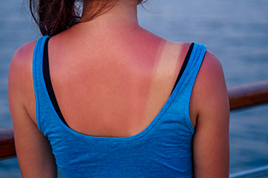

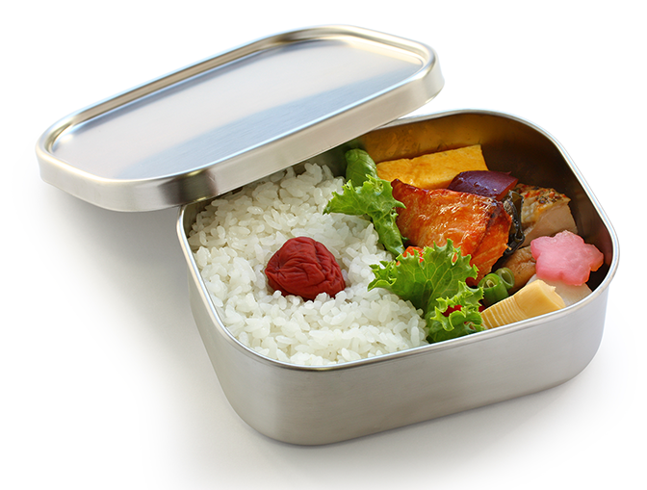
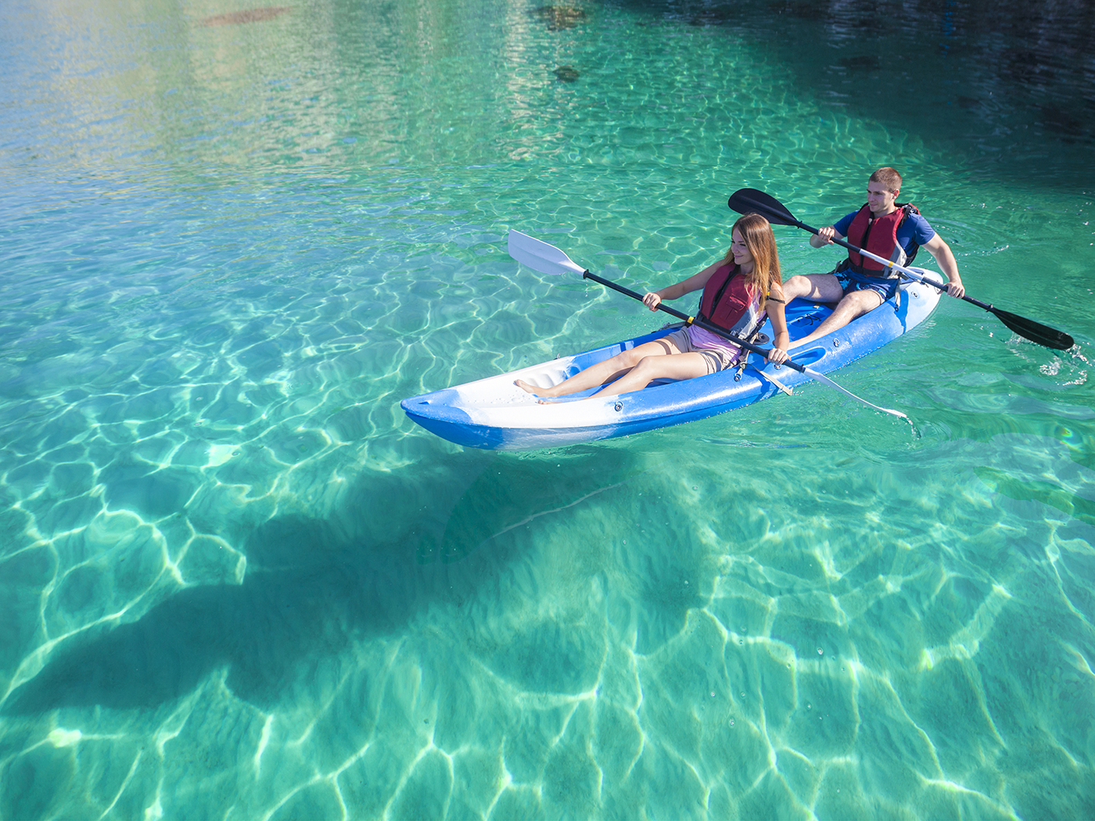
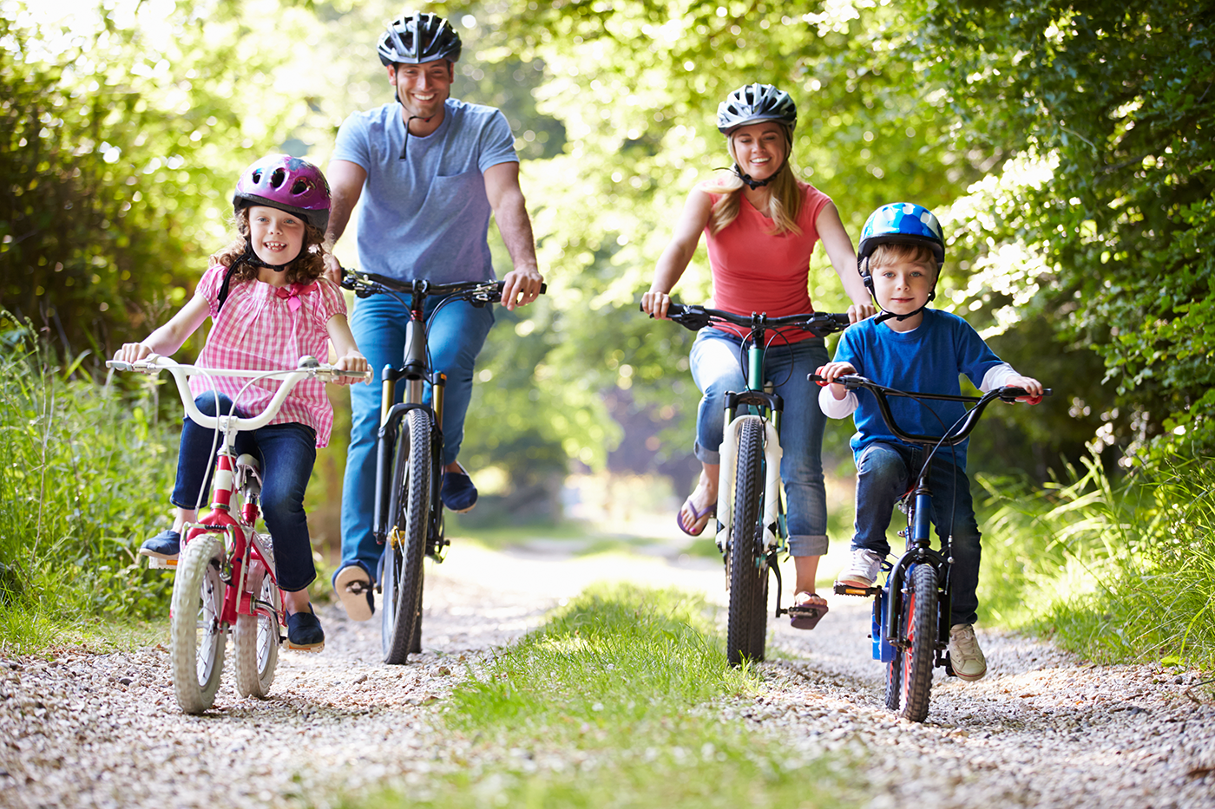
3. Write a word or phrase from the box under its picture.
boating
suncream
sunburn
suncream
lunch box
lunch box
sunburn
cycling
boating
cycling

Slide 10
4. Complete each sentence with a word from the conversation.
1. In the picture, Mark and his father are __________.
2. The people in Mark’s neighbourhood love to go to the _________ .
3. Mi’s family often goes cycling in the ___________.
4. - I don’t want to get sunburn.
- Wear a hat and use __________.
5. Fruit and water are good for our _________ .

Slide 11
4. Complete each sentence with a word from the conversation.
1. In the picture, Mark and his father are __________.
boating
Mi: This is a nice picture, Mark.
Mark: That’s my dad and I boating at Yen So Park.
2. The people in Mark’s neighbourhood love to go to the _________ .
park
Mark: That’s my dad and I boating at Yen So Park.
Mi: It also see a lot of people exercise there.
Mark: Yes, it’s a popular place for people in my neighbourhood.

Slide 12
4. Complete each sentence with a word from the conversation.
3. Mi’s family often goes cycling in the ____________.
countryside
Mi: Outdoor activities are good for our health. My family often goes cycling in the countryside. It’s quiet and there’s a lot of fresh air.
4. - I don’t want to get sunburn.
- Wear a hat and use __________.
suncream
Mi: Sure. Bring along a hat and suncream.
Mark: Why suncream?
Mi: It’s really hot and sunny at noon so you might get sunburn.

Slide 13
4. Complete each sentence with a word from the conversation.
5. Fruit and water are good for our _________ .
health
Mi: Outdoor activities are good for our health. My family often goes cycling in the countryside. It’s quiet and there’s a lot of fresh air.
Mark: It sounds interesting.
Mi: Yes, it’s lots of fun. We also bring fruit, water, and a lunch box with us.

Slide 14
Good / bad for health

Slide 15
Good / bad for health!
Work in groups of 6.
Make a survey.
Ask and answer what daily activities you think are good/ bad and reason why.
Report in front of the class.

Slide 16
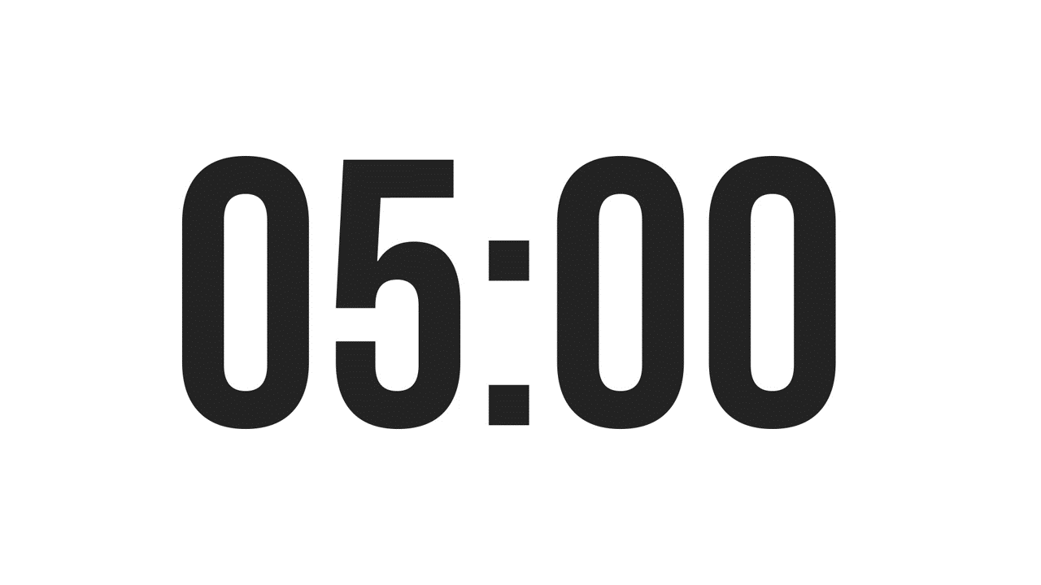
Survey!
Example:
A: I walk to school.
B: I think it’s good for your health.
A: I rarely eat breakfast.
B: It’s not good. Breakfast is very important. It gives us energy for the day.
Daily activities | How often | Good | Bad | Why?
Walking to school | Every day | √ |  | healthy

Slide 17
Let’s present!

Slide 18
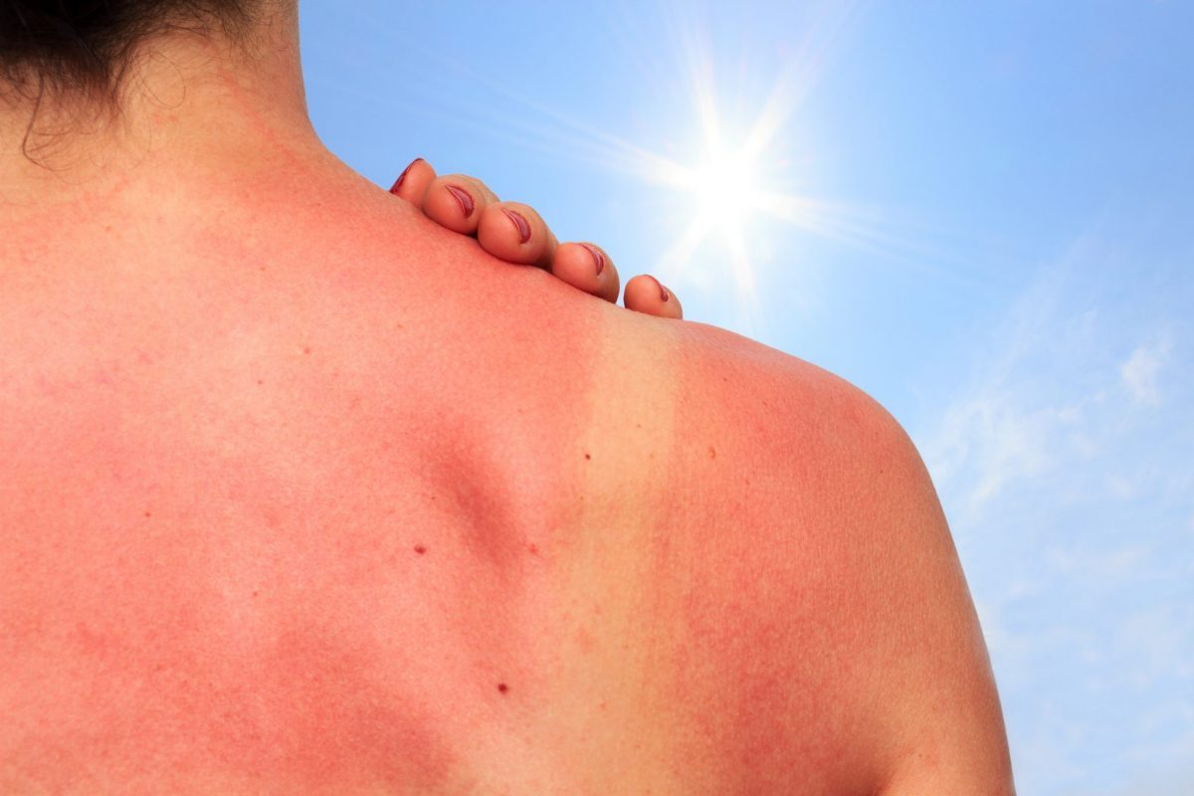
RECAP
1
What activities are good for your health?
A. cycling
B. boating
C. rarely eating breakfast
2
What health problem is it?
A. sunny
B. sunburn
C. suncream

Slide 19
Thanks
Do you have any questions?
Please keep this slide for attribution

