Slide 1

UNIT 1:
Local community
Lesson 5 – Skills 1

Slide 2
Objectives
After this lesson, students will be able to:
01
READING
Read for specific information about special products in some areas.
02
SPEAKING
Give a short presentation about a speciality.

Slide 3
01
READING

Slide 4
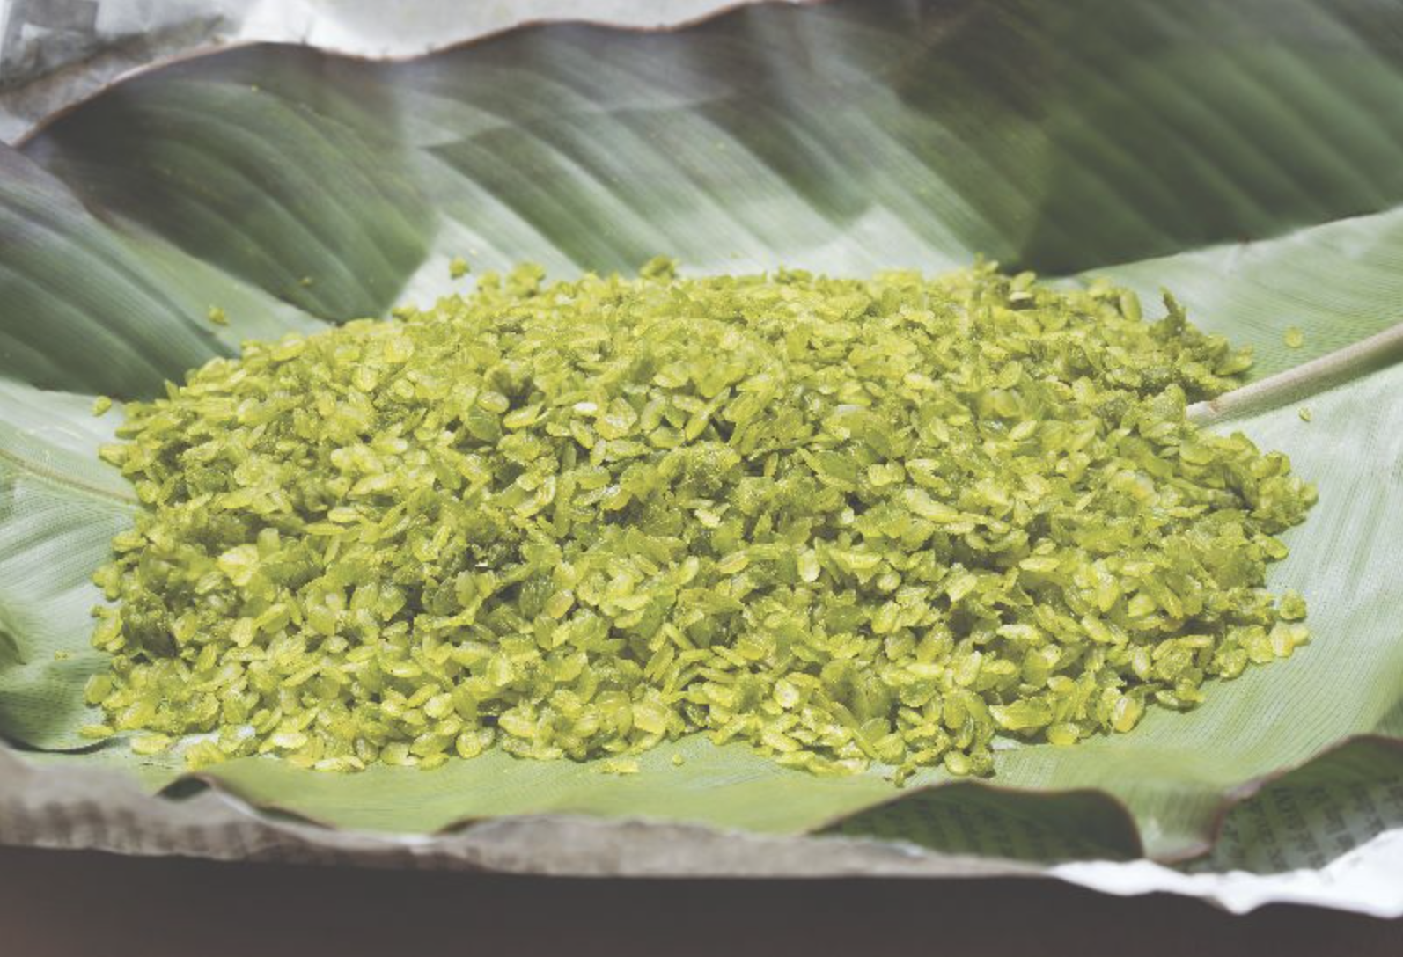
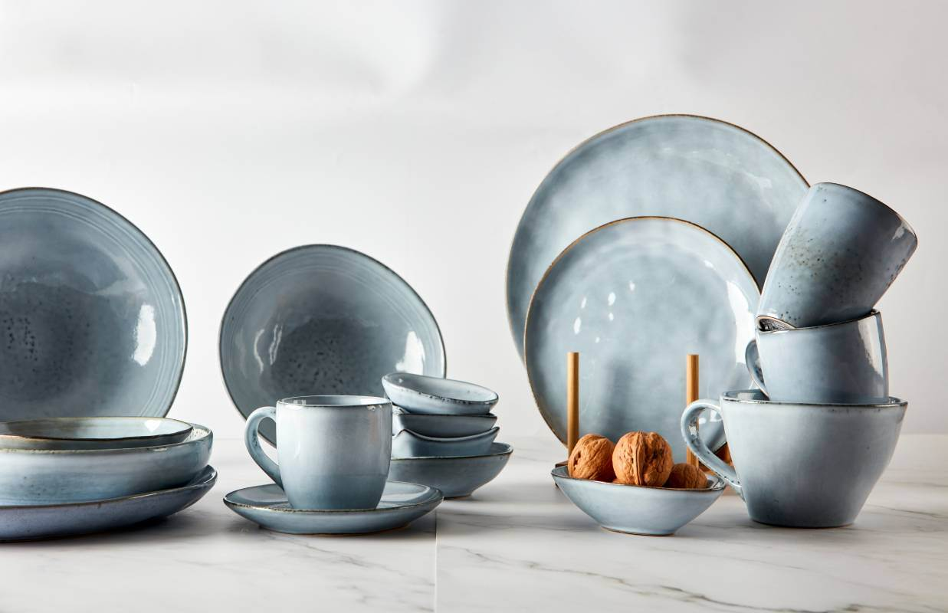
Exercise 1. Work in pairs. Answer the questions
1. What can you see in each picture?
2. Do you know any place(s) where people make the thing(s) in each picture?
a
b

Slide 5
Exercise 1. Work in pairs. Answer the questions
1. What can you see in each picture?
2. Do you know any place(s) where people make the thing(s) in each picture?
a
- Picture a: cốm (young sticky rice) - from Vong Village, Ha Noi
- Another place which makes “com”: Tu Le Commune in Yen Bai Province
- Picture b: pottery - from Denby, England.
- In Viet Nam, there are some pottery villages: Bat Trang, Bau Truc, Phu Lang, …

Slide 6
Exercise 1. Work in pairs. Answer the questions
1. What can you see in each picture?
2. Do you know any place(s) where people make the thing(s) in each picture?
b
- Picture b: pottery - from Denby, England.
- In Viet Nam, there are some pottery villages: Bat Trang, Bau Truc, Phu Lang, …

Slide 7


Vocabulary
preserve (v)
/prɪˈzɜːv/
bảo tồn

Slide 8

Vocabulary
fragrance (n)
/ˈfreɪɡrəns/
hương thơm

Slide 9

Vocabulary
original (adj)
əˈrɪdʒɪnəl
nguyên bản

Slide 10
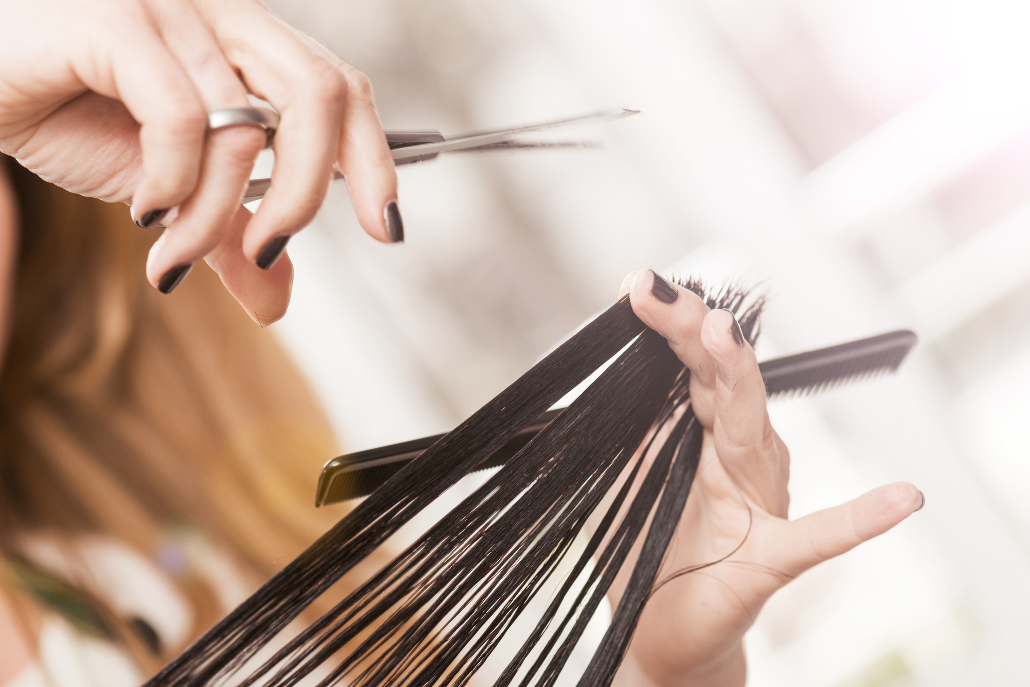
Vocabulary
shorten (v)
ˈʃɔː.tən
rút ngắn

Slide 11

Vocabulary
function (n)
/ˈfʌŋk.ʃən/
chức năng

Slide 12
Exercise 2. Read the brochure introducing different places with special products. Match each highlighted word with its definition.
Vong, a small village in Ha Noi, is famous for a speciality food: com (young sticky rice flakes). To make com, artisans follow a series of steps. They preserve the techniques by passing them down to their sons. In the past, people made com by hand, but now they use machines for some steps to shorten the process. They wrap the final product in two layers of leaves to preserve its fragrance before selling it to consumers. Com Lang Vong is well known in Viet Nam as a speciality of Ha Noi autumn.
Denby is a village in the county of Derbyshire, England. It is the home of the famous Denby Pottery, which is made from the finest local clay. Going around the village, we can see artisans hand-craft pottery collections. They still use some of the original techniques passed down through generations. In Denby products, we can see their beauty and function which make them world-famous. Today Denby is also a tourist attraction. Visitors can make pottery in workshops or find out about the history of pottery in the museum.

Slide 13
Vong, a small village in Ha Noi, is famous for a speciality food: com (young sticky rice flakes). To make com, artisans follow a series of steps. They preserve the techniques by passing them down to their sons. In the past, people made com by hand, but now they use machines for some steps to shorten the process. They wrap the final product in two layers of leaves to preserve its fragrance before selling it to consumers. Com Lang Vong is well known in Viet Nam as a speciality of Ha Noi autumn.
Denby is a village in the county of Derbyshire, England. It is the home of the famous Denby Pottery, which is made from the finest local clay. Going around the village, we can see artisans hand-craft pottery collections. They still use some of the original techniques passed down through generations. In Denby products, we can see their beauty and function which make them world-famous. Today Denby is also a tourist attraction. Visitors can make pottery in workshops or find out about the history of pottery in the museum.
Exercise 2. Read the brochure introducing different places with special products. Match each highlighted word with its definition.
1. preserve
bảo tồn
a. existing since the beginning
2. shorten
rút ngắn
b. to keep something as it is
3. fragrance
hương thơm
c. to make something shorter
4. original
nguyên bản
d. a special purpose of a thing
5. function
chức năng
e. a pleasant smell

Slide 14
Exercise 2. Read the brochure introducing different places with special products. Match each highlighted word with its definition.
1. preserve
bảo tồn
b. to keep something as it is
2. shorten
rút ngắn
a. existing since the beginning
3. fragrance
hương thơm
c. to make something shorter
4. original
nguyên bản
d. a special purpose of a thing
5. function
chức năng
e. a pleasant smell

Slide 15
Exercise 2. Read the brochure introducing different places with special products. Match each highlighted word with its definition.
1. preserve
bảo tồn
b. to keep something as it is
2. shorten
rút ngắn
c. to make something shorter
3. fragrance
hương thơm
a. existing since the beginning
4. original
nguyên bản
d. a special purpose of a thing
5. function
chức năng
e. a pleasant smell

Slide 16
Exercise 2. Read the brochure introducing different places with special products. Match each highlighted word with its definition.
1. preserve
bảo tồn
b. to keep something as it is
2. shorten
rút ngắn
c. to make something shorter
3. fragrance
hương thơm
e. a pleasant smell
4. original
nguyên bản
d. a special purpose of a thing
5. function
chức năng
a. existing since the beginning

Slide 17
Exercise 2. Read the brochure introducing different places with special products. Match each highlighted word with its definition.
1. preserve
bảo tồn
b. to keep something as it is
2. shorten
rút ngắn
c. to make something shorter
3. fragrance
hương thơm
e. a pleasant smell
4. original
nguyên bản
a. existing since the beginning
5. function
chức năng
d. a special purpose of a thing

Slide 18
Vong, a small village in Ha Noi, is famous for a speciality food: com (young sticky rice flakes). To make com, artisans follow a series of steps. They preserve the techniques by passing them down to their sons. In the past, people made com by hand, but now they use machines for some steps to shorten the process. They wrap the final product in two layers of leaves to preserve its fragrance before selling it to consumers. Com Lang Vong is well known in Viet Nam as a speciality of Ha Noi autumn.
Denby is a village in the county of Derbyshire, England. It is the home of the famous Denby Pottery, which is made from the finest local clay. Going around the village, we can see artisans hand-craft pottery collections. They still use some of the original techniques passed down through generations. In Denby products, we can see their beauty and function which make them world-famous. Today Denby is also a tourist attraction. Visitors can make pottery in workshops or find out about the history of pottery in the museum.
Exercise 2. Read the brochure introducing different places with special products. Match each highlighted word with its definition.
Exercise 3. Read the brochure again. Decide which place each detail below belongs to.
1. preserve
bảo tồn
b. to keep something as it is
2. shorten
rút ngắn
c. to make something shorter
3. fragrance
hương thơm
e. a pleasant smell
4. original
nguyên bản
a. existing since the beginning
5. function
chức năng
d. a special purpose of a thing

Slide 19
Exercise 3. Read the brochure again. Decide which place each detail below belongs to.
Vong, a small village in Ha Noi, is famous for a speciality food: com (young sticky rice flakes). To make com, artisans follow a series of steps. They preserve the techniques by passing them down to their sons. In the past, people made com by hand, but now they use machines for some steps to shorten the process. They wrap the final product in two layers of leaves to preserve its fragrance before selling it to consumers. Com Lang Vong is well known in Viet Nam as a speciality of Ha Noi autumn.
Denby is a village in the county of Derbyshire, England. It is the home of the famous Denby Pottery, which is made from the finest local clay. Going around the village, we can see artisans hand-craft pottery collections. They still use some of the original techniques passed down through generations. In Denby products, we can see their beauty and function which make them world-famous. Today Denby is also a tourist attraction. Visitors can make pottery in workshops or find out about the history of pottery in the museum.

Slide 20
Vong, a small village in Ha Noi, is famous for a speciality food: com (young sticky rice flakes). To make com, artisans follow a series of steps. They preserve the techniques by passing them down to their sons. In the past, people made com by hand, but now they use machines for some steps to shorten the process. They wrap the final product in two layers of leaves to preserve its fragrance before selling it to consumers. Com Lang Vong is well known in Viet Nam as a speciality of Ha Noi autumn.
Denby is a village in the county of Derbyshire, England. It is the home of the famous Denby Pottery, which is made from the finest local clay. Going around the village, we can see artisans hand-craft pottery collections. They still use some of the original techniques passed down through generations. In Denby products, we can see their beauty and function which make them world-famous. Today Denby is also a tourist attraction. Visitors can make pottery in workshops or find out about the history of pottery in the museum.
Exercise 3. Read the brochure again. Decide which place each detail below belongs to.
In which place ...? | Vong | Denby
1. people make the speciality from local material
2. people make the product from plants
3. people make the product with some traditional techniques
4. the product is famous worldwide
5. the product symbolises a season

Slide 21
Exercise 3. Read the brochure again. Decide which place each detail below belongs to.
In which place ...? | Vong | Denby
1. people make the speciality from local material
Denby Pottery, which is made from the finest local clay. Going around the village, we can see artisans hand-craft pottery collections.

Slide 22
Exercise 3. Read the brochure again. Decide which place each detail below belongs to.
In which place ...? | Vong | Denby
2. people make the product from plants
Vong, a small village in Ha Noi, is famous for a speciality food: com (young sticky rice flakes).

Slide 23
Exercise 3. Read the brochure again. Decide which place each detail below belongs to.
In which place ...? | Vong | Denby
3. people make the product with some traditional techniques
They preserve the techniques by passing them down to their sons.
They still use some of the original techniques passed down through generations.

Slide 24
Exercise 3. Read the brochure again. Decide which place each detail below belongs to.
In which place ...? | Vong | Denby
4. the product is famous worldwide
In Denby products, we can see their beauty and function which make them world-famous.

Slide 25
Exercise 3. Read the brochure again. Decide which place each detail below belongs to.
In which place ...? | Vong | Denby
5. the product symbolises a season
Com Lang Vong is well known in Viet Nam as a speciality of Ha Noi autumn.

Slide 26
02
SPEAKING

Slide 27

Exercise 4. Work in pairs.
Ask and answer about a speciality in your neighbourhood, your home town, or the area you know. Use the questions below.
1. What speciality is it?
2. What do people make it from?
3. Do people make it in the traditional way?
4. What can people do with it?
5. Is it well known in only your country or around the world?

Slide 28
Exercise 5. Work in groups.
Give a short presentation about the speciality you discussed in 4.
Example:
I live in Tay Ho Village, 12 kilometres from Hue City. My village is famous for its conical hats. We make conical hats from goi leaves.
We still follow 15 traditional steps to make a hat. A conical hat protects us from the sun and the rain as well as makes us more graceful. What is special about our conical hats is that each of them carries a poem. Tay Ho conical hats are not only famous in Hue but all over Viet Nam.

Slide 29

It's your show time

Slide 30
WRAP-UP
What have you learnt in this lesson?
Read for specific information about special products in some areas.
01
02
Give a short presentation about a speciality.

Slide 31
Homework
01
02
03

Slide 32
Thank
You!!!

