Slide 1


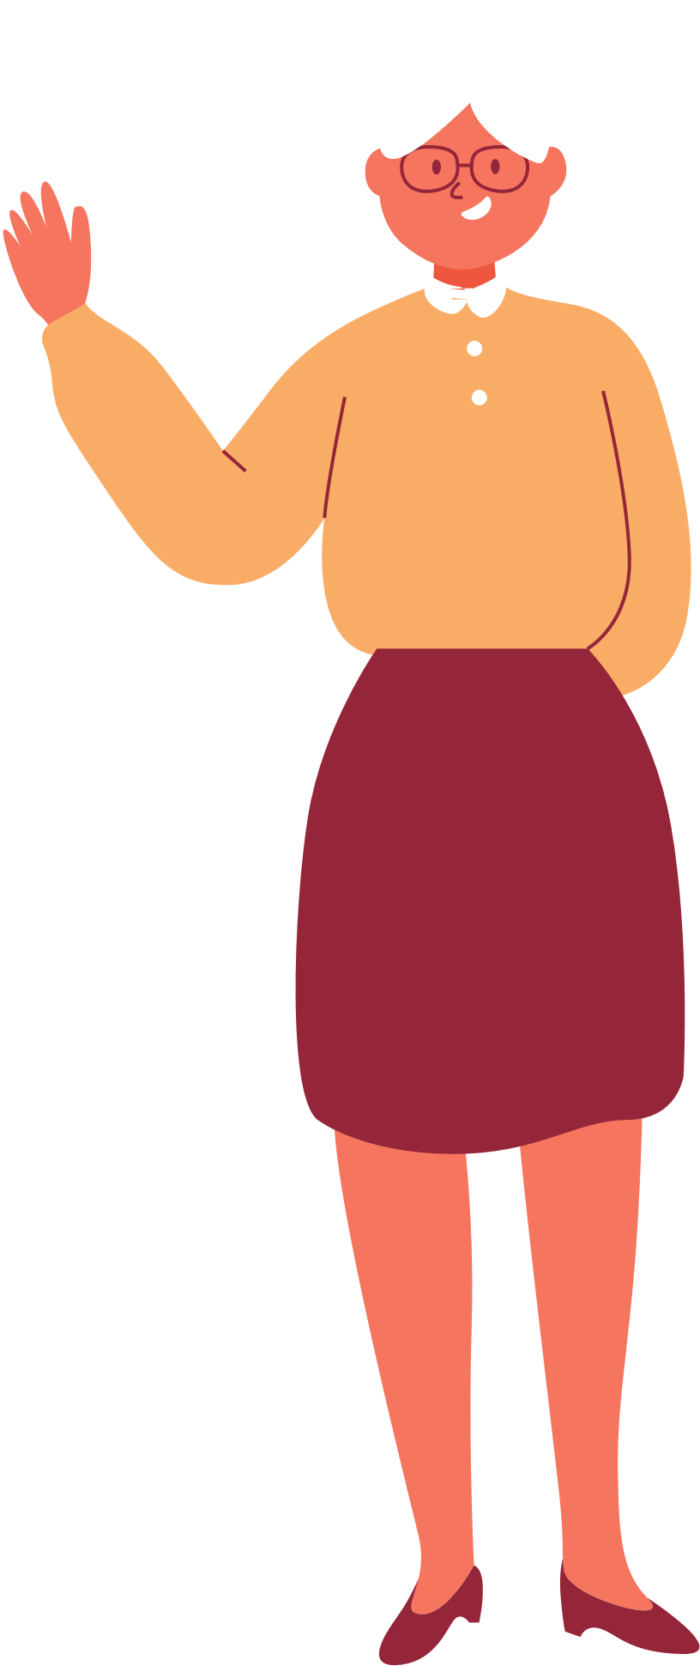

GAME:
GUESS WHO?

Slide 2
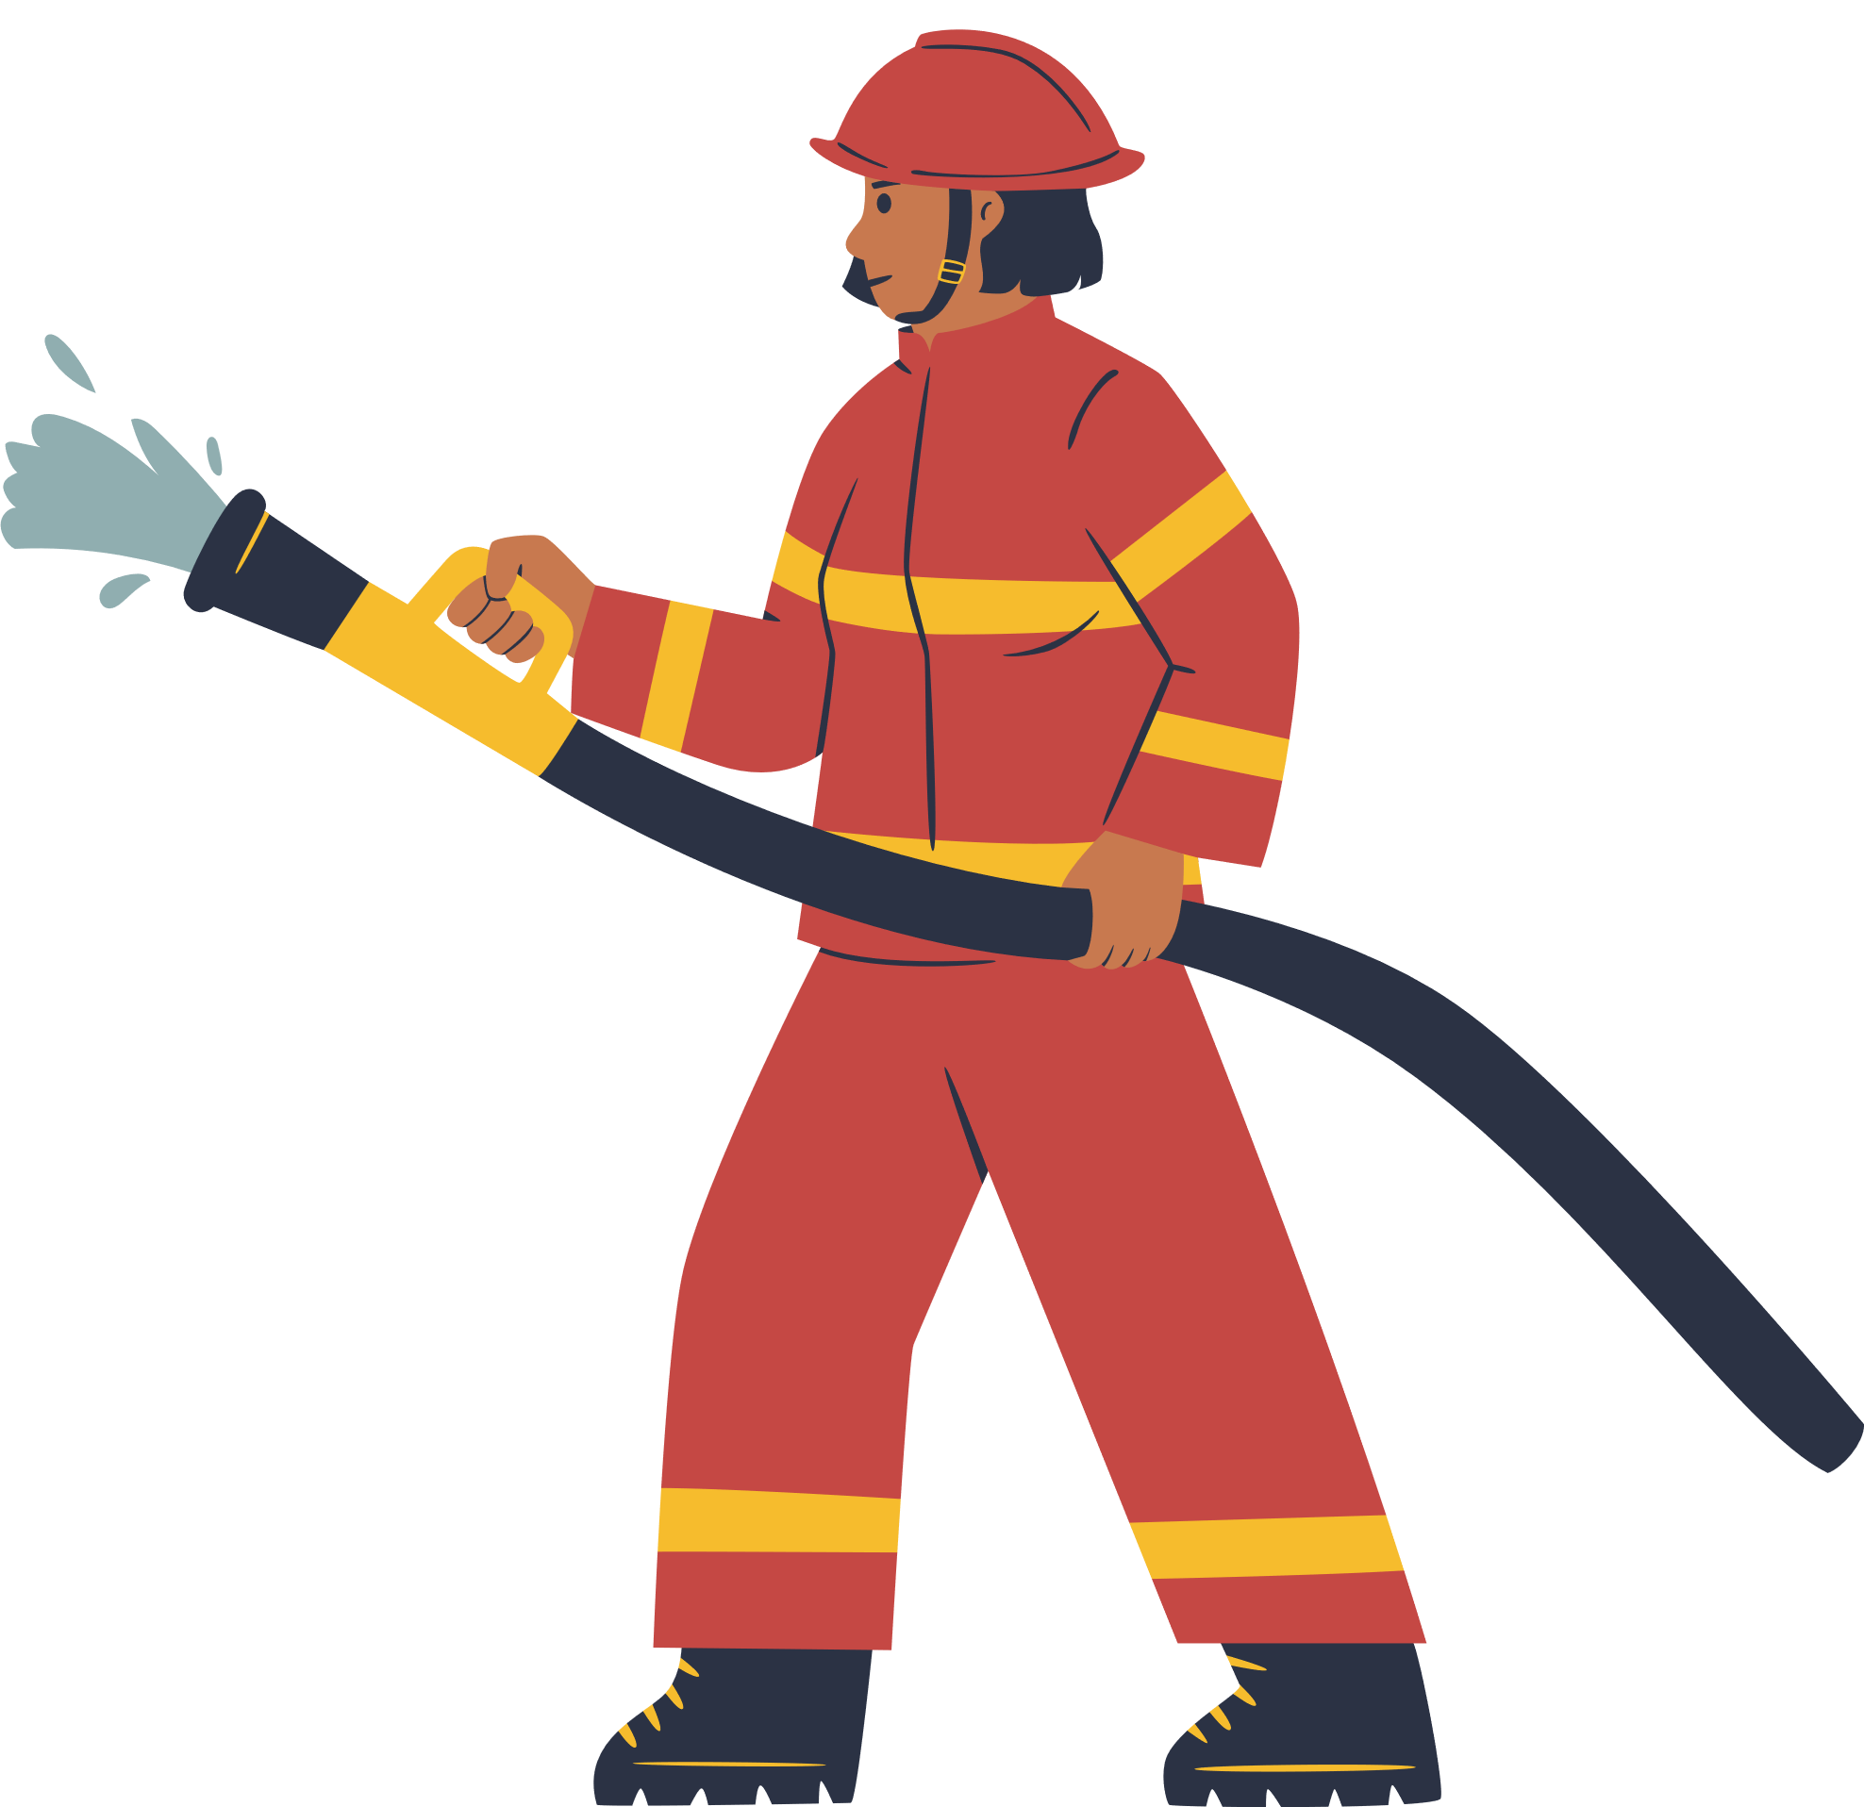


GUESS WHO?
FIREFIGHTER

Slide 3
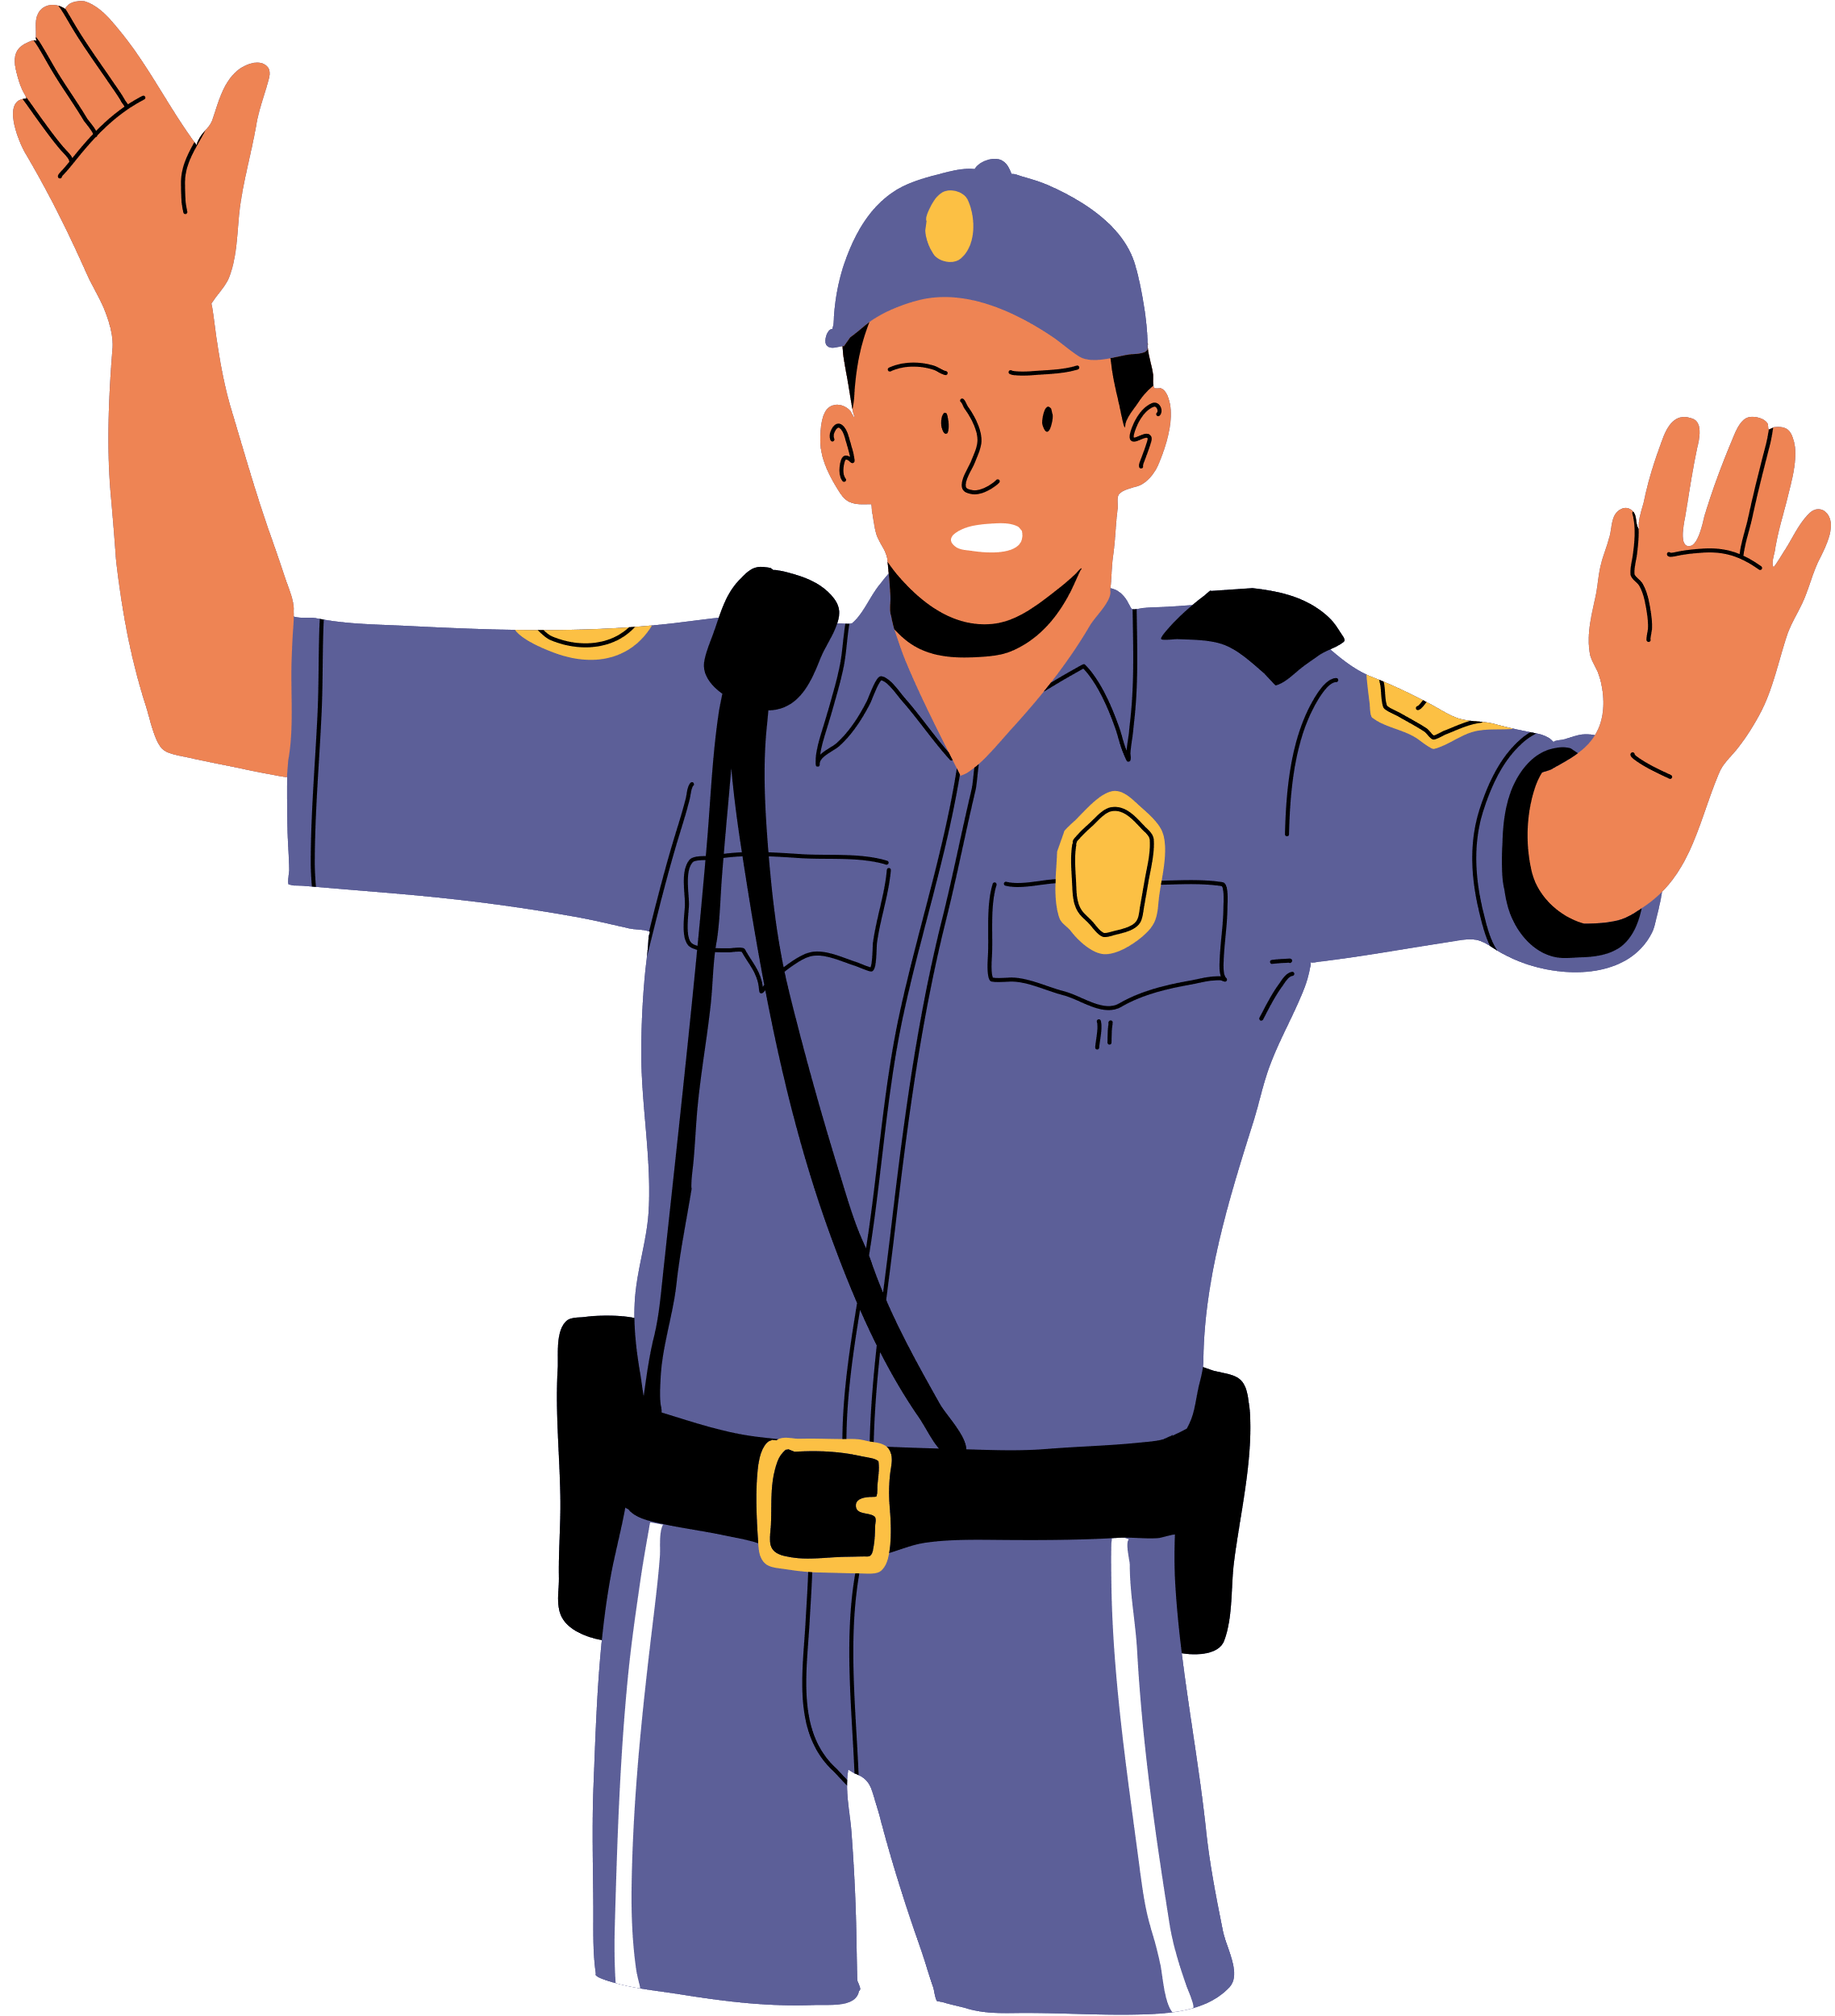
GUESS WHO?
POLICE OFFICER

Slide 4
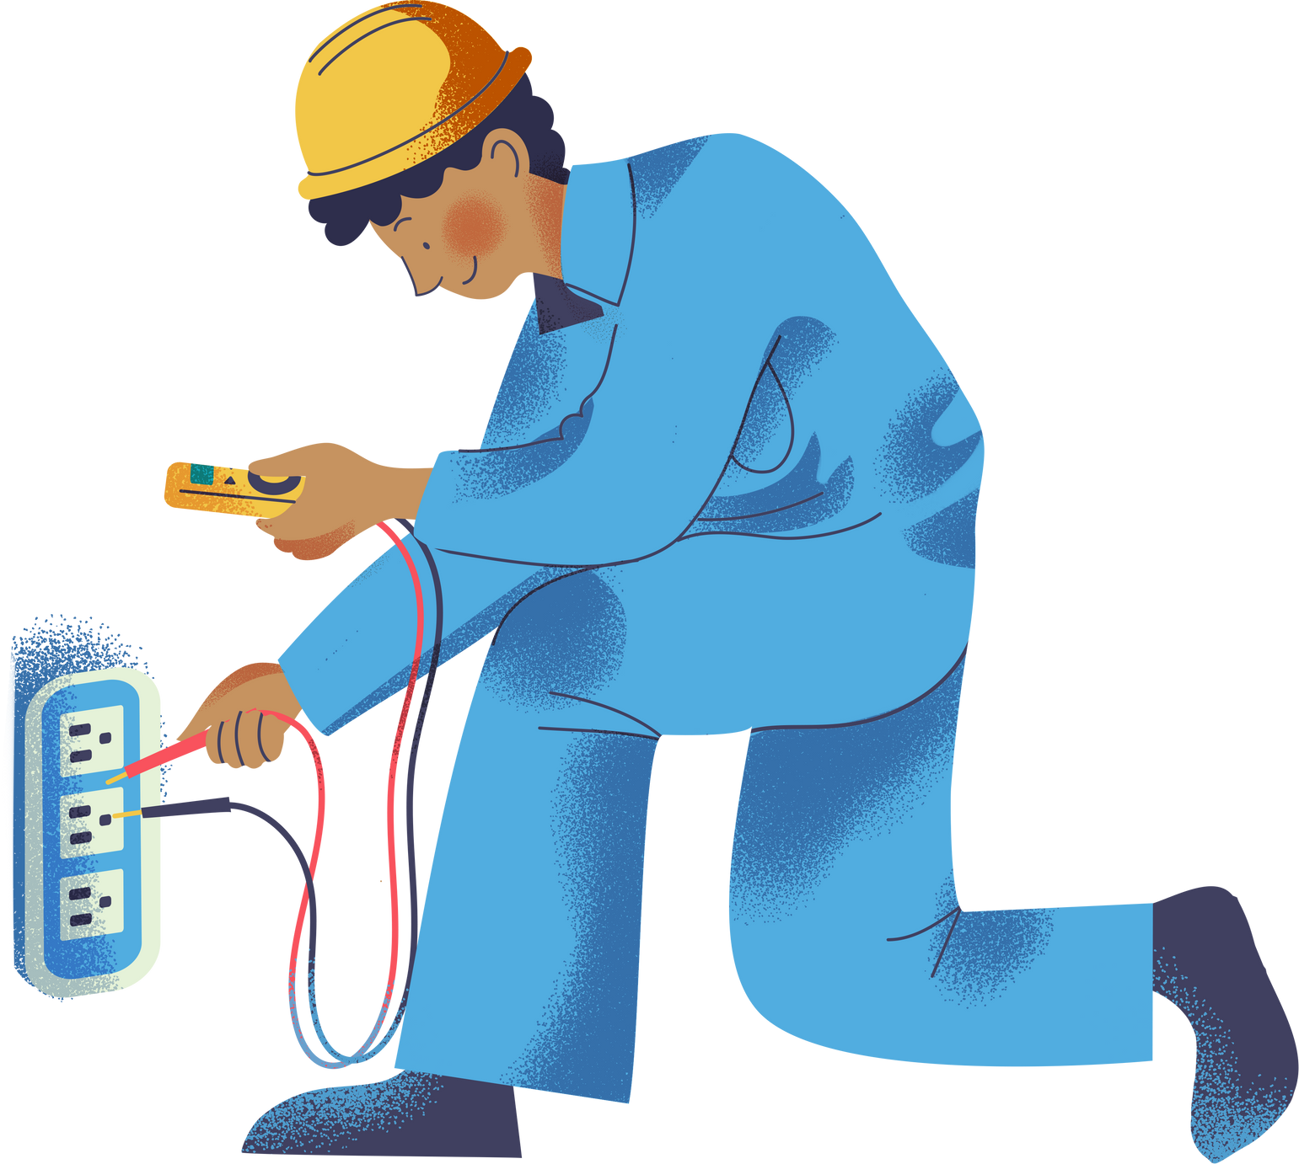
GUESS WHO?
ELECTRICIAN

Slide 5

GUESS WHO?
LIBRARIAN

Slide 6
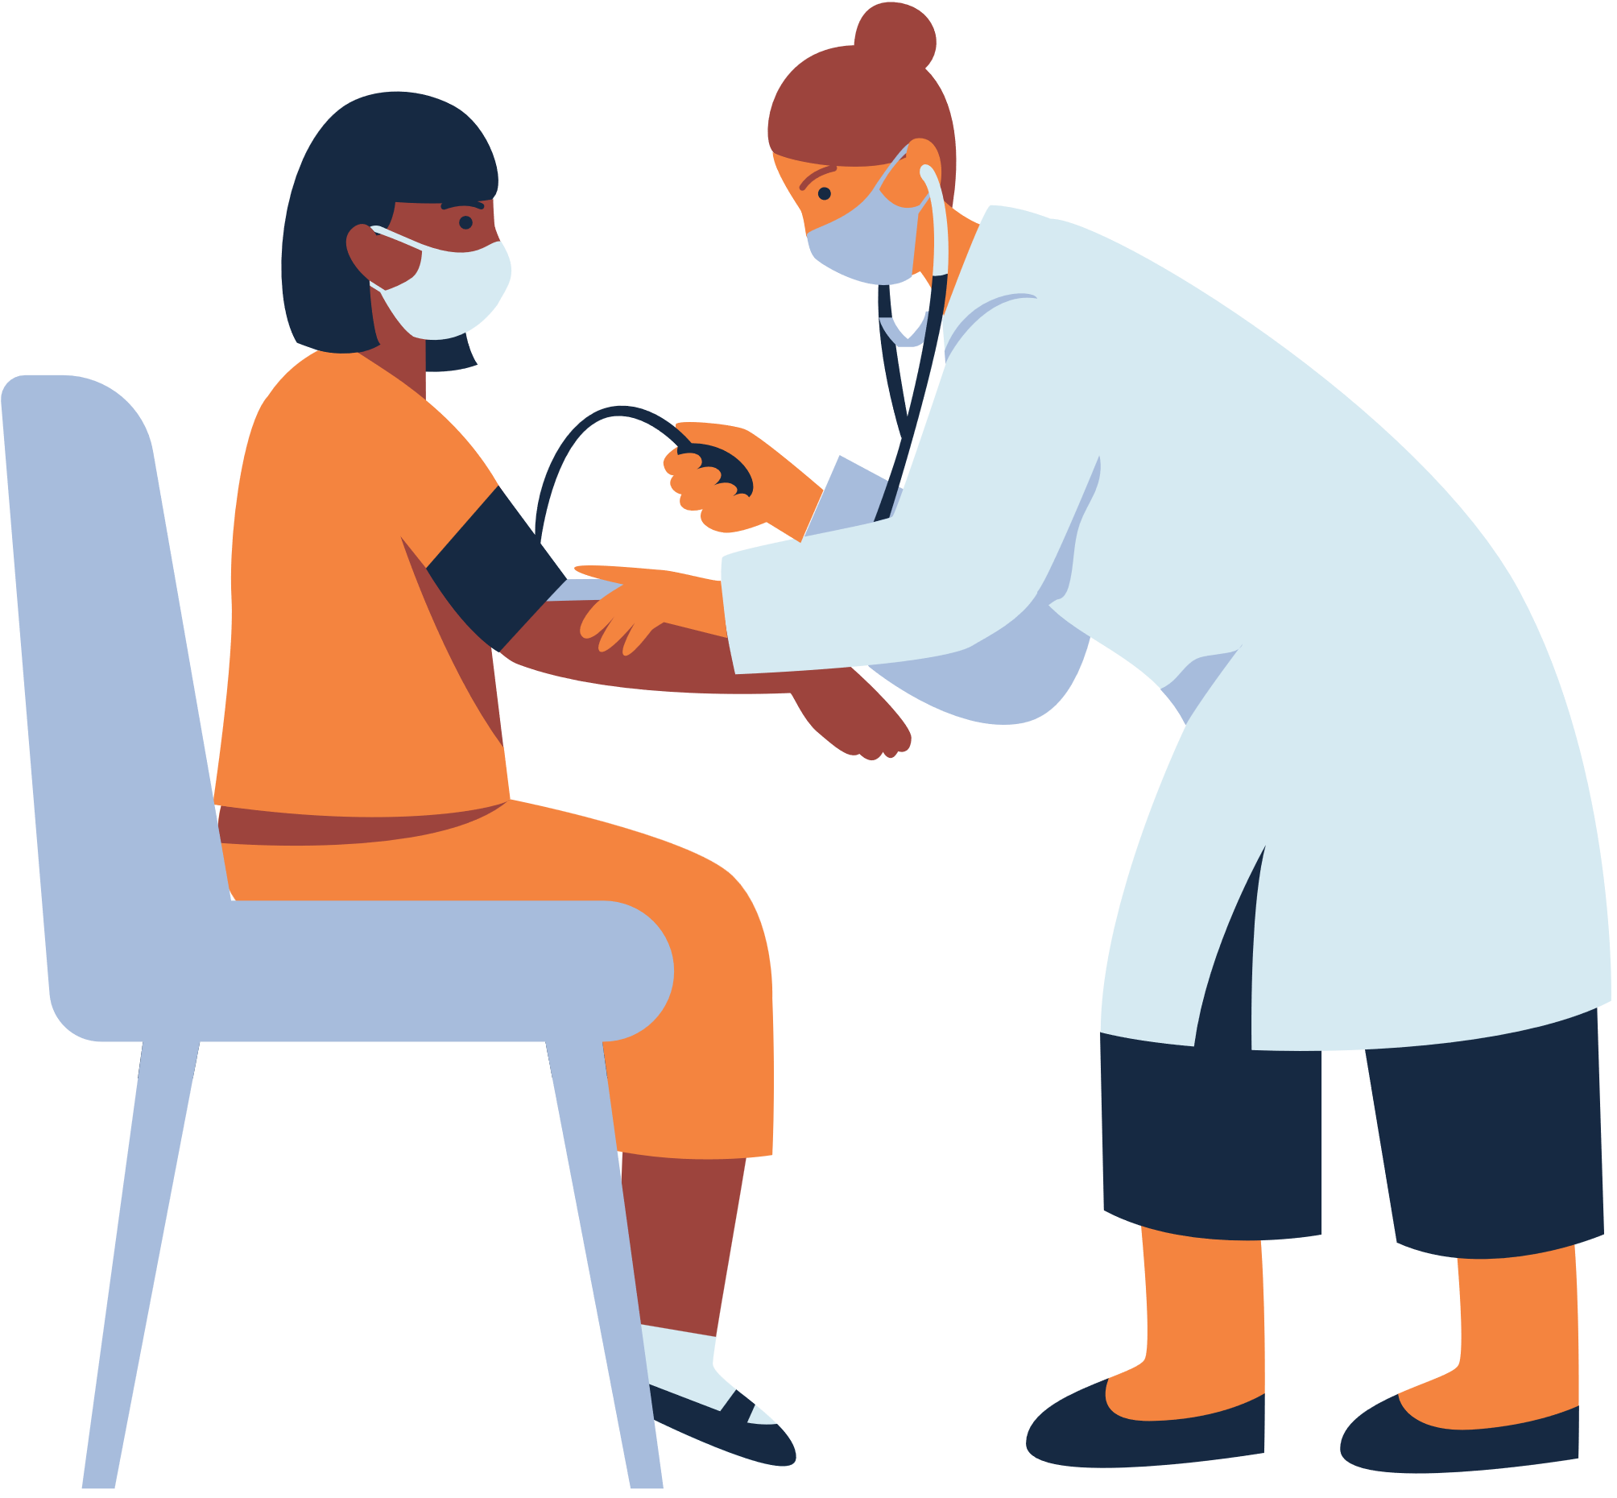
GUESS WHO?
DOCTOR

Slide 7
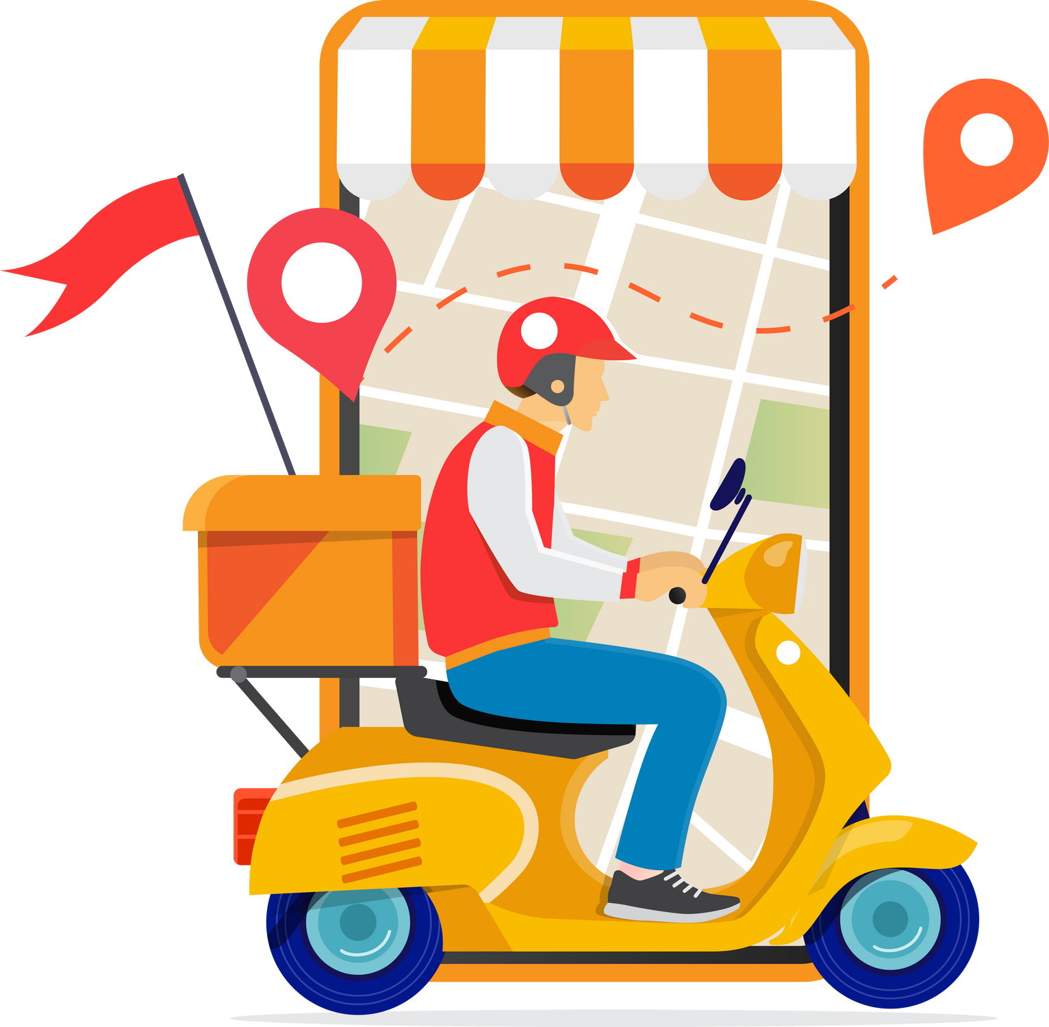
GUESS WHO?
DELIVERY PERSON

Slide 8
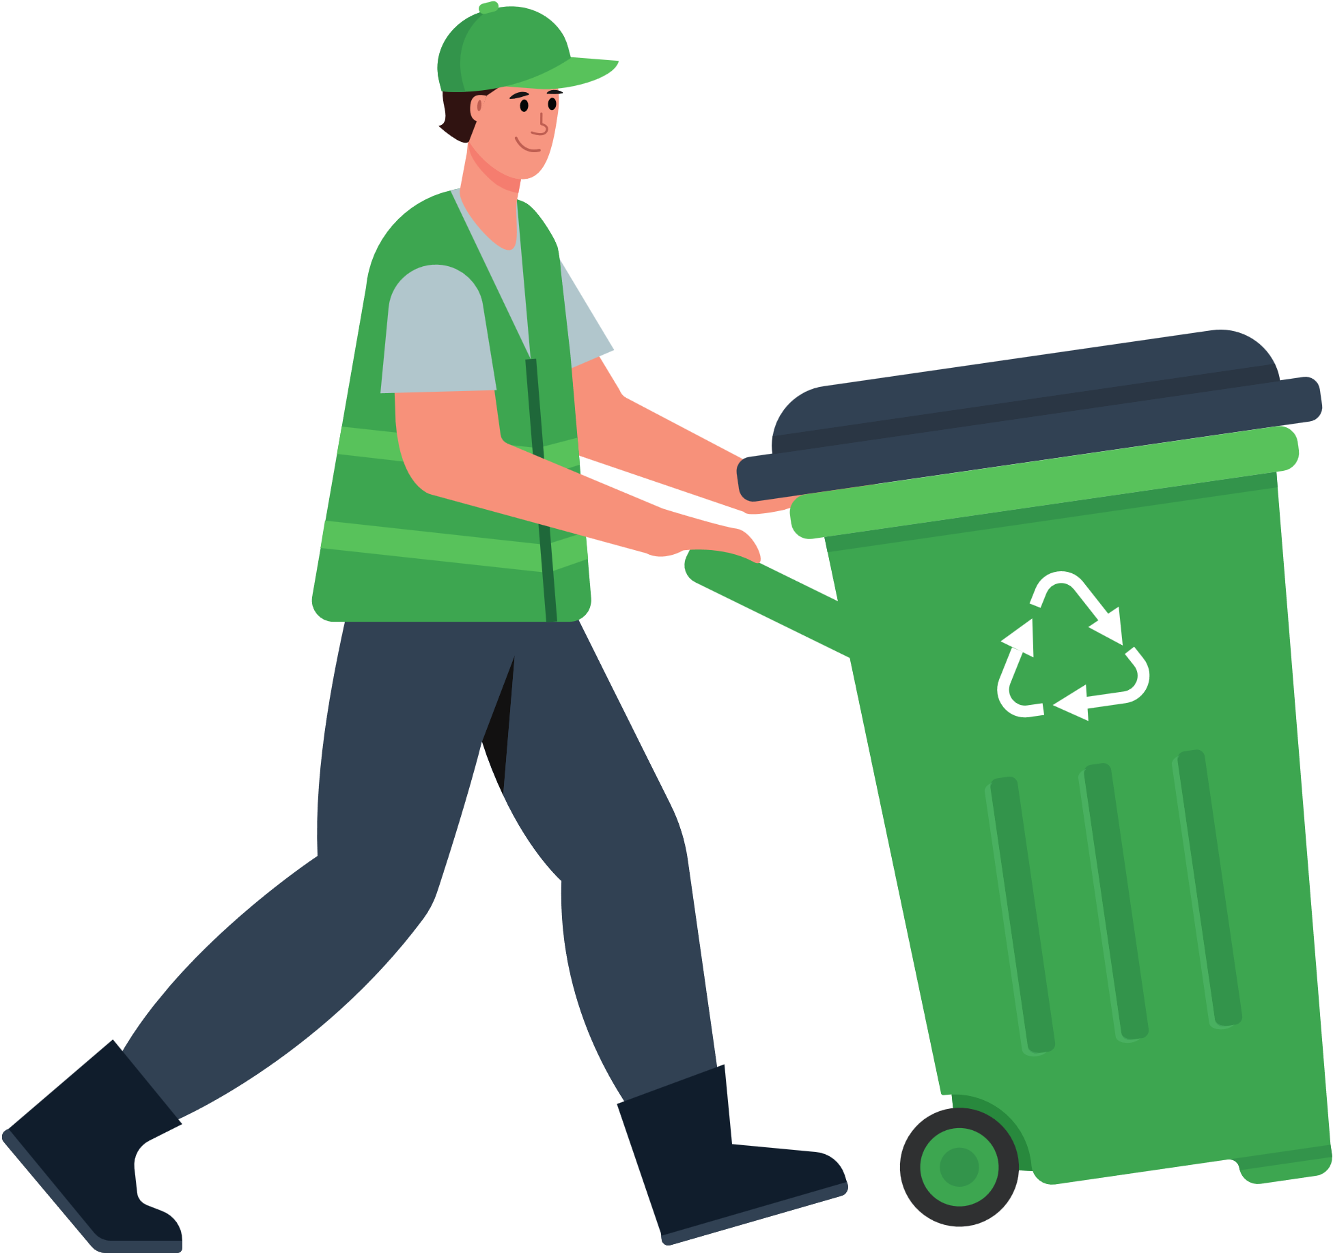
GUESS WHO?
GARBAGE COLLECTOR

Slide 9
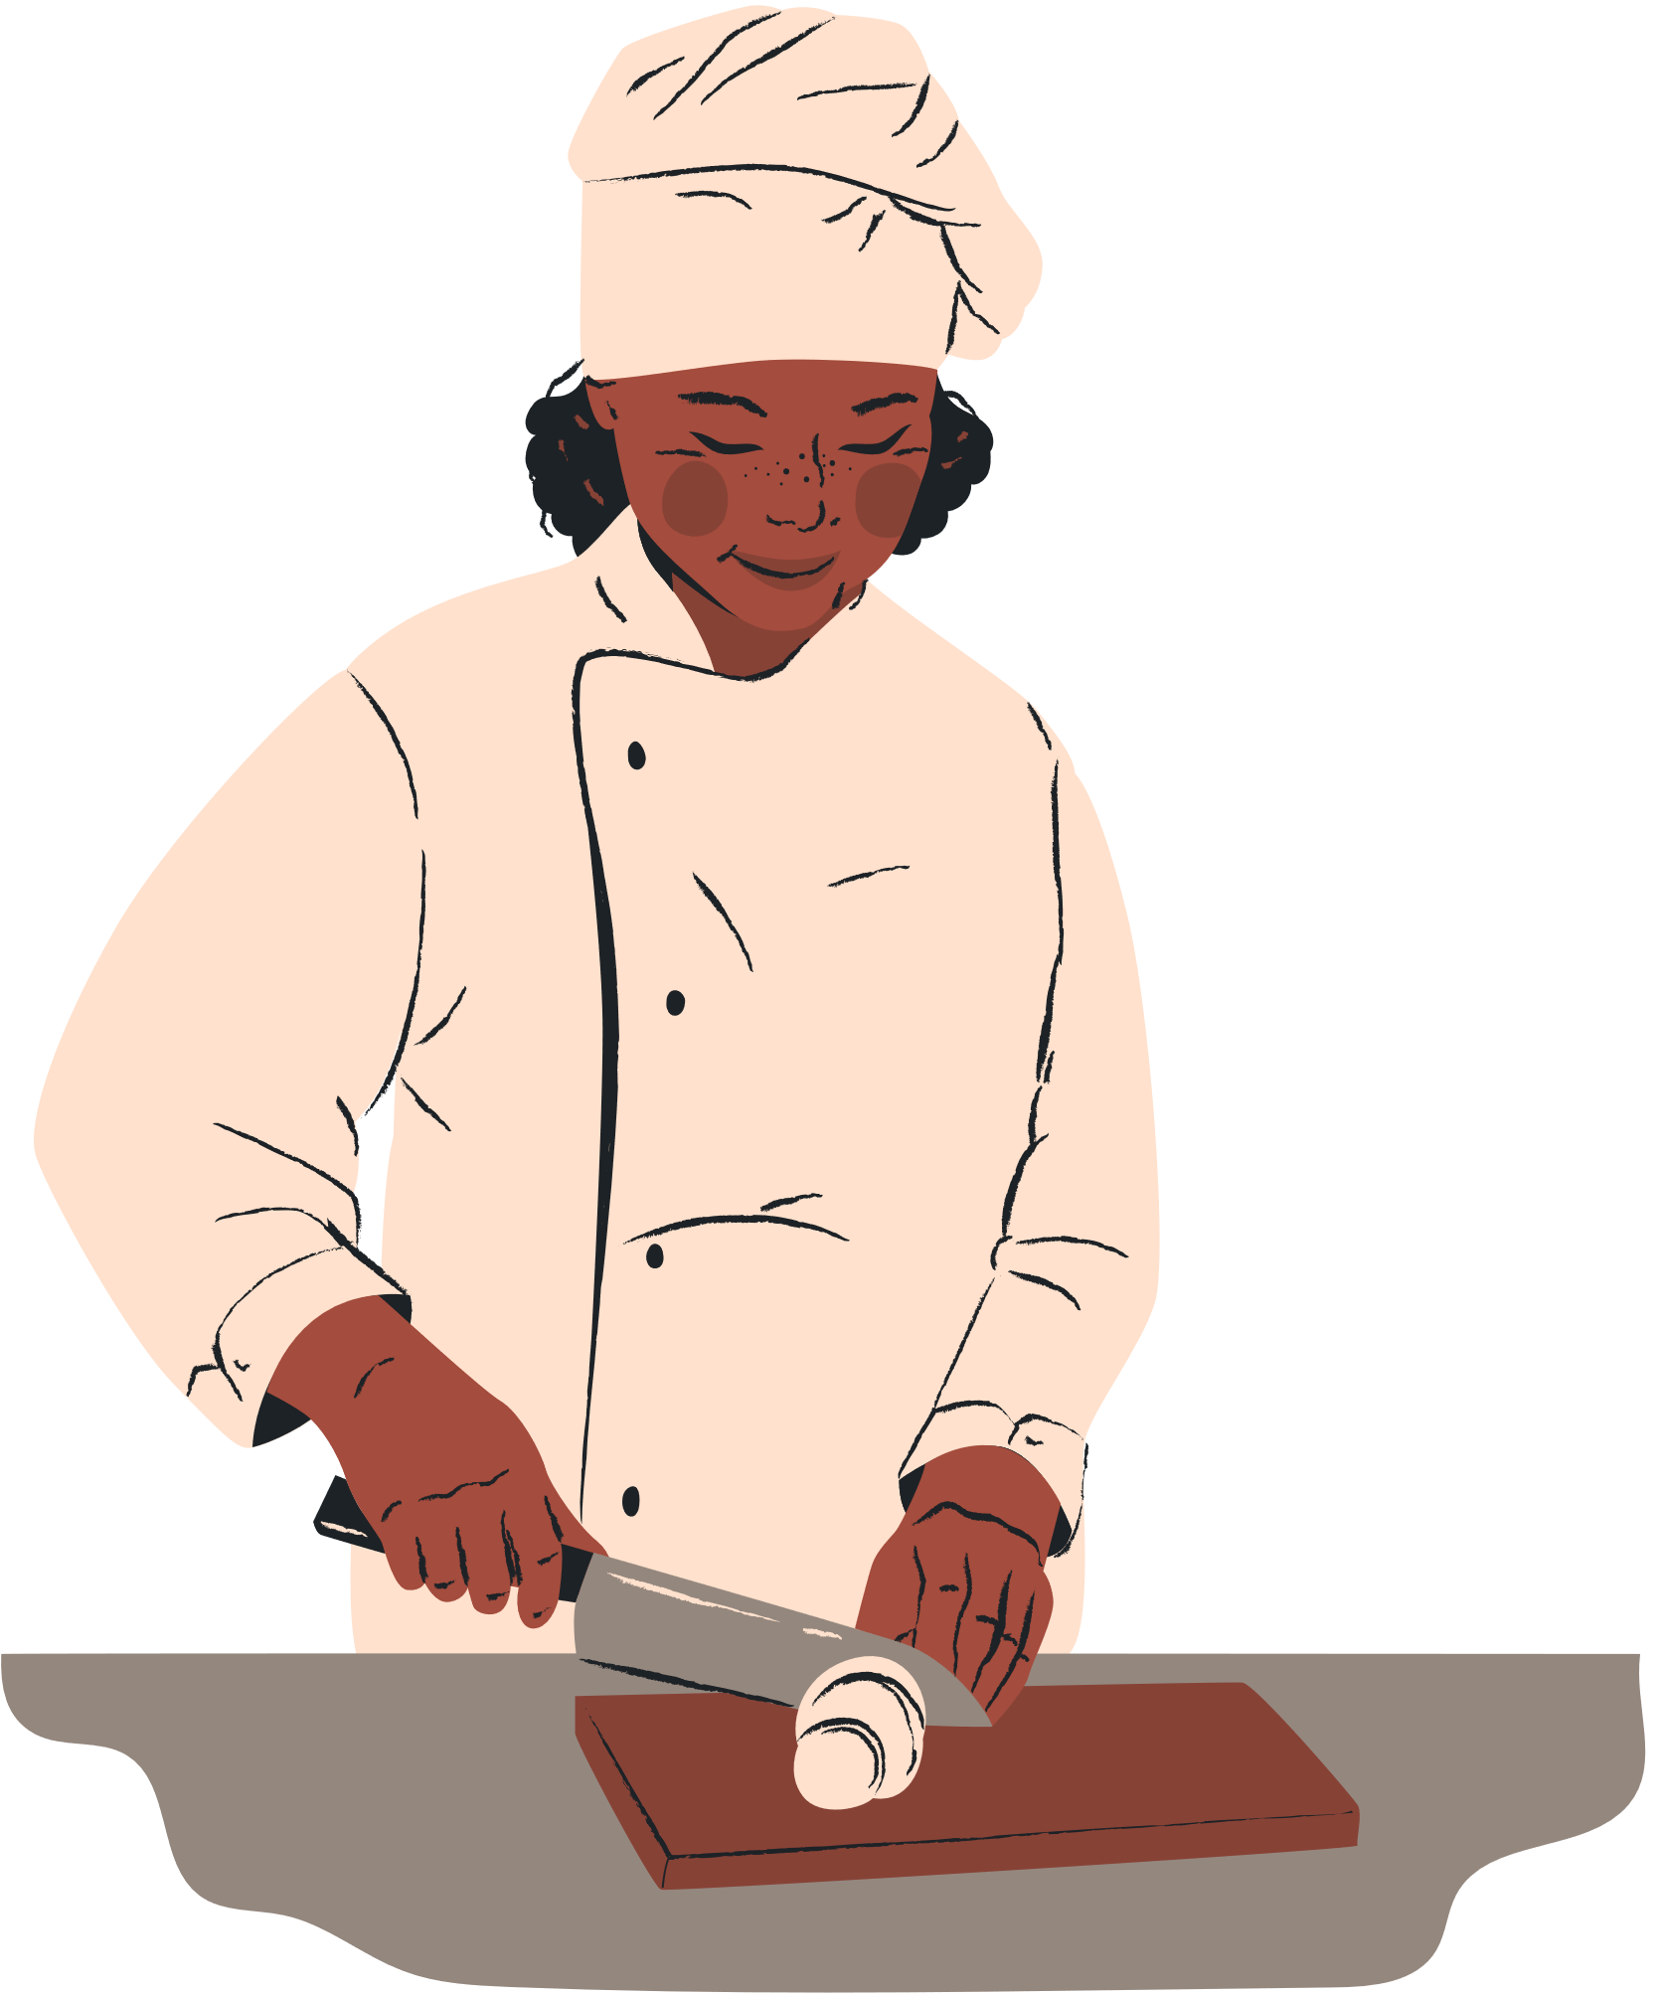
GUESS WHO?
CHEF

Slide 10
What are their responsibilities?
COMMUNITY HELPERS
firefighter
police officer
electrician
librarian
doctor
delivery person
garbage collector
chef

Slide 11


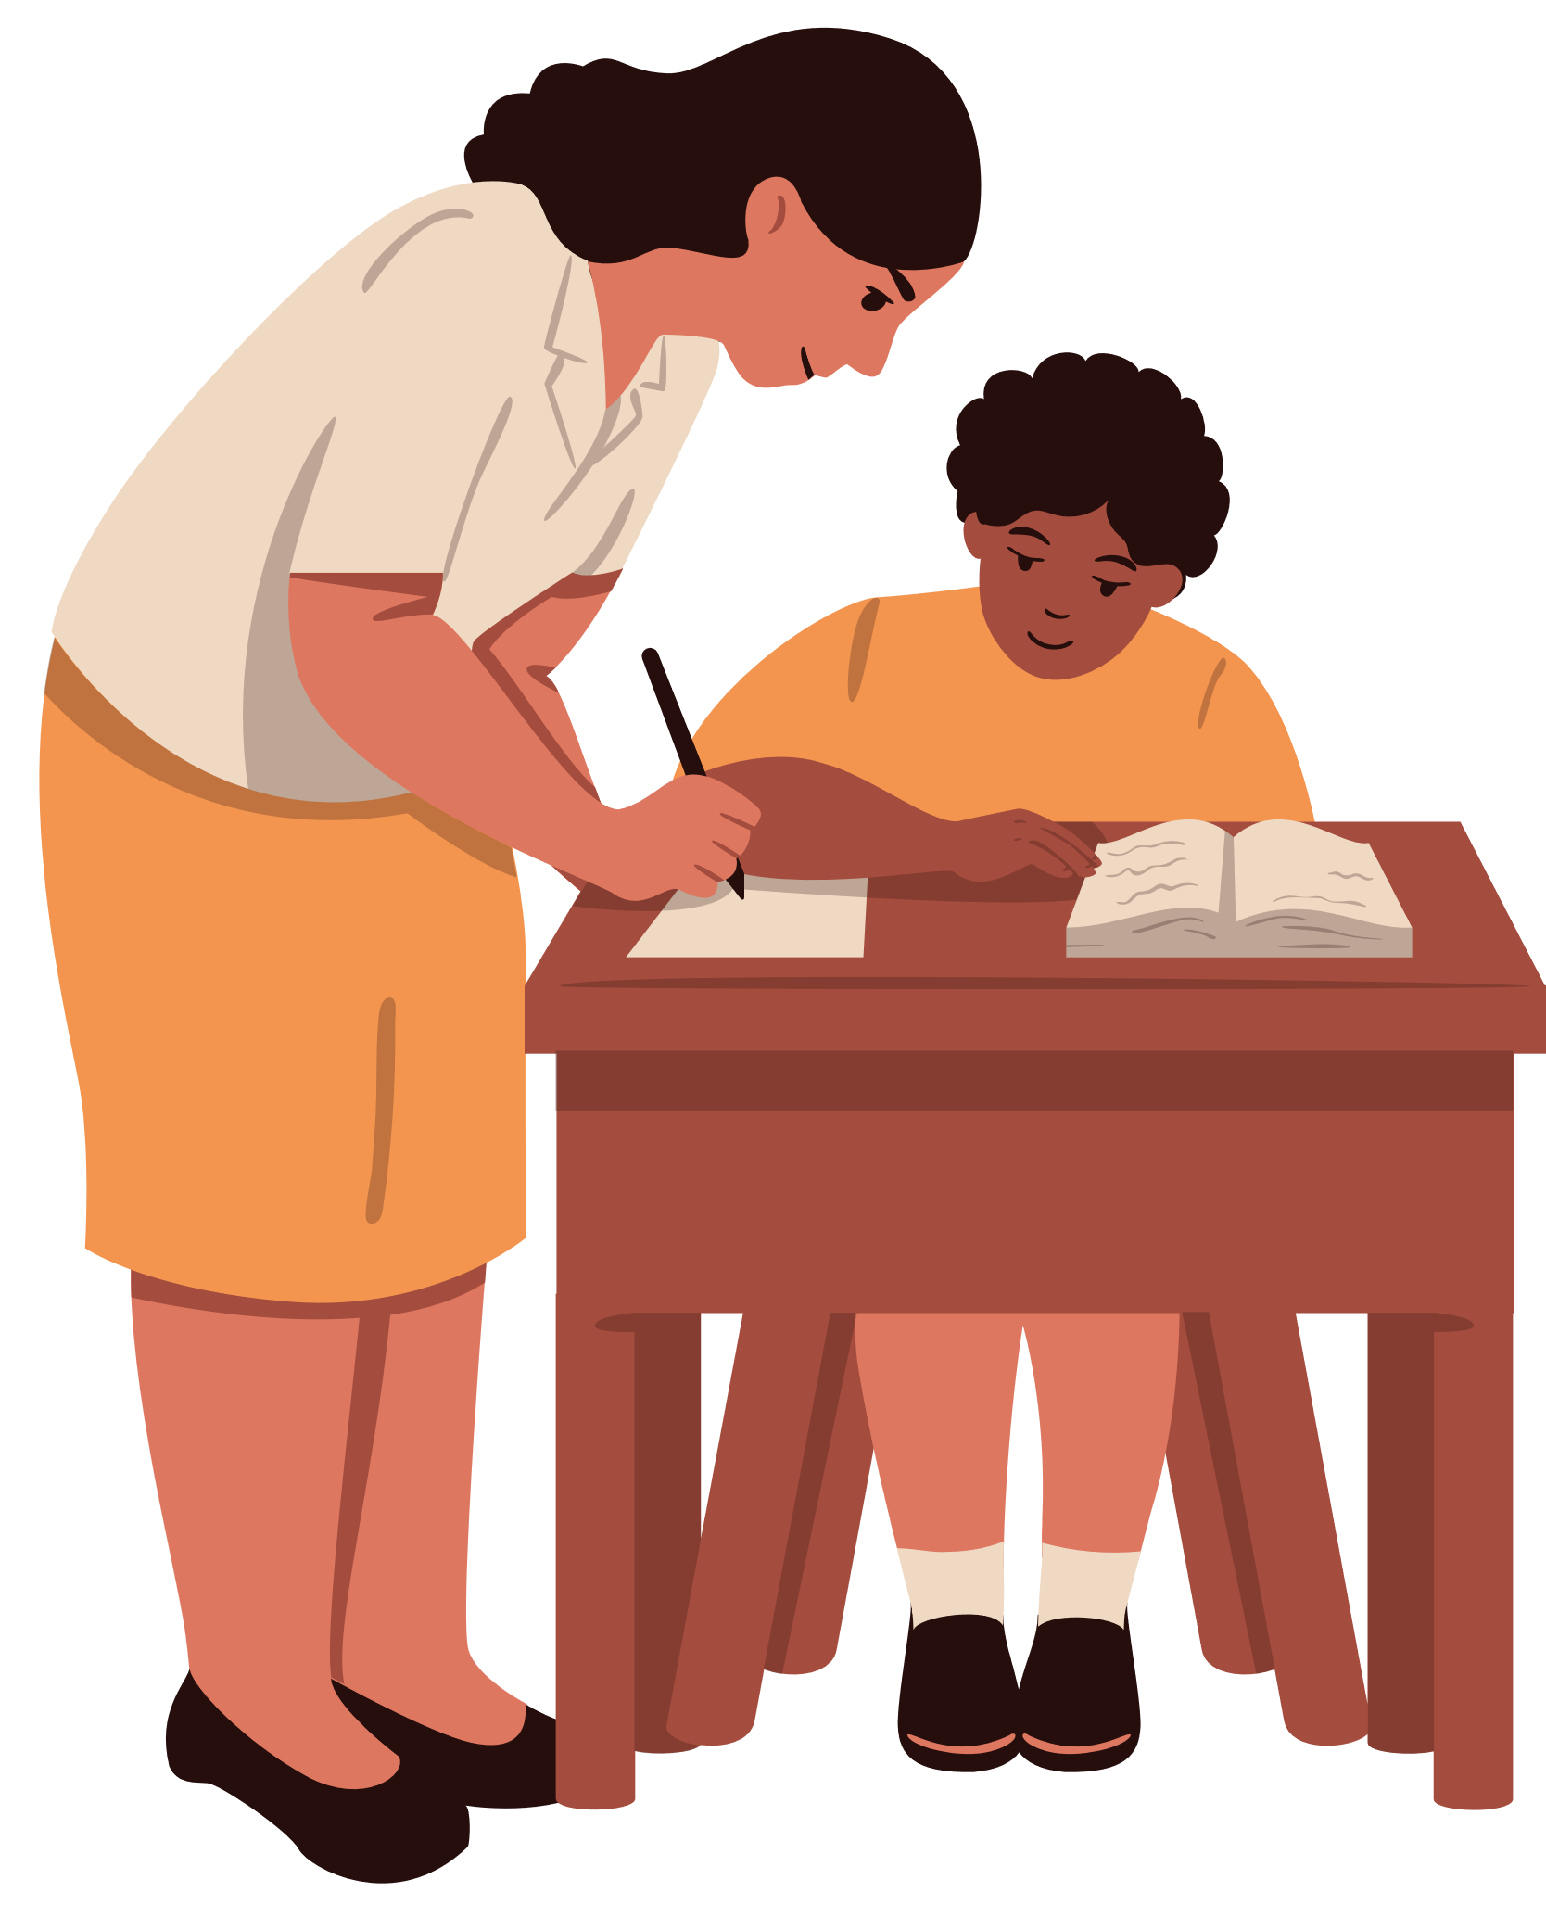


UNIT 1:
Local community
Lesson 2: A CLOSER LOOK 1

Slide 12


Objectives
By the end of the lesson, students will be able to:
Vocabulary
01
use the lexical items related to Local community.
Pronunciation
02
Pronounce the vowel sounds /æ/, /ɑ:/, and /e/ in words and sentences correctly.

Slide 13
01
VOCABULARY

Slide 14

garbage collector (n)
/ˈɡɑːbɪdʒ kəlektə/
nhân viên dọn vệ sinh

Slide 15
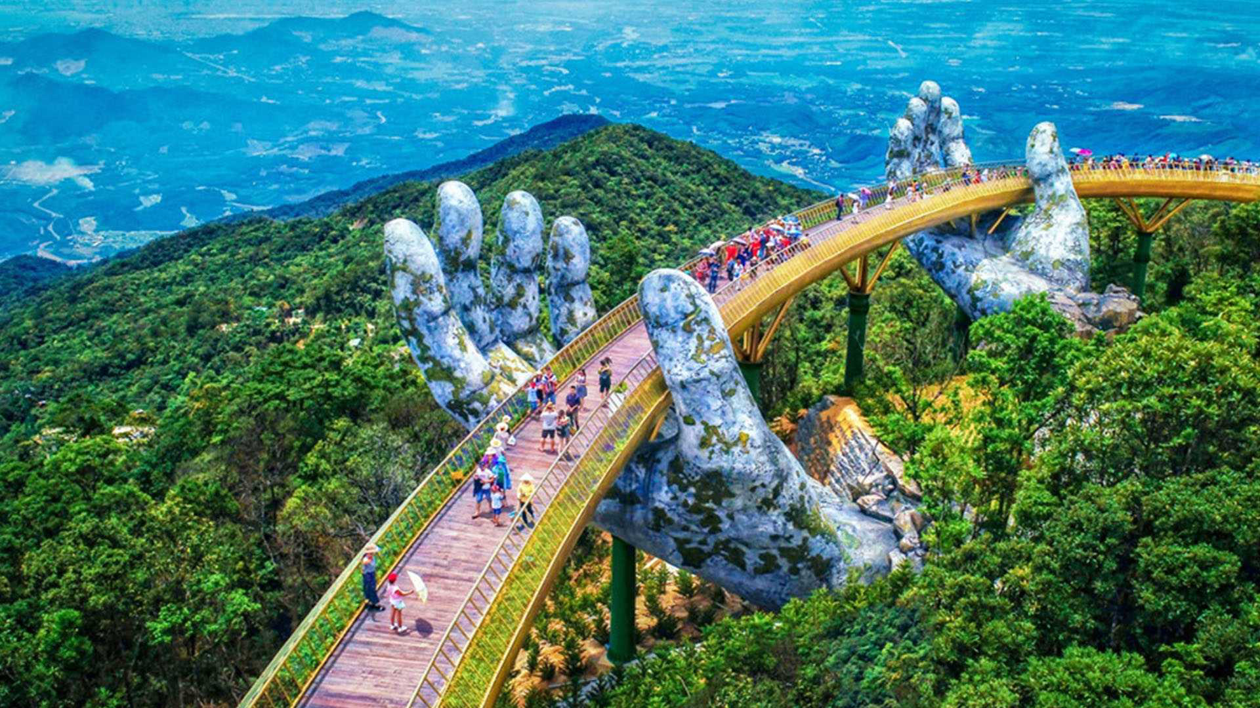
tourist attraction
(n.p)
/ˈtʊə.rɪst əˈtræk.ʃən/
địa điểm thu hút khách du lịch
“a place that people visit for pleasure and interest, usually while they are on holiday”

Slide 16
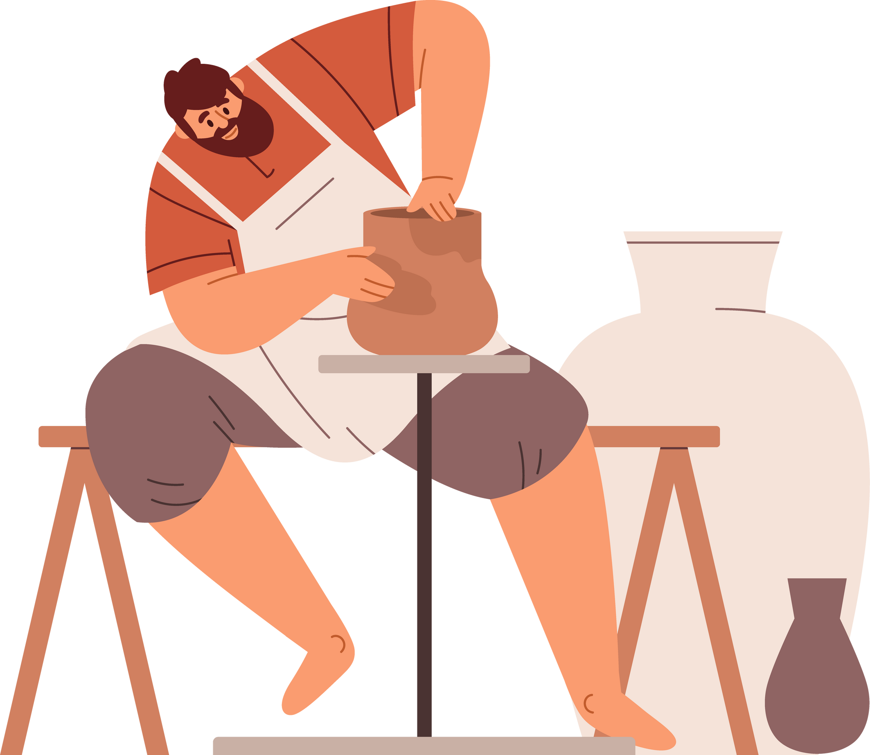
artisan (n)
/ˌɑːtɪˈzæn/
/ˈɑːrtɪzən/
thợ làm nghề thủ công

Slide 17
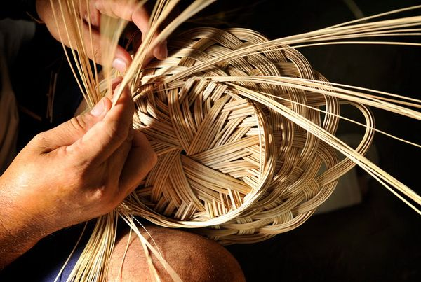
handicraft (n)
/ˈhæn.dɪ.krɑːft/
đồ thủ công mỹ nghệ

Slide 18
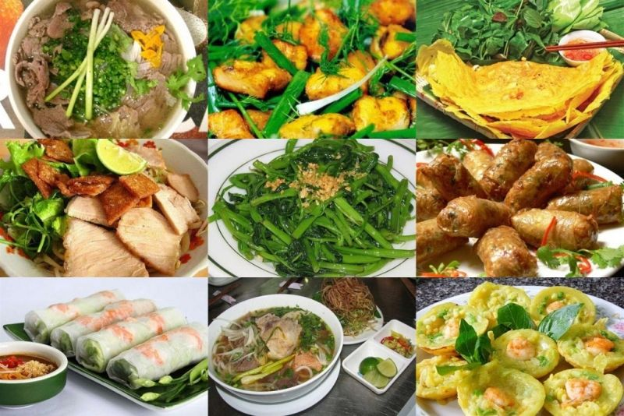
speciality (n)
/ˌspeʃ.iˈæl.ə.ti/
đặc sản, sản phẩm đặc biệt
“a product that is extremely good in a particular place”

Slide 19
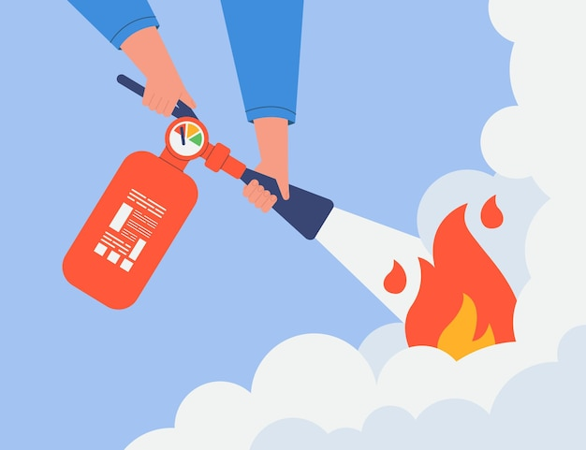
put something out (phr.v)
/pʊt aʊt/
dập, tắt (lửa, tàn thuốc/ đèn…)

Slide 20
VOCABULARY
Words | Pronunciation | Meanings
garbage collector (n) | /ˈɡɑːbɪdʒ kəlektə/ | nhân viên dọn vệ sinh
tourist attraction (n) | /ˈtʊə.rɪst əˈtræk.ʃən/ | địa điểm thu hút khách du lịch
artisan (n) | /ˌɑːtɪˈzæn/ /ˈɑːrtɪzən/ | thợ làm nghề thủ công
handicraft (n) | /ˈhæn.dɪ.krɑːft/ | đồ thủ công mỹ nghệ
speciality (n) | /ˌspeʃ.iˈæl.ə.ti/ | đặc sản, sản phẩm đặc biệt
put something out (phr.v) | /pʊt aʊt/ | dập, tắt (lửa, tàn thuốc/ đèn…)

Slide 21
Ex 1. Match the community helpers with their responsibilities. (p.10)
a. puts in, checks, and repairs electrical wires and equipment
1. police officer
b. puts out fires and saves people from dangerous fires
2. garbage collector
c. protects people and property, makes people obey the law, prevents and solves crimes
3. electrician
4. firefighter
d. delivers goods to people’s houses or workplaces
5. delivery person
e. takes people’s rubbish away

Slide 22

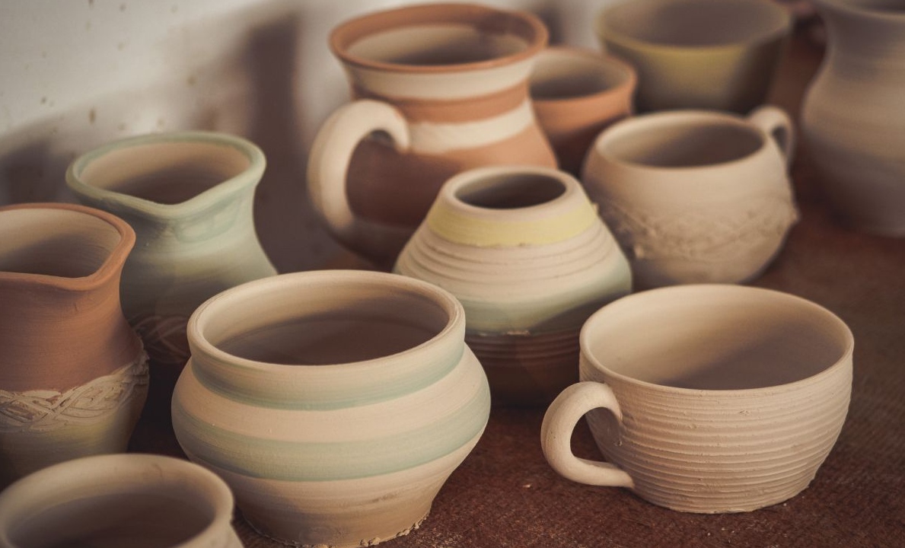
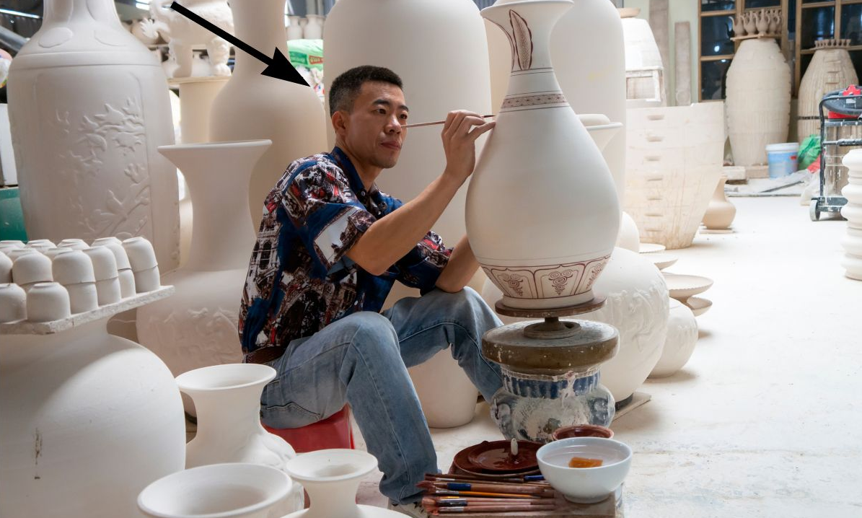
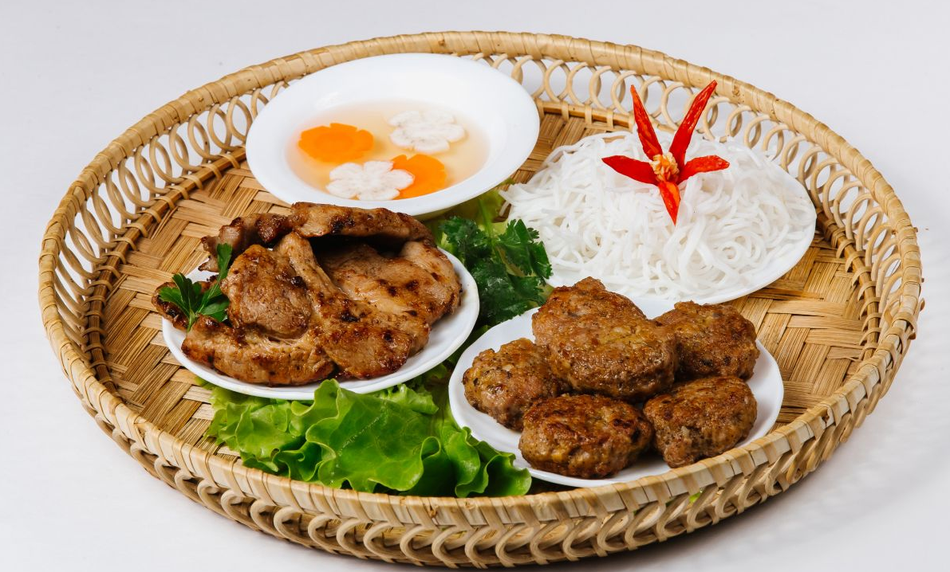
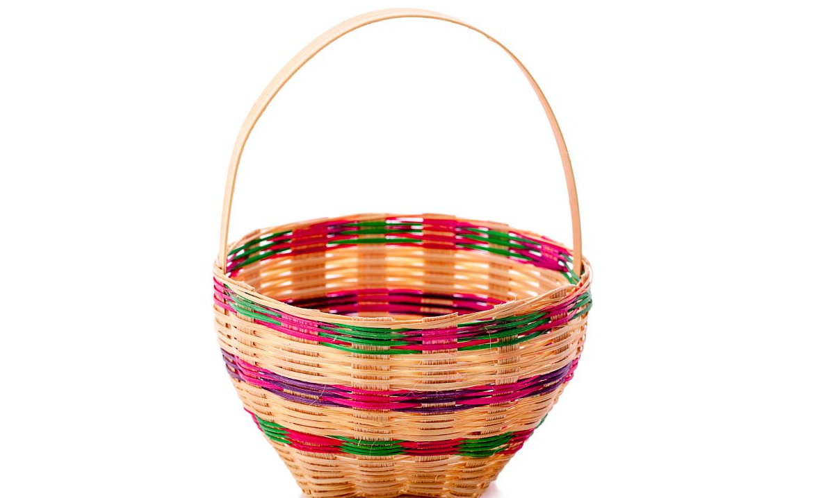
Ex 2. Write a word or phrase in the box under the correct picture. (p.10)
tourist attraction
artisan
handicraft
speciality food
pottery
1
2
3
tourist attraction
pottery
artisan
4
5
speciality food
handicraft

Slide 23
Ex 3. Fill in each blank with a word or phrase from the box.
artisans
electrician
handicrafts
speciality
garbage collector
artisans
1. Skilled local ____________ made these beautiful flower vases.
2. The electrical wires in our neighbourhood broke down yesterday, so we had to call a(n) ______________.
3. Bun cha, pho, and hu tieu are examples of famous Vietnamese ________________.
4. The _________________ in our street usually comes at 6 p.m. to take the rubbish away.
5. Tourists to Hoi An usually buy traditional ______________ such as lanterns as souvenirs.
Skilled local
made
vases
electrical wires
broke down
call
electrician
Bun cha, pho
hu tieu
Vietnamese
speciality
garbage collector
take
rubbish away
Tourists
buy
handicrafts
lanterns
souvenirs

Slide 24
02
PRONUNCIATION
/æ/, /ɑ:/, and /e/

Slide 25
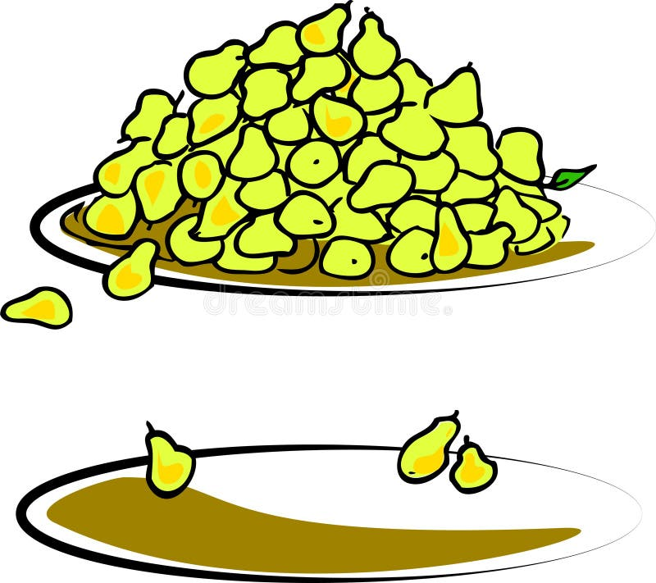

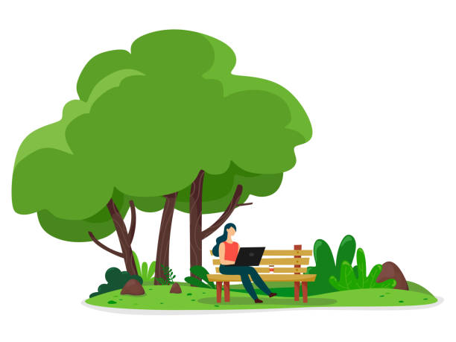

What are they?
many
cattle
park
/ˈmen.i/
/ˈkæt.əl/
/pɑːk/

Slide 26

Watch and take notes

Slide 27
Ex 4. Listen and number the words you hear. Then listen again and repeat.
______ pack ______ park
______ kettle ______ cattle
______ marry ______ merry
______ chart ______ chat
3
5
/pæk/
/pɑːk/
7
4
/ˈket.əl/
/ˈkæt.əl/
8
2
/ˈmær.i/
/ˈmer.i/
1
6
/tʃɑːt/
/tʃæt/

Slide 28
Ex 4. Listen and practise the sentences. Underline the bold words with /æ/, circle the bold words with /ɑ:/, and tick the bold words with /e/.
1. Thanks to garbage collectors, our streets are clean.
2. My grandmother is a well-known artist.
3. That bakery makes the best bread in our neighbourhood.
4. Do you know where to buy bamboo beds?
5. We sometimes go to the park to relax.



Slide 29
WRAP-UP
What do you have learnt in the lesson today?
01
My wallet was stolen when I was shopping. Who can help me?
A. artisan B. electrician
C. garbage collector D. police officer
02
Choose the word that pronounced differently.
A. marry B. cattle C. park D. chat
/ˈmær.i/
/ˈkæt.əl/
/pɑːk/
/tʃæt/

Slide 30



THANKS!
Do you have any questions?

Slide 31
GAME:
WHO IS THE HELPER?
Notes:
OPTIONAL: NẾU CÒN THỜI GIAN có thể cho HS củng cố từ vựng bằng trò chơi này.

Slide 32


Directions:
  Your teacher will read you a scenario about a person who needs help.
  Listen carefully and think about what community helper can help the person in the scenario.
  Once you have your answer, you can raise your hand to share it with the class.

Slide 33
Scenario 1
Sarah's cat is stuck up in a tree and can't get down.
Who can help her?
A. A firefighter
B. A chef

Slide 34
The answer is a firefighter.

Slide 35
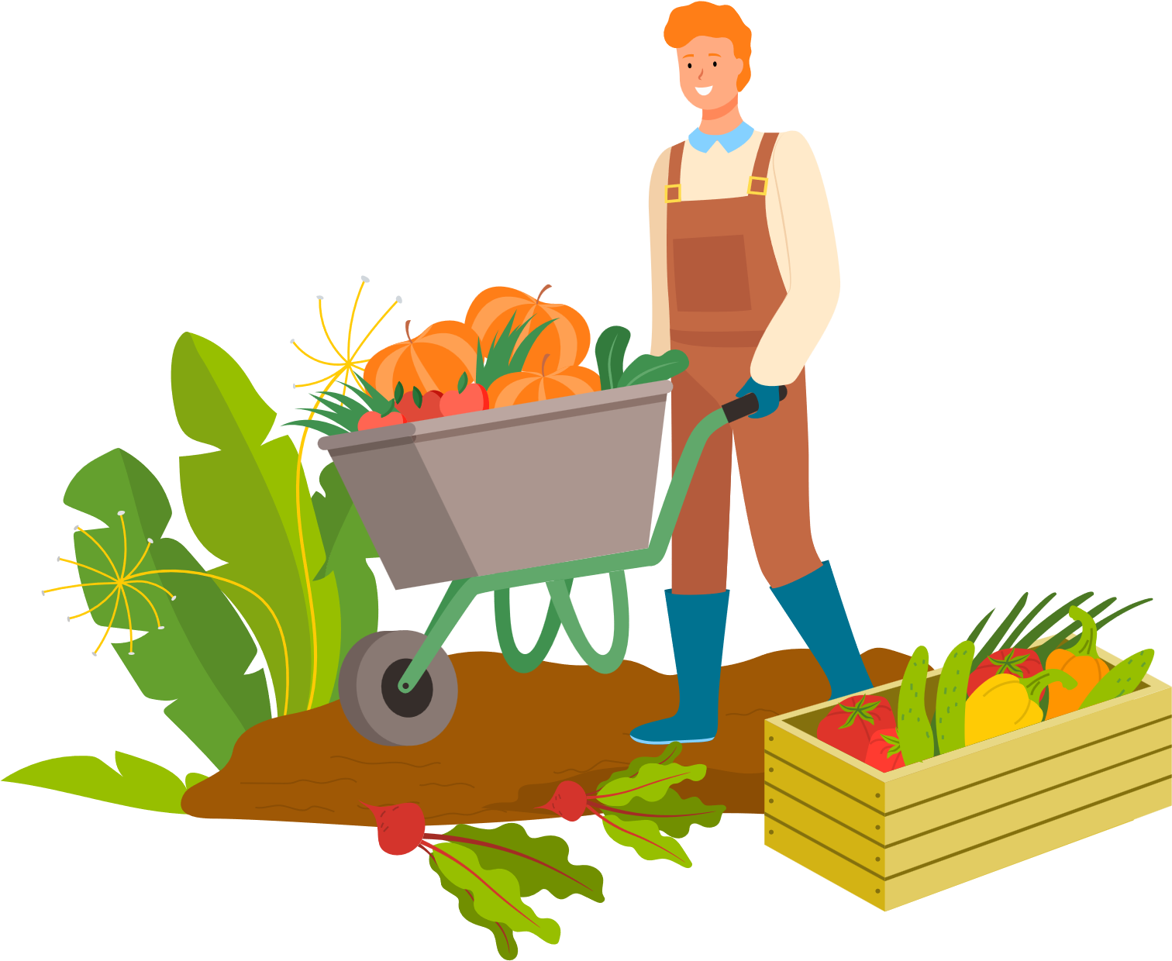

Scenario 2
Elbert wants to check out a book from the library but needs help finding it. Who can help him?
A. A farmer
B. A librarian

Slide 36
The answer is a librarian.

Slide 37

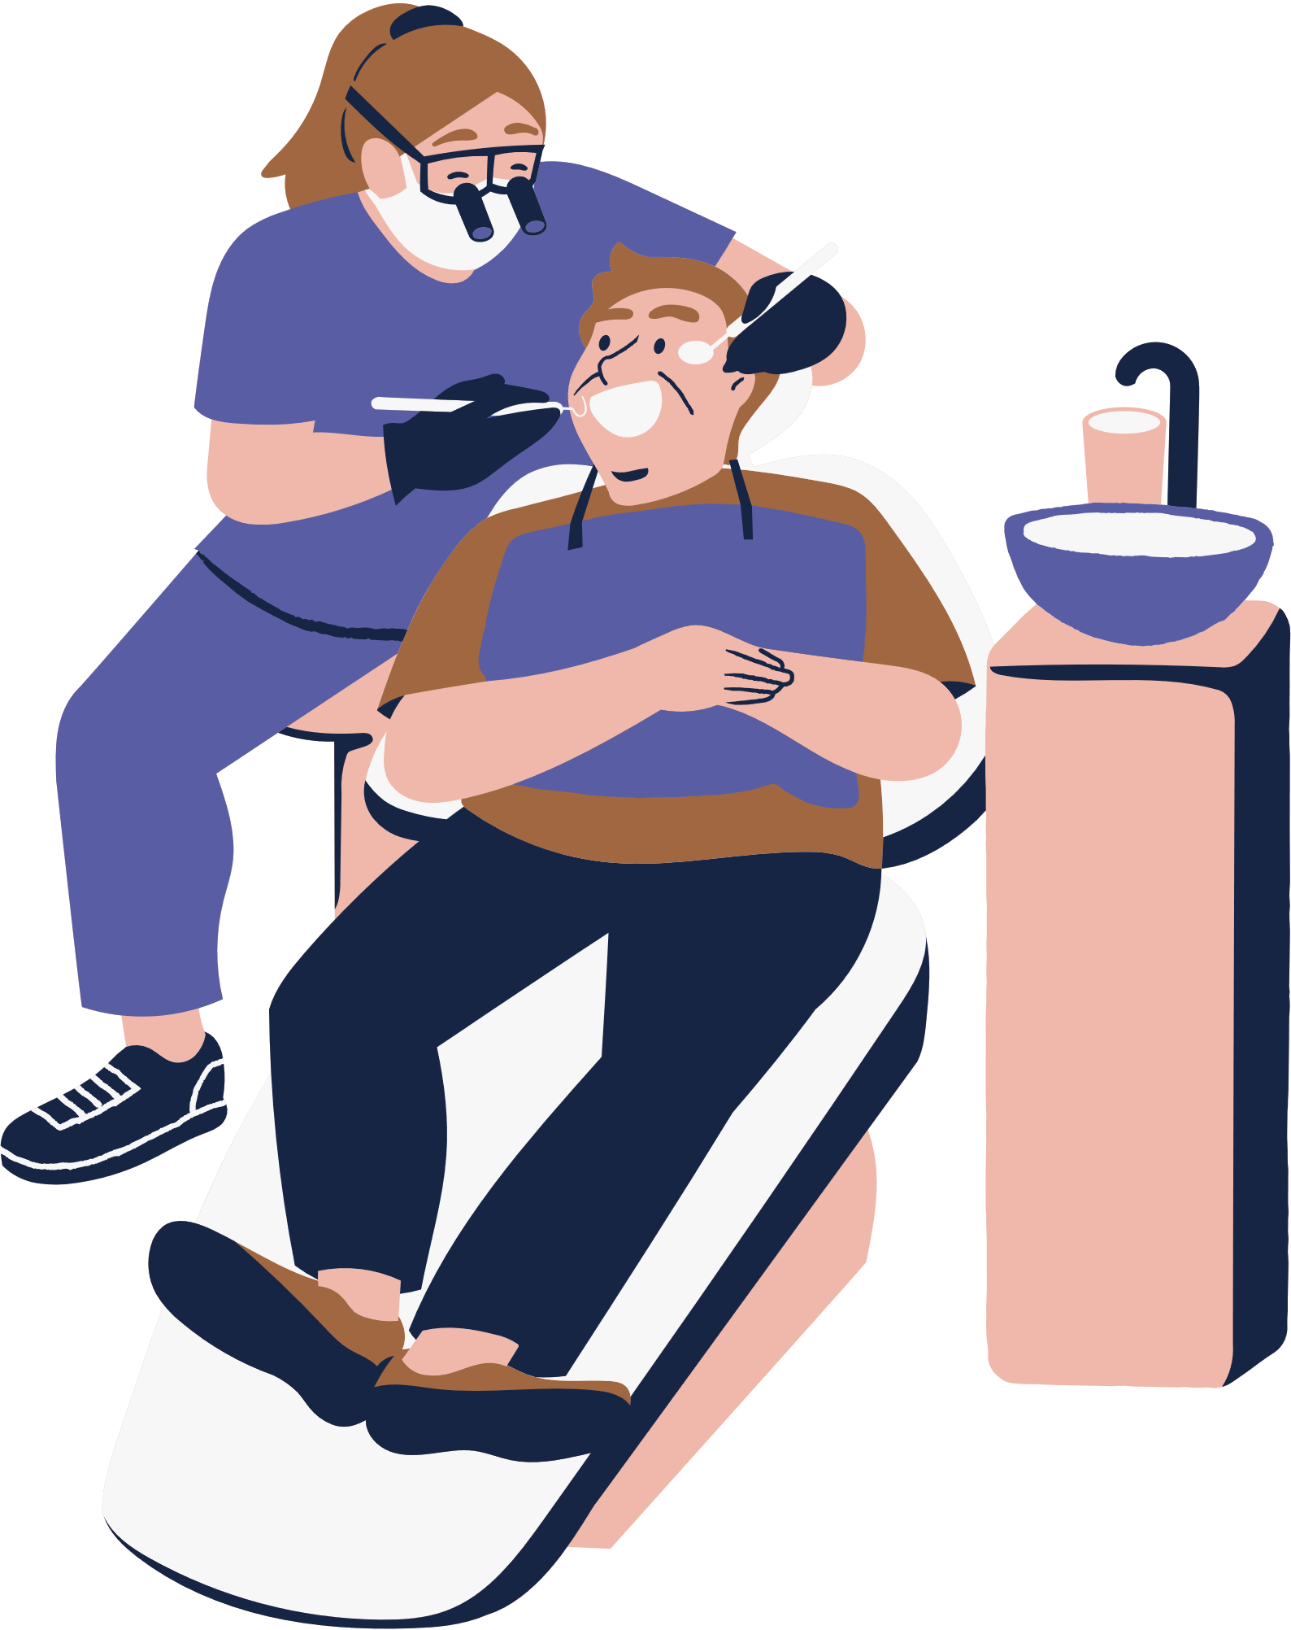
Scenario 3
Emily has a cavity and needs to get her tooth fixed. Who can help her?
A. A scientist
B. A dentist

Slide 38
The answer is a dentist.

Slide 39
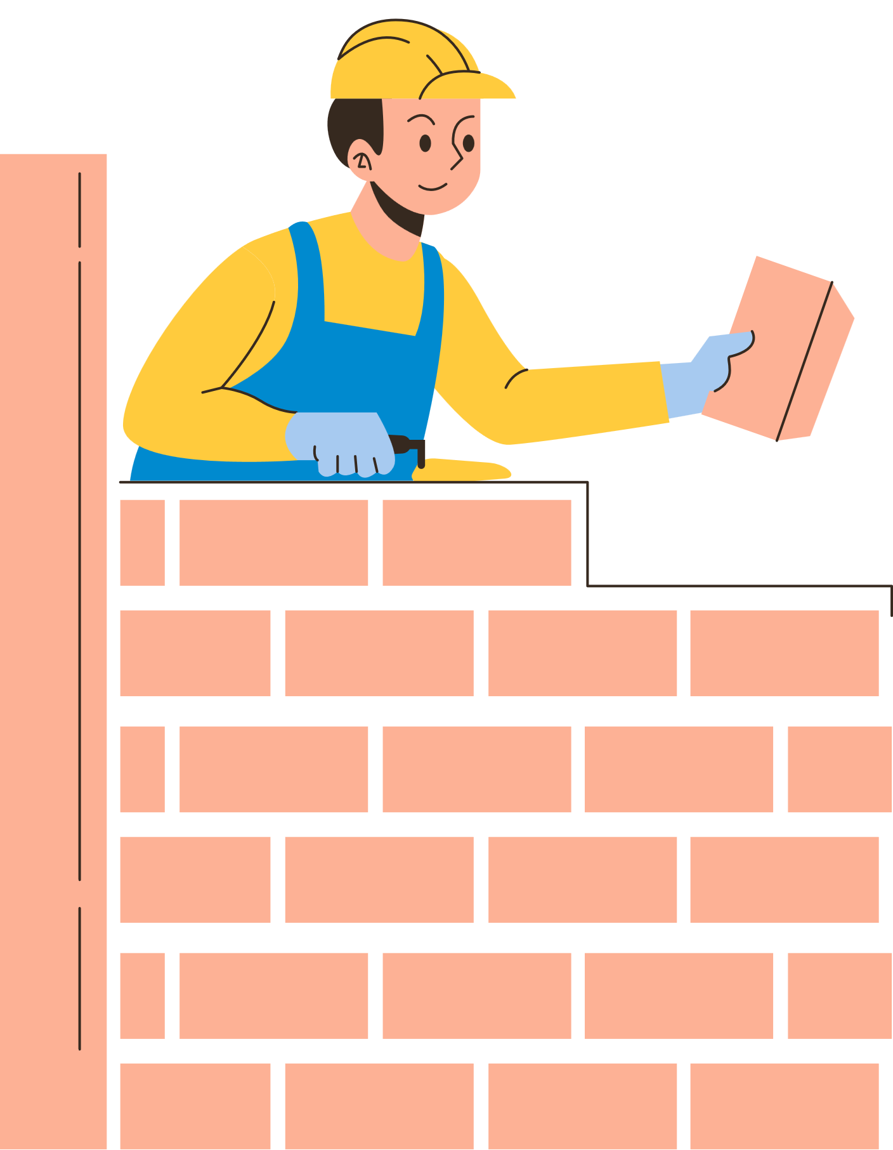
Scenario 4
John has been feeling very sick for a few days. His throat is hurting badly. Who can help him?
A. A doctor
B. A builder

Slide 40
The answer is a doctor.

Slide 41
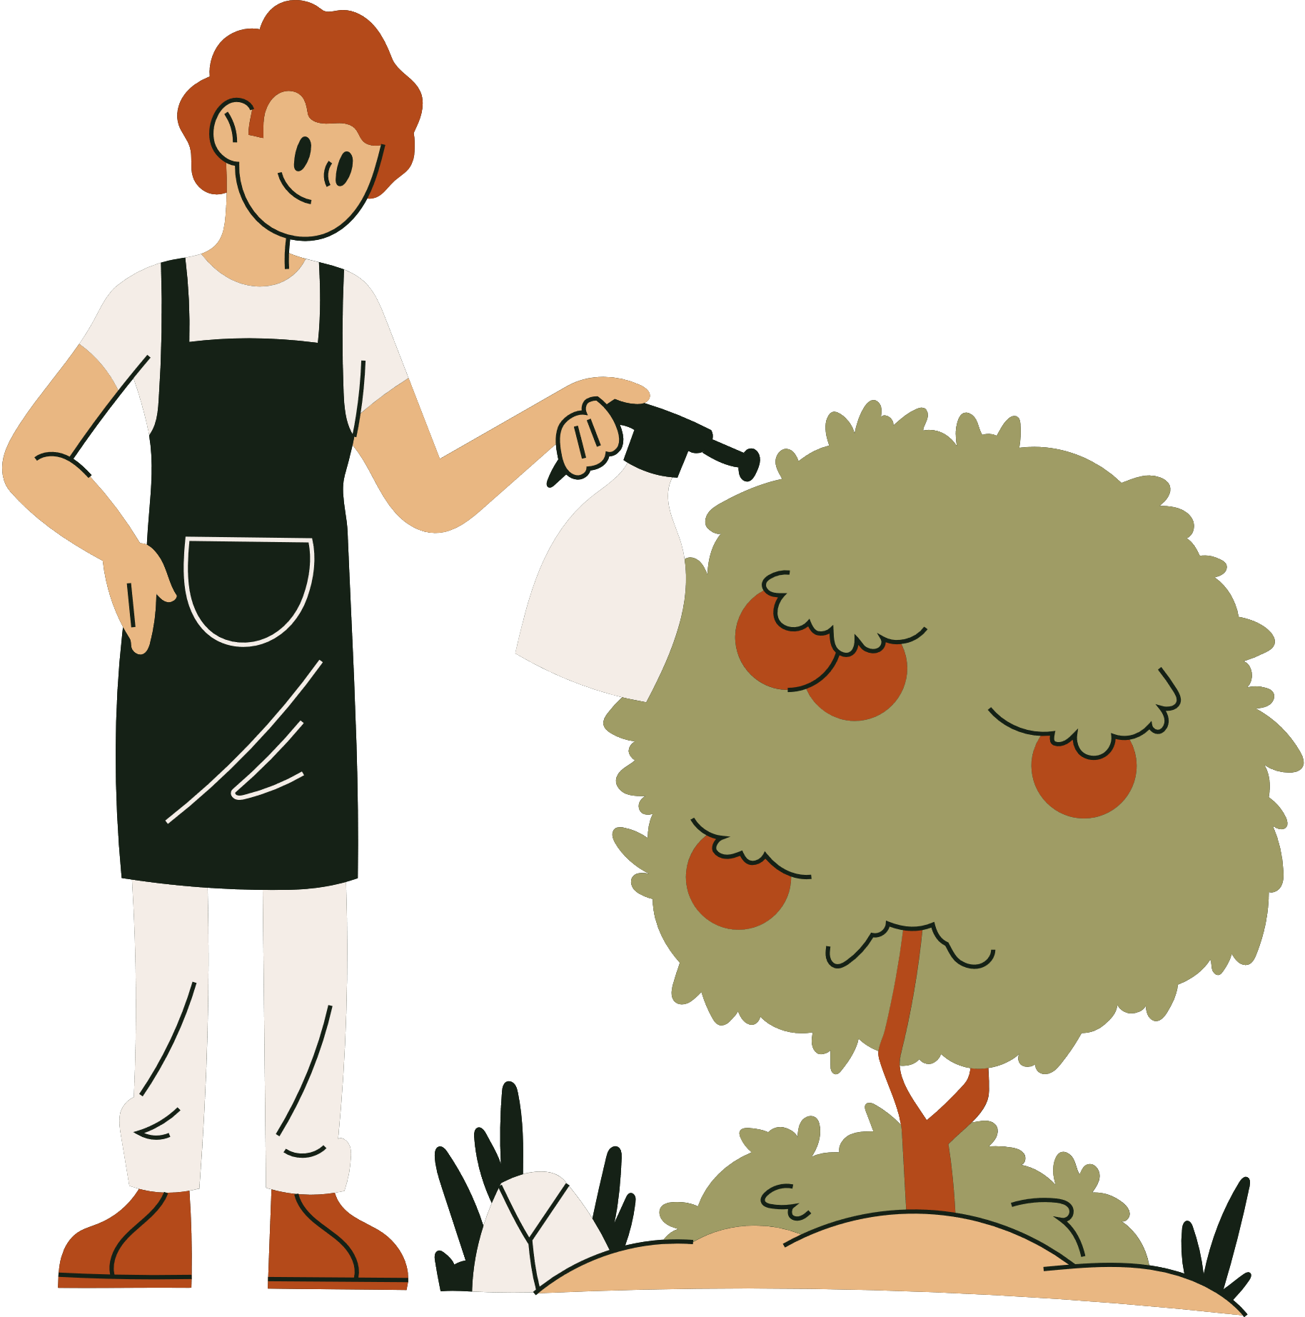
Scenario 5
Mrs. Jones had her wallet stolen while walking on the street. Who can help her?
A. A police officer
B. A gardener

Slide 42
The answer is a police officer.

Slide 43
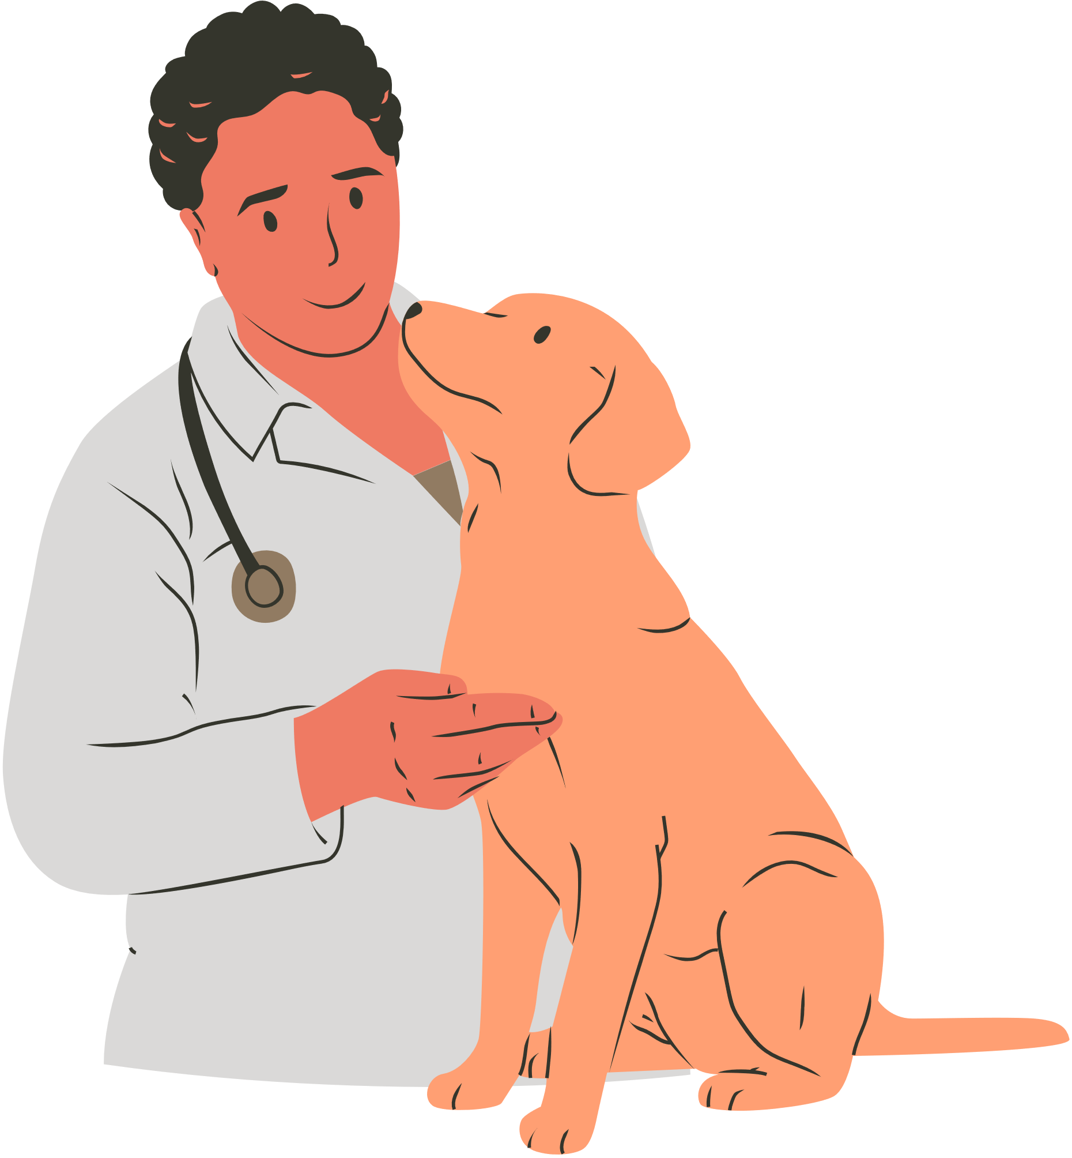
Scenario 6
The power has gone out in the neighborhood. Who can help fix it?
A. A veterinary
B. An electrician

Slide 44
The answer is an electrician.

Slide 45
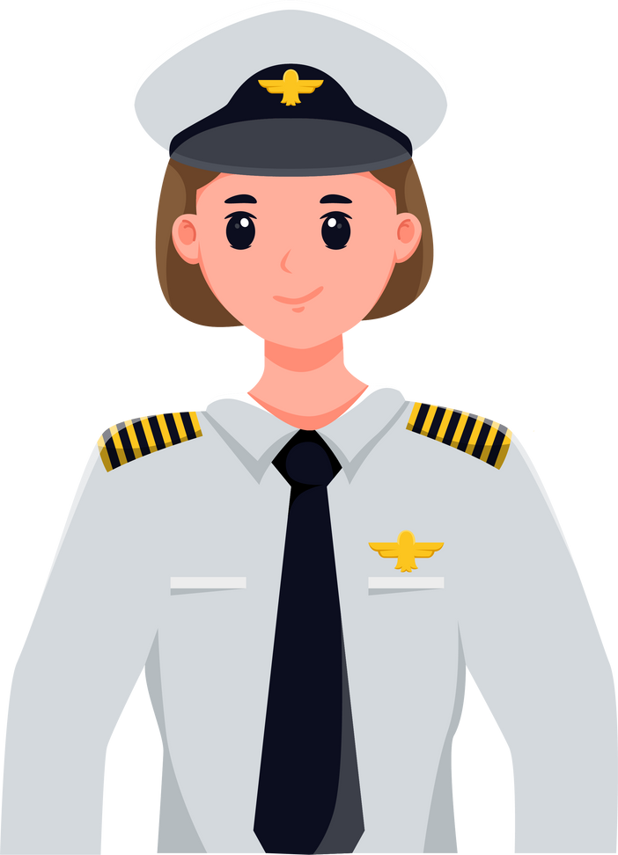
Scenario 7
Max's dog is sick and needs to be checked. Who can help him?
A. A pilot
B. A veterinary

Slide 46
The answer is a veterinary.

Slide 47
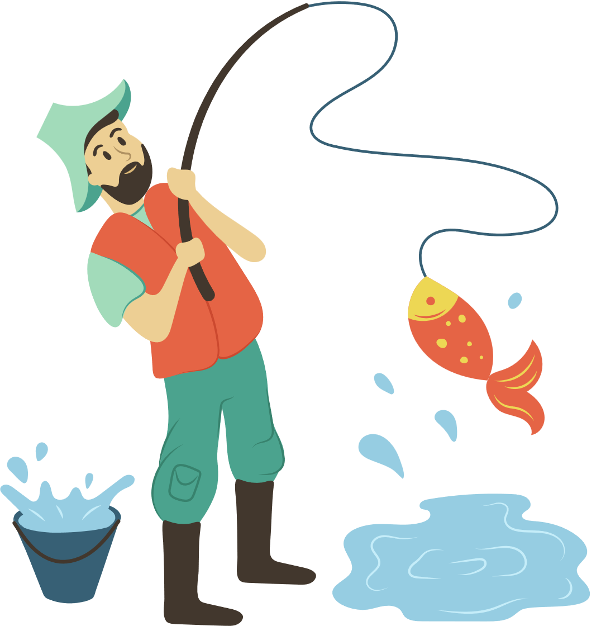
Scenario 8
Joanna is having trouble reading and needs extra help. Who can help her?
A. A teacher
B. A fisherman

Slide 48
The answer is a teacher.

