Slide 1
WARM-UP

Slide 2


LIKE OR DISLIKE?
love
like
detest
fancy
dislike
enjoy
hate
prefer
love
like
detest
dislike
fancy
enjoy
hate
prefer

Slide 3
Verbs of liking
Verbs of disliking
love
like
detest
dislike
fancy
enjoy
hate
How to use them?
Can you add more?
prefer

Slide 4
UNIT 1:
LEISURE TIME
LESSON 3: A CLOSER LOOK 2

Slide 5
OBJECTIVES
By the end of the lesson, students will be able to:
use the verbs of liking and disliking with gerunds and to-infinitive

Slide 6


Verbs of liking/disliking + gerunds (V-ing)
She likes reading book.
He dislikes surfing the Internet.
V-ing
V-ing
Notes:
Ask Ss to make a sentence

Slide 7
1
She likes reading book.
2
She likes to read book.
to V
Some verbs of liking/ disliking + gerunds/ to infinitives

Slide 8
Ex 1. (P.11) Work in pairs. Put the verbs into the correct column.
love
like
detest
fancy
dislike
enjoy
hate
prefer
Verbs followed by gerunds only | Verbs followed by both gerunds and to-infinitives
detest
fancy
love
like
dislike
enjoy
hate
prefer

Slide 9
Ex 2. (P.11) Choose the correct answer A, B, C or D.
1. I love ______, so in my leisure time, I go to some villages near Ha Noi to relax and enjoy the outdoors.
A. travelling B. travelled C. a travel
2. Tom enjoys ______ puzzles, especially Sudoku.
A. doing B. do C. to do
3. When do you like ______ TV?
A. watched B. watch C. to watch
4. Do you fancy ______ to the cinema this weekend?
A. go B. going C. to go
5. I detest ______. I think it’s cruel to harm animals.
A. hunting B. to hunt C. hunt

Slide 10
Ex 2. (P.11) Choose the correct answer A, B, C or D.
1. I love ______, so in my leisure time, I go to some villages near Ha Noi to relax and enjoy the outdoors.
travelling B. travelled C. a travel
2. Tom enjoys ______ puzzles, especially Sudoku.
A. doing B. do C. to do
love
love + V-ing/ to V
enjoys
enjoy + V-ing

Slide 11
Ex 2. (P.11) Choose the correct answer A, B, C or D.
3. When do you like ______ TV?
A. watched B. watch C. to watch
4. Do you fancy ______ to the cinema this weekend?
go B. going C. to go
5. I detest ______. I think it’s cruel to harm animals.
A. hunting B. to hunt C. hunt
like
like + V-ing/ to V
fancy
fancy + V-ing
detest
detest + V-ing

Slide 12
GAME: TYPHOON

Slide 13



Pick a box
Answer the question
Get a random prize below
The winning team has the most points
10
Your point
Blow friend’s point
Swap point

Slide 14

PICK A BOX
10
1
20
2
3
20
4
5
10
6

Slide 15
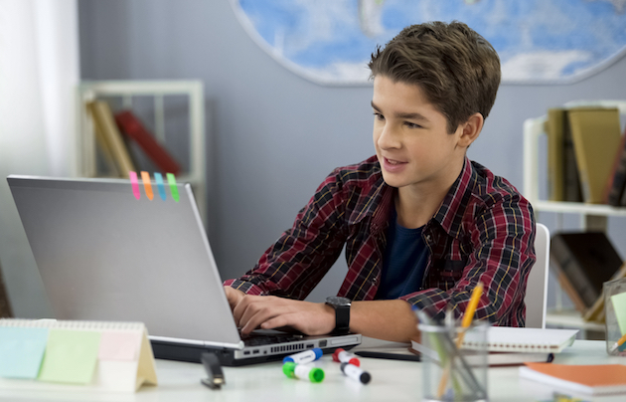

Finish the sentence.
likes surfing the Internet/
likes to surf the Internet
1. Mark _________________. (like)

Slide 16
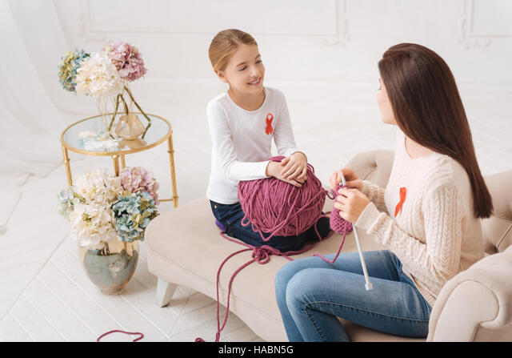
Finish the sentence.
enjoy knitting
2. The girls ________________. (enjoy)

Slide 17
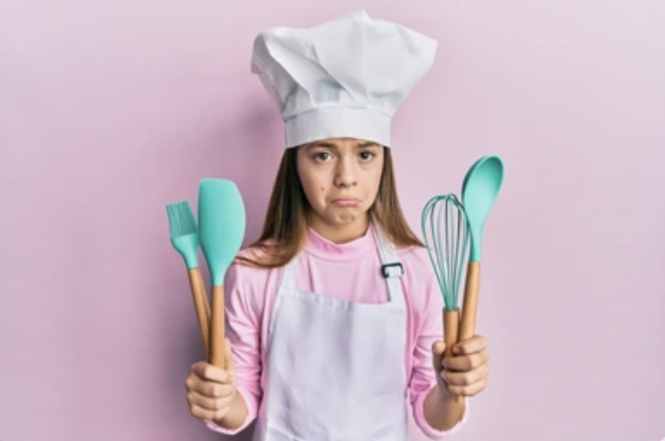
Finish the sentence.
dislikes cooking
3. My cousin ________________. (dislike)

Slide 18
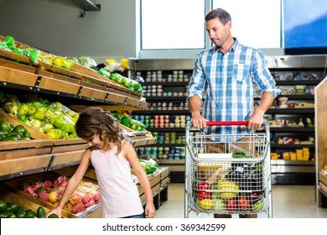
Finish the sentence.
hates going shopping/
hates to go shopping
4. My father ________________. (hate)

Slide 19
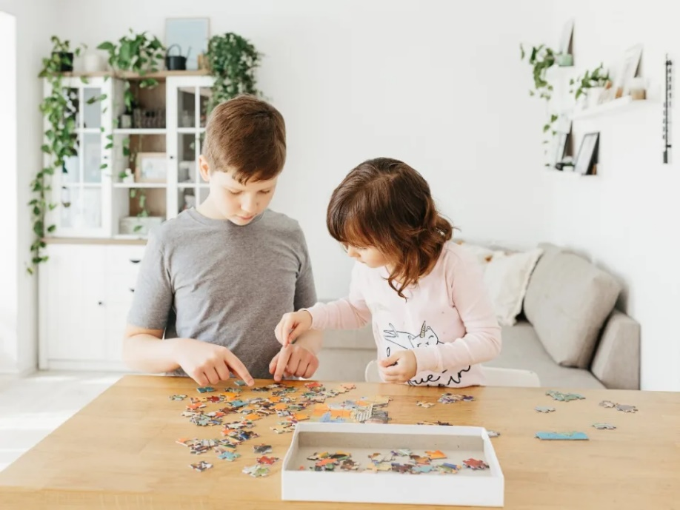
Finish the sentence.
prefer doing puzzles/
prefer to do puzzles
5. Tom and his sister ________________. (prefer)

Slide 20


Slide 21
Ex 4. (P.12) Complete the sentences about yourself.
All about me
I like ______. I prefer ______. I love ______. | I dislike ______. I hate ______. I detest ______.

Slide 22
GAME
LIKES & DISLIKES MIMES

Slide 23
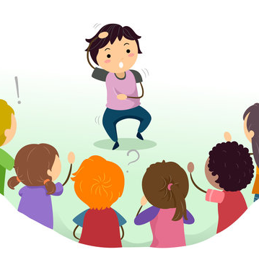
Likes & dislikes mimes
 Work in groups.
 One mimes a leisure activity he/ she likes or dislikes.
 The others guess the activity by asking YES/NO questions.
A: Do you like surfing the net?
B: No, I don’t.
C: Do you love messaging your friends?
B: Yes, I do.

Slide 24

Let’s play in groups!

Slide 25
IT’S SHOW TIME
Notes:
Play in the whole class.

Slide 26
WRAP - UP
Choose the correct answer.
1
My sister fancies ______ flowers.
A. arrange B. arranging C. to arrange
2
The children hate _____ swimming.
A. to go B. to going C. go

Slide 27
HOMEWORK
Finish Ex 4 (P.12)
Do exercises in your Workbook (Grammar)

Slide 28
Thanks!
Do you have any questions?

