Slide 1
UNIT 1:
LEISURE TIME
Lesson 2: A closer look 1

Slide 2
OBJECTIVES
1
2
Remember the lexical items related to Leisure time
Correctly pronounce words that contain the sounds /ʊ/ and /u:/

Slide 3
LET’S WRAM UP!

Slide 4


CHAIN GAME!!
-1 student begins to say 1 hobby.
- Another repeat and say his hobby using another verb of liking
- Keep going until someone forget.
I like football,
I love reading, and I ….
I like football
and I love reading.
I like football

Slide 5
I. Vocabulary

Slide 6
1. Match a word/ phrase in column A with a word in column B to make expressions about likes.
be fond
be keen
be interested
be crazy
be
about
in
on
into
of

Slide 7
VOCABULARY
New words | Pronunciation | Meaning
1. be interested in | /biː ɪntrəstɪd ɪn/ | hứng thú với
2. be fond of | /biː fɒnd əv/ | thích
3. be keen on | /biː kiːn ɒn/ | quan tâm đến
4. be crazy about | /biː ˈkreɪzi əˈbaʊt/ | say mê
5. be into | /biː ˈɪntuː/ | thích

Slide 8
2. Fill in each blank with a correct word from the box.
into fond keen interested about
fond
I’m _________ of taking photos. In my free time, I usually go out and take photos of people and things.
Mai is _______________ in history. She often goes to museums to see new exhibits and learn about the past.
My sister is _________ on cooking. She wants to become a chef in the future.
My brother spends lots of time surfing the net, but I’m not _________ it.
I’m not crazy _________ doing DIY. I’m never able to finish any DIY projects I start.
interested
keen
into
about

Slide 9
3. Complete the sentences about what you like or dislike doing. Use the word or phrases from the box or your own ideas.
cooking doing DIY surfing the net
playing sport doing puzzles messaging friends
Example: I’m interested in doing DIY.
1. I’m crazy about ______.
2. I’m keen on ______.
3. I’m fond of ______.
4. I’m not interested in ______.
5. I’m not into ______.

Slide 10


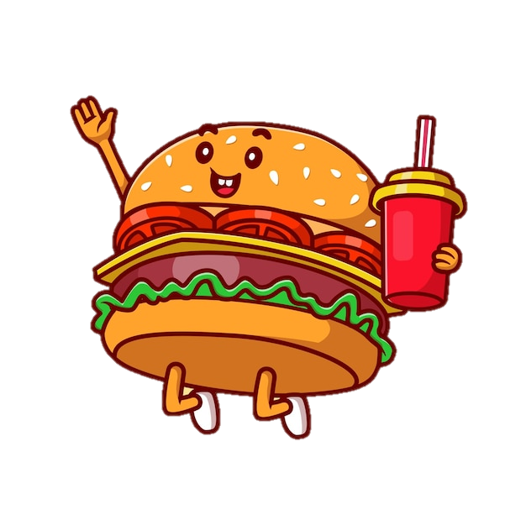

FOOT OR FOOD
/fʊt/ /fuːd/
ʊ
uː

Slide 11
II. Pronunciation
/ʊ/and /u:/

Slide 12

HISTORY OF THIS DAY
Mercury is the closest planet to the Sun and the smallest one in the entire Solar System. This planet's name has nothing to do with the liquid metal, since Mercury was named after the Roman messenger god. Despite being closer to the Sun than Venus, its temperatures aren't as terribly hot as that planet's. Its surface is quite similar to that of Earth's Moon, which means there are a lot of craters and plains
Speaking of craters, many of them were named after artists or authors who made significant contributions to their respective fields. Mercury takes a little more than 58 days to complete its rotation, so try to imagine how long days must be there! Since the temperatures are so extreme, albeit not as extreme as in Venus, and the solar radiation is so high, Mercury has been deemed to be non-habitable for humans

Slide 13
4. Listen and repeat the words. Pay attention to the sounds /ʊ/and /u:/. Then put the words into the correct columns.
cook group push June
school would woman move
/ʊ/ | /u:/
cook
would
group
school
push
woman
June
move

Slide 14
5. Listen and practise the sentences. Underline the bold words with /ʊ/, and circle the bold words with /u:/.
She likes reading books and swimming in the pool.
When it is cool, we like to play football.
She drew and made puddings in her free time.
My mum loves pumpkin soup and coffee with a little sugar.
My brother is fond of watching the cartoon about a clever wolf.

Slide 15
TONGUE TWISTERS

Slide 16
TONGUE TWISTERS
The good groom flooded the room.
/ʊ/ /u:/ /u:/

Slide 17
TONGUE TWISTERS
He stood on a spoon and looked at the
/ʊ/ /u:/ /ʊ/
moon.
/u:/

Slide 18
TONGUE TWISTERS
The woodpeckers at the zoo used wool /ʊ/ /u:/ /ʊ/
for their room.
/u:/

Slide 19
LET’S WRAP UP
1. Fill in the blank:
I’m _________ of biking while Minh is ______ on dancing.
My sister is ______________ in studying abroad but my mother is not so ________ that idea
2. Choose the one with different pronunciation
A. food B. shoes C. shoot D. foot
A. cook B. push C. group D. would
fond
keen
interested
into
/u:/ /u:/ /u:/ /ʊ/
/ʊ/ /ʊ/ /u:/ /ʊ/

Slide 20
1. Make your own list of verbs of liking and disliking
2. Do the exercise in your workbook
HOMEWORK

Slide 21
Thanks for listening!!

