Slide 1
Welcome to our class today!

Slide 3
DESCRIBE THE PICTURE
Community service
(work that people do without payment to help other people)

Slide 4
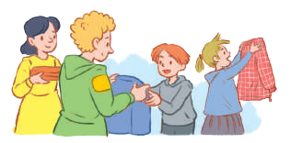
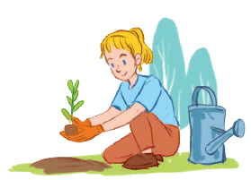
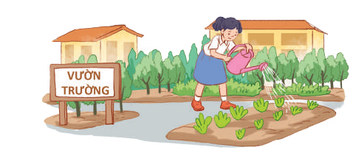
Thursday, October 13th, 2022
Unit
3
COMMUNITY SERVICE
LESSON 1: GETTING STARTED
Sounds like great work!
Unit
HOBBIES

Slide 5
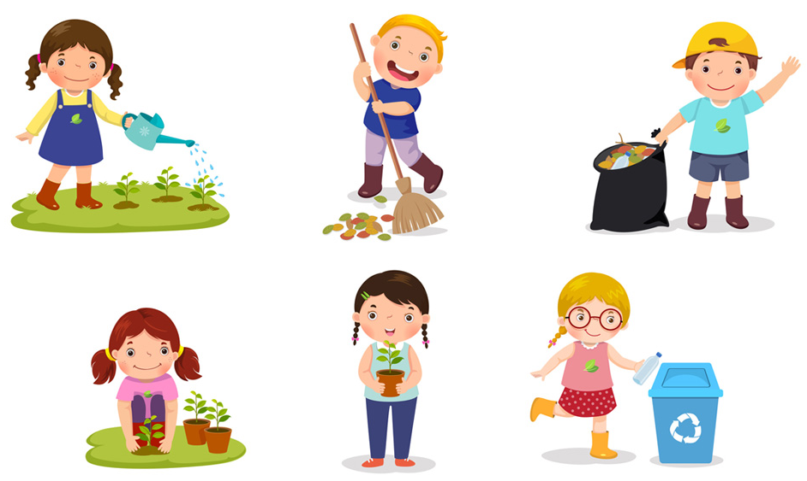
* Vocabulary
community activity (n.phr.):
/kəˈmjuːnɪti ækˈtɪvɪti/
hoạt động cộng đồng

Slide 6
donate (v):
/dəʊˈneɪt/
quyên góp, ủng hộ

Slide 7
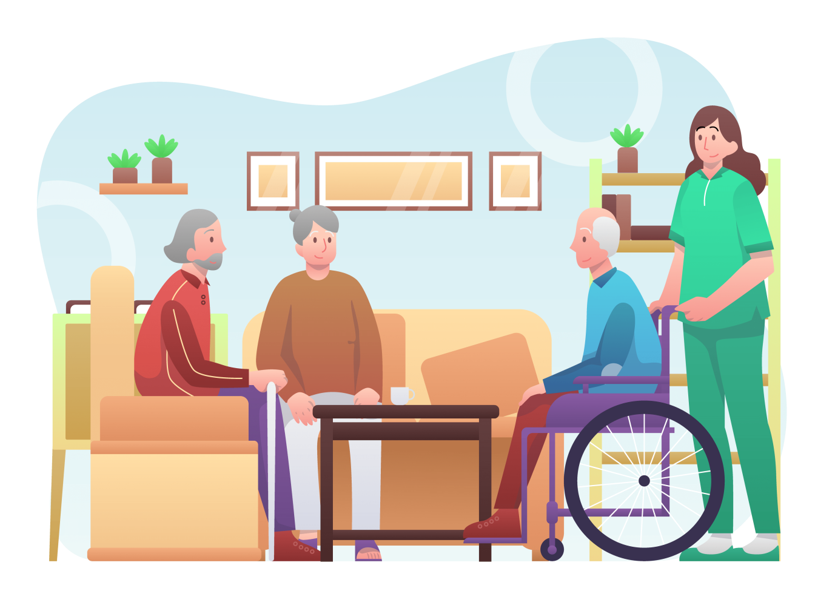
nursing home (n.phr.):
/ˈnɜːsɪŋ həʊm/
viện dưỡng lão

Slide 8
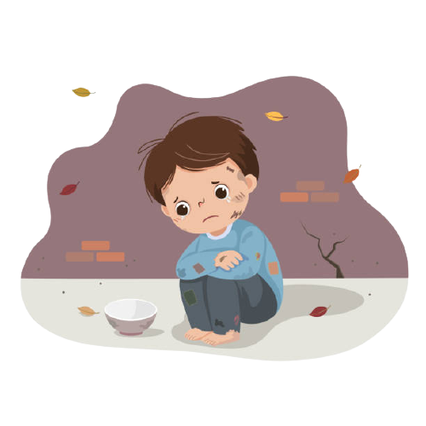
homeless (adj):
/ˈhəʊmləs/
vô gia cư

Slide 9
VOCABULARY
New words | Pronunciation | Meaning
community activity | /kəˈmjuːnɪti ækˈtɪvɪti/ | hoạt động cộng đồng
donate | /dəʊˈneɪt/ | quyên góp, ủng hộ
nursing home | /ˈnɜːsɪŋ həʊm/ | viện dưỡng lão
homeless | /ˈhəʊmləs/ | vô gia cư

Slide 10
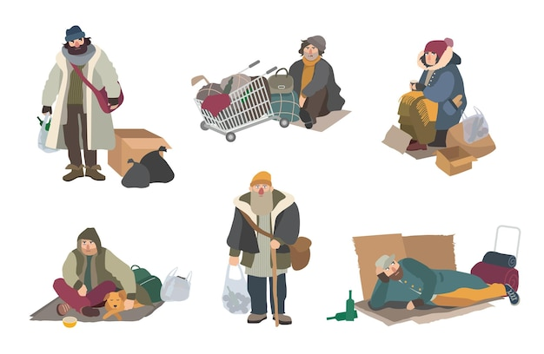
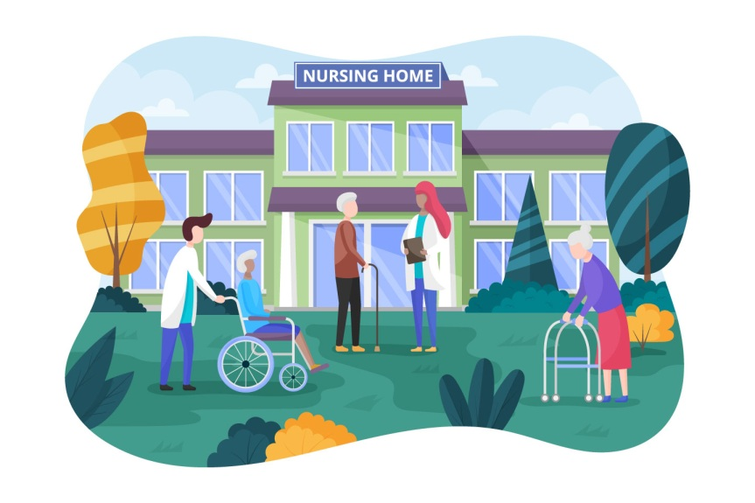
Check vocabulary
1
2
3
4

Slide 11
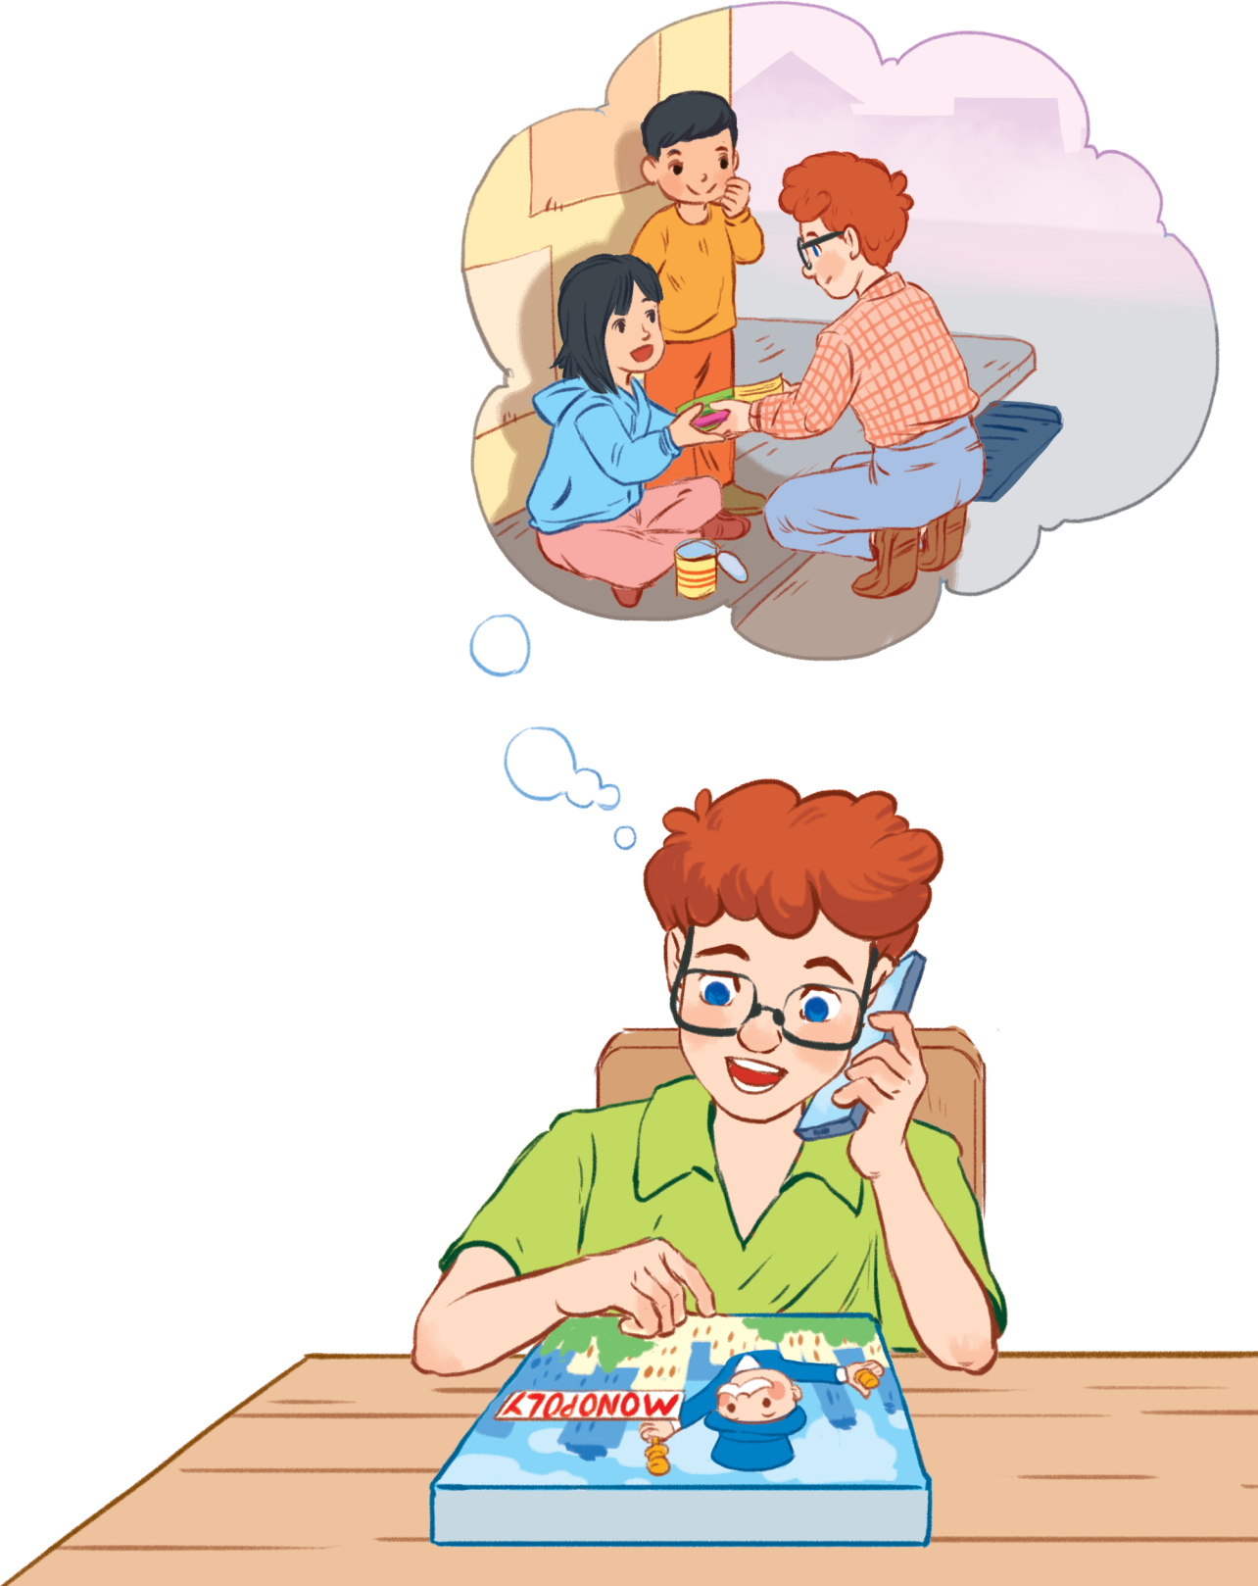
Minh

Slide 12
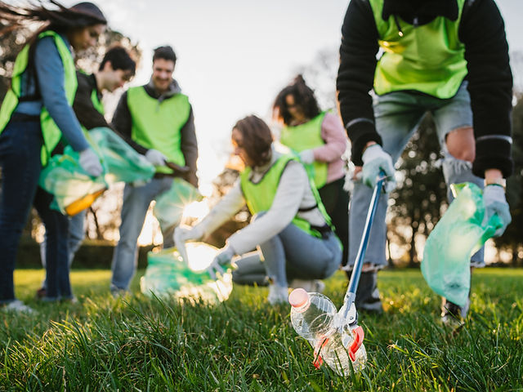
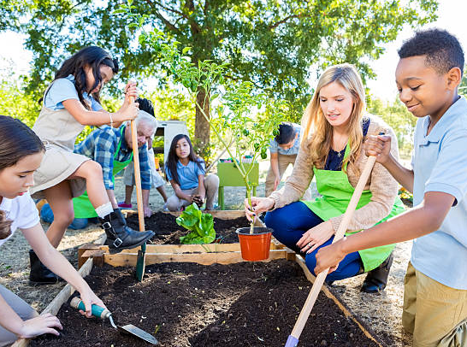
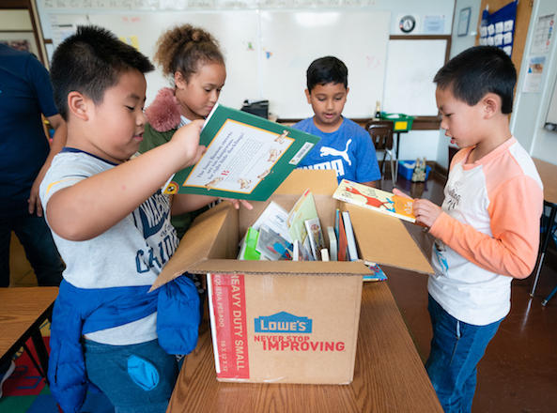
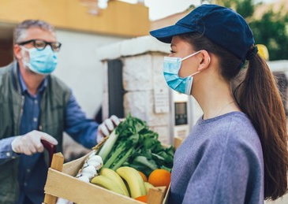
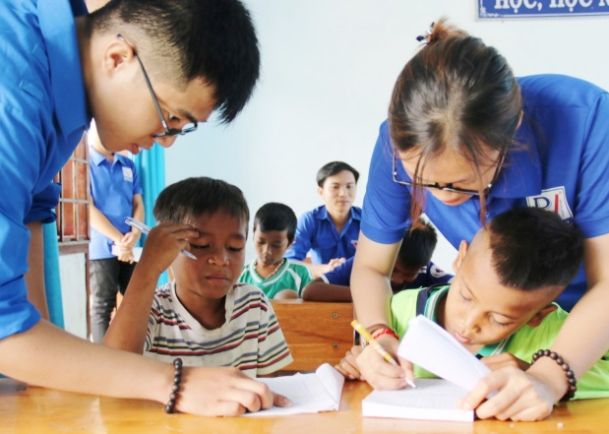
Look and answer.
What can you see in the picture?
picking up litter
planting vegetables
What do you think the boys and the girls are doing?
donating books
Listen and check.
donating vegetables
teaching English

Slide 13
PRACTICE
1
Listen and read.
Minh: Hi, Tom. Are you back in Ha Noi? Tom: Yes. I came back yesterday. Can we meet up this Sunday morning? I bought you a board game. Minh: Sure, I can’t wait! But our Green School Club will have some community activities on that morning. Tom: What activities does your club do? Minh: Well, we pick up litter around our school and plant vegetables in our school garden. Tom: School gardening? That’s fantastic! Minh: Yes. We donate the vegetables to a nursing home. Does your school have any activities like these? Tom: Yes. We donate books to homeless children. We also have English classes. Last summer, we taught English to 30 kids in the area. Minh: Sounds like great work! Tom: Thanks. Minh: ... So, let’s meet in the afternoon then.

Slide 14
PRACTICE
2
Read the conversation again and tick the appropriate box.
Community activity | Minh’s club | Tom’s club
1. picking up litter
2. planting vegetables
3. donating books
4. donating vegetables
5. teaching English
Minh: Well, we pick up litter around our school and plant vegetables in our school garden. Tom: School gardening? That’s fantastic! Minh: Yes. We donate the vegetables to a nursing home.

Slide 15
PRACTICE
2
Read the conversation again and tick the appropriate box.
Community activity | Minh’s club | Tom’s club
1. picking up litter
2. planting vegetables
3. donating books
4. donating vegetables
5. teaching English
Minh: Does your school have any activities like these?
Tom: Yes. We donate books to homeless children. We also have English classes. Last summer, we taught English to 30 kids in the area.

Slide 16
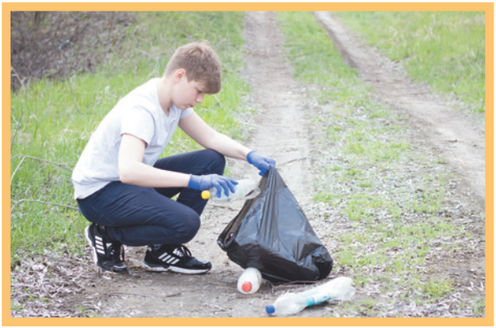
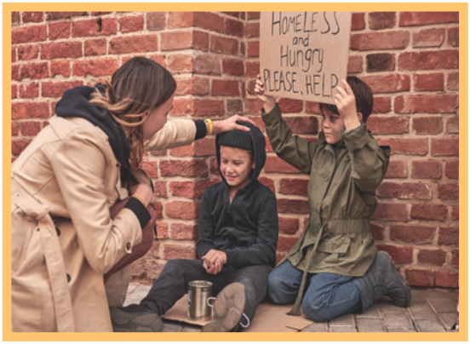
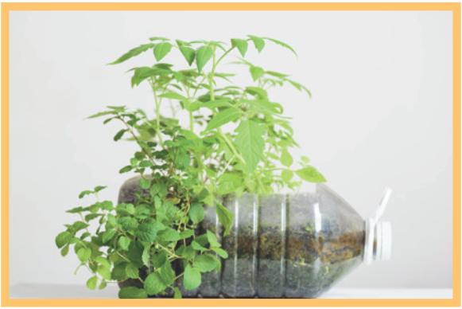
PRACTICE
3
Complete the phrases under the pictures with the verbs below.
pick up clean donate recycle help
pick up
help
recycle
1. ________ litter
2. ______ homeless children
3. _______ plastic bottles

Slide 17
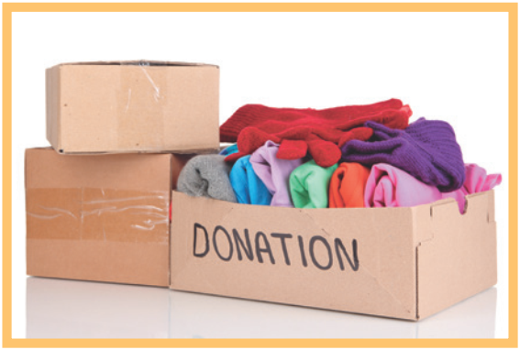
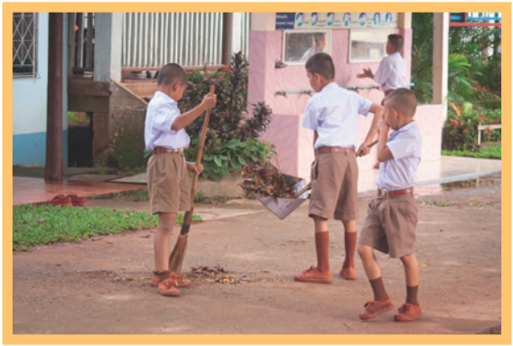
PRACTICE
3
Complete the phrases under the pictures with the verbs below.
pick up clean donate recycle help
donate
clean
4. _________ clothes
5. ________ the playground

Slide 18
PRACTICE
4
Complete the sentences with the correct words or phrases below.
old people homeless children planted litter taught
1. We collected clothes and gave them to _________________. 2. Those students picked up all the __________ on the street. 3. We helped ____________ in the nursing home last Sunday. 4. The club members ________ maths to primary students during school holidays. 5. We __________ a lot of trees in the park last summer.
homeless children
litter
old people
taught
planted

Slide 19
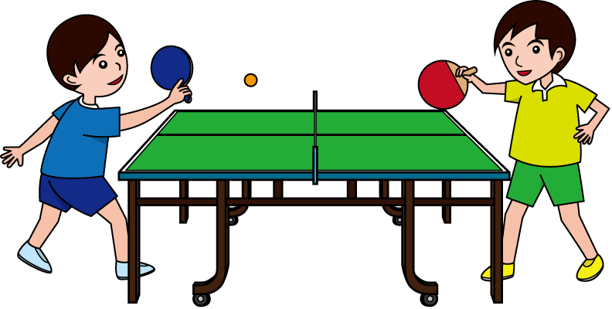
PRODUCTION
5
Game: Vocabulary Ping-pong
Work in two teams.
Team A provides a cue word.
Team B makes up a sentence with it.
Then switch roles.
Example: Team A: Litter Team B: We often pick up litter in the park. Trees Team A: We plant trees in our school every year. Book
Team A: …

Slide 20
CONSOLIDATION
1
WRAP-UP
What have we learnt in this lesson?
identify the topic of the unit
use lexical items related to community activities
identify the language features that are covered in the unit

Slide 21
CONSOLIDATION
1
WRAP-UP
2. What are some community activities you have learnt?
A. donating books
B. help homeless children
C. teaching English
D. pick up litter
E. Cook food for sick children
Notes:
1. picking up litter
2. planting vegetables
3. donating books
4. donating vegetables
5. teaching English

Slide 22
CONSOLIDATION
2
HOMEWORK
Think about community activities that students can do (at least 3 activities)
Prepare for the A closer look 1

Slide 23
THANKS FOR YOUR ATTENTION!
Goodbye!
See you again!

