Slide 1

Unit 4: HOME
Lesson 3.1
Page 58

Slide 2
Lesson Outline
Warm-up
Vocabulary
Structure
Consolidation
Wrap-up

Slide 3
Objectives
By the end of this lesson, students will be able to ask where things are.
Vocabulary: mirror, picture, sofa, table, box, house.
Structure: Is the picture in the living room? Yes, it is.
Is the cat in the house? No, it isn’t.

Slide 4

WARM UP

Slide 5

In pairs, ask what people are doing.
What are they doing?
They are reading books.

Slide 6
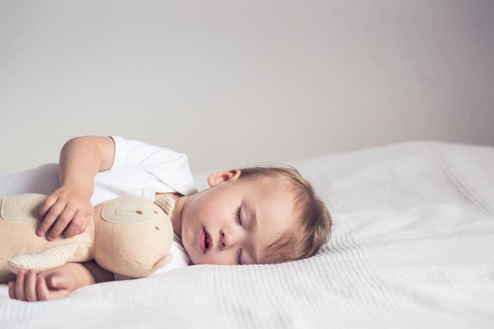
In pairs, ask what people are doing.
Where’s he?
He’s in the bedroom.
What’s he doing?
He’s sleeping.

Slide 7
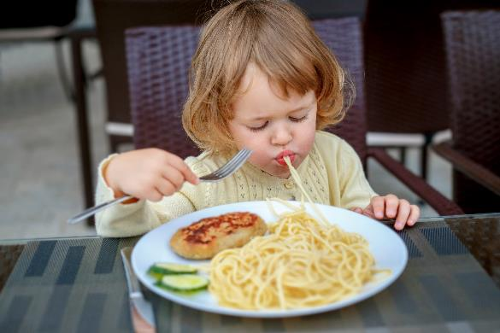
In pairs, ask what people are doing.
What’s she doing?
She’s eating.

Slide 8
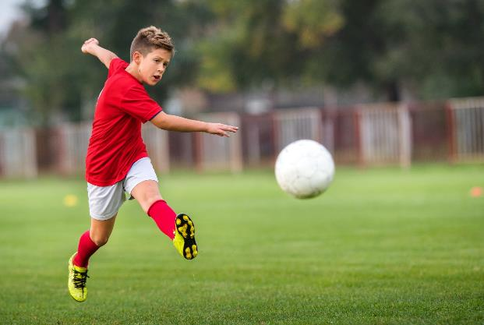
In pairs, ask what people are doing.
What’s he doing?
He’s playing football.

Slide 9

It’s time to learn …

Slide 10

Vocabulary

Slide 11
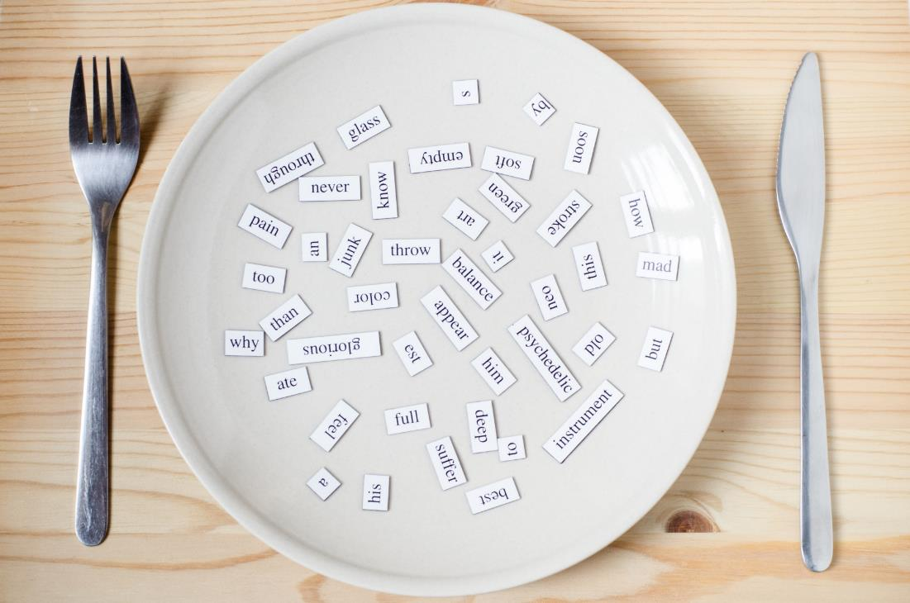
New words
mirror,
picture,
sofa,
table,
box,
house.

Slide 12

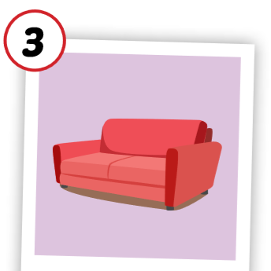

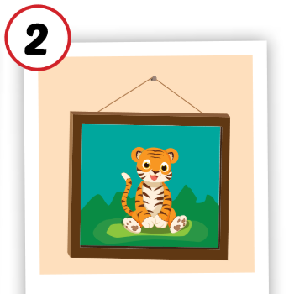
Click each English word to hear the sound.
mirror
picture
sofa
/ˈmɪrər/
cái gương
/ˈpɪktʃər/
bức tranh
/ˈsəʊfə/
ghế sô-pha

Slide 13
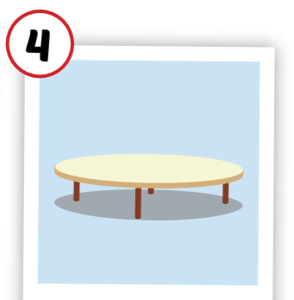

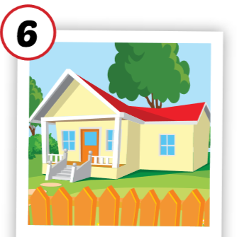
Click each English word to hear the sound.
table
box
house
/ˈteɪbl/
cái bàn
/bɑːks/
cái hộp
/haʊs/
ngôi nhà

Slide 14
Click each English word to hear the sound.
mirror
/ˈmɪrər/
cái gương

Slide 15
Click each English word to hear the sound.
picture
/ˈpɪktʃər/
bức tranh

Slide 16
Click each English word to hear the sound.
sofa
/ˈsəʊfə/
ghế sô-pha

Slide 17
Click each English word to hear the sound.
table
/ˈteɪbl/
cái bàn

Slide 18
Click each English word to hear the sound.
box
/bɑːks/
cái hộp

Slide 19
Click each English word to hear the sound.
house
/haʊs/
ngôi nhà

Slide 20



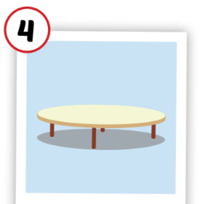
What’s missing.

Slide 21
What’s missing.

Slide 22
What’s missing.

Slide 23
What’s missing.

Slide 24
What’s missing.

Slide 25


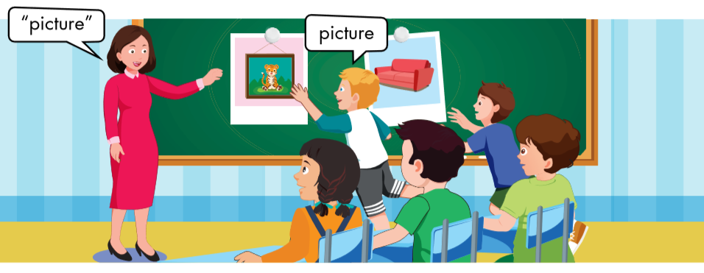
Sofa
Sofa

Slide 26



“mirror”
mirror
box
box

Slide 27


table
Table?
house
house

Slide 28

Structure

Slide 29
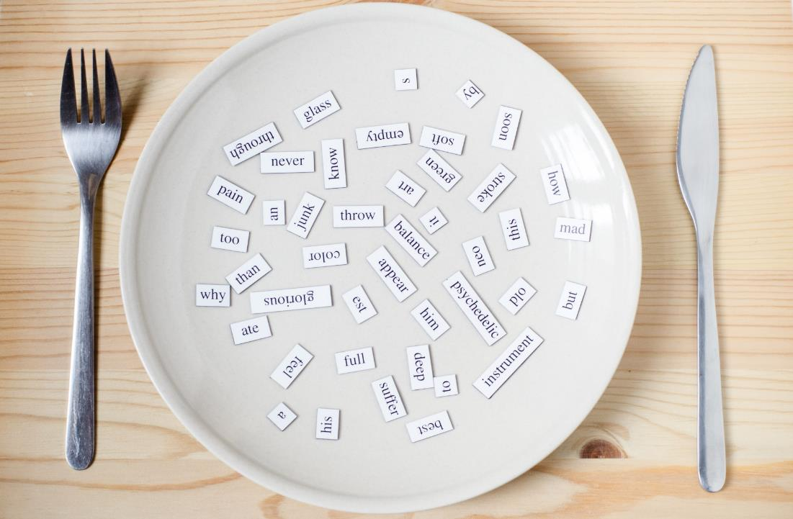
Structures
Is the picture in the living room?
Yes, it is.
Is the cat in the house?
No, it isn’t.

Slide 30





Slide 31




Slide 32

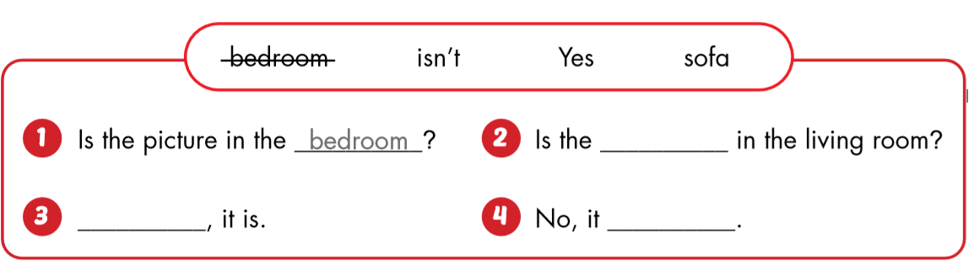
bedroom?
sofa
Yes
isn’t.

Slide 33

Workbook
p. 42

Slide 34

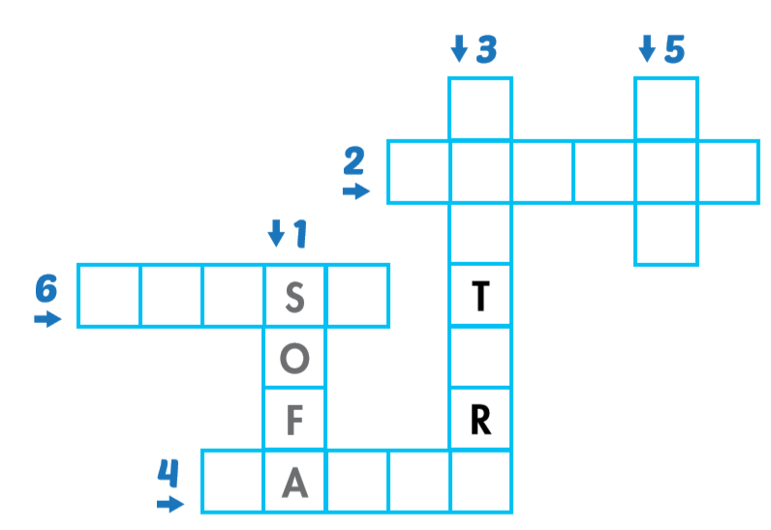
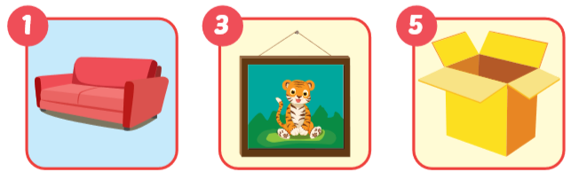
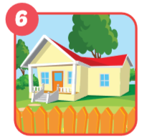
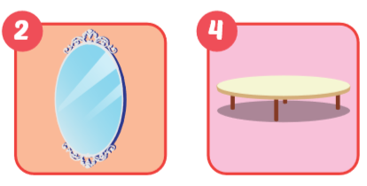
P
c
u
e
b
x
m i r r o r
h o u e
t b l

Slide 35

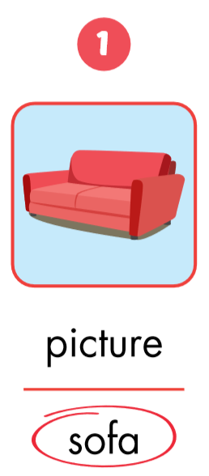
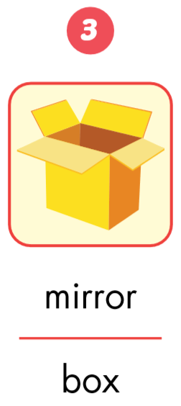
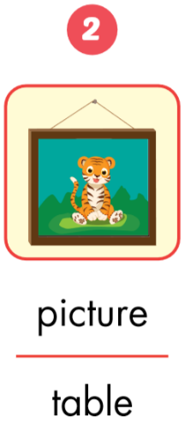

Slide 36
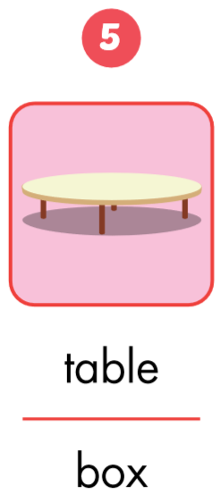
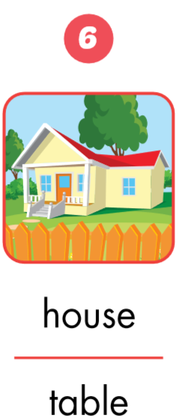
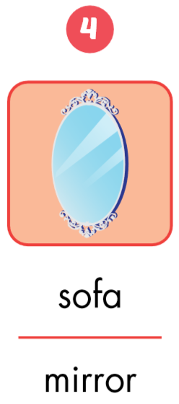

Slide 37

CONSOLIDATION

Slide 38

Is the picture in the living room?
Yes, it is.

Slide 39

Is the table in the living room?
Yes, it is.
Is the picture in the living room?
No, it isn’t.

Slide 40

WRAP-UP

Slide 41
Lesson 3
Today’s lesson
Structures/ Sentence patterns
Is the picture in the living room?
Yes, it is.
Is the cat in the house?
No, it isn’t.
Vocabularies
mirror, picture,
sofa,
table,
box,
house.

Slide 42
Homework
Review the vocabularies and sentence patterns. Make sentences using them.
Do the exercises on page 42 (WB)
Prepare the next lesson (page 59 SB)
Play the consolidation games in Tiếng Anh 3 i-Learn Smart Start DHA App on www.eduhome.com.vn
Do the exercises in Tiếng Anh 3 i-Learn Smart Start Notebook (Page 30)

Slide 43

Enjoy your day!

Slide 44

Have a nice day!

