Slide 1

Getting Started
Lesson 5
Page 9

Slide 2
Lesson Outline
Warm-up
Vocabulary
Structure
Consolidation
Wrap-up

Slide 3
Objectives
By the end of this lesson, students will be able to ask how old someone is.
Vocabulary:
one, two, three, four, five, six, seven, eight, nine, ten
Structures:
How old are you?
I’m eight.

Slide 4

WARM UP

Slide 5
1
4
6
1
SPIN
2
5
2
5
4
3
3
6
Next Part

Slide 6

What color is it?
Go back

Slide 7

Say and do.
Go back

Slide 8
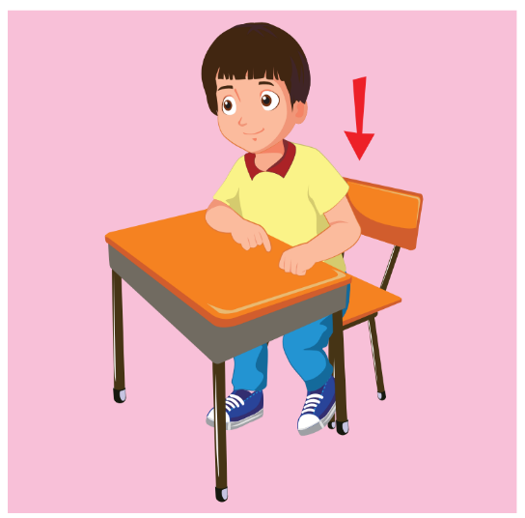
Say and do.
Go back

Slide 9

Say and do.
Go back

Slide 10

What’s your name?
Go back

Slide 11

What color is it?
Go back

Slide 12

It’s time to learn …

Slide 13
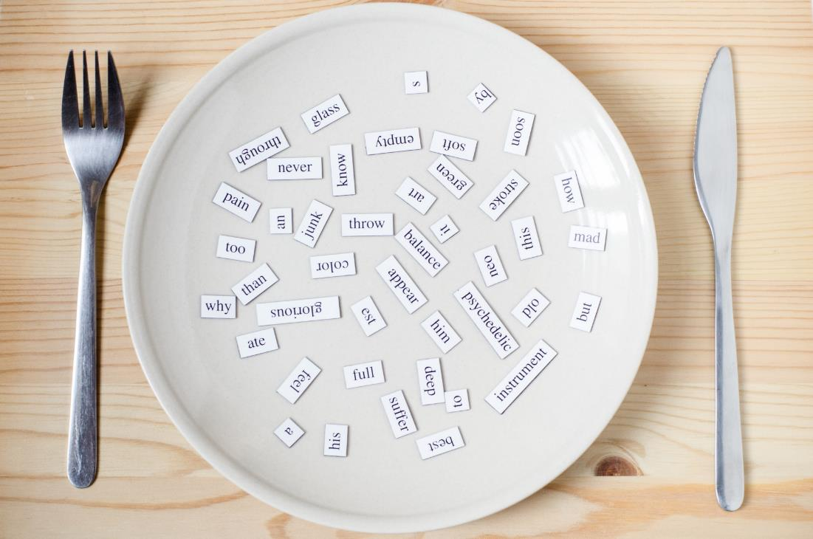
New words
red
yellow
blue
black
white

Slide 14

Presentation

Slide 15

A
Listen and point. Repeat. (CD1 Track 10)
A
B
C
D
E
1
2
3
4
5
one
two
three
four
five
/wʌn/
số một
/tuː/
số hai
/θriː/
số ba
/fɔːr /
số bốn
/faɪv/
số năm
Click on each English word to hear the sound.

Slide 16
A
Listen and point. Repeat. (CD1 Track 10)
F
G
H
I
J
6
7
8
9
10
six
seven
eight
nine
ten
/sɪks/
số sáu
/ˈsevn/
số bảy
/eɪt/
số tám
/naɪn/
số chín
/ten/
số mười
Click on each English word to hear the sound.

Slide 17

Listen and choose.
6
10
1
8
4
Keys
Notes:
Click on the headphone icon to play the audio.
Have students listen and choose the correct number.

Slide 18
Listen and choose.
4
7
5
9
2
Keys
Notes:
Click on the headphone icon to play the audio.
Have students listen and choose the correct number.

Slide 19
Listen and choose.
1
4
8
3
10
Keys
Notes:
Click on the headphone icon to play the audio.
Have students listen and choose the correct number.

Slide 20
Listen and choose.
3
6
2
7
1
Keys
Notes:
Click on the headphone icon to play the audio.
Have students listen and choose the correct number.

Slide 21
Listen and choose.
3
9
2
8
10
Keys
Notes:
Click on the headphone icon to play the audio.
Have students listen and choose the correct number.

Slide 22
Listen and choose.
2
6
5
1
9
Keys
Notes:
Click on the headphone icon to play the audio.
Have students listen and choose the correct number.

Slide 23
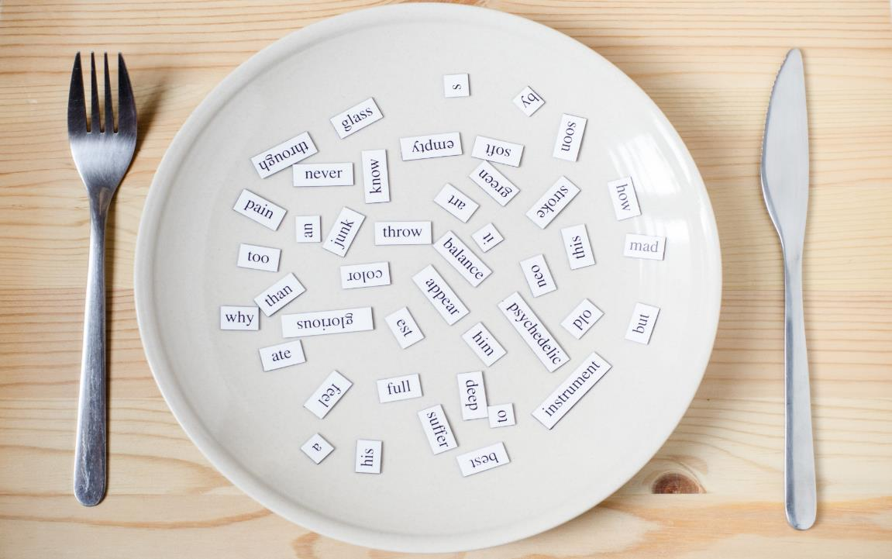
Structures
How old are you?
I’m eight.

Slide 24
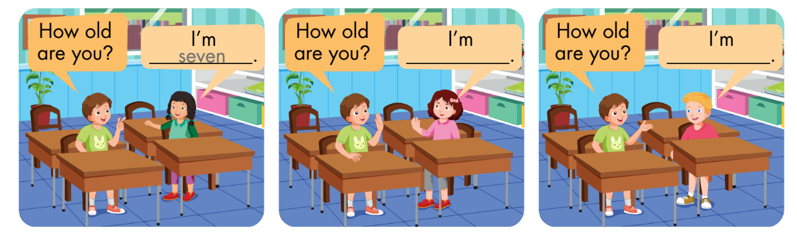
B
Listen and fill in the blanks. Repeat. Role-play. (CD1 Track 11)
Notes:
B. Listen and fill in the blanks. Repeat. Role-play. (CD1 Track 11)
Have students call out the things they can see in each picture.
Play the audio and have them fill in the blanks.
Play the audio again and have them repeat the new words.
Divide the class into pairs to role-play the dialogue.
Swap roles and repeat.
Invite some pairs to demonstrate the activity in front of the whole class.
Go around the class and support them if necessary.

Slide 25

Practice

Slide 26
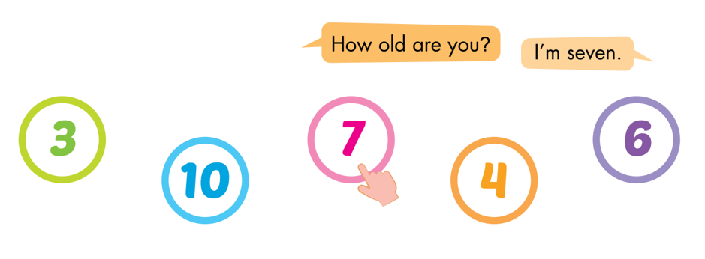
C
Point, ask, and answer.
Notes:
C. Point, ask, and answer.
Divide the class into two teams.
Have the student A point and ask and the student B answer.
Swap roles and repeat.
Afterwards, have some pairs demonstrate the activity in front of the class.
Monitor the class and support if needed.

Slide 27
Speaking

Slide 28
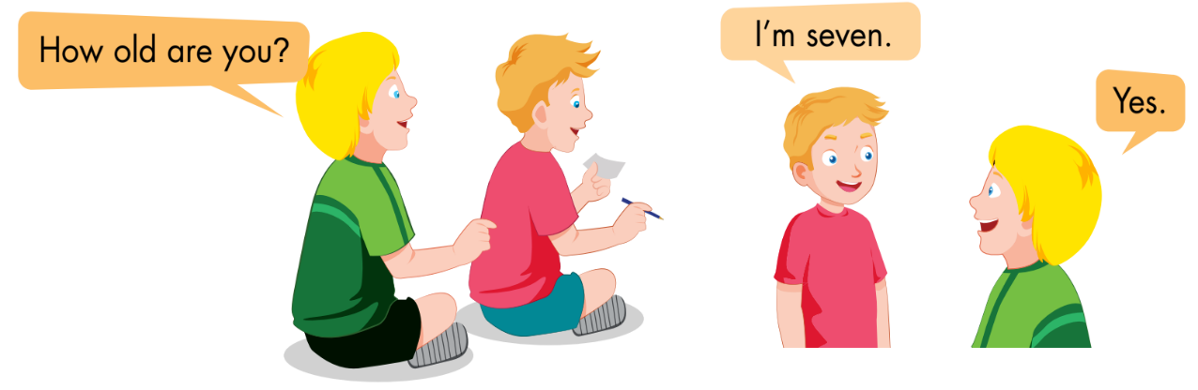
D
Play Magic finger.
Notes:
D. Play Magic finger.
Have students time to look and read at the examples.
Divide the class into pairs.
Have the student A ask a question and write a number with their finger on the student B’s back.
Have the student B try to guess which number it is and answer.
Have the students swap roles and repeat.

Slide 29
Further Practice

Slide 30
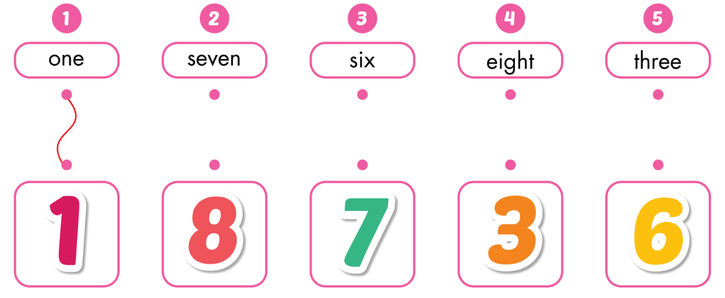
A
Draw lines.

Slide 31
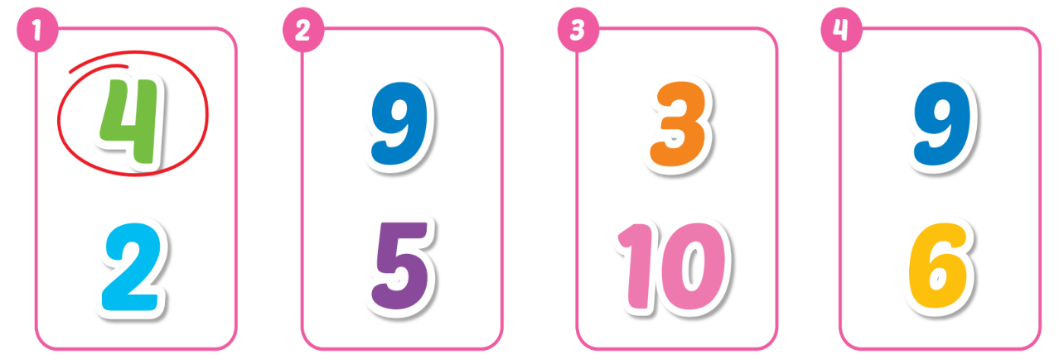
B
Listen and circle. (WB Track 06)
Keys

Slide 32
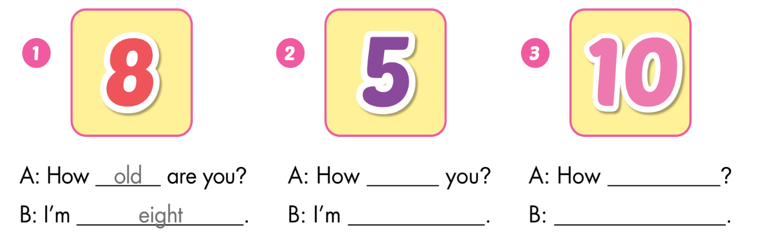
C
Look and write.
old are
old are you
five
I’m ten

Slide 33

Consolidation

Slide 34

Say and clap your hands.
1
2
3
4
5
6
7
8
9
10
4
6
3
8
1
9
5
4
2
7
9
1
10
8
6
2
7
Notes:
Clap your hands
Show the class the numbers.
Ask them to clap once if it is the odd number.
Ask them to clap twice if it is the even number.
Support them if necessary.

Slide 35

WRAP-UP

Slide 36
Today’s lesson
Vocabulary:
one, two, three, four, five, six, seven, eight, nine, ten
Structures:
How old are you?
I’m eight.

Slide 37
Homework
Practice vocabularies and structure. Make sentences using them.
Do the exercises in Tiếng Anh 3 i-Learn Smart Start Workbook (page 7).
Practice the vocabulary and structure in Tiếng Anh 3 i-Learn Smart Start Notebook (page 7).
Play the consolidation games in Tiếng Anh 3 i-Learn Smart Start DHA App on www.eduhome.com.vn
Prepare the next lesson (page 10).

Slide 38

Enjoy your day!

