Slide 1

Getting Started
Lesson 4
Page 8

Slide 2
Lesson Outline
Warm-up
Vocabulary
Structure
Consolidation
Wrap-up

Slide 3
Objectives
By the end of this lesson, students will be able to ask the colors of things.
Vocabulary:
red, yellow, blue, black, white
Structures:
What color is it?/ It’s yellow.

Slide 4

WARM UP

Slide 5



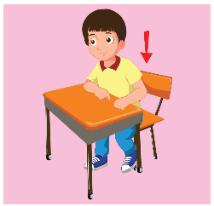
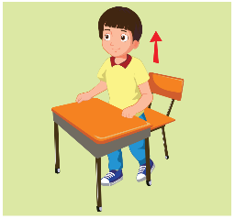



What’s missing?
1
2
3
4
5
6
7
8

Slide 6

It’s time to learn …

Slide 7
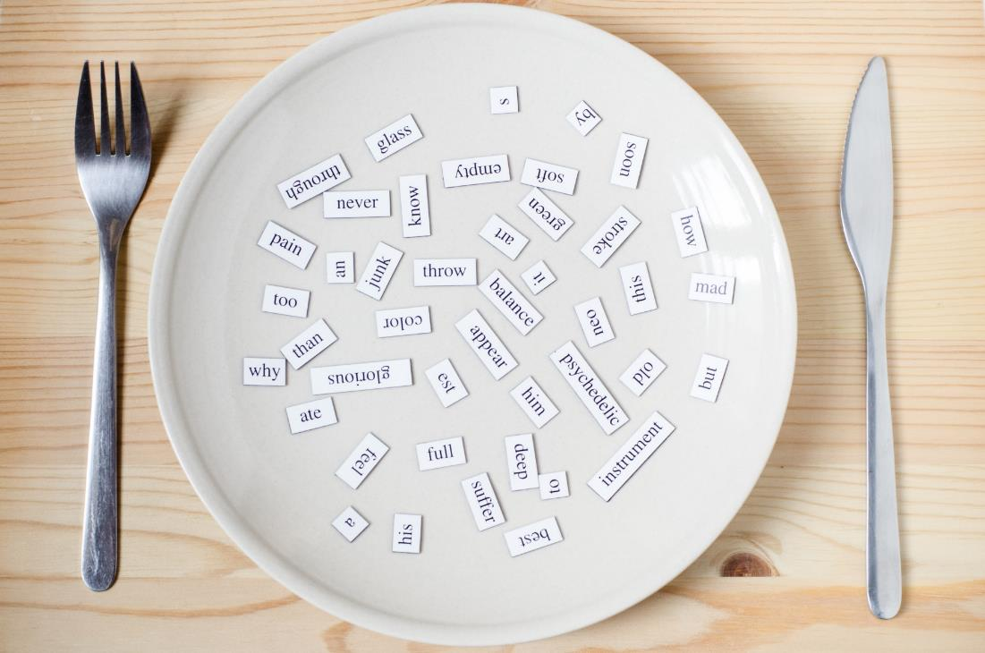
New words
red
yellow
blue
black
white

Slide 8

Presentation

Slide 9






A
Listen and point. Repeat. (CD1 Track 08)
1
2
3
4
5
red
yellow
blue
black
white
/red/
màu đỏ
/ˈjeləʊ/
màu vàng
/bluː/
màu xanh dương
/blæk/
màu đen
/waɪt/
màu trắng
Click on each English word to hear the sound.

Slide 10

Listen and match.
1
2
3
4
5
a
b
c
d
e
Keys

Slide 11
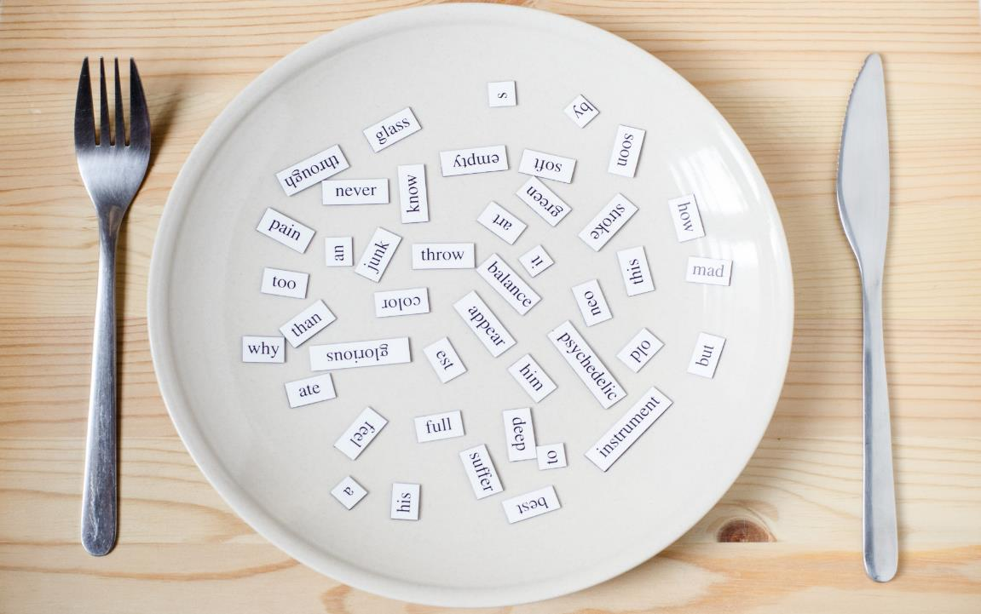
Structures
What color is it?
It’s yellow.

Slide 12
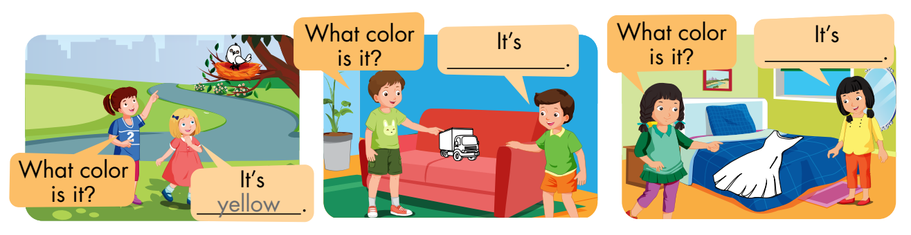
B
Listen and point. Repeat. Role-play. (CD1 Track 09)
Notes:
B. Listen and point. Repeat. Role-play. (CD1 Track 09)
Have students call out the things they can see in each picture.
Play the audio and have them point to the characters.
Play the audio again and have them repeat the new words.
Divide the class into pairs to role-play the dialogue.
Swap roles and repeat.
Invite some pairs to demonstrate the activity in front of the whole class.
Go around the class and support them if necessary.

Slide 13

Practice

Slide 14
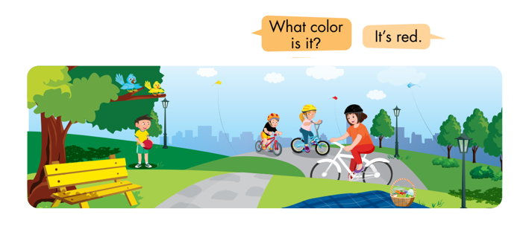
C
Point, ask, and answer.
Notes:
C. Point, ask, and answer.
Divide the class into two teams.
Have the student A point and ask and the student B answer.
Swap roles and repeat.
Afterwards, have some pairs demonstrate the activity in front of the class.
Monitor the class and support if needed.

Slide 15
Speaking

Slide 16
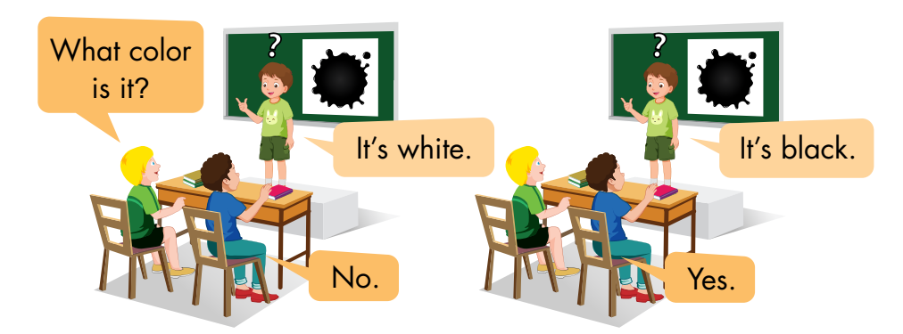
D
Play Guess the picture.
Notes:
D. Play Guess the picture.
Have the students time to look and read at the examples.
Divide the class into two teams.
Have a student stand facing away from the board and stick a flashcard on the board behind them.
Have someone from the same team ask the student a question about the flashcard.
Have a student try to guess the answer without looking at the flashcard.
Give that team one point if it’s a correct guess.
Have teams take turns asking and guessing.

Slide 17
Further Practice

Slide 18
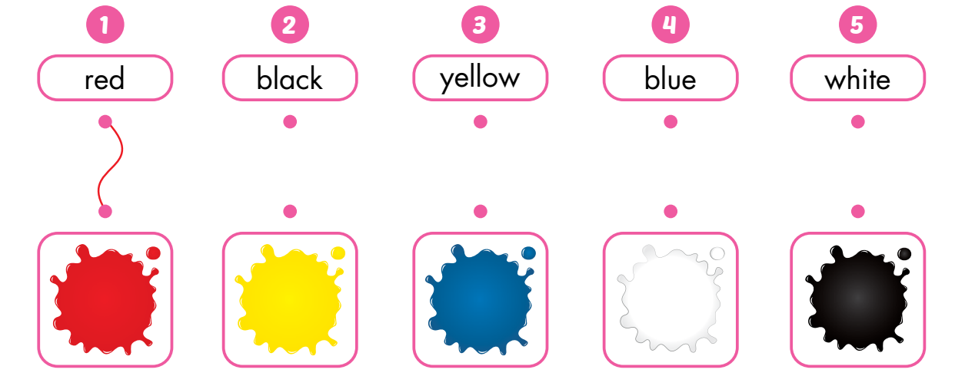
A
Draw lines.

Slide 19
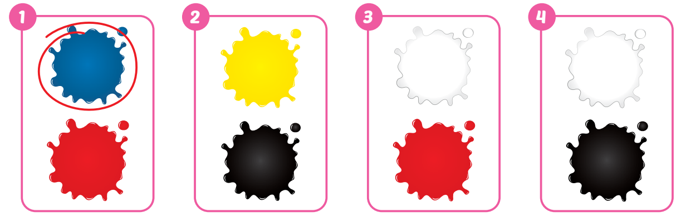
B
Listen and circle. (WB Track 05)

Slide 20
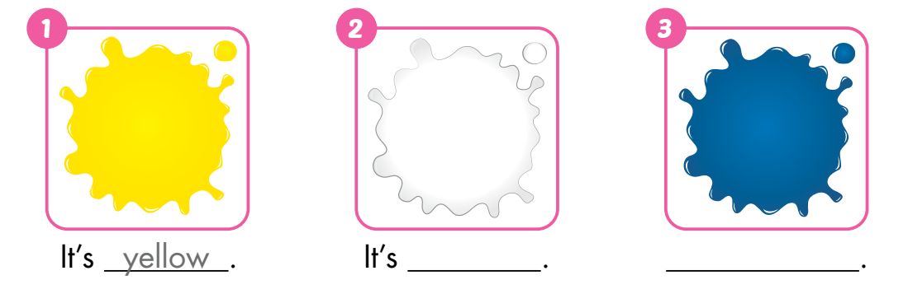
C
Look and write.
white
blue

Slide 21

Consolidation

Slide 22





Find something in… .
Notes:
Finding game
Have students stand up to play this game.
Show them the colors and ask them to find a thing in the classroom in (red/yellow/black/white/blue).
Demonstrate the activity in front of the class.
Help the class if necessary.

Slide 23

WRAP-UP

Slide 24
Today’s lesson
Vocabulary:
red, yellow, blue, black, white
Structures:
What color is it?
It’s yellow.

Slide 25
Homework
Practice vocabularies and structure. Make sentences using them.
Do the exercises in Tiếng Anh 3 i-Learn Smart Start Workbook (page 6).
Practice the vocabulary and structure in Tiếng Anh 3 i-Learn Smart Start Notebook (page 6).
Play the consolidation games in Tiếng Anh 3 i-Learn Smart Start DHA App on www.eduhome.com.vn
Prepare the next lesson (page 9).

Slide 26
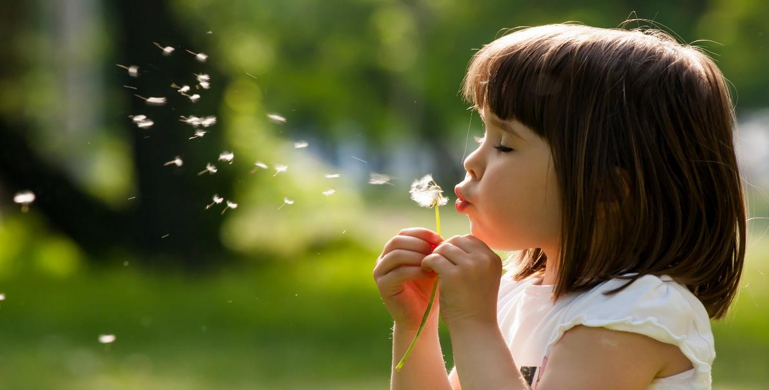
Enjoy your day!

