Slide 1








  LET'S PLAY!
W
O
R
D
P
U
Z
Z
L
E
Rearrange the letters to create new word

Slide 2








  ARE YOU READY?

Slide 3





A
P
P
O
I
N
T
M
E
N
T
  11 LETTER WORD

Slide 4






  1
  ROUND
E
D
A
O
I
U
C
T
N
  EDUCATION

Slide 5
A
P
P
O
I
N
T
M
E
N
T
  11 LETTER WORD

Slide 6



  2
  ROUND
F
A
T
R
E
  AFTER

Slide 7
A
P
P
O
I
N
T
M
E
N
T
  11 LETTER WORD

Slide 8


  3
  ROUND
E
C
O
D
Y
S
N
A
R
  SECONDARY

Slide 9
A
P
P
O
I
N
T
M
E
N
T
  11 LETTER WORD

Slide 10
  4
  ROUND
C
H
S
O
L
O
  SCHOOL

Slide 11
A
P
P
O
I
N
T
M
E
N
T
  11 LETTER WORD

Slide 12
A
P
P
O
I
N
T
M
E
N
T
  11 LETTER WORD

Slide 13





  Thank you for playing!

Slide 14




Task 1: Listen and complete the conversation with the expressions in the box. Then practise it in pairs.
suit you B. shall I come
C. I have another appointment D. could I meet you
Lan: Ms Ha, (1) __________ on Thursday afternoon? I would like your advice on how to prepare for my university entrance exam next year?
Ms Ha: Sorry, (2) _________ at that time. But I’m free on Saturday morning.
Lan: That would be good for me. What time (3) __________ to see you?
Ms Ha: Would 9 o’clock (4) _________?
Lan: Yes, sounds good. Thank you, Ms Ha.
Ms Ha: Ok, then. See you on Saturday in the staff room.
D
C
B
A

Slide 15
Task 2: Work in pairs. Use the model in 1 to make similar conversations for these situations. One of you is Student A, the other is Student B. Use the expressions below to help you.
Making an appointment | Giving a positive response
• Will you be available on/at …? • I’d like to make/arrange an appointment with you on/at … • Would … suit you/be OK for you? • When’s convenient for you? | • All right, I’ll see you then. • OK, I’ll see you (next week) (at around 3 p.m.).
 | Giving a negative response and proposing another time/ date
 | • Sorry, I’ve got another appointment at that time. How about …? • I’m afraid I can’t make it at that time. Are you free on/at …?
Useful expressions

Slide 16
Make similar conversations for these situations.
Student A, a secondary school student, makes an appointment to see Student B, a university representative, to ask for advice on his/her education plans after leaving school. Student B can't make the suggested day/time and proposes another day/time.
Student B, a secondary school student, makes an appointment to see Student A, a career advisor, to ask for advice on vocational courses. Student A can't make the suggested day/ time and proposes another day/time.

Slide 17
Task 1: Read the text and complete the table.
 | UK education after secondary school
Age at end of formal education | • 16 in the UK • stay until the age of (1) ________ in full-time education or do training in England
Vocational education | • lasts up to three years • also called career education or (2) _________________ • some students still go on to (3) _______________
Sixth form | • lasts two years • Students study subjects they are interested in or subjects related to higher education • Grades are used to apply for (4) _______________.
University education | Students study to get a (5) ____________________, a master’s degree, or a doctorate.
18
technical education
higher education
university courses
bachelor’s degree

Slide 18



Task 2: Work in groups. Discuss the similarities and differences between education after leaving school in Viet Nam and in the UK.
Suggested answer
Similarities
Both systems provide vocational education after secondary school.
Students in both countries can start university at 18.
Differences:
In Viet Nam, students can leave school at 15 after they finish lower secondary school.
In some parts of the UK, students can leave school at 16.

Slide 19
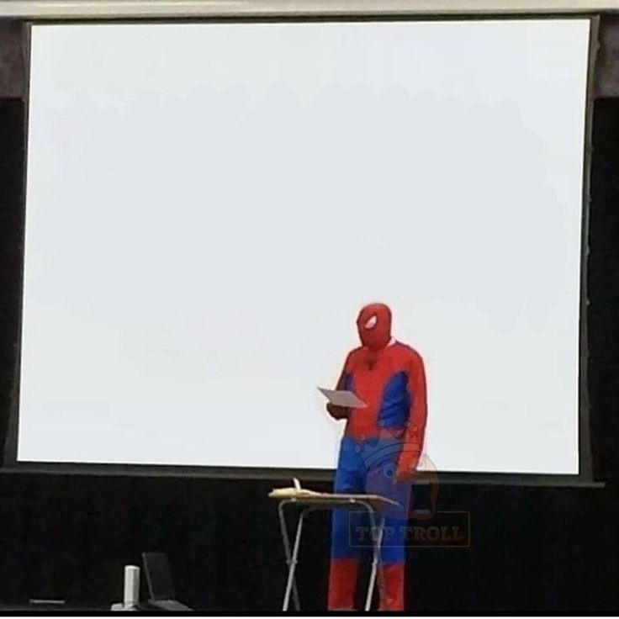

HOMEWORK:
- Do exercises in the workbook.
- Prepare for Lesson 8 - Looking back and project

