Slide 3
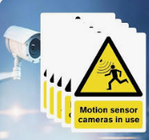
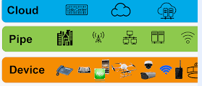
1
2
3
smart devices
loneliness
5
Friendly and helpful neighbours
4
cameras and sensors
Personal privacy

Slide 4
cameras and sensors
Friendly and helpful neighbours
Personal privacy
loneliness
smart devices

Slide 5
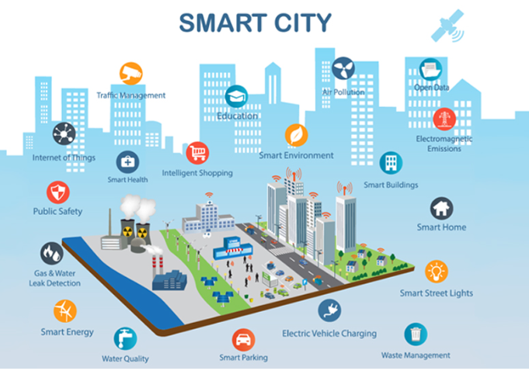
UNIT
3
CITIES OF THE FUTURE
Unit
FAMILY LIFE

Slide 6
PRELISTENING: VOCABULARY: LISTEN AND REPEAT
Match the words and phrase with their meanings. Then listen and repeat.
1
1. interact
2. privacy
3. sense of community
4. neighbourhood
A. an area of a town
B. the feeling of belonging to a group
C. to talk or do things with other people
D. the state of being alone and not watched or interrupted by other people

Slide 7
WHILE LISTENING
2. Listen to an interview and choose the correct answers A, B, or C.
What is the interview mainly about?
A. Advantages of living in a smart city.
B. Problems of living in a smart city.
C. Attractions of urban lifestyles.
2. How are cameras and sensors used in a smart city?
To collect information about city dwellers and their activities.
B. To collect information about the government and some companies.
C. To improve city dwellers' safety and security.
3. Why does Ms Stevens feel lonely?
Because she doesn't interact with many people.
Because she can't use the smart devices.
Because she doesn't like her neighbourhood.

Slide 8
3
Listen to the interview again and complete the table. Use no more than THREE words for each answer.
Situations | Problems
There are cameras and sensors everywhere. | City dwellers may lose their (1) _______________ in public areas.
People use (2) ________________ to help them with household chores. | it is not easy for some people to get familiar with and use the smart devices.
Some city dwellers (3) ____________ with each other face to face less. | There is no (4) ______________ in the neighbourhood.
right to privacy
smart technologies
interact
sense of community

Slide 9
Tapescripts
Interviewer: Good morning. Welcome to our weekly program Urban Lifestyle. In today's program, we'll be talking about the disadvantages of living in a smart city. Joining me now in the studio is Miss Stevens, a city dweller who has been living in a smart city for a year now. Good morning, Miss Stevens.
Miss Stevens: Good morning.
Interviewer:I understand that you don't like living in the smart city. Why is that? What are you worried about most?
Miss Stevens: Well, my main worry is losing my right to privacy in public places. You know, cameras and sensors are everywhere, and they collect information about me and my activities.
Interviewer: So it seems that someone is watching you all the time, right?
Miss Stevens:Exactly. The government and some companies have so much personal information about city dwellers, but we don't know how they might use it.
Interviewer:Yes, it's a bit worrying. But this information probably enables smart cities to create useful programs and improve people's lives. Smart technologies can also help with daily household chores. Are you not happy with that?
Miss Stevens: No, I don't think so. It took me a long time to get familiar with all the smart devices at home. I don't really have any friends to ask for help in the neighborhood.
Interviewer: This leads me to my next question. Do you think there is a sense of community in your neighborhood?
Miss Stevens: No, there isn't. I interact with very few people face to face because most of the activities can be done online.
Interviewer: Do you feel lonely sometimes?
Miss Stevens: Yes, our smart devices are all connected, but it seems we're becoming lonelier than any previous generation.
Interviewer: That's very sad. Thank you for sharing your thoughts with us, Miss Stevens.
Miss Stevens: You're welcome

Slide 10
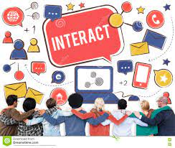
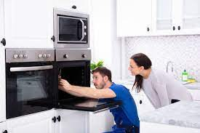
POST- LISTENING
Work in groups. Discuss the following questions.
Do you agree with Ms Stevens? Which of the disadvantages she mentions do you think is the most serious? Why? What should we do to solve the problem?
5
No sense of
community
Difficulty in getting familiar with and use the smart devices.
Loss of right to privacy

Slide 11
CONSOLIDATION
6
Wrap-up
What have you learnt today?
Words and phrases related to living in a smart city
Listening for main ideas and specific information

