Slide 1
WELCOME TO MY CLASS

Slide 3
Unit
3
CITIES OF THE FUTURE
Unit
FAMILY LIFE
LESSON 5
LISTENING
Living in a smart city

Slide 4
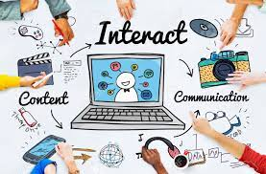
PRE-LISTENING
interact
/ˌɪn.təˈrækt/
to communicate with or react to
E.g. Ms. My interacts with other students in the class.

Slide 5
PRE-LISTENING
privacy (n)
Eg: You don't get much privacy if you live in an extended family.
/ˈprɪvəsi, ˈpraɪ-/
the state of being able to be alone, and not seen or heard by other people

Slide 6
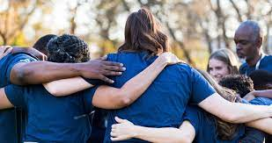
PRE-LISTENING
sense of community (n)
/sens əv kəˈmjuː.nə.ti/
the feeling that you belong to a community

Slide 7
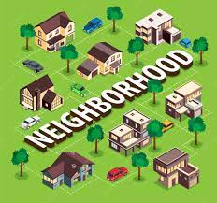
PRE-LISTENING
neighbourhood (n)
/ˈneɪbəhud/
the area of a town that surrounds someone's home, or the people who live in this area

Slide 8
PRE-LISTENING
Form | Pronunciation | Meaning
1. to interact (v) | /ˌɪn.təˈrækt/ | to communicate with or react to
2. privacy (n) | /ˈprɪvəsi, ˈpraɪ-/ | the state of being able to be alone, and not seen or heard by other people
3. sense of community (n) | /sens əv kəˈmjuː.nə.ti/ | the feeling that you belong to a community
4. neighbourhood (n) | /ˈneɪbəhud/ | the area of a town that surrounds someone's home, or the people who live in this area

Slide 9
PRE-LISTENING
1
Match the words and phrase with their meanings.
interact
privacy
sense of community
neighbourhood
an area of a town
the feeling of belonging to a group
to talk or do things with other people
the state of being alone and not watched or interrupted by other people

Slide 10
WHILE-LISTENING
2
Listen to an interview and choose the correct answers A, B, or C.
1. What is the interview mainly about?
2. How are cameras and sensors used in a smart city?
3. Why does Ms Stevens feel lonely?
A. Because she doesn’t interact with many people.
A. To collect information about city dwellers and their activities.
A. Because she doesn’t interact with many people.
A. Advantages of living in a smart city.
A. To collect information about city dwellers and their activities.
B. Problems of living in a smart city.
B. Problems of living in a smart city.
B. To collect information about the government and some companies.
B. Because she can't use the smart devices.
C. Attractions of urban lifestyles.
C. To improve city dwellers’ safety and security.
C. Because she doesn’t like her neighbourhood.

Slide 11
WHILE-LISTENING
3
Listen to the interview again and complete the table.
Situations | Problems
There are cameras and sensors everywhere. | City dwellers may lose their (1) ______________ in public areas.
People use (2) ________________ to help them with household chores. | it is not easy for some people to get familiar with and use the smart devices.
Some city dwellers (3) _________ with each other face to face less. | There is no (4) ___________________ in the neighbourhood.
right to privacy
smart technologies
interact
sense of community

Slide 12
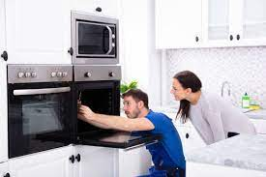
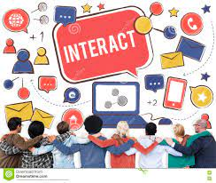
POST-LISTENING
Work in groups. Discuss the following questions.
Do you agree with Ms. Stevens? Which of the disadvantages she mentions do you think is the most serious? Why?
Take note your ideas and present them.
Notes:
https://jamboard.google.com/d/15QZGoXzq55I3L8hcvri4HmiCdKb8W6qs5i0AXy6NXSA/edit?usp=sharing

Slide 13
CONSOLIDATION
ANGEL NUMBERS

Slide 14
ANGEL NUMBERS

Slide 15
The host and Ms. Stevens talk about the ___________ of living in a smart city.
A. advantages
B. disadvantages

Slide 16
Ms. Stevens thinks that cameras and sensors collect information about her and her activities.
False

Slide 17
How does Ms. Stevens feel about the community in her neighborhood?
A. She feels very connected to her neighbors
B. She feels lonely.
C. She is satisfied with the community.
D. She is indifferent to the community

Slide 18
Ms. Stevens likes living in the smart city.
True
False

Slide 19
Ms. Stevens finds it easy to use smart devices.
True
False

Slide 20
It took Ms. Stevens a long time to get familiar with all the _____ _____ at home.
smart devices

Slide 21
What is Ms. Stevens most worried about
in the smart city?
A. The cost of living
B. The lack of privacy
C. The noise pollution

Slide 24
Homework
- Learn vocabulary by heart
- Prepare the next lesson (Writing)

Slide 25
THANK YOU

Slide 26
- taking her a long time to get familiar with all the smart devices at home.
- having few friends to ask for help in the neighbourhood.
- losing her right to privacy in public places.
- becoming lonelier.

Slide 33
CONSOLIDATION
What have you learnt today?

Slide 34
Why does Ms. Stevens feel lonely in the smart city?
A. She doesn't like the weather.
B. She doesn't have many friends.
C. She doesn't like the food.
D. She doesn't have a car.

