Slide 1
Teacher: ĐÀO THỊ XUÂN LONG

Slide 2
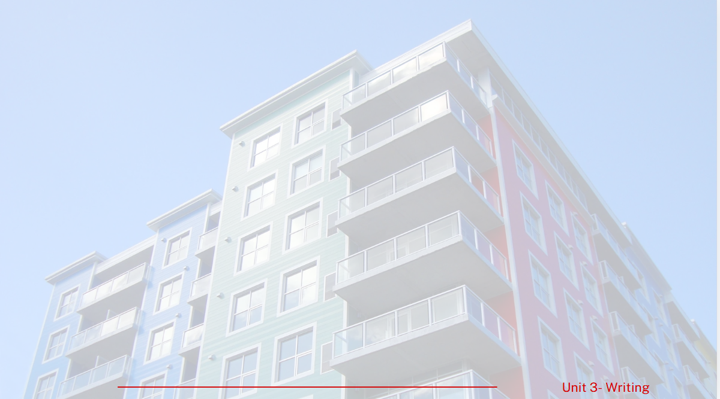
LUCKY STAR

Slide 3
What is it?
It is an article

Slide 4
Fill in the gap with one suitable word
Smart technologies make people's lives ________ reducing household chores.
by

Slide 5
Rearrange the words to make a full sentence
find/ use/ the/ it/ technologies/ difficult/ in/ the/ People/ smart/ to/ city.
People find it difficult to use the technologies in the smart city.

Slide 6
What do you call the topic of the article?
It is the title (of the article)

Slide 8
PRE-WRITING
1
Read the following ideas and decide whether they are advantages or disadvantages of living in a smart city.
 | Advantages | Disadvantages
Smart technologies make people’s lives easier by reducing household chores.
Without training, people will not know how to use the technologies in the smart city.
People have limited privacy due to the cameras installed everywhere in the city.
The negative impact on the environment is less.
Smart technologies help the city operate more efficiently.
People become worried because their personal information might not be protected.

Slide 9
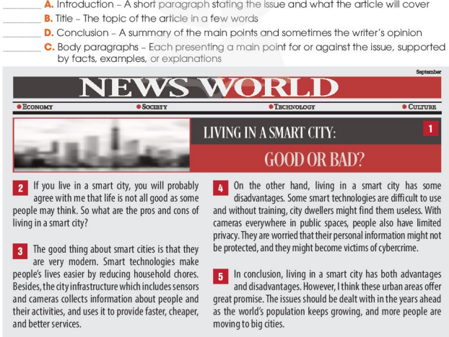
PRE-WRITING: Read the following ideas and decide whether they are advantages or disadvantages of living in a smart city.

Slide 10
PRE-WRITING
2
Read the article and match its parts with the correct descriptions.
2
______ A. Introduction – A short paragraph stating the issue and what the article will cover ______ B. Title – The topic of the article in a few words ______ C. Body paragraphs – Each presenting a main point for or against the issue, supported by facts, examples, or explanations ______ D. Conclusion – A summary of the main points and sometimes the writer’s opinion
1
3-4
5

Slide 11
Advantages and Disadvantages Essays
This type of essays is easy to recognize and divide the layout, one body paragraph for advantages and the other body paragraph for the disadvantages. The question is often given very clearly: “What are the advantages and disadvantages of…?”
Ex: • What are the advantages and disadvantages of children's using mobile phones? • What are the advantages and disadvantages of social networking in the workplace?
In addition, we can meet more question type: “Do the advantages outweigh the disadvantages?”. When encountering such a question, you also have the same presentation as above, which means Body 1 is for advantages and Body 2 is for the disadvantages. The Conclusion section will be the place where you answer "Yes" or "No" to the question.

Slide 12
PRE-WRITING
Parts of an article about advantages and disadvantages of living in a smart city
1. TILTE
2. INTRODUCTION
3. BODY PARAGRAPHS
+PARAGRAPH 1: Advantages- supporting ideas
(facts/ examples/explanations)
+PARAGRAPH 2: Disadvantages- supporting ideas
(facts/examples/explanations)
4. CONCLUSION

Slide 13
WHILE-WRITING
3
Write an article (120-150 words) about other advantages and disadvantages of living in a smart city.
Smart cities are built on new technologies to improve people’s life. The idea of living in one of them sounds very exciting. But is a life controlled by smart technologies good or bad for us?
Let’s start with the advantages. …………………………………………………………………………………………......
………………………………………………………………………………………………………………………………………………………
……………………………………………………………………………………………………………………………………………………….
……........................................................................................................................................................
What about the disadvantages? ……………………………………………………………………………………………….
……………………………………………………………………………………………………………………………………………………………………………………………………………………………………………………………………………………………………………….
……………………………………………………………………………………………………………………………………………………….
In conclusion, there are both advantages and disadvantages of living in a smart city. In my opinion,………………………………………………………………………………………………………………………………………………………………………………………………………………………………………………………………………………………………….

Slide 14
POST-WRITING
4
Peer correction: Exchange your writing with your friend for peer review.
Writing rubric
Organisation: … /2,0
Vocabulary use: …/2,0
Ideas: …/2,0
Grammar use: …/2,0
TOTAL: …/10,0

Slide 15
Suggested answer
POST-WRITING
Smart cities are built on new technologies to improve people’s life. The idea of living in one of them sounds very exciting. But is a life controlled by smart technologies good or bad for us?
Let’s start with the advantages. Living in a smart city can reduce the negative impact on the environment. Future smart cities will be built in new urban areas with a lot of green space. City dwellers will also care more about the environment, so they will try to find ways to make their cities greener and more sustainable, for example, by growing vegetables in their roof gardens.
What about the disadvantages? Smart cities can also affect people’s private life. When cameras are installed for security purposes, city dwellers will lose their right to privacy. They may think that someone is watching them all the time, and feel uncomfortable.
In conclusion, there are both advantages and disadvantages of living in a smart city. In my opinion, the benefits are greater, and people will find a way to adapt to the new lifestyle and overcome the challenges.

Slide 16
CONSOLIDATION
1
Answer the question
How many parts are there in an article about advantages and disadvantages of smart cities? What do you write in each part?

Slide 17
CONSOLIDATION
2
Homework
Do exercises in the workbook.
Prepare for lesson 7 unit 3.

