Slide 1

GOOD MORNING
developed

Slide 2


WELCOME TO OUR CLASS
PHAM THI NGA
QUOC HOC QUY NHON

Slide 3
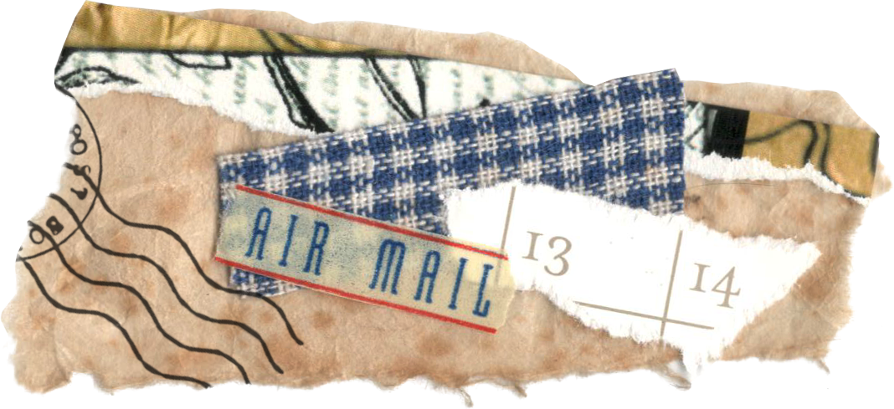



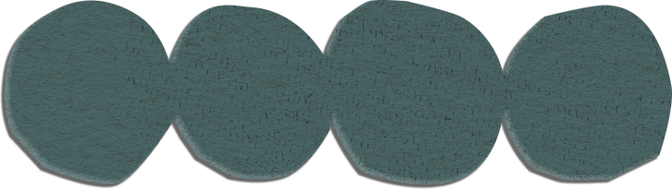

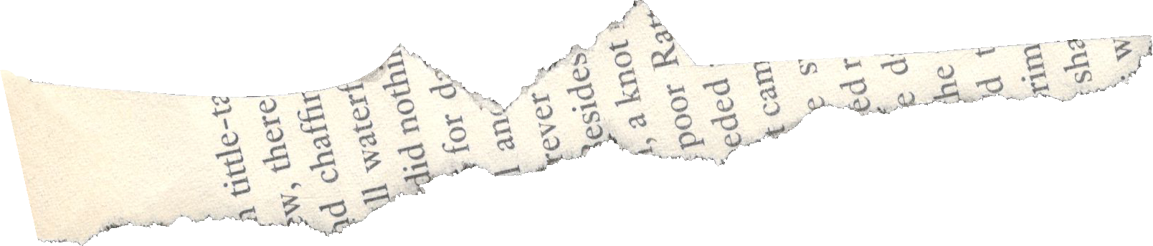
MEMORY GAME
2.
have 45 seconds to go to the board and write what you remember (name of the photos).
3.
The team with more correct answers is the winner.
1.
work in 2 teams. Memorize the photos on screen
in 20 seconds.

Slide 4
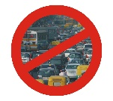

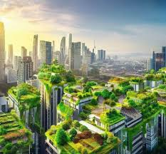

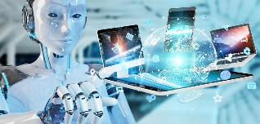
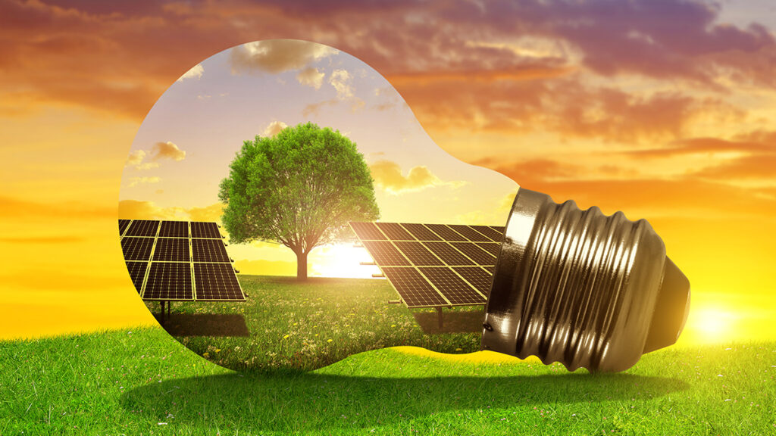

Slide 5
tall buildings
green city
No traffic jam/congestion
robots/computers
solar energy
No pollution

Slide 6
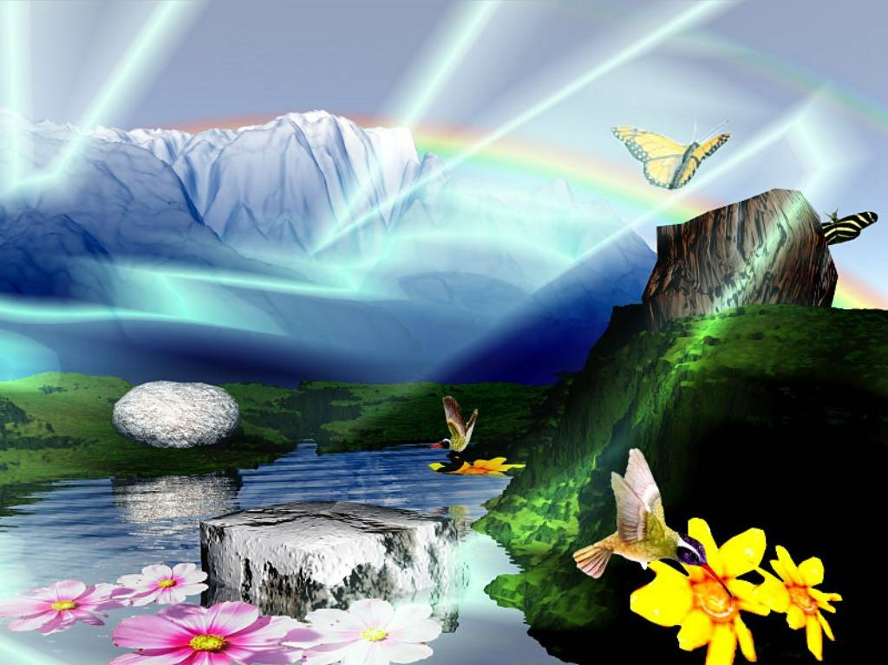




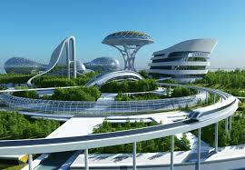
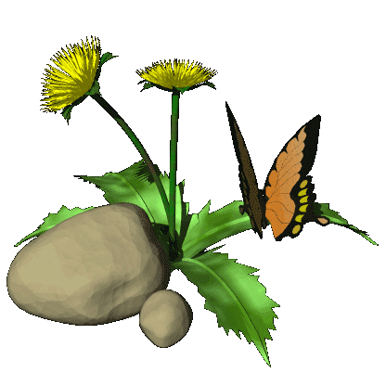

Wednesday, October 23rd, 2024
Unit 3. CITIES OF THE FUTURE
Lesson 3: READING
Characteristics of future cities
6

Slide 7
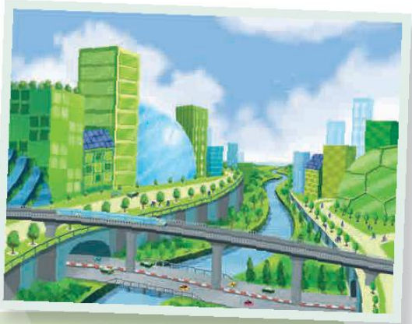
PRE-READING
1
Work in pairs. Discuss the questions.
1. What will future cities look like?
2. Do you think they will be ‘smarter’ and more sustainable? Why/ Why not?

Slide 8


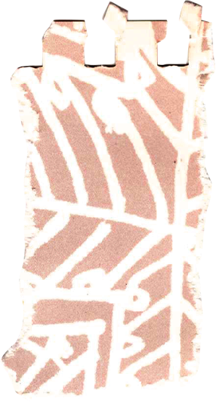
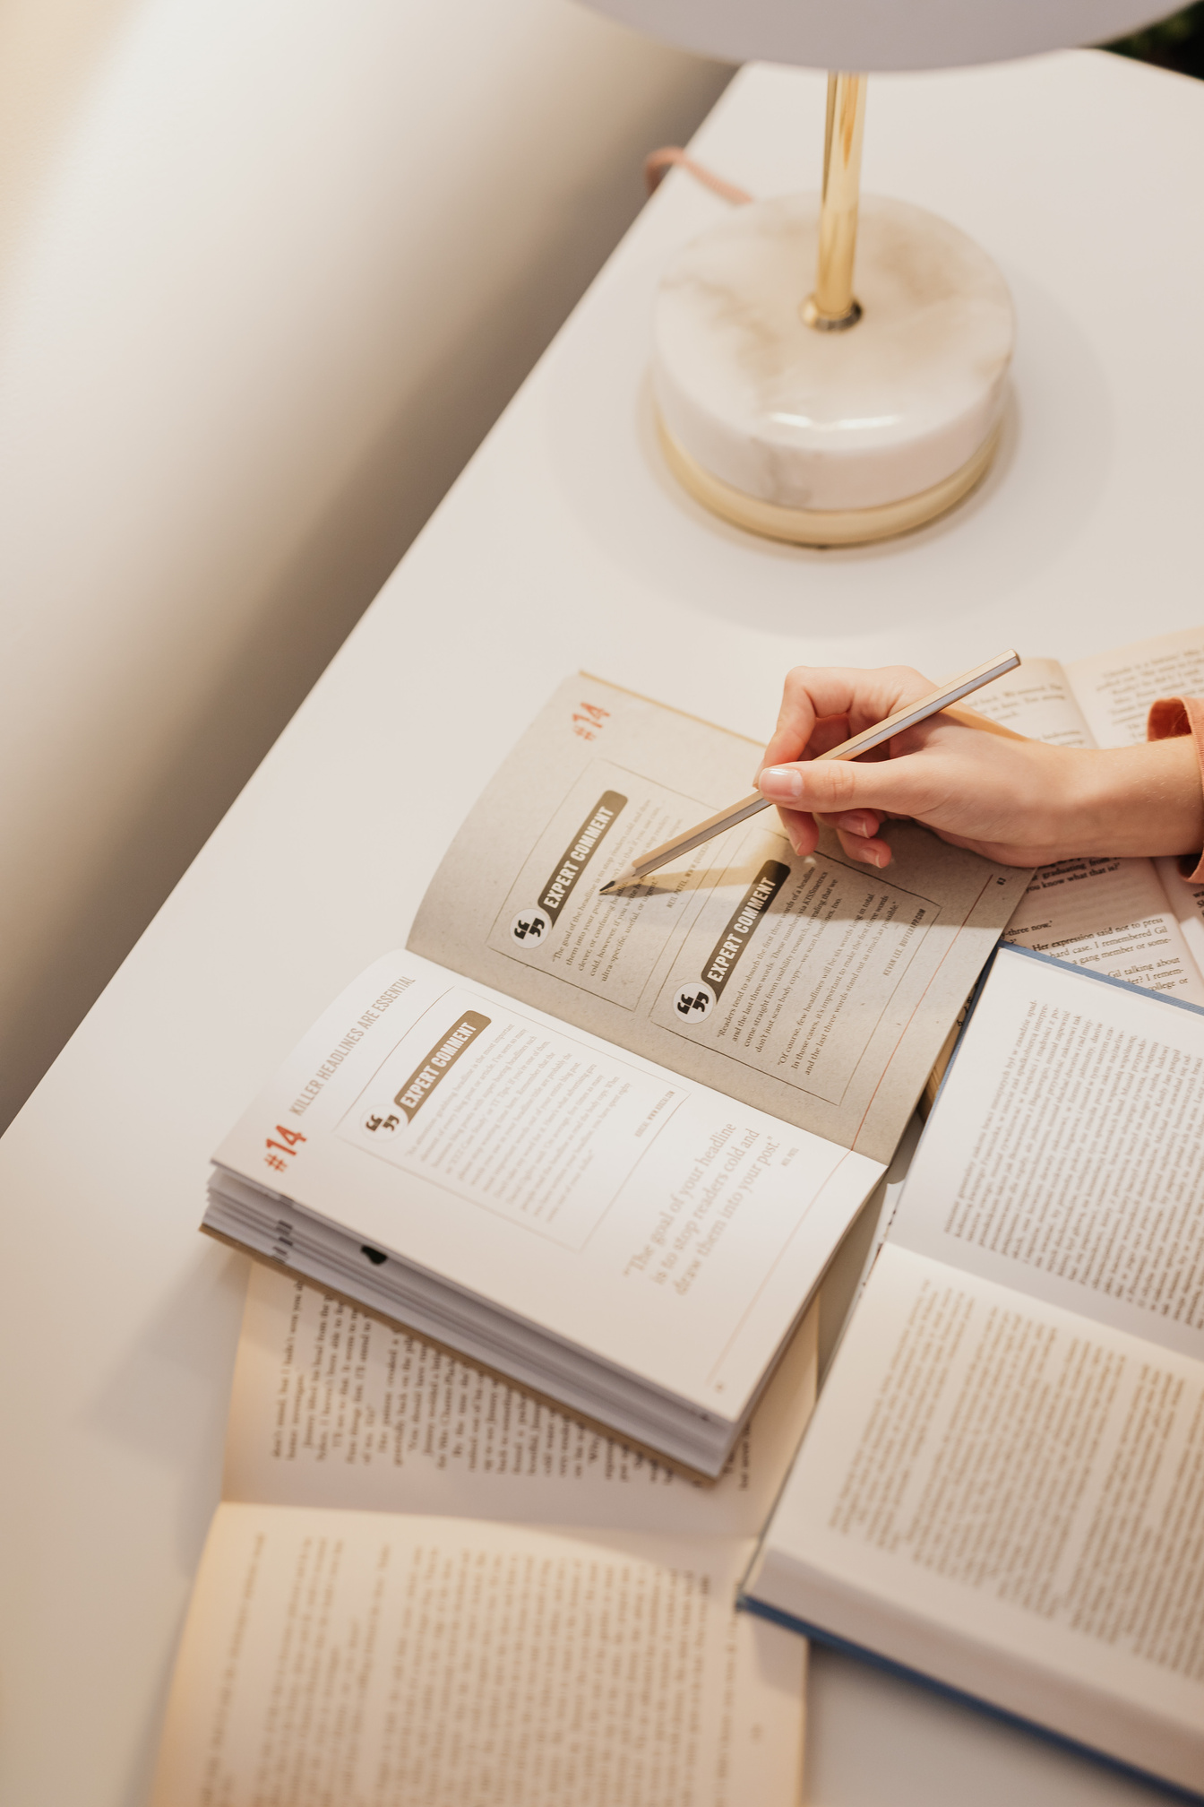


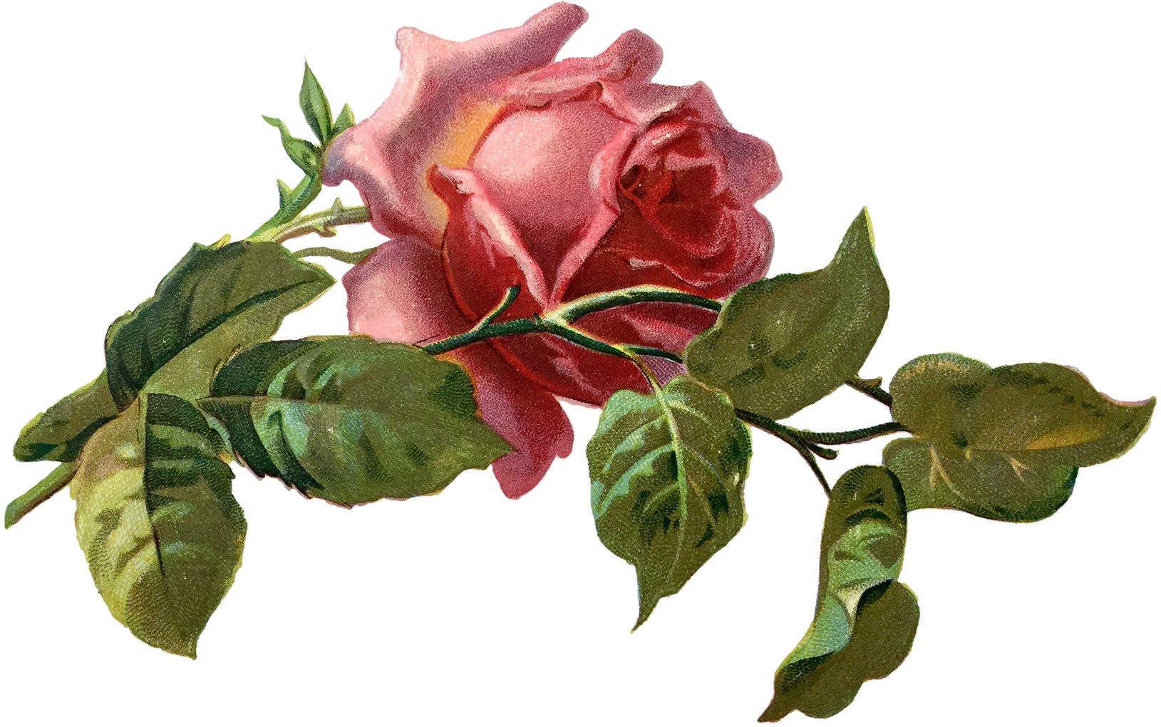
PRE-READING
2
Vocabulary

Slide 9
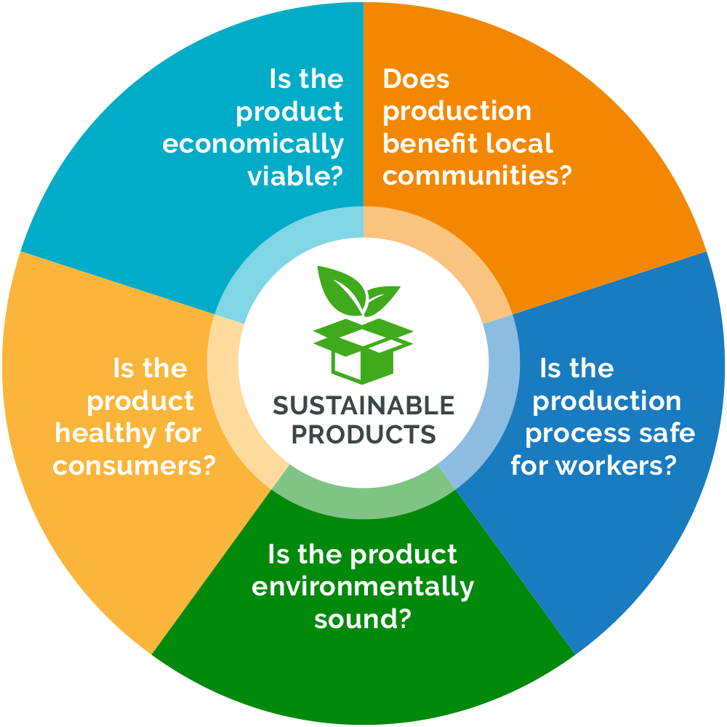


PRE-READING
sustainable (adj)
/səˈsteɪ.nə.bļ/
able to be used without harming the environment

Slide 10
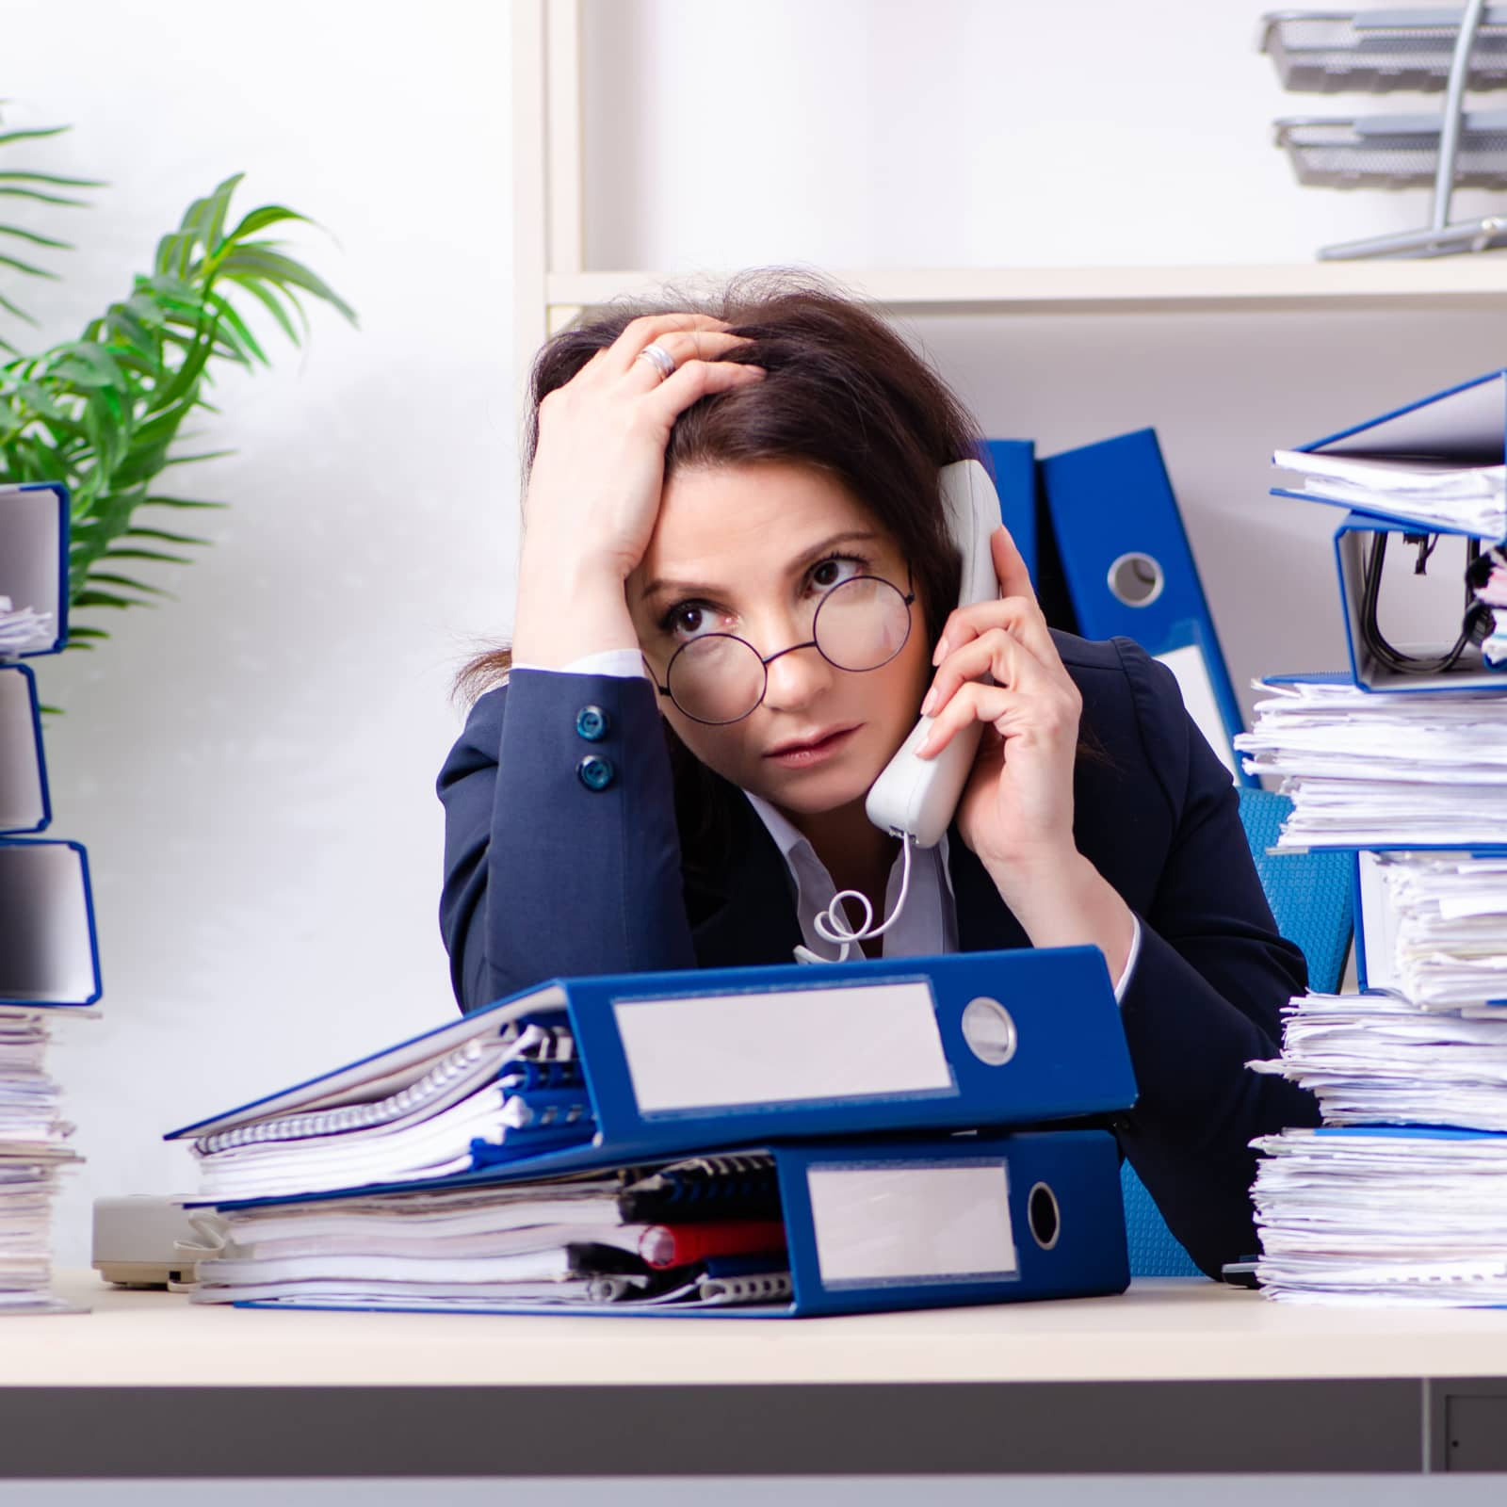
PRE-READING
deal with (v)
cope with (v)
=
/kəʊp wɪð /
She can't cope with all her work.

Slide 11
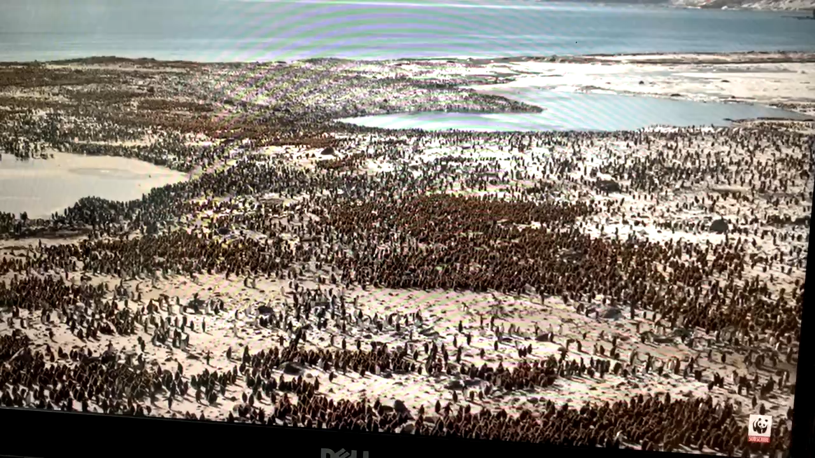
PRE-READING
biodiversity (n)
/ˌbaɪ.əʊ.daɪˈvɜː.sə.ti/
the number and types of plants
and animals that exist in a
particular area or in the
world generally

Slide 12
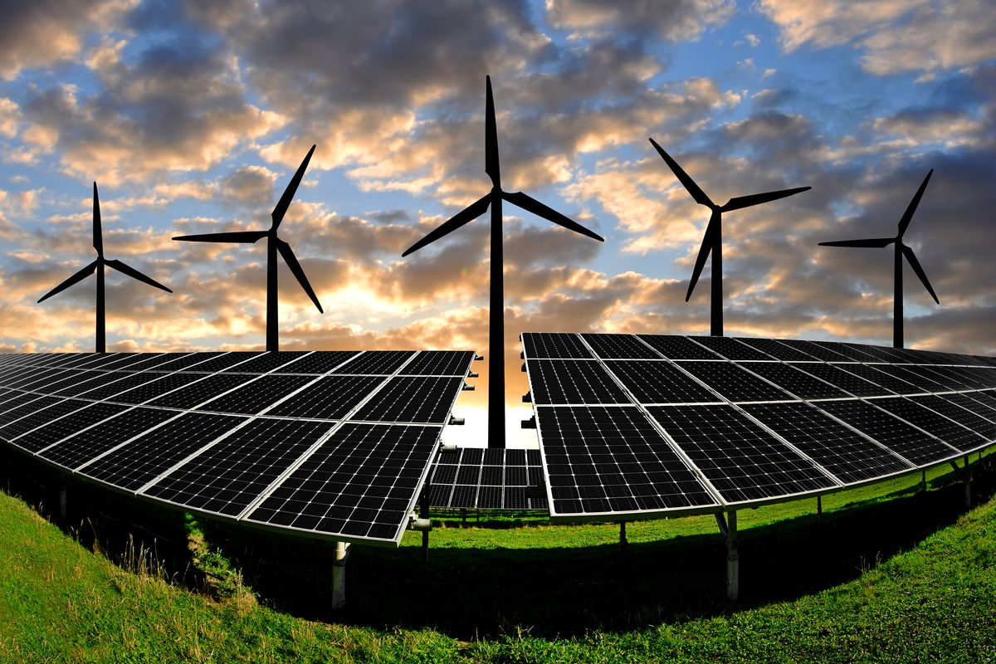
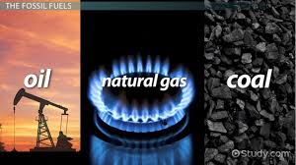
PRE-READING
renewable (adj) ><
non-renewable (adj)
/rɪˈnjuːəbəl/

Slide 13
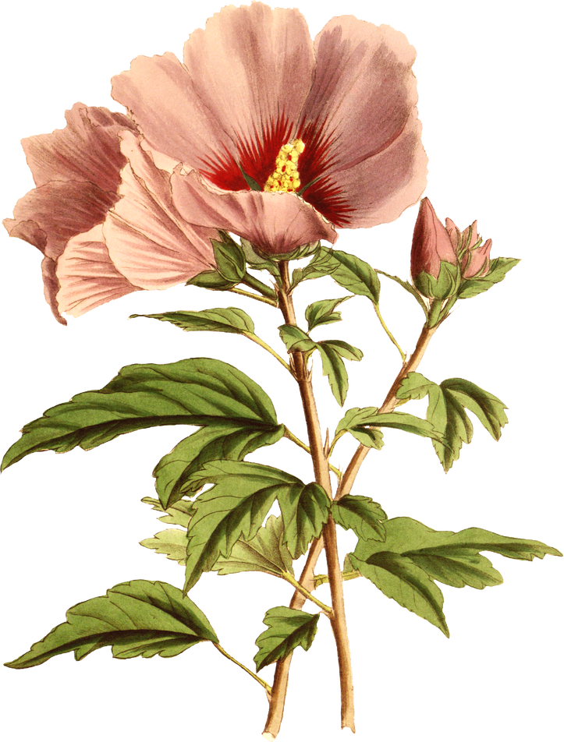

CHECKING VOCABULARY
Fill in the blanks with a suitable word/phrase .
renewable
1. The most common____________ sources of energy are wind and sun.
2. Farmers should use ____________ methods to produce clean and healthy food.
3. Staying within the safe environmental limits,much of the __________ would be conserved.
4.The city planners design and carry out projects which aim to __________ global climate change.
sustainable
biodiversity
cope with

Slide 14
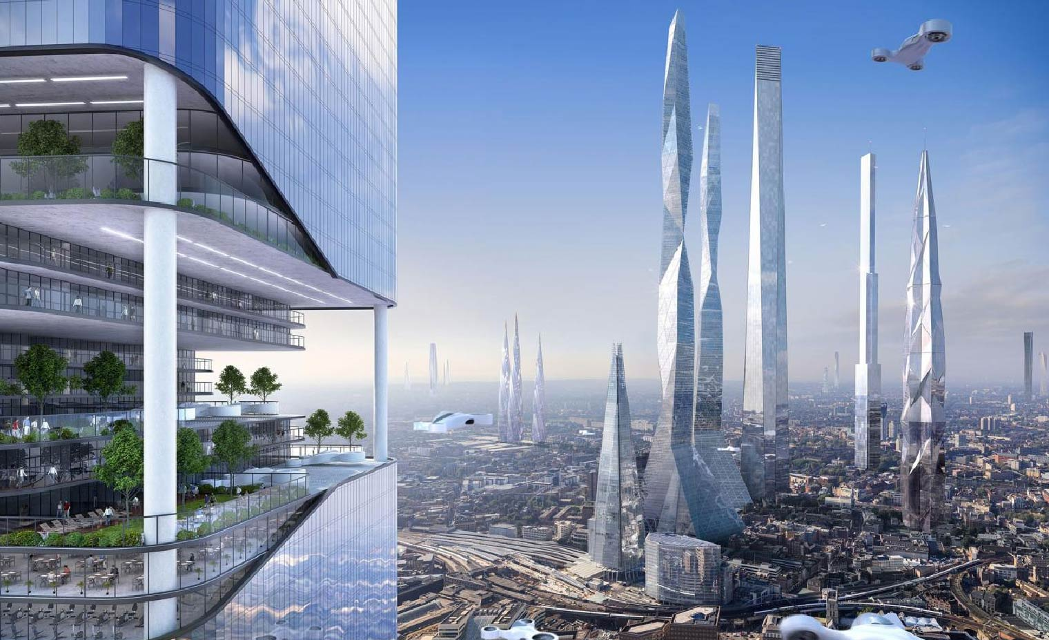
WHILE-READING
2
Read the article . Choose the correct meanings of the highlighted words and phrases.

Slide 15

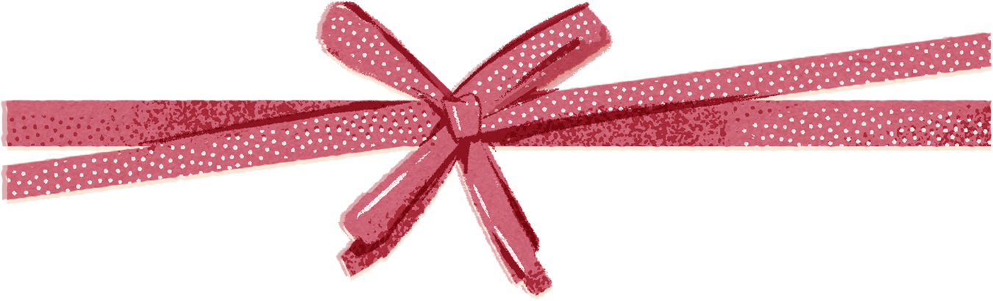
WHILE-READING
Read the article . Choose the correct meanings of the highlighted words and phrases.
2
2
By 2050 the world’s population is expected to reach 10 billion, and nearly 70 per cent of these people will live in cities. The cities of the future will be ‘smarter’ and more sustainable to cope with a growing population and improve people’s lives.
A smart city is a modern urban area that uses a range of technologies to provide services, solve problems, and support people better. The new technologies can help save time by predicting changes in the traffic and warning people of possible traffic jams. They will also help cities operate more efficiently. For example, street lights can turn off when the streets are empty, and sensors can inform waste collection teams when the bins are full. These smart technologies will help save energy, reduce air pollution, and fight climate change.
Cities in the future will also be sustainable. They will include a lot of green space and become home to more plants and animals. Making room for biodiversity and nature can be done in various ways including underground and rooftop farming, green roofs, and roof gardens. As people will care more about the environment, most cities will use renewable and clean energy. Modern infrastructure will also be more eco-friendly. Computer-controlled transport systems like electric buses and trains will produce less greenhouse gas emissions. In addition, more pedestrian zones for walking and cycle paths will be made available for people in all neighbourhoods.
These features will make future cities more liveable and will provide a high quality of life to city dwellers.

Slide 16
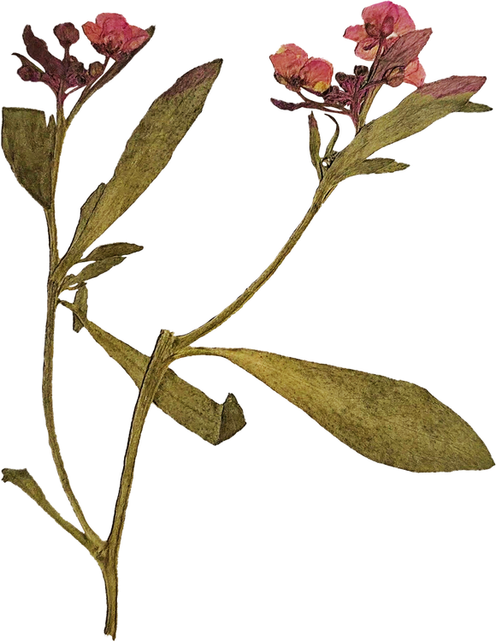
WHILE-READING
2
Circle the correct meanings of the highlighted words and phrases.
1. operate more efficiently
A. to work better without wasting time, money, or energy
B. to control a machine without wasting resources
C. to cut a body open for medical reasons in a more careful way
2. sensors
A. devices that can react to light, heat, or pressure
B. instruments that can be played by people
C. devices for discovering rubbish

Slide 17
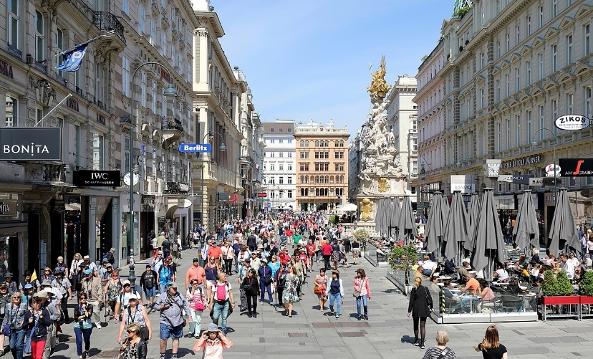
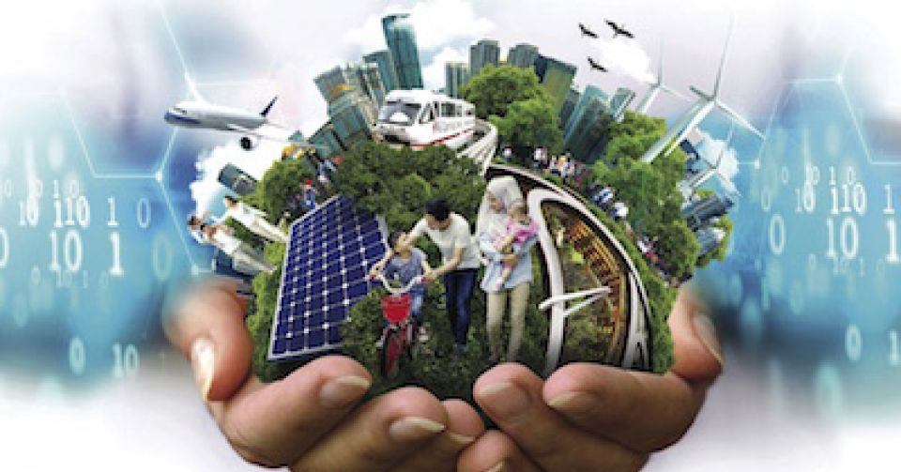
WHILE-READING
2
Circle the correct meanings of the highlighted words and phrases.
3. pedestrian zones
A. areas for cars only
B. areas for electric buses
C. areas for walking only
4. liveable
A. suitable for farming
B. nice to live in
C. good for the environment

Slide 18
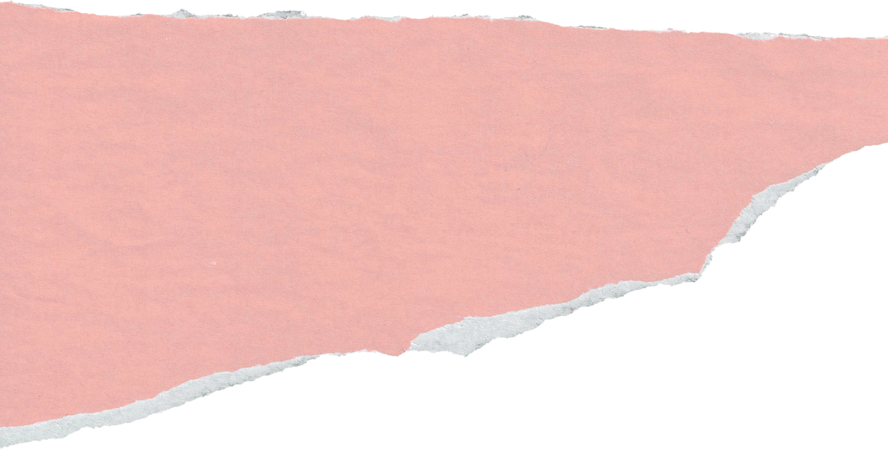
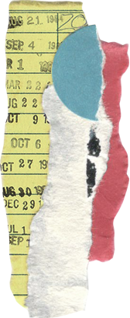
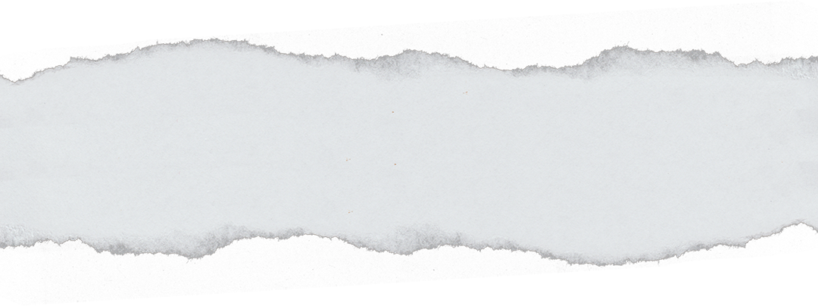



WHILE-READING
3. Read the article again
and decide whether the statements are true(T) or false(F)
2
 | T | F
1. About 70 million people will live in cities by 2050.
2. Smart cities use modern technologies to save time and provide better services.
3. City dwellers will be able to grow vegetables underground or in roof gardens.
4. Modern infrastructure will also be more expensive.
5. Space for walking and cycling will be replaced with computer-controlled transport systems.

Slide 19


40
30
-20
X2
50
20
00000
-30
-20
100
150
-50

Slide 20
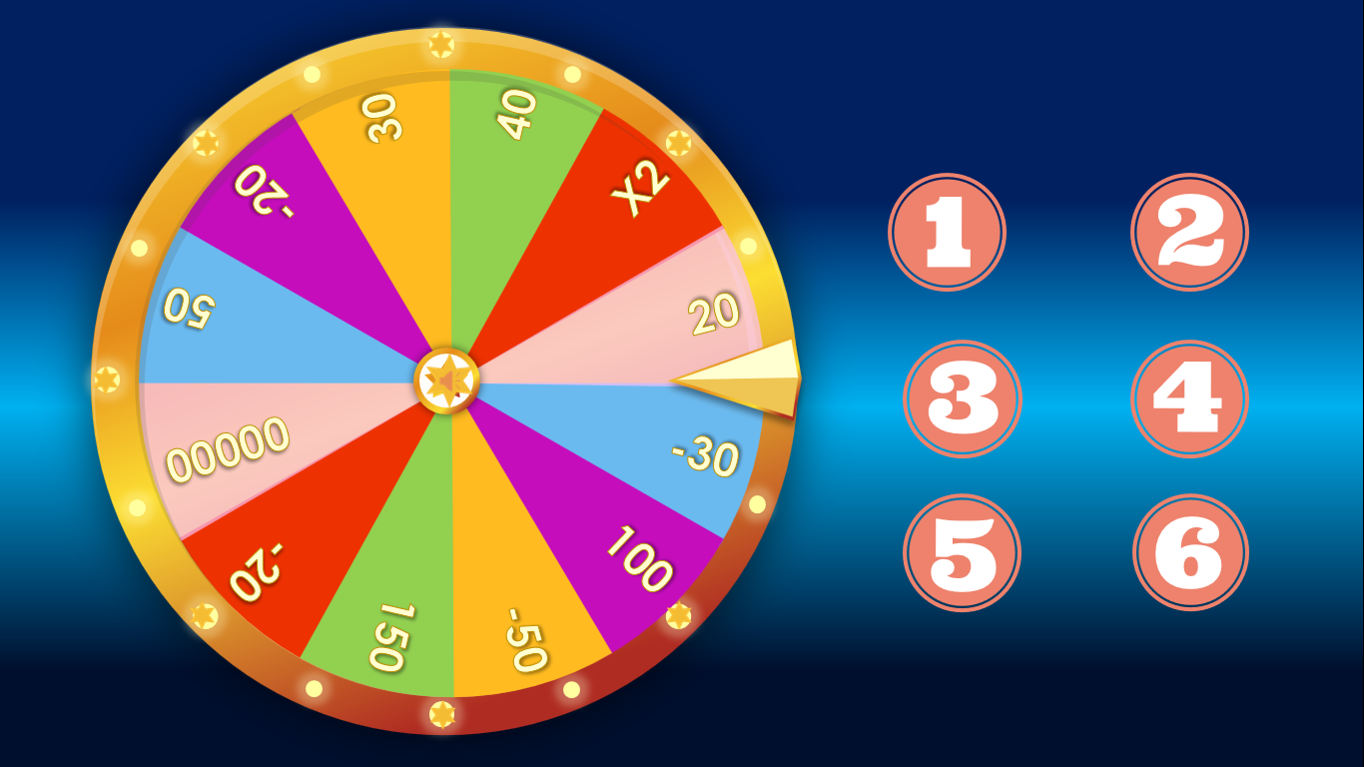
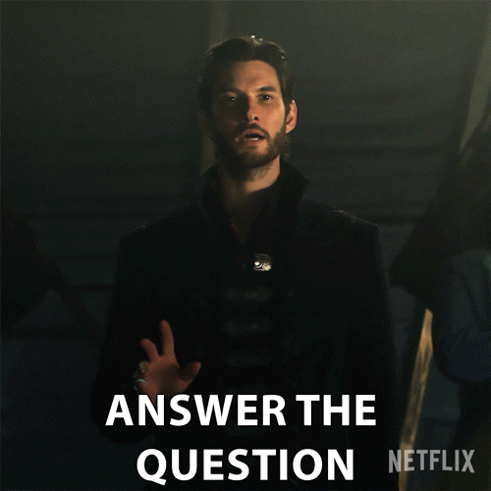

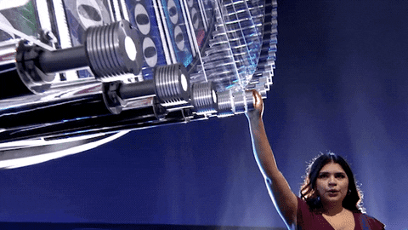

Slide 21







40
30
-20
X2
50
20
00000
-30
-20
100
150
-50
SPIN

Slide 22







About 70 million people will live in cities by 2050.
.
False
( nearly 70 per cent )

Slide 23
.
Smart cities use modern technologies to save time and provide better services.
True
(L.1,2- para 2)

Slide 24
City dwellers will be able to grow vegetables underground or in roof gardens.
.
True
( L.3, para 3 )

Slide 25
Modern infrastructure will also be more expensive.
False
( more eco-friendly)

Slide 26
Space for walking and cycling will be replaced with computer-controlled transport systems.
False
( made available for people in all neighbourhoods )

Slide 27
+150 POINTS

Slide 28
WHILE-READING
3
Read the article again and decide whether the statements are true (T) of false (F).
1. About 70 million people will live in cities by 2050.
2. Smart cities use modern technologies to save time and provide better services.
3. City dwellers will be able to grow vegetables underground or in roof gardens.
4. Modern infrastructure will also be more expensive expensive.
F
T
T
F
5. Space for walking and cycling will be replaced with computer-controlled transport systems.
F

Slide 29
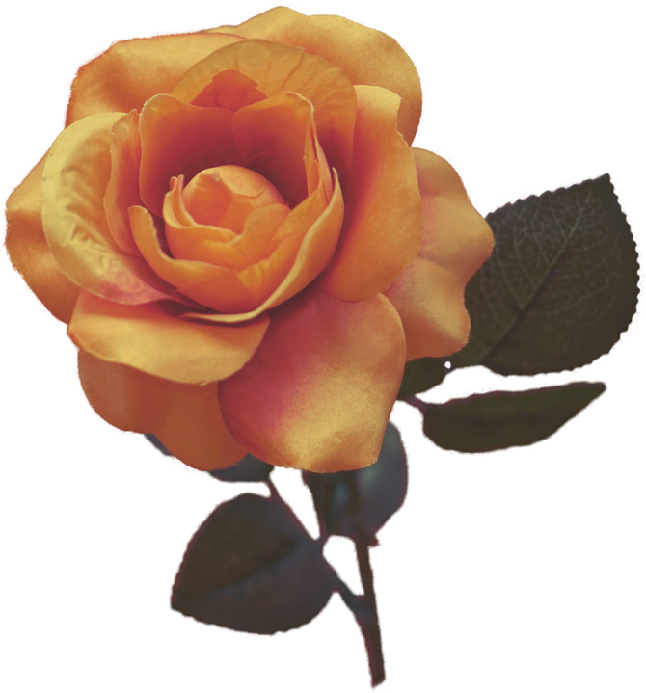
WHILE-READING
4
Read the article again and complete the diagram.
Smart
Modern technologies are used to (1) __________ people better.
Smart devices help cities (2) __________ more efficiently.
support
operate
Cities of the future
Sustainable
Cities will include a lot of (3) ___________ and become home to more plants and animals.
Eco-friendly (4) ______________ will reduce greenhouse gas emissions.
green space
infrastructure

Slide 30
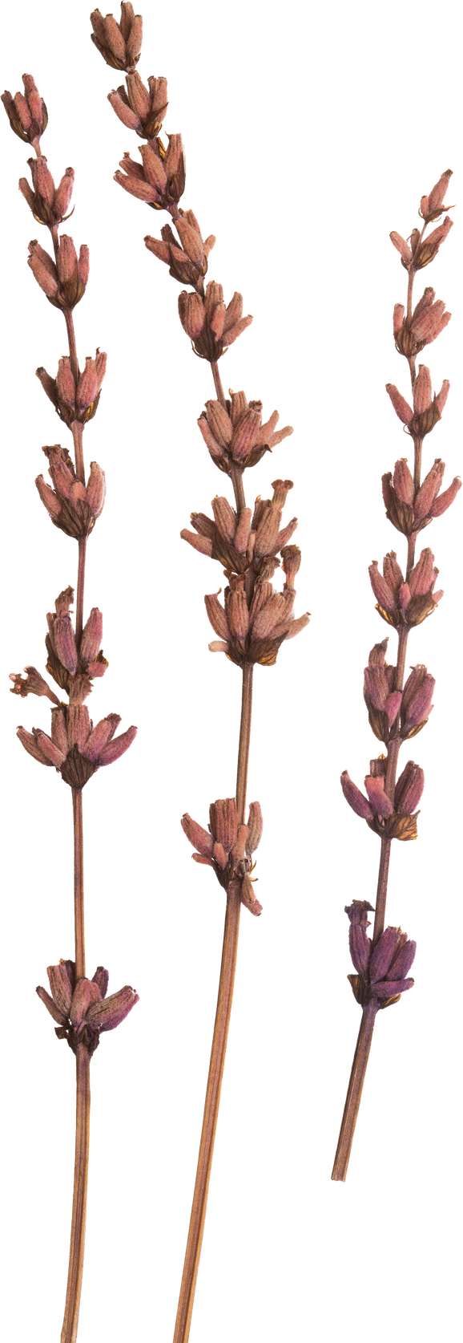
WHILE-READING
4
Characteristics of the future cities
smart
sustainable
- uses modern technologies
to improve people’s lives
- designed to reduce environmental impacts

Slide 31
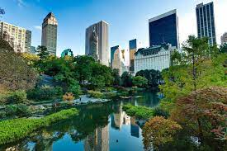
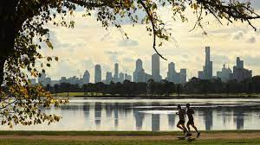
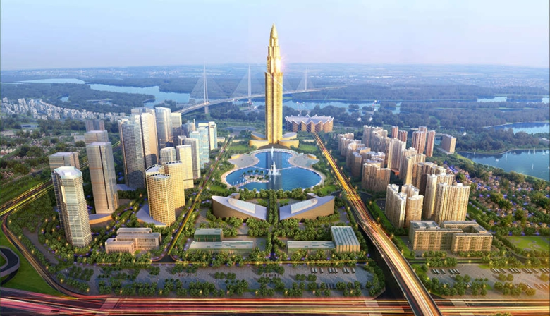
POST-READING
5
Work in groups. Discuss the following questions.
Would you like to live in a smart and sustainable city?
Why/Why not?

Slide 32
CONSOLIDATION
What have you learnt today?
Characteristics of future cities: smart and sustainable
Some lexical items about characteristics of future cities
Reading for main ideas and specific information about future cities
Using the language and ideas from the reading to express opinions and give reasons

Slide 33
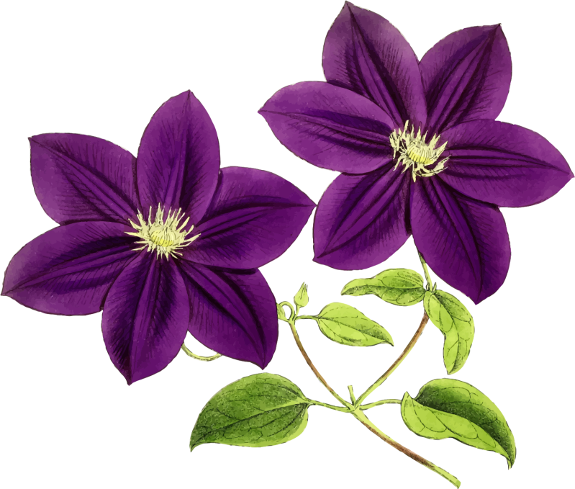


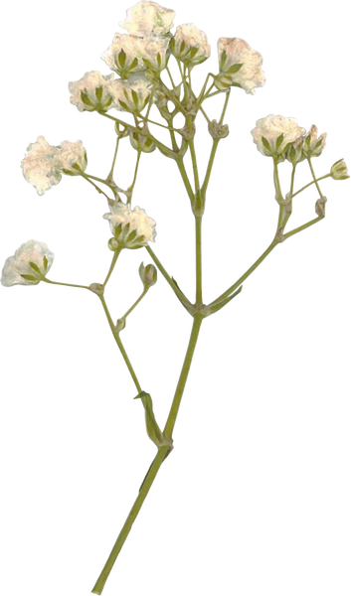
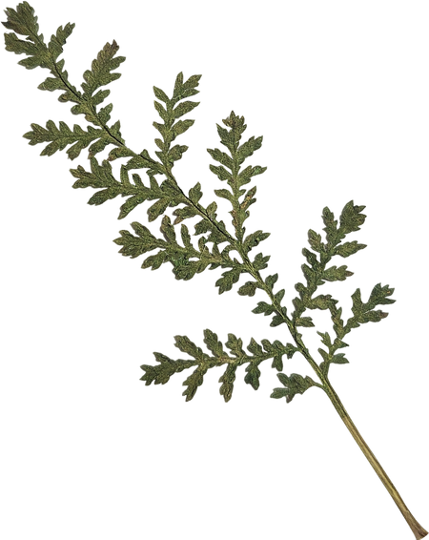



Homework
1.
2.
3.
Write a short paragraph about the smart and sustainable city you would like to live in.
(please send your task to my email :
phamthinga@quochocquynhon.edu.vn)
Do exercises
in the workbook
Prepare for Lesson 4 -
Unit 3. SPEAKING

Slide 34
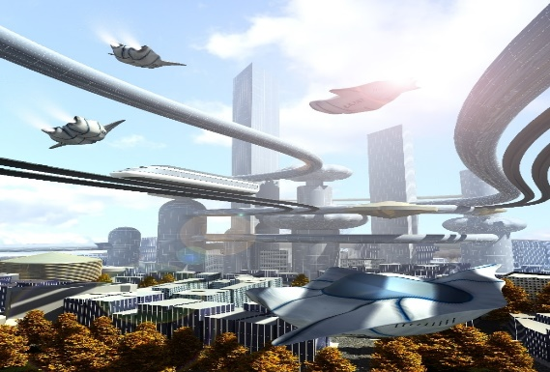
Thanks for your attention !
Goodbye !

