Slide 2
Unit 2
A multicultural world
LESSON I
GETTING STARTED
At the International Cultural Festival

Slide 3
WARM-UP
Game: What is this?

Slide 4
WARM-UP
Rules
- Work in two teams.
- There are 6 pictures of 6 signature dishes of Viet Nam, Japan and Korea.
- Only one student from each group sees a picture.
- Use your own words to describe the food.
- Others guess the name of the food.
+ If the answer is correct ➔ one point for your team.
+ If the answer is incorrect ➔ the chance to answer is transferred to the other team.
+ The team having more points is the winner of the game.

Slide 5
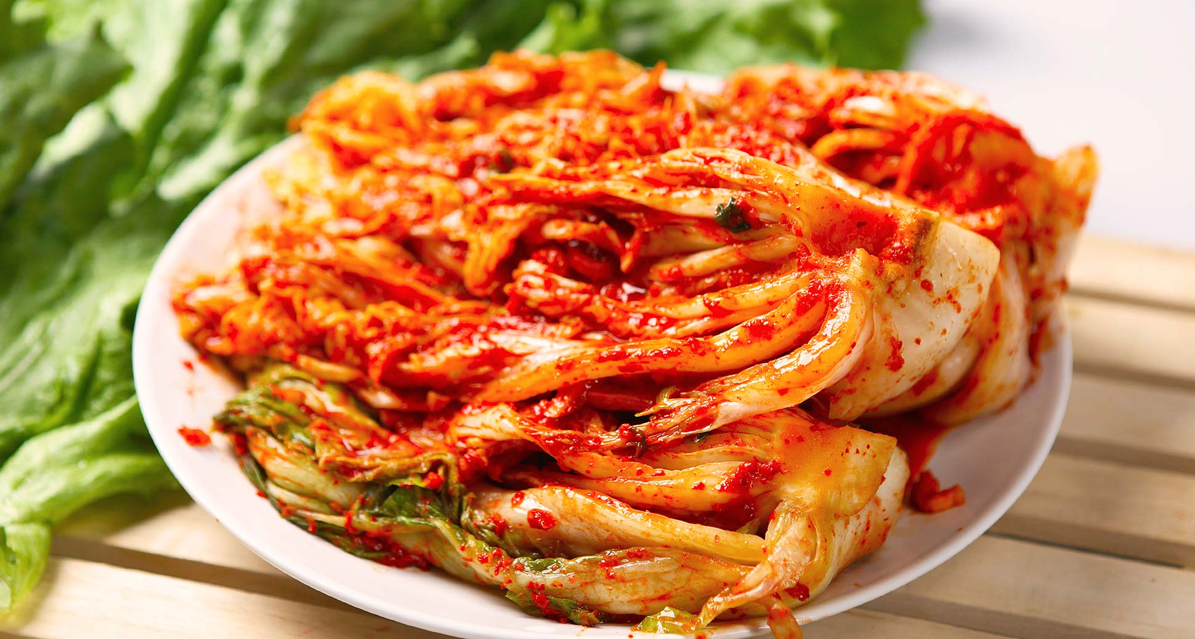
WARM-UP
kimchi

Slide 6
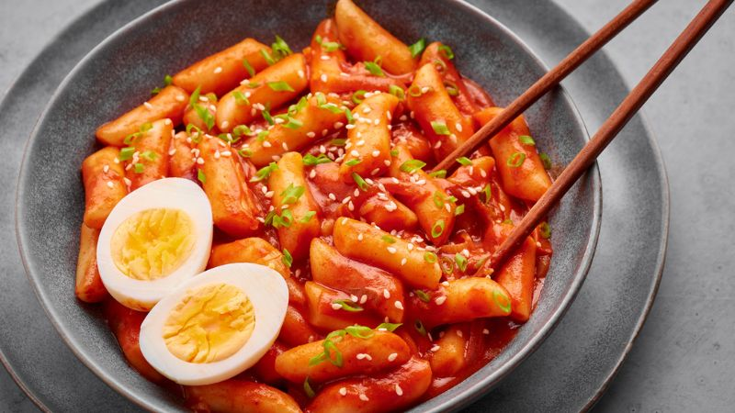
WARM-UP
tteokbokki – spicy rice cakes

Slide 7
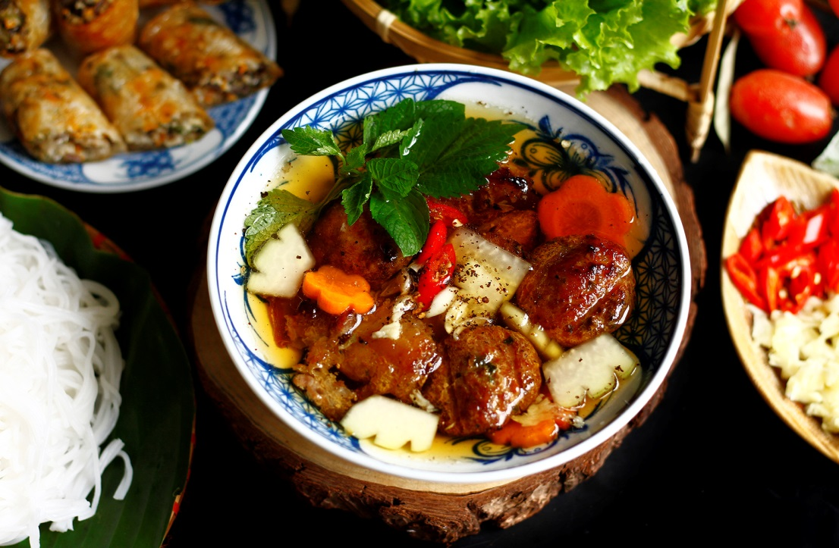
WARM-UP
bun cha – grilled pork meatballs with noodles

Slide 8
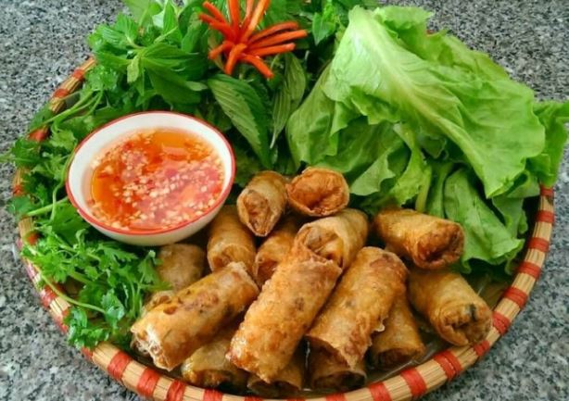
WARM-UP
spring rolls

Slide 9
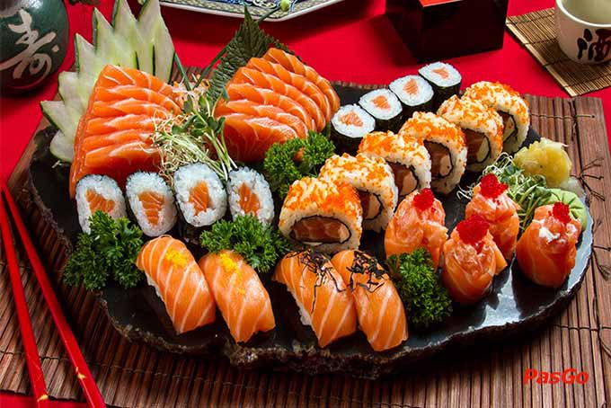
WARM-UP
sushi

Slide 10
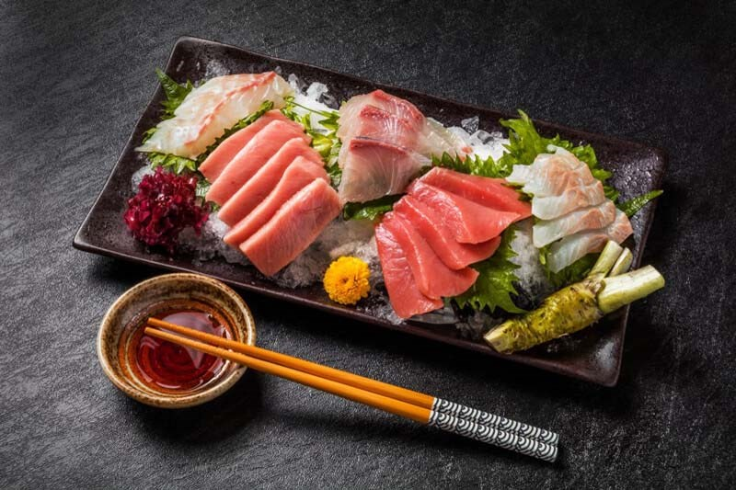
WARM-UP
sashimi

Slide 11
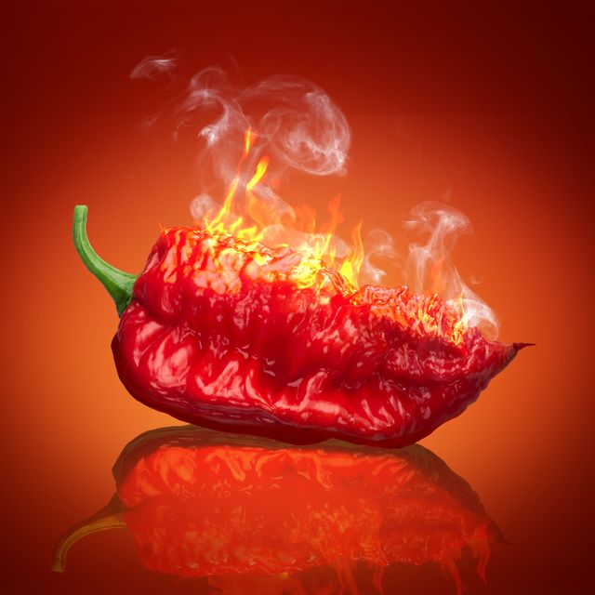
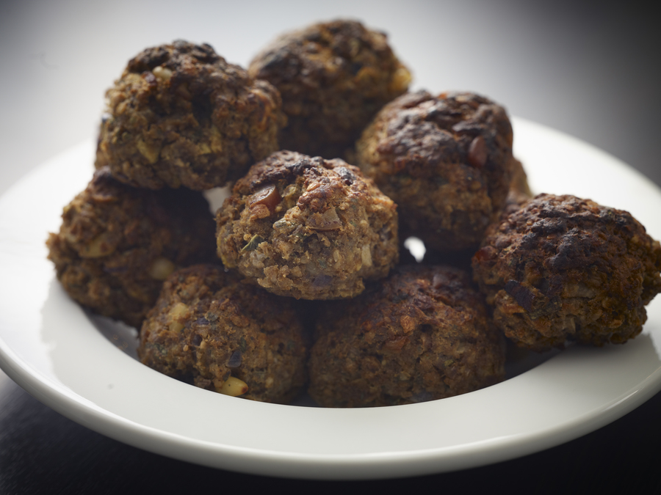
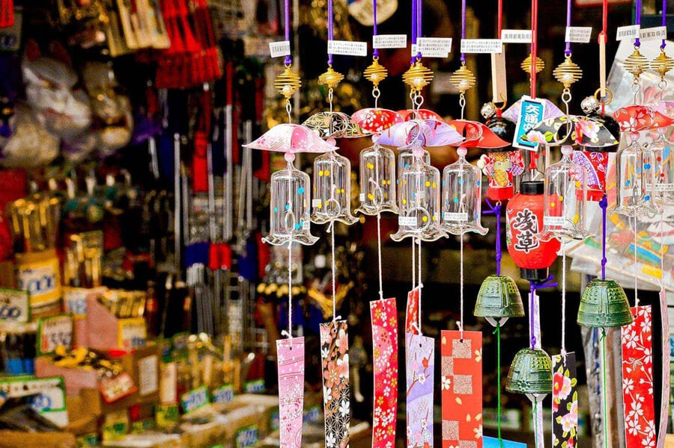
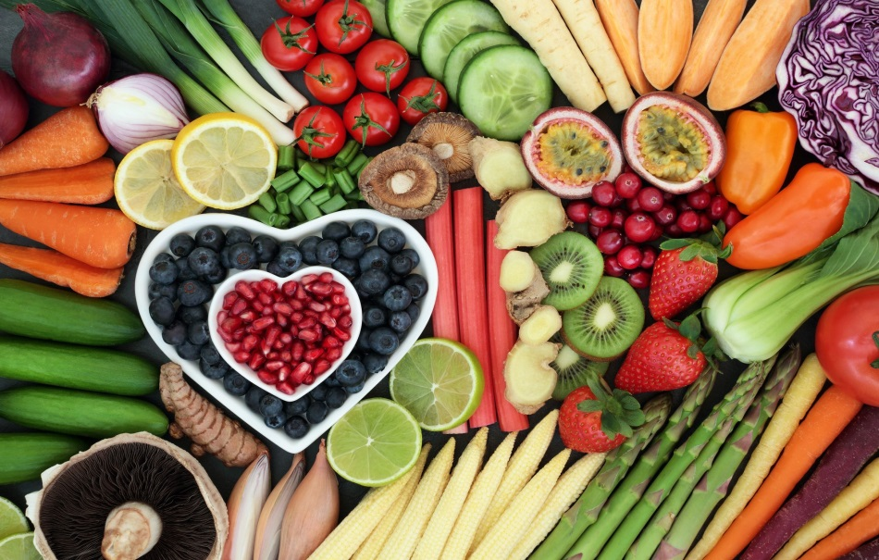
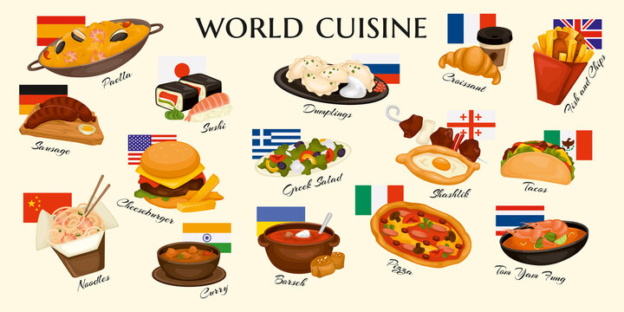
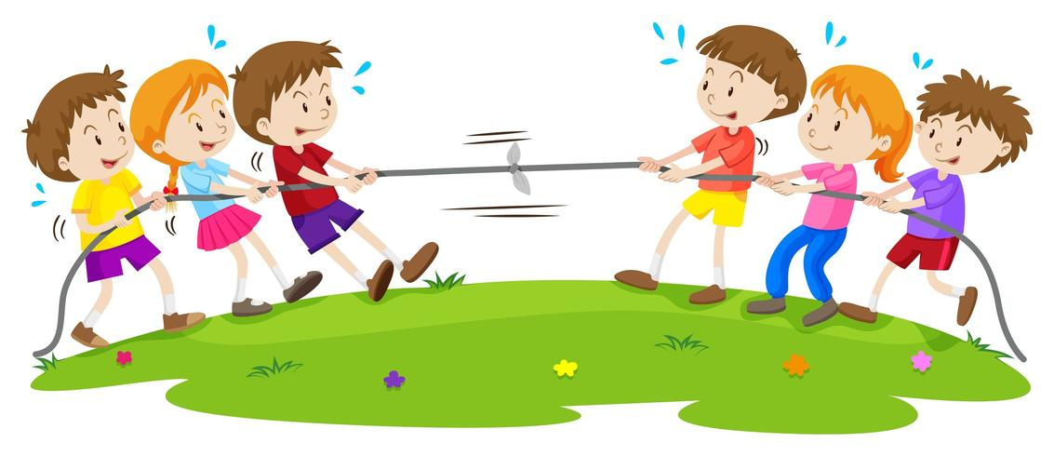



* Vocabulary:
1. cultural /ˈkʌltʃərəl/ (adj) văn hóa; culture (n)
2. diversity /daɪˈvɜːsəti/ (n) sự đa dạng; diversify (v)
Cultural diversity: sự đa dạng văn hóa
3. cuisine /kwɪˈziːn/ (n) ẩm thực
4. autograph /ˈɔːtəɡrɑːf/ (n) chữ ký
5. booth /buːð/ (n) gian hàng
6. Tug of war /ˌtʌɡ əv ˈwɔːr/ (n): trò chơi kéo co
7. spicy /ˈspaɪsi/ (adj) cay
8. meatball /ˈmiːtbɔːl/ (n) thịt viên
9. healthy /ˈhelθi/ (adj) khỏe mạnh/ lành mạnh
10. souvenir /ˌsuːvəˈnɪə(r)/ (n) quà lưu niệm

Slide 12

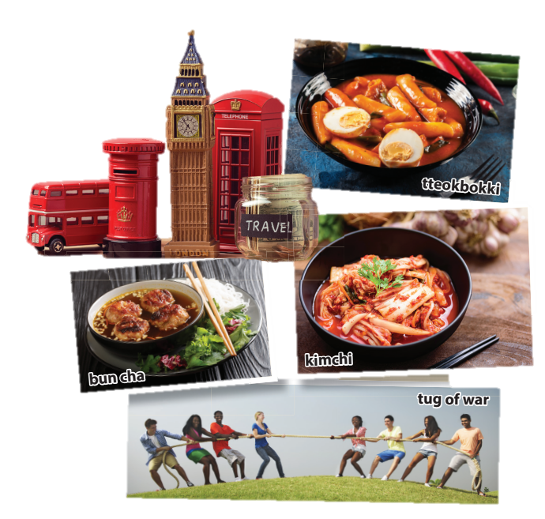
PRACTICE
1
Listen and read.
Where can you buy those souvenirs?
2. What food do you see in the 2nd picture?
3. What can you see in the last photo?
4. Who are the speakers?
England
a bowl of kimchi, bun cha, tteokbokki
some teenagers playing tug-of-war
Nam, Mai and Linda

Slide 13
PRACTICE
2
Read the conversation again and complete the table. Use no more than THREE words for each blank.
Country | Food to try | Things to do or buy
Japan | (1) _________
Korea | kimchi, tteokbokki | meet a K-pop (2) ___________ ________________
Britain | (3) ____________ | buy souvenirs
Viet Nam | spring rolls, (4) _________ | play games (tug of war, bamboo dancing)
sushi
group / singers
and get autographs
fish and chips
bun cha

Slide 14
PRACTICE
3
Find words and a phrase in 1 that have the same or similar meaning to the following words and phrases.
1. variety
2. a style of cooking
3. tasty
4. interesting places
diversity
cuisine
delicious
attractions

Slide 15
PRACTICE
4
Complete the sentences based on the conversation. use the correct article (a, an, the) or ∅ (no article).
1. Nam took Mai and Linda to _____ International Cultural Festival in Ha Noi.
2. Tasting food from different countries is a way to learn about _____ cultural diversity.
3. Nam tells his friends that ____ famous K-pop group will be at the Korean booth.
4. The Vietnamese booth is ____ open booth, and is very big.
the
∅
a
an

Slide 16

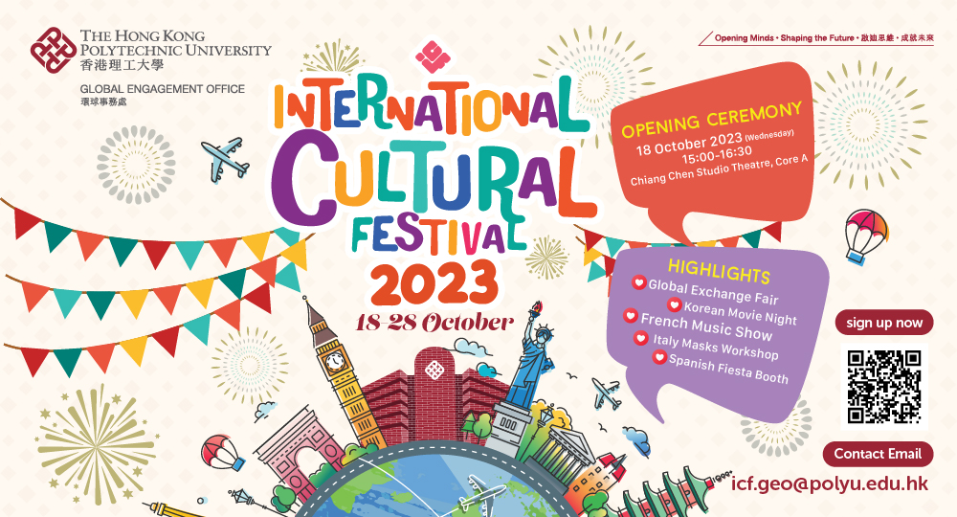
PRODUCTION
Design a poster to introduce the International Cultural Festival

Slide 17
CONSOLIDATION
1
Wrap-up
What have you learnt today?
Some lexical items the topic A multicultural world
Reading for specific information
The article

Slide 18
CONSOLIDATION
2
Homework
Do exercises in the workbook.
Prepare for the project in Lesson 8.

Slide 19
Website: hoclieu.vn
Fanpage: https://www.facebook.com/tienganhglobalsuccess.vn/

