Slide 1


WELCOME TO CLASS 11a4
Teacher:HƯƠNG LAN

Slide 3

Happy teacher day
developed
Thu, Now 14

Slide 4
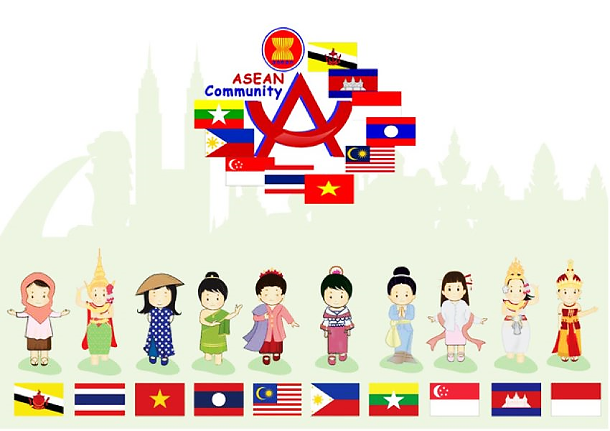
WARM-UP
CHOOSE THE CORRECT INFORMATION ABOUT ASEAN
Rule: Members in each team will choose the correct answers by raising hand. The group which has more correct answer will be winner.

Slide 5


How many colours are there on the ASEAN flag?
1
2
4
3
5

Slide 6
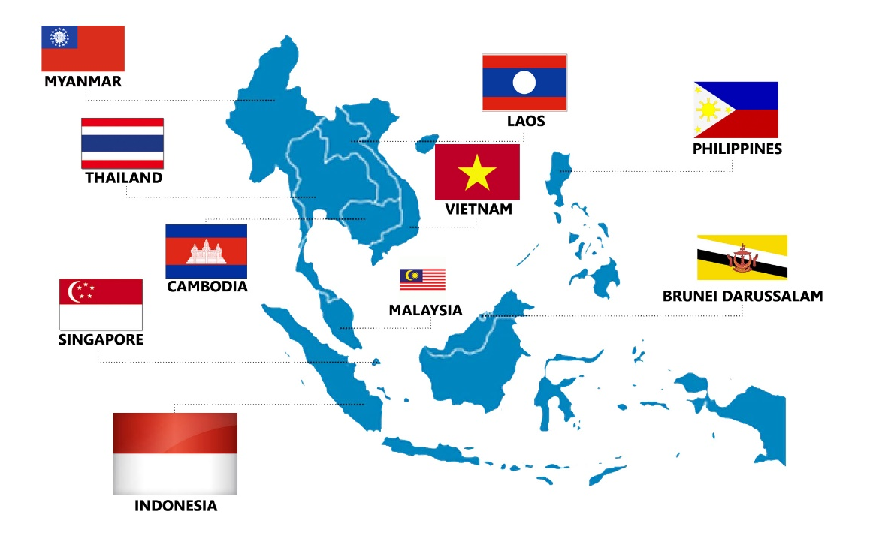
How many ASEAN members are there today?
2
8
9
10
11

Slide 7
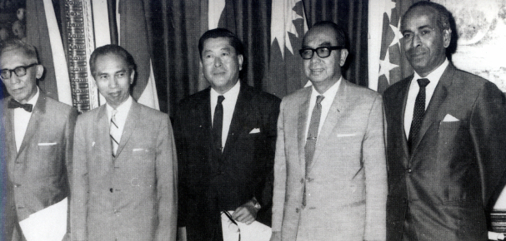
When was ASEAN founded?
3
1999
1988
1979
1967

Slide 8

What does ASEAN stand for?
4
Association of Southeast Asean Nations
Association of South - East Asean Nation
Association of South -East Asian Nations
Association of Southeast Asian Nation

Slide 9

When is ASEAN Day?
5
The eighth of August
The eighth of September
The eighth of November
The eighth of October

Slide 10


6. What is the name of the song?
It’s THE ASEAN WAY
-The anthem of ASEAN-

Slide 11



Slide 12





Unit
4
Asean and Viet Nam
ASEAN NEWS

Slide 13

PRE-READING
1
Work in pairs. Discuss the following questions.

Slide 14

PRE-READING: VOCABULARY
relation (n) /rɪˈleɪʃən/
mối quan hệ
the connection between people, groups, organizations, or countries

Slide 15

PRE-READING: VOCABULARY
eye-opening (adj):
mở mang tầm nhìn
/ˈaɪˌəʊpənɪŋ/
surprising, and teaching you new facts about life, people, etc.

Slide 16

PRE-READING: VOCABULARY
represent (v)
đại diện
/ˌreprɪˈzent/
to speak, act, or be present officially for another person or people

Slide 17

PRE-READING: VOCABULARY
live stream (n)
phát trực tiếp
/ˈlaɪvstriːm/
a broadcast of the video and sound of an event over the internet as it happens

Slide 18
Form | Pronunciation | Meaning
1. relation (n): | /rɪˈleɪʃən/ | mối quan hệ
2. eye-opening (adj): | /ˈaɪˌəʊpənɪŋ/ | mở mang tầm nhìn
3. represent (v): | /ˌreprɪˈzent/ | đại diện
4. live stream (n): | /ˈlaɪvstriːm/ | phát trực tiếp

Slide 19
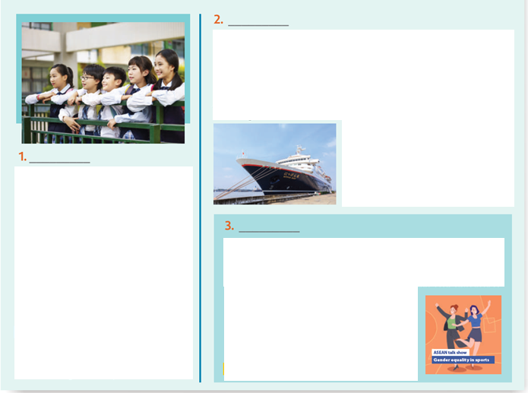
WHILE-READING
2
Read the news items and choose the most suitable headline for each one.
A
The Ship for Southeast Asian and Japanese Youth Programme (SSEAYP) is looking for participants. Organised by the government of Japan and supported by the governments of Southeast Asia, this journey will last for 50 days and will bring together over 300 youths from ASEAN countries and Japan. Young people will have the opportunity to take part in exciting discussions on current social and youth issues, and eye-opening cultural exchanges.
The Ship for Southeast Asian and Japanese Youth Programme (SSEAYP) is looking for participants. Organised by the government of Japan and supported by the governments of Southeast Asia, this journey will last for 50 days and will bring together over 300 youths from ASEAN countries and Japan. Young people will have the opportunity to take part in exciting discussions on current social and youth issues, and eye-opening cultural exchanges.
A. Don't miss this opportunity to represent your country!
B. Travelling to ASEAN counties
C. Equality in sport for ASEAN women
D. Korean and ASEAN students
E. Volunteers needed to take part in cultural exchanges
They will also receive training to help them develop problem- solving and leadership skills. The journey starts in Japan and participants travel to five ASEAN countries.
D
They will also receive training to help them develop problem- solving and leadership skills. The journey starts in Japan and participants travel to five ASEAN countries.
To raise awareness of ASEAN and promote cultural exchanges between the youths of Korea and ASEAN, the ASEAN-Korea Centre (AKC) regularly organises an ASEAN School Tour Programme. Last week, the AKC welcomed 121 Korean and Asian students from six schools. They learnt about ASEAN members, and discussed why ASEAN was important to Korea, and how to strengthen ASEAN-Korea relations. The students also took part in a variety of cultural activities such as singing traditional songs and making ASEAN posters.
To raise awareness of ASEAN and promote cultural exchanges between the youths of Korea and ASEAN, the ASEAN-Korea Centre (AKC) regularly organises an ASEAN School Tour Programme. Last week, the AKC welcomed 121 Korean and Asian students from six schools. They learnt about ASEAN members, and discussed why ASEAN was important to Korea, and how to strengthen ASEAN-Korea relations. The students also took part in a variety of cultural activities such as singing traditional songs and making ASEAN posters.
C
An ASEAN talk show on women in sport took place in December. Its goal was promoting gender equality in and through sport. It featured 10 female sports representatives from 10 ASEAN countries. The talk show also discussed the rights of
An ASEAN talk show on women in sport took place in December. Its goal was promoting gender equality in and through sport. It featured 10 female sports representatives from 10 ASEAN countries. The talk show also discussed the rights of
sports people with disabilities. All participants agreed that women and girls should be given more opportunities to play sports and represent their countries at international events. The talk show was live – streamed on the ASEAN webpage.

Slide 20
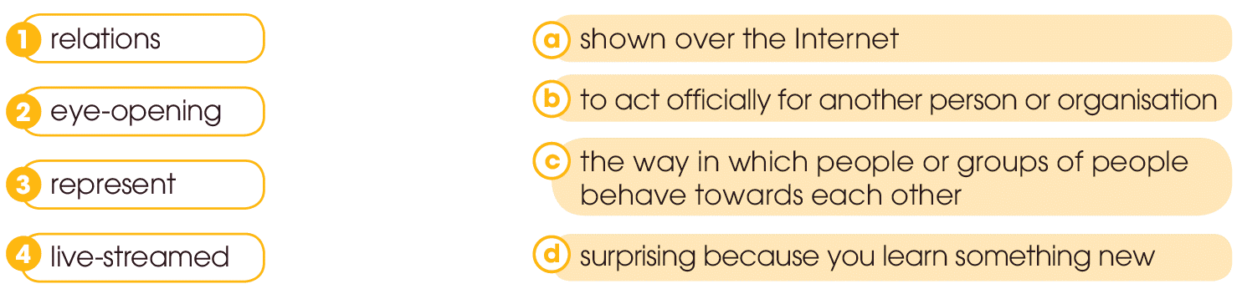
WHILE-READING
3
Read the news items again and match the highlighted words with their meanings.

Slide 21


WHILE-READING
4
Read the news items again and choose the best answer
1.How many students visited the AKC last week?
A.121 B. 212 C. 211
2.How long will SSEAYP participants stay together on board the ship?
A.15 days B. 50 days C. 50 day
3.What will participants in SSEAYP discuss besides youth issues?
A.current cultural issues B. current social issues C. cultural issues
4.When did the ASEAN talk show on women in sport happen?
A.(in) November B. (in) September C. (in) December
5.Where was the talk show shown live?
A.(on) ASEAN posters B. (on) the ASEAN webpage C. (on) news apps

Slide 22
POST-READING
5
Work in groups of five. Read the paragraph again decide the statement True or False
 | TRUE | FALSE
Last month, the AKC welcomed 121 Korean and Asian students from six schools. Students learnt about ASEAN members, and discussed why ASEAN was important to Korea, and how to strengthen ASEAN-Korea relations Young people on the SSEAYP will have the opportunity to take part in exciting discussions on current cultural and youth issues, and eye-opening cultural exchanges. An ASEAN talk show on women in sport’s goal was promoting gender equality in and through sport. Women and girls should be given more opportunities to play sports and represent their countries at international events .
✓
=> Last week
✓
✓
=> Current social
✓
✓

Slide 23
CONSOLIDATION
1
Wrap-up
What have you learnt today?
Read for main ideas and specific information in news items about ASEAN countries.
New vocabulary words

Slide 24

CONSOLIDATION
2
Homework
Do exercises in the workbook.
Prepare for Lesson 4 - Unit 4.

Slide 25




Thank you for
your cooperation

