Slide 2
Unit 1
Life stories we admire
LESSON 5
LISTENING
The father of Mickey Mouse

Slide 3

WARM-UP
Lucky song
1
2
3
4
5
6
7
8

Slide 4


WARM-UP
Question 1:
I see the light
Tangled OST

Slide 5

WARM-UP
Question 2:
Beauty and the beast
Beauty and the beast OST

Slide 6

WARM-UP
Question 3:
A whole new world
Aladdin OST

Slide 7

WARM-UP
Question 4:
Let it go
Frozen OST

Slide 8
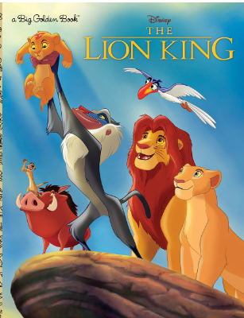
WARM-UP
Question 5:
Can you feel the love tonight?
Lion King OST

Slide 9

WARM-UP

Slide 10
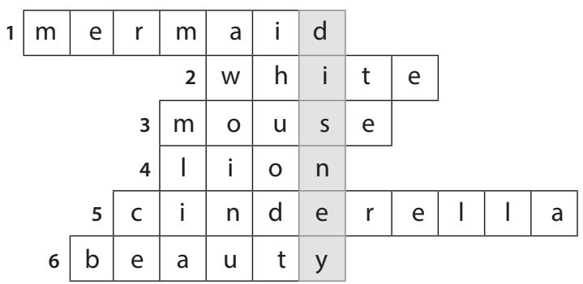
PRE-LISTENING
1
Solve the crossword to reveal the secret name.
NAME THE STORY CHARACTERS!

Slide 11
About Disney
Walter Elias Disney was an American animator, movie producer, and entrepreneur. A number of his films have been enshrined in the National Film Registry by the Library of Congress and several of them have been recognized as among the greatest films ever by the American Film Institute. Renowned for his remarkable cartoons like Snow White and the Seven Dwarfs, Cinderella, and The Lion King,... Walt Disney received multiple Academy Awards in recognition of his contributions to the film industry.

Slide 12
* Vocabulary:
1. animator /'ænimeitə[r]/ (n) nhà sản xuất phim hoạt hình; animated (adj) hoạt hình hóa
2. producer /prə'dju:sə[r]/ (n) người sản xuất; produce (v), product (n)
3. entrepreneur /,ɒntrəprə'nɜ:[r]/ (n) doanh nghiệp, doanh nhân
4. enshrine /in'∫rain/ (v) lưu giữ
5. profitable /prɒfitəbl/ (adj) có lời, có lãi
6. character /'kærəktə[r]/ (n) tính cách, tính nết, nhân vật
7. release /ri'li:s/ (v) phát hành (phim)
8. inspire /in'spaiə[r]/ (v) gây cảm hứng
9. magical /'mædʒikl/ (adj) ma thuật
10. success /sək'ses/ (n) thành công; successful (adj); succeed (v)

Slide 13
WHILE-LISTENING
Listen to a talk about Walt Disney’s life. Number the events in the order they are mentioned.
2
2
1
5
3
4
6
A. A difficult beginning
B. An introduction to Walt Disney
C. Creating the world’s most popular tourist attraction
D. The birth of Mickey Mouse
E. The success of Snow White and the Seven Dwarfs
F. The continued success of The Walt Disney Studios

Slide 14
WHILE-LISTENING
3
Listen to the talk again. Choose the correct answer A, B, or C
1. Walt Disney moved to Hollywood because _____.
A. his parents moved to work there
B. he wanted to start his career again
C. his company became very successful
2. Which is true about Mickey Mouse?
A. It was based on a real pet.
B. It was first voiced by a famous actor.
C. It was not very popular.

Slide 15
WHILE-LISTENING
3
Listen to the talk again. Choose the correct answer A, B, or C
3. What is NOT mentioned as an achievement of Snow White and the Seven Dwarfs?
A. It earned more than 400 million dollars.
B. It won several Oscars.
C. It was the best movie in the film industry.
4. What is true about Disney’s achievements?
A. He created the first animated cartoon.
B. He holds the record for the most Oscars in history.
C. He designed all the Disneyland theme parks.

Slide 16
WHILE-LISTENING
3
Listen to the talk again. Choose the correct answer A, B, or C
5. Why did he create Disneyland theme parks?
A. So that visitors can share their magical stories with Disney characters.
B. So that fans can see Disney characters live on stage and interact with them.
C. So that visitors can learn to make animated films.

Slide 17
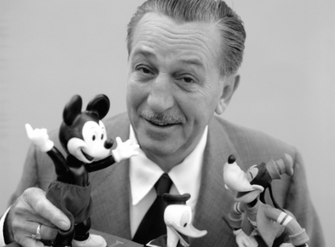
POST-LISTENING
3
Work in pairs. Discuss the question.
What do you think is most impressive about Walt Disney’s life and achievements?

Slide 18
CONSOLIDATION
1
Wrap-up
What have you learnt today?
An overview about Walt Disney’s life;
Listening skills for general ideas and for specific information

Slide 19
CONSOLIDATION
2
Homework
Do exercises in the workbook.
Prepare for Lesson 6 - Writing.

Slide 20
Website: hoclieu.vn
Fanpage: facebook.com/www.tienganhglobalsuccess.vn

