Slide 2
Unit 1
Life stories we admire
LESSON 7
COMMUNICATION & CULTURE / CLIL

Slide 3
WARM-UP
Game: Who says it?
- Work as two teams.
- There are 6 famous sayings by famous people on the slides.
- Say who said that.
- If the answer is correct ➔ one point for their team.
- If the answer is incorrect ➔ the chance is transferred to the other team.
- The team with higher score is the winner.

Slide 4
WARM-UP
WARM-UP
Answer the question in each puzzle.
1
2
3
4
5
6

Slide 5
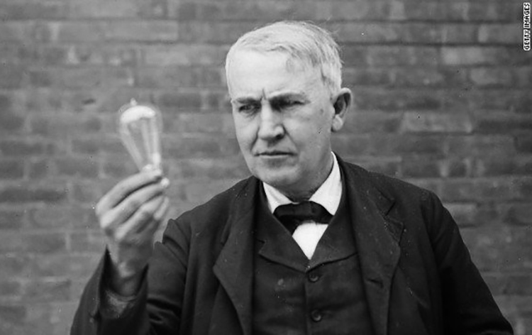
WARM-UP
WARM-UP
Question 1
“Genius is one percent inspiration, ninety-nine percent perspiration.”
➔ Thomas Edison
BACK

Slide 6
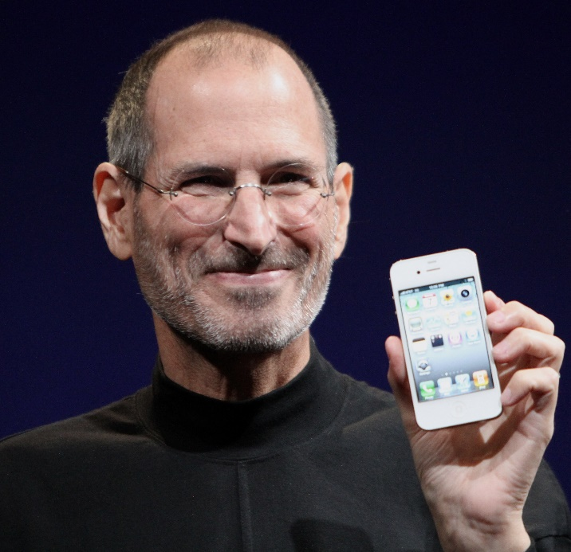
WARM-UP
WARM-UP
Question 2
“Stay hungry, stay foolish.”
➔ Steve Jobs
BACK

Slide 7
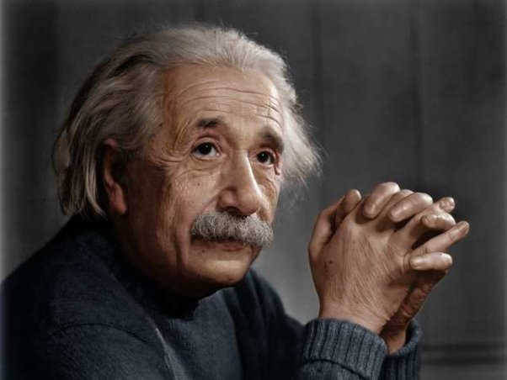
WARM-UP
WARM-UP
Question 3
“Life is like riding a bicycle. To keep your balance, you must keep moving.”
➔ Albert Einstein
BACK

Slide 8

WARM-UP
WARM-UP
Question 4
“If you want something said, ask a man; if you want something done, ask a woman.”
➔ Margaret Thatcher
BACK

Slide 9
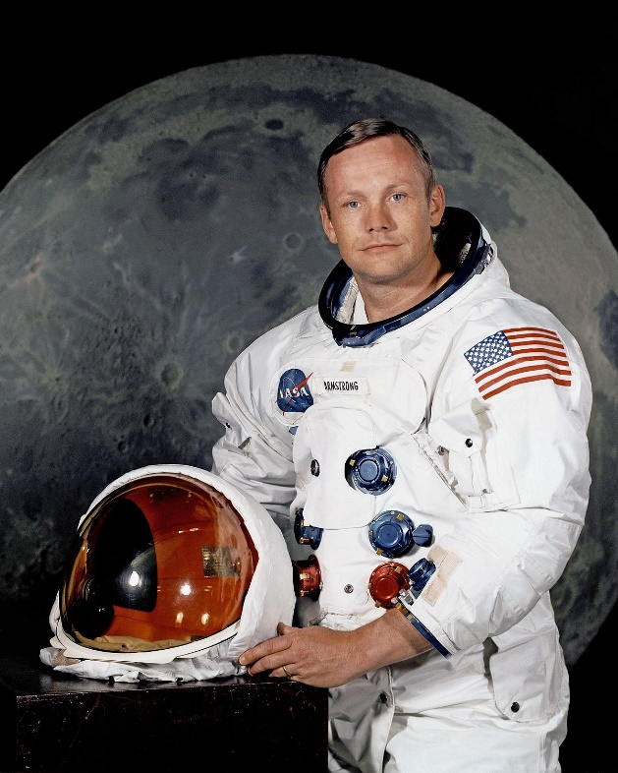
WARM-UP
WARM-UP
Question 5
“That’s one small step for a man, a giant leap for mankind.”
➔ Neil Armstrong
BACK

Slide 10
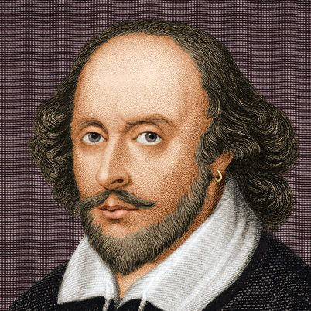
WARM-UP
WARM-UP
Question 6
“To be or not to be, that is the question.”
➔ William Shakespeare
BACK

Slide 11

EVERYDAY ENGLISH
1
Listen and complete the conversations.
1
Mark: (1) ____________________ ! I’ve just learnt that my poem about Viet Nam’s national heroes has won the first prize in the poetry competition for teenagers.
Nam: (2) _________________! It’s a very inspiring poem.
I’m on top of the world
I’m so happy for you

Slide 12
EVERYDAY ENGLISH
1
Listen and complete the conversations.
2
Phong: I took part in a public-speaking event and gave a talk about Steve Jobs’ innovations in technology. (3) __________________ to be among so many talented speakers. They invited me to give another presentation.
Mai: (4) ______________! I’ve always thought you’re a great speaker.
It was such a pleasure
That’s fantastic

Slide 13
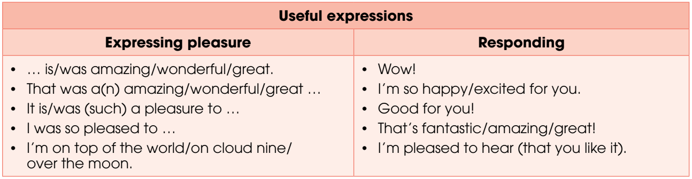
EVERYDAY ENGLISH

Slide 14

EVERYDAY ENGLISH
2
Make similar conversations.
Sample conversations:
1. A: Yesterday, I saw the new Disney movie, The Lion King. I enjoyed it so much. It’s such a wonderful
animated movie.
B: That’s great. I’m pleased to hear you like it.
2. B: I’m on cloud nine! My article about Steve Job’s life and achievements has just been published in the local newspaper!
A: Wow! I’m so happy for you! You’ve worked so hard on it!

Slide 15
* Vocabulary:
1. poetry /ˈpəʊətri/ (n) thơ, ca; poem(n) bài thơ
2. defeat /dɪˈfiːt/ (v) đánh bại
3. ambitious /æmˈbɪʃəs/ (adj) có tham vọng
4. dedicated /ˈdedɪkeɪtɪd/ (adj) tận tụy
5. determination /dɪˌtɜː.mɪˈneɪ.ʃən/ (n) sự quyết tâm
6. innovation /ˌɪnəˈveɪʃn/ (n) sự cải tiến
7. independent /ˌɪndɪˈpendənt/ (adj) độc lập
8. over the moon /ˈəʊ.vər ðiː muːn/ (idiom) sung sướng
9. on top of the world /ɒn tɒp əv ðiː wɜːld/ (idiom) cực hạnh phúc
10. expand /ɪkˈspænd/ (v) mở rộng

Slide 16
CULTURE
1
Read the following text and complete the comparison table on page 18.
 | Cleopatra VII | Elizabeth I | Catherine II
Country | Egypt | (1) _________ | (2) _________
Years of being queen | (3) _________ | 45 | (4) _________
Characteristics | determined, intelligent | determined, intelligent | intelligent, ambitious
Achievements | (5) _________ | (6) _________ | expanded the Russian Empire; improved education for children and women; encouraged great developments in architecture, trade, and culture
England
Russia
21
34
saved her country from becoming part of the expanding Roman Empire
defeated the powerful Spanish Navy; encouraged the development of arts

Slide 17
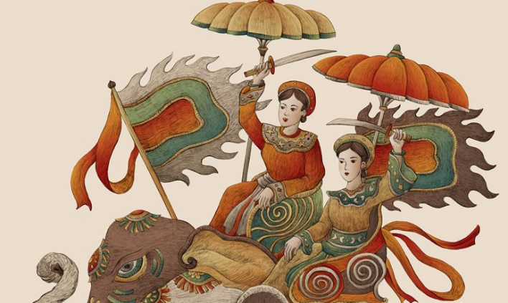
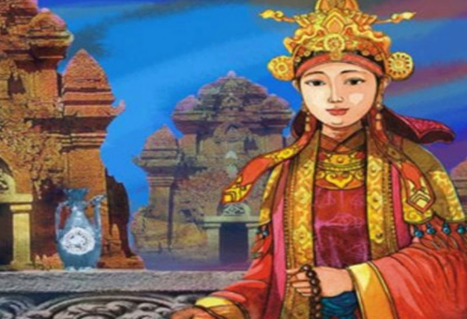
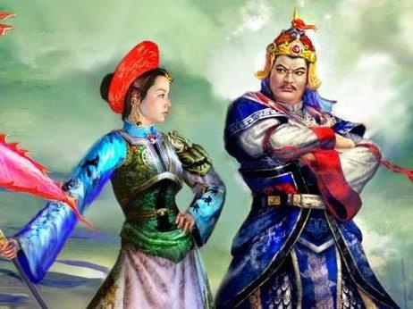
CULTURE
2
Work in groups. Discuss the questions.
Do you know any female rulers or famous women in Vietnamese history? Share what you know about them.
Hai Ba Trung
Queen Mother Y Lan
Queen Le Ngoc Han

Slide 18
CONSOLIDATION
1
Wrap-up
What have you learnt today?
Gain knowledge about some famous queens of the world;
Review expressions for expressing pleasure and happiness and responding;
Talk about some famous queens in Viet Nam.

Slide 19
CONSOLIDATION
2
Homework
- Do exercises in the workbook.
- Prepare for the next lesson – Looking back and Project.

Slide 20
Website: hoclieu.vn
Fanpage: https://www.facebook.com/tienganhglobalsuccess.vn/

