Slide 2
Unit 1
Life stories we admire
LESSON 4
SPEAKING
National heroes of Viet Nam

Slide 3
WARM-UP
Guessing game
- Work as 2 groups.
- There are 4 questions, the answers of which provide four clues for the key word.
- Choose and answer the question.
- If you have a correct answer ➔ one point.
- If you can guess the key word ➔ 5 points.
- The team with more points is the winner.

Slide 4
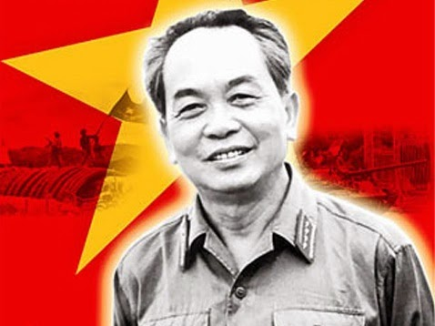
WARM-UP
WARM-UP
Answer the question in each puzzle.
1
2
3
4

Slide 5
WARM-UP
WARM-UP
Question 1
Which was a decisive Vietnamese military victory that
brought an end to French colonial rule in Vietnam?
➔ Dien Bien Phu
BACK

Slide 6
WARM-UP
WARM-UP
Question 2
Which province is home to the World Heritage Phong Nha - Ke Bang National Park?
➔ Quang Binh
BACK

Slide 7
WARM-UP
WARM-UP
Question 3
Fill in the blank:
They’re calling on all men and boys over the age of 18 to join the ______.
➔ army
BACK

Slide 8
WARM-UP
WARM-UP
Question 4
When did Nguyen Tat Thanh start his journey abroad from Nha Rong Wharf?
➔ 1911
BACK

Slide 9
WARM-UP
WARM-UP
KEY WORD: GENERAL VO NGUYEN GIAP

Slide 10
Presentation: Vocabulary
1. military /ˈmɪlətri/ (adj) quân sự
2. Communist Party of VietNam /ˈkɒm.jə.nɪst ˈpɑː.ti əv Viet Nam/ (n.phr) Đảng Cộng sản Việt Nam
3. battle /ˈbætl/ (n) chiến trường
4. attack /əˈtæk/ (v/n) tấn công, cuộc tấn công
5. pass away /pɑːs /əˈweɪ/ (phr.v) mất/ qua đời = die
6. prison /ˈprɪz.ən/ (n) nhà tù
7. campaign /kæm'pein/ (n) chiến dịch
8. commitment /kə'mitəmənt/ (n) sự tận tụy
9. remarkable /ri'mɑ:kəbl/ (adj) đáng chú ý, đặc biệt
10. strategist /strə'ti:dʒist/ (n) nhà chiến lược

Slide 11
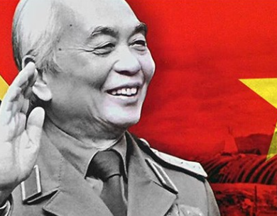
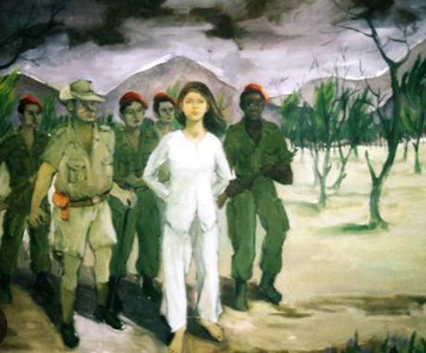
CONTROLLED PRACTICE
Work in pairs. One of you is A, the other is B. A reads the information card about General Vo Nguyen Giap. B reads the information card about Vo Thi Sau below.
1
Student A’s card
Student B’s card

Slide 12


CONTROLLED PRACTICE
Work in pairs. A should ask B questions to complete his/her card about Vo Thi Sau. Then B should do the same to complete his/her card about General Vo Nguyen Giap. Then compare your notes.
2
Example questions
Who is/was …?
When did he/she …?
How old was he/she when …?
What happened in …?

Slide 13
Ask about General Vo Nguyen Giap
1. Who was General Vo Nguyen Giap?
2. Where was he born?
3. When did he join the Communist Party of Viet Nam?
4. When did he lead the army and win many important battles?
5. When did he lead the army and win the final Ho Chi Minh campaign?
6. What happened in 2013 in his life?

Slide 14
LESS-CONTROLLED PRACTICE
3
Use your notes to tell the life story of General Vo Nguyen Giap.
Suggested answer:
General Vo Nguyen Giap was a military genius and was born in Quang Binh Province in 1911. In 1927, at the age of 16, he joined the Communist Party of Viet Nam, setting the stage for a lifelong commitment to the revolutionary cause. The years 1946-1975 were regarded as a remarkable period of his military leadership. During this time, he led the Vietnamese army in a series of crucial battles, earning a reputation as a brilliant strategist. Notably, in 1954, he achieved a historic victory at the Battle of Dien Bien Phu and continued to showcase his military prowess in the final Ho Chi Minh campaign in 1975. In 2013, General Vo Nguyen Giap passed away in Ha Noi but his contributions remain deeply embedded in the nation's history.

Slide 15
Ask about Vo Thi Sau
1. Who was Vo Thi Sau?
2. Where was she born?
3. When did she carry out attacks against French soldiers?
4. When was she caught and held in prison?
5. What transpired in 1952 in Vo Thi Sau's life?

Slide 16
LESS-CONTROLLED PRACTICE
3
Use your notes to tell the life story of General Vo Nguyen Giap or Vo Thi Sau to the class. Vote for the best-told story.
Suggested answer:
We’d like to talk about the life of Vo Thi Sau, a national heroine of our country. She was born in 1933 in Ba Ria Province. At the age of 15, she joined the Viet Minh, the league for the independence of Viet Nam from French rule. In 1947, she was brave enough to carry out attacks against French soldiers. She managed to kill some of them by throwing grenades at them. Unfortunately, in another unsuccessful attempt in 1949, she was caught and put in prison. She was sentenced to death at Con Son Prison, Con Dao Island at the age of 19. Although she died nearly 80 years ago, many generations in Viet Nam still admire Vo Thi Sau for her great bravery and sacrifice for the independence of our country.

Slide 17
CONSOLIDATION
1
Wrap-up
What have you learnt today?
An overview about the lives of a famous hero and heroine in Viet Nam;
Vocabulary to talk about the lives of a famous hero and heroine in Viet Nam.

Slide 18
CONSOLIDATION
2
Homework
- Write a paragraph about the life of a national hero that you admire.
- Do exercises in the workbook.
- Prepare for the next lesson – Listening.

Slide 19
Website: hoclieu.vn
Fanpage: facebook.com/www.tienganhglobalsuccess.vn

