Slide 1

Warmly welcome
all the teachers
attending our class !

Slide 2

Watch the video carefully and answer a question:
What do American volunteers do for their community?

Slide 3
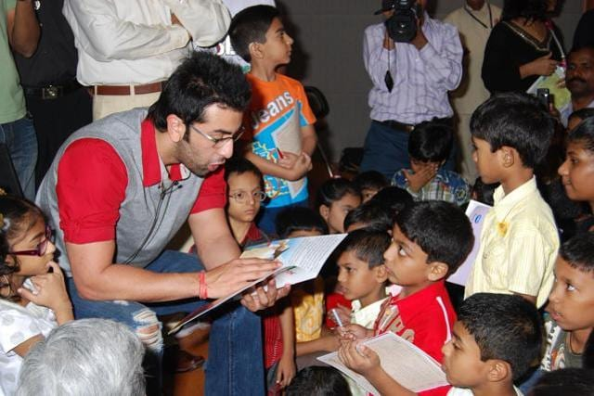
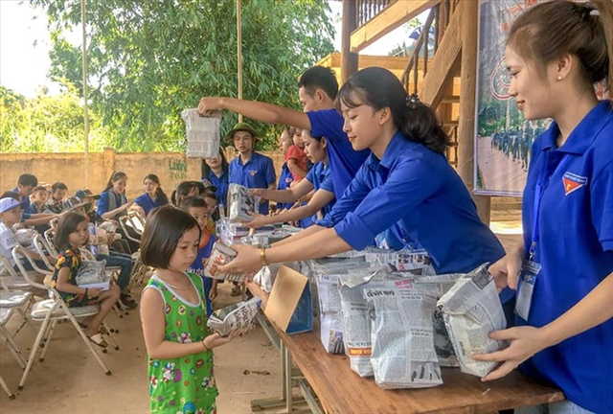
Clip watching
What do American volunteers do for their community?
+ Read books for children in orphanages
+ Visit and play games with them or listen to their problems
+ Work in home of sick and old people
+ Volunteer to work in remote or mountainous areas

Slide 4

Unit
4
1
Unit
FAMILY LIFE
FOR A BETTER COMMUNITY
LESSON 1
GETTING STARTED
Volunteering in the community

Slide 5


I/ VOCABULARY:
volunteer (n)
/ˌvɒlənˈtɪə(r)/
a person who does a job without being paid for it

Slide 6

I/ VOCABULARY:
advertisement (n)
/ədˈvɜːtɪsmənt/
a notice, picture or film telling people about a product, job or service

Slide 7

I/ VOCABULARY:
community (n)
/kəˈmjuːnəti/
all the people who live in a particular area, country, etc. when talked about as a group

Slide 8

I/ VOCABULARY:
boost (v)
/buːst/
to make something increase, or become better or more successful

Slide 9
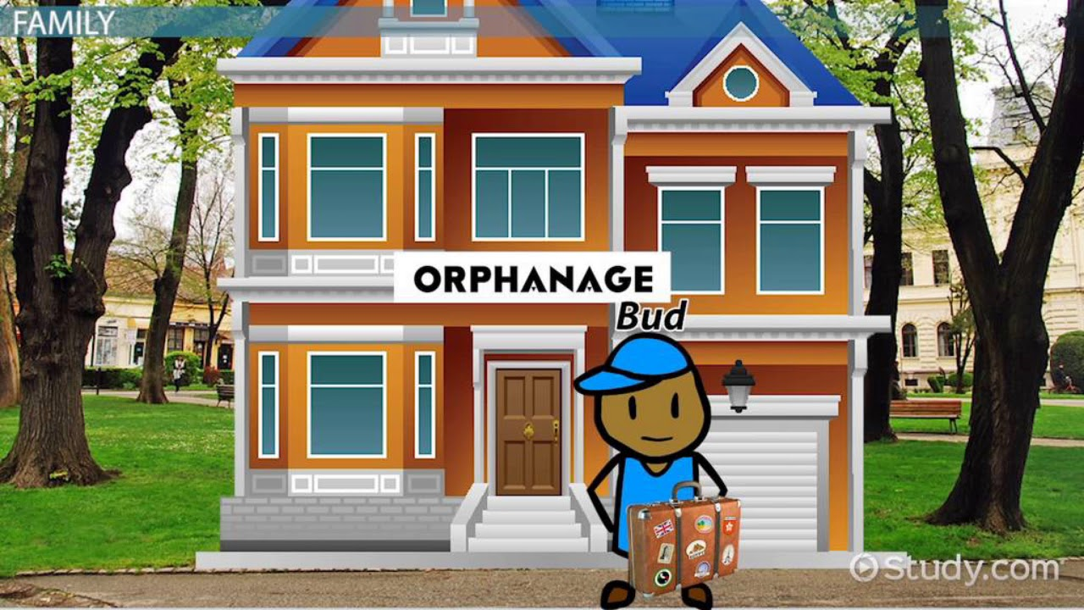
I/ VOCABULARY:
orphanage (n)
/ˈɔːfənɪdʒ/
a home for children whose parents are dead

Slide 10
* Use the correct form of words:
volunteer
1/ You are working as a (voluntary) ……………........... at our local centre for community development.
2/ You can join a local environmental group to clean up the park once a week or volunteer at an (orphan)…………………….
3/ (Communicate)……………………. service not only benefits the local area, but can also boost our confidence and help you learn many useful skills.
Community
orphanage

Slide 11
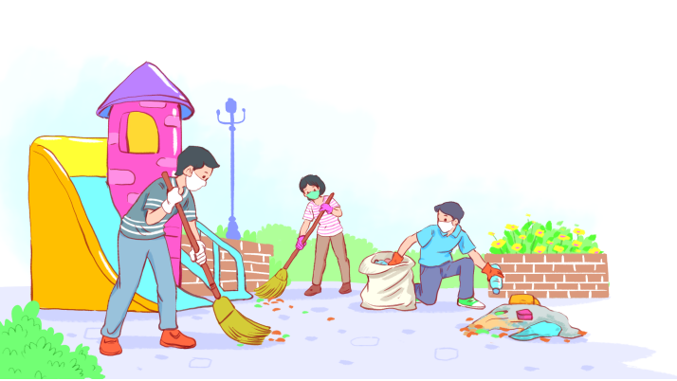
II/ PRACTICE
1
Listen and read.
Volunteering in the community

Slide 12

1/ Listen and read.
Kim: Hi, Tam. I went to your house at 9 a.m., but you weren’t there.
Tam: Oh, when you came, I was working as a volunteer at our local centre for community development.
Kim: Ah, I see. How did you become a volunteer there?
Tam: Just by chance. Last summer, while I was visiting the centre, I saw an advertisement for volunteers. I applied and my application was successful.
Kim: I also want to be a volunteer. I find community work very interesting.
Tam: I agree. Community service not only benefits the local area, but can also boost our confidence and help us learn many useful skills.
Kim: What are the regular activities organised by the centre?
Tam: Oh, there are endless opportunities for getting involved. For example, you can join a local environmental group to clean up the park once a week or volunteer at an orphanage.
Kim: Sounds good. How can I apply?
Tam: I’ll email you the form. You just fill it in and send it in.
Kim: Thanks so much. I’m so excited about volunteering at the centre.
Tam: No problem. Good luck. Hope your application is successful and you enjoy the work.

Slide 13
II/ PRACTICE
PRACTICE
2
Read the conversation again and answer the questions.
1. What was Tam doing when Kim went to her house?
She was working as a volunteer at the local centre for community development.
2. What are some regular activities at the centre for community development?
=> Cleaning up the park or volunteering at the orphanage.
3. How can Kim apply for volunteer work at the centre?
She needs to fill in the form, then send it in.

Slide 14
II/ PRACTICE
3
Find a verb or verb phrase in the conversation to complete each sentence.
1. Oh, when you came, I____________ as a volunteer at our local centre for community development.
2. Last summer, while I was visiting the centre, I_____ an advertisement for volunteers.
was working
saw

Slide 15
II/ PRACTICE
4
Find the adjectives with the following suffixes in the conversation and write them below.
suffixes | adjectives
-ed
-ing
-ful
-less
excited
interesting
useful, successful
endless

Slide 16
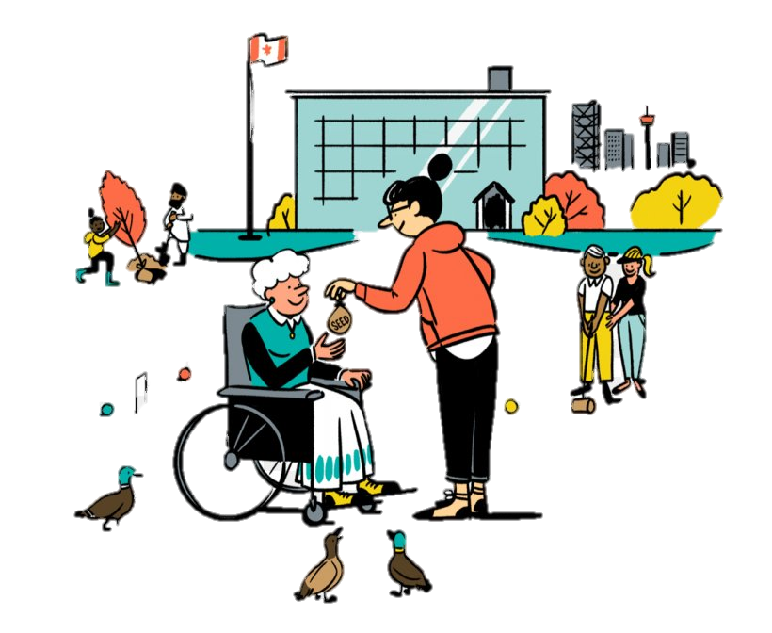
III/ PRODUCTION
SELF-REFLECTION
- Talk about activities you have done to make your community a better one for a minute
- Your talk should include:
1. How many activities did you want to talk about?
2. Where did you do those activities?
3. Who did you do with?
4. How often do you do those activities?

Slide 17

Presentation about the benefits of volunteering activities
1/Coming into contact with other teenagers with similar interests
2/Improving essential life skills, such as skills that will get you a job, or time management skills
3/Gaining life experiences

Slide 18





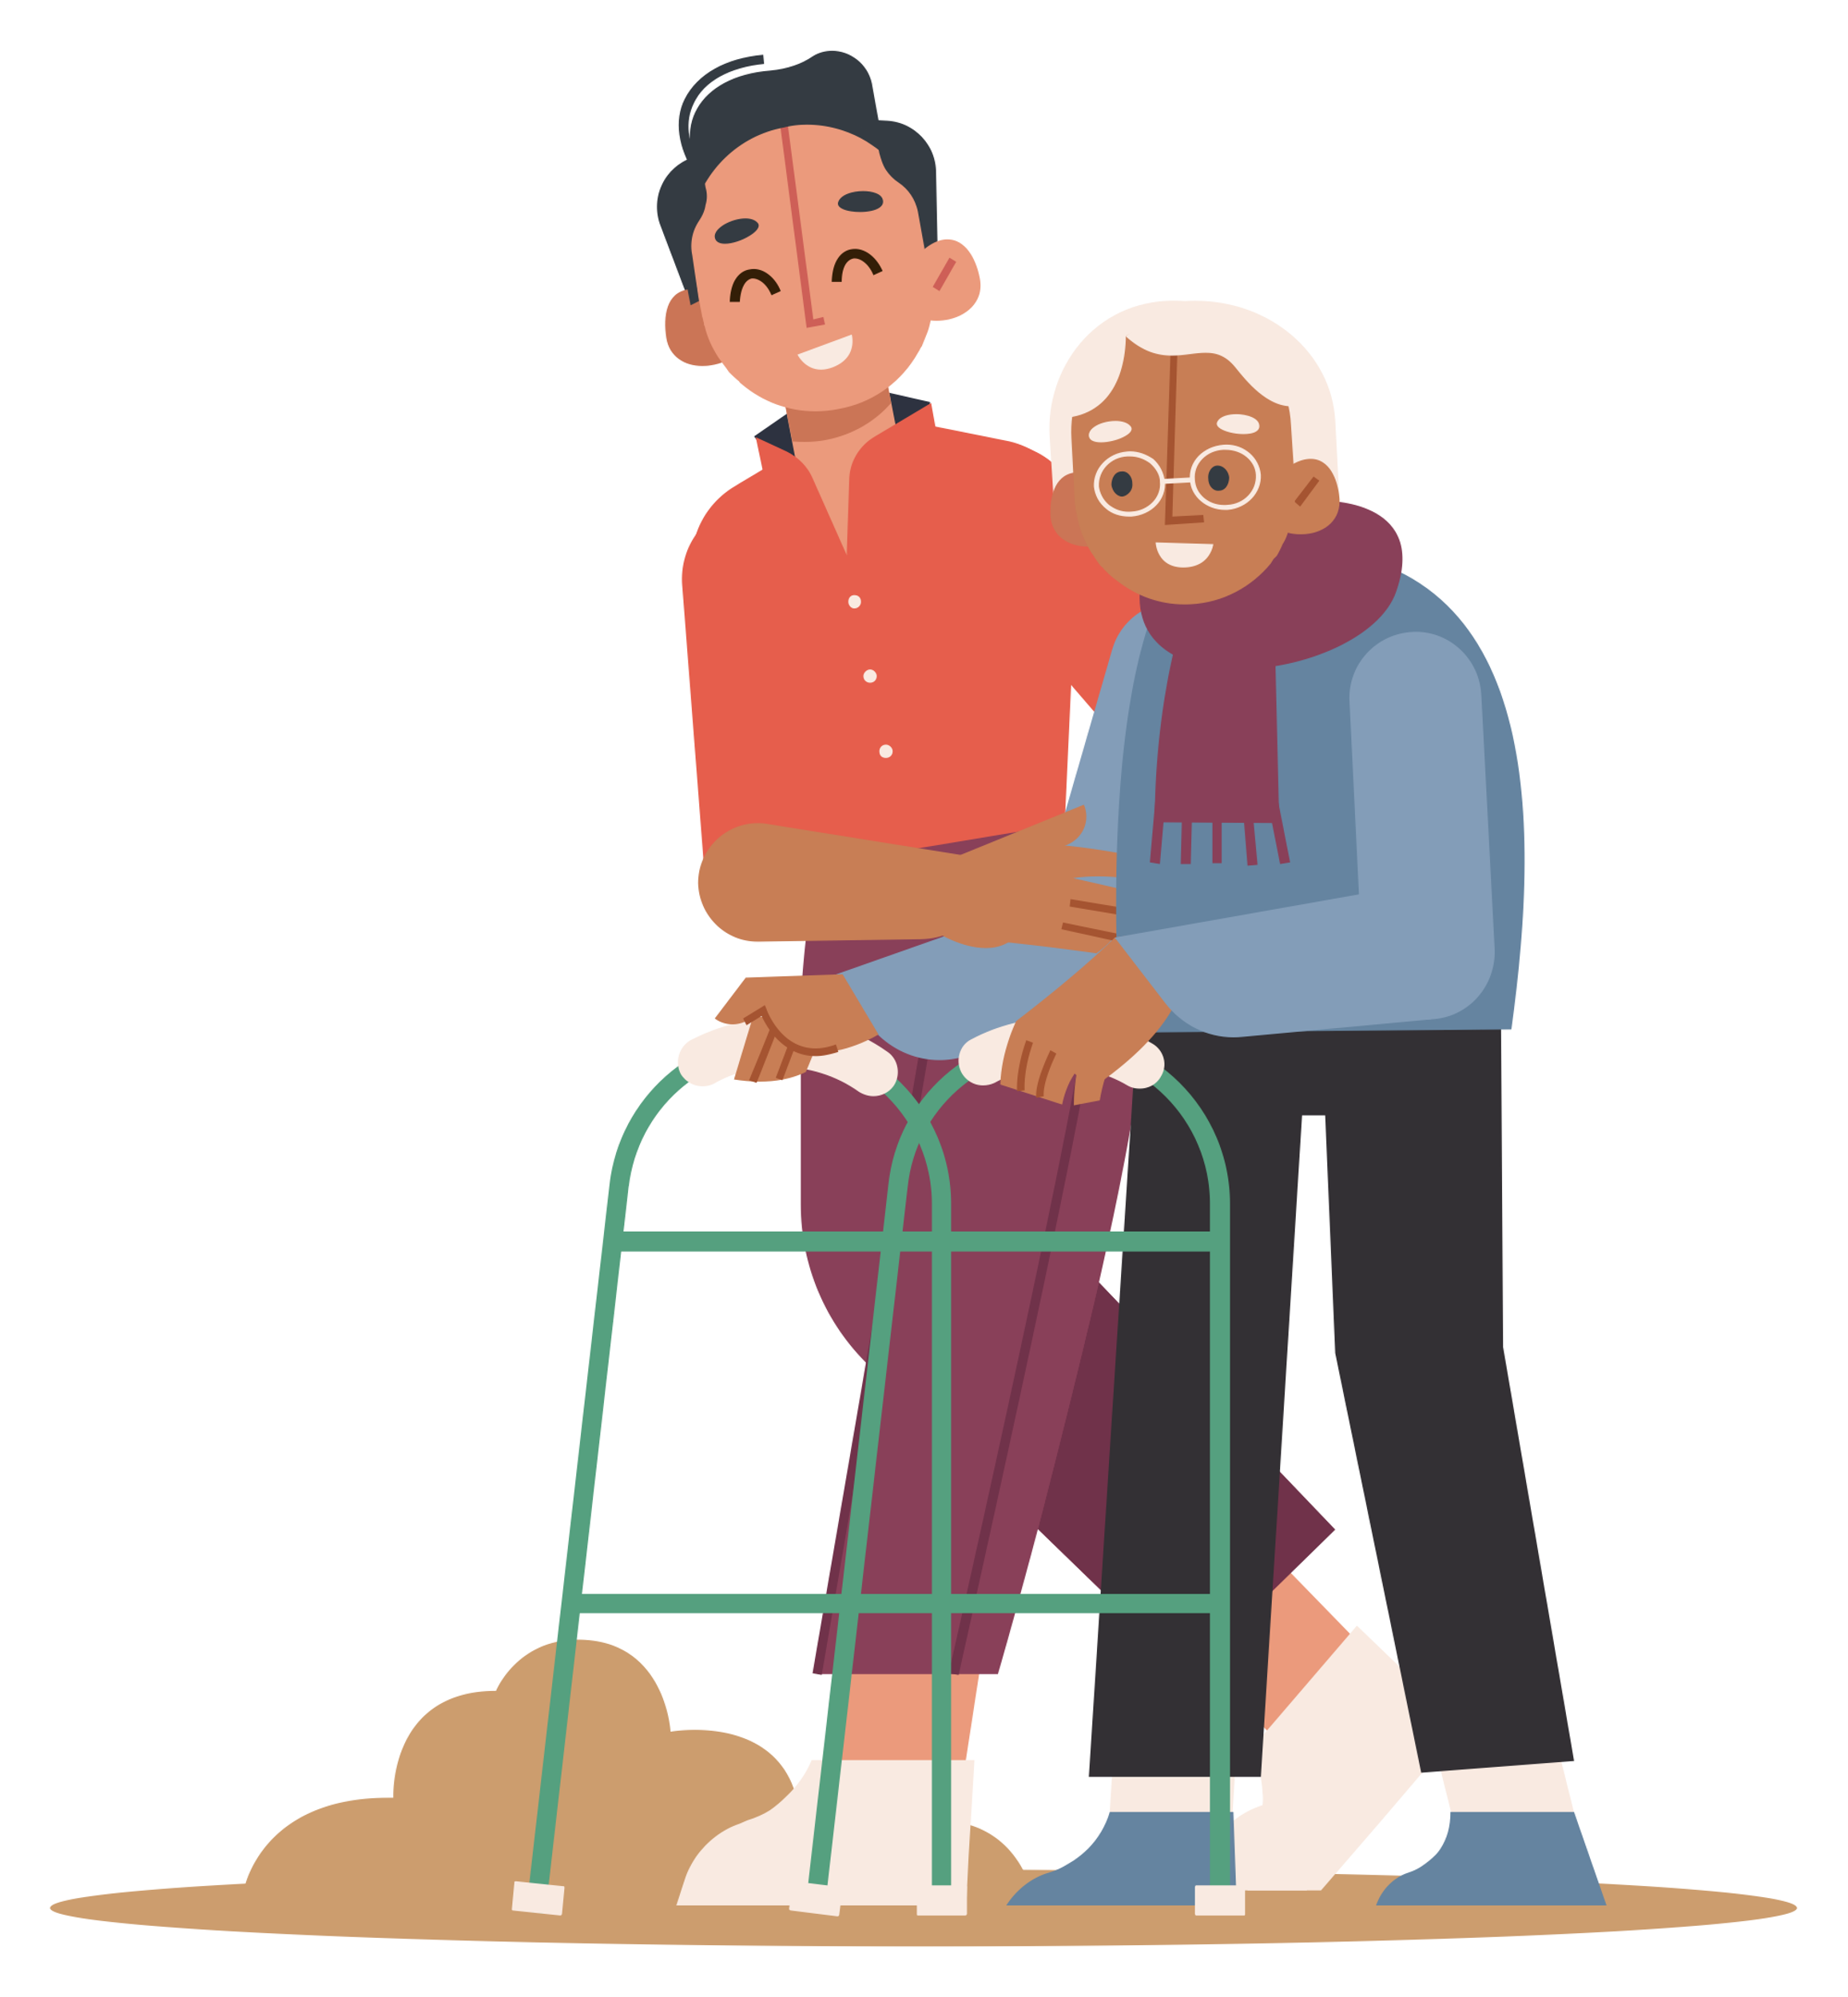

Volunteer work
Time to test your knowledge

Slide 19




Look at the video and
answer a question

Slide 20


What can you see in the video?
Solution A
Solution B
Visit and give gifts
to veterans
Create a mural to
promote tourism
Solution C
Solution D
Clean up the beach to make it green, clean, and beautiful.
A,B and C

Slide 21

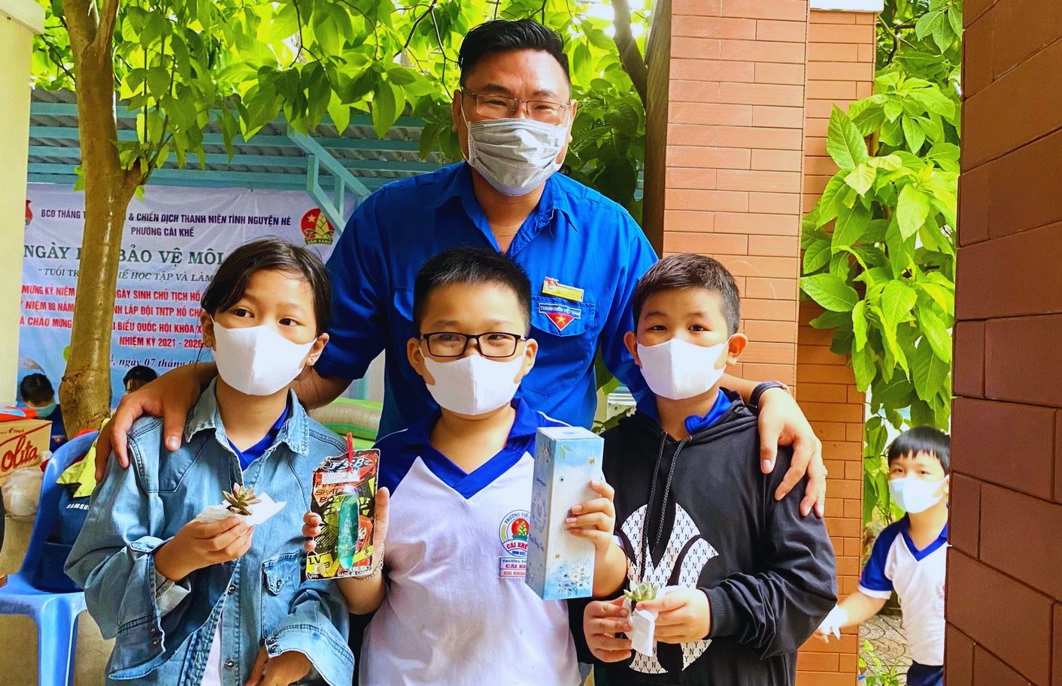

Volunteer Activities
Volunteering can include a variety of activities, such as protecting the environment, helping the poor, caring for children, and participating in health awareness campaigns

Slide 22


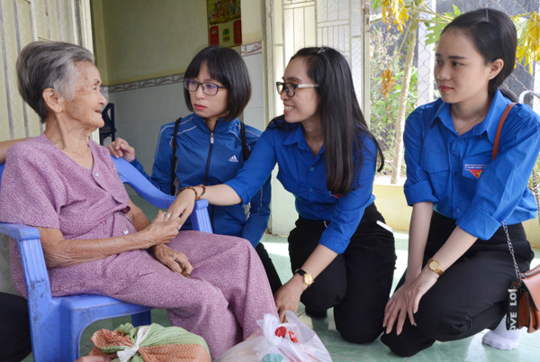
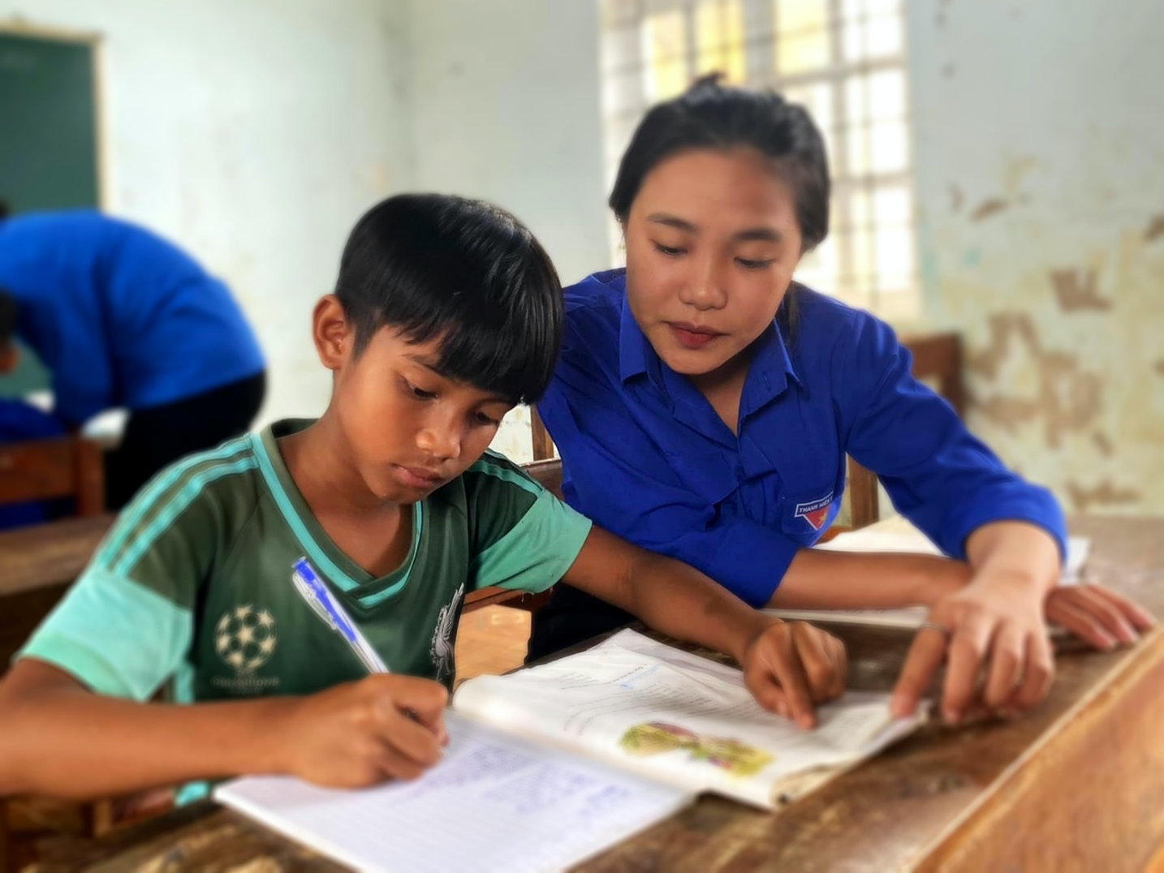

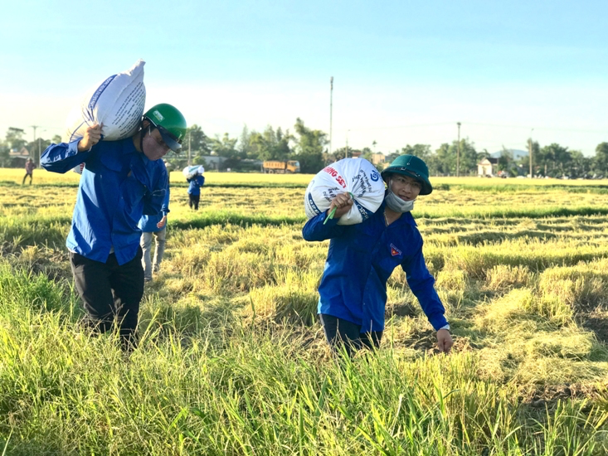
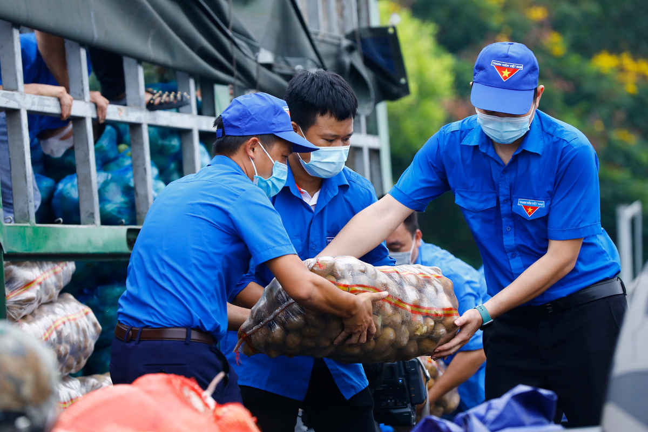


Slide 23
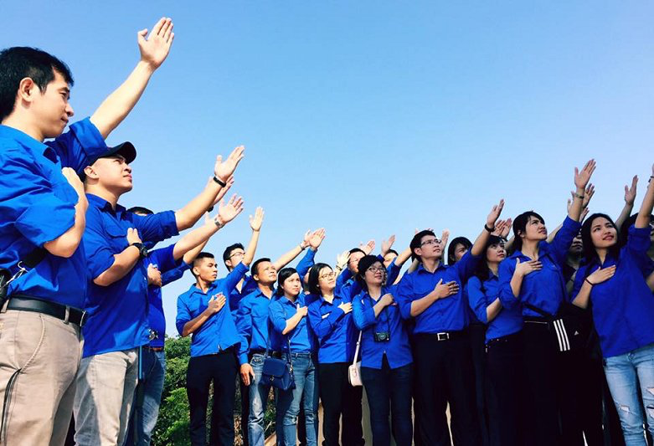




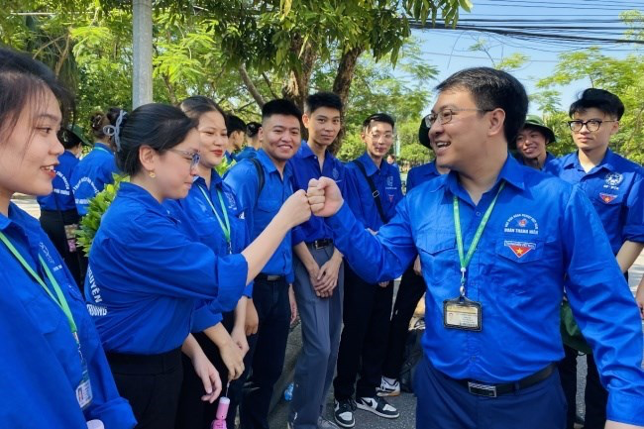

You can participate in initiatives organized by our school or company
You can join volunteer clubs with our friends
If you want to become a volunteer...

Slide 24


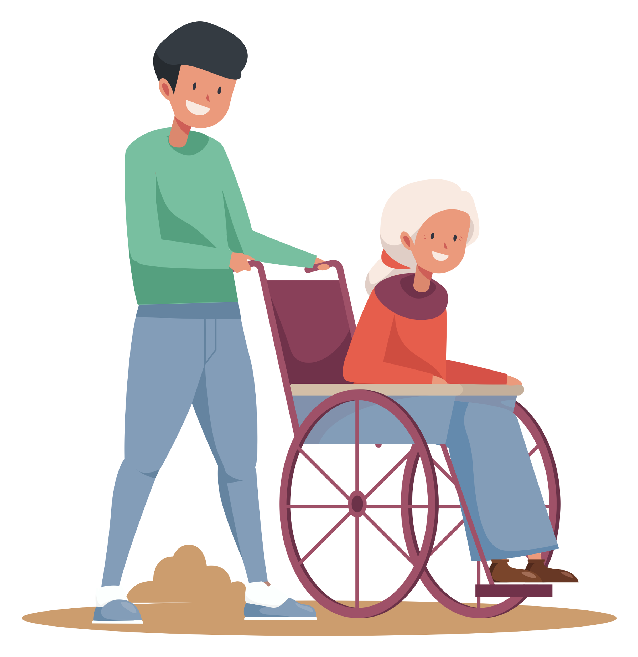

when becoming a volunteer
  You can come into contact with other teenagers with similar interests
  You can improve essential life skills, such as skills that will get you a job, or time management skills
  You can gain life experiences

Slide 25
Presentation about the benefits of volunteering activities
1/ coming into contact with other teenagers with similar interests
sharing common interests and values
helping you become more confident
…
learning good things from each other

Slide 26
Presentation about the benefits of volunteering activities
2/improving essential life skills
time management skills
communication skills
…
group working skills

Slide 27
Presentation about the benefits of volunteering activities
…
…
…
…
helping different people
3/ gaining life experiences
going to different places
dealing with different situations

Slide 28
                Volunteers believe that some of the happiest people in the world are those who help to bring happiness to others

Slide 29
IV/ CONSOLIDATION
CONSOLIDATION
Wrap-up
1.Gain an overview about the topic For a better community
2. Gain vocabulary to talk about voluntary work
Homework
1. Do exercises in the workbook
2. Prepare for the next lesson
3. Prepare for the Project

