Slide 1




Notes:
Ask sts to close their book

Slide 2


Slide 3
Table of contents
02
01
Warm-up
03
Look, listen and repeat.
Listen, point and say.
04
Let’s talk.
05

Slide 4
01
Warm-up

Slide 5





Let’s review!
Look and read.
Choose Yes or No.

Slide 6

At the shopping centre
Lesson 2 (1 2 3)

Slide 7
New words

Slide 8

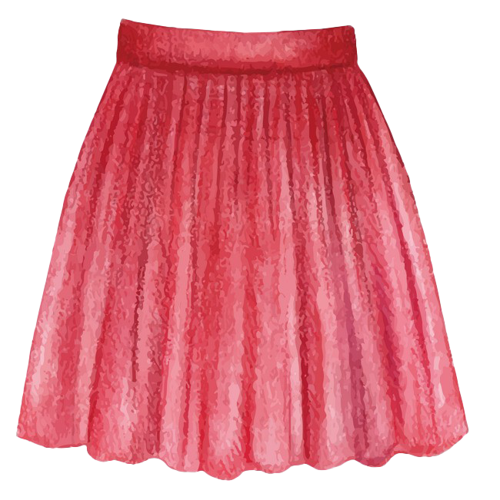

New words:
skirt
T-shirt

Slide 9
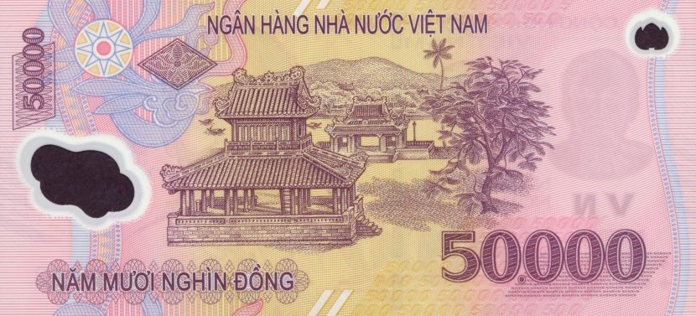
New words:
dong
thousand

Slide 10
Unit 18. At the shopping centre
Lesson 1 (1 2 3)
New words:
skirt
dong
thousand
T-shirt
Notes:
Cho 2 hs đọc lại
Yêu cần hs viết bài, 2 phút

Slide 11


Checking your memory
The flash
Notes:
Look at the screen
There is 1 picture. It will go way.
Let’s guess.
Are u ready? Let’s go

Slide 12
Checking your memory
dong

Slide 13
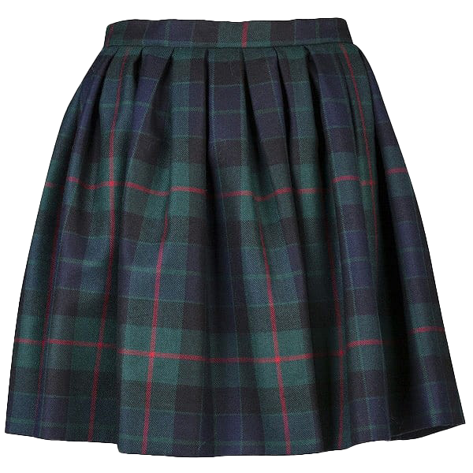
Checking your memory
skirt

Slide 14
Checking your memory
thousand

Slide 15
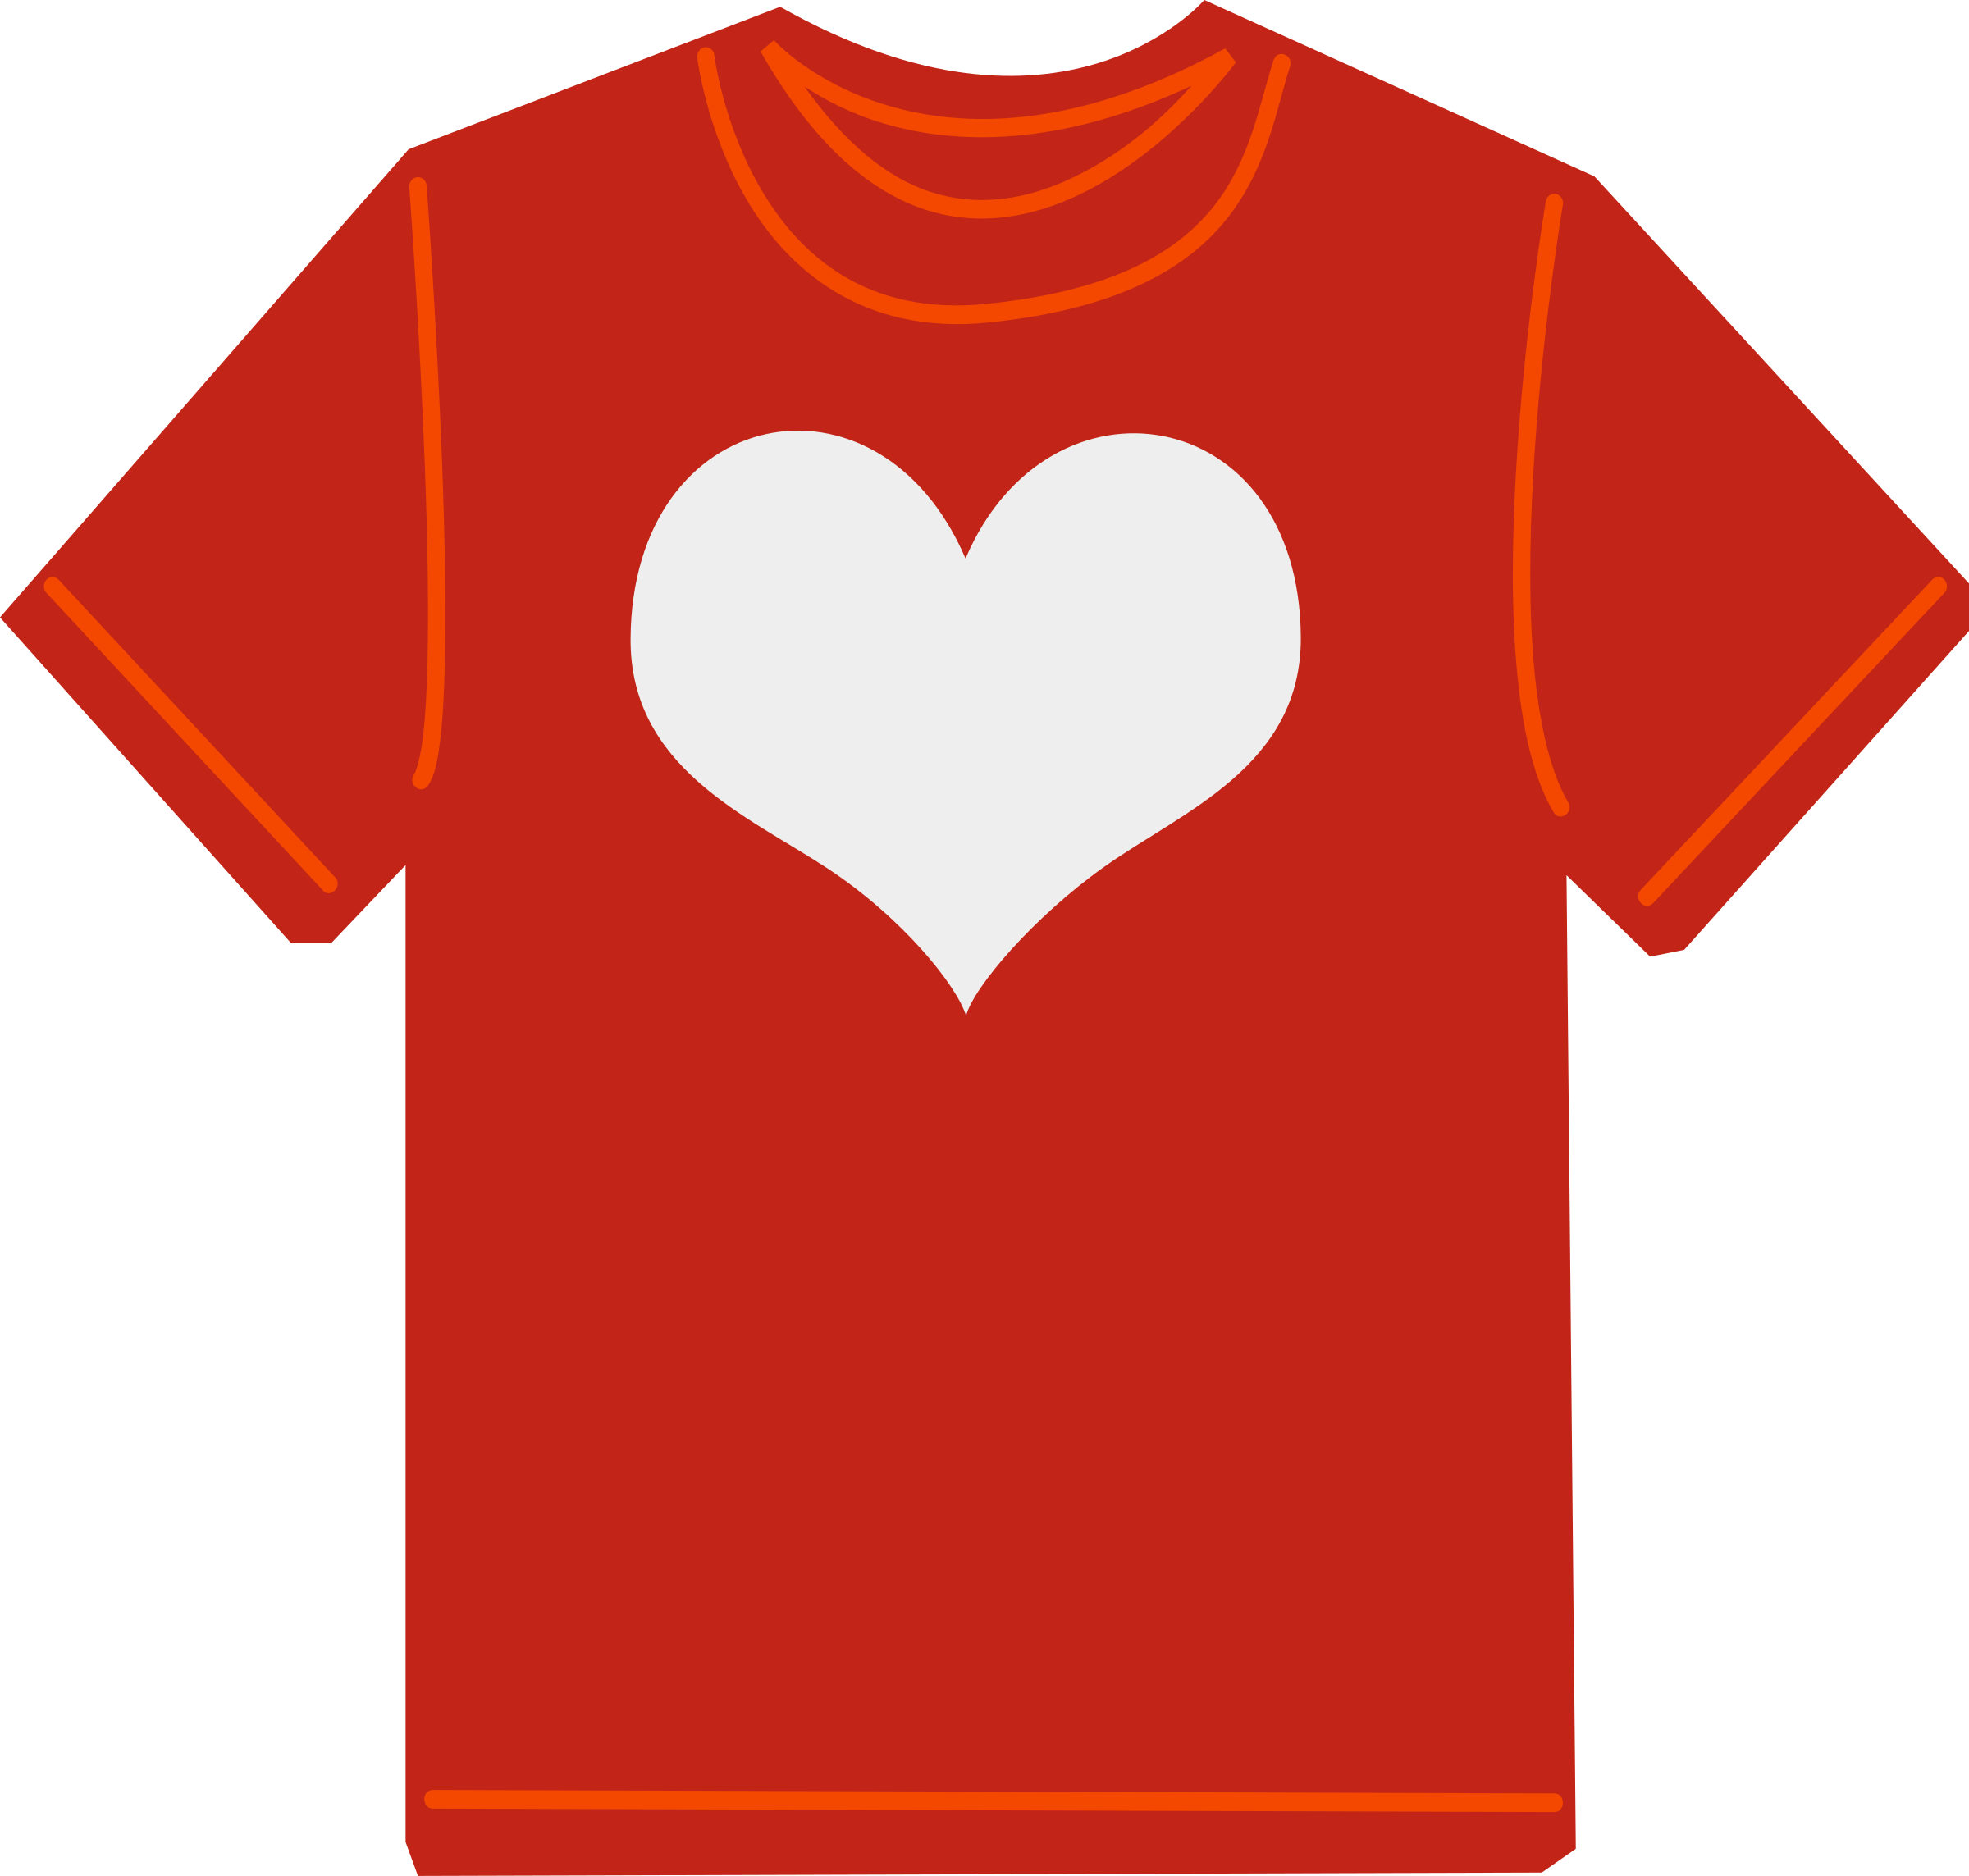
Checking your memory
T-shirt

Slide 16

Notes:
Good memory class.
Clap your hands please.
Now, move on the next part, 2

Slide 17
02
Look, listen and repeat.
Notes:
Open your book page 54

Slide 18

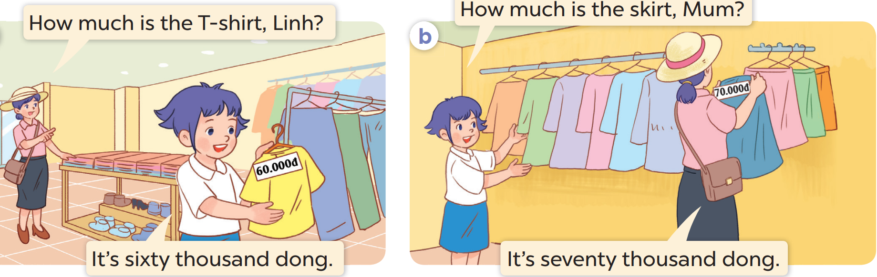
Who are they?
Where are they?
What do they buy?
Notes:
Cho nghe 1 lần
Nghe và lặp lại từng câu.
Thực hành nhóm

Slide 19


Look and think.
Notes:
Giáo dục

Slide 20
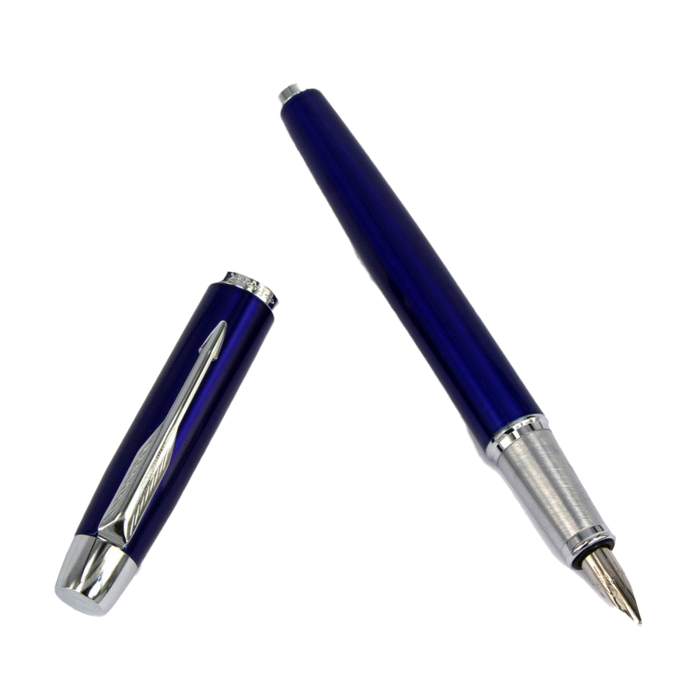
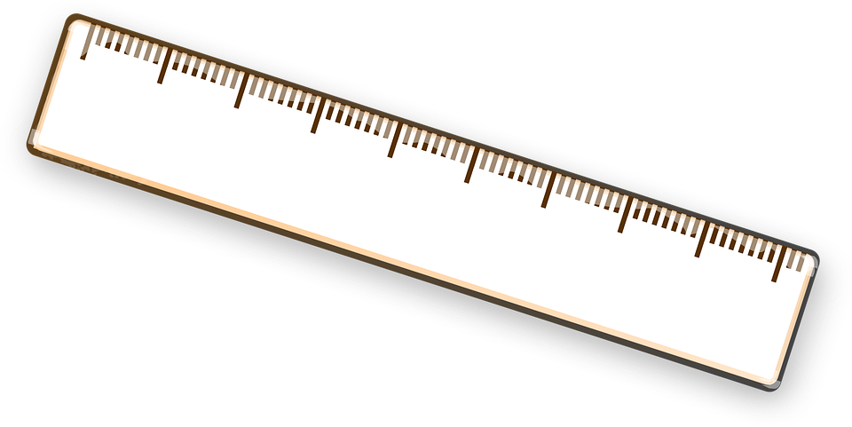
Tuesday, April 16th, 2024
Unit 18. At the shopping centre
Lesson 1 (1 2 3)
Structure:
Hỏi-trả lời về giá của 1 vật.
pen
ruler
How much is the ______?
pen/
20,000 dong
ten
ruler/
10,000 dong
twenty
→ It’s ______ thousand dong.
Notes:
Move on part 2 to practice more

Slide 21
03
Listen, point and say.

Slide 22
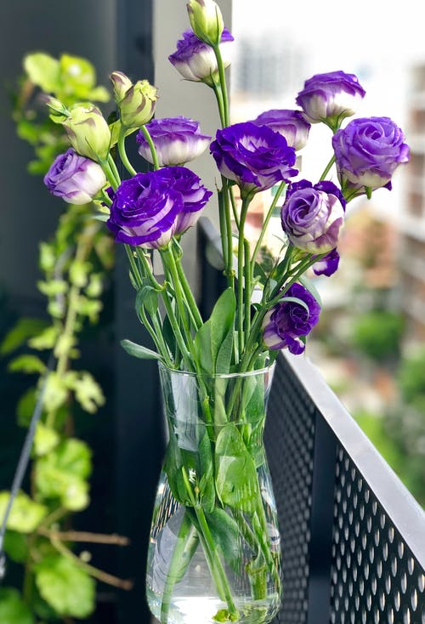
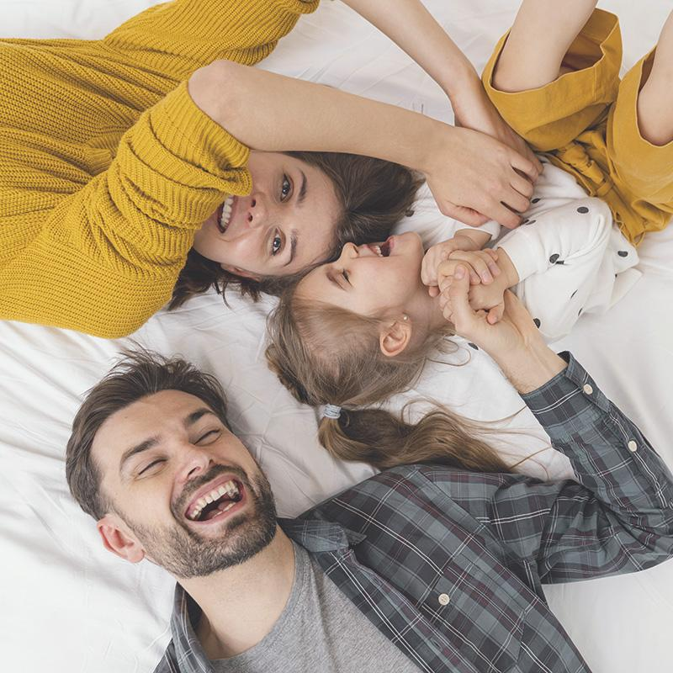
04
Let's talk!

Slide 23
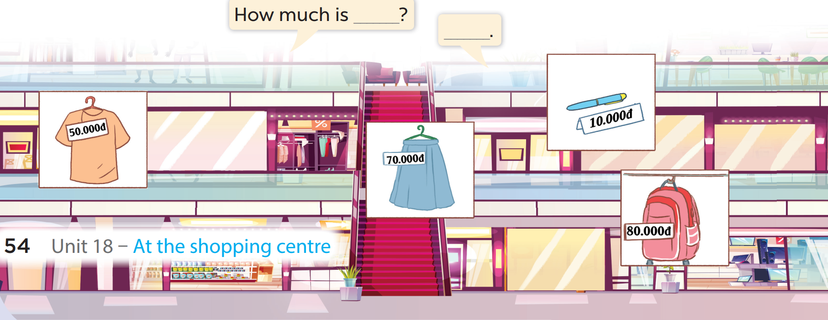

Slide 24
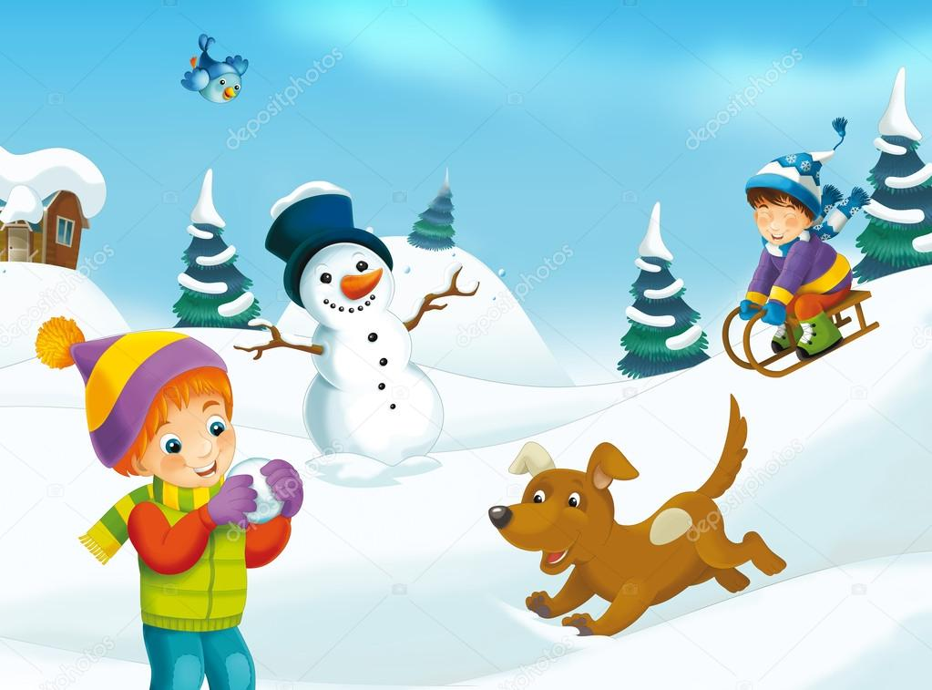

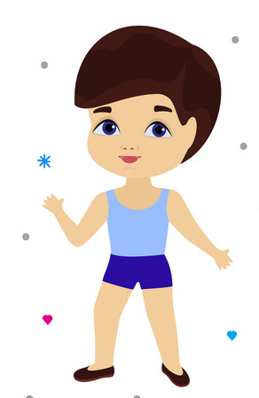
Let’s go shopping!

Slide 25

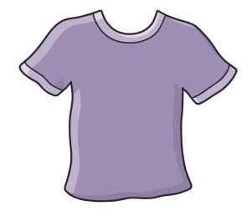



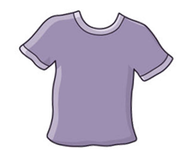







A
B

Slide 26


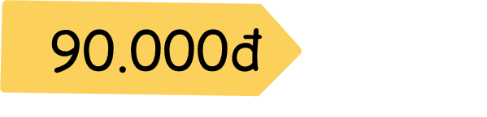
T-shirt
How much is the_______?
It's ninety thousand dong.

Slide 27


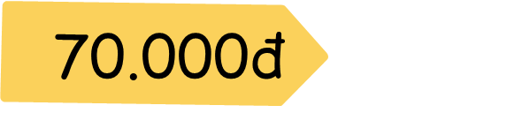
skirt
How much is the____?
It's seventy thousand dong.

Slide 28


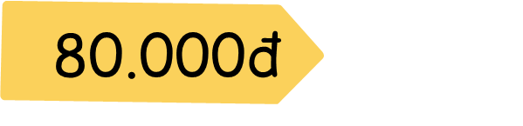
school bag
How much is the ________?
It's eighty thousand dong.

Slide 29



pen
How much is the ___?
It's twenty thousand dong.

Slide 30


book
How much is the____?
It's fifty thousand dong.

Slide 31


bread
How much is the_____?
It's ten thousand dong.

Slide 32




Slide 33
At home
- Learn the new words
- Prepare the new lesson

Slide 34


