Slide 1



Unit 6: Our school facilities
Lesson 3: Part: 1, 2, 3
Class: 4A
Subject: English
Teacher: Nguyen Thi Cam Giang

Slide 2
Welcome to our class
Teacher: Nguyen Thi Cam Giang
My Tho No 1 Primary School
School year: 2023 - 2024

Slide 3


Notes:
3

Slide 4

1.

Slide 5

2.

Slide 6

3. Raise your hand

Slide 7

4. Listen to the teacher

Slide 8
Play Game

Slide 9







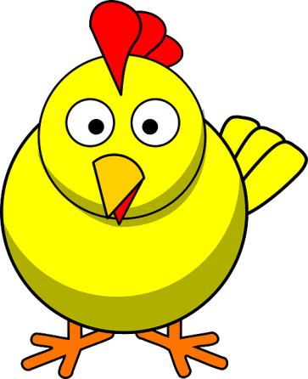
LUCKY CHICKEN
Next Activity

Slide 10

Where’s your school?
It’s in the city.

Slide 11
There are two ____ at my school.
A. building B. buildings
B. buildings

Slide 12
_____ one garden at my school.
A. There is B. There are
A. There is

Slide 13

We can play football in the ___.
A. garden B. playground
B. playground

Slide 14
How many computer rooms _____?
A. are there B. there are
A. are there

Slide 15
Where’s your school?
It’s in the ___.

Slide 16

Lucky chicken

Slide 17
Lucky chicken

Slide 18
Lucky chicken

Slide 19

mountains

Slide 20

village

Slide 22
Monday, November 13th, 2023
Unit 6: Our school facilities
Lesson 3: Part 1, 2, 3
1. Listen and repeat.
2. Listen and circle.
3. Let’s chant.

Slide 23
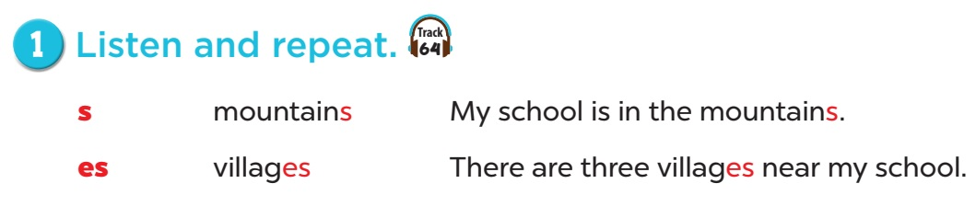

S / z /
es / IZ /

Slide 24


Slide 25


Slide 26
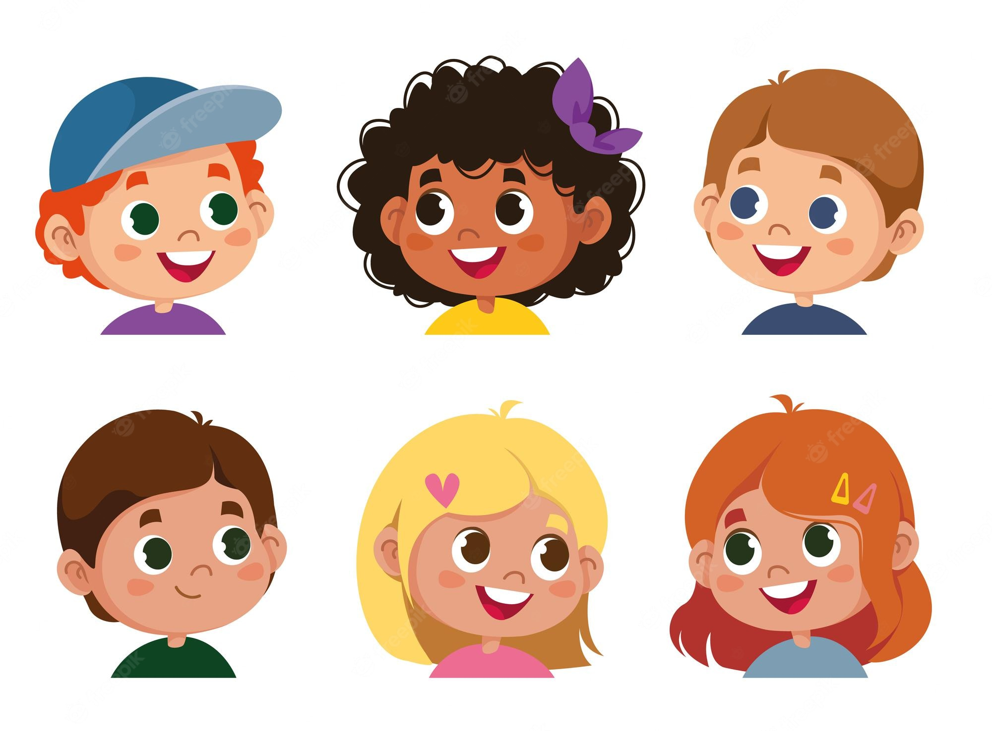

Let’s practise!
s | es
mountains
villages
Computer rooms
horses
playgrounds
boxes

Slide 27
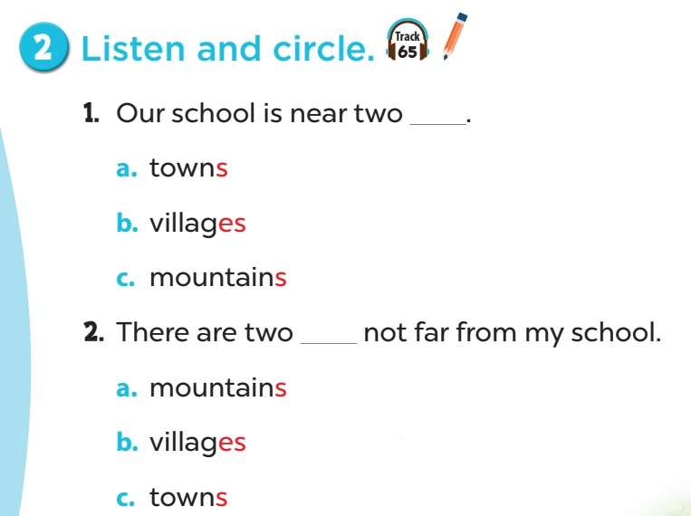

Slide 28
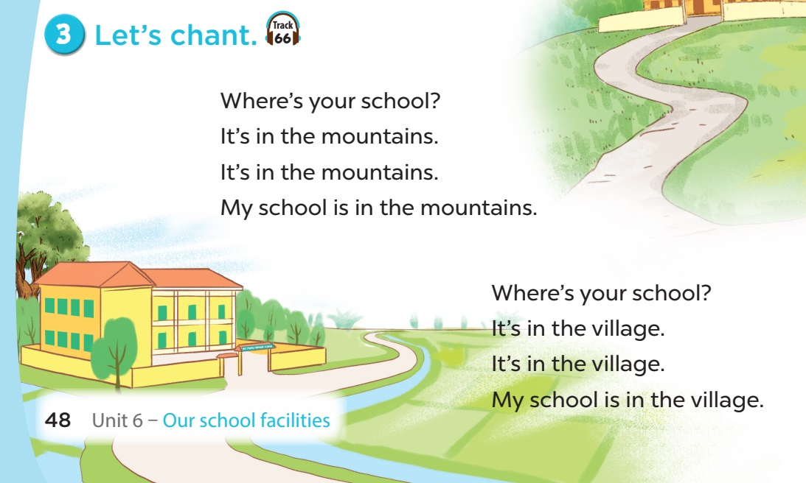
towns
towns
towns
city
city
city

Slide 29
BINGO
Game

Slide 30
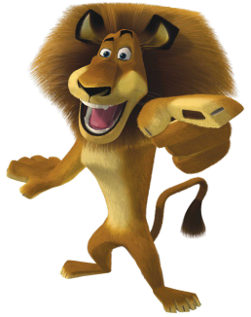
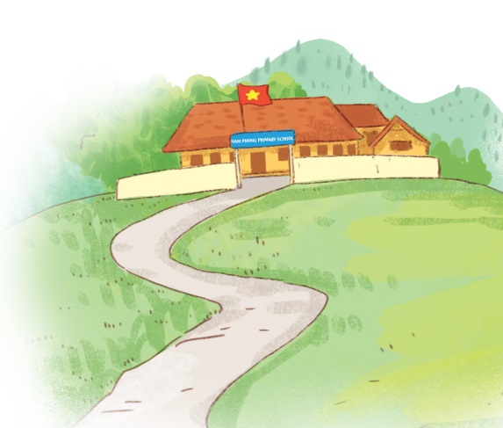
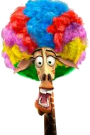
Where’s your school?
It’s in the mountains.

Slide 31
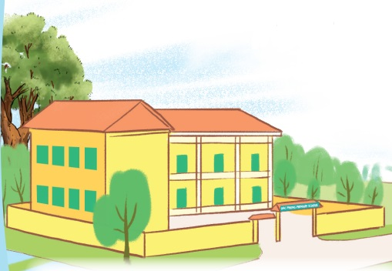
Where’s your school?
It’s in the village.

Slide 32
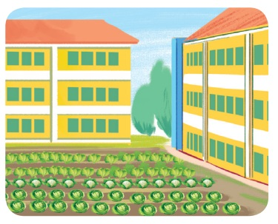
How many gardens are there
at your school?
There is one .

Slide 33

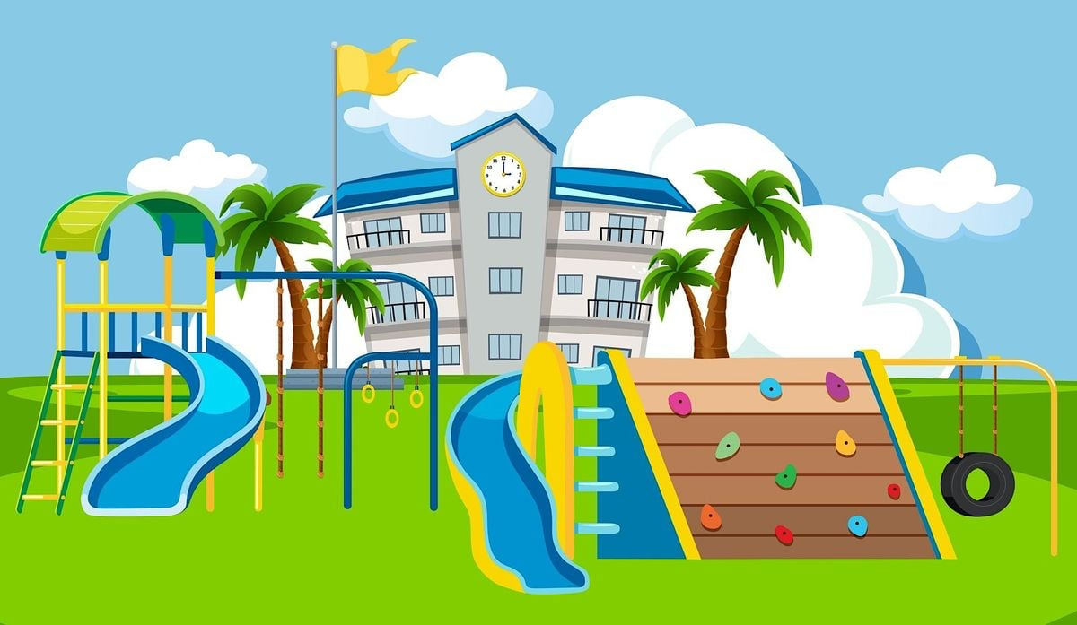
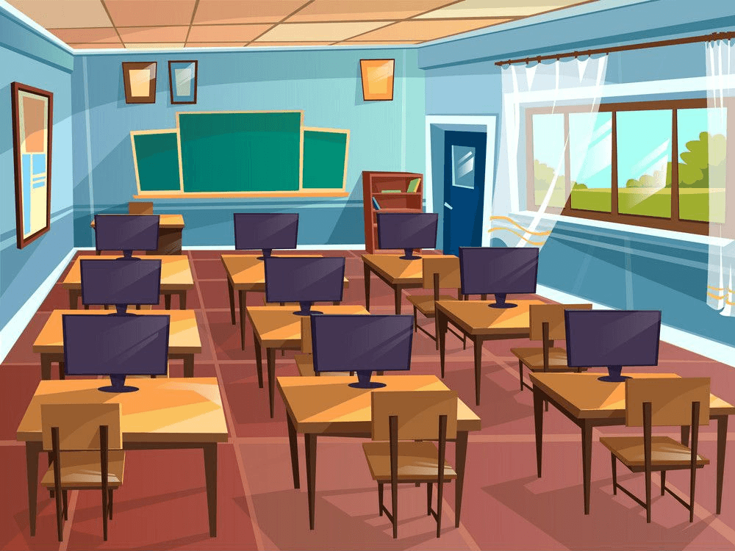
It’s in a playground.
A. B.
A

Slide 34
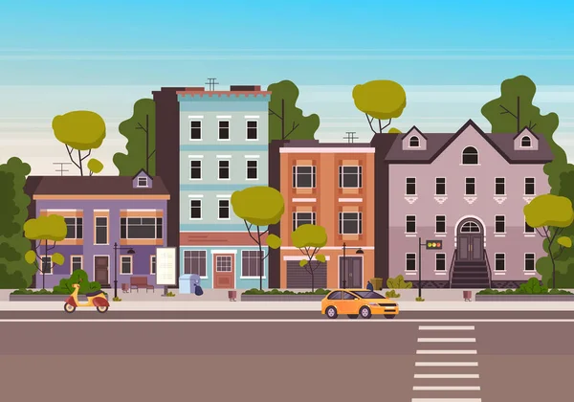
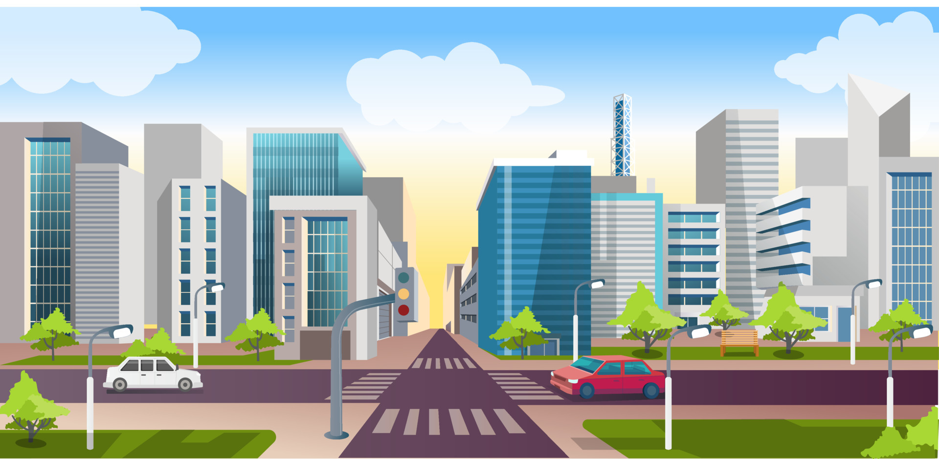
It’s in the city.
A. B.
B

Slide 35
There are two ___ at my school.
computer rooms

Slide 36
There is one ____ at my school.
garden

Slide 37
There ____ one computer room at my school.
is

Slide 38
There __ two buildings
at my school.
are

Slide 39


Goodbye teachers

