Slide 1



Unit 18: At the shopping centre
Lesson 3: Part: 1, 2, 3
Class: 4A
Subject: English
Teacher: Nguyen Thi Cam Giang

Slide 2
Welcome to our class
Teacher: Nguyen Thi Cam Giang
My Tho No 1 Primary School
School year: 2023 - 2024

Slide 3


Notes:
3

Slide 4

1.

Slide 5

2.

Slide 6

3. Raise your hand

Slide 7

4. Listen to the teacher

Slide 8
Table of contents
Warm-up and review
1.
Listen and repeat.
2.
3.
Listen and circle.
Let’s chant.

Slide 9



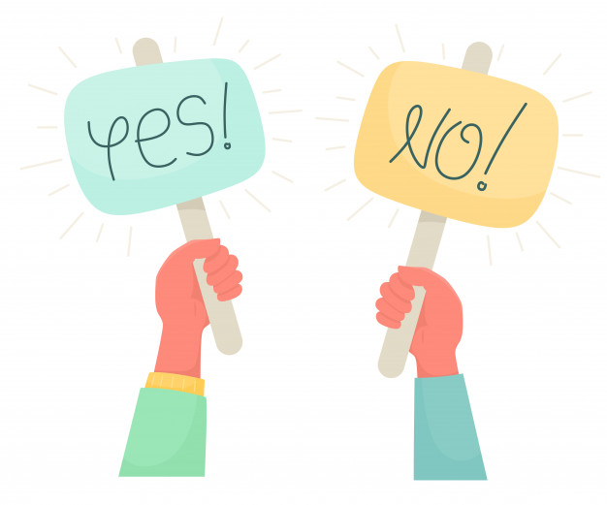
Let’s review!
Look and read.
Choose Yes or No.
15 seconds

Slide 10

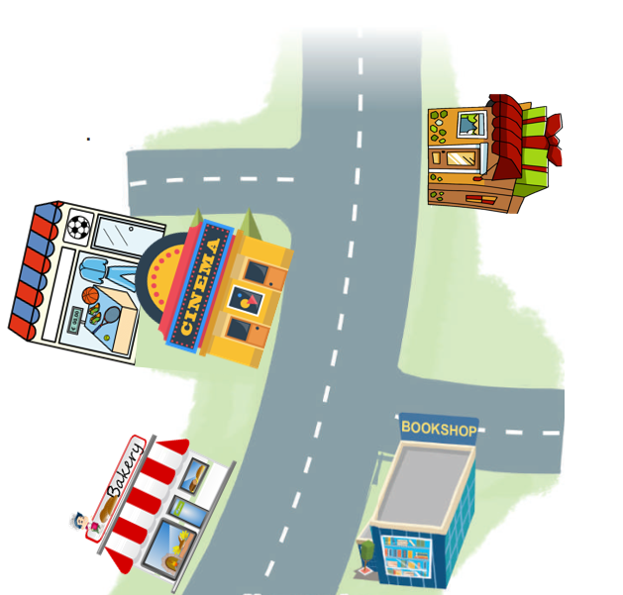
15
1
2
3
4
5
6
7
8
9
10
11
12
13
14
The sports shop is behind the cinema.

Slide 11
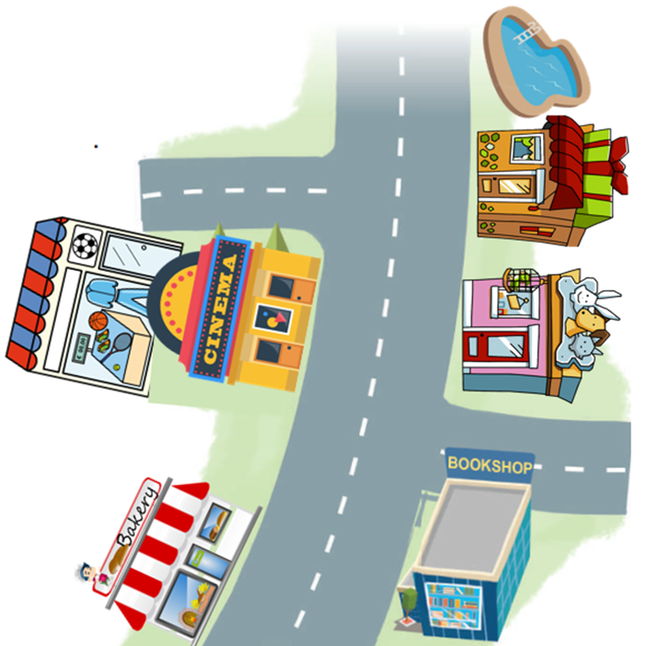
15
1
2
3
4
5
6
7
8
9
10
11
12
13
14
The bakery is near the swimming pool.

Slide 12
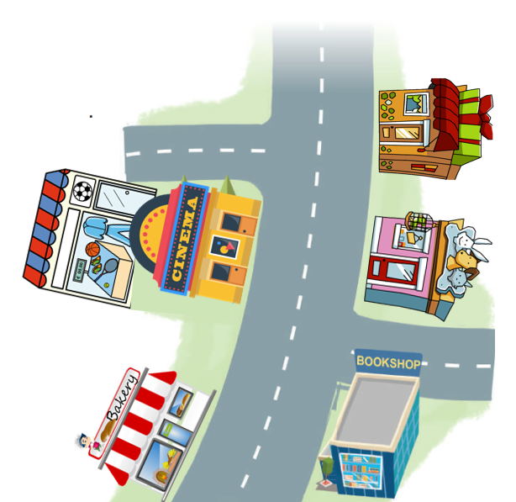
15
1
2
3
4
5
6
7
8
9
10
11
12
13
14
The pet shop is opposite the cinema.

Slide 13

15
1
2
3
4
5
6
7
8
9
10
11
12
13
14
The cinema is behind the sports shop.

Slide 14

15
1
2
3
4
5
6
7
8
9
10
11
12
13
14
The gift shop is between the swimming pool and the pet shop.

Slide 15
15
1
2
3
4
5
6
7
8
9
10
11
12
13
14
The gift shop is opposite the pet shop.

Slide 16
15
1
2
3
4
5
6
7
8
9
10
11
12
13
14
The bakery is near the sports shop.

Slide 17

Listen and clap. Which syllable is stressed?

Slide 18


campsite
‘campsite

Slide 19
shopping
‘shopping

Slide 20
‘bookshop
bookshop

Slide 21
centre
‘centre

Slide 22
be’hind
behind

Slide 23
between
be’tween

Slide 24
The stress is on the second syllable
be’hind
be’tween

Slide 25
Friday, April 19th, 2024
Unit 18: At the shopping centre
Lesson 3: Part 1, 2, 3
1. Listen and repeat.
2. Listen and circle.
3. Let’s chant.

Slide 26
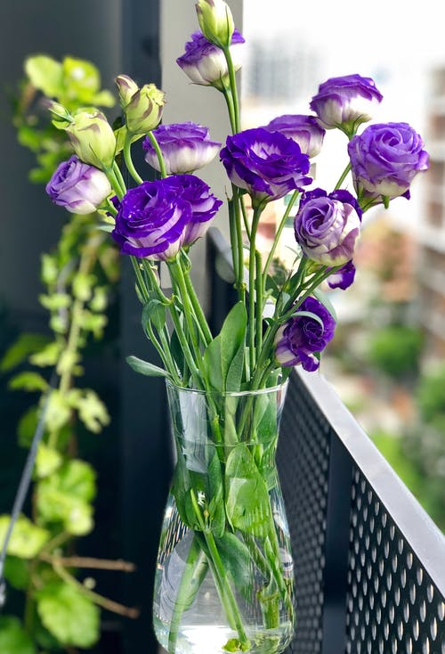
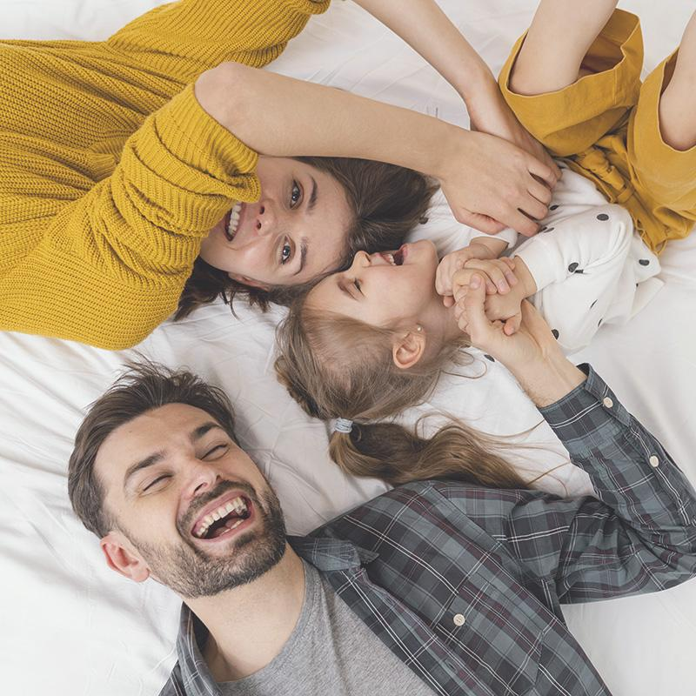
1.
Listen and repeat.
Pupil’s book page 56

Slide 27
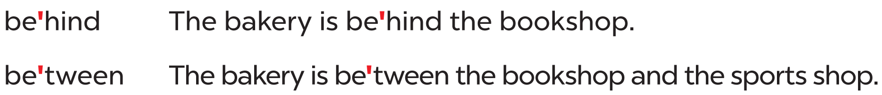
Listen and repeat.

Slide 28
Fun corner

Slide 29
2.
Listen and circle.

Slide 30
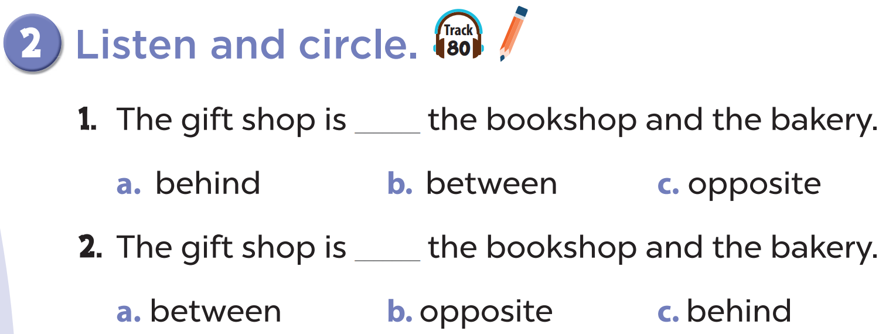

Listen and circle.
Look and read.

Slide 31


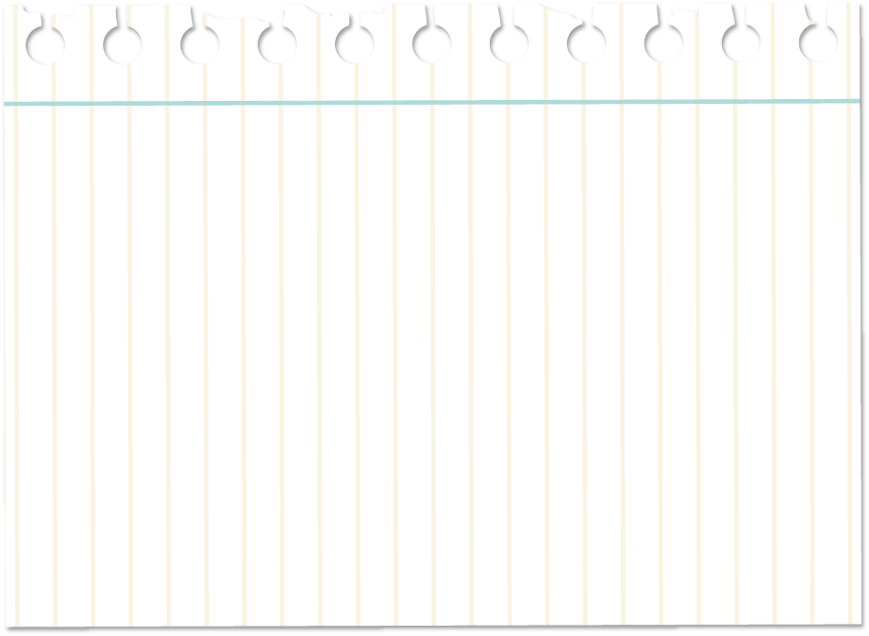
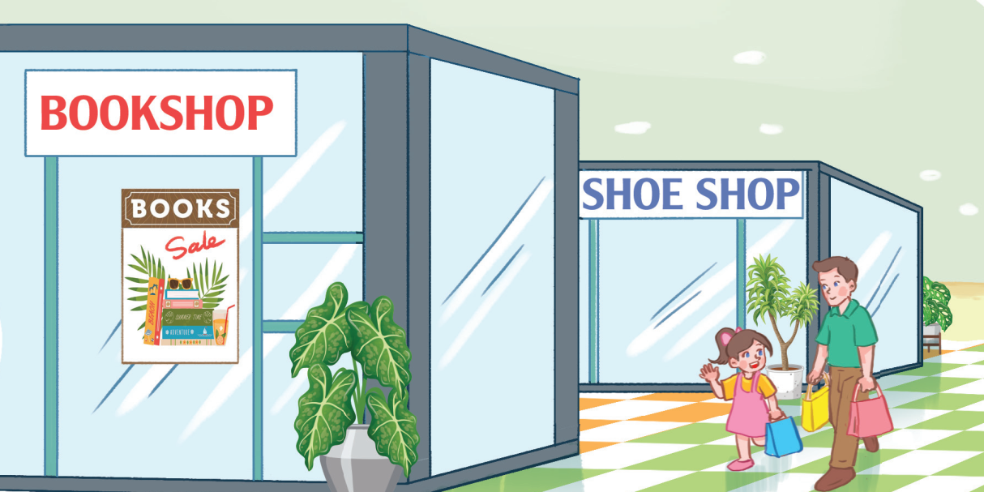
Where is the shoe shop?
It’s behind the bookshop.

Slide 32
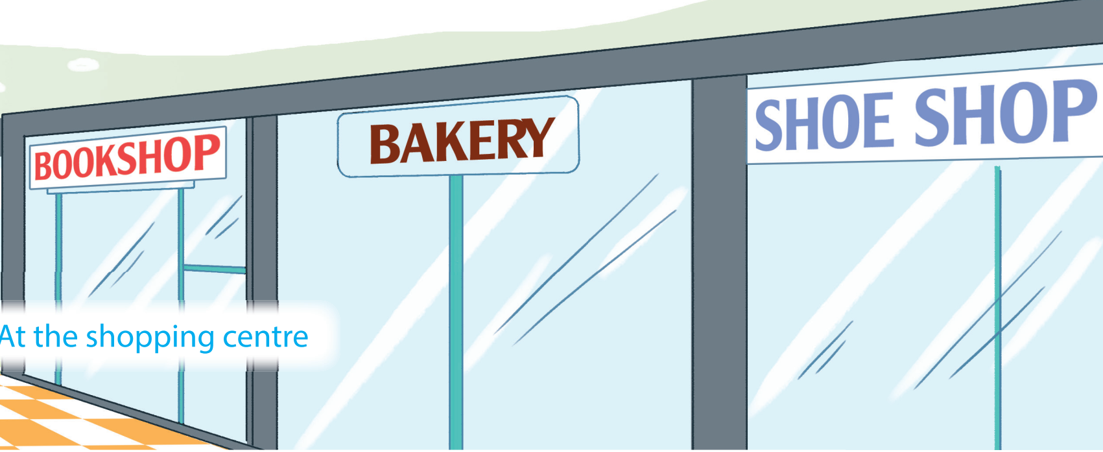
Where is the bakery?
It’s between the bookshop and the shoe shop.

Slide 33
3.
Let’s chant.

Slide 34
Play game

Slide 35
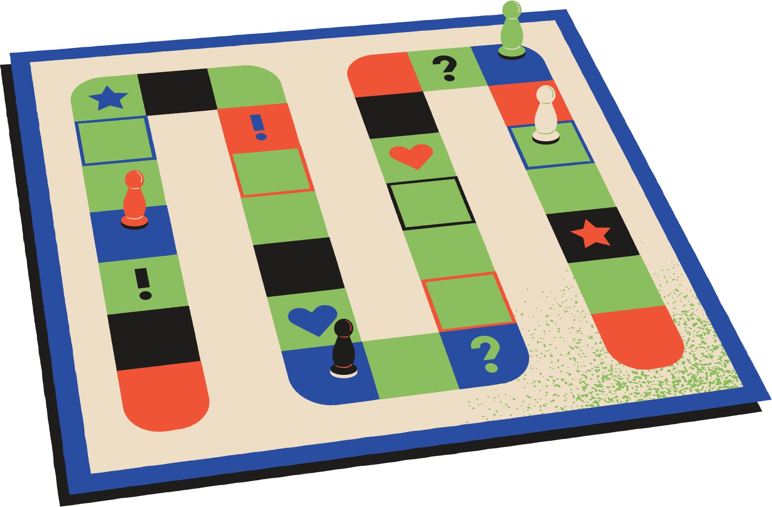


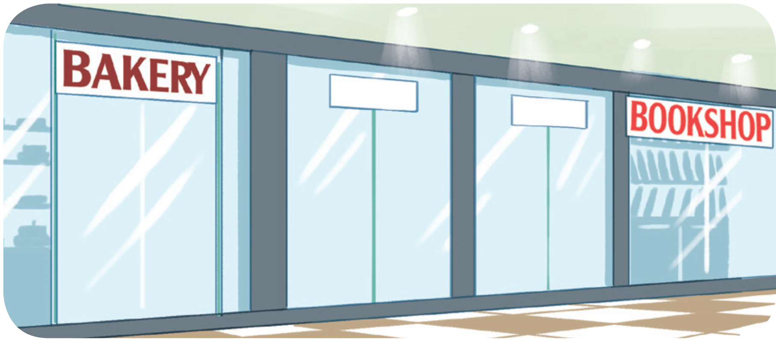
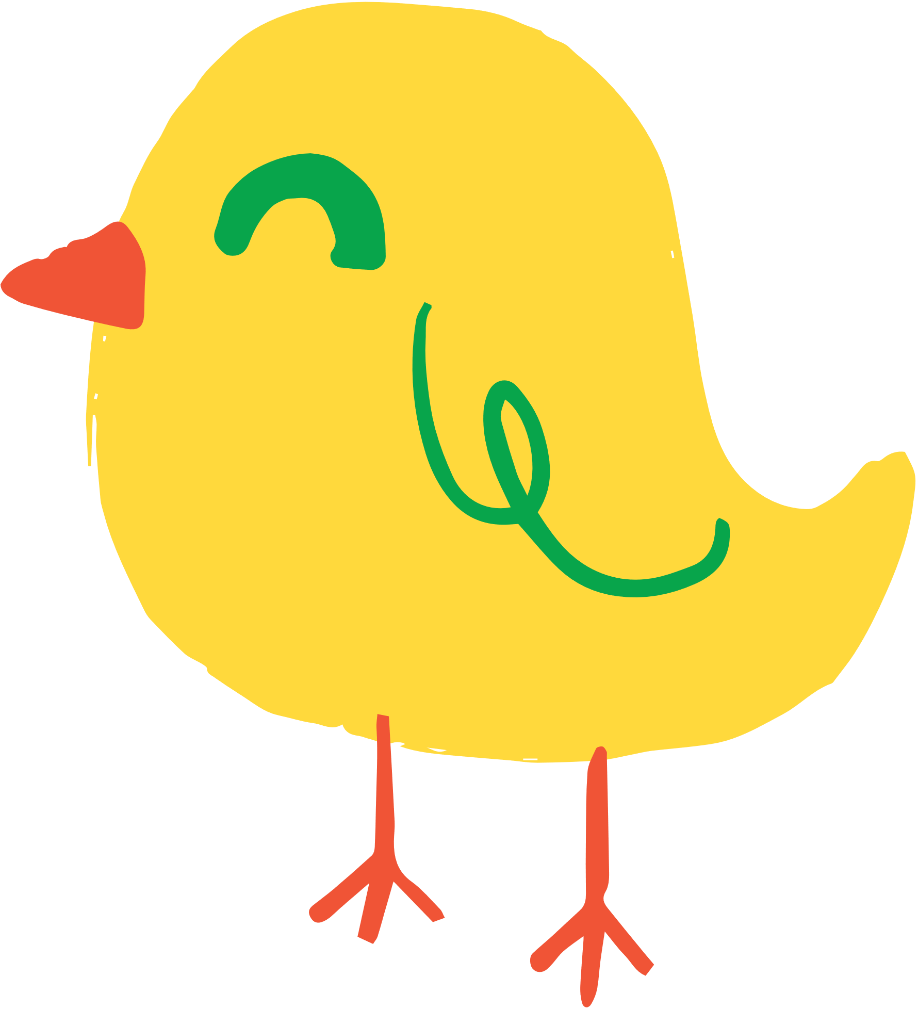
Where is the bookshop?
Insert one question here
It’s near the bakery.

Slide 36
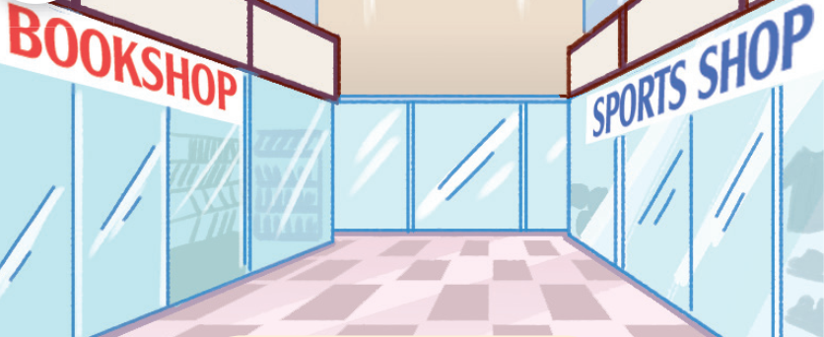
Where is the sports shop?
Insert one question here
Insert one question here
Insert one question here
It’s opposite the bookshop.

Slide 37
Insert one question here
Where is the bakery?
Insert one question here
Insert one question here
It’s near the bookshop.

Slide 38
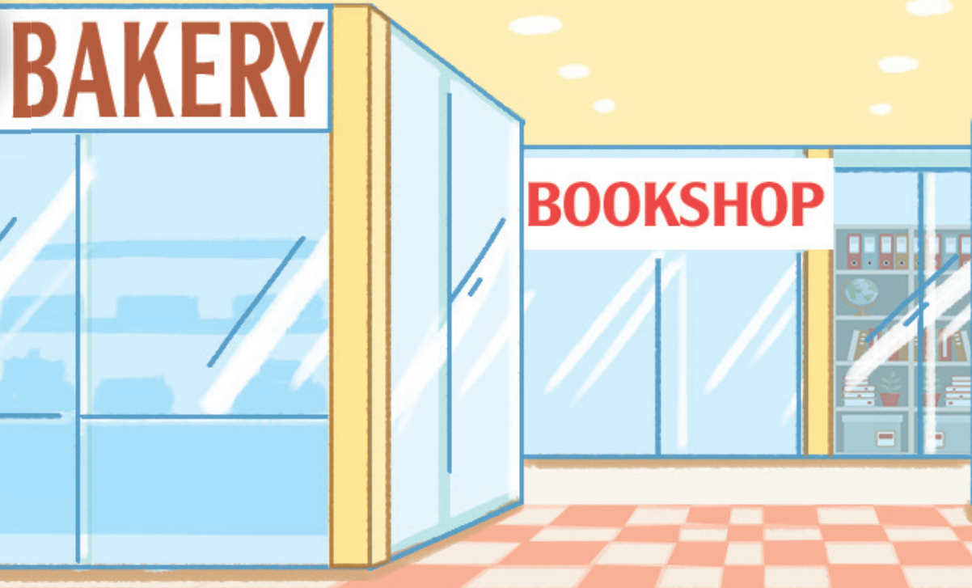
Where is the bookshop?
Insert one question here
Insert one question here
Insert one question here
It’s behind the bakery.

Slide 39
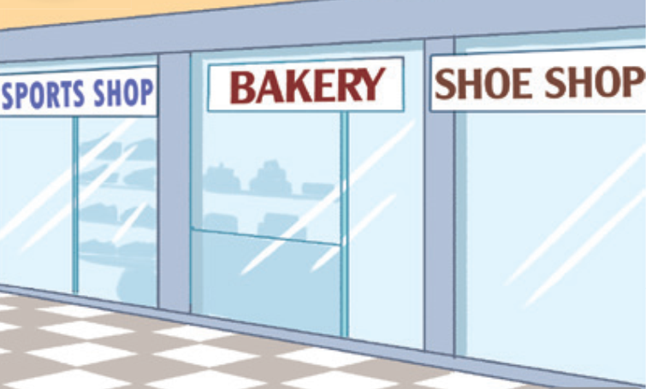
Insert one question here
Where is the bakery?
Insert one question here
It’s between the sports shop and the shoe shop.
Insert one question here

Slide 40
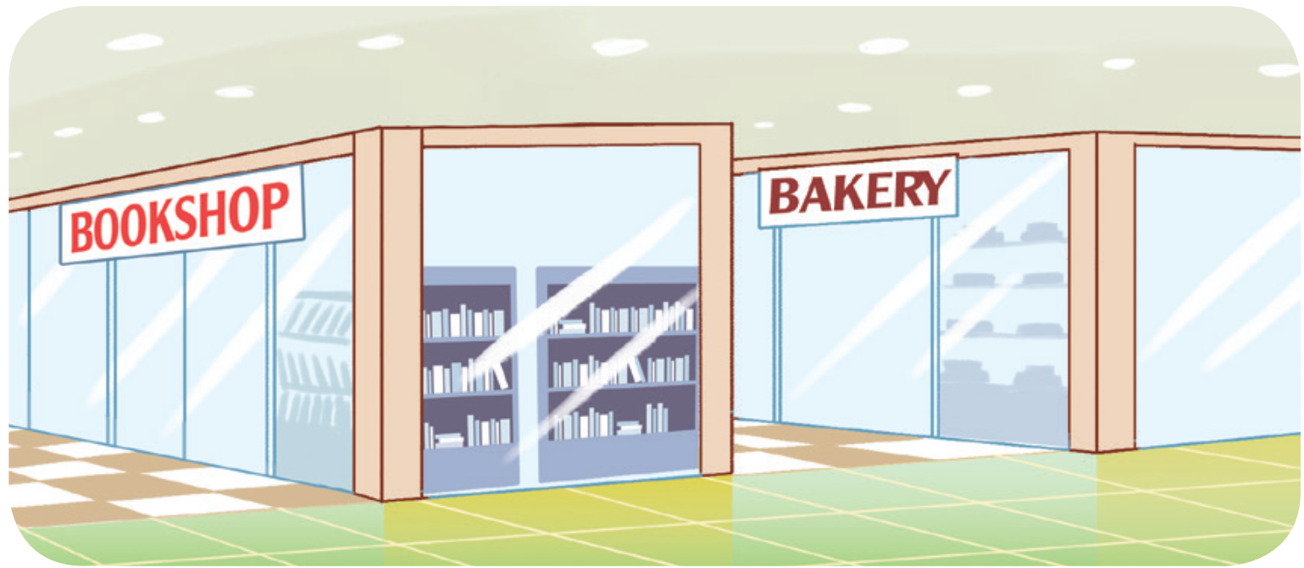
Insert one question here
Where is the bookshop?
Insert one question here
Insert one question here
It’s in front of the bakery.

Slide 41
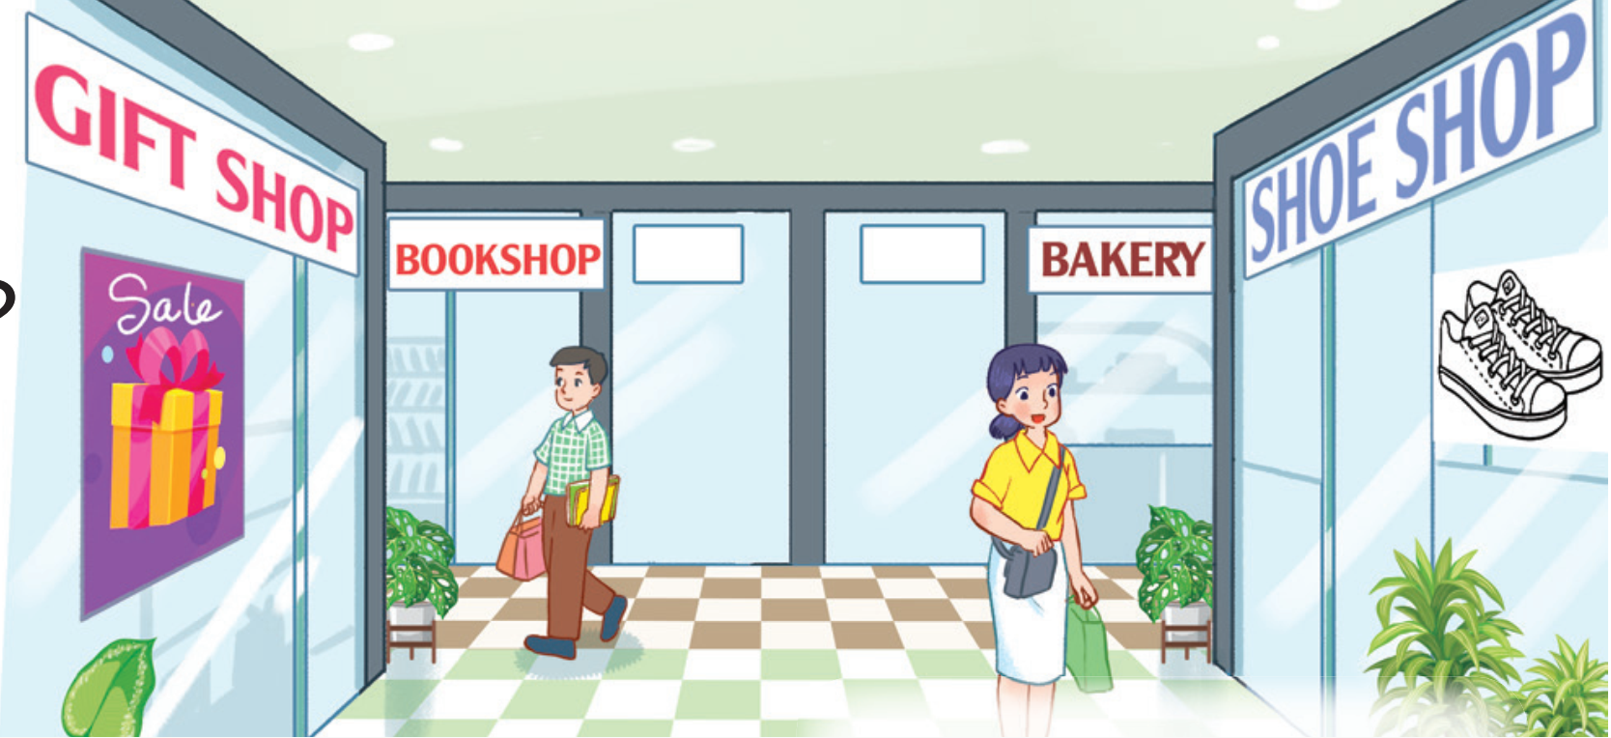
Insert one question here
Where is the gift shop?
Insert one question here
Insert one question here
It’s opposite the shoe shop.

Slide 42
Where is the shoe shop?
Insert one question here
Insert one question here
Insert one question here
It’s opposite the gift shop.

Slide 43
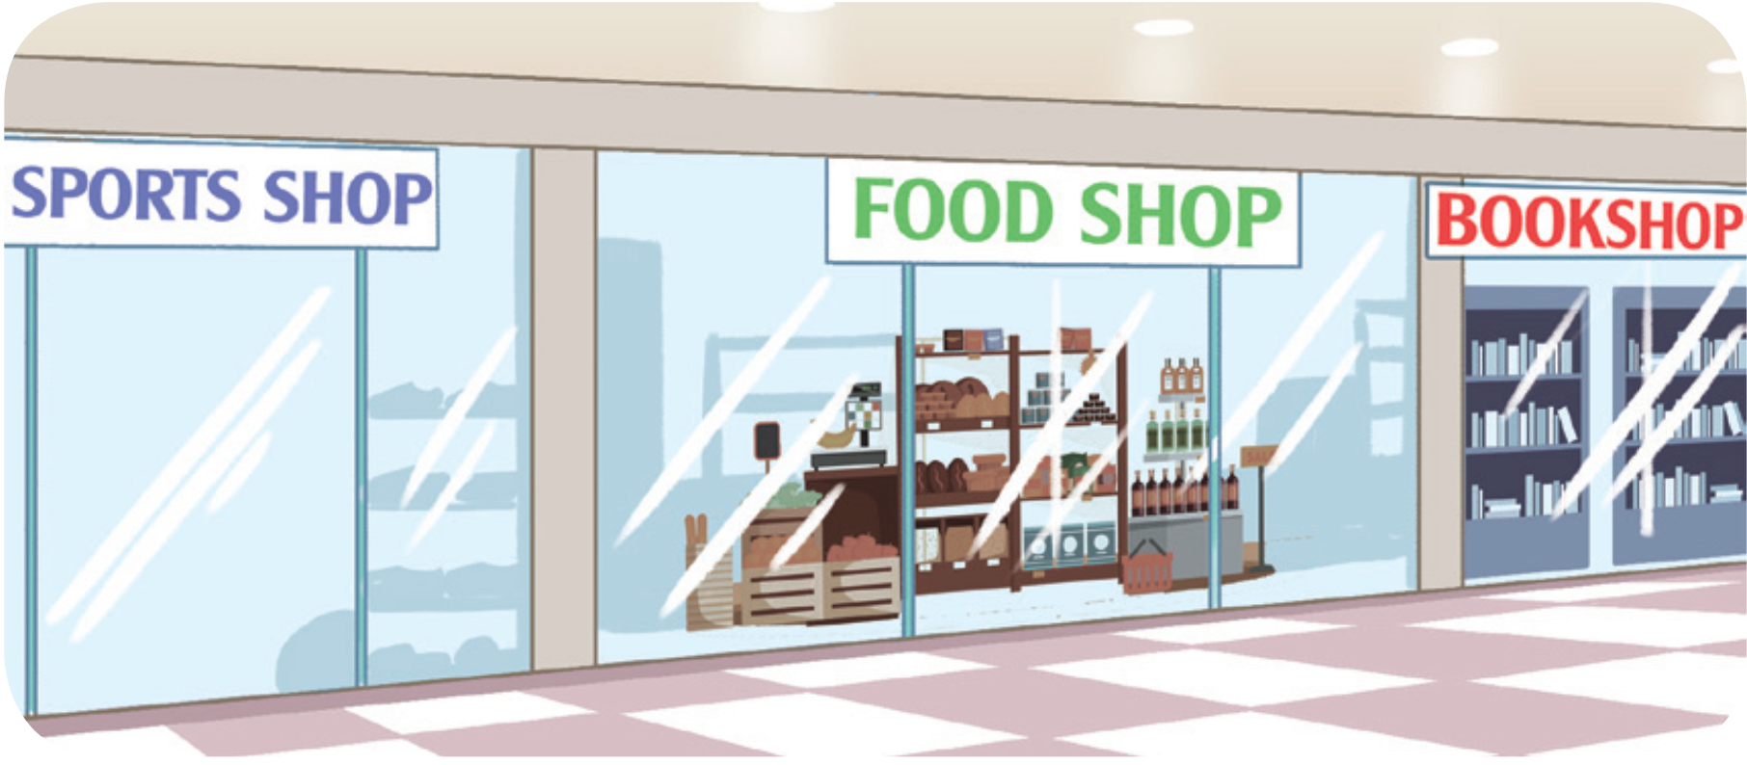
Where is the food shop?
Insert one question here
Insert one question here
It’s between the sports shop and the bookshop.
Insert one question here

Slide 44
Homework
Learn by heart, do exersice.
opposite, bakery, village, city,

