Slide 2



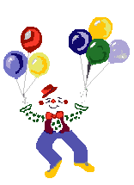

Welcome to our class 5A
Teacher: Le Thi Loan
My Thanh No.1 primary school

Slide 3





01
Warm-up and Review

Slide 4



Let’s dance

Slide 5
Let’s play a game.
What food/ drinks will you have at the party?

Slide 6

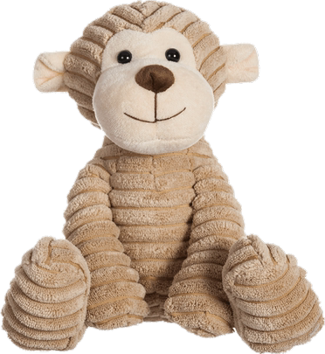


pizza
I will have ………… .
pizza
burger
lemonade

Slide 7


milk tea.
We will have …………….
lemonade
juice
milk tea

Slide 8
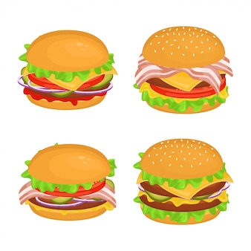

burgers
I will have ………………
cake
burgers
pizza

Slide 9



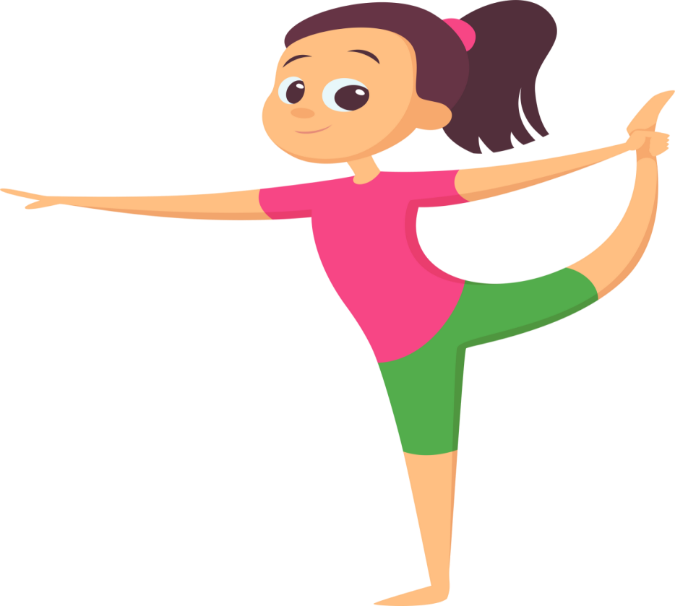

Thursday, February 27th, 2025
Unit 14: STAYING HEALTHY
Lesson 1 – Part 1, 2, 3

Slide 10












Healthy and
unhealthy food

Slide 11

Healthy food is food that gives you all the nutrients you need to stay healthy, feel well and have plenty of energy.
What's
healthy
food?

Slide 12

Unhealthy food is food that lack nutrients, vitamins and minerals. They are also high in energy, salts, sugars and fats.
What's
unhealthy
food?

Slide 13
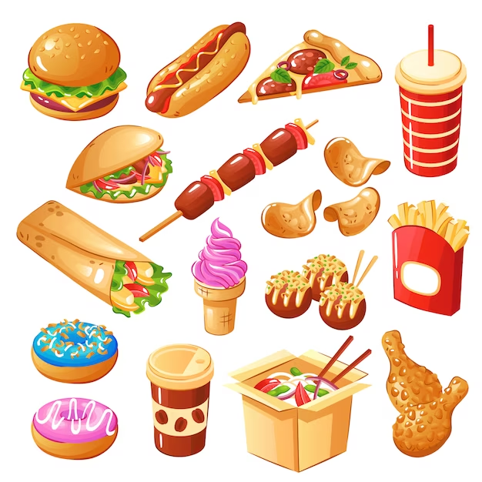



✓
healthy
unhealthy

Slide 14
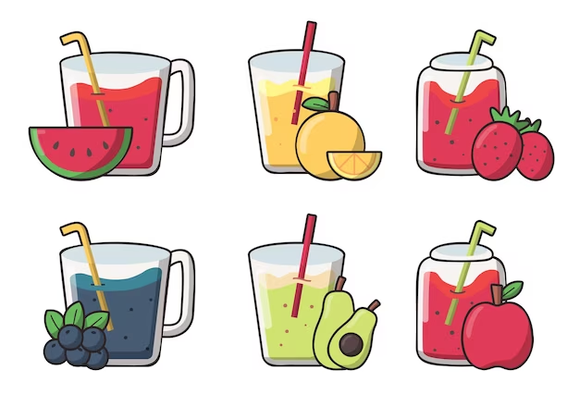

✓
healthy
unhealthy

Slide 15
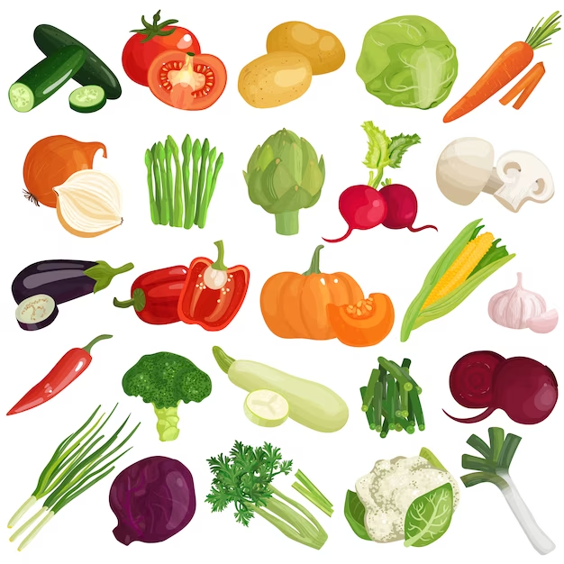

✓
healthy
unhealthy

Slide 16
02
Exploration

Slide 17



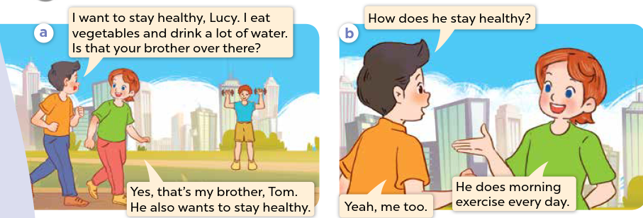


W
1.Who’s he/she?
2.What are they talking about?
Notes:
Step 1: Ask pupils to look at Pictures a and b and identify the characters and say what they can see in the pictures.
Step 2: Have pupils look at Picture a and b and guess what the characters are talking about. Pupils can use Vietnamese, then repeat their responses in English.

Slide 18
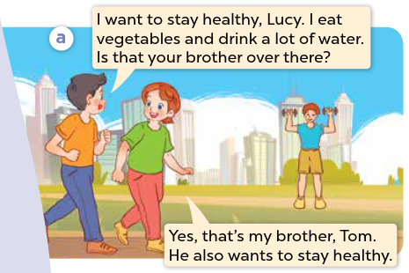

1.Look, listen and repeat.
Notes:
Step 3: Play the recording and encourage pupils to point at the characters while listening.

Slide 19
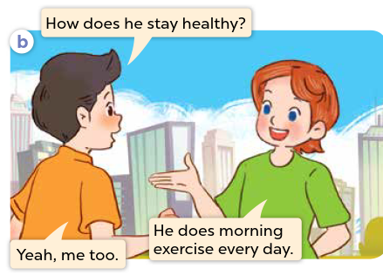
Look, listen and repeat.
Notes:
Step 3: Play the recording and encourage pupils to point at the characters while listening.

Slide 20
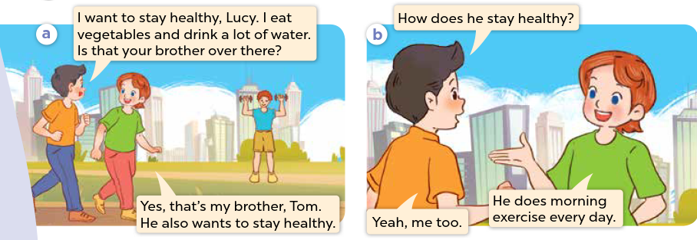
Look, listen and repeat.
Notes:
Step 4: Play the recording again, sentence by sentence, for pupils to listen, point to the sentences and repeat. Correct their pronunciation where necessary.
Step 5: Draw pupils’ attention to the question How does he stay healthy? and the answers He does morning exercise every day. Explain that they are used to talk about a someone’s lifestyle.

Slide 21
03
Knowledge construction

Slide 22


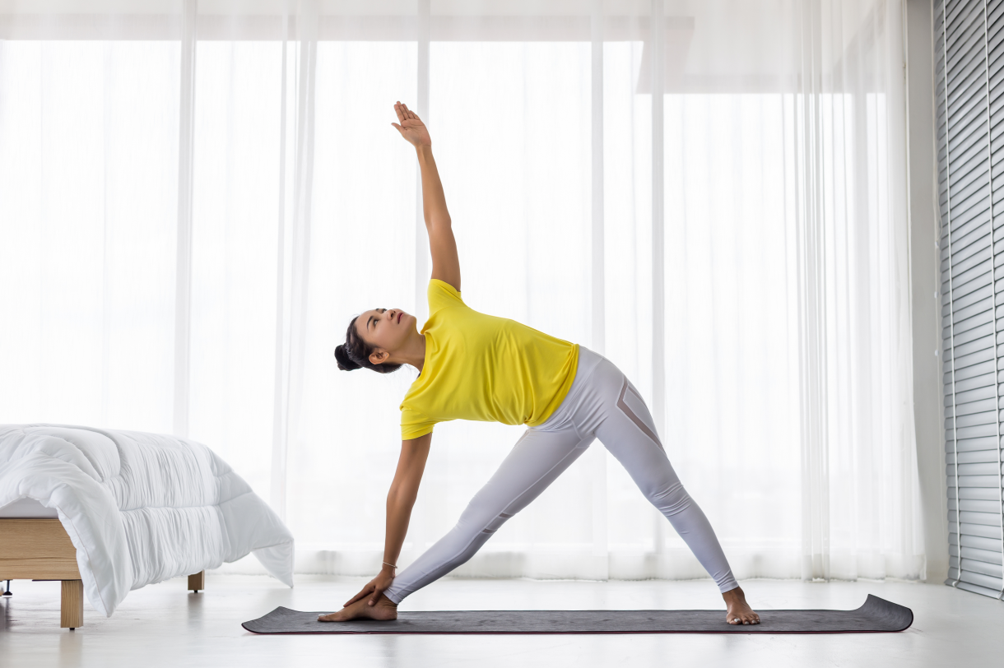





2.Listen, point and say.
1. Vocabulary
- do morning exercise
- play sports
- drink fresh juice
- eat healthy food
Notes:
Step 1: Have pupils look at the pictures, say what they can see in the pictures and identify the activities the characters do.

Slide 23
Check vocabulary

Slide 24
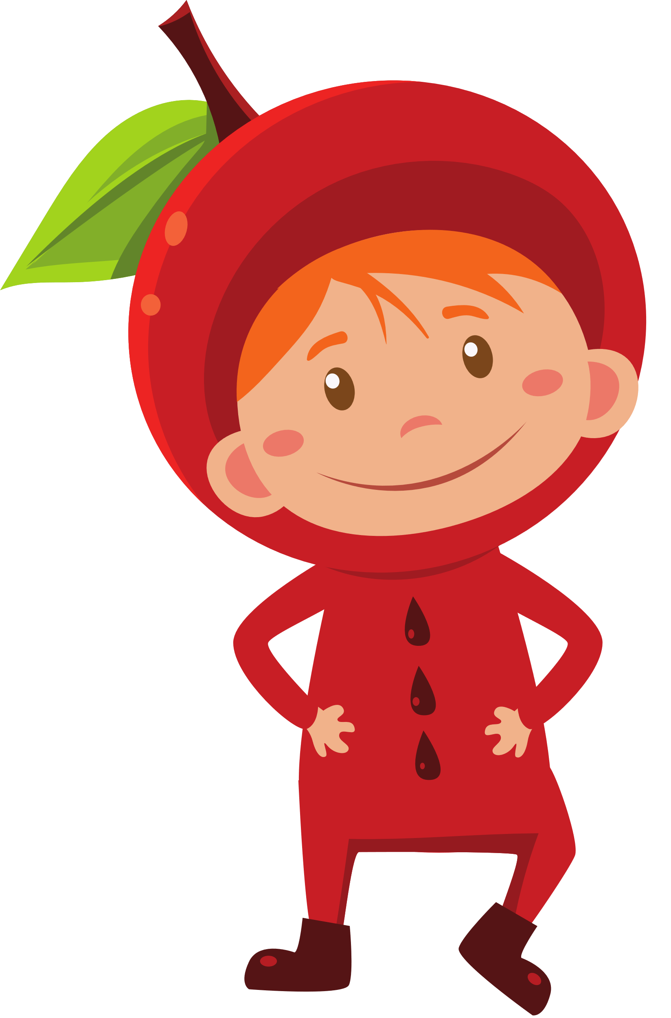
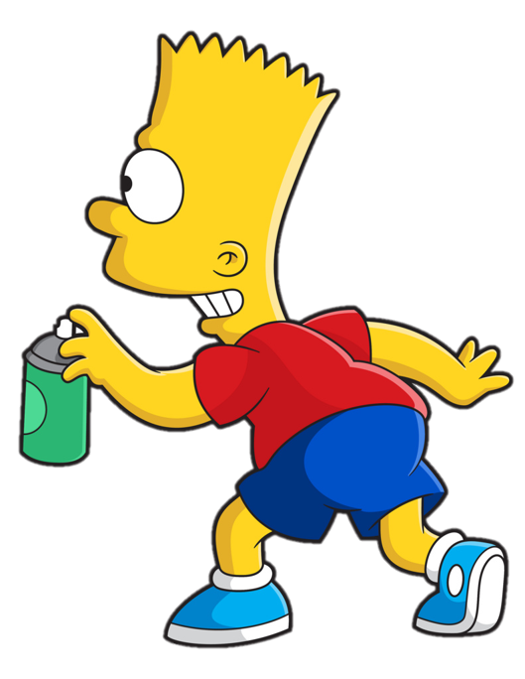


Slide 25












> Someone has deleted some words.
> Guess the deleted word within the time limit (12 seconds).
Notes:
Thanh Yen Tran 0967 255 149 /081 811 4340 zalo / FB https://www.facebook.com/thanhyentrangiaoandientu

Slide 26


do morning exercise
CHECK
Notes:
26

Slide 27
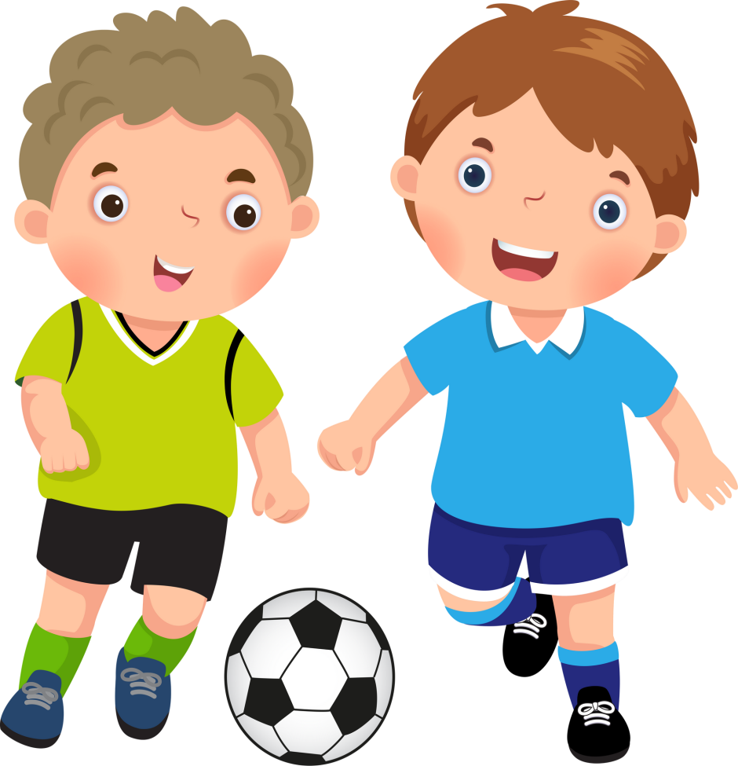
play sports
CHECK
Notes:
27
Thanh Yen Tran 0967 255 149 /081 811 4340 zalo / FB https://www.facebook.com/thanhyentrangiaoandientu

Slide 28
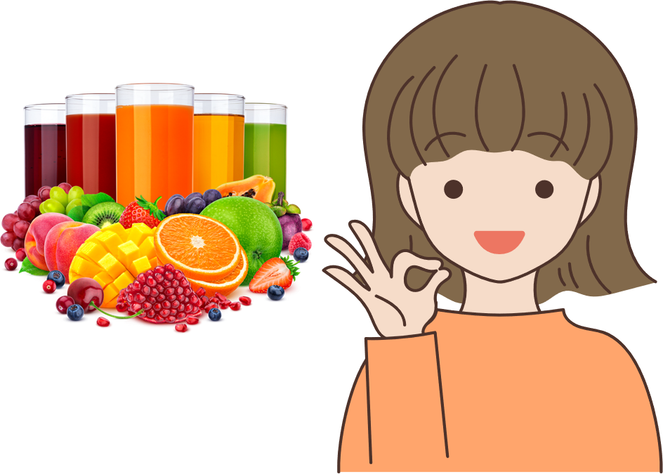
Y
drink fresh juice
CHECK
Notes:
28

Slide 29
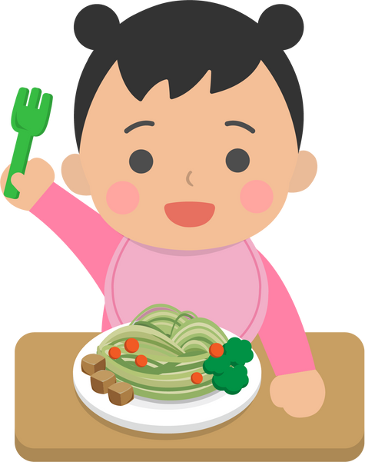
eat healthy food
CHECK
Notes:
29
Thanh Yen Tran 0967 255 149 /081 811 4340 zalo / FB https://www.facebook.com/thanhyentrangiaoandientu

Slide 30




2. Listen, point and say.
2. Model sentence.
Hỏi đáp về việc ai đó làm cách nào để giữ cơ thể khỏe mạnh
How does he stay healthy?
Anh ấy làm cách nào để giữ cơ thể khỏe mạnh vậy?
He does morning exercise everyday.
Anh ấy tập thể dục buổi sáng mỗi ngày
Notes:
Step 5: Invite a few pairs to point at the pictures and ask and answer questions about a family member’s lifestyle.

Slide 31

Listen, point and say.
How does she stay healthy?
She does morning exercise.
a. do morning exercise
Notes:
Step 5: Invite a few pairs to point at the pictures and ask and answer questions about a family member’s lifestyle.

Slide 32



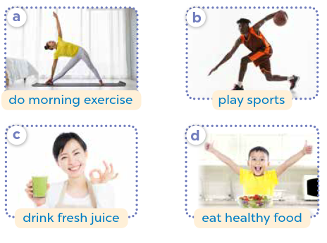


Work in pairs.
How does he / she stay healthy?
He / She _____.
Notes:
Step 5: Invite a few pairs to point at the pictures and ask and answer questions about a family member’s lifestyle.

Slide 33
Listen, point and say.
How does he stay healthy?
He plays sports.
b. play sports
Notes:
Step 5: Invite a few pairs to point at the pictures and ask and answer questions about a family member’s lifestyle.

Slide 34
Listen, point and say.
How does she stay healthy?
She drinks fresh juice.
c. drink fresh juice
Notes:
Step 5: Invite a few pairs to point at the pictures and ask and answer questions about a family member’s lifestyle.

Slide 35
Listen, point and say.
How does he stay healthy?
He eats healthy food.
d. eat healthy food
Notes:
Step 5: Invite a few pairs to point at the pictures and ask and answer questions about a family member’s lifestyle.

Slide 36
04
Production
3. Let’s talk.

Slide 37





Let’s talk.
Work in pairs
How does your _____ stay healthy?
_____.
Notes:
Step 1: Draw pupils’ attention to the picture. Ask questions to help them identify the context (see Input).
Step 2: Point at the first character and elicit the question in the first speech bubble (e.g. How does your sister stay healthy?) and the answer in the second speech bubble (She does morning exercise.) as an example. Then write the sentences on the board. Get pupils to say the completed sentences. Repeat the same procedure with other pictures.

Slide 38
05
Fun corner and wrap-up.

Slide 39



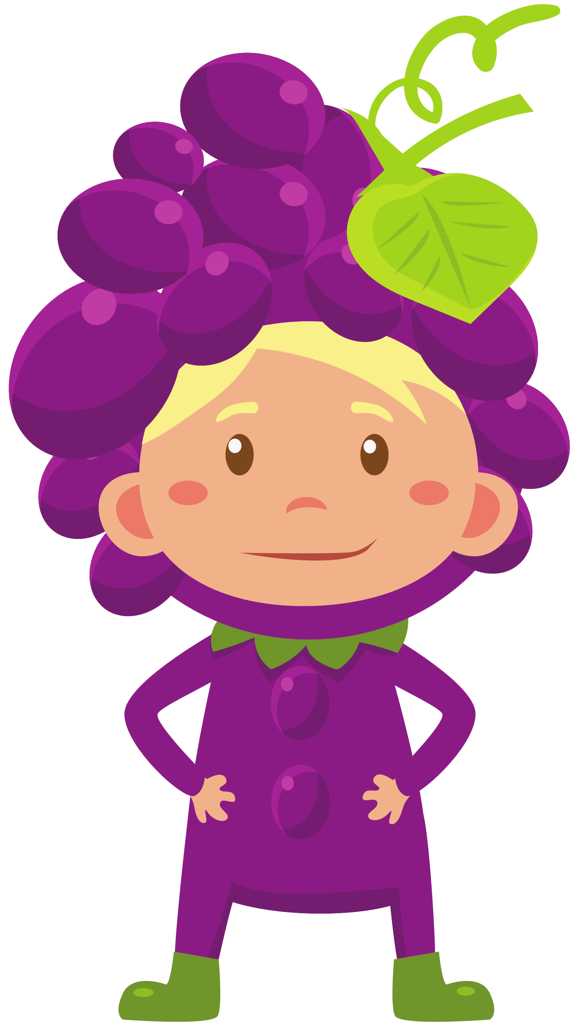
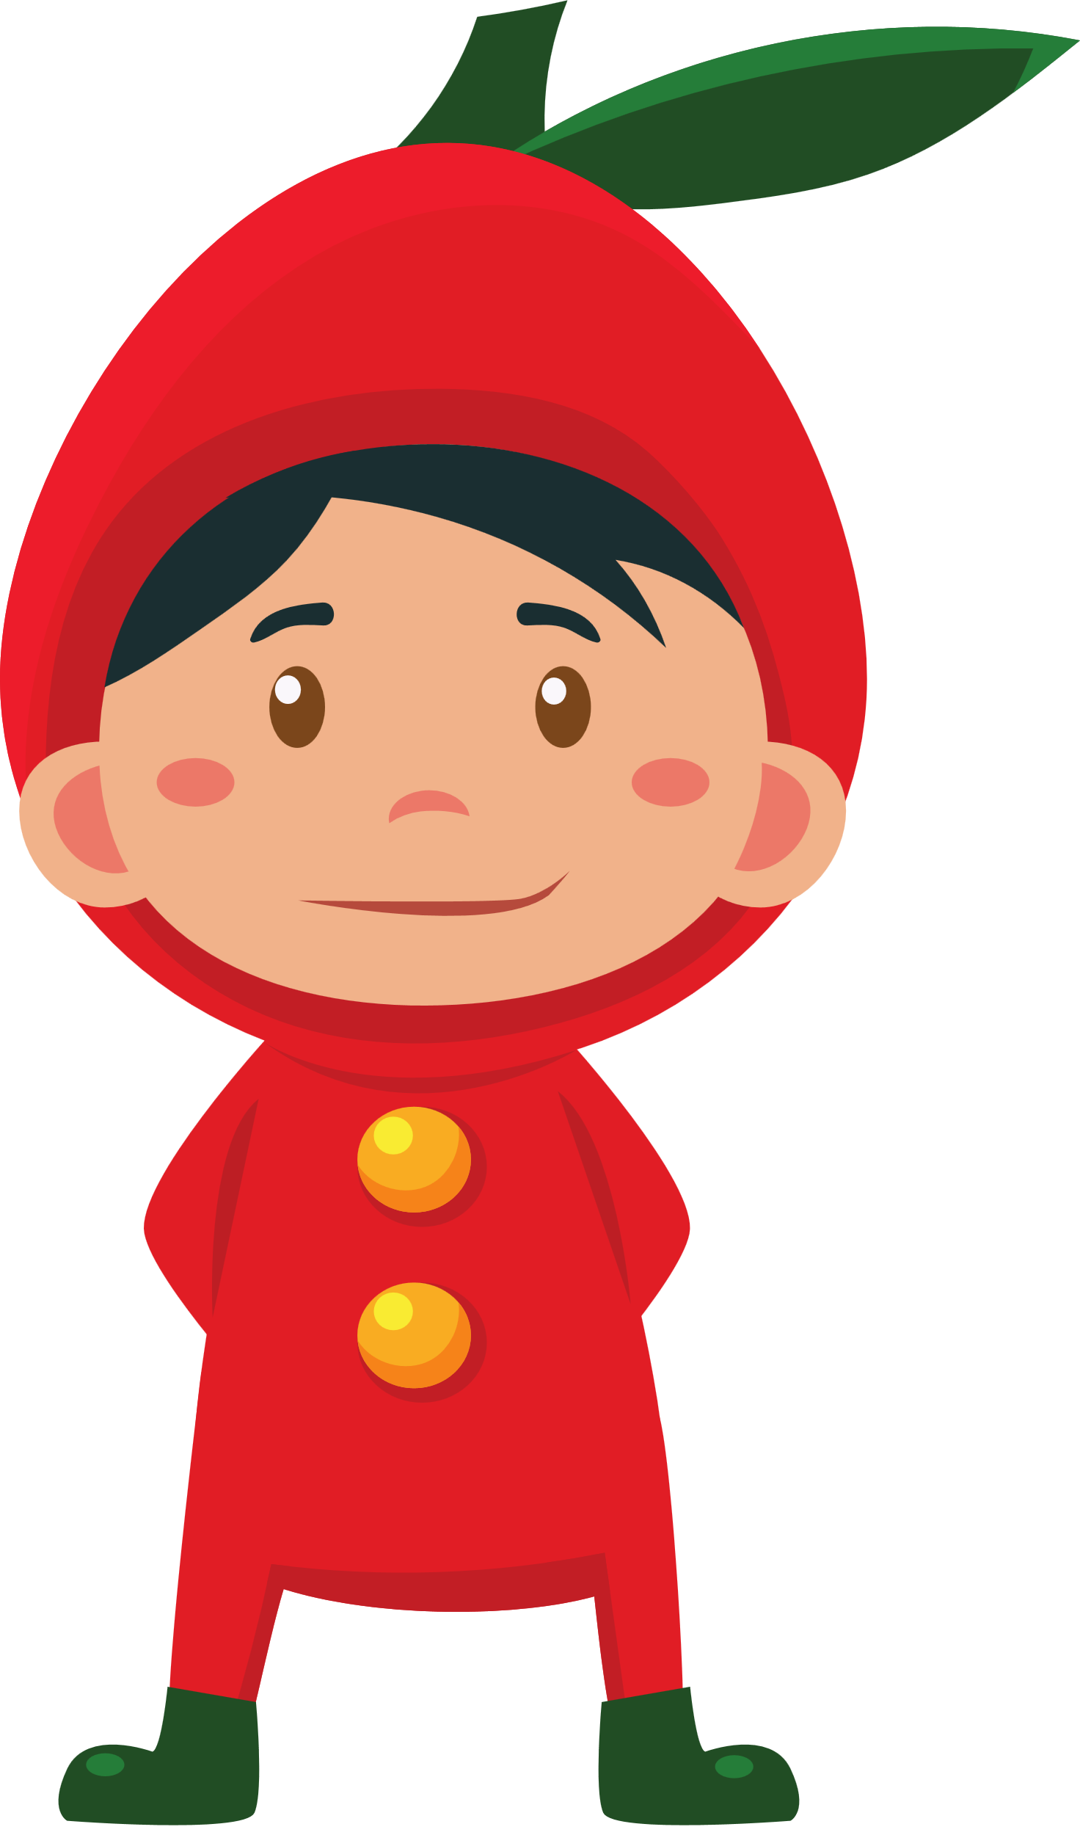

LET’S PLAY A GAME.

Slide 40






LUCKY FRUITS
Notes:
Click fruits to choose
After finishing, click LUCKY FRUITS to move the next slide

Slide 41


How does your sister stay healthy?
She _________.
Notes:
Click the fruit to GO BACK

Slide 42


Notes:
Click the fruit to GO BACK

Slide 43

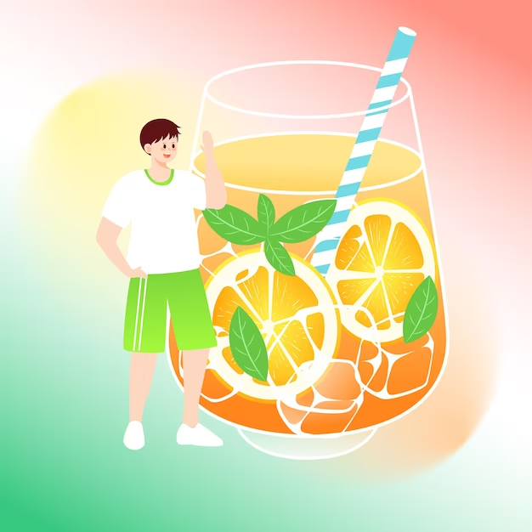
How does your brother stay healthy?
He _________.
Notes:
Click the fruit to GO BACK

Slide 44

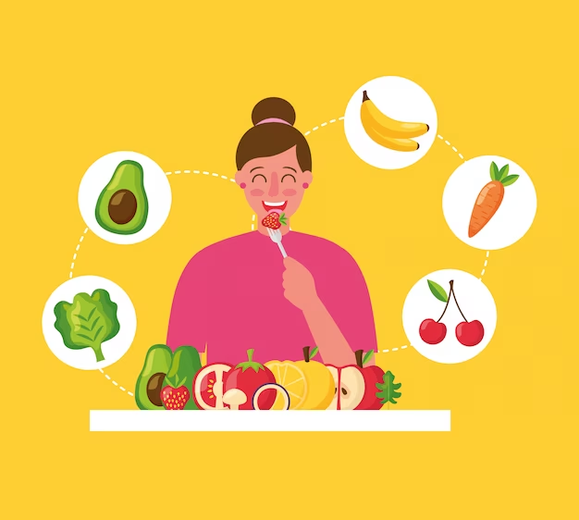
How does your sister stay healthy?
She _________.
Notes:
Click the fruit to GO BACK

Slide 45
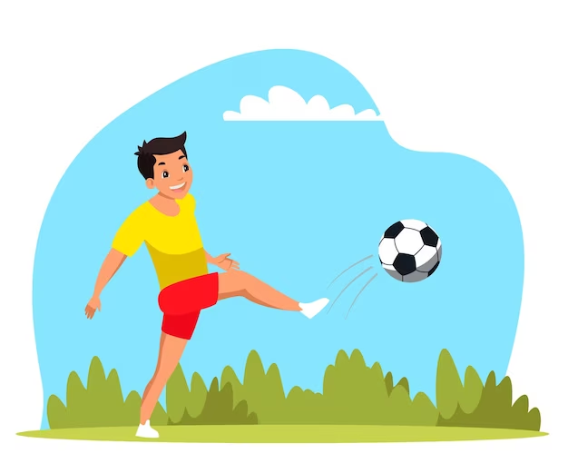
How does your brother stay healthy?
He _________.
Notes:
Click the fruit to GO BACK

Slide 46


Slide 47
THANK YOU FOR PLAYING!

