Slide 1

Unit 15:
My family’s weekend
LESSON 2: ( 4, 5, 6)

Slide 2
TABLE OF CONTENTS
01
02
03
WARM UP
PRACTICE
LET’S PLAY

Slide 3
01
WARM UP

Slide 4


Slide 5
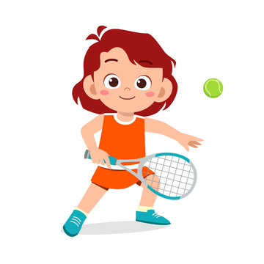
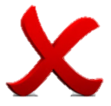


a. Play football
b. Play tennis
c. Play basketball
incorrect
correct

Slide 6

a. Watch films
b. Cook meals
c. Do yoga
incorrect
correct

Slide 7
What does he do on Mondays ?
He did yoga.
He is doing yoga
He does yoga.
a
b
c
incorrect
correct

Slide 8
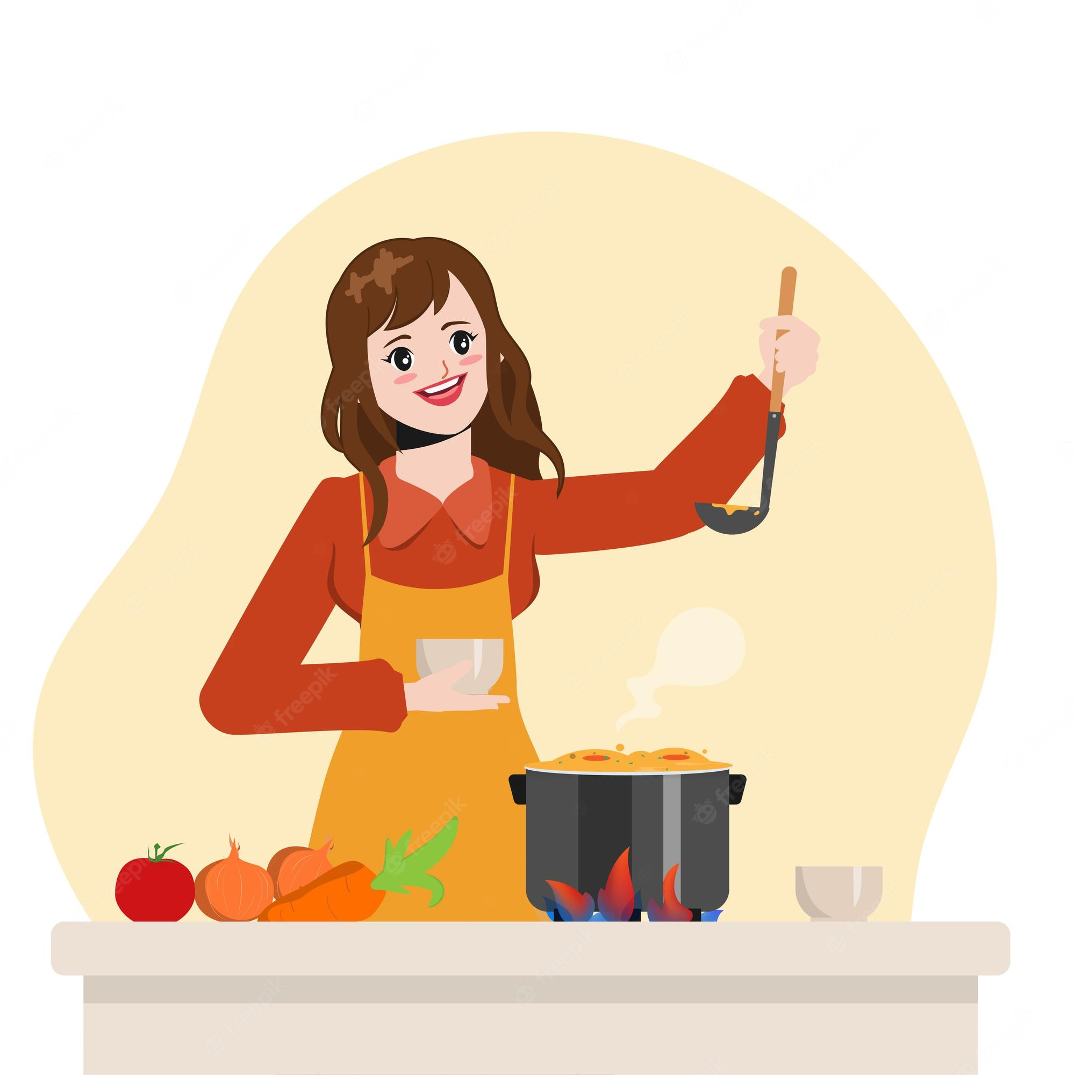
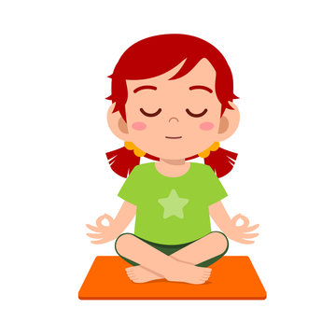
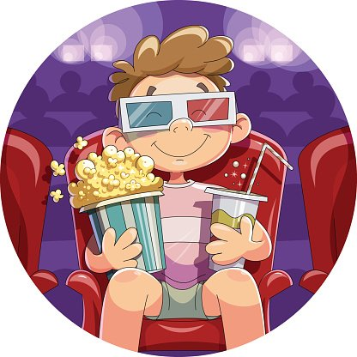
a
b
c
incorrect
correct

Slide 9
She watches films on Thursdays.
a. Does she watch films on Fridays ?
b. When does she do on Thursdays ?
c. What does she do on Thursdays ?
a
b
c
incorrect
correct

Slide 10
……does she do on Sundays ?
She cooks meals.
a. Who
b. What
c. When
incorrect
correct

Slide 11
PRACTICE
02

Slide 12



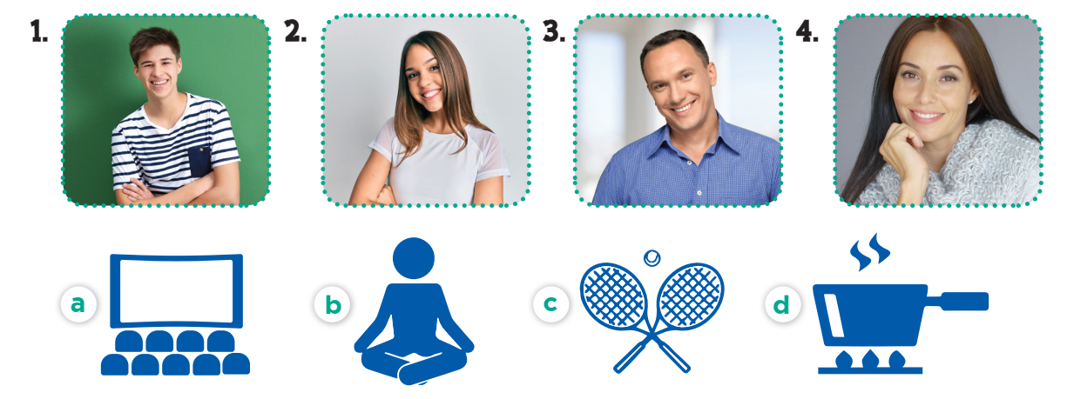
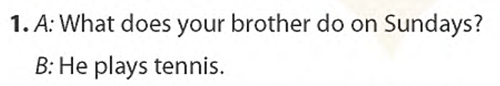
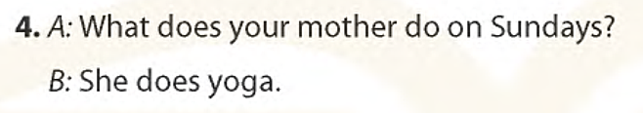
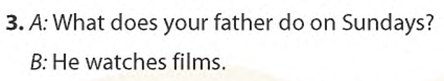


Slide 13
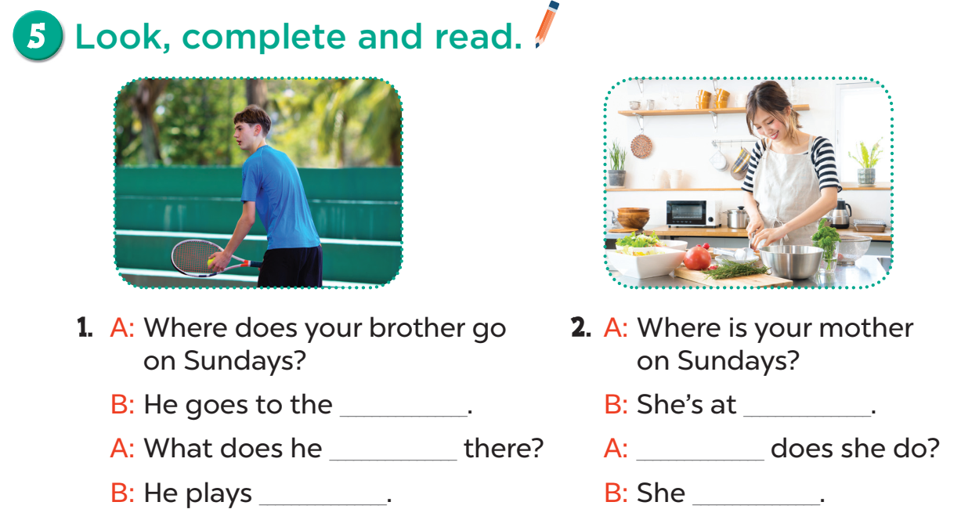

Slide 14
sports center.
home
do
What
tennis
cooks meals.

Slide 15
03
Let’s play

Slide 16
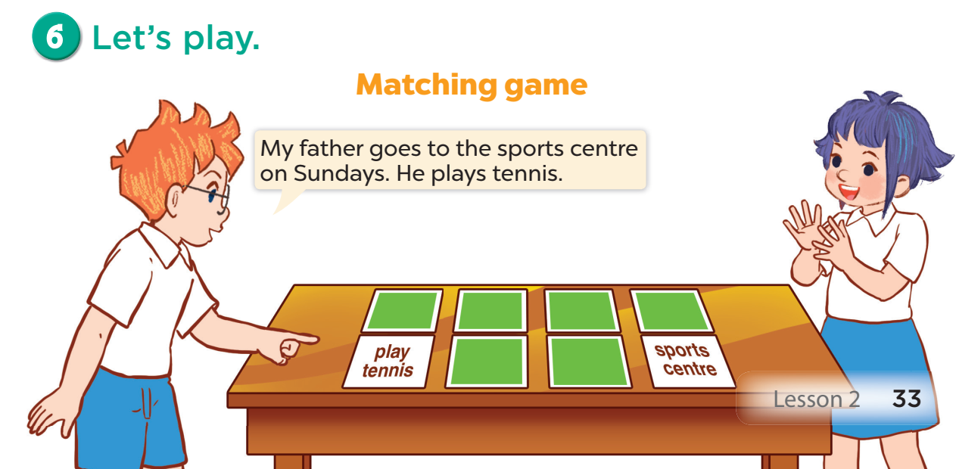

Slide 17
GOODBYE

