Slide 1


WELCOME TO MY LESSON

Slide 2
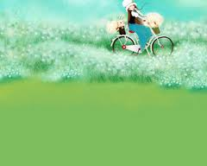

GAME:
CROSS - WORD

Slide 3
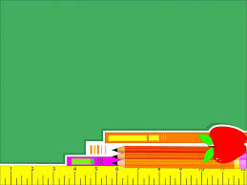
RULE:
+ There are 5 rows in the cross-word; 1 number with a row including a picture.
+ You will fill the letters in each row by seeing the picture, and answering the question: Which activity is the picture
about?

Slide 4
1
S
W
I
M
M
I
N
G
2
F
I
S
H
I
N
G
3
C
O
L
L
E
C
T
I
N
G
S
T
A
M
P
S
4
K
E
E
P
I
I
S
N
G
F
H
5
P
L
A
Y
I
N
G
T
H
E
G
U
I
T
A
R

Slide 5
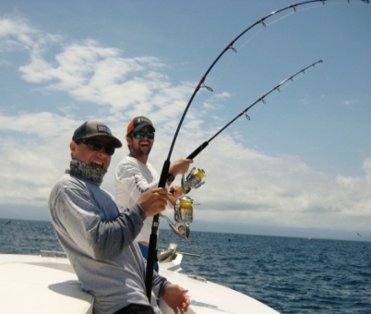
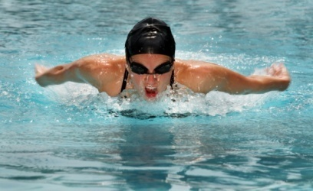
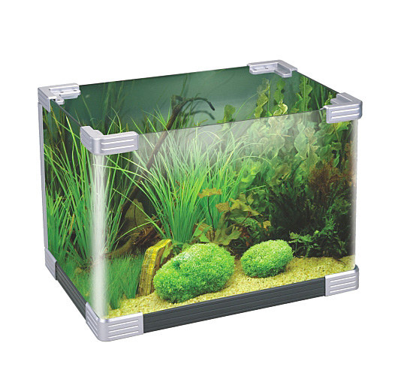
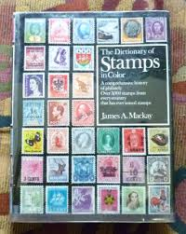
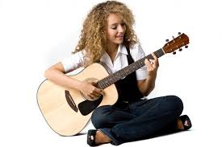
4
3
2
1
5
Which activity is the picture about?

Slide 6

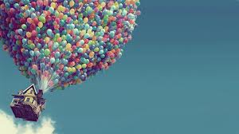
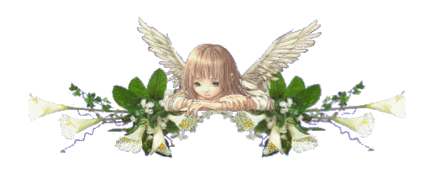
UNIT 13: HOBBIES
A - READING

Slide 7

UNIT 13: HOBBIES - READING
Before you read
Look at the pictures and name of the activities

Slide 8
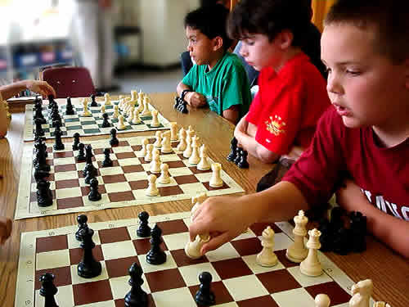
PLAYING THE GUITAR
COLLECTING STAMPS
PLAYING CHESS

Slide 9
KEEPING FISH
SWIMMING
FISHING

Slide 10
UNIT 13: HOBBIES - READING
Before you read
Work in pairs to ask and answer the question: “What do you like to do in your free time?”

Slide 11

UNIT 13: HOBBIES - READING
While you read

Slide 12
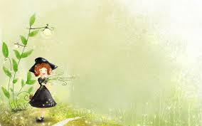
UNIT 13: HOBBIES - READING
Task 1 : Read the text then use a dictionary to get their meaning and translate them into Vietnamese.

Slide 13
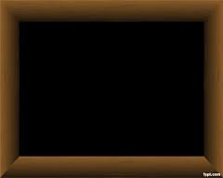
UNIT 13: HOBBIES - READING
Accomplished _{(adj )} /ə'kɔmpliʃt /
Accompanying _{(v)} /ə'kʌmpəniη/
Modest _{(adj)} /'mɔdist /
Avid _{( adj)} / 'ævid /
Discarded _{(adj)} / di’skɑ:did/
Indulge in _{( v)} / in'dʌldʒ in/
Keep me occupied / ki:p mi: 'ɒkjʊpaid /

Slide 14

Accomplished (well-trained, skilled) (a) :
tài hoa
Discarded (thrown away) (a) :
loại bỏ
Accompanying (going with a singer ,using a musical instrument) (v):
đệm đàn
Indulge in ( allow oneself the pleasure of) :
nhỏ, khiêm tốn
Modest ( humble, unasuming) (a):
đam mê vào (1 việc gì đó)
Keep me occupied (keep me busy) :
Avid (eager) (a):
say mê
làm cho ai bận rộn

Slide 15
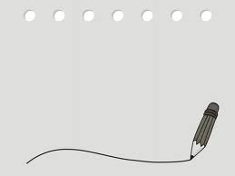
Accomplished (a) :tài hoa
Accompanying (v): đệm đàn
Modest (a): nhỏ, khiêm tốn
Avid (a): : say mê
Discarded (a) : loại bỏ
Indulge in : đam mê vào (1 việc gì đó)
Keep me occupied : làm cho ai bận rộn

Slide 16
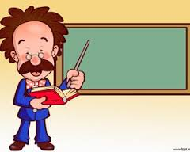
UNIT 13: HOBBIES - READING
Task 2: Scan the passage again, then work in pairs to ask and answer the questions

Slide 17

UNIT 13: HOBBIES - READING
Some tips:
Underline the key words in 7 questions.
Scan the passage again to find the answers.

Slide 18
UNIT 13: HOBBIES - READING
1. What is the writer’s first hobby?
2. Is the writer an accomplished guitarist?
3. Why does the writer admire his uncle?
4. What is the writer’s second hobby?
5. How did he collect his fish?
6. What kind of stamp collector is the writer?
7. Where does he collect the stamps?

Slide 19
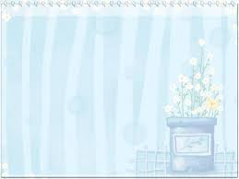
UNIT 13: HOBBIES - READING
1
What is the writer’s first hobby?
His first hobby is playing his guitar.
2
Is the writer an accomplished guitarist?
No, he isn’t.

Slide 20
UNIT 13: HOBBIES - READING
3
Why does the writer admire his uncle?
Because he is an accomplished guitarist and he is good at accompanying people singing by his guitar.
4
What is the writer’s second hobby?
His second hobby is keeping fish.

Slide 21
UNIT 13: HOBBIES - READING
5
How did he collect his fish?
He bought some from the shop and collected some from the rice field near his house.
6
What kind of stamp collector is the writer?
He is an avid stamp collector.

Slide 22
UNIT 13: HOBBIES - READING
7
Where does he collect the stamps?
He collects them from discarded envelopes his relatives and friends give him.

Slide 23
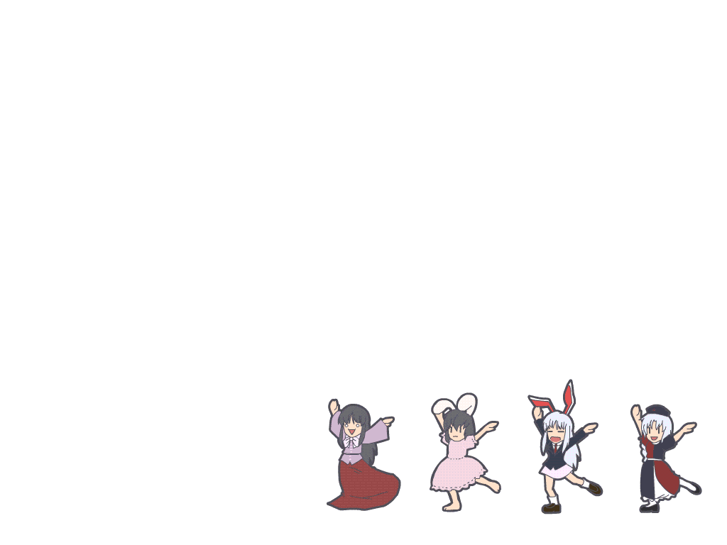


UNIT 13: HOBBIES - READING
AFTER YOU READ
Talk about your hobbies

Slide 24
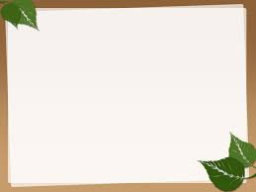

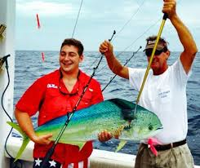
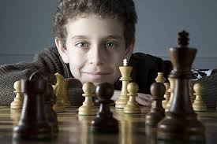
➢

Slide 25

UNIT 13: HOBBIES - READING
Guiding report:
There are a lot of things I like to do in my free time. The thing I like most is playing chess. It helps me relax after I work hard. Another thing is swimming . It keeps me have a wonderful body. I’m really glad to do them when I’m free.

Slide 26

Consolidation
- Learn the vocabulary about “Hobbies”.
- Scan for specific information (answer the questions)
- Talk about hobbies.

Slide 27

Homework:
- Assigns homework: Complete the following sentences with suitable words or phrases.
1. Now they don’t eat meat anymore. They ………..... eating a lot of vegetables.
2. Van Cao’s an ……. musician. All his songs are very popular.
3. I love all of stamps. I’m an ……. collector of stamps.
4. He doesn’t like a big house in the city. He just wants a ……….. little house in the country.
5. I spend free time collecting stamps. They really make me ………….
- Asks sts to prepare for the new lesson: Unit 13 – Part B. Speaking

Slide 28


THANK YOU FOR YOUR COOPERATION

