Slide 1









OUR CLASS 5D

Slide 2
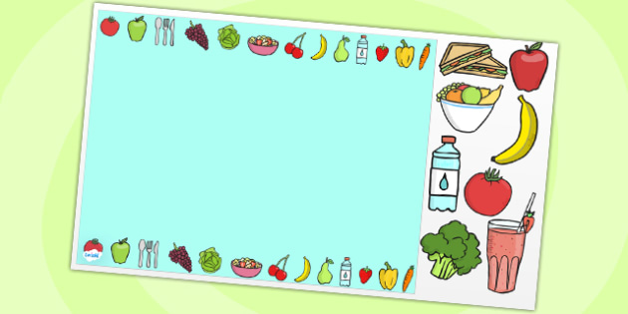
Warm-up :GUESSING GAME

Slide 3

GUESSING GAME

Slide 4

GUESSING GAME

Slide 5

GUESSING GAME

Slide 6

GUESSING GAME

Slide 7

GUESSING GAME

Slide 8






Slide 9

UNIT 17 : WHAT WOULD YOU LIKE TO EAT?
Lesson 1-part 1,2,3.

Slide 10

I. New words
rice
a bowl of
noodles

Slide 11

I. New words
a packet of
biscuits
biscuits

Slide 12

I. New words
a bar of
chocolate

Slide 13


I. New words
water
a glass of
orange juice

Slide 14


I. New words
a carton of
milk
lemonade

Slide 15

MATCHING GAME

Slide 16

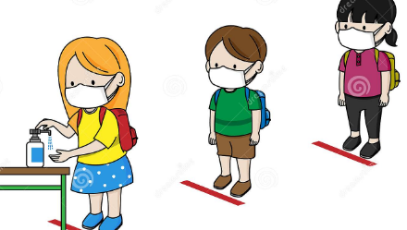




What would you like to eat?
What would you like to drink?
I’d like , please.
a bowl of noodles
a carton of milk

Slide 17

II. Model sentences
What would you like to eat/ drink?
I’d like + (food/ drink), please.
What did you do yesterday?
I watered the flowers

Slide 18
III. Practice

Slide 19
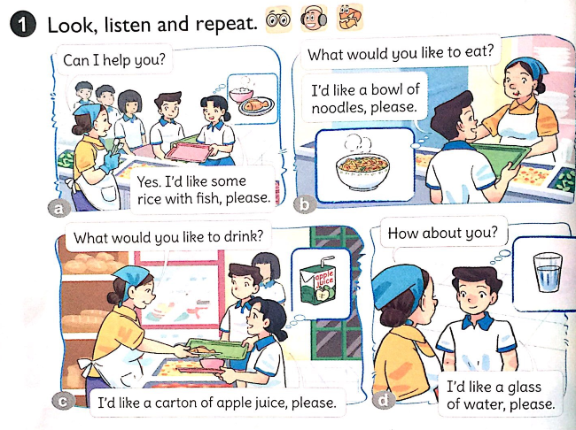


Slide 20
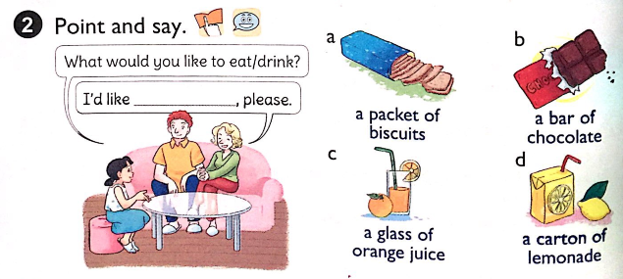

Slide 21


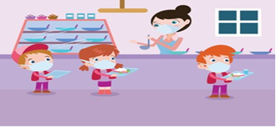





Slide 22

PASS THE BALL

Slide 23



Slide 24

IV. Consolidation
“What would you like to eat or drink?
Eat or drink, eat or drink.
What would you like to eat or drink?
A packet of biscuits”.

Slide 25


Thank you for your listening

