Slide 1


Slide 2
LOOKING BACK AND PROJECT
Unit
9
SOCIAL ISSUES
Unit
FAMILY LIFE
11TH GRADE
Lesson 8

Slide 3
LESSON 8
LOOKING BACK AND PROJECT
WARM-UP
Video watching
Pronunciation: Mark the intonation.
Vocabulary: Crossword
Grammar: Choose the correct answer to complete each sentence.
LOOKING BACK
PROJECT
A social awareness campaign
CONSOLIDATION
Wrap up
Homework

Slide 4
WARM-UP
Watch the video and decide if the sentences are using rising or
falling intonation.

Slide 5

Watch the video and decide if the sentences are using rising or falling intonation.

Slide 6
ANSWER

Slide 7


PRONUNCIATION
Mark the intonation in these questions.
1. Should we report bullying to teachers or speak to our parents first?
2. Is this social awareness campaign about poverty or crime?
3. Have you ever experienced any physical, verbal, or social bullying?
4. Do you worry about peer pressure, body shaming, or bullying?

Slide 8
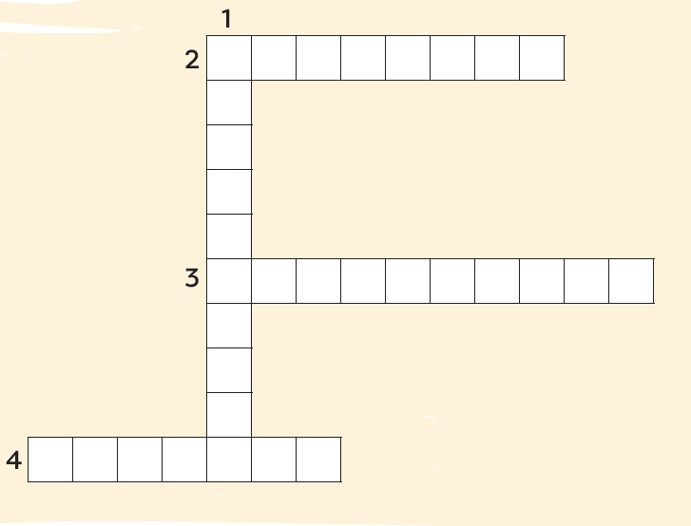
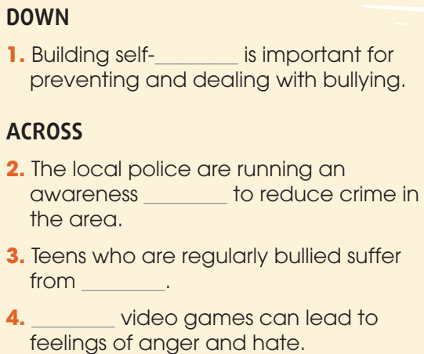
VOCABULARY
Solve the crossword.
C
A
M
P
A
I
G
N
O
N
F
I
D
E
P
R
E
S
S
I
O
N
E
N
C
V
I
O
L
E
N
T

Slide 9


GRAMMAR
Choose the correct answer to complete each sentence below.
1. We started a campaign against bullying in our school. However / In addition, we organised classes for teens to try new things and become more confident.
2. Sharing someone’s personal information online is illegal. Therefore / Moreover, you should be very careful about what you post online.

Slide 10
GRAMMAR
Choose the correct answer to complete each sentence below.
3. Because / Because of our health campaign was successful, more teenagers now eat healthy food and exercise regularly.
4. Although / In spite of all our efforts, we were not able to solve the problem.

Slide 11
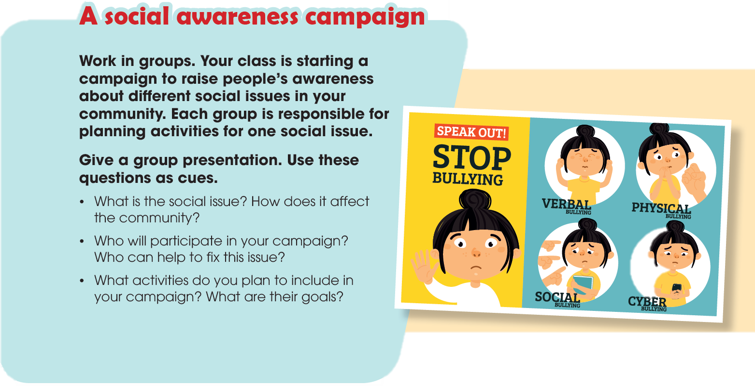
PROJECT

Slide 12


CONSOLIDATION
Review the vocabulary and grammar of Unit 9.
Plan activities for a campaign to raise people's awareness about a social issue and give a group presentation about it.

Slide 13

CONSOLIDATION
Do exercises in the workbook.
Prepare for Unit 10.

Slide 14

Website: hoclieu.vn
Fanpage: facebook.com/www.tienganhglobalsuccess.vn/

