Slide 2
Unit
8
1
FAMILY LIFE
Unit
NEW WAYS TO LEARN
LESSON 1
GETTING STARTED
New learning activities

Slide 3
Unit
1
1
OBJECTIVES
FAMILY LIFE
Unit
Family Life
1. Knowledge
- Be aware of the new learning activities and their importance
- Expand vocabulary of the topic 'New learning activities' and practice them
- Get to know the language aspect: relative pronouns
- Read and listen for specific information in the task 'True or False'
2. Skills
- Develop listening and reading skills
- Be collaborative and supportive in pair work and teamwork
3. Attitude
- Familiarize with new learning activities
- Develop self-study skills

Slide 4
LESSON 1
GETTING STARTED
GETTING STARTED
WARM-UP
Game: Kahoot!
I. PRESENTATION
Vocabulary
Task 1: Listen and read.
Task 2: Read the conversation again and tick (✔) T (True) or F (False).
Task 3: Complete the sentences.
Task 4: Speak
II. PRACTICE
CONSOLIDATION
Wrap-up
Homework

Slide 5
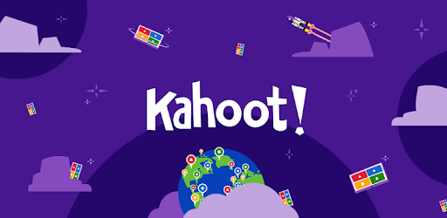
LESSON 1
GETTING STARTED
Unit
GETTING STARTED
*WARM-UP: Game 'Kahoot!'
https://create.kahoot.it/share/new-learning-activities/e8e880dc-82c5-49f2-b944-747e2451e166

Slide 6
Pairwork
Groupwork
Debate
???
LEARNING ACTIVITIES
Experiment
Project
Presentation

Slide 7
PRE-LISTENING
Vocabulary
Groupwork | /ˈɡruːp wɜːk/ | Làm việc theo nhóm
Pairwork | /peə(r) wɜːk/ | Làm việc theo đôi
Presentation | /ˌpreznˈteɪʃn/ | Bài thuyết trình
Debate | /dɪˈbeɪt/ | Tranh luận
Project | /ˈprɒdʒekt/ | Dự án
Experiment | /ɪkˈsperɪmənt/ | Thí nghiệm

Slide 8
LESSON 1
GETTING STARTED
Unit
GETTING STARTED
WARM-UP
Game: Kahoot!
PRESENTATION
Vocabulary

Slide 9
PRESENTATION
***Vocabulary game: WHO IS FASTER?
- Team A & B: 6 verbs
- 6 phrases on the board
- Each team: go to the board, stick your cards to form a correct phrase.
Example:
A
wear
a mask
B
wear

Slide 10
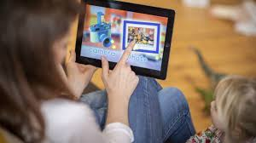
PRESENTATION
upload
1. ............ a video

Slide 11
PRESENTATION
find
2. ............ information
~ search for information

Slide 12
PRESENTATION
discuss
3. ............ a topic

Slide 13
PRESENTATION
4. ............ notes
take

Slide 14
PRESENTATION
prepare
5. ............ materials

Slide 15
PRESENTATION
do
6. ............ a project

Slide 16
PRESENTATION
Vocabulary
1. upload a video
2. find/search for information
3. discuss a topic
4. take notes
5. prepare materials
6. do a project
đăng tải video
tìm thông tin
thảo luận về một đề tài
ghi chép
chuẩn bị tài liệu
làm dự án

Slide 17
LESSON 1
GETTING STARTED
Unit
GETTING STARTED
WARM-UP
Game: Kahoot!
I. PRESENTATION
Vocabulary
Task 1: Listen and read.
Task 2: Tick (✔) T (True) or F (False).
Task 3: Complete the sentences.
Task 4: Speak
II. PRACTICE

Slide 18
PRESENTATION
1
Listen and read.
New learning activities (page 86)
Long: Hi, Nick. What are you doing?
Nick: I’m watching the video that my geography teacher uploaded on Eclass.
Long: Really? What is it about?
Nick: It’s about global warming. My teacher asked us to watch the video and find more information about this topic.
Long: So, is watching the video part of your homework?
Nick: Yes, then next week, we’ll work in groups and discuss the topic in class.
Long: Sounds interesting. You can watch the video many times and also search for more information at home.
Nick: You’re right. I’m not good at taking notes in class, you know. So I prefer this way of learning. It gives me a chance to discuss with my classmates, who may have original ideas on the topic.
Long: Does your teacher often ask you to prepare materials at home and discuss in class, Nick?
Nick: Yes, she does. We’re doing a lot of projects that help us understand the lessons better. This way of studying, which gives us more control over our own learning, is quite useful.
Long: You’re lucky. My teachers use very traditional methods of teaching at my schools. I wish I could try these new learning activities.
What are Long and Nick talking about???

Slide 19
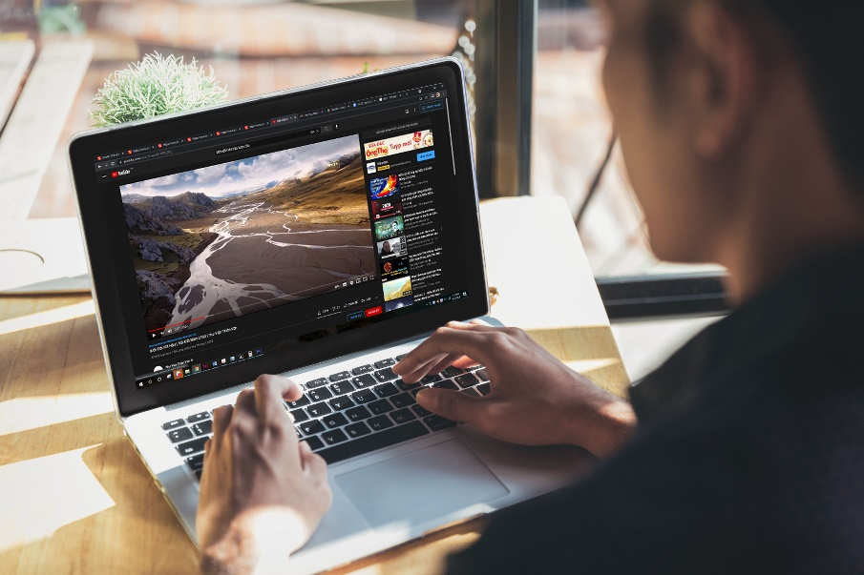
PRACTICE
1
Listen and read.
New learning activities (page 86)
Long: Hi, Nick. What are you doing?
Nick: I’m watching the video that my geography teacher uploaded on Eclass.
Long: Really? What is it about?
Nick: It’s about global warming. My teacher asked us to watch the video and find more information about this topic.
Long: So, is watching the video part of your homework?
Nick: Yes, then next week, we’ll work in groups and discuss the topic in class.
Long: Sounds interesting. You can watch the video many times and also search for more information at home.
Nick: You’re right. I’m not good at taking notes in class, you know. So I prefer this way of learning. It gives me a chance to discuss with my classmates, who may have original ideas on the topic.
Long: Does your teacher often ask you to prepare materials at home and discuss in class, Nick?
Nick: Yes, she does. We’re doing a lot of projects that help us understand the lessons better. This way of studying, which gives us more control over our own learning, is quite useful.
Long: You’re lucky. My teachers use very traditional methods of teaching at my schools. I wish I could try these new learning activities.
They are talking about:
- Nick's geography homework about global warming.
- their ways of learning: watching a video, working in groups, doing projects...

Slide 20
PRACTICE
2
Read the conversation in pairs and tick () T (True) or F (False). (part 2, p.87)
STATEMENT | TRUE | FALSE
1. Nick is preparing for his next geography class.
2. Nick’s note taking skills are quite good.
3. Nick’s class is working on many projects now.

Slide 21
PRACTICE
4
Match steps to do 'TRUE or FALSE' task:
......???........
STEP 1
.......???.........
STEP 2
.......???.........
STEP 3
.......???.........
STEP 4
- Find SIMILAR WORDS in the text
- Identify KEY WORDS (nouns, verbs, adjectives) in the statement
- If the same --> True. If opposite --> False
- Evaluate if KEY WORDS and SIMILAR WORDS are the same or opposite

Slide 22
PRACTICE
4
Match steps to do 'TRUE or FALSE' task:
......???........
STEP 1
.......???.........
STEP 2
.......???.........
STEP 3
.......???.........
STEP 4
- Find SIMILAR WORDS in the text
- Identify KEY WORDS (nouns, verbs, adjectives) in the statement
- If they are the same --> True. If they are opposite --> False
- Evaluate if KEY WORDS and SIMILAR WORDS are the same or opposite

Slide 23
CORRECTION
STATEMENT | TRUE | FALSE
1. Nick is preparing for his next geography class.
✓
Long: Hi, Nick. What are you doing?
Nick: I’m watching the video that my geography teacher uploaded on Eclass.
Long: Really? What is it about?
Nick: It’s about global warming. My teacher asked us to watch the video and find more information about this topic.
Long: So, is watching the video part of your homework?
Nick: Yes, then next week, we’ll work in groups and discuss the topic in class.
Long: Sounds interesting. You can watch the video many times and also search for more information at home.
Nick: You’re right. I’m not good at taking notes in class, you know. So I prefer this way of learning. It gives me a chance to discuss with my classmates, who may have original ideas on the topic.
Long: Does your teacher often ask you to prepare materials at home and discuss in class, Nick?
Nick: Yes, she does. We’re doing a lot of projects that help us understand the lessons better. This way of studying, which gives us more control over our own learning, is quite useful.
Long: You’re lucky. My teachers use very traditional methods of teaching at my schools. I wish I could try these new learning activities.

Slide 24
CORRECTION
STATEMENT | TRUE | FALSE
2. Nick’s note taking skills are quite good.
not good.
✓
Long: Hi, Nick. What are you doing?
Nick: I’m watching the video that my geography teacher uploaded on Eclass.
Long: Really? What is it about?
Nick: It’s about global warming. My teacher asked us to watch the video and find more information about this topic.
Long: So, is watching the video part of your homework?
Nick: Yes, then next week, we’ll work in groups and discuss the topic in class.
Long: Sounds interesting. You can watch the video many times and also search for more information at home.
Nick: You’re right. I’m not good at taking notes in class, you know. So I prefer this way of learning. It gives me a chance to discuss with my classmates, who may have original ideas on the topic.
Long: Does your teacher often ask you to prepare materials at home and discuss in class, Nick?
Nick: Yes, she does. We’re doing a lot of projects that help us understand the lessons better. This way of studying, which gives us more control over our own learning, is quite useful.
Long: You’re lucky. My teachers use very traditional methods of teaching at my schools. I wish I could try these new learning activities.

Slide 25
CORRECTION
STATEMENT | TRUE | FALSE
3. Nick’s class is working on many projects now.
✓
Long: Hi, Nick. What are you doing?
Nick: I’m watching the video that my geography teacher uploaded on Eclass.
Long: Really? What is it about?
Nick: It’s about global warming. My teacher asked us to watch the video and find more information about this topic.
Long: So, is watching the video part of your homework?
Nick: Yes, then next week, we’ll work in groups and discuss the topic in class.
Long: Sounds interesting. You can watch the video many times and also search for more information at home.
Nick: You’re right. I’m not good at taking notes in class, you know. So I prefer this way of learning. It gives me a chance to discuss with my classmates, who may have original ideas on the topic.
Long: Does your teacher often ask you to prepare materials at home and discuss in class, Nick?
Nick: Yes, she does. We’re doing a lot of projects that help us understand the lessons better. This way of studying, which gives us more control over our own learning, is quite useful.
Long: You’re lucky. My teachers use very traditional methods of teaching at my schools. I wish I could try these new learning activities.

Slide 26
PRACTICE
3
Complete the sentences with ONE word only. (part 4, page 87)
1. Nick is watching the video _______ his geography teacher uploaded on Eclass.
2. This way of learning gives him a chance to discuss with his classmates, _______ may have original ideas on the topic.
3. They are doing a lot of projects _______ help them understand the lessons better.
4. That way of studying, _______ gives them more control over their own learning, is quite useful

Slide 27
CORRECTION
that
1. Nick is watching the video ________ his geography teacher uploaded on Eclass.
Long: Hi, Nick. What are you doing?
Nick: I’m watching the video that my geography teacher uploaded on Eclass.
Long: Really? What is it about?
Nick: It’s about global warming. My teacher asked us to watch the video and find more information about this topic.
Long: So, is watching the video part of your homework?
Nick: Yes, then next week, we’ll work in groups and discuss the topic in class.
Long: Sounds interesting. You can watch the video many times and also search for more information at home.
Nick: You’re right. I’m not good at taking notes in class, you know. So I prefer this way of learning. It gives me a chance to discuss with my classmates, who may have original ideas on the topic.
Long: Does your teacher often ask you to prepare materials at home and discuss in class, Nick?
Nick: Yes, she does. We’re doing a lot of projects that help us understand the lessons better. This way of studying, which gives us more control over our own learning, is quite useful.
Long: You’re lucky. My teachers use very traditional methods of teaching at my schools. I wish I could try these new learning activities.

Slide 28
CORRECTION
2. This way of learning gives him a chance to discuss with his classmates, _______ may have original ideas on the topic.
who
Long: Hi, Nick. What are you doing?
Nick: I’m watching the video that my geography teacher uploaded on Eclass.
Long: Really? What is it about?
Nick: It’s about global warming. My teacher asked us to watch the video and find more information about this topic.
Long: So, is watching the video part of your homework?
Nick: Yes, then next week, we’ll work in groups and discuss the topic in class.
Long: Sounds interesting. You can watch the video many times and also search for more information at home.
Nick: You’re right. I’m not good at taking notes in class, you know. So I prefer this way of learning. It gives me a chance to discuss with my classmates, who may have original ideas on the topic.
Long: Does your teacher often ask you to prepare materials at home and discuss in class, Nick?
Nick: Yes, she does. We’re doing a lot of projects that help us understand the lessons better. This way of studying, which gives us more control over our own learning, is quite useful.
Long: You’re lucky. My teachers use very traditional methods of teaching at my schools. I wish I could try these new learning activities.

Slide 29
CORRECTION
that
3. They are doing a lot of projects _____ help them understand the lessons better.
Long: Hi, Nick. What are you doing?
Nick: I’m watching the video that my geography teacher uploaded on Eclass.
Long: Really? What is it about?
Nick: It’s about global warming. My teacher asked us to watch the video and find more information about this topic.
Long: So, is watching the video part of your homework?
Nick: Yes, then next week, we’ll work in groups and discuss the topic in class.
Long: Sounds interesting. You can watch the video many times and also search for more information at home.
Nick: You’re right. I’m not good at taking notes in class, you know. So I prefer this way of learning. It gives me a chance to discuss with my classmates, who may have original ideas on the topic.
Long: Does your teacher often ask you to prepare materials at home and discuss in class, Nick?
Nick: Yes, she does. We’re doing a lot of projects that help us understand the lessons better. This way of studying, which gives us more control over our own learning, is quite useful.
Long: You’re lucky. My teachers use very traditional methods of teaching at my schools. I wish I could try these new learning activities.

Slide 30
CORRECTION
which
4. That way of studying, _______ gives them more control over their own learning, is quite useful.
Long: Hi, Nick. What are you doing?
Nick: I’m watching the video that my geography teacher uploaded on Eclass.
Long: Really? What is it about?
Nick: It’s about global warming. My teacher asked us to watch the video and find more information about this topic.
Long: So, is watching the video part of your homework?
Nick: Yes, then next week, we’ll work in groups and discuss the topic in class.
Long: Sounds interesting. You can watch the video many times and also search for more information at home.
Nick: You’re right. I’m not good at taking notes in class, you know. So I prefer this way of learning. It gives me a chance to discuss with my classmates, who may have original ideas on the topic.
Long: Does your teacher often ask you to prepare materials at home and discuss in class, Nick?
Nick: Yes, she does. We’re doing a lot of projects that help us understand the lessons better. This way of studying, which gives us more control over our own learning, is quite useful.
Long: You’re lucky. My teachers use very traditional methods of teaching at my schools. I wish I could try these new learning activities.

Slide 31
Long: Hi, Nick. What are you doing?
Nick: I’m watching the video that my geography teacher uploaded on Eclass.
Long: Really? What is it about?
Nick: It’s about global warming. My teacher asked us to watch the video and find more information about this topic.
Long: So, is watching the video part of your homework?
Nick: Yes, then next week, we’ll work in groups and discuss the topic in class.
Long: Sounds interesting. You can watch the video many times and also search for more information at home.
Nick: You’re right. I’m not good at taking notes in class, you know. So I prefer this way of learning. It gives me a chance to discuss with my classmates, who may have original ideas on the topic.
Long: Does your teacher often ask you to prepare materials at home and discuss in class, Nick?
Nick: Yes, she does. We’re doing a lot of projects that help us understand the lessons better. This way of studying, which gives us more control over our own learning, is quite useful.
Long: You’re lucky. My teachers use very traditional methods of teaching at my schools. I wish I could try these new learning activities.
RELATIVE PRONOUNS

Slide 32
PRACTICE
4
Talk about your favorite learning activity, choosing ONE from 6 activities below.
Pairwork
Groupwork
Debate
???
LEARNING ACTIVITIES
Experiment
Project
Presentation

Slide 33
PRACTICE
4
Talk about your favorite learning activity in 2 minutes.
1. What is it called? (debate, presentation, experiment ...)
2. In what subject have you applied this learning activity?
3. What have you learnt from this activity? (teamwork, note-taking, confidence....)
Marking criteria:
Task achievement: answer all 3 questions above
Pronunciation
Fluency
Vocabulary: use words/phrases we have learnt today
Grammar
10
✓
✓
✓
✓
✓

Slide 34
LESSON 1
GETTING STARTED
GETTING STARTED
WARM-UP
Game: Kahoot!
I. PRESENTATION
Vocabulary
Task 1: Listen and read.
Task 2: Read the conversation again and tick (✔) T (True) or F (False).
Task 3: Complete the sentences.
Task 4: Speak
II. PRACTICE
CONSOLIDATION
Wrap-up
Homework

Slide 35
CONSOLIDATION
1
Wrap-up: What have we learnt today?
- Learn language items:
+ Words/phrases related to topic 'New learning activities'
+ Grammar: relative pronouns
- Get to know different learning activities and how they are done in and out of class.

Slide 36
CONSOLIDATION
2
Homework
- Practice the words/phrases in Vocabulary section
- Do the exercises: Unit 8 - Lesson 1, Workbook

Slide 37
Website: hoclieu.vn
Fanpage: facebook.com/tienganhglobalsuccess.vn/

