Slide 1
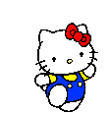
WARMLY WELCOME TO OUR CLASS

Slide 3
Unit
10
1
Unit
FAMILY LIFE
ECOTOURISM
LESSON 4
SPEAKING
How to become an ecotourist

Slide 4
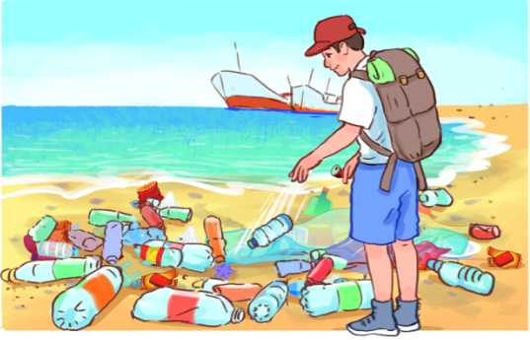
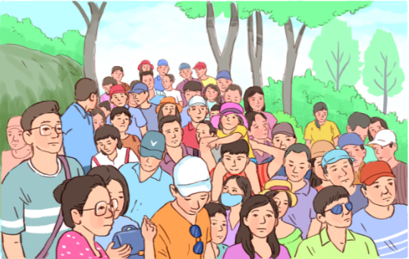
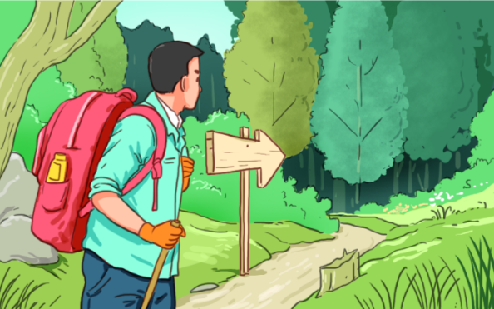
WARM-UP
1
Match each verb with a phrase. Use the pictures to help you.
1. litter
2. avoid
3. follow
c. on the beach or the street
d. crowded places
a. walking paths and trails

Slide 5
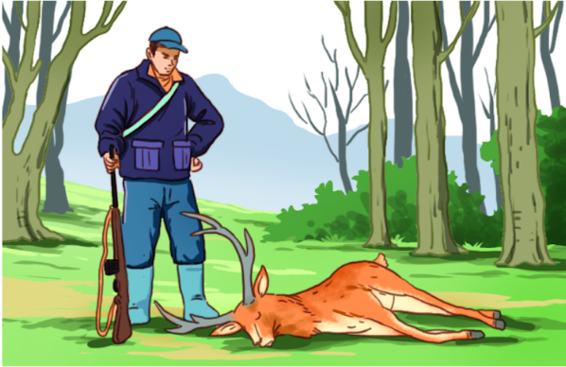
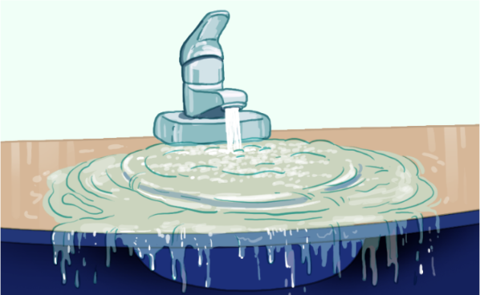
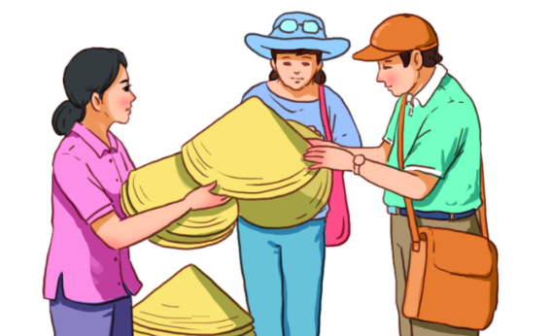
1
Match each verb with a phrase. Use the pictures to help you.
4. hunt
5. waste
6. buy
b. wild animals
f. water and electricity
e. locally made souvenirs

Slide 6
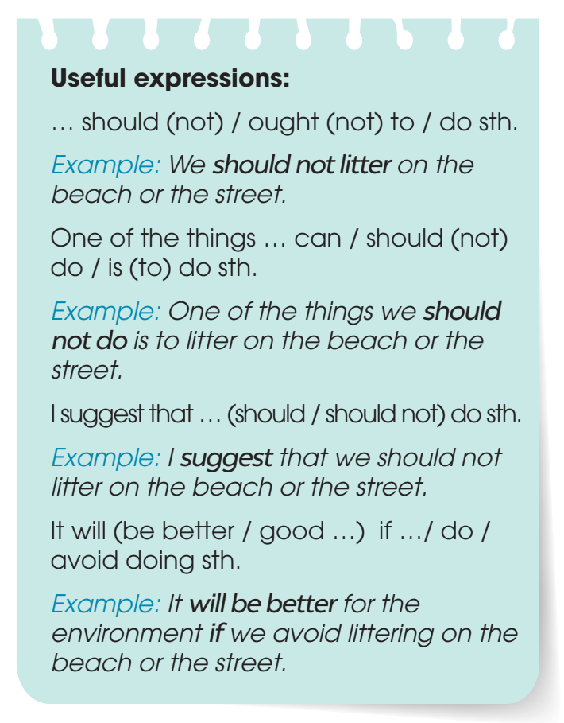
2
Work in pairs. discuss which of the things in Task 1 we should or should not do to become ecotourists. Use the expressions below to help you.

Slide 7
1
Match each verb with a phrase. Use the pictures to help you.
1. litter
2. avoid
3. follow
c. on the beach or the street
d. crowded places
a. walking paths and trails

Slide 8
1
Match each verb with a phrase. Use the pictures to help you.
4. hunt
5. waste
6. buy
b. wild animals
f. water and electricity
e. locally made souvenirs

Slide 9
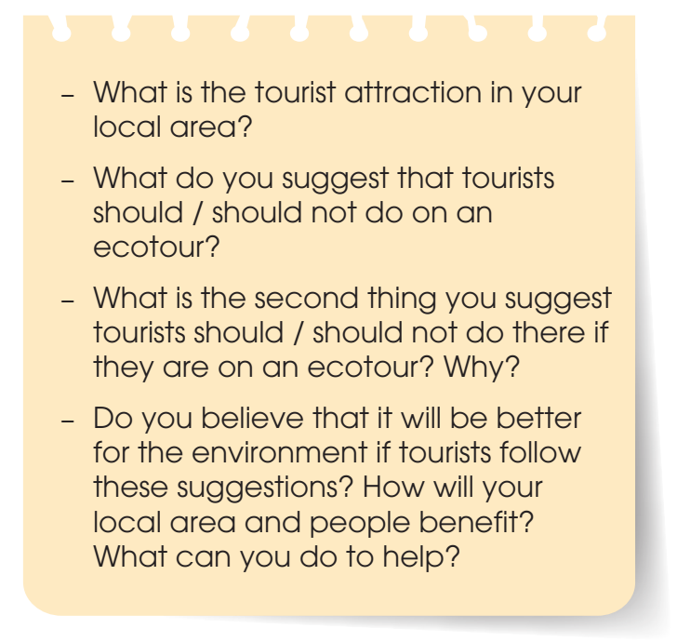
3
Work in groups. Talk about what tourists should or should not do if they are on an ecotour to a tourist attraction in your local area. Use the discussion questions below to help you.

Slide 10
4
Share your ideas with the whole class. Vote for the best ideas.

Slide 11
Talk about how to become an ecotourist

Slide 12
CONSOLIDATION
2
Homework
Prepare for the next lesson: Unit 10 – Listening
2. Do exercises in the workbook

Slide 13
Website: hoclieu.vn
Fanpage: facebook.com/tienganhglobalsuccess.vn/

