Slide 1





ENGLISH 10
UNIT 10
ECOTOURISM
-----------------------------
Lesson 7 : Communication & Culture

Slide 2
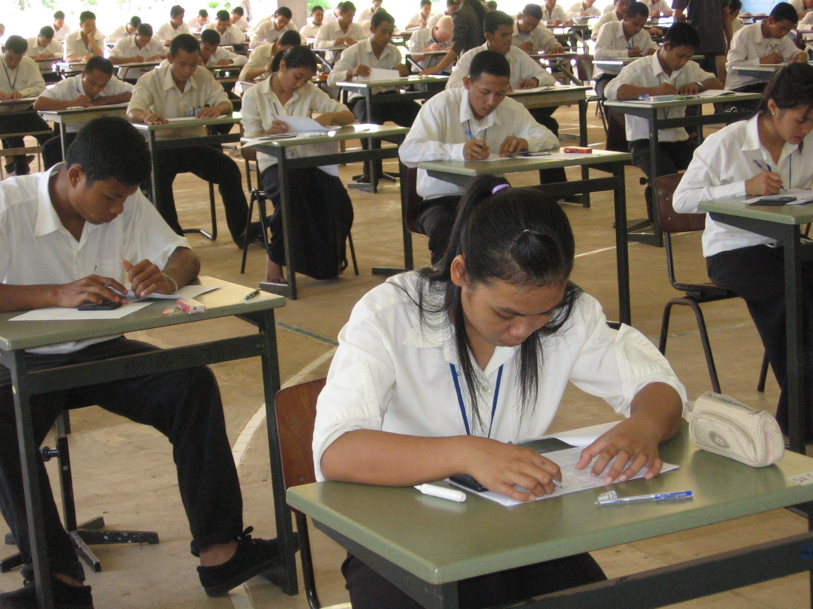
A stressful exam

Slide 3
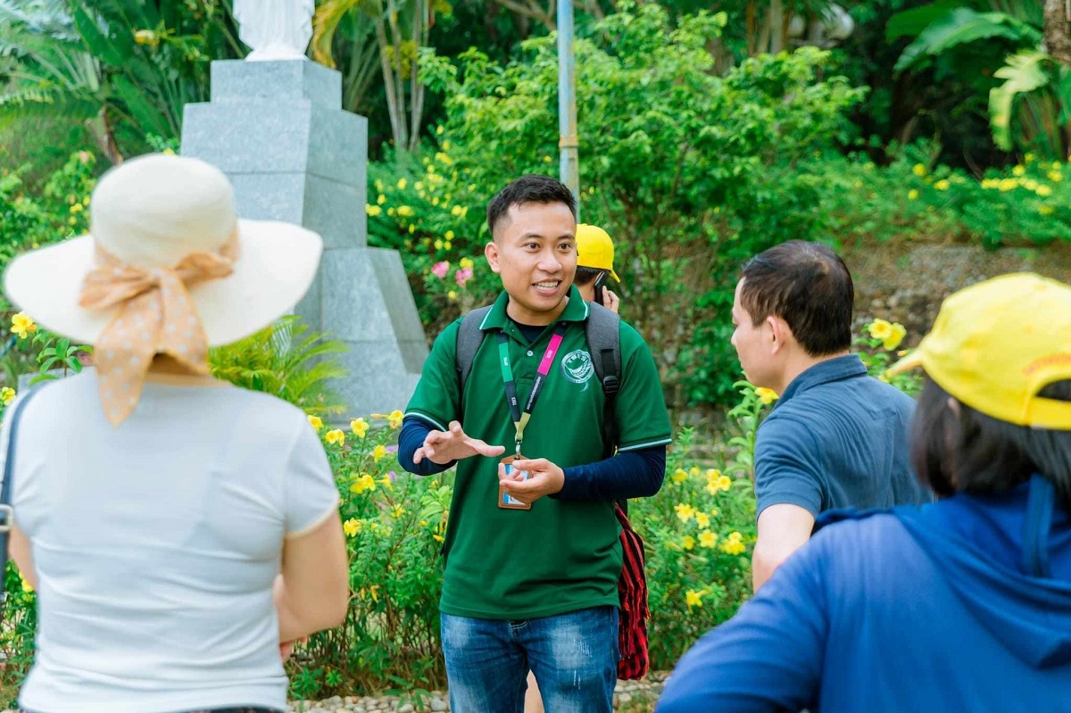
What kinds of advice do you need before a tour/trip?
what clothes to wear
what equipment to bring
what activities to do
what/where to eat

Slide 4
Unit
ECOTOURISM
Unit 10
Lesson 7: Communication & Culture
(page 117)
I. EVERYDAY ENGLISH:
ASKING FOR AND GIVING ADVICE
Task 1.
Listen to a conversation between a woman and a tour guide.
Fill in each gap with ONE word you hear.
Then practice it with your partner

Slide 5
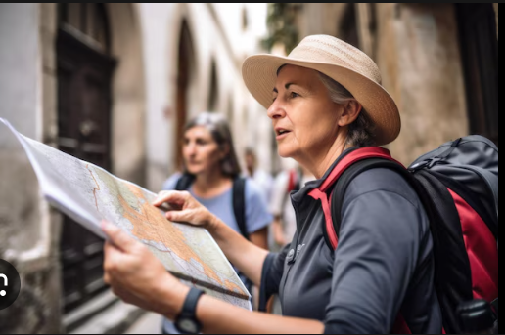
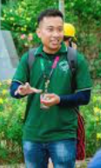
https://www.sachmem.vn/trial/books/293/exercises/48952/169?type=teacher
Woman: Excuse me. What do you think we (1)……. wear tomorrow?
Guide: Well, it may be windy on the beach, so if I (2)……… you, I would bring some warm clothes.
Woman: Thanks. And my friend is interested in diving. (3)……… he bring his equipment?
Guide: I don’t think that would be a good idea because the sea will probably be rough tomorrow. I’d (4)……… surfing instead. People can rent surfboards and wetsuits at the beach shop.
Woman: That’s a great idea. Thanks! task 1.mp3

Slide 6
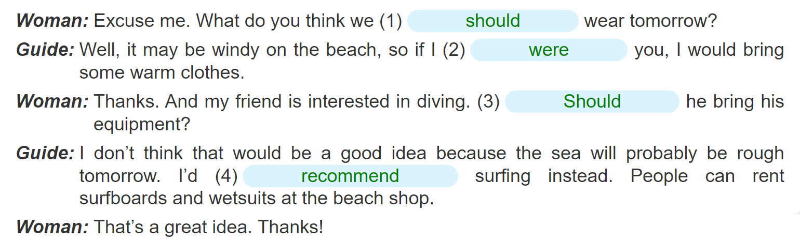
Practice with your partner:

Slide 7
Task 2.
Work in pairs. Make similar conversations asking for and giving advice
about trips. Use the expressions below to help you:
Useful expressions
Asking for advice | Giving advice
Can you help me (with (sth))? I have a problem and I need your help / advice. Should I (do sth)? What do you think I should (do / bring...)? | You should / ought to / had better (do sth). It’s / It’ll be a good idea (to do sth). If I were you, I would (do sth). What about / How about (doing sth)? Why don’t you (do sth)? I’d recommend (doing sth).

Slide 8
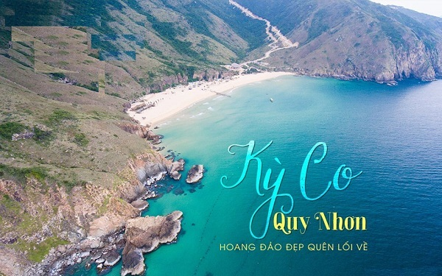
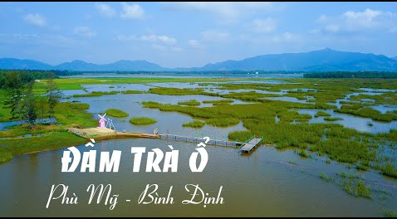
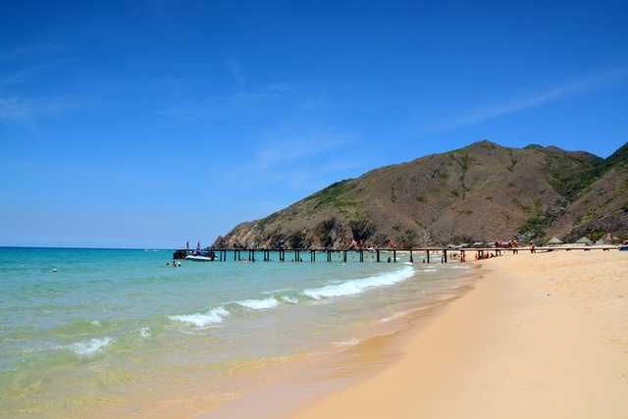
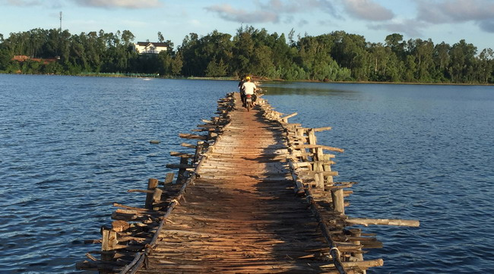
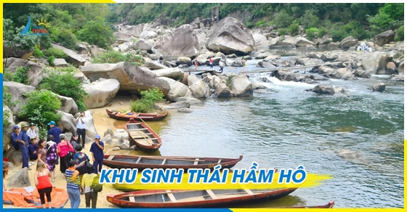
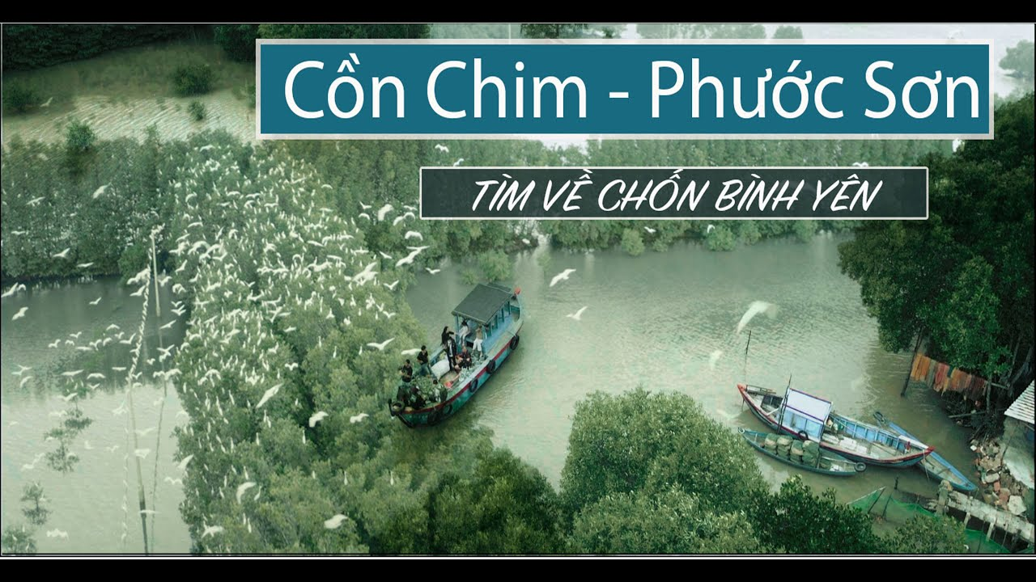
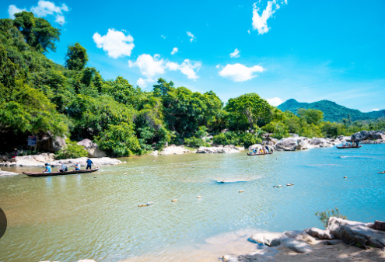
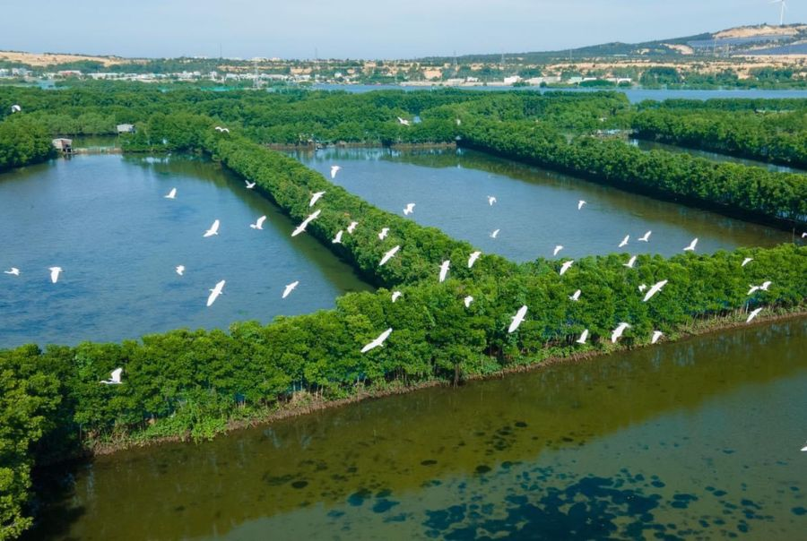
Destinations in Binh Dinh
TRA O LAGOON
KY CO BEACH
HAM HO ECOTOURISM AREA
CON CHIM ECOTOURSIM AREA

Slide 9
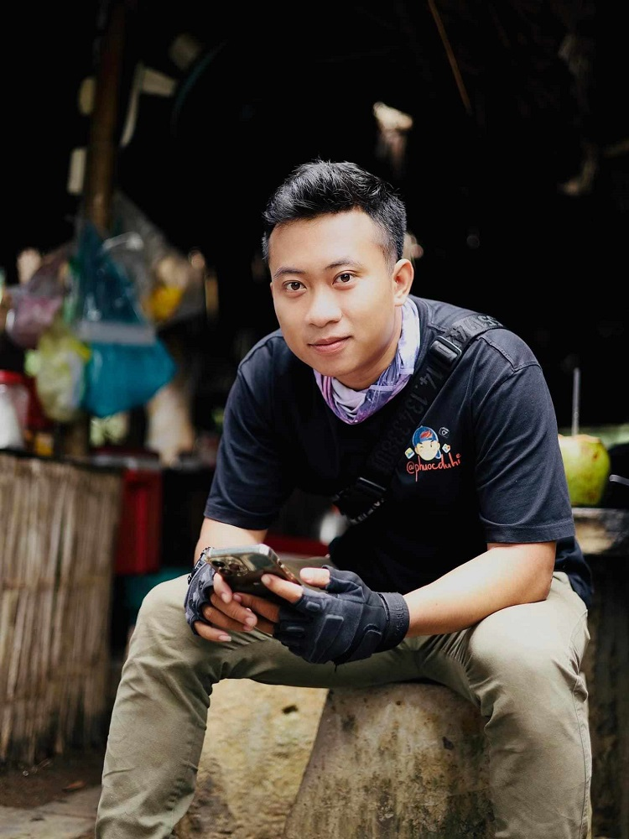
Make a similar conversation:
I would like to visit ……………………
Can you help me with some information about ………..?
What can I wear and bring ?
What do you think I should bring my camera?
Ky Co is a beautiful natural beach in Binh Dinh. Come here, you can ….
I think you should bring ….

Slide 10
Suggested answer:
Woman: Excuse me. I have a problem and I need your advice.
Guide: What’s the matter?
Woman: Well, I have an eco-tour to Binh Dinh with my colleagues. What should I bring?
Guide: You had better bring swimwear as there are many beautiful beaches. You also take fashionable clothes with you to check.
Woman: Right. And we plan to enjoy seafood in the evening. That would be wonderful!
Guide: If I were you, I would enjoy seafood in the afternoon and a light breakfast.
Woman: That’s a great idea. Thanks!

Slide 11
Unit
ECOTOURISM
Unit 10
Lesson 7: Communication & Culture
(page 117)
I. EVERYDAY ENGLISH:
ASKING FOR AND GIVING ADVICE
II. CLIL:
ENVIRONMENTAL IMPACT OF TOURISM

Slide 12
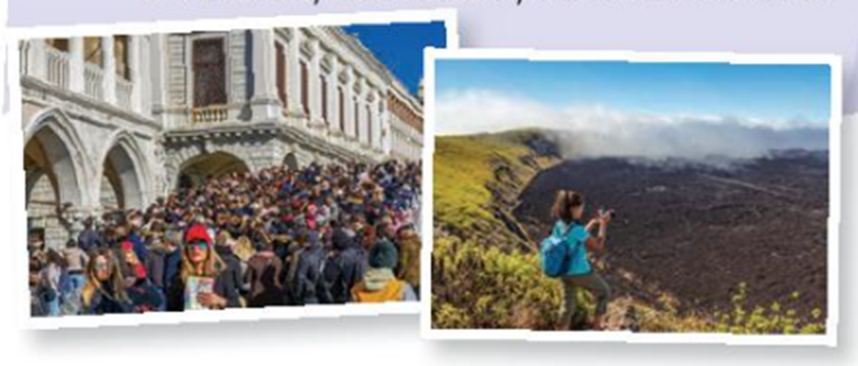
PRE-READING QUESTION:
1. What kinds of impact does tourism have on the environment?
-> negative and positive
=> i. Mass tourism
ii. Ecotourism
iii. Sustainable tourism
iv. Responsible tourism
2. Name some types of tourism do you know?
3. Look at the two pictures on page 117 in TB:
think of opposite adjectives to describe them
p1: crowded, noisy,
polluted
P2: private, quiet,
eco-friendly
4. Why is tourism called “ the smokeless industry”?
=> not make or manufacture an actual product and non-polluting

Slide 13
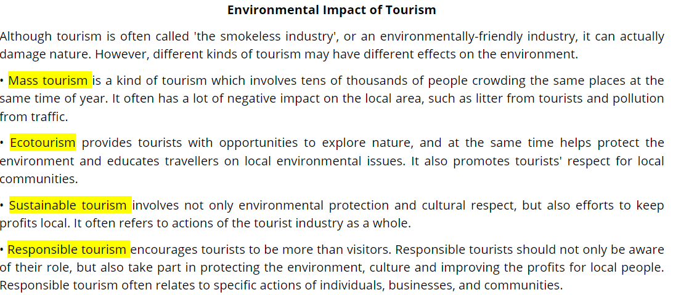
CLIL: Task 1.
Read the text below and fill in each gap in the table below with ONE
of the highlighted words from the text:
NEGATIVE IMPACT | POSITIVE IMPACT
(1) …………………………………………… | (2) …………………………………………… (3) …………………………………………… (4) ……………………………………………
Mass tourism
Ecotourism
Sustainable tourism
Responsible tourism

Slide 14
CLIL: Task 2.
Which kind of tourism does each description below fit best? Tick (√)
The appropriate column.
 | Mass tourism | Ecotourism | Sustainable tourism | Responsible tourism
1. It attracts many tourists at the same time.
2. It stresses the active role and specific actions of visitors in saving the environment.
3. It stresses the role of the whole tourist industry.
√
Tens of thousands of people crowding the same places
at the same time of year
√
Relating to specific actions of individuals,
businesses and communities
Referring to actions of the tourist industry
as a whole
√

Slide 15
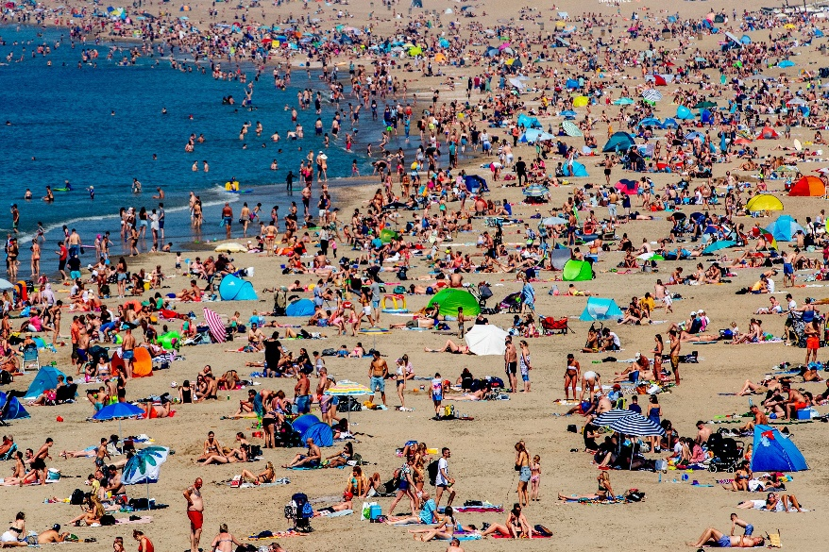
Mass tourism
- Avoid mass tourism by putting together a trip off the beaten track.
- Choose locations that still receive few tourists
- Stay at small-scale lodges and homestays
- Eat at locally owned restaurants and food trucks.

Slide 16
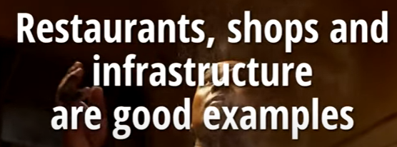
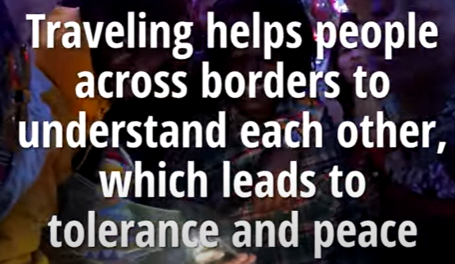
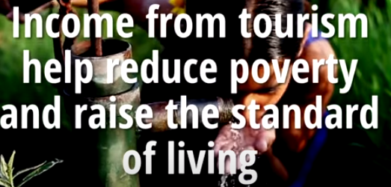
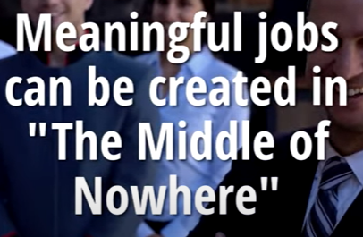
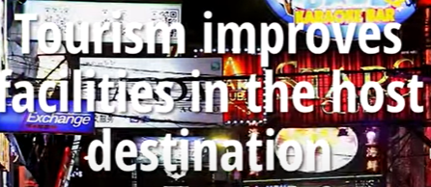
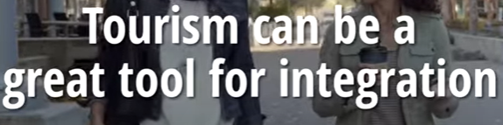
https://www.youtube.com/watch?v=XRXZON--Ang
Watch the video and take notes some positive and negative impact of tourism on the environment.
POSITIVE IMPACT

Slide 17
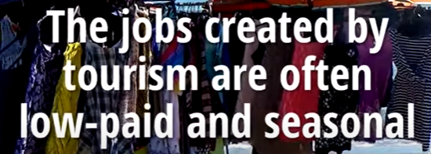
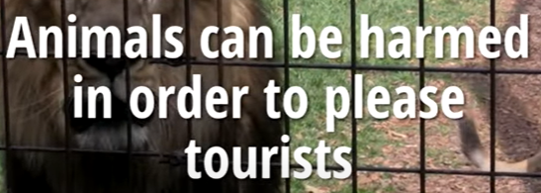
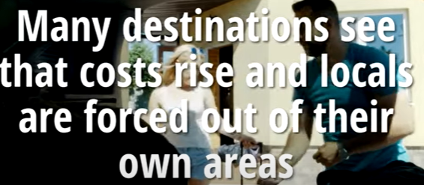
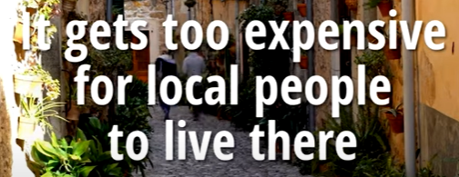

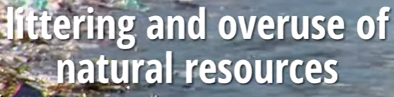

NEGATIVE IMPACT

Slide 18
HOMEWORK
Learn how to ask for and give advice
and practice them
Read the text again and distinguish the
types of tourism.
Prepare “Looking back” and complete the
“Project” to present next period.

Slide 19


