Slide 2
Unit
10
The ecosystem
Unit
FAMILY LIFE
COMMUNICATION AND CULTURE / CLIL
LESSON 7

Slide 3
LESSON 7
COMMUNICATION AND CULTURE / CLIL
WARM-UP
Watch a video
Task 1: : Complete the conversation
Task 2: Make similar conversations.
COMMUNICATION
CLIL
Task 1: Tick the correct project in the table
Task 2. Discussion.
CONSOLIDATION
Wrap-up
Homework

Slide 4
WARM-UP
WATCH A VIDEO
Which expressions are used to talk about likes and dislikes?

Slide 5
WARM-UP
Answer key:
Likes | Dislikes
I’d love to I love them. Sounds good Sounds great Perfect Great Wonderful | … sounds better to me Not my style I don’t like No thanks No way It’s just awful It’s terrible I’m not a fan

Slide 6
EVERYDAY ENGLISH
1
Listen and complete the conversation with the expressions in the box. Then practice it in pairs
C
A
B

Slide 7
EVERYDAY ENGLISH
Useful expressions
Expressing likes | Expressing dislikes
+ I love/adore … + I’m really into … + I’m a (big) fan of … + I’m keen on … + I’m into … | + I hate/don’t like … + I can’t bear/stand … + I’m not really into … + … is not my favorite

Slide 8
EVERYDAY ENGLISH
2
Work in pairs. Use the model in Task 1 to make similar conversations for these situations. One of you is Student A, the other is Student B. Use the expressions below to help you.
1. Student A is talking about activities he/she does on field trips to national parks. Student B expresses likes/dislikes about these activities.
2. Student A and Student B are planning an eco-friendly class party. They talked about the things and activities they like or dislike at the party.

Slide 9
EVERYDAY ENGLISH
2
Work in pairs. Make similar conversations for these situations.
Situation 1. Sample conversation
A: In our field trip to Cat Ba National Park, we should bring snacks to feed the birds. They like snacks.
B: I’m not really into that idea. Snacks are not good for their health. Moreover, it can be harmful to other wildlife animals.
B: Really, I don’t know that. How about burning the camp fire in the forest?
A: I think we should do it. It can lead to the forest fire. It’s clearly stated in the national park regulations.
1. Student A is talking about activities he/she does on field trips to national parks. Student B expresses likes/dislikes about these activities.

Slide 10
EVERYDAY ENGLISH
2
Work in pairs. Make similar conversations for these situations.
Situation 2. Sample conversation
A: We are going to have an eco-friendly party. What should we prepare for it?
A: Shall we decorate the party with flowers and plants. It will be the greenest party ever.
B: Oh I love it. We can also use paper cups, straws and plates instead of plastic ones.
A: I’m really into that idea. How about organizing a fashion show in which our friends are wearing clothes made from eco-friendly materials?
B: Perfect. Let’s do it.
2. Student A and Student B are planning an eco-friendly class party. They talked about the things and activities they like or dislike at the party.

Slide 11
CLIL
fancy (v)
/ˈfænsi/
to want something or want to do something

Slide 12
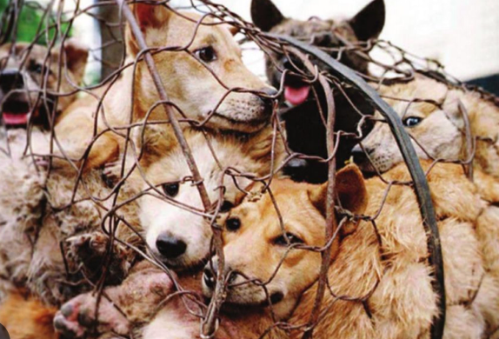
CLIL
cruelty (n)
/ˈkruːəlti/
cruelty (to somebody/something)
behaviour that causes physical or mental pain to others and makes them suffer, especially deliberately

Slide 13
CLIL
barrier (n)
/ˈbæriə(r)/
something that exists between one thing or person and another and keeps them separate

Slide 14
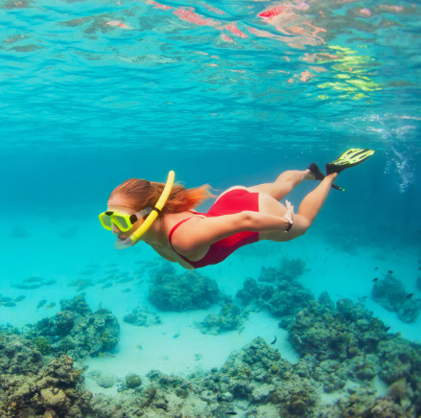
CLIL
snorkelling (n)
/ˈsnɔːkəlɪŋ/
the sport or activity of swimming underwater with a snorkel

Slide 15
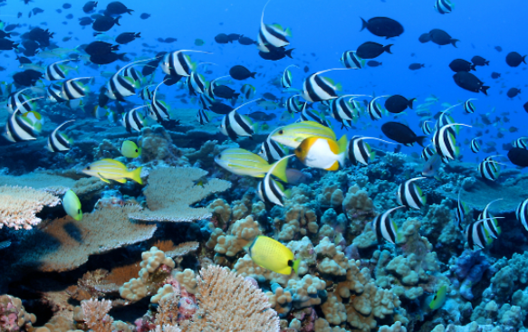
CLIL
marine (adj)
/məˈriːn/
connected with the sea and the creatures and plants that live there

Slide 16
CLIL
Form | Pronunciation | Meaning | Vietnamese equivalent
1. fancy (v) | /ˈfænsi/ | to want something or want to do something | Thích
2. cruelty (n) | /ˈkruːəlti/ | cruelty (to somebody/something) behaviour that causes physical or mental pain to others and makes them suffer, especially deliberately | Sự tàn ác
3. barrier (n) | /ˈbæriə(r)/ | something that exists between one thing or person and another and keeps them separate | Hàng rào
4. snorkelling (n) | /ˈsnɔːkəlɪŋ/ | the sport or activity of swimming underwater with a snorkel | Môn lặn biển
5. marine (adj) | /məˈriːn/ | connected with the sea and the creatures and plants that live there | Thuộc về đại dương

Slide 17
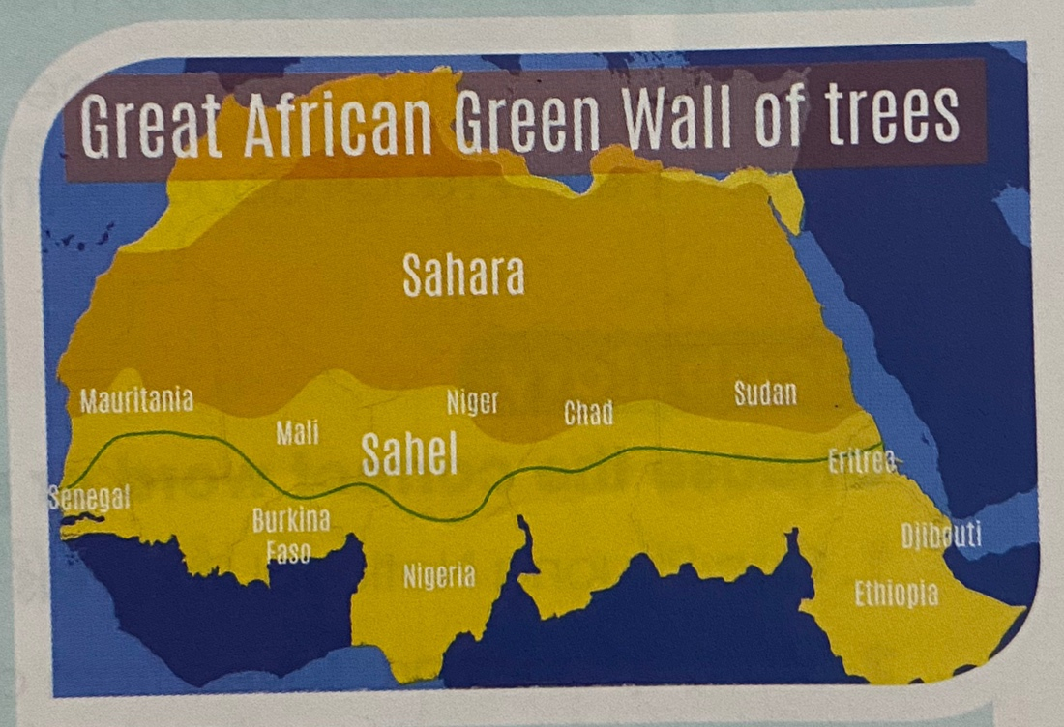
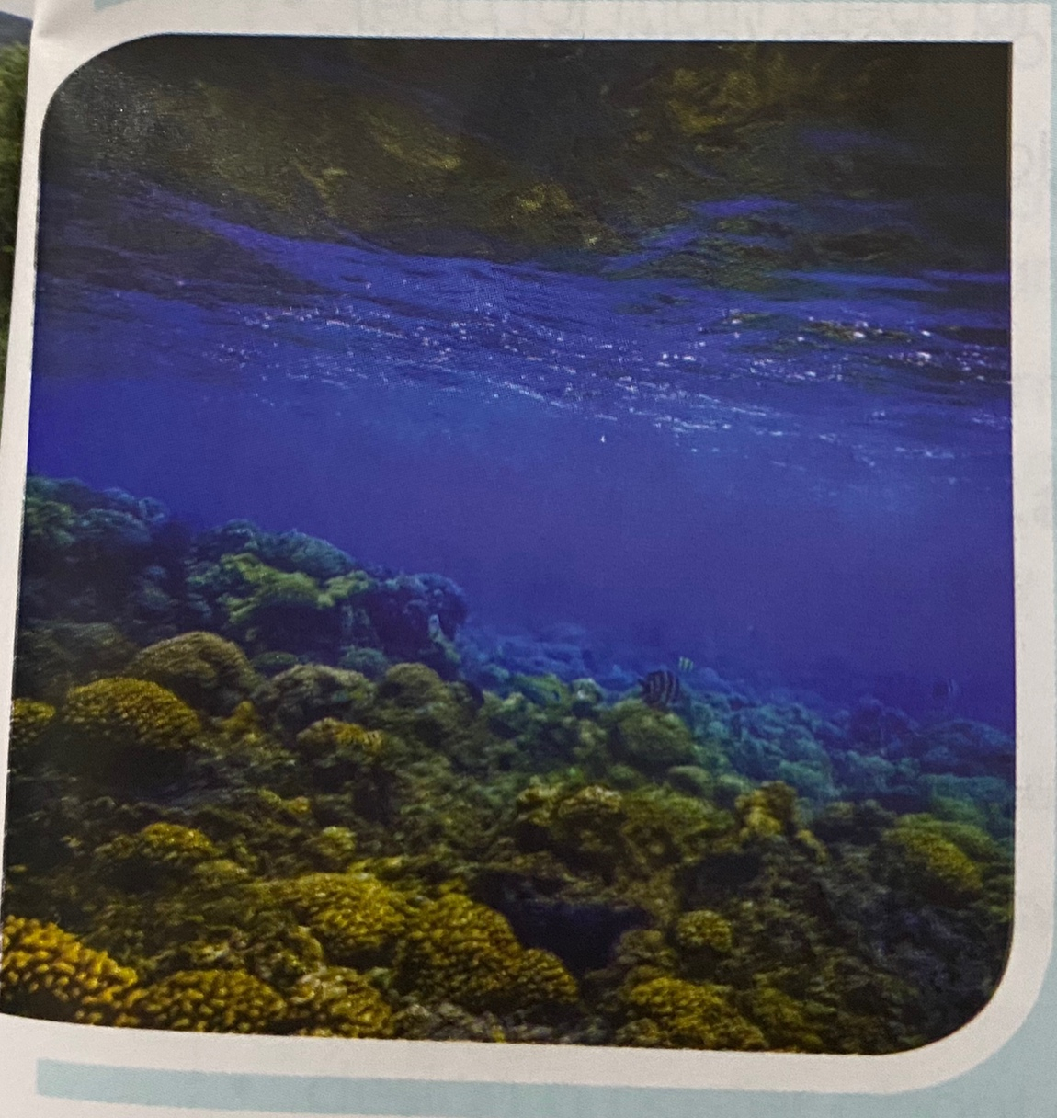
PROTECTING ECOSYSTEMS – IDEAS FROM AROUND THE WORLD
TheThe healthier our ecosystems are, the healthier our planet and its people become. Ecosystem restoration can help end poverty, fight climate change, and prevent los of flora and fauna on every continent and in every ocean. Below are two examples of successful ecological projects.
The Great Green Wall
The golThe goal of this project is to create the largest loving structure on the planet. The plan is to restore 100 million hectares of damaged land, limit the amount of carbon dioxide and create 10 million green jobs in Africa. This will provide rich land, food security, and improve the region’s ability to deal with climate change. Since its launch in 2007, Ethiopia and Nigeria have restored millions of hectares of land, and Senegal has planted more than 10 million trees.
Belize Barrier Reef
The Belize Barier Reef was once described as the most amazing reef in the West Indies. It is home to a large diversity of plants and animals. It is Belize’s top tourist destinanion, popular for scuba diving and snorkelling, and a UNESSCO Natural World Heritage Site . Between 2009 and 2018, it was declared endangered because of pollution and the destruction of its ecosystems. However, because of convervation effort, a large part of the reef is now protected. There are seven marine reserves. Belize has also stopped oil drilling near the Barrier Reef, banned plastic products, and created ‘ no-take zones’, where removing plants and animals is not allowed.

Slide 18
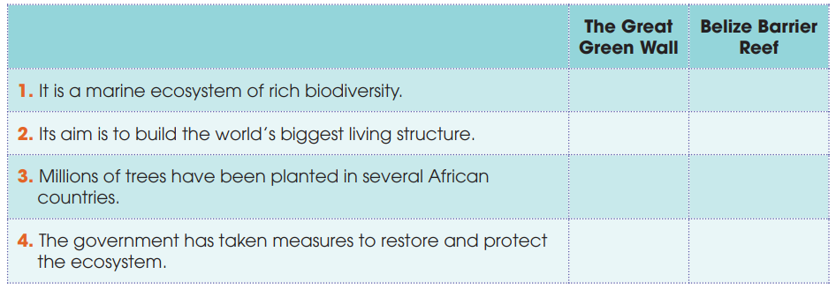
CLIL
1
Read the text and tick the correct project in the table
√
√
√
√

Slide 19
CLIL
2
Work in groups. Discuss the following questions
Are there similar projects in Viet Nam? Do you think the projects in Task 1 can be applied in Viet Nam?

Slide 20
CONSOLIDATION
1
Wrap-up
What have you learnt today?
Some methods for protecting local ecosystems in the world;
Review expressions for likes and dislikes.

Slide 21
CONSOLIDATION
2
Homework
Do exercises in the workbook.
Prepare for Lesson 8 - Unit 10.

Slide 22
Website: hoclieu.vn
Fanpage: facebook.com/sachmem.vn/
Website: hoclieu.vn
Fanpage: facebook.com/www.tienganhglobalsuccess.vn/

