Slide 4
I like……………..
summer
spring

Slide 5
summer

Slide 7
This summer, I am going to work as a…………….
tutor
tour guide

Slide 8
tour guide

Slide 10
Working as a tour guide helps me
to improve my speaking skill
to boost my confidence

Slide 11
to boost my confidence

Slide 12
Unit 9: CHOOSING A CAREER
LESSON 7: Communication and Culture

Slide 14
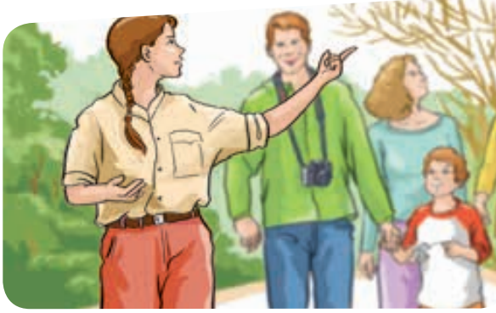
dishwasher
tutor
tour guide

Slide 15
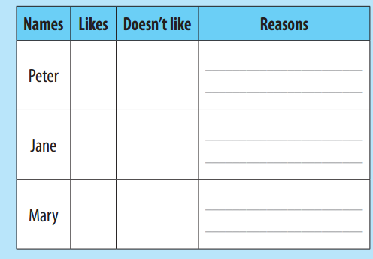
hard
It’s a pretty ………job
hot
It’s ……..in the kitchen
She loves ………..
It’s………
working with the kids
fun
interesting
It’s very …………….
She has the ………………
to see lots of historical buildings and sights
opportunity

Slide 16
TIME FOR YOU TO PRACTISE SPEAKING
Imagine you are going to do a summer job. Work with your partner and tell him or her about your job and why you like or dislike it
A. What kind of job are you going to do this summer?
B. Well, I am going to work as a tour guide.
A. It sounds interesting, but what have you to do ?
B. I will show our famous places to visitors.
Do you like it?
B. Yes, of course. It is a great job that helps me to meet a lot of people and especially improve my confidence in front of the crowd.

Slide 18
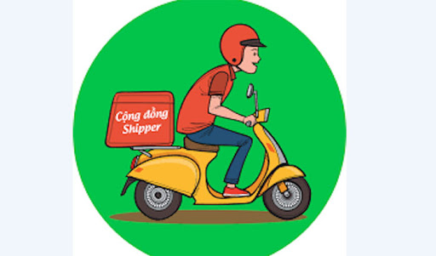
shipper
shop assistant
waiter/ waitress

Slide 19
online seller
babysitter

Slide 20
During this summer, I like working as a tour guide. It is a great job that helps me to meet a lot of people and especially improve my confidence in front of the crowd.

Slide 22
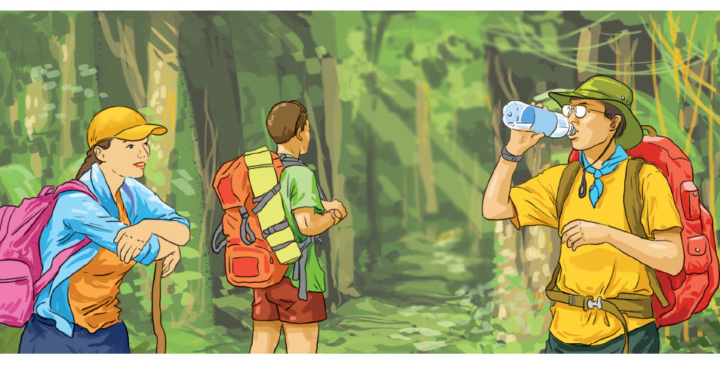
II. CULTURE
Taking a year out

Slide 23
Activity 1: Read the passage and choose the best answer.
Tom has just finished his A levels and he has got a place at university, but he would really like a break from the academic world. Like many young people today he's thinking about taking a year out first, or as people often say, spending a year at ‘the university of life'.
There are lots of things which Tom can choose from. He could work in a bank or do community work. He might even do something adventurous, such as joining an expedition to a rainforest. The experience will broaden his horizons and teach him new skills. It may also give him the chance to earn some money, which will be very helpful when he eventually starts his studies.
Before Tom decides to take a gap year, he must make sure that the university will hold his place for him till the following year. Most are quite happy to do this, as they find that year-out students are more mature, confident, and independent. But each student should know that it is a year out, not a year off. His university will want to know what he is going to do. They will not be very pleased if he just wants to do nothing for a year.

Slide 24
Activity 2: Read the passage again and answer the questions.
1. What would Tom really like to do after securing a place at university?
=> He would really like a break from the academic world.
2. What are the things that he can do in his gap year?
=> He could work in a bank or do community work. He might even do something adventurous, such as joining an expedition to a rainforest.
3. What are the benefits that the experience will give him during a gap year?
=> His experience during a gap year will broaden his horizons and teach him new skills. It may also give him the chance to earn some money.
4. What must Tom check before he decides to take a year out?
=> Before deciding to take a year out, he must make sure that the university will hold his place for him till the following year.
5. What does ‘the university of life' mean?
=> It means the education one gets from experience in the real world.

Slide 25
Activity 3: Read the passage and choose the best answer.
Question 1: What is the main idea of the passage?
A. Finishing A levels B. Taking a year off
C. Taking a year out D. Winning a place at university
Question 2: After securing a place at university, Tom would really like to ______.
A. have a long summer vacation B. work in a bank
C. join an expedition D. have a break from his studies
Question 3: The word “horizons” in paragraph 2 mostly means ______.
A. the lines at the farthest that can be seen
B. the range of things that someone knows
C. the things that are likely to happen
D. beautiful clouds in the sky
Question 4: The author mentions all of the following as the benefits that the experience will give him during a gap year EXCEPT ______.
A. broadening his horizons B. holding his place at university
C. teaching him new skills D. giving him the chance to earn some money
Question 5: The word “it” in paragraph 3 refers to ______.
A. the university B. a year off C. the following year D. a gap year

Slide 26
Discussion: What will you do in your gap year?
1. Working : earn money and gain new skills at home or aboard…………….
2. Travel : explore the world, discover new cultures, and develop your independent living skills at the same time!
3. Volunteering – aware of global issues, feel more engaged in the community…………

Slide 27
If I am allowed to take a gap year, I would like to join an international organisation for volunteering in the remotest areas in the world like Africa. This helps me to gain independence and learn to cope with unfamiliar environment. More importantly, It is also a time for me to do something useful
for underprevileged people

Slide 28
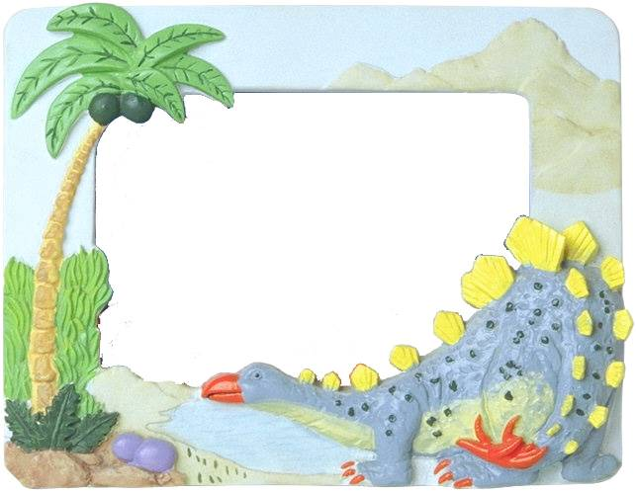
HOMEWORK
Learn the lesson.
Do exercises in the workbook.
Prepare Unit 9. Looking back and Project.

