Slide 1
Friday, 6th April, 2024
Teacher : NGUYỄN THỊ HOÀNG CHUNG
Class: 10A2
Welcome !

Slide 2
Unit
9
1
Unit
FAMILY LIFE
Protecting the environment
* Let’s play a game: Ocean rescue
LISTENING
RULES: to rescue the animals kept in the fishing net :
- You have to answer the question
- The correct answer will rescue the animals to escape from the trap

Slide 3
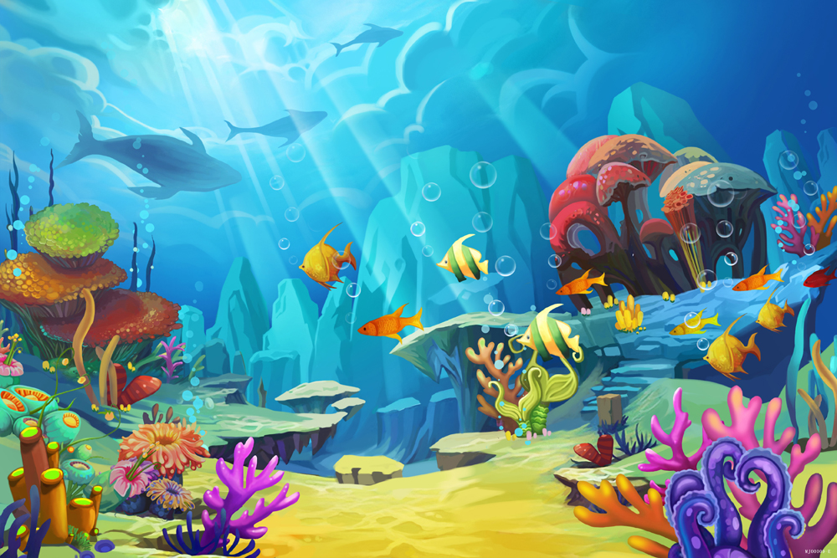
OCEAN RESCUE

Slide 4
It is a large heavy animal with very thick skin and either one or two horns on its nose.
Start!
A. An elephant
B. A crocodile
C. A hippo
D. A rhino
TIME’S UP

Slide 5
Start!
Rhinos are large animals found
in rivers and lakes in …............
A. America
B. South Africa
C. Europe
D. Australia
TIME’S UP

Slide 6
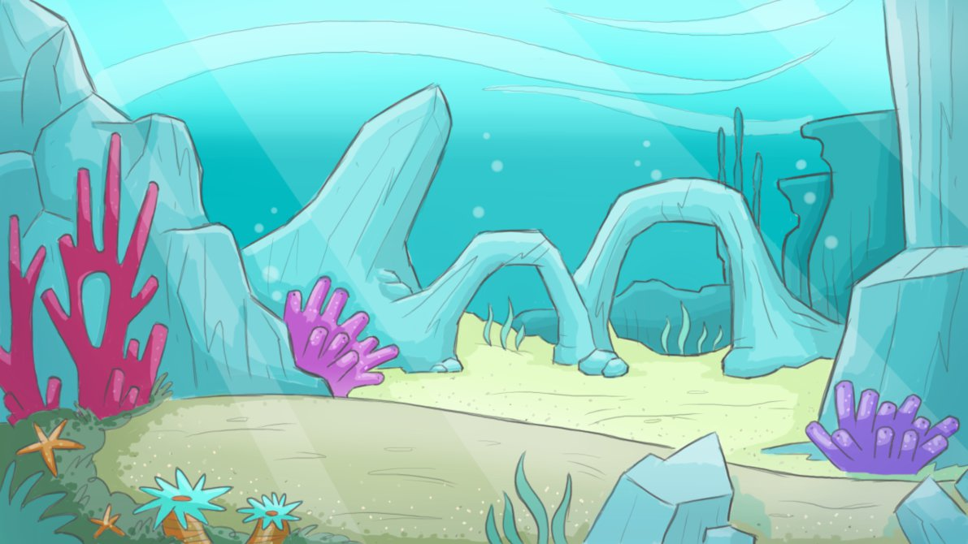
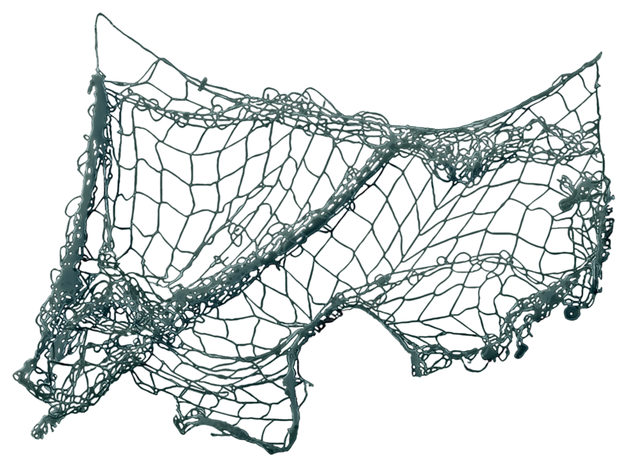
Start!
Rhinos are threatened by
illegal hunting and loss of …............
A. habitat
B. water
C. river
D. ocean
TIME’S UP

Slide 7
Start!
The tiger is the largest living …........., and lives in forest habitats.
A. panda
B. lion
C. cat
D. pangolin
TIME’S UP

Slide 8
Start!
Tigers are endangered animals and there are not more than …......... tigers in the wild now.
A. 35
B. 350
C. 3500
D. 35000
TIME’S UP

Slide 9
Unit
9
1
Unit
FAMILY LIFE
Protecting the environment
LESSON 5
LISTENING
Saving endangered animals

Slide 10
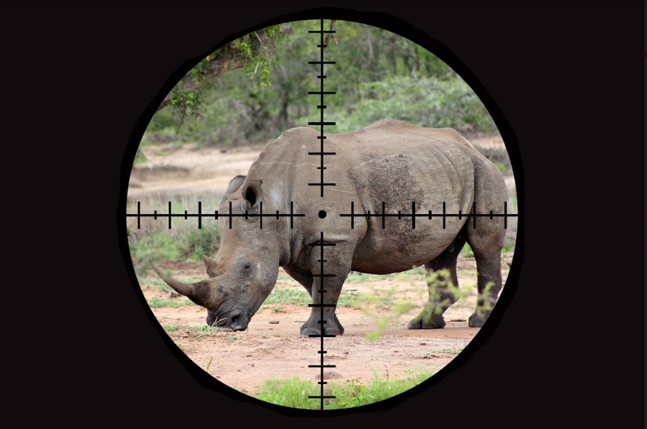
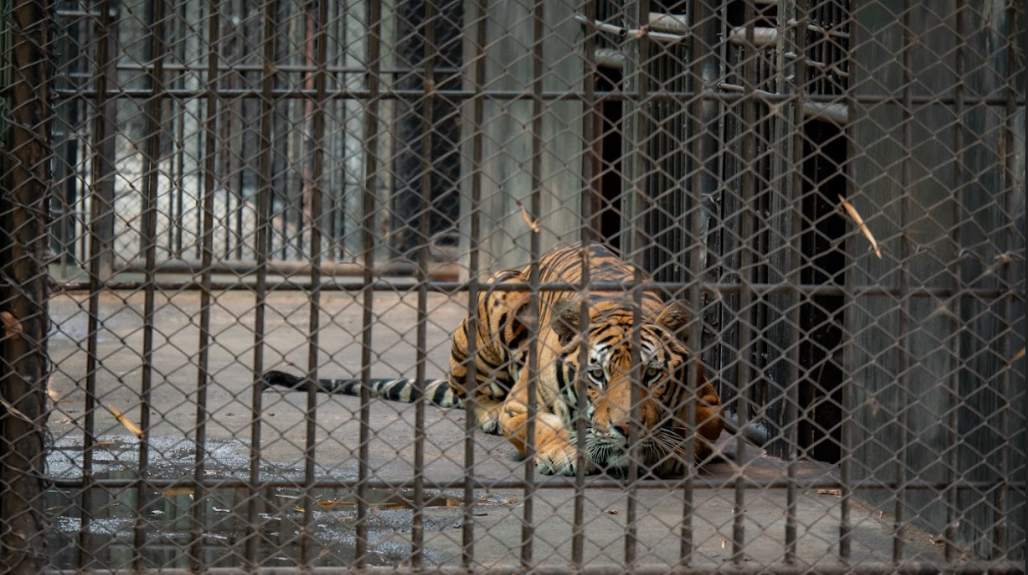
PRE-LISTENING
1
Answer the questions.
What is happening to the animals in the pictures?
The wild tiger is being kept in a cage. /
The wild tiger is being held in captivity.
The rhino is being hunted.

Slide 11
PRE-LISTENING
* New words:
bất hợp pháp
illegal /ɪˈliː.ɡəl/(adj) :
strict /strɪkt/ (adj) :
ban /bæn/(v) : cấm
nghiêm khắc
CHOOSE THE BEST OPTION:
One of the reasons that reduce the number of wild animals is illegal/legal hunting.
Government should have strict /strictly laws to prevent hunters from hunting wildlife illegally.
Wildlife trade should be banned /baned to make sure souvenirs not made from endangered animal parts.
illegal
strict
banned

Slide 12
WHILE-LISTENING
Nam and Mai are talking about Mai’s project on ways to save endangered animals. Listen to the conversation and decide whether the statements are true (T) or false (F).
2
 | T | F
1. Mai will complete her mid-term project in two weeks.
2. Nam believes that people should first be made aware of the importance of the problem.
3. Mai thinks that illegal hunting may not destroy wild animals’ natural habitats.
4. Nam believes that illegal hunting can be prevented by banning wildlife trade.
✓
I'm trying to complete it by next Monday
the first thing you should do is help people understand
the importance of this problem
✓
hunting causes a lot of suffering to wild animals.
It destroys their natural habitats
✓
wildlife trade should be banned
✓

Slide 13
WHILE-LISTENING
3
Listen to the conversation again and complete the notes. Use ONE word for each gap
Ways to save endangered animals
1. Helping people understand the (1)……………………………….of the problem. 2. Introducing strict (2)………………………to prevent people from illegal hunting. 3. Banning wildlife (3)…………………………………… 4. Avoiding products made from endangered(4) …………………..parts.
importance
laws
trade
animal

Slide 14
POST-LISTENING
4
Work in groups and answer the questions.
Which is the most effective way to save endangered animals? Why?
- Each group prepares a 3-min summary on the most effective way to save endangered animals.
- Take turns presenting the summary of their discussions to the whole class.

Slide 15
Useful expressions
Welcoming the audience and introducing the topic Hi everyone. Good morning/ afternoon. I’m here today to talk about/ discuss … I’d like to talk about … Today, I’d like to share with you …
Introducing the first point/ idea Firstly, the problem can be solved by … The first solution is to …
Introducing the second point/ idea My next point is … Another solution is to …
Finishing the presentation and thanking the audience That concludes our presentation. That’s the end of our presentation today. Thank you for listening. Thank you for your attention.

Slide 16
Suggested answers:
To protect animal’s life (not kill, hunt…)
To ban illegal hunting
To raise people’s awareness
To ban wildlife trade
To refuse to use products from wild animal parts
…..
Hi, everyone! I believe that the best way to protect endangered animals is to protect their lives. In other words, introducing strict laws to prevent people from illegal hunting is the most effective way. If people stop hunting animals illegally, we are not going to lose animals quickly, especially endangered ones.

Slide 17
CONSOLIDATION
1
Wrap-up
Tell some solutions to protect endangered species

Slide 18
Nam: Hi, Mai. How's your mid-term project going?
Mai: Good! I'm trying to complete it by next Monday. But I'm still working on the last part: saving endangered animals. Do you have any ideas, Nam?
Nam: Well, I think the first thing you should do is help people understand the importance of this problem.
Mai: Yes, I agree. Some people think this is a natural process that would happen with or without humans. They also believe that's not their responsibility.
Nam: You should also do some research on the number of endangered animals. We are losing animals quicker now than ever before. And one of the reasons is illegal hunting.
Mai: Yes, hunting causes a lot of suffering to wild animals. It destroys their natural habitats, and leaves baby animals behind to die.
Nam: Well, I think strict laws can really help. Heavy punishment may prevent people from illegal hunting. Besides, wildlife trade should be banned as well.
Mai: That would stop illegal hunting. Any more ideas, Nam?
Nam: And we should make sure that the souvenirs we buy on holiday are not made from endangered animal parts.
Mai: That's true. Thanks, Nam! You've been so helpful.

Slide 19
CONSOLIDATION
2
Homework
Do exercises in the workbook.
Write some solutions to protect endangered species
Prepare new lesson: WRITING

Slide 21
1. DISAPPEARANCE OF ENDANGERED ANIMALS
c. Stop illegal hunting and fishing
e. Avoid products that are made from animal parts
2. DEFORESTATION
a. Recycle paper, plastics, and wood products
f. Introduce strict laws to prevent the cutting of natural forests
3. AIR POLLUTION
b. Use electric vehicles or public transport, and plant more trees
d. Stop burning leaves, rubbish, and other materials

Slide 22
