Slide 2
Unit 1
Life stories we admire
LESSON 5
LISTENING
The father of Mickey Mouse

Slide 3
LESSON 5
LISTENING
WARM-UP
Lucky song
PRE-LISTENING
Task 1: Solve the crossword.
Vocabulary
Task 2: Listen and number.
Task 3: Choose the correct answer.
WHILE-LISTENING
POST-LISTENING
Task 4: ﻿Work in pairs and discuss.
CONSOLIDATION
Wrap-up
Homework

Slide 4
WARM-UP
Lucky song
1
2
3
4
5
6
7
8

Slide 5
WARM-UP
Question 1:
I see the light
Tangled OST

Slide 6
WARM-UP
Question 2:
Beauty and the beast
Beauty and the beast OST

Slide 7
WARM-UP
Question 3:
A whole new world
Aladdin OST

Slide 8
WARM-UP
Question 4:
Let it go
Frozen OST

Slide 9
WARM-UP
Question 5:
Can you feel the love tonight?
Lion King OST

Slide 10
WARM-UP

Slide 11
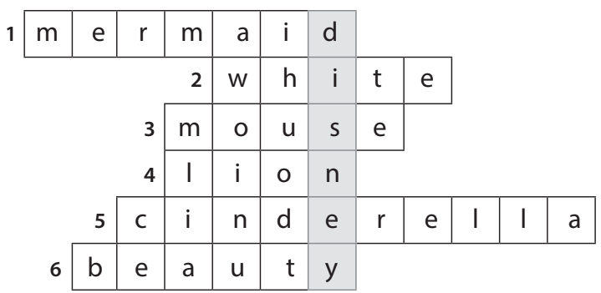
PRE-LISTENING
1
Solve the crossword to reveal the secret name.
NAME THE STORY CHARACTERS!

Slide 12
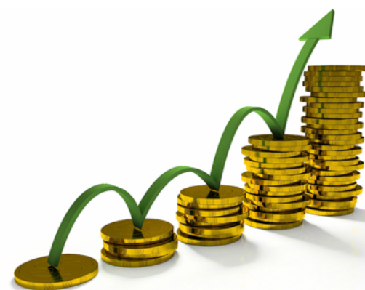
PRE-LISTENING
profitable (adj)
/ˈprɒfɪtəbl/
that makes or is likely to make money

Slide 13
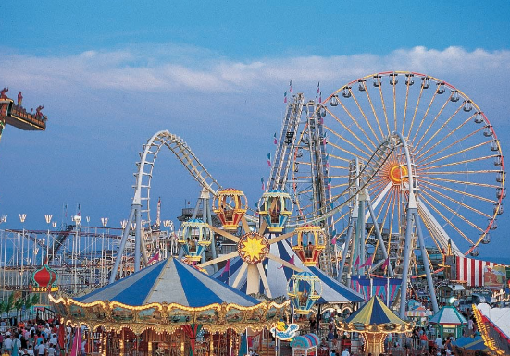
PRE-LISTENING
theme park
/ˈθiːm pɑːk/
a large park where people go to enjoy themselves, for example by riding on large machines such as roller coasters, and where much of the entertainment is connected with one subject or idea

Slide 14
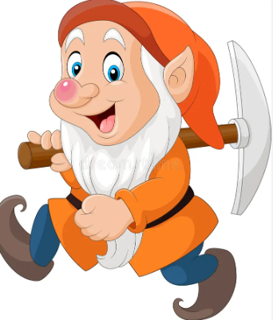
PRE-LISTENING
dwarf (n)
/dwɔːf/
(in stories) a creature like a small man, who has magic powers and who is usually described as living and working under the ground, especially working with metal

Slide 15
PRE-LISTENING
inspire (v)
/ɪnˈspaɪə(r)/
to give somebody the desire, confidence or enthusiasm to do something well

Slide 16
PRE-READING
Form | Pronunciation | Meaning | Vietnamese equivalent
1.profitable (adj) | /ˈprɒfɪtəbl/ | that makes or is likely to make money | có lợi nhuận
2. theme park | /ˈθiːm pɑːk/ | a large park where people go to enjoy themselves, for example by riding on large machines such as roller coasters, and where much of the entertainment is connected with one subject or idea | công viên giải trí
3. dwarf (n) | /dwɔːf/ | (in stories) a creature like a small man, who has magic powers and who is usually described as living and working under the ground, especially working with metal | chú lùn
4. inspire (v) | /ɪnˈspaɪə(r)/ | to give somebody the desire, confidence or enthusiasm to do something well | truyền cảm hứng

Slide 17
WHILE-LISTENING
Listen to a talk about Walt Disney’s life. Number the events in the order they are mentioned.
2
2
1
5
3
4
6
A. A difficult beginning
B. An introduction to Walt Disney
C. Creating the world’s most popular tourist attraction
D. The birth of Mickey Mouse
E. The success of Snow White and the Seven Dwarfs
F. The continued success of The Walt Disney Studios

Slide 18
WHILE-LISTENING
3
Listen to the talk again. Choose the correct answer A, B, or C
1. Walt Disney moved to Hollywood because _______.
A. his parents moved to work there
B. he wanted to start his career again
C. his company became very successful
2. Which is true about Mickey Mouse?
A. It was based on a real pet.
B. It was first voiced by a famous actor.
C. It was not very popular.

Slide 19
WHILE-LISTENING
3
Listen to the talk again. Choose the correct answer A, B, or C
3. What is NOT mentioned as an achievement of Snow White and the Seven Dwarfs?
A. It earned more than 400 million dollars.
B. It won several Oscars.
C. It was the best movie in the film industry.
4. What is true about Disney’s achievements?
A. He created the first animated cartoon.
B. He holds the record for the most Oscars in history.
C. He designed all the Disneyland theme parks.

Slide 20
WHILE-LISTENING
3
Listen to the talk again. Choose the correct answer A, B, or C
5. Why did he create Disneyland theme parks?
A. So that visitors can share their magical stories with Disney characters.
B. So that fans can see Disney characters live on stage and interact with them.
C. So that visitors can learn to make animated films.

Slide 21
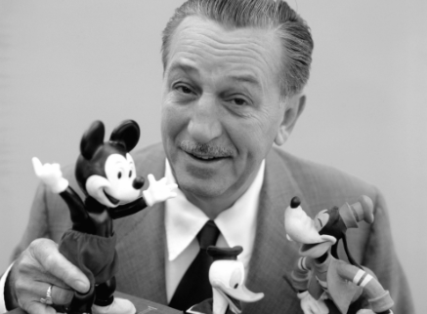
POST-LISTENING
3
Work in pairs. Discuss the question.
What do you think is most impressive about Walt Disney’s life and achievements?

Slide 22
CONSOLIDATION
1
Wrap-up
What have you learnt today?
An overview about Walt Disney’s life;
Listening skills for general ideas and for specific information

Slide 23
CONSOLIDATION
2
Homework
Do exercises in the workbook.
Prepare for Lesson 6 - Writing.

Slide 24
Website: hoclieu.vn
Fanpage: facebook.com/www.tienganhglobalsuccess.vn

