Slide 2
Unit 1
Life stories we admire
LESSON 3
READING
A creative genius

Slide 3
LESSON 3
READING
WARM-UP
Watch a video
PRE-READING
Task 1: Discuss the questions.
Task 2: Choose the words with the closest meaning to the highlighted.
Task 3: Match each section with a heading.
Task 4: Complete the diagram.
WHILE-READING
POST-READING
Task 5: Discussion.
CONSOLIDATION
Wrap-up
Homework

Slide 4
WARM-UP
Video watching
- Work as 2 groups.
- Watch the video carefully and try to remember as many details as possible.
- Teacher shows questions on the slide, Ss raise their hands and say BINGO to grab the chance to answer.
- If the answer is correct ➔ one point.
- The team with higher score will be the winner.

Slide 5
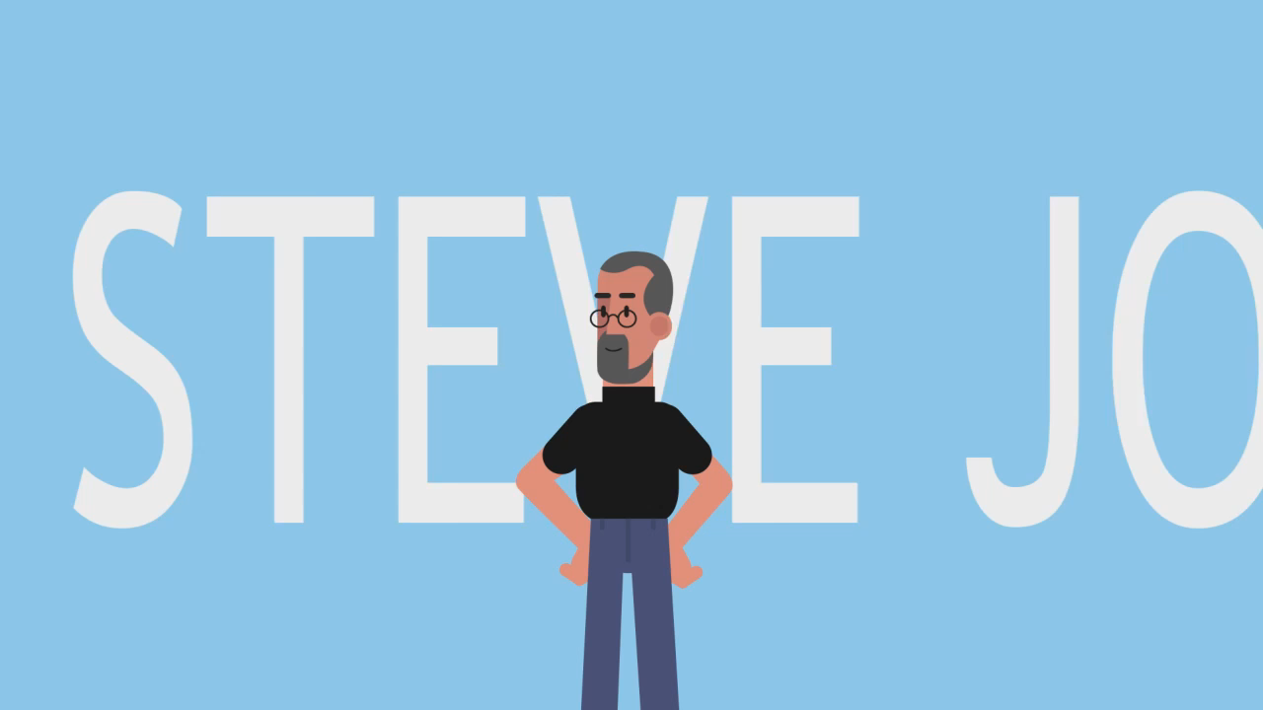
WARM-UP
Video watching
Notes:
Link: https://www.youtube.com/watch?v=bTpvbKCYaoQ

Slide 6
WARM-UP
Question 1:
Where was he born?
San Francisco

Slide 7
WARM-UP
Question 2:
Who are Clara and Paul?
his foster parents

Slide 8
WARM-UP
Question 3:
What does his dad do?
a mechanic

Slide 9
WARM-UP
Question 4:
What does his mom do?
an accountant

Slide 10
WARM-UP
Question 5:
Where did he meet his best friend?
in computer club

Slide 11
WARM-UP
Question 6:
What do Steve Jobs and his best friend both love?
electronics

Slide 12
WARM-UP
Question 7:
Which company did Steve Job and his best friend create?
Apple

Slide 13
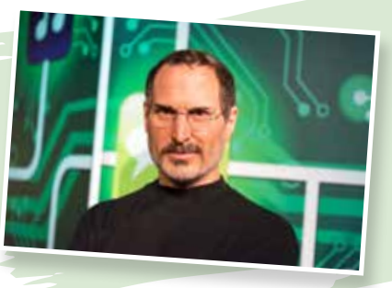
PRE-READING
1
Work in pairs. Discuss the questions
1. Who is the man in the photo?
2. What is he most famous for?

Slide 14


PRE-READING
(to) bond
/bɒnd/
to develop or create a relationship of trust with somebody

Slide 15

PRE-READING
cutting-edge (adj)
/ˌkʌtɪŋ ˈedʒ/
at the newest, most advanced stage in the development of something

Slide 16
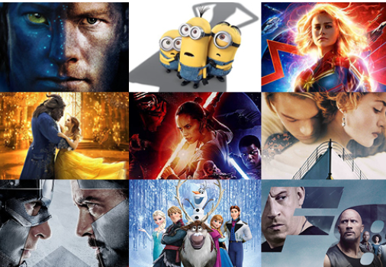
PRE-READING
blockbuster (n)
/ˈblɒkbʌstə(r)/
something very successful, especially a very successful book or film

Slide 17

PRE-READING
(to) diagnose with
/ˈdaɪəɡnəʊz/
to say exactly what an illness or the cause of a problem is

Slide 18
PRE-READING
visionary (adj)
/ˈvɪʒənri/
original and showing the ability to think about or plan the future with great imagination and intelligence

Slide 19
PRE-READING
Form | Pronunciation | Meaning | Vietnamese equivalent
1. (to) bond | /bɒnd/ | to develop or create a relationship of trust with somebody | gắn bó
2. cutting-edge (adj) | /ˌkʌtɪŋ ˈedʒ/ | at the newest, most advanced stage in the development of something | tiên tiến
3. blockbuster (n) | /ˈblɒkbʌstə(r)/ | something very successful, especially a very successful book or film | phim bom tấn
4. (to) diagnose with | /ˈdaɪəɡnəʊz/ | to say exactly what an illness or the cause of a problem is | chẩn đoán
5. visionary (adj) | /ˈvɪʒənri/ | original and showing the ability to think about or plan the future with great imagination and intelligence | có tầm nhìn

Slide 20
WHILE-READING
2
Choose the words or phrases with the closest meaning to the highlighted words or phrases in the text.
1. adopted
A. given birth to
B. taken by another family as their own child
2. dropped out
A. continued to study
B. left school/college before completing your studies
3. cancer
A. a serious disease
B. a dangerous animal

Slide 21
WHILE-READING
2
Choose the words or phrases with the closest meaning to the highlighted words or phrases in the text.
4. passed away
A. died
B. went past something
5. genius
A. a very intelligent person
B. an ordinary person

Slide 22
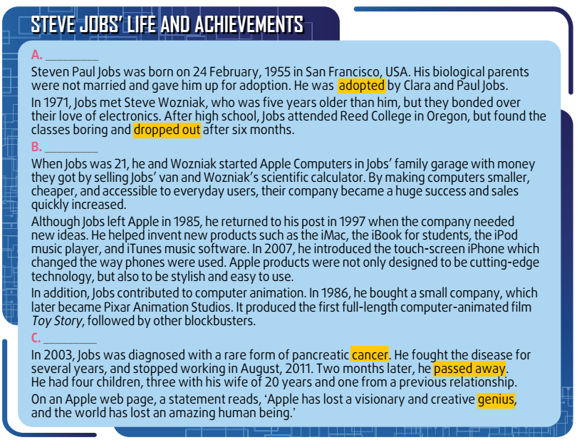
WHILE-READING
3
Match each section (a–c) with a heading (1–5).
Key:
A – 2
B – 1
C – 5

Slide 23
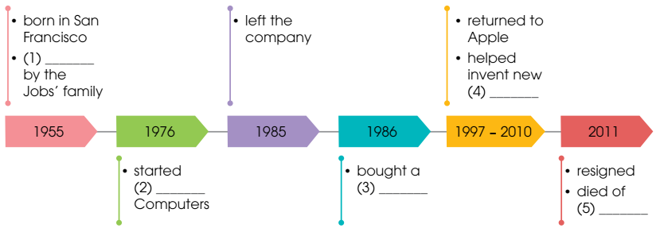
WHILE-READING
4
Complete the diagram with information from the text.
adopted
products
Apple
company
cancer

Slide 24
POST-READING
5
Work in pairs. Discuss the following question.
What do you admire the most about Steve Jobs?
Suggested answers:
What I admire the most about Steve Jobs is how he overcame difficulties in his life to achieve a significant breakthrough in communication technology. He dedicated his life to building technology and inventing the first real personal computer, that is user-friendly, efficient and stylish.

Slide 25
CONSOLIDATION
1
Wrap-up
What have you learnt today?
Some lexical items about a famous person’s life
Reading skills for general ideas and for specific information about a famous person

Slide 26
CONSOLIDATION
2
Homework
Write a short paragraph about life stories of Steve Jobs and what you admire most about him.
Do exercises in the workbook.
Prepare for Lesson 4.

Slide 27
Website: hoclieu.vn
Fanpage: facebook.com/www.tienganhglobalsuccess.vn

