Slide 1
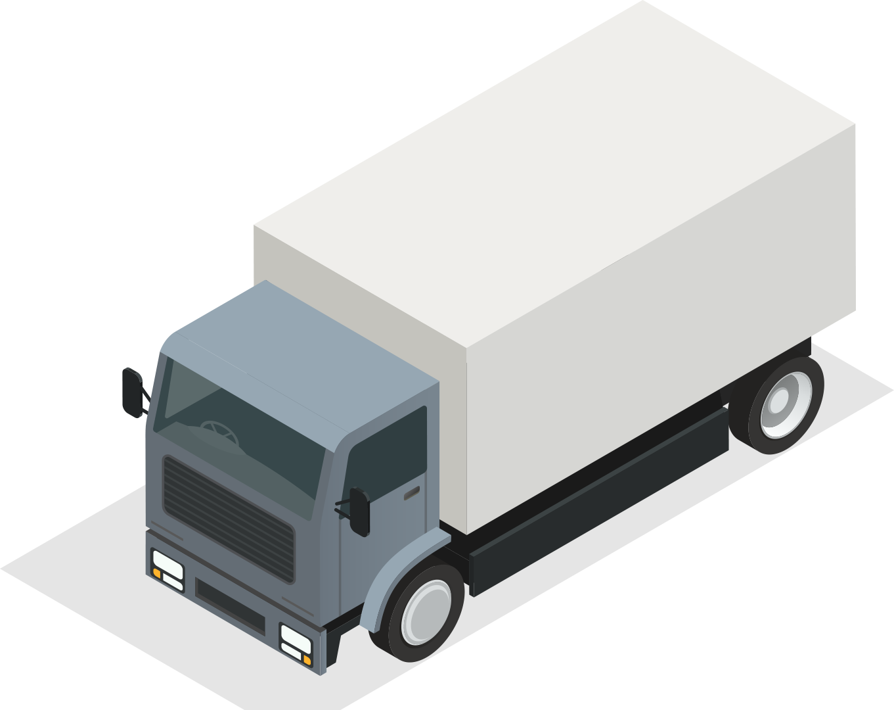
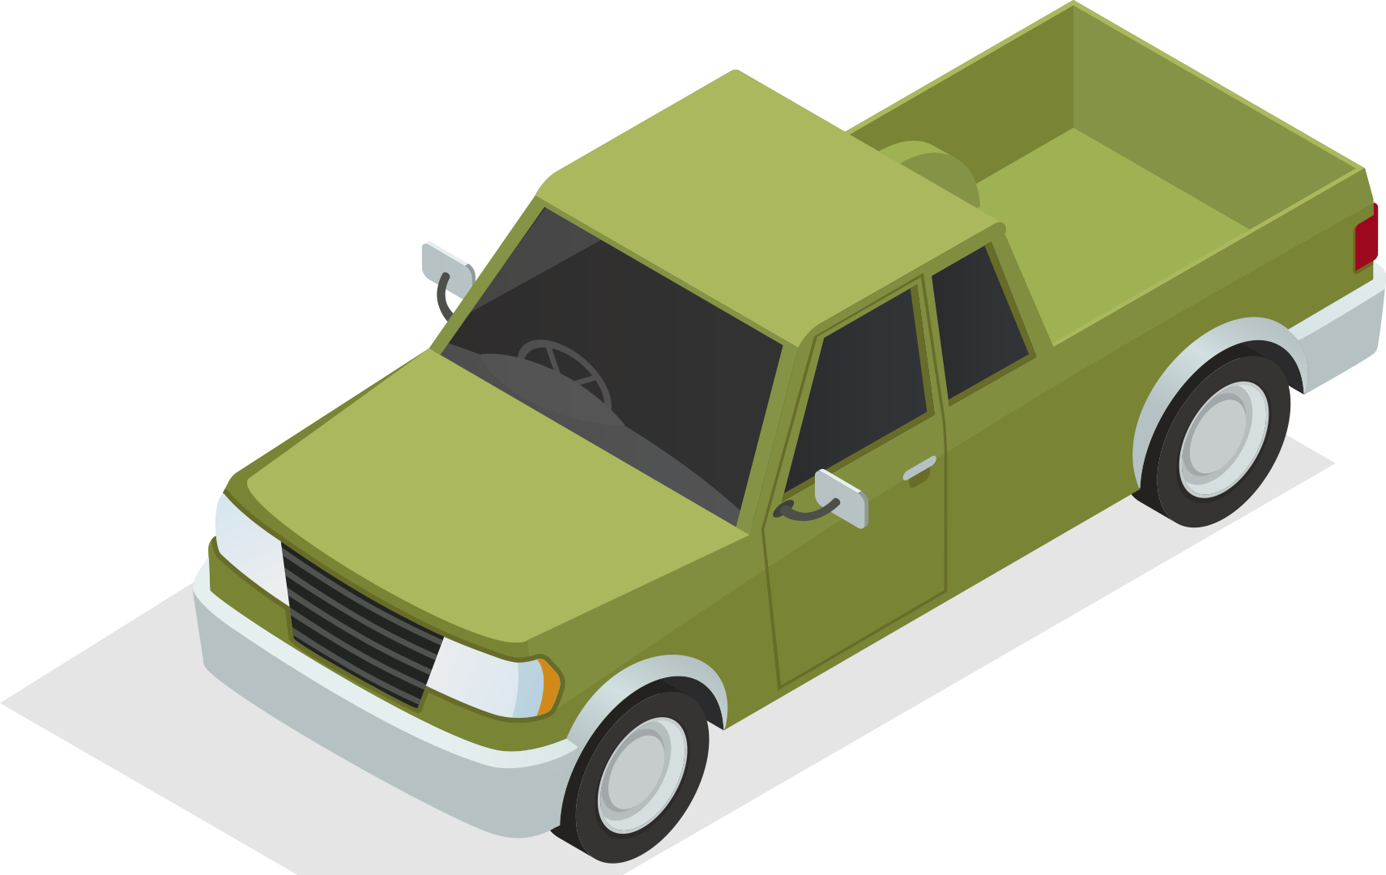
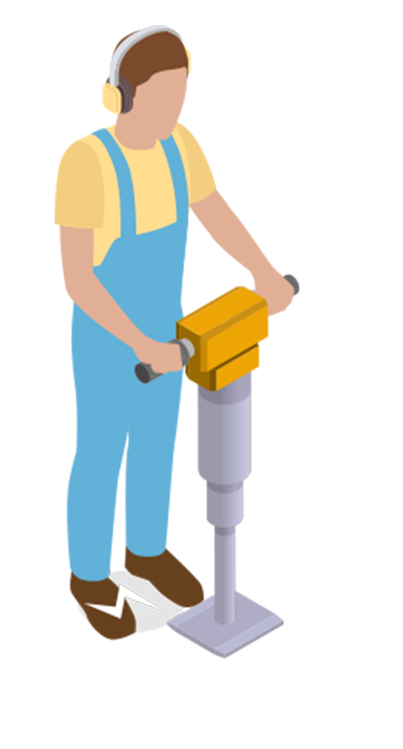
UNIT 5 GETTING AROUND
LESSON 3.3

Slide 2
TABLE OF CONTENTS
01
WARM UP
02
SPEAKING
03
CLASS ACTIVITIES

Slide 3
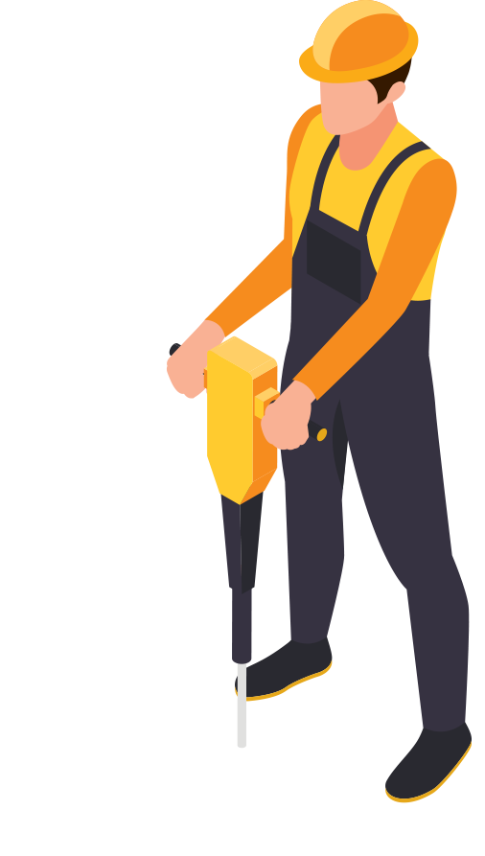
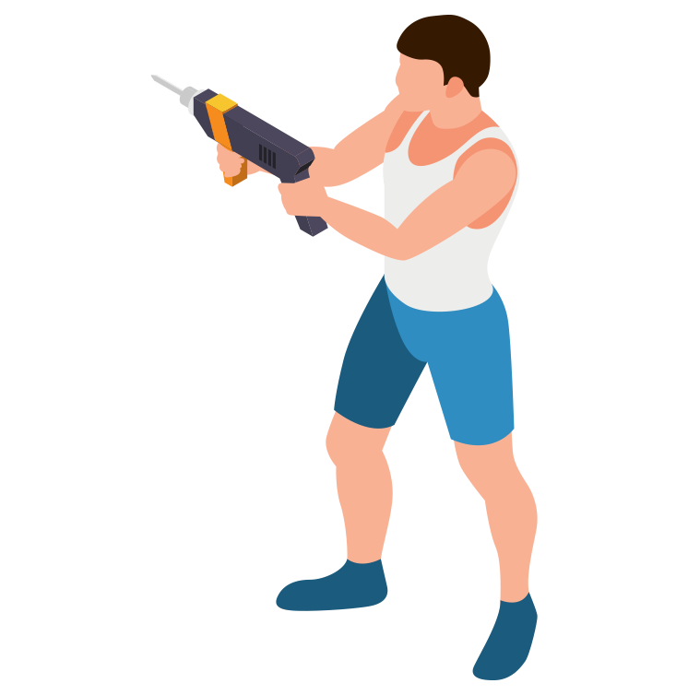
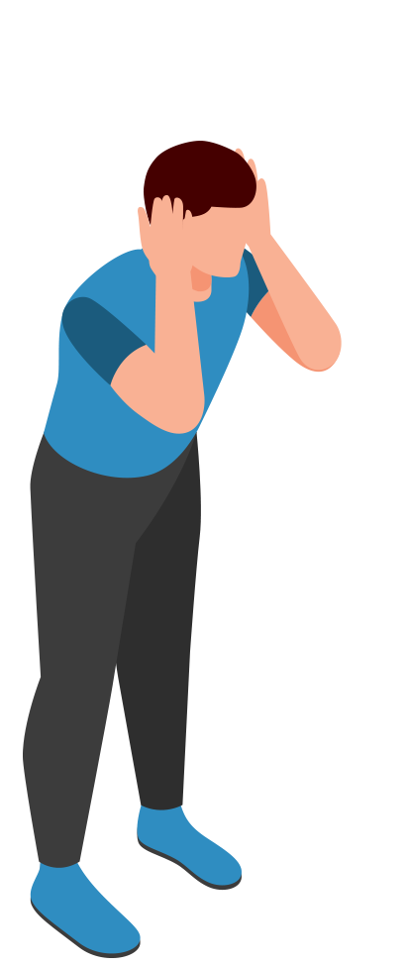
1
WARM UP

Slide 4
ROUND 1:
READ AND CHOOSE
How to play:
Divide the class into teams.
Ask students choose the correct answers
Raise the fingers to show the answer.
If all the students in the team have the right answer, they receive 2 points.
Play

Slide 5
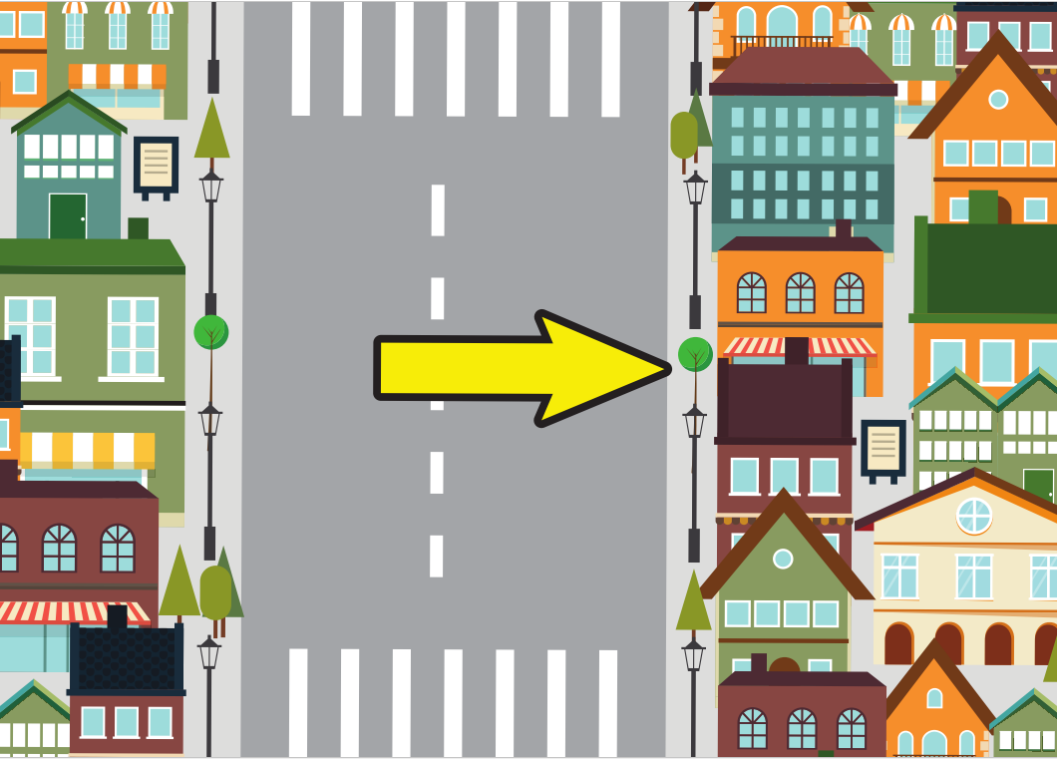
LOOK AND CHOOSE
1
2
3
on the left
on the right
go over

Slide 6
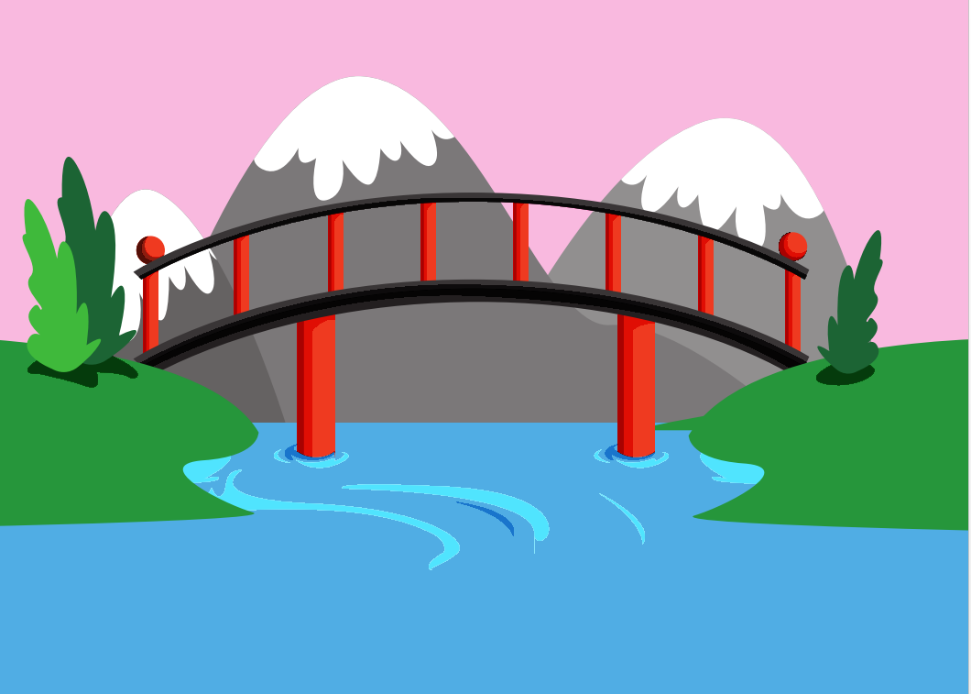
traffic lights
1
2
3

Slide 7
______________
Turn right. Then, go over the bridge. It’s on the left.
1
2
3
What are you doing?
What your name?
How do I get to the library?

Slide 8
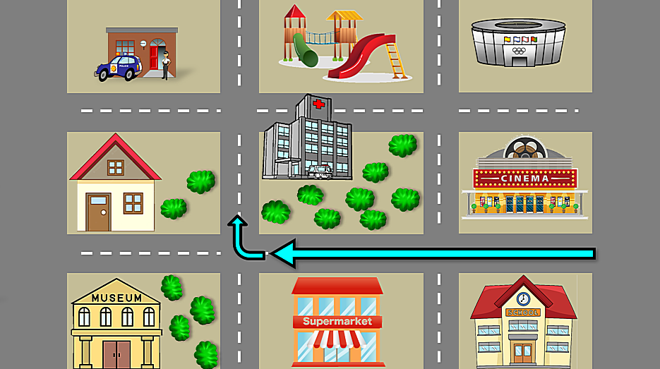
How do I get to the hospital?
1
2
3
Go straight two blocks. Then, turn right. It’s on the right.
Go straight two blocks. Then, turn left. It’s on the right.
Go straight one blocks. Then, turn right. It’s on the right.

Slide 9
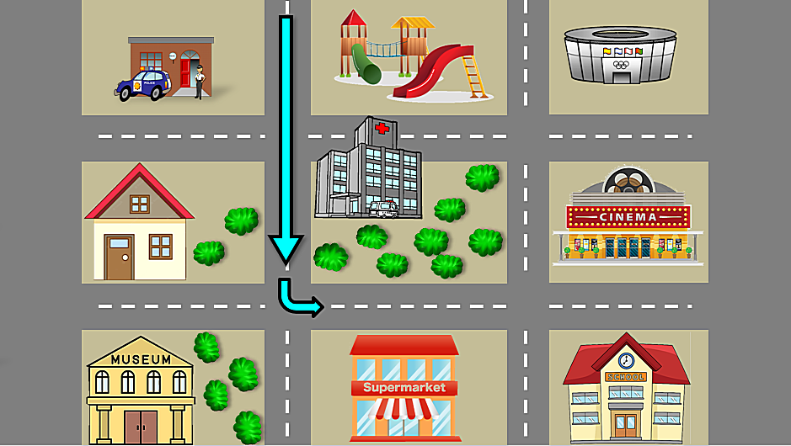
How do I get to the supermarket ?
1
2
3
Go straight two blocks. Then, turn left. It’s on the right.
Go straight two blocks. Then, turn right. It’s on the right.
Go straight one blocks. Then, turn left. It’s on the left.

Slide 10
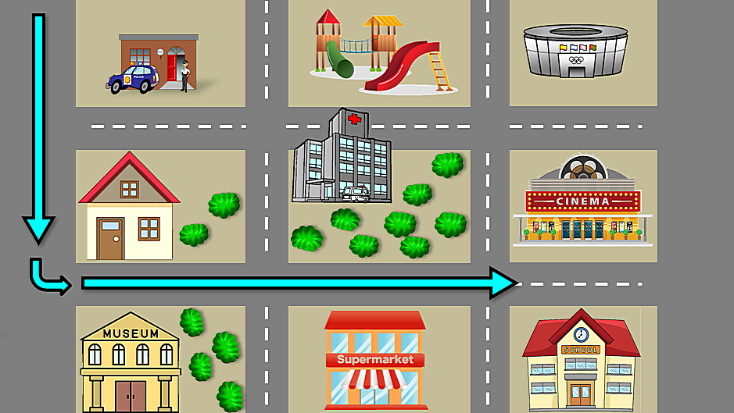
How do I get to the school?
1
2
3
Go straight two blocks. Then, turn left. Then, go straight two blocks. It’s on the right.
Go straight two blocks. Then, turn left. Then, go straight one blocks. It’s on the right.
Go straight one blocks. Then, turn left. Then, go straight one blocks. It’s on the left.

Slide 11
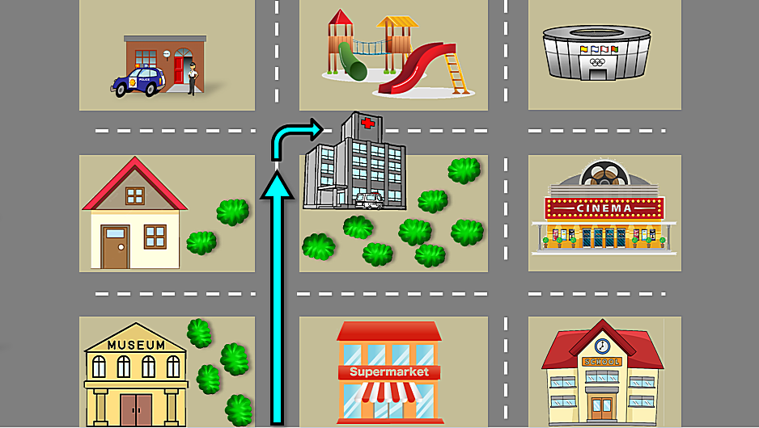
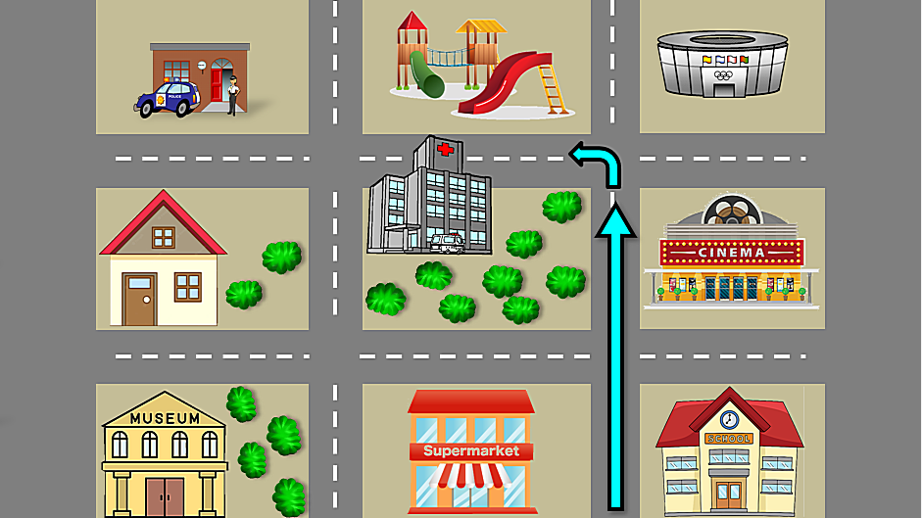
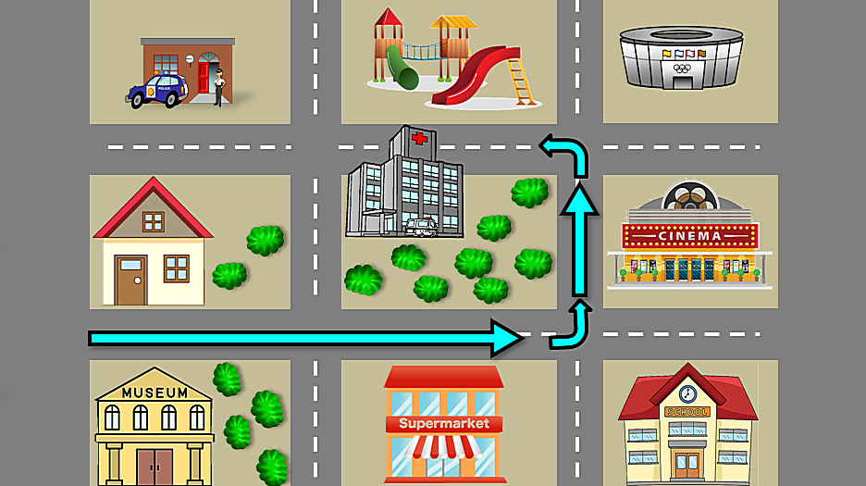
How do I get to the playground?
Go straight two blocks. Then, turn left. It’s on the right.
1
2
3

Slide 12
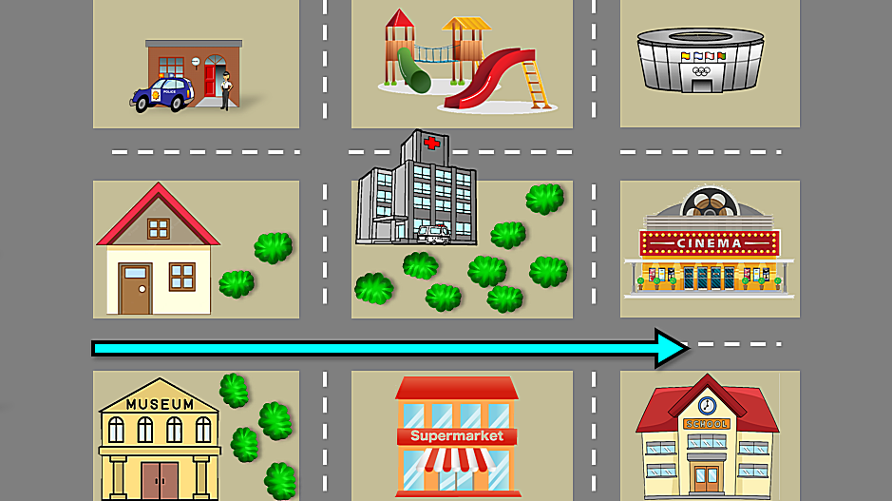
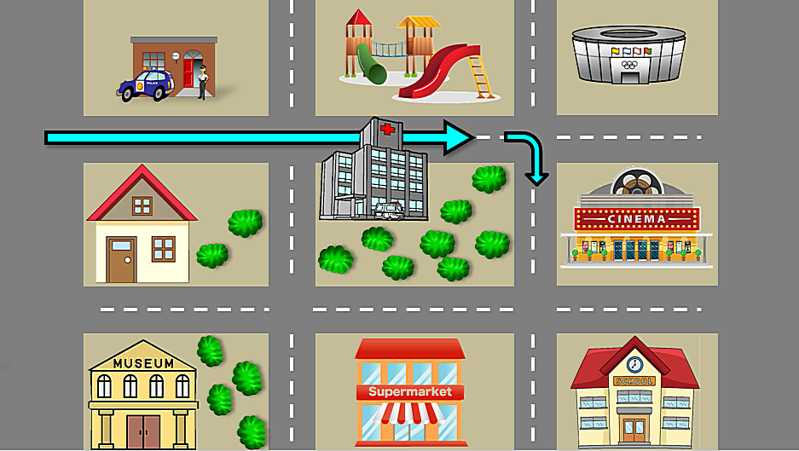
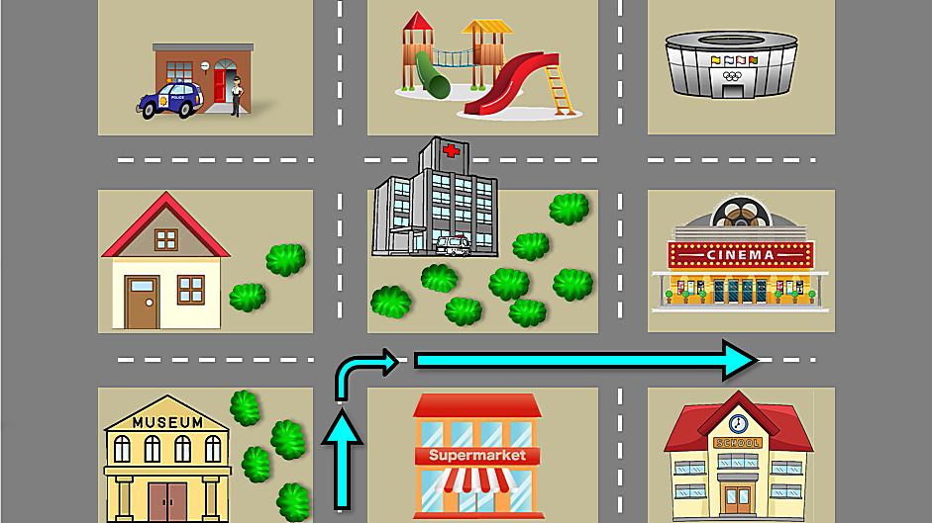
How do I get to the cinema?
Go straight one blocks. Then, turn right. Then go straight one blocks. It’s on the left.
1
2
3

Slide 13
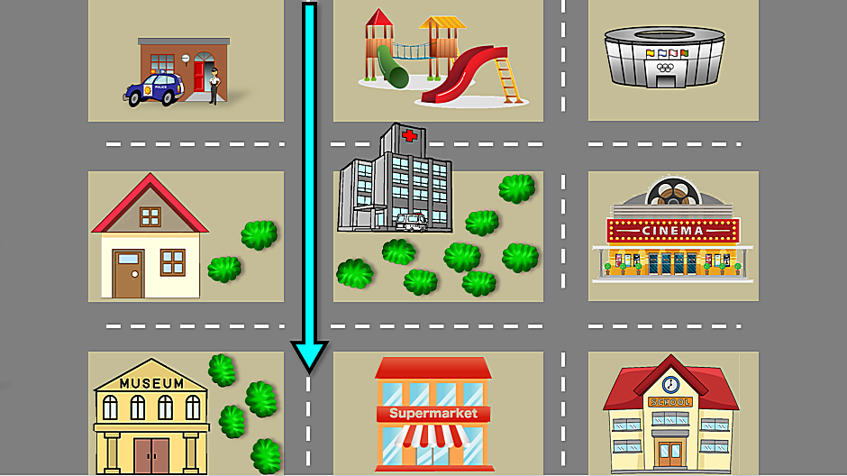
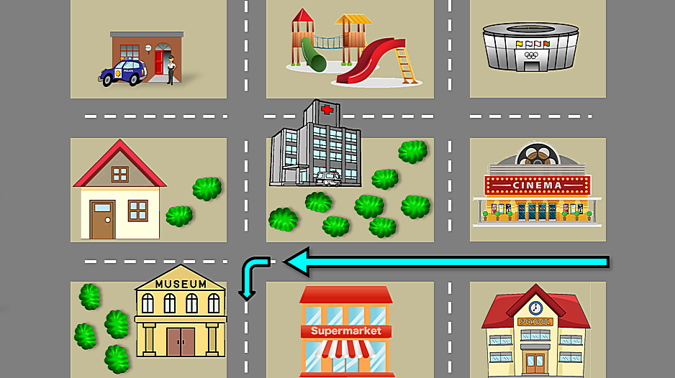
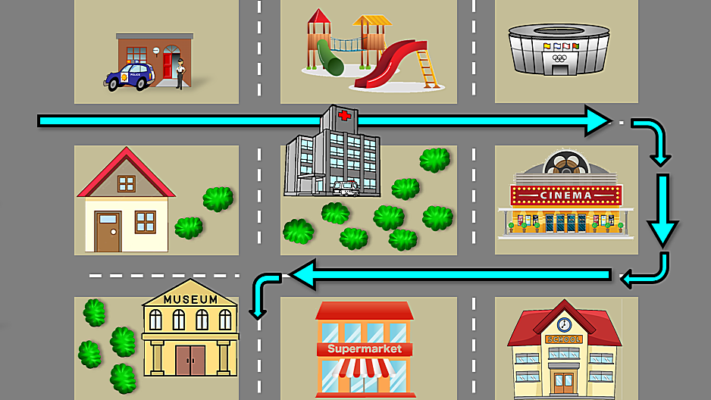
How do I get to the museum?
Go straight two blocks. Then, turn left. It’s on the right.
1
2
3

Slide 14
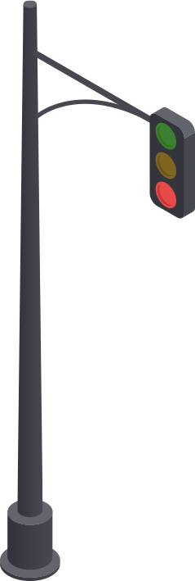
02 SPEAKING

Slide 15
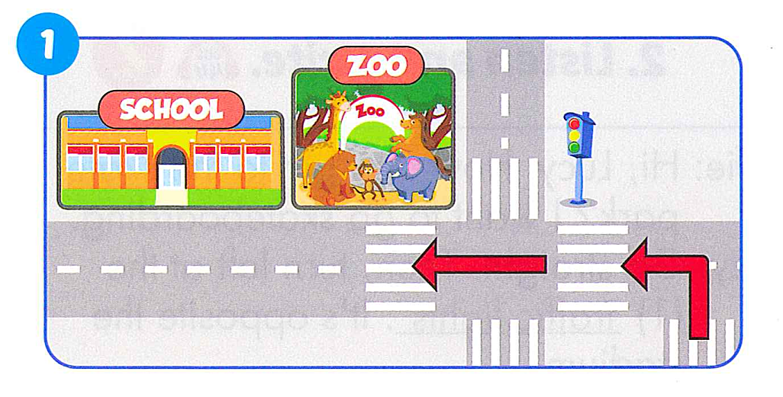
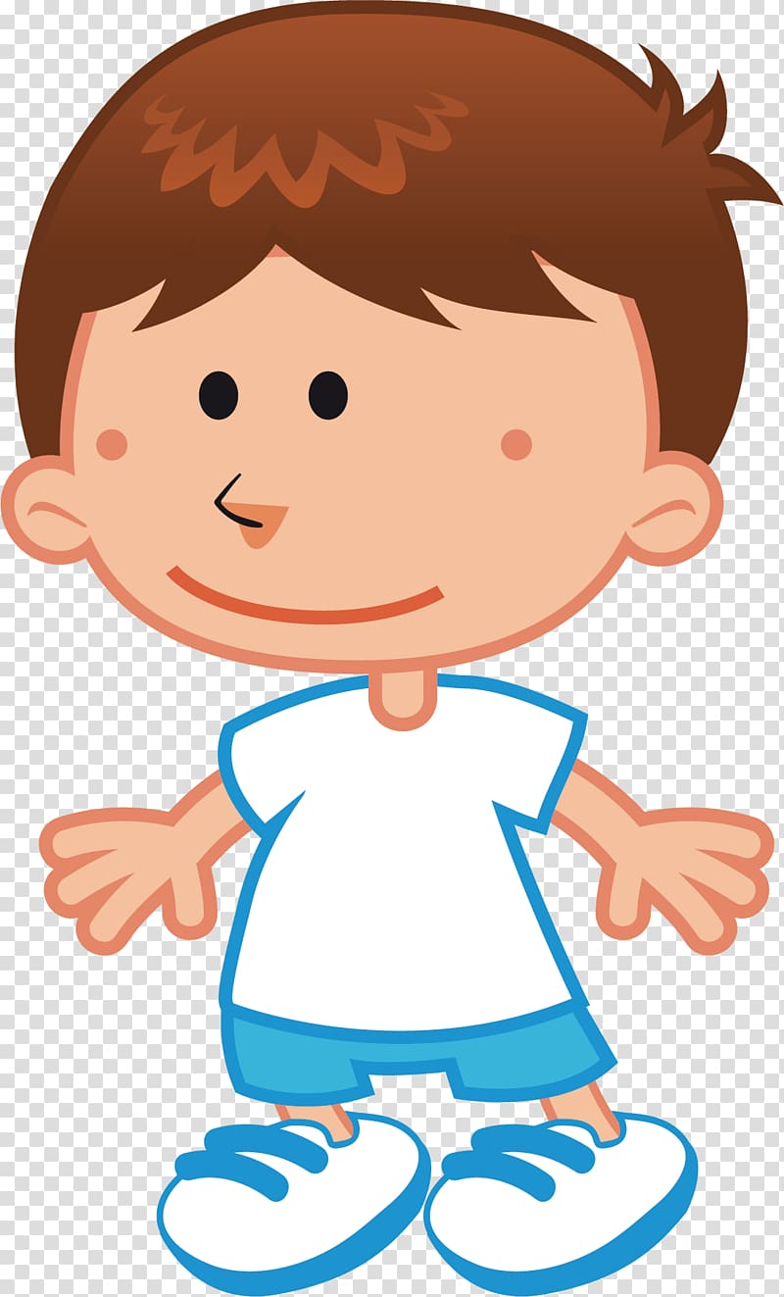
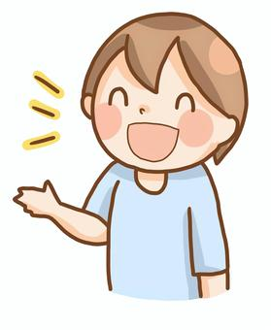
Turn left. Then, go straight at the traffic lights. It’s next to the zoo.
How do I get to the school ?

Slide 16
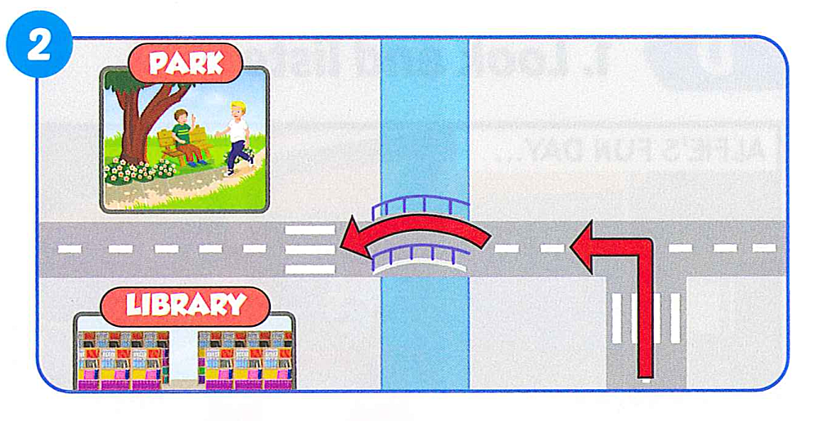
Turn left. Then, go over the bridge. It’s opposite the library.
How do I get to the park ?

Slide 17
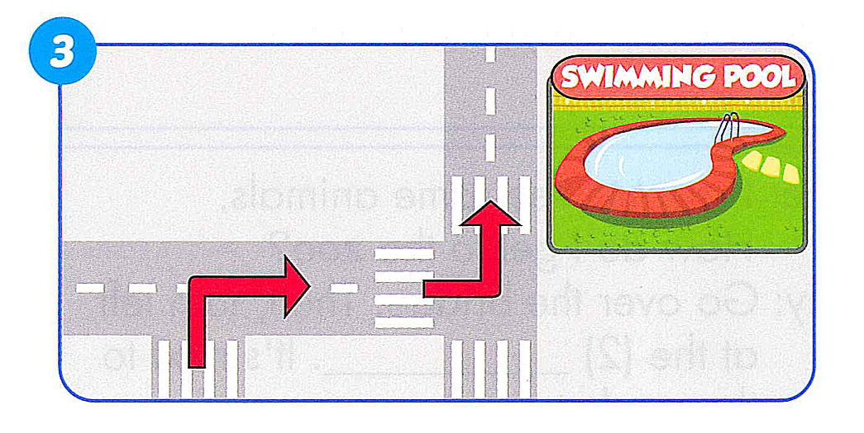
Turn right. Then, turn left. It’s on the right.
How do I get to the swimming pool ?.

Slide 18
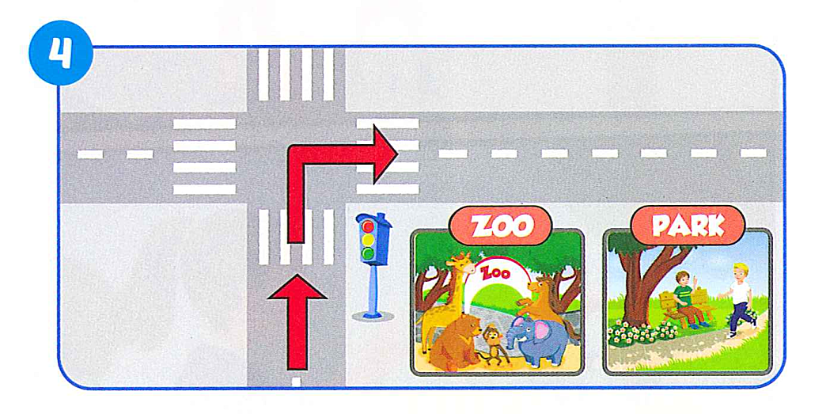
How do I get to the park ?
Go straight. Then, turn right at the traffic lights. It’s next to the zoo.

Slide 19
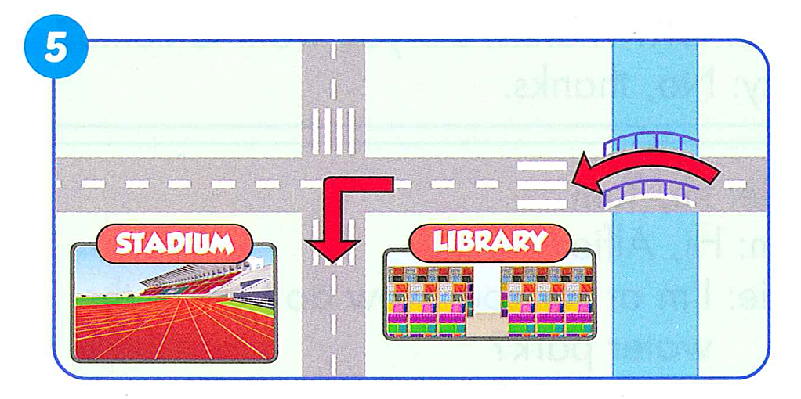
Go over the bridge. Then turn left. It’s opposite the library.
How do I get to the stadium ?

Slide 20
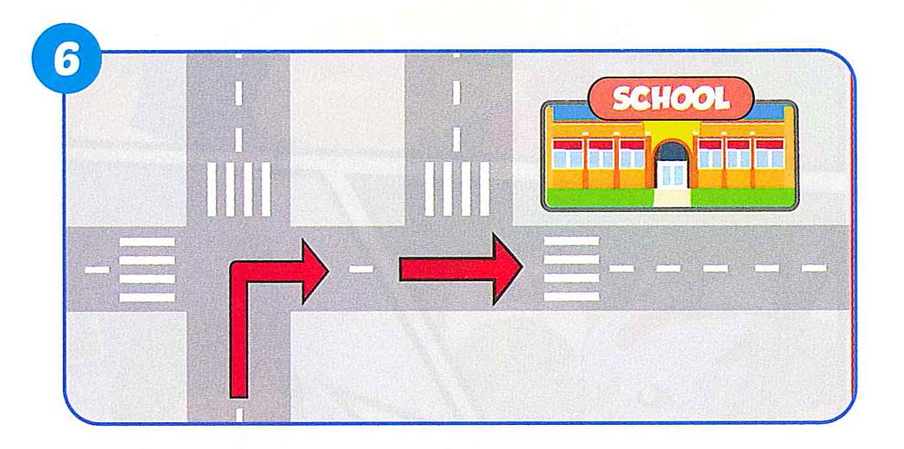
Turn right. Then, go straight. It’s on the corner.
How do I get to the school ?

Slide 21
CLASS ACTIVITY

Slide 22
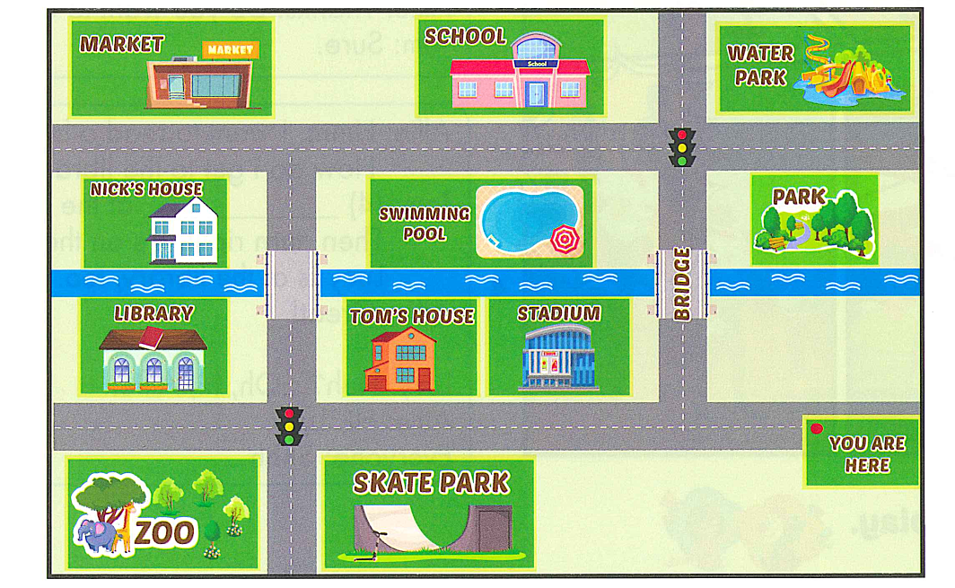

Slide 23
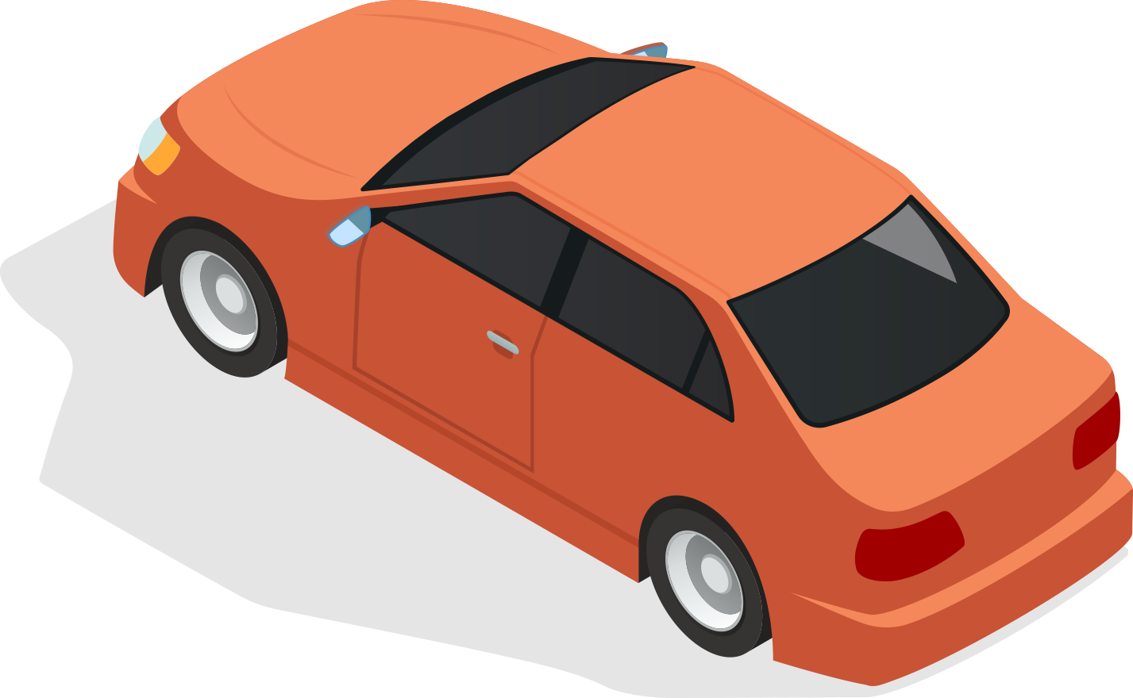
GOOD BYE

