Slide 1
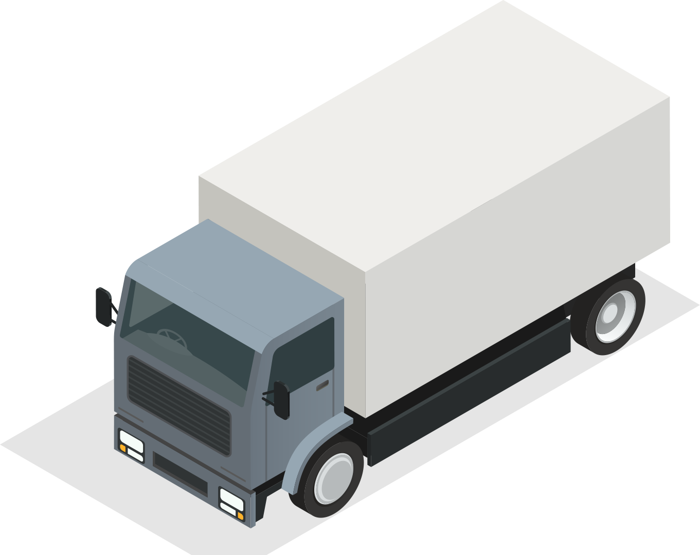
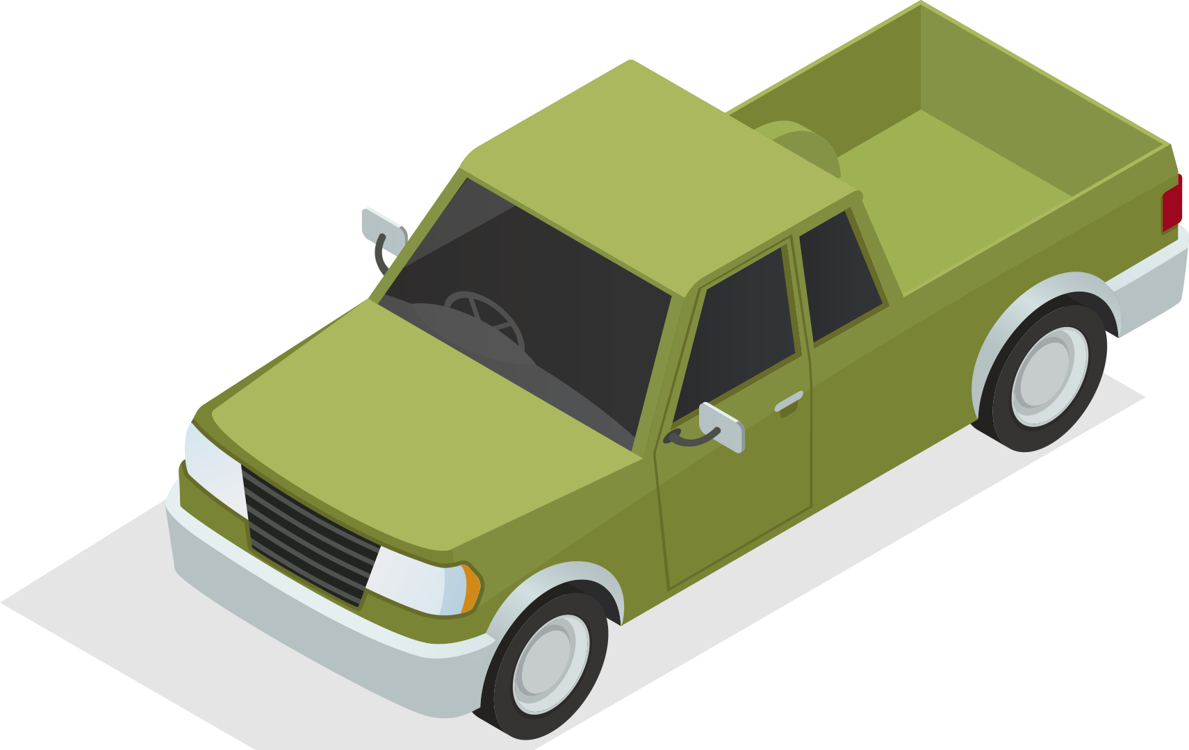
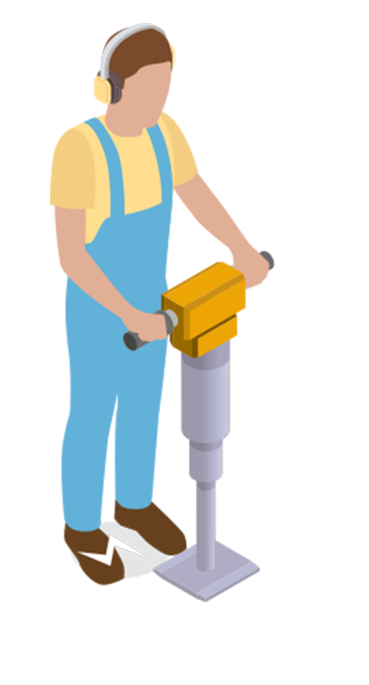
UNIT 5 GETTING AROUND
LESSON 3.1

Slide 2
TABLE OF CONTENTS
01
WARM UP
02
VOCABULARY
03
GRAMMAR

Slide 3
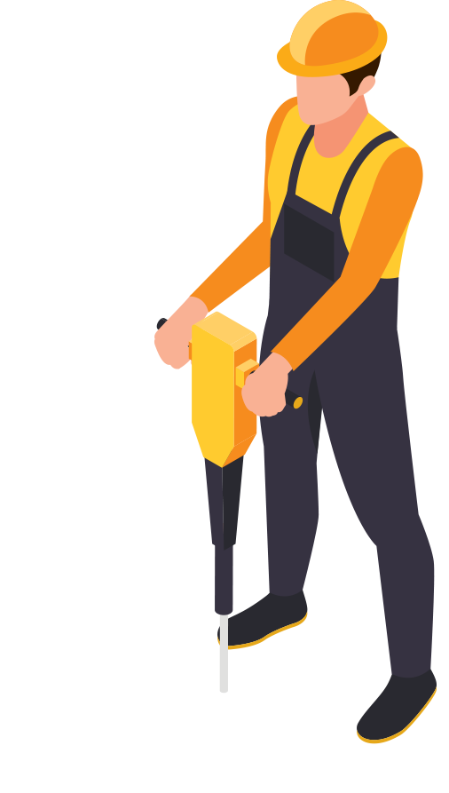
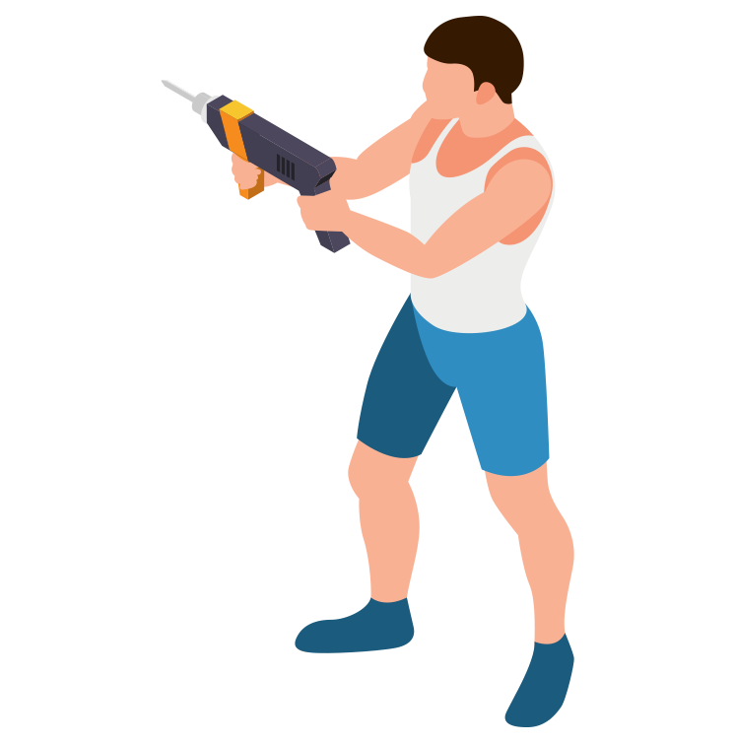
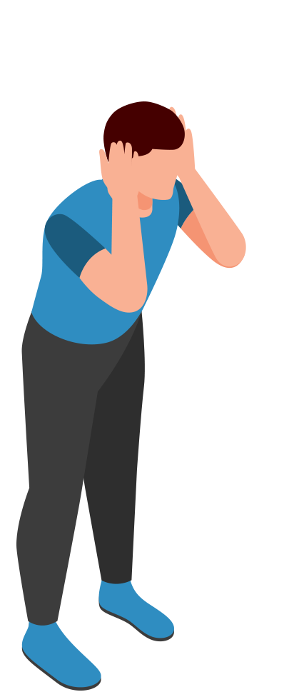
1
WARM UP

Slide 5
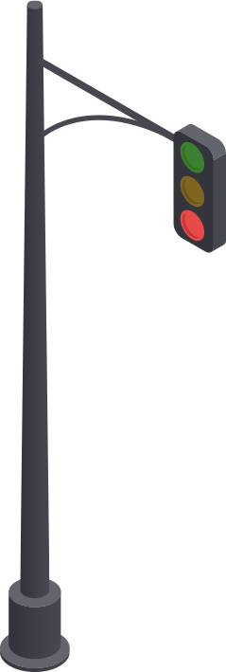
02 VOCABULARY

Slide 6
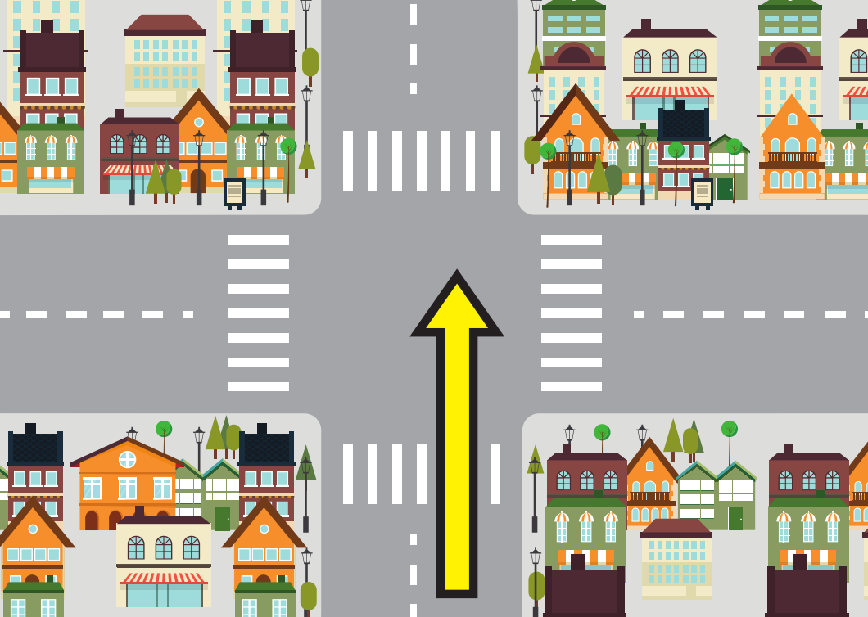
snake
go straight

Slide 7
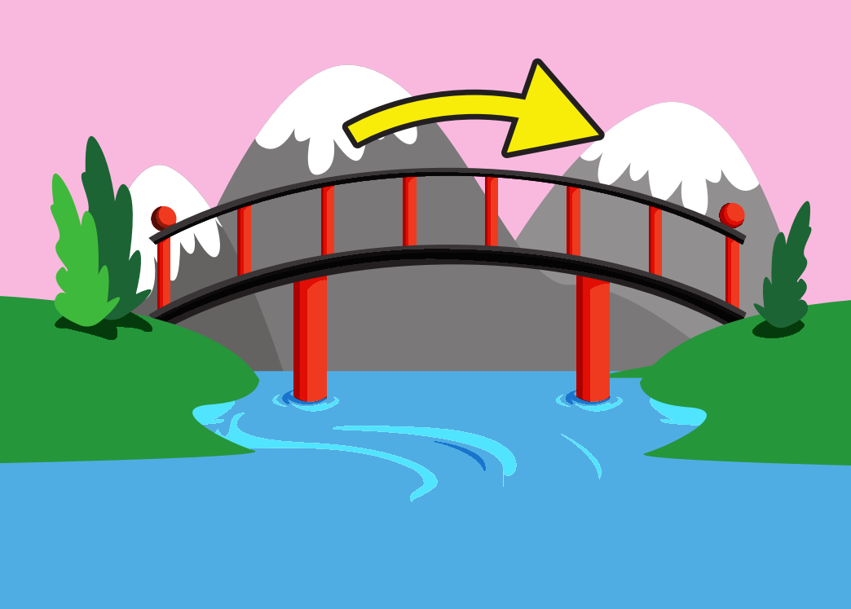
snake
go over

Slide 8
snake
traffic lights

Slide 9
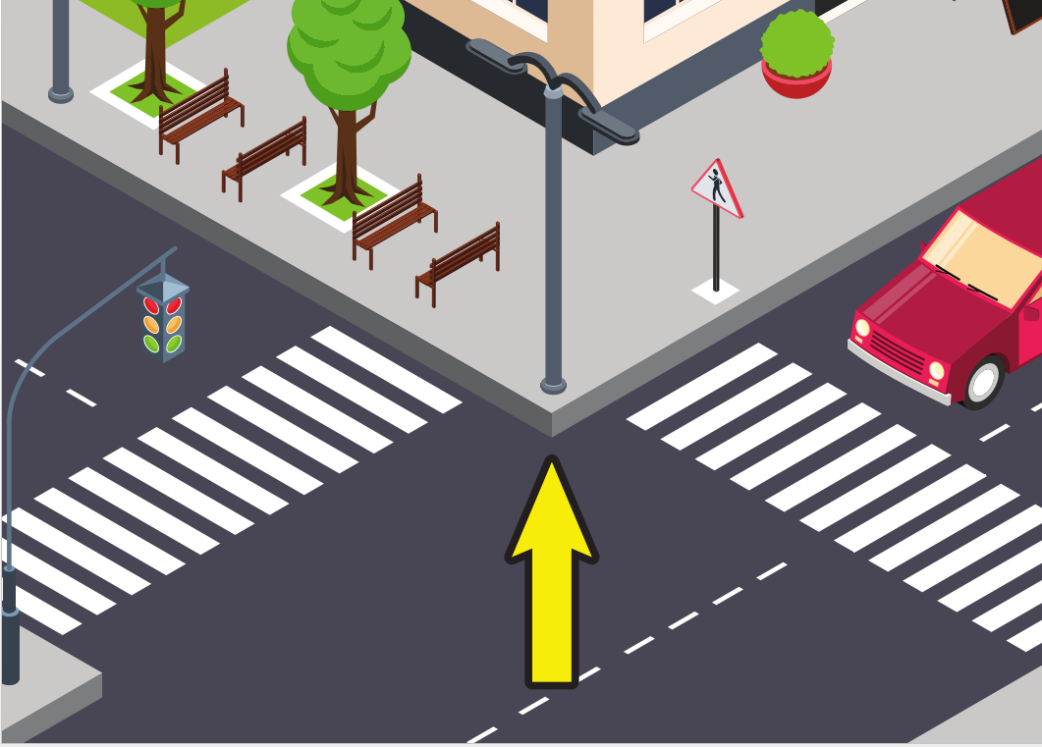
snake
corner

Slide 10
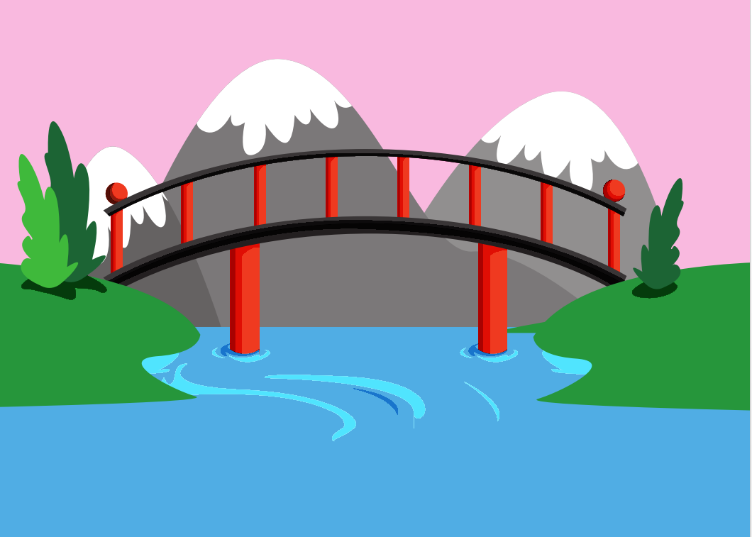
snake
bridge

Slide 11
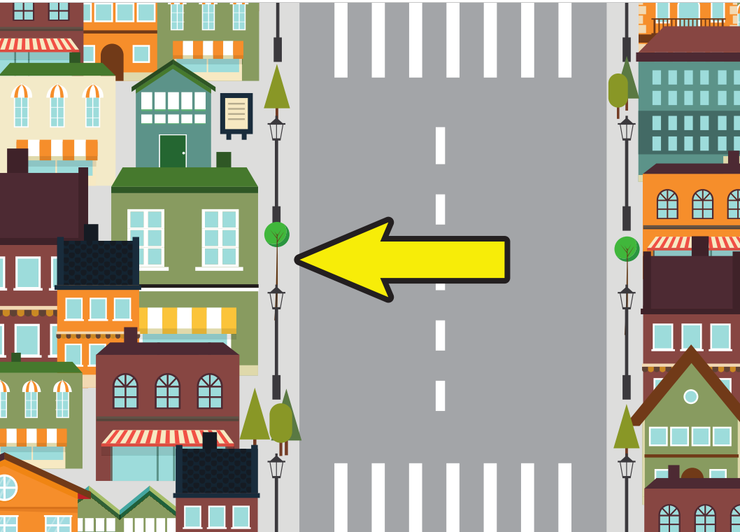
snake
on the left

Slide 12
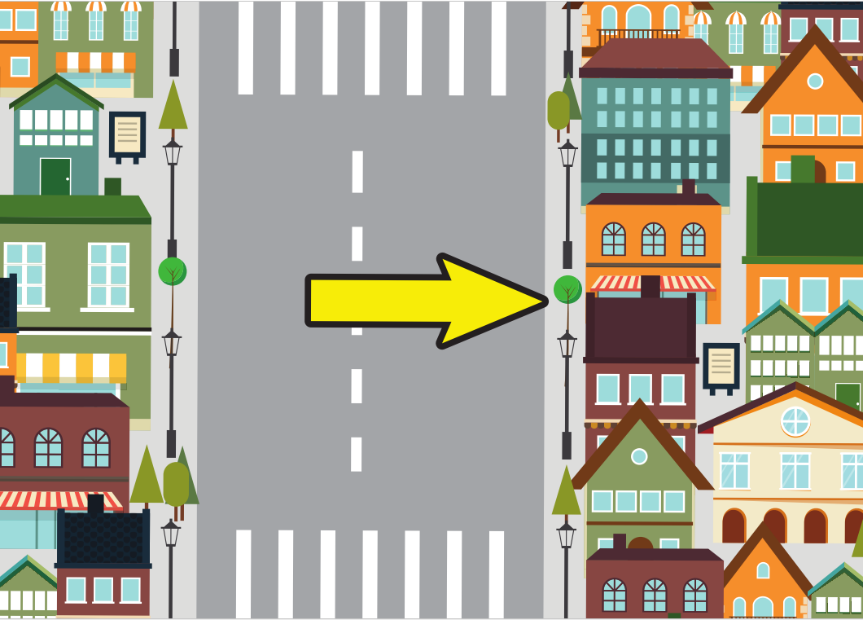
snake
on the right

Slide 13
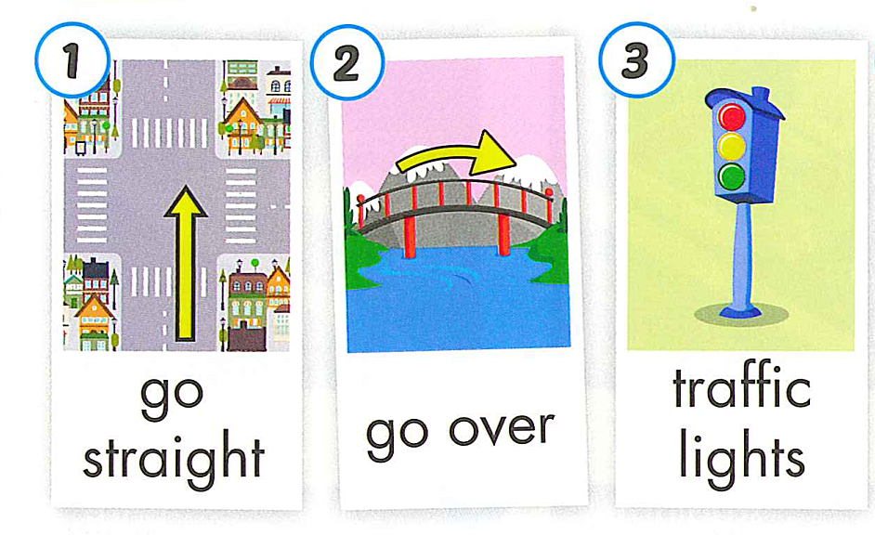
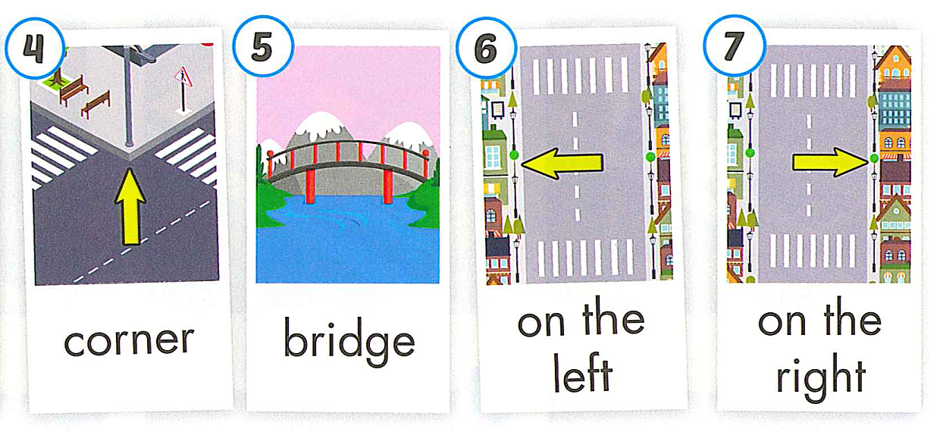

Slide 15
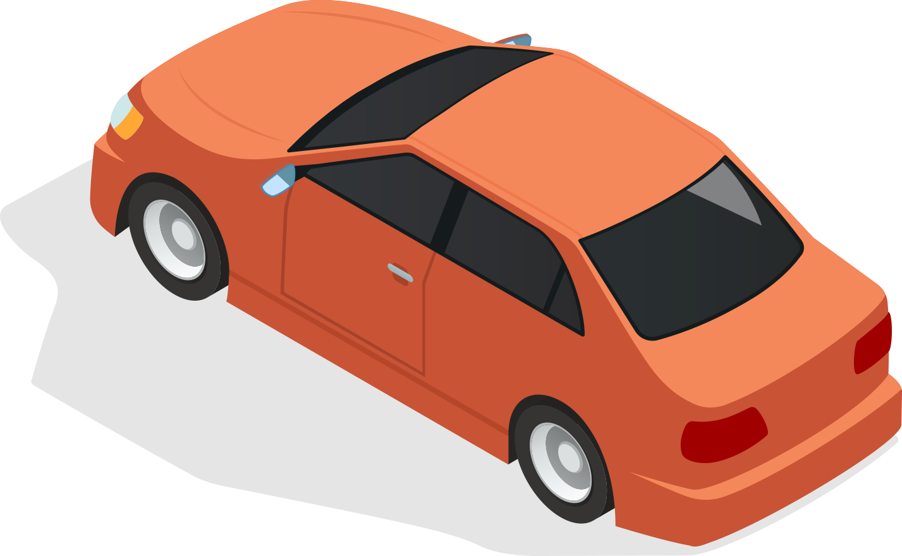
REVIEW VOCABULARY

Slide 16
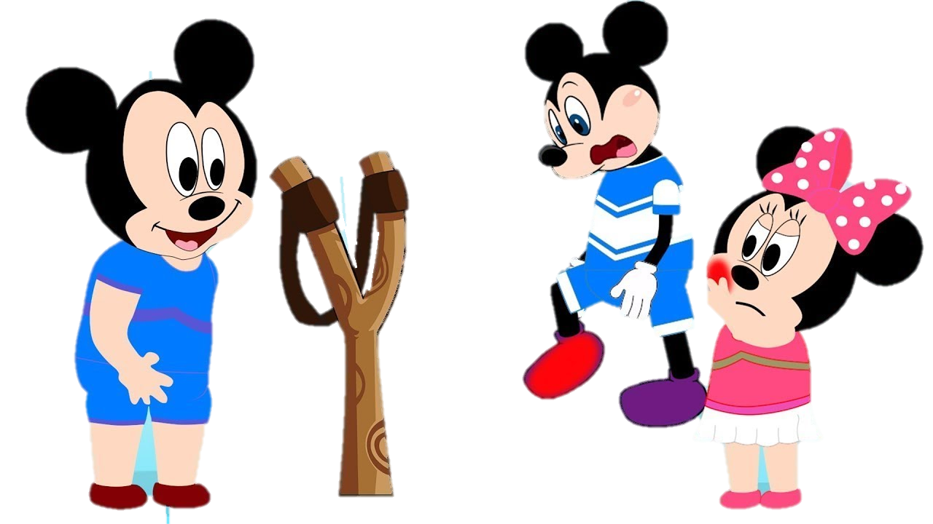

Slide 17
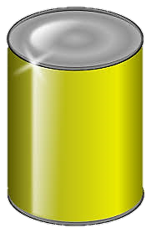
What word
is it?
a. traffic lights
b. bridge
c. light
NEXT
Click on the right can

Slide 18
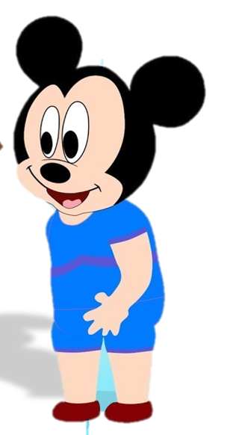
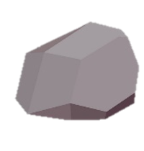
LOOK AND CHOOSE
a. go over
c. traffic lights
b. bridge
Sorry, I don’t have.
NEXT
Click on the right can

Slide 19
LOOK AND CHOOSE
a. bridge
c. Traffic lights
b. go over
Sorry, I don’t have.
NEXT
Click on the right can

Slide 20
Listen and choose
a. corner
b. on the left
c. on the right
NEXT
Click on the right can

Slide 21
Listen and choose
charger
A
B
C
NEXT
Click on the right can

Slide 22
go straight.
charger
A
B
C
NEXT
Click on the right can

Slide 23
LOOK AND CHOOSE
a. on the left
b. on the right
c. corner
Yes, here you are.
NEXT
Click on the right can

Slide 24
03 GRAMMAR

Slide 26
How + do + I + get to the……?
Go straight. Then, turn left.
It’s ……….

Slide 27
REVIEW GRAMMAR

Slide 28
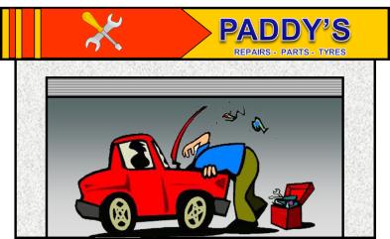
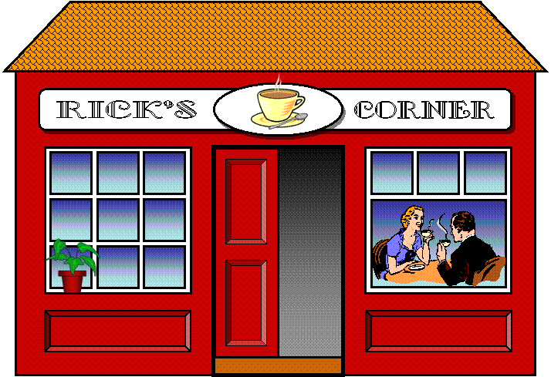
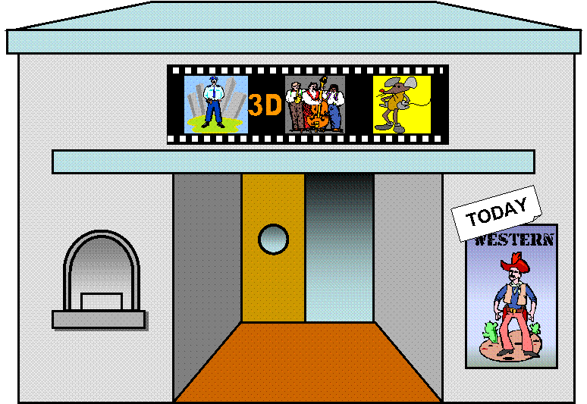
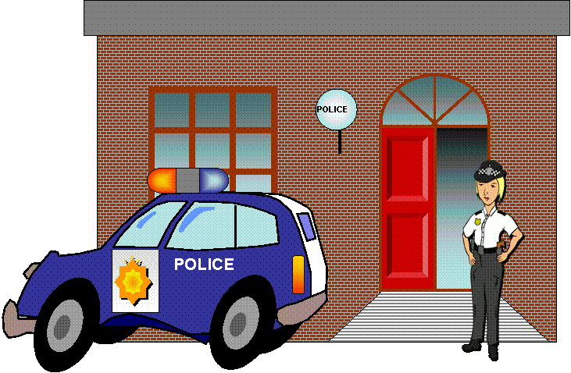
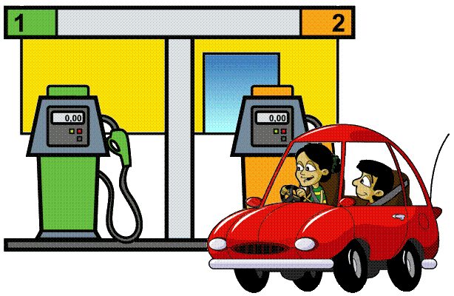
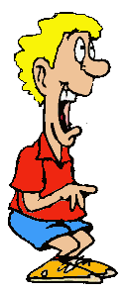
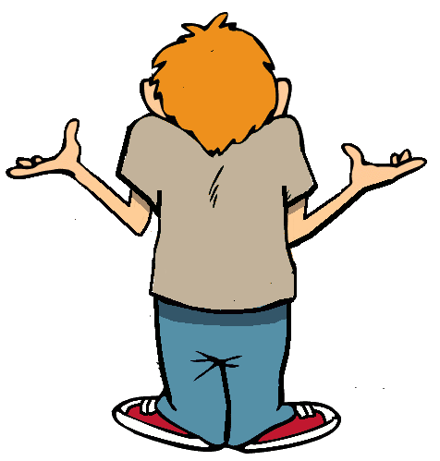
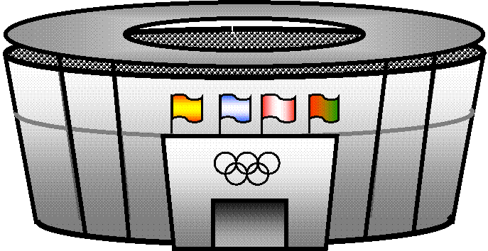
How do I get to the police station?

Slide 29
1. Go straight
2. Turn right
3. It’s on the left

Slide 30
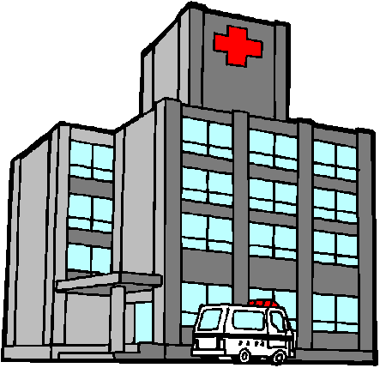
How do I get to the hospital?
Park Avenue
Oak Street

Slide 31
1. turn right
2. Go straight
3. Turn right
4. It’s on the right
Park Avenue
Oak Street

Slide 32
How do I get to the stadium?
Park Avenue
Oak Street

Slide 33
1. Turn right
2. Go straight
3. It’s on the right
Park Avenue
Oak Street

Slide 34
How do I get to the garage?
Park Avenue
Oak Street

Slide 35
1. Go straight
2. Turn left
4. It’s on the right
Park Avenue
4
Oak Street

Slide 36
PRACTICE

Slide 37
corner
on the right
bridge

Slide 38
Monday, January 29th, 2024 Unit 5: Getting around Lesson 3
New words:
go straight : đi thẳng
go over : đi qua
traffic lights : đèn giao thông
corner : góc đường
bridge : cầu
on the left : bên trái
on the right : bên phải
Structures: Hoỉ và chỉ đường
How do I get to the swimming pool?
Go straight. Then turn left. It’s on the right.

Slide 39
GOOD BYE

