Slide 1

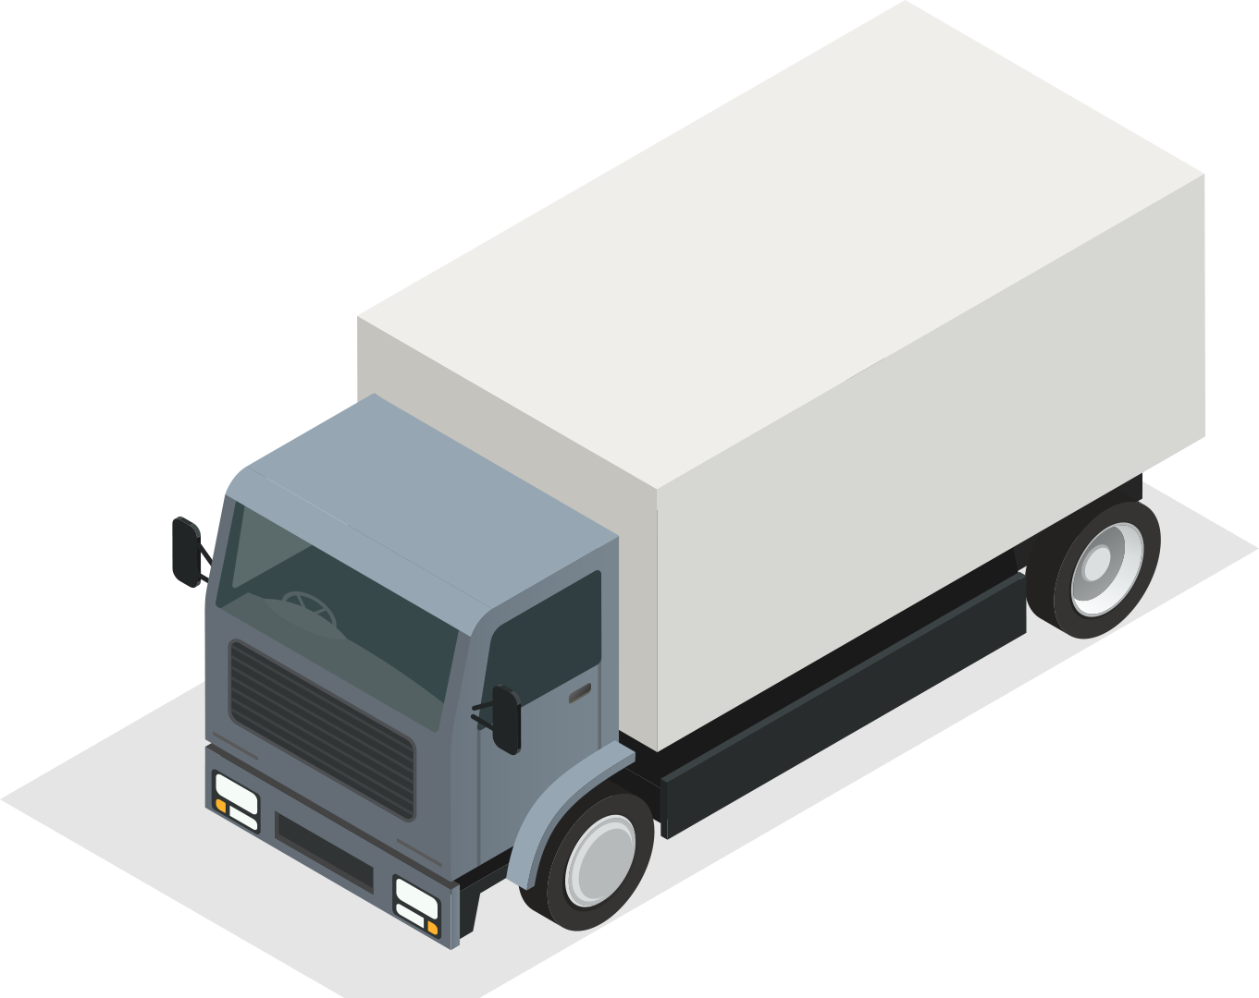
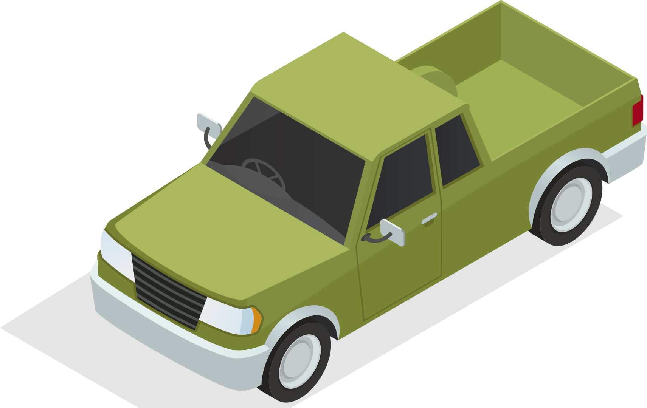



UNIT 5
GETTING AROUND
LESSON 3.2

Slide 2
TABLE OF CONTENTS
01
WARM UP
02
SOUND
03
GRAMMAR

Slide 3
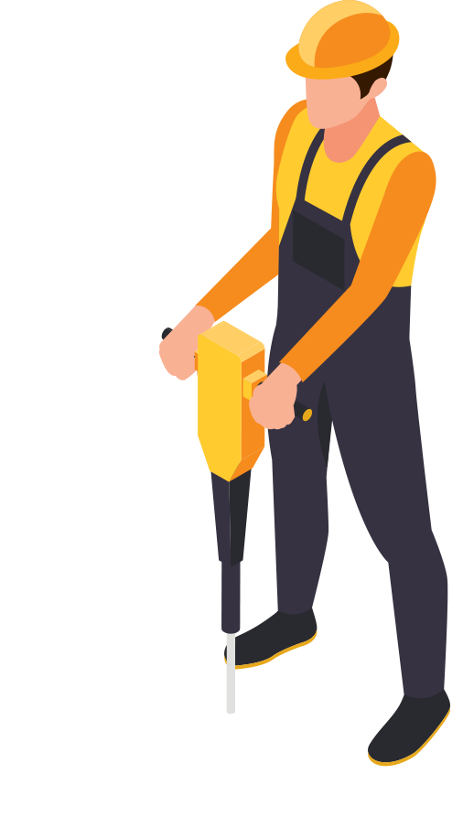

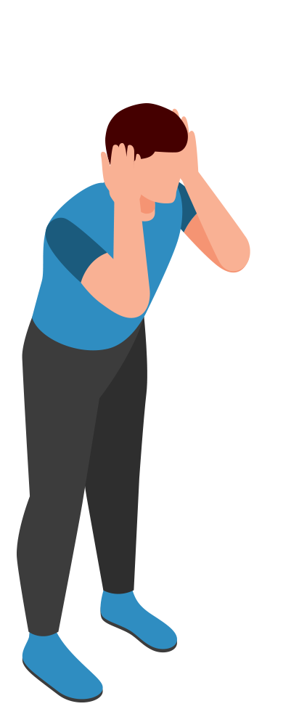
1
WARM UP

Slide 4
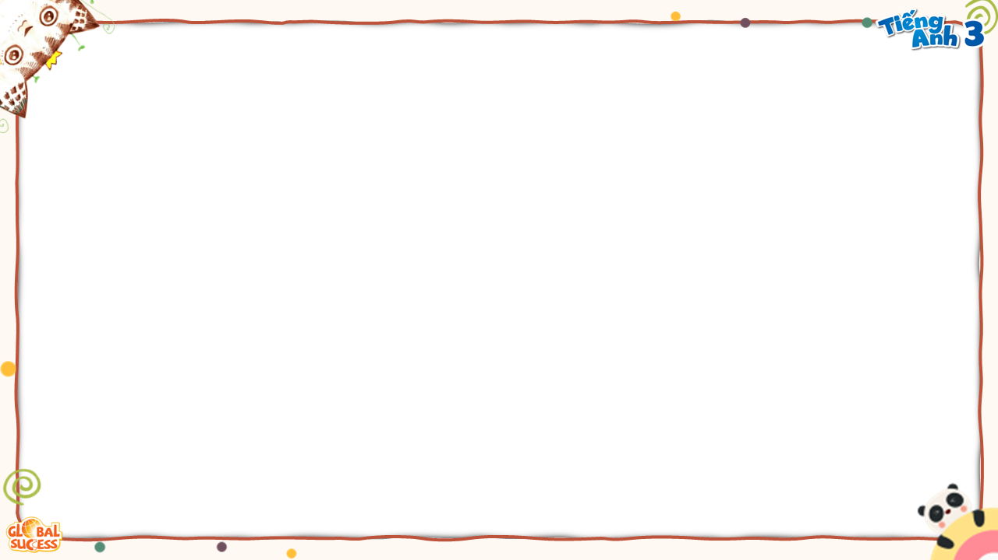
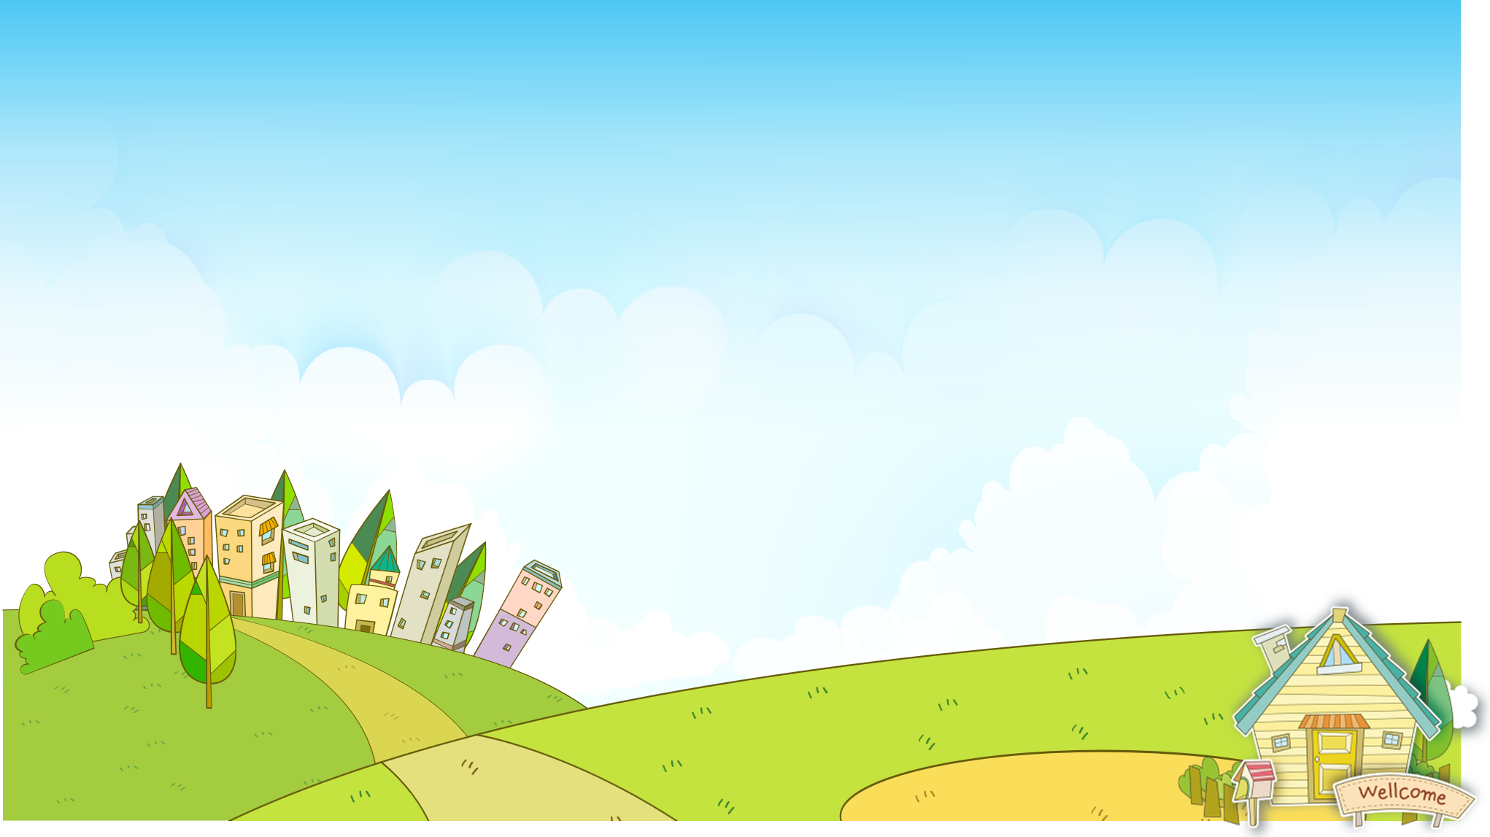




Odd one out
RULES
PLAY

Slide 5
Odd one out
PLAY

Slide 6
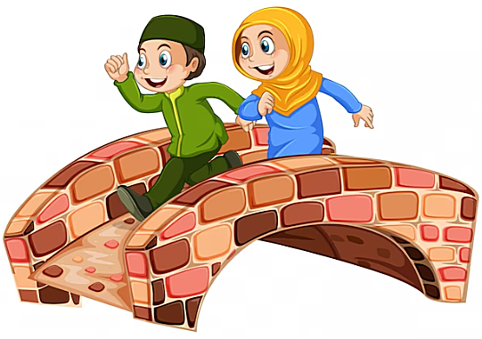
LOOK AND CHOOSE
b. go over
a. corner
c. on the left
Next

Slide 7
___ do I get to the store?
Go straight. Then, turn left. It’s on the right.
b. Where
a. What
c. How
Next

Slide 8
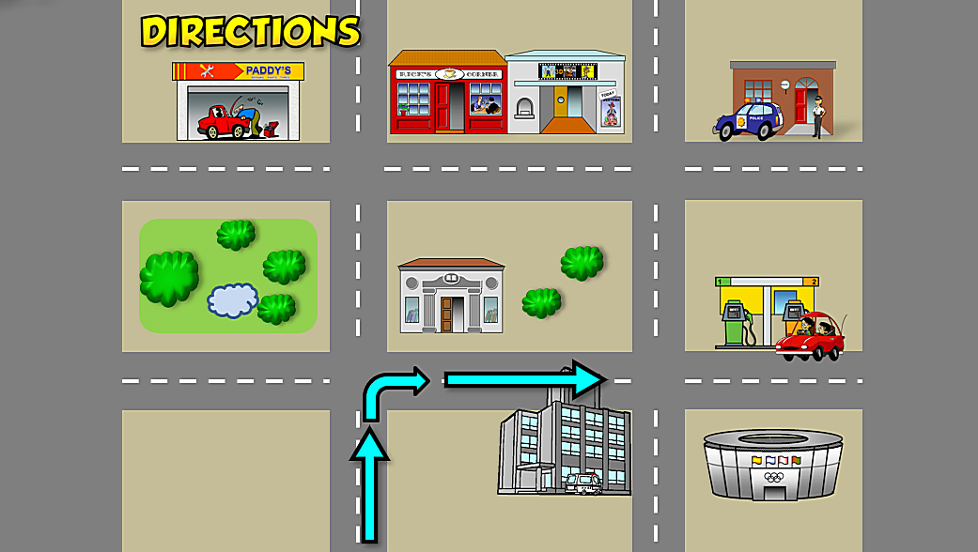
How do I get to the hospital?
Go straight. Then, turn right.
It’s _____
a. on the right
b. on the left
Next

Slide 9
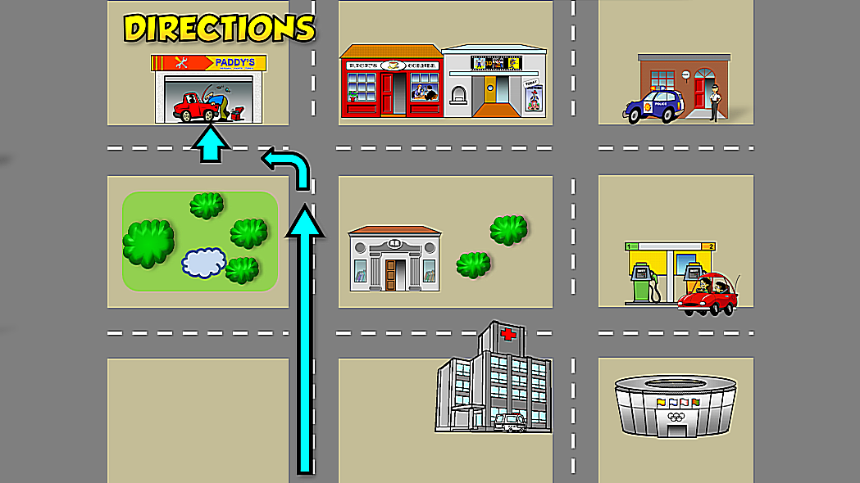
How do I get to the garage?
Go straight. Then, ___. It’s on the right.
a. turn left
b. Turn right
Next

Slide 10
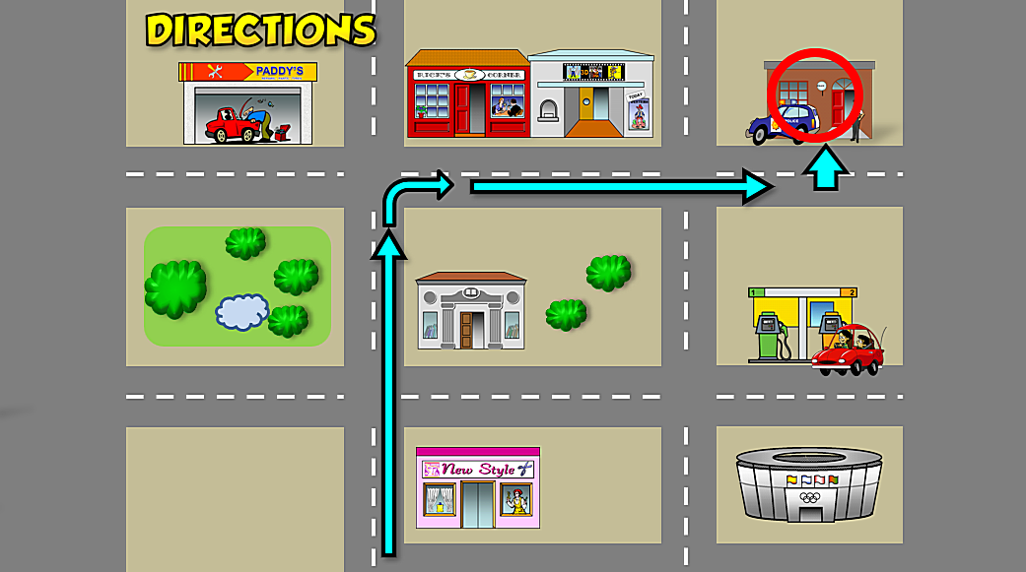
How do I get to the polite station?
a. Go straight. Then, turn left. Then, go straight. It’s on the left.
b. Go straight. Then, turn right. Then go straight. It’s on the left.
Next

Slide 11
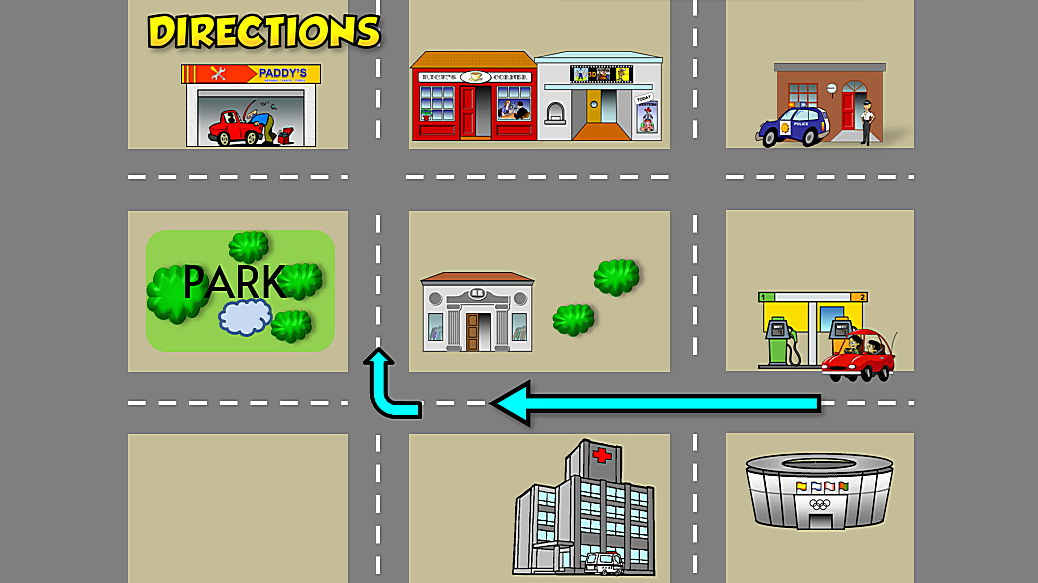
How do I get to the park?
a. Go straight. Then, turn left. It’s on the right.
b. Go straight. Then, turn right. It’s on the left.
Next

Slide 12




Great job!
End

Slide 13



SOUND
2

Slide 14

1. Listen and repeat
/tr/, /tr/, traffic lights
/tr/, /tr/, tree

Slide 15
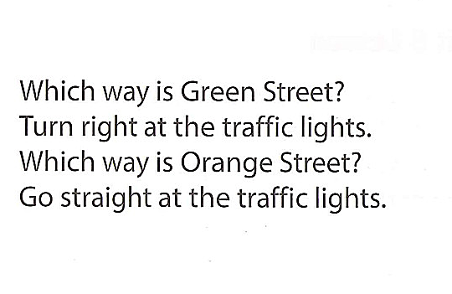
2. Chant

Slide 16
READING
3

Slide 17

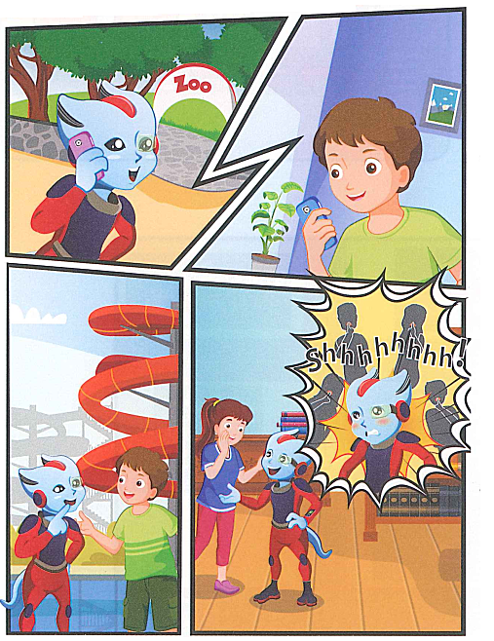
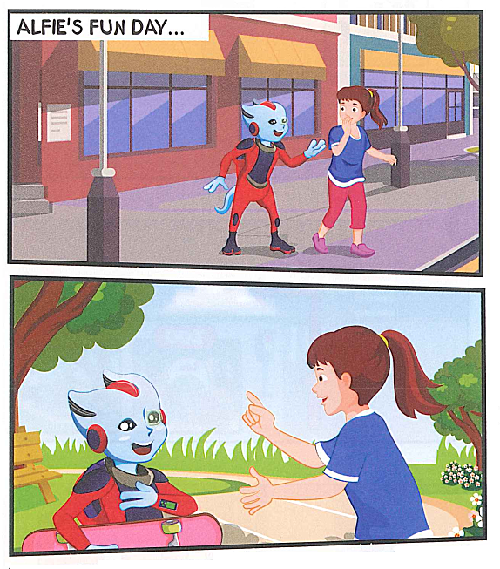

Slide 18

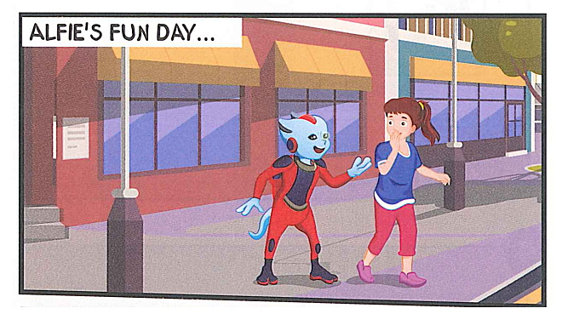
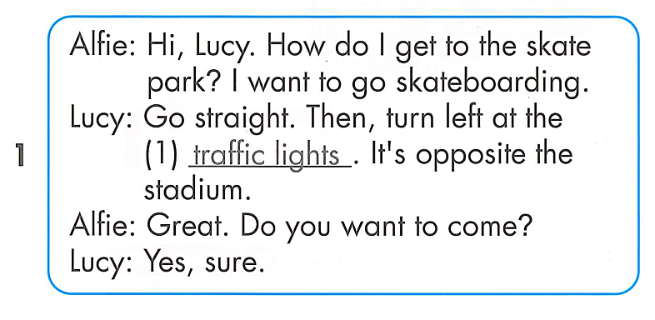

Slide 19
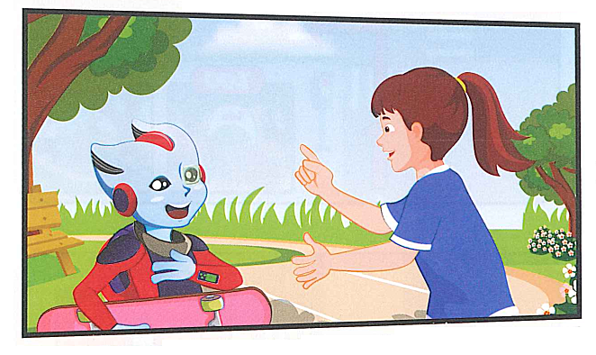

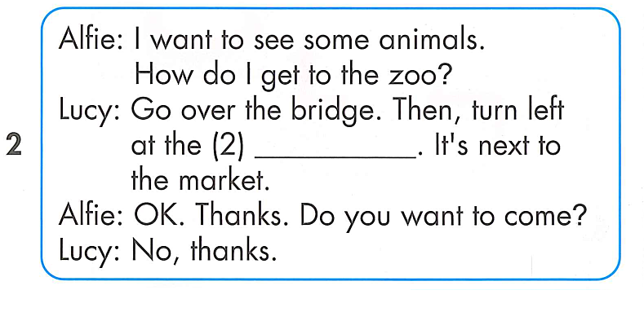
corner

Slide 20
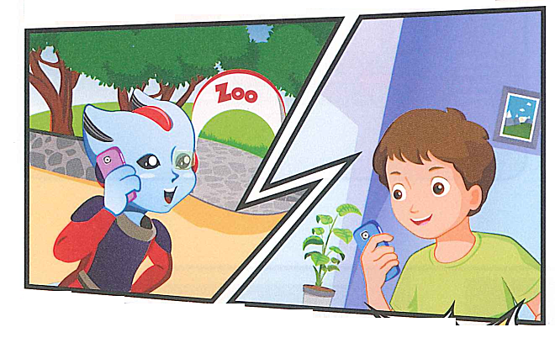
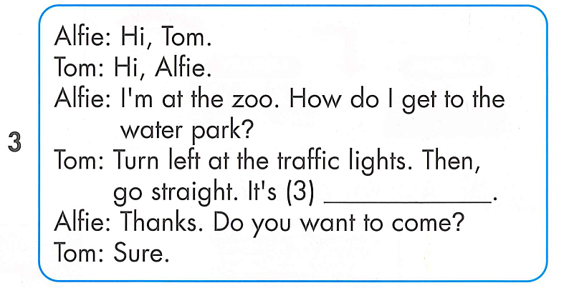
on the right

Slide 21
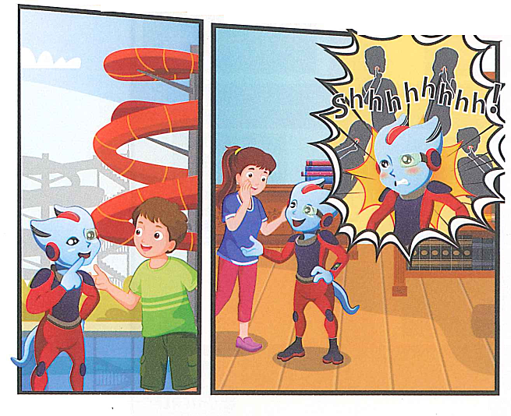
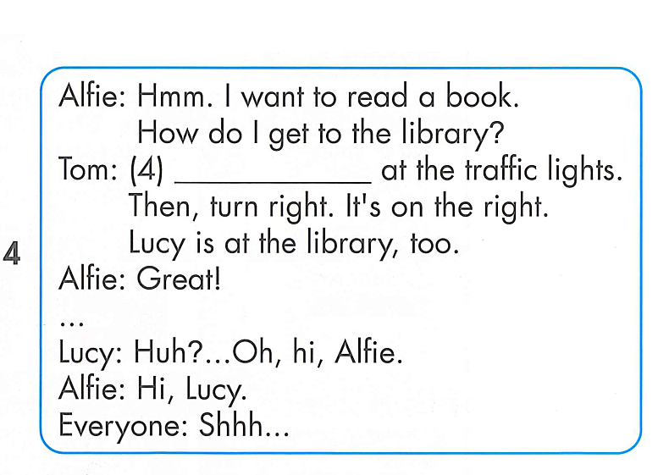
Go straight

Slide 22
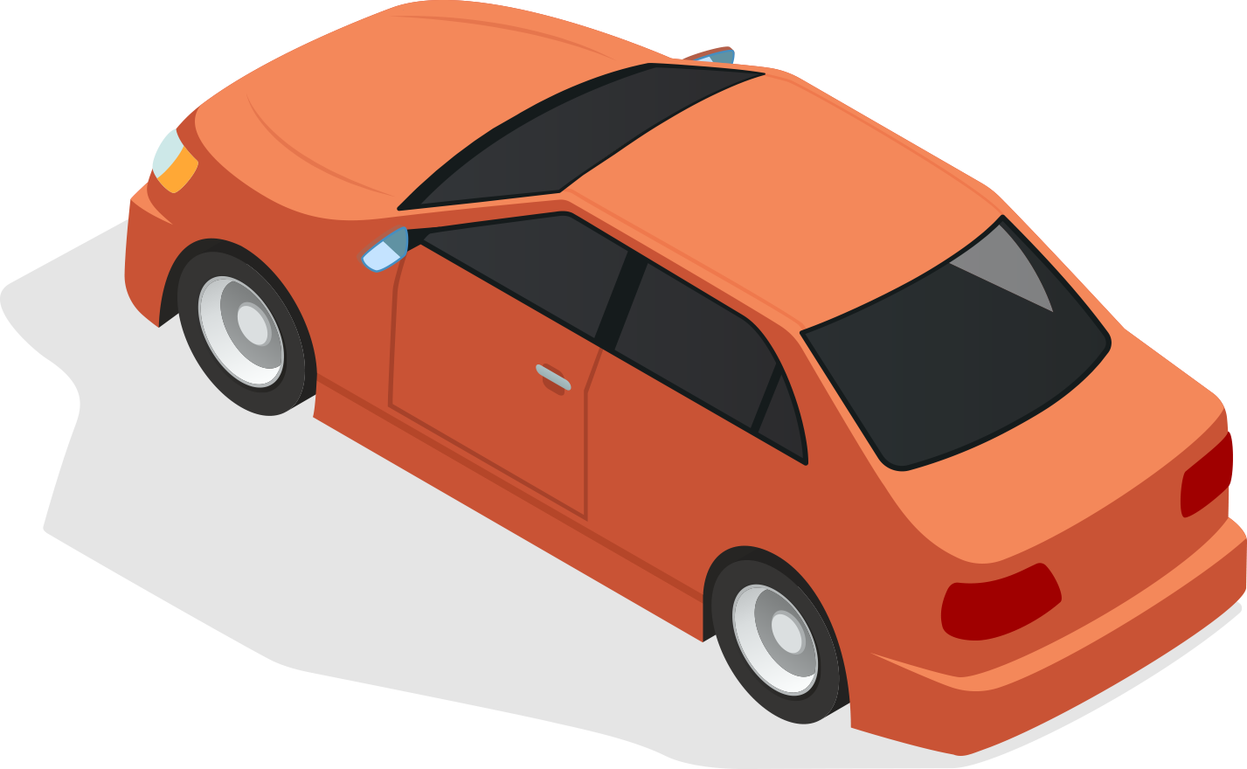
REVIEW
READING

Slide 23
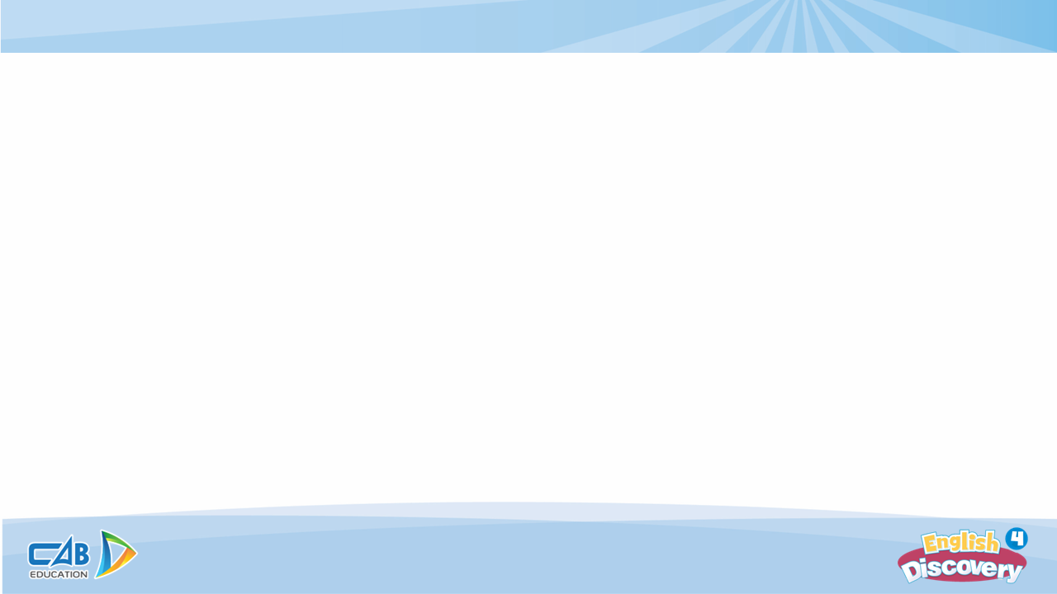


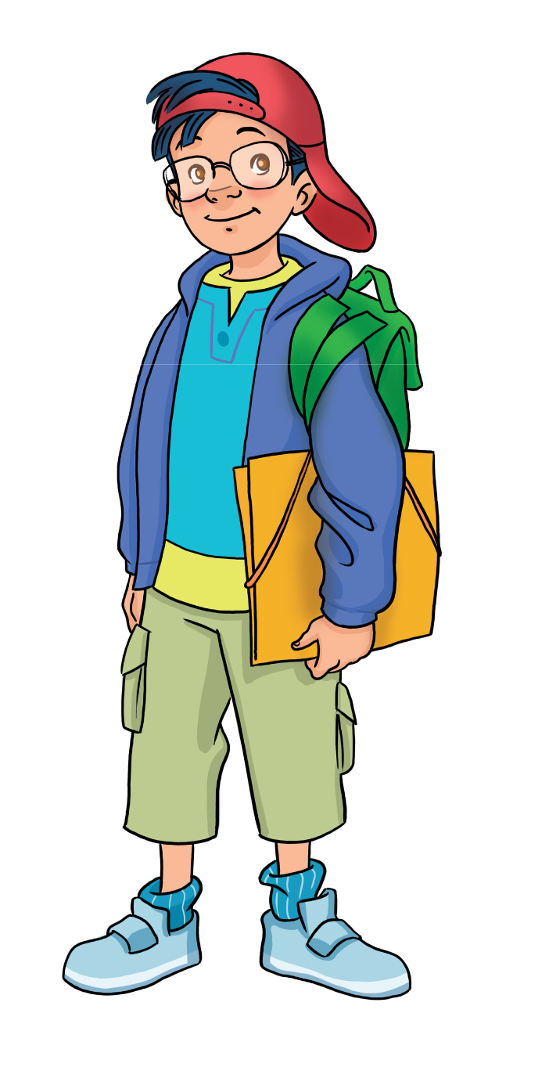
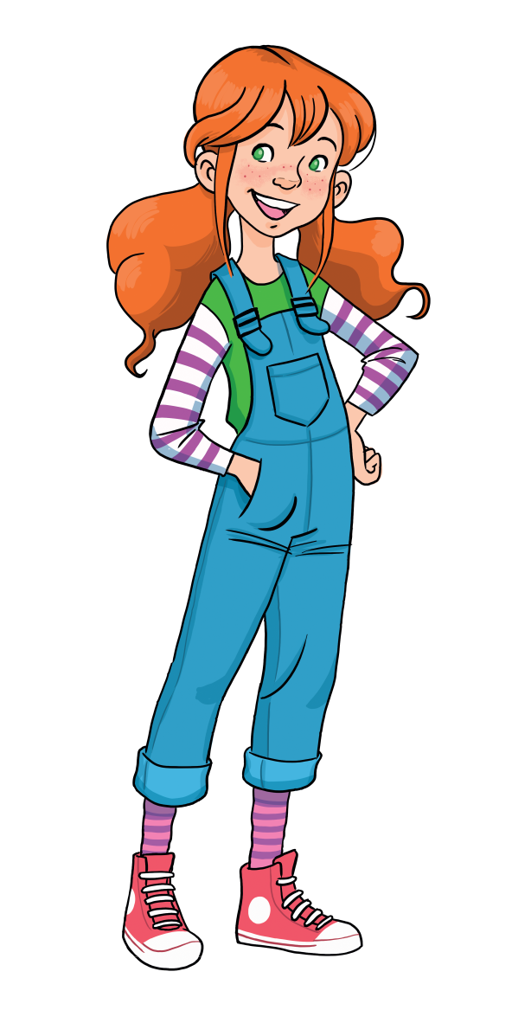
Let’s play!
Put students in pairs.
Students look at the pictures and choose the correct answer A, B, C or D.
1 correct answer = 1 point.
All students say aloud the answers.

Slide 24




How do they get to the skate park?
Go straight. Then, __ at the traffic lights. It’s opposite the
___.
turn left-museum
turn right- stadium
turn right-museum
turn left-stadium
Next

Slide 25
How do they get to the zoo?
Go __. The, turn left at the corner. It’s next to the __.
straight-market
Straight-store
over the bridge-store
over the bridge- market
Next

Slide 26
How do they get to the water park?
___at the traffic lights. Then, go straight. It’s on the __.
Turn left- right
Turn right-right
Turn right-left
Turn left- left
Next

Slide 27
How do they get to the library?
Go straight at the traffic lights. Then, turn __. It’s on the __.
right-left
right-right
left-right
left-left
Next

Slide 28
Did Lucy go to the zoo with Alfie?
Yes, she did.
No, she didn’t.
Next

Slide 29
You’re
well done!

Slide 30
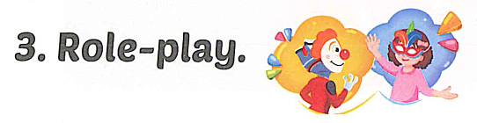
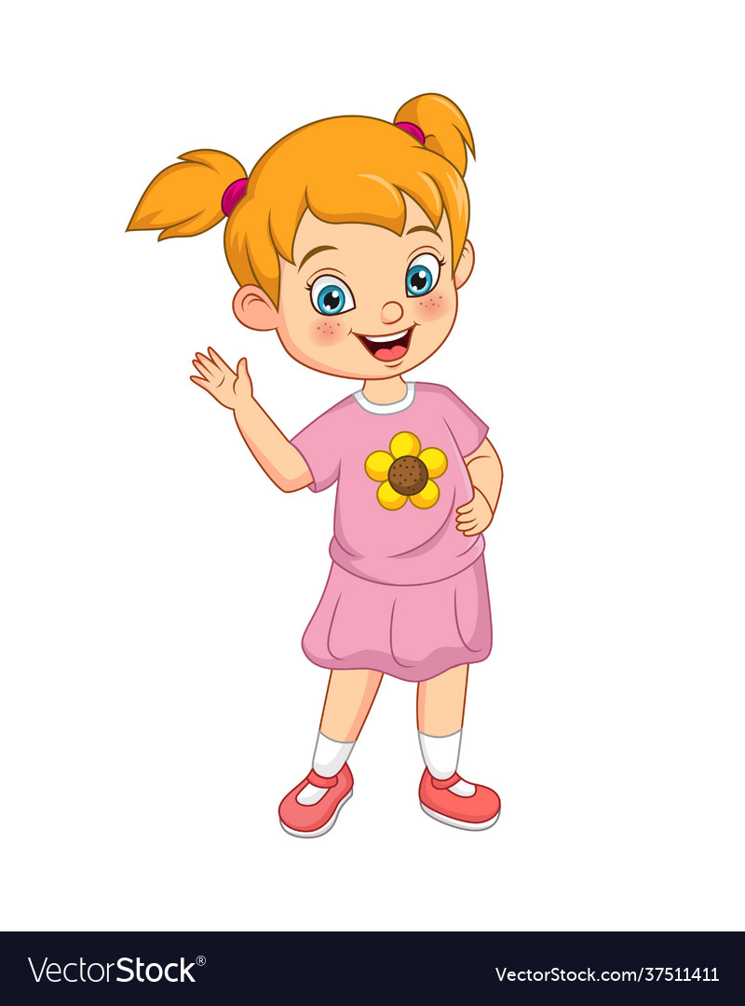
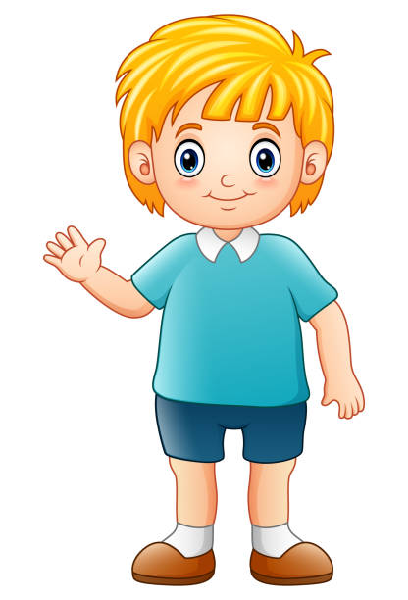

Slide 31
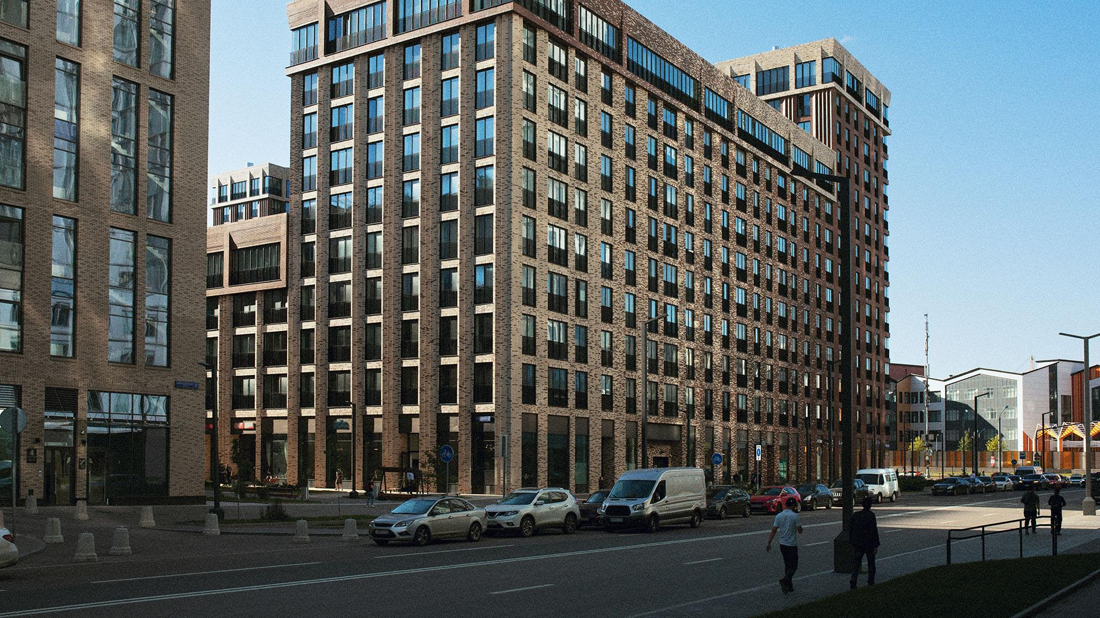
GOOD BYE

