Slide 1

UNIT 5
GETTING AROUND
LESSON 2.2

Slide 2
Table of contents
01
02
03
WARM UP
VOCABULARY
GRAMMAR

Slide 3
01
WARM UP

Slide 4
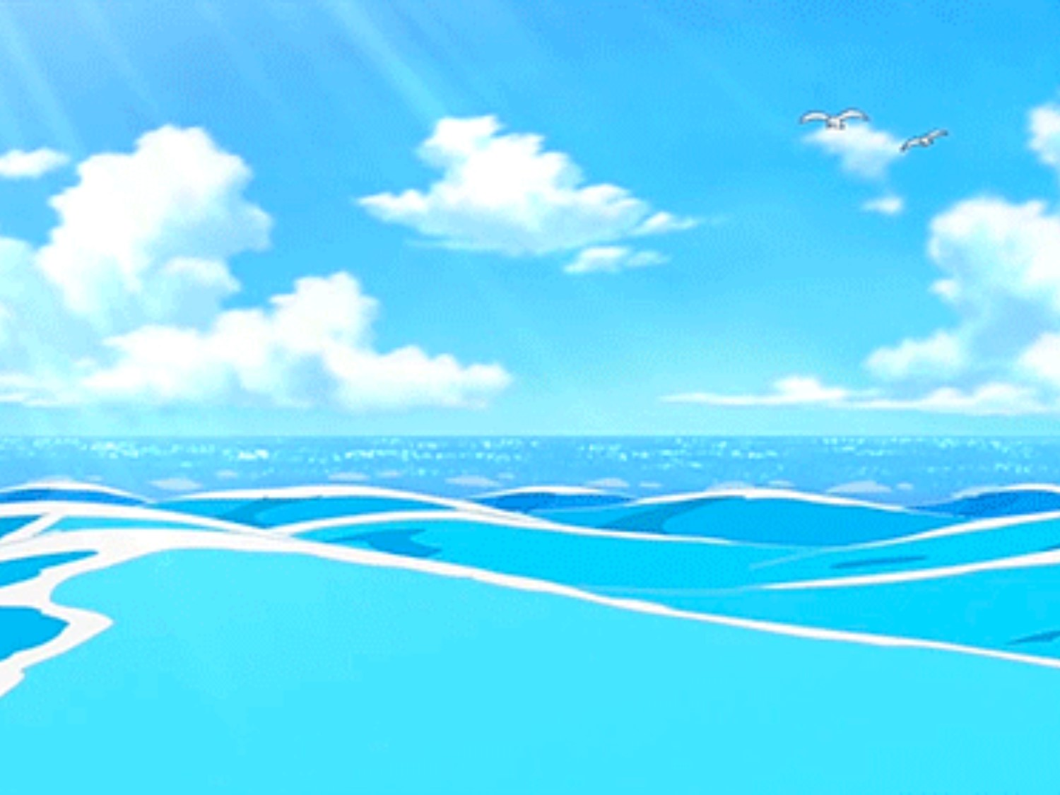




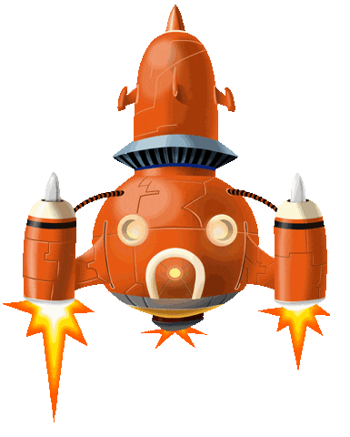
I went to school.
I went to school.

Slide 5




Where’s the library ?
It’s…..the stadium.
a. next to
b. behind
c. opposite

Slide 6
Listen and choose
a. in front of
b. near

Slide 7
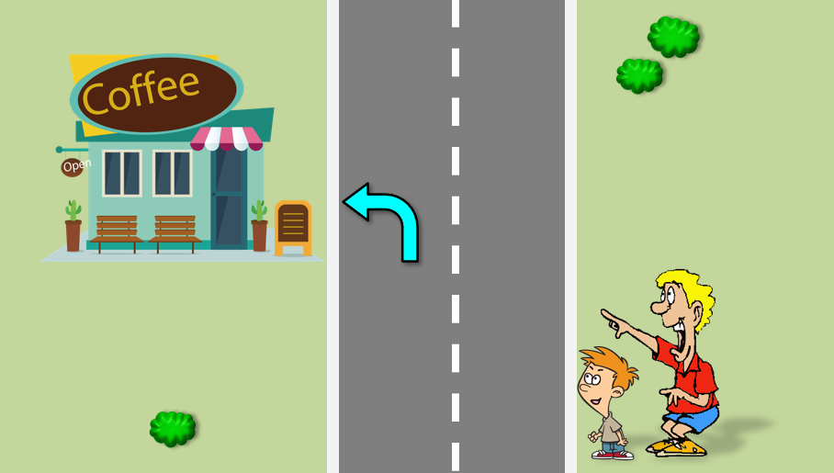

Where’s the coffee shop ?
It’s……..
a. on the left
b. on the right
c. go over

Slide 8
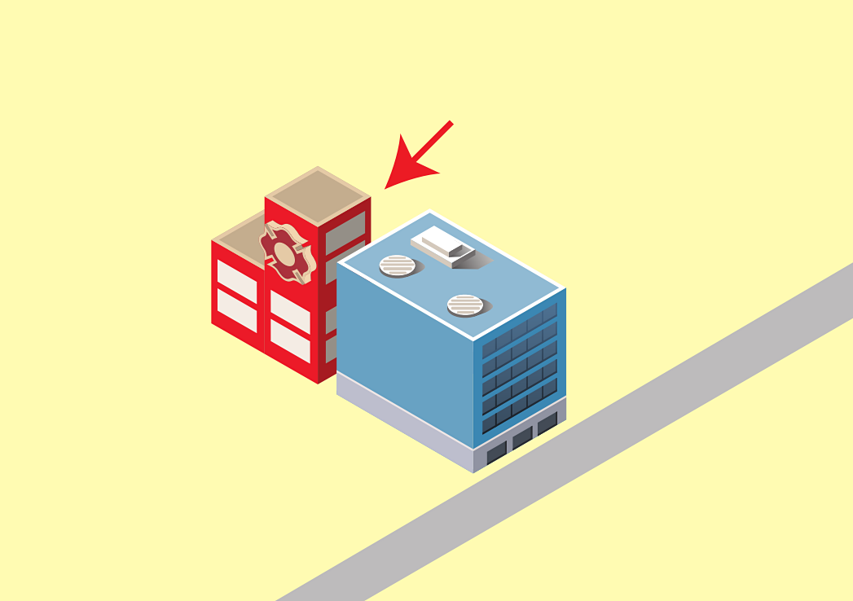
d-b-i-n-e-h
a. bihend
b. behind
c. benhid

Slide 9

Where…the park ?
It’s near the zoo.
a. does
c. is
b. are

Slide 10
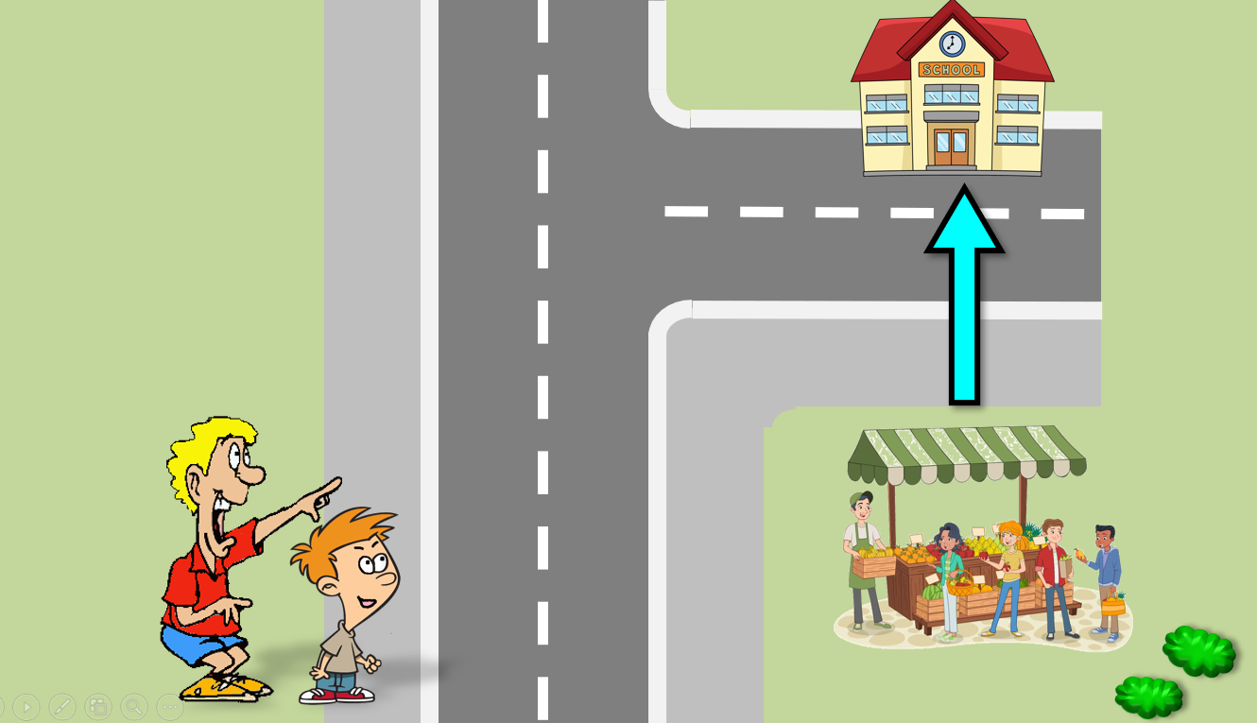
Where’s the market ?
It’s….the school.
a. behind
c. opposite
b. next to

Slide 11
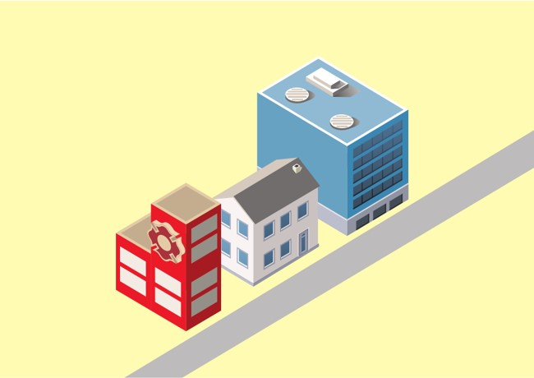
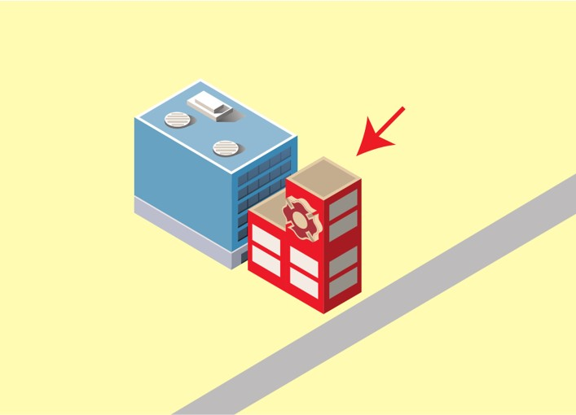
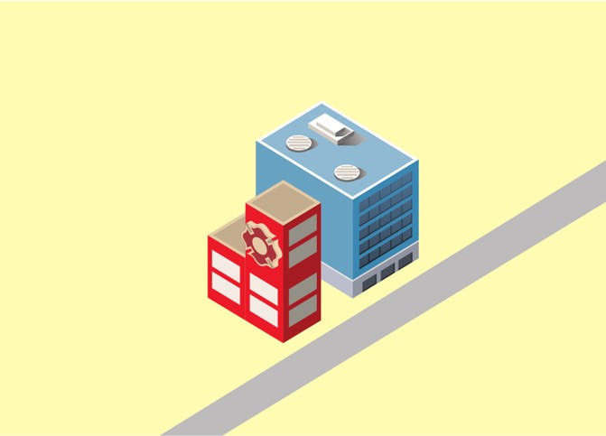
Listen and choose
A
B
C

Slide 12
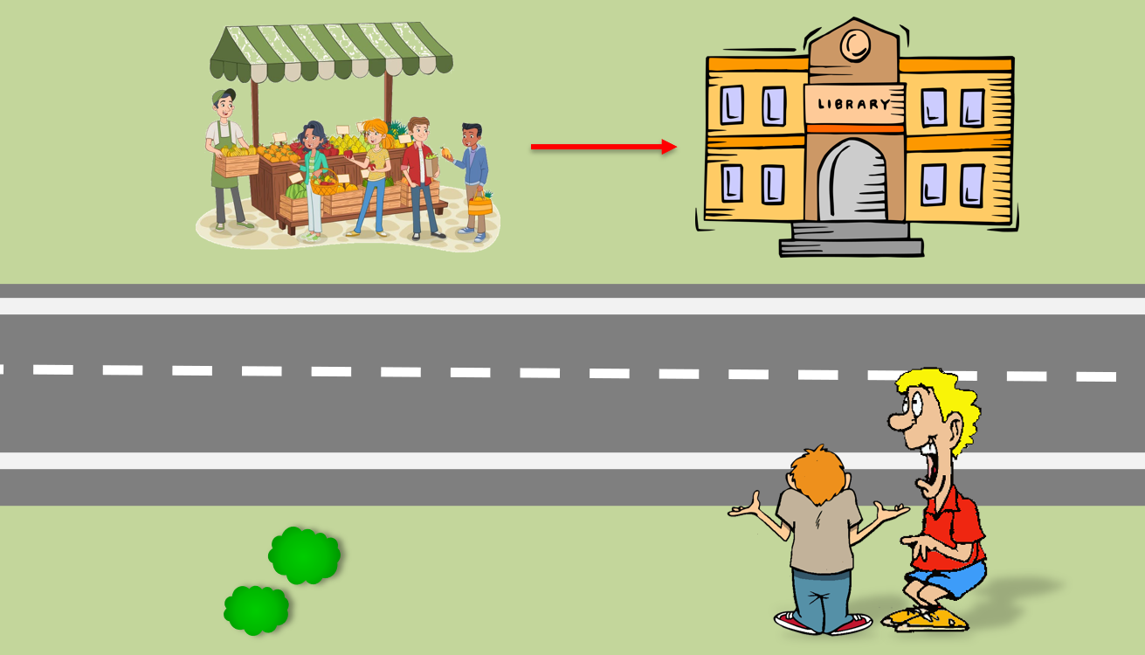
Where’s the library ?
It’s…..the market.
a. in front of
b. next to

Slide 13
Goodbye
Thank you!

Slide 14
02
SOUND

Slide 15
1. Listen and repeat
/ei/, /ei/, skate
/ei/, /ei/, today

Slide 16
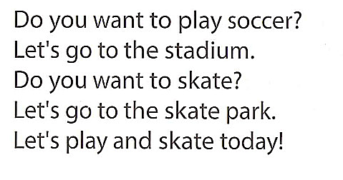
Wednesday, January 17th, 2024
Unit 5: Getting around
Lesson 2
1. Chant

Slide 17
03
LISTENING

Slide 18
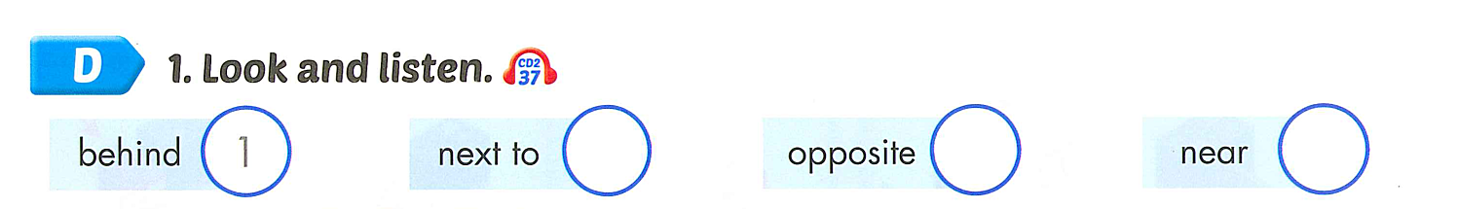

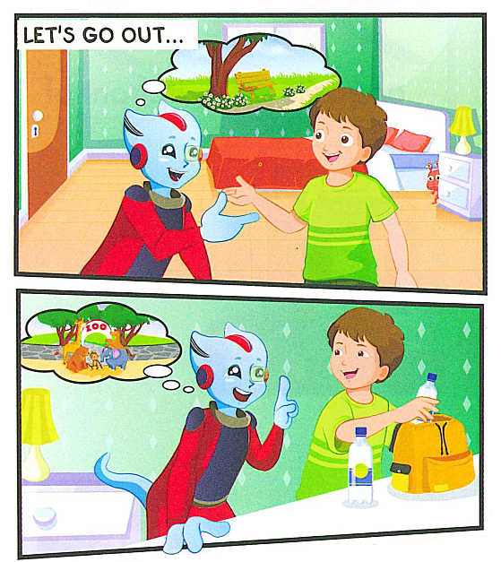
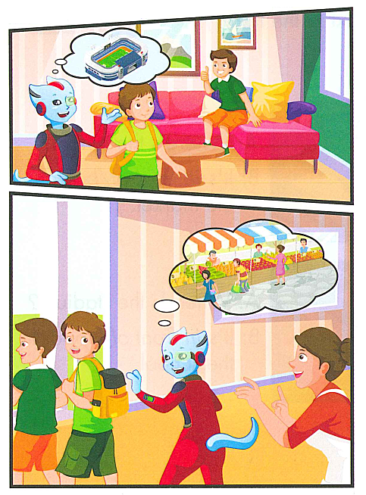
3
4
2

Slide 19

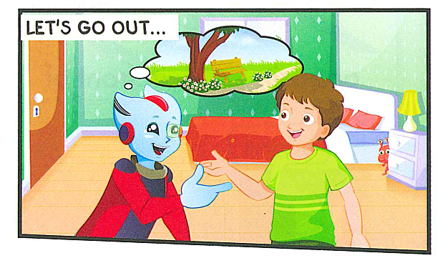
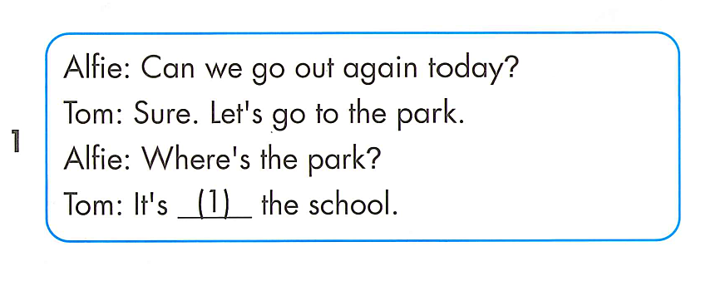
behind

Slide 20
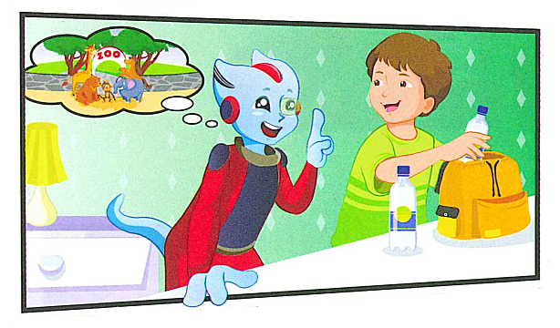
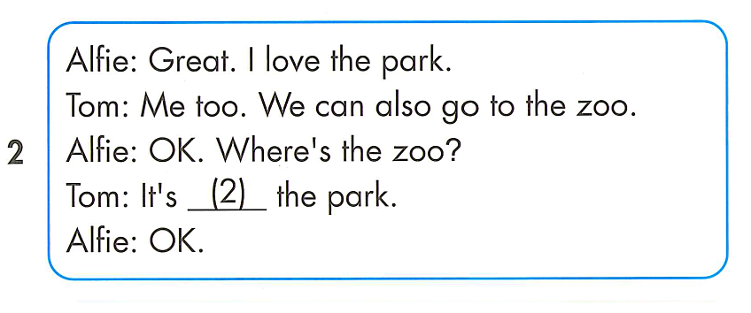
near

Slide 21
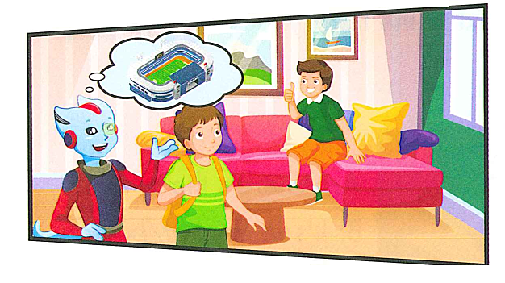
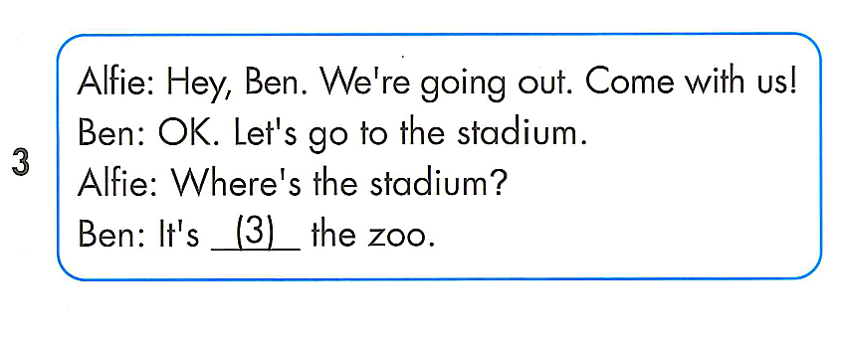
next to

Slide 22
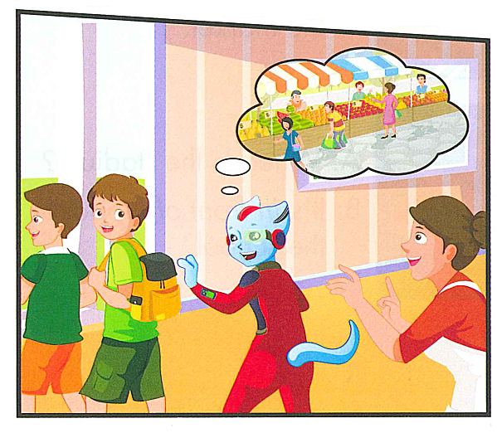
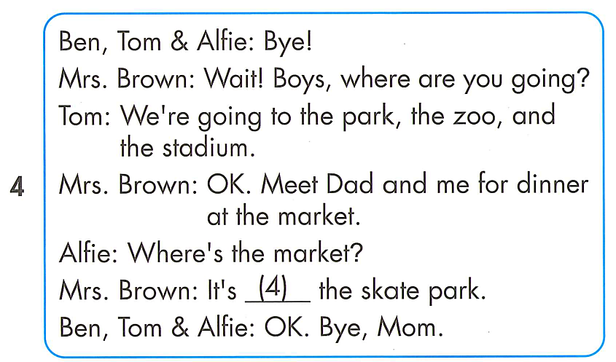
opposite

Slide 23
Review reading

Slide 24
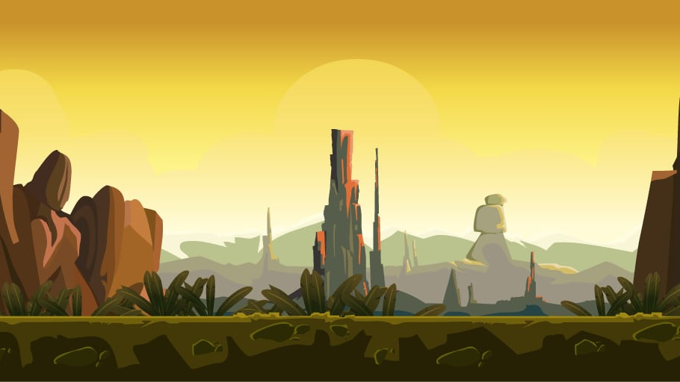
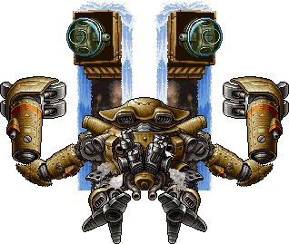
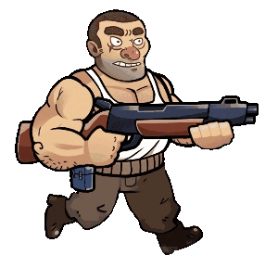
Gun the monsters

Slide 25
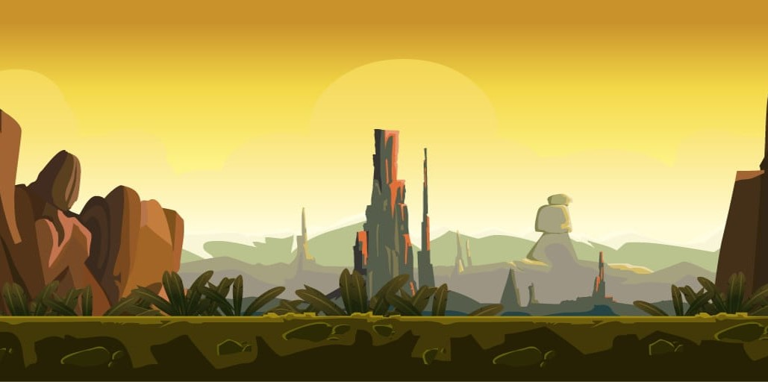




Slide 26




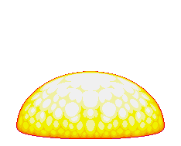
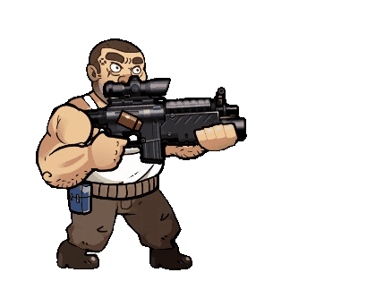

a. near
Where’s the park ?
→ It’s….the school.
b. next to
c. behind
d. opposite

Slide 27




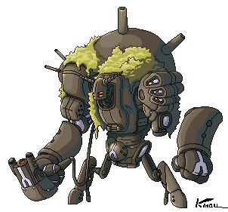
a. the park and the stadium.
Where are Tom,
Ben and Alfie going?
→ They’re going to….
b. the zoo and the park.
c. the zoo and the stadium.
d. the park, the zoo and the stadium.

Slide 28



a. market
The…. is next to the zoo.
b. park
c. library
d. stadium

Slide 29



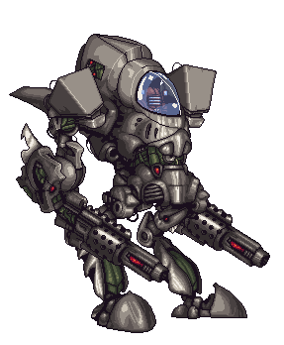
a. at the market.
Where did Mrs. Brown eat dinner ?
→ He ate dinner……..
b. at the restaurant
c. at home
d. at the supermarket

Slide 30



a. stadium
The skate park is opposite
the……..
b. park
c. market
d. zoo

Slide 31
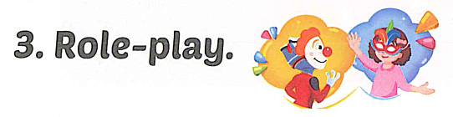
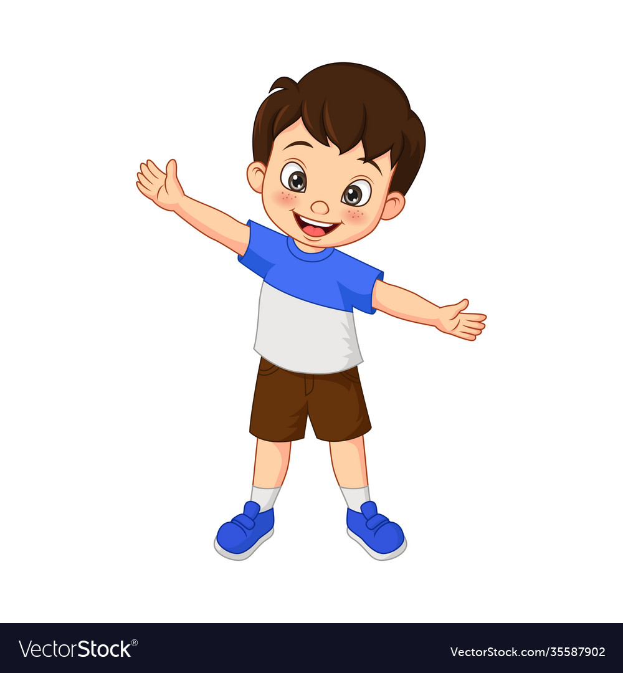
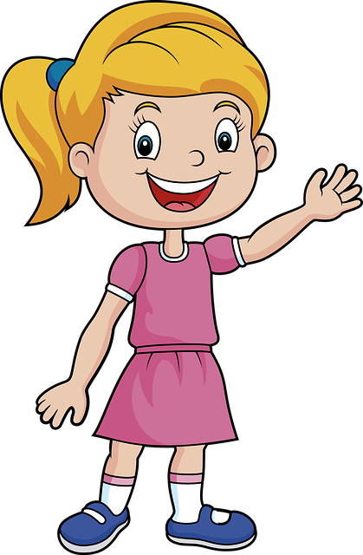

Slide 32
GOOD BYE

