Slide 1

UNIT 5
GETTING AROUND
LESSON 2.3

Slide 2
Table of contents
01
02
03
WARM UP
SPEAKING
CLASS ACTIVITIES

Slide 3
01
WARM UP

Slide 4


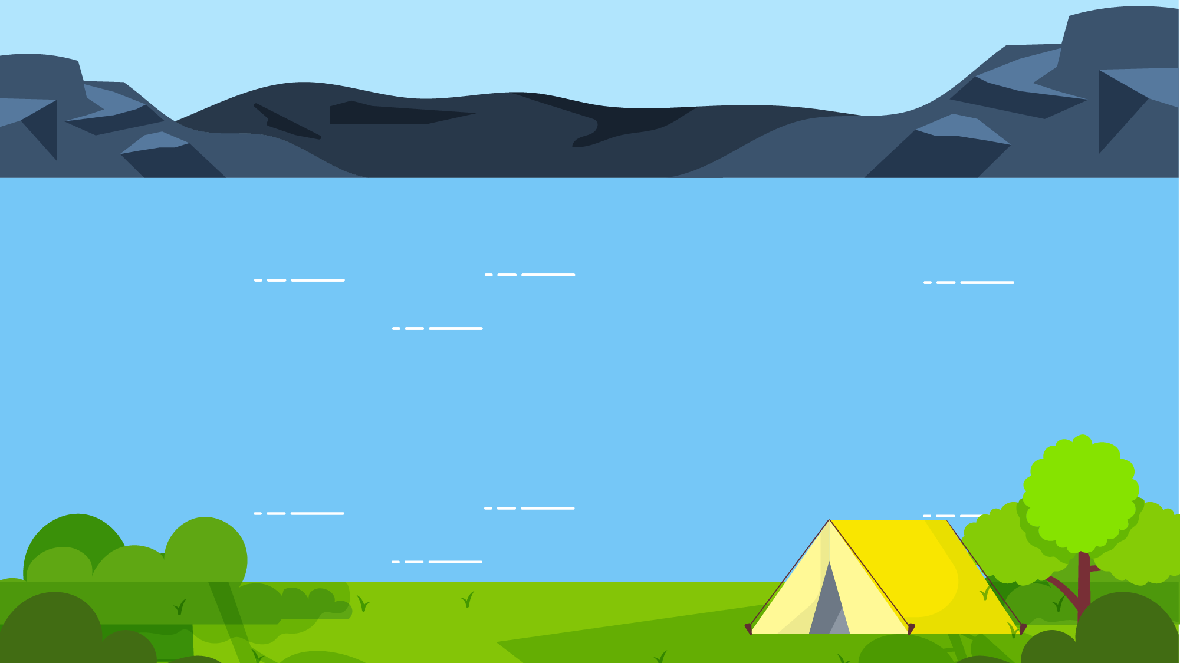
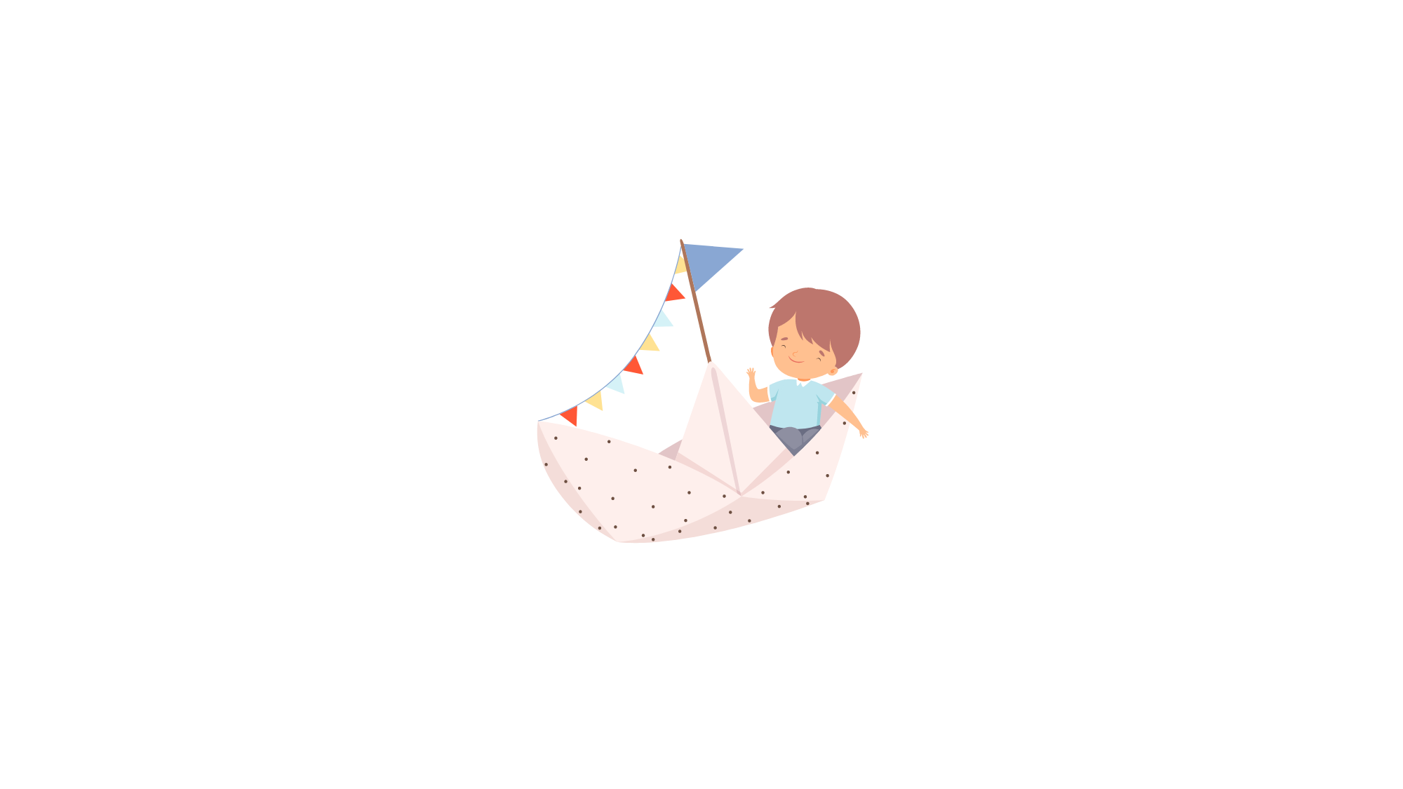



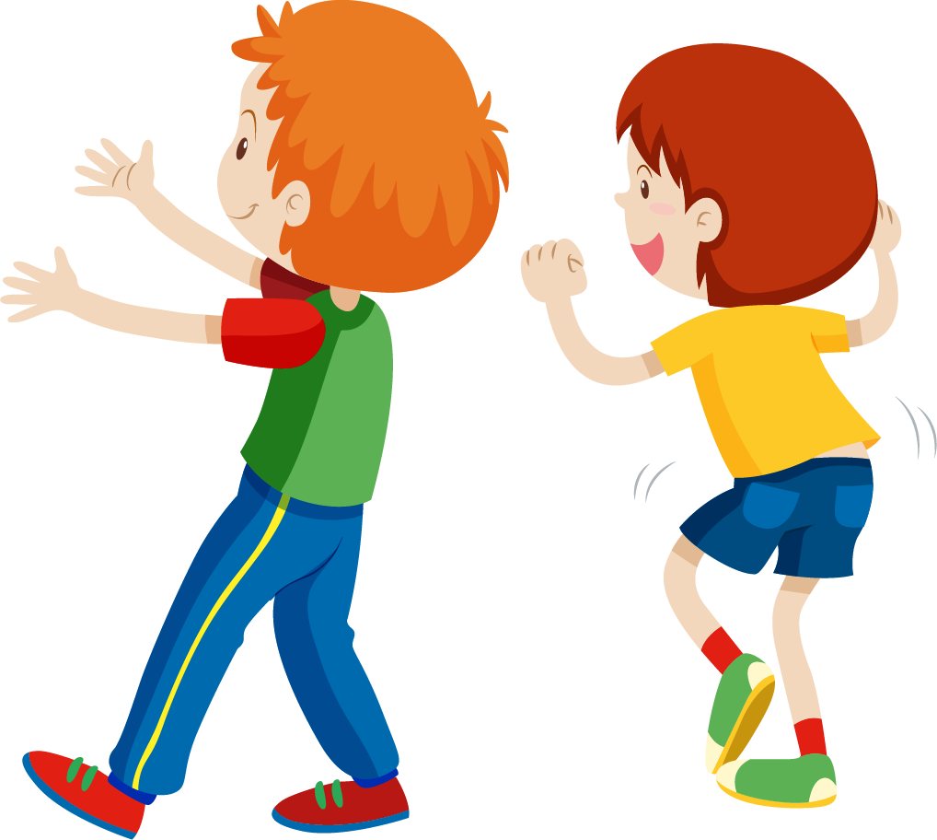
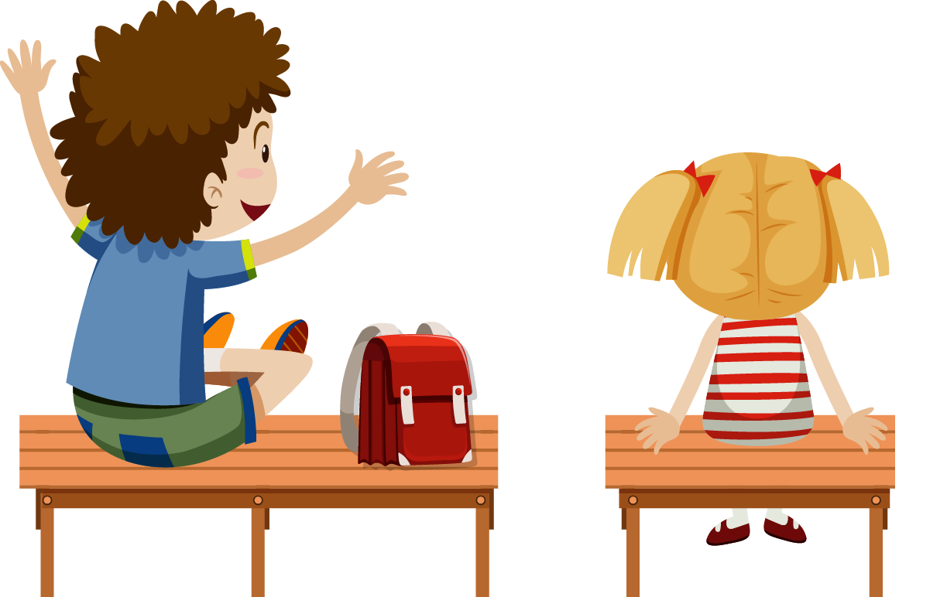

Boat Racing

Slide 5









NEXT

Slide 6




…… the swimming pool?
It’s opposite the park.
a. Where’s
b. What’s
c. Which
d. Who

Slide 7
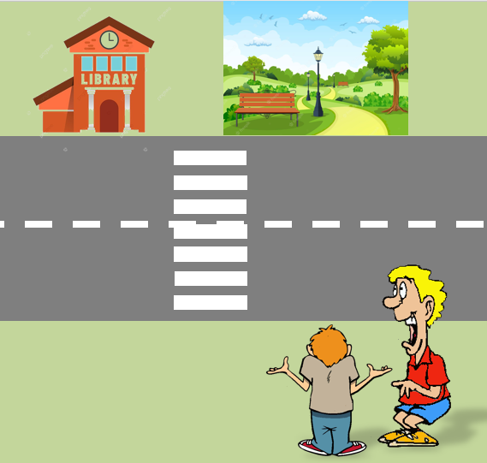
Where’s the library?
a. It’s near the market.
b. It’s near the park.
c. It’s near the school.
d. It’s next to the behind,.

Slide 8
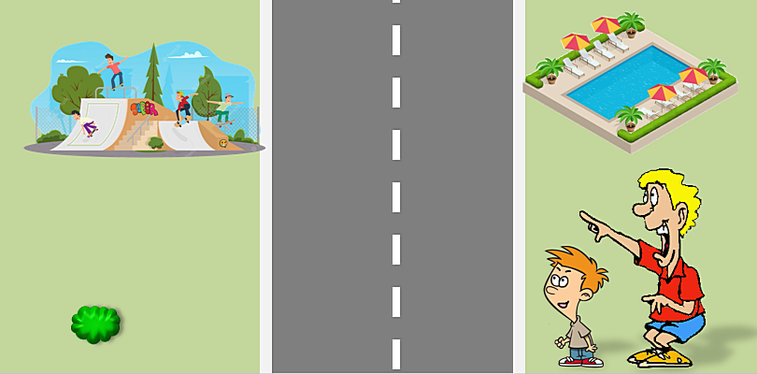

Where’s the
skate park?
a. It’s opposite the swimming pool.
b. It’s next to the swimming pool.
c. It’s behind the swimming pool.
d. It’s in front of the swimming pool.

Slide 9
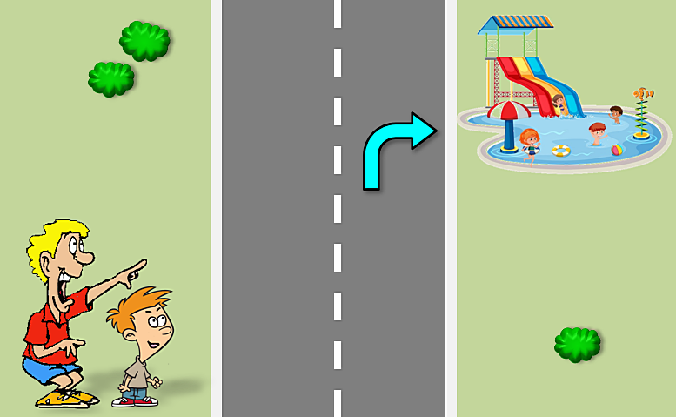
Where’s the
water park?
a. It’s on the right.
b. It’s on the left.

Slide 10
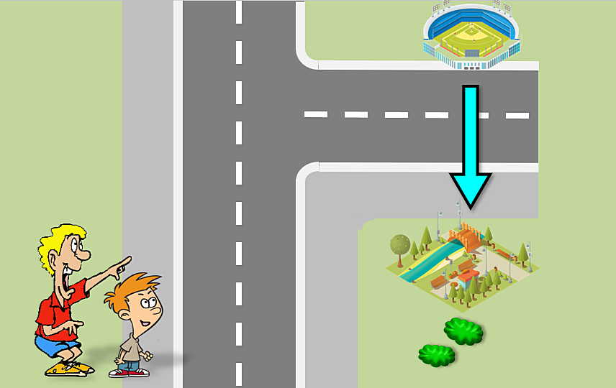
Where’s the park?
a. It’s opposite the stadium.
b. It’s near the stadium.
c. It’s next to the stadium.
d. It’s in front of the stadium.

Slide 11
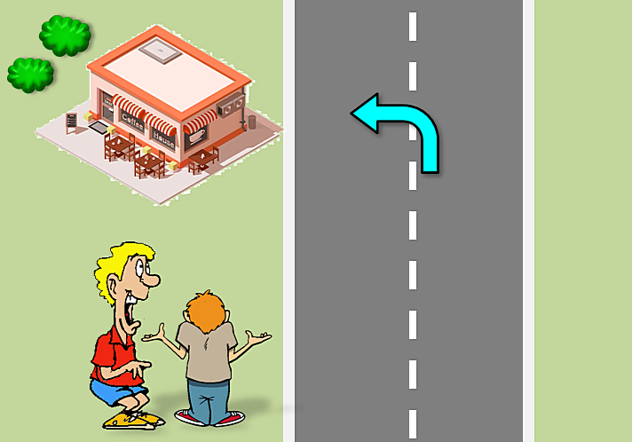
Where’s the coffee
shop?
c. It’s on the left.
d. It’s on the right.

Slide 12
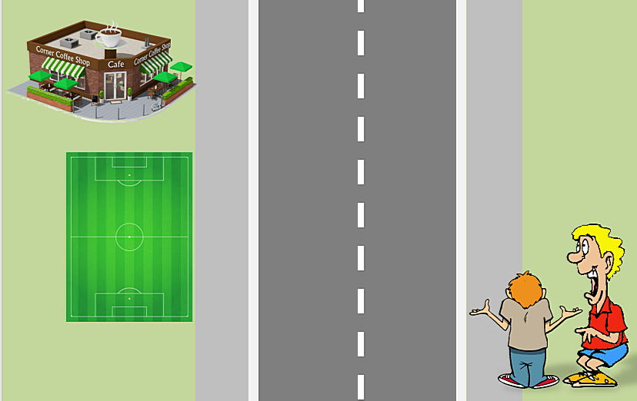
Where’s the
soccer field?
a. It’s opposite the coffee shop.
b. It’s next to the coffee shop.
c. It’s behind the coffee.
d. It’s next to the skate park.

Slide 13
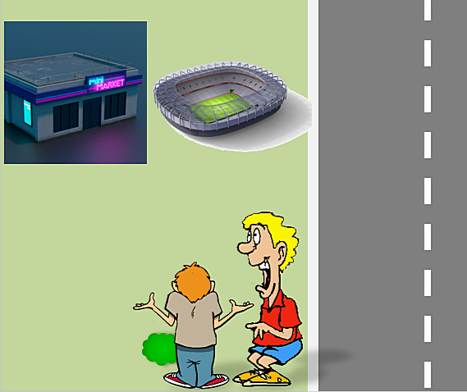
Where’s the market?
a. It’s next to the stadium.
b. It’s next to the water park.
c. It’s behind the stadium.
d. It’s behind the library.

Slide 14
02
SPEAKING

Slide 15

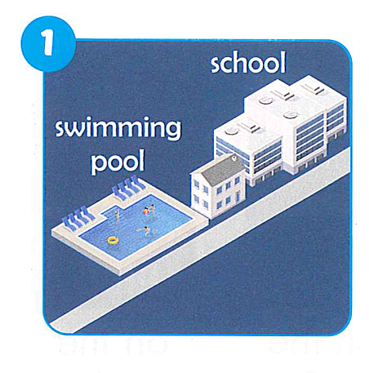
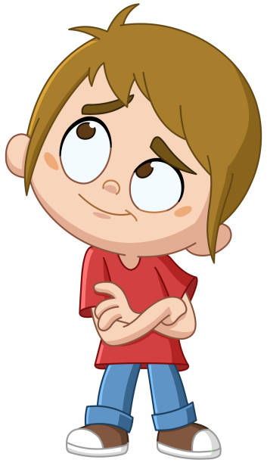
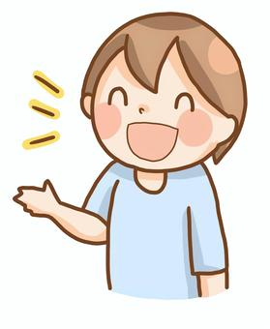
Where’s the school ?
It’s near the swimming pool.

Slide 16
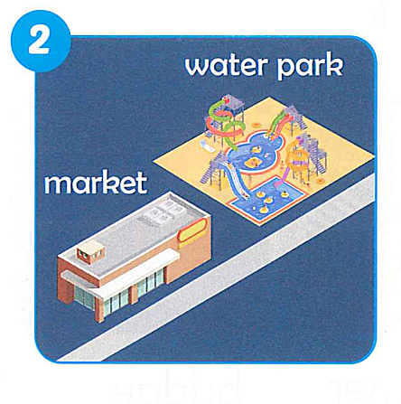
Where’s the water park ?
It’s next to the market.

Slide 17
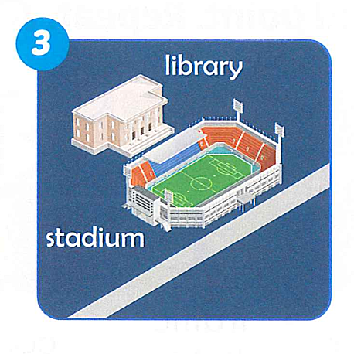
Where’s the stadium ?
It’s in front of the library.

Slide 18
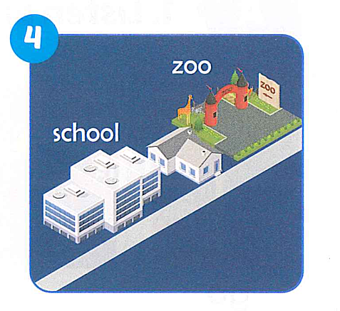
Where’s the school ?
It’s near the zoo.

Slide 19
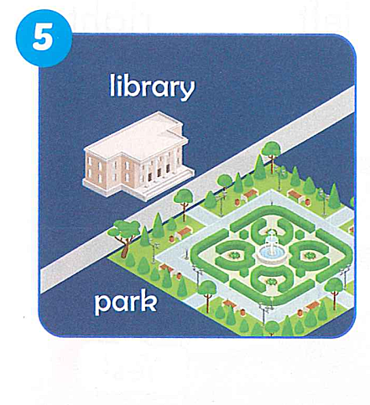
Where’s the library ?
It’s opposite the park.

Slide 20
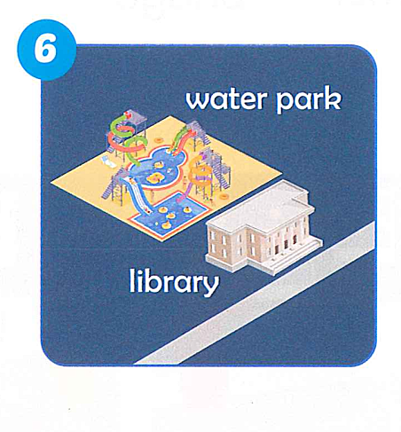
Where’s the water park ?
It’s behind the library.

Slide 21
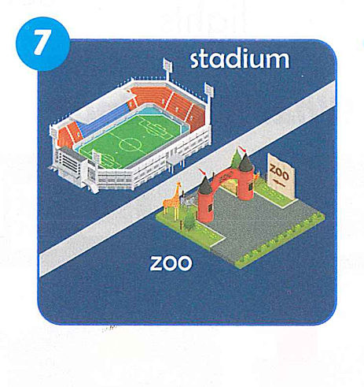
Where’s the zoo ?
It’s opposite the stadium.

Slide 22
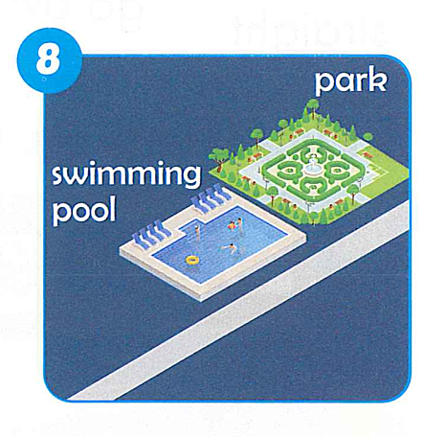
Where’s the park ?
It’s next to the swimming pool.

Slide 23
Tuesday, January 23rd, 2024
Unit 5: Getting around
Write
2. Where’s the water park?
It’s ………………
3.

Slide 24
CLASS ACTIVITY

Slide 25

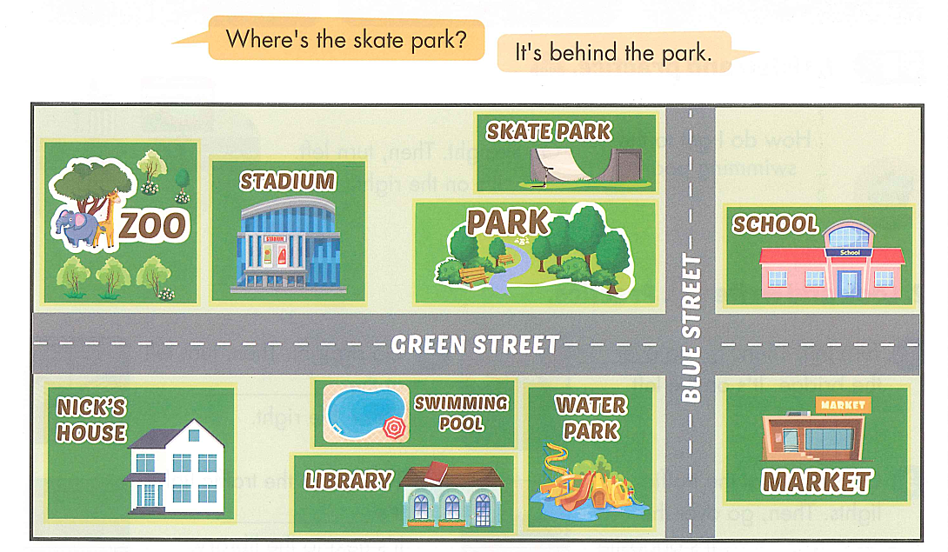

Slide 26
GOOD BYE

