Slide 1

UNIT 5
GETTING AROUND
LESSON 2.1

Slide 2
Table of contents
01
02
03
WARM UP
VOCABULARY
GRAMMAR

Slide 3
01
WARM UP

Slide 4


Slide 5
02
VOCABULARY

Slide 6
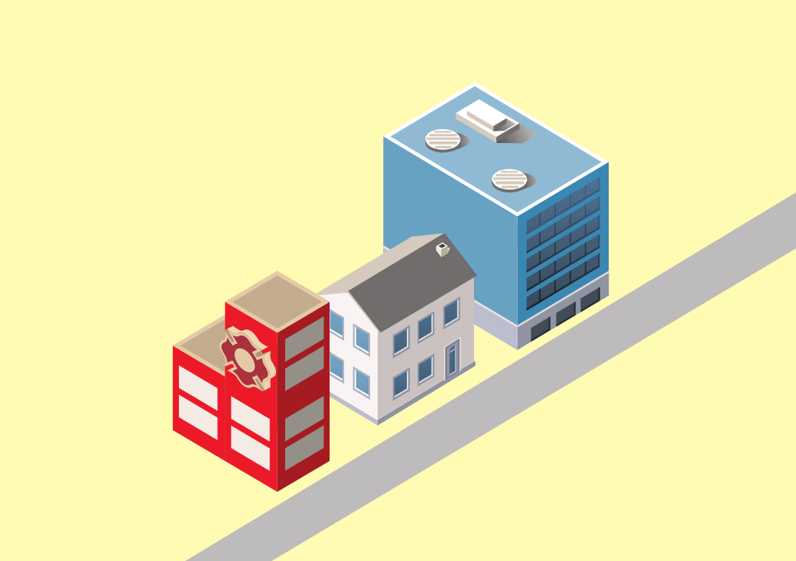

near

Slide 7
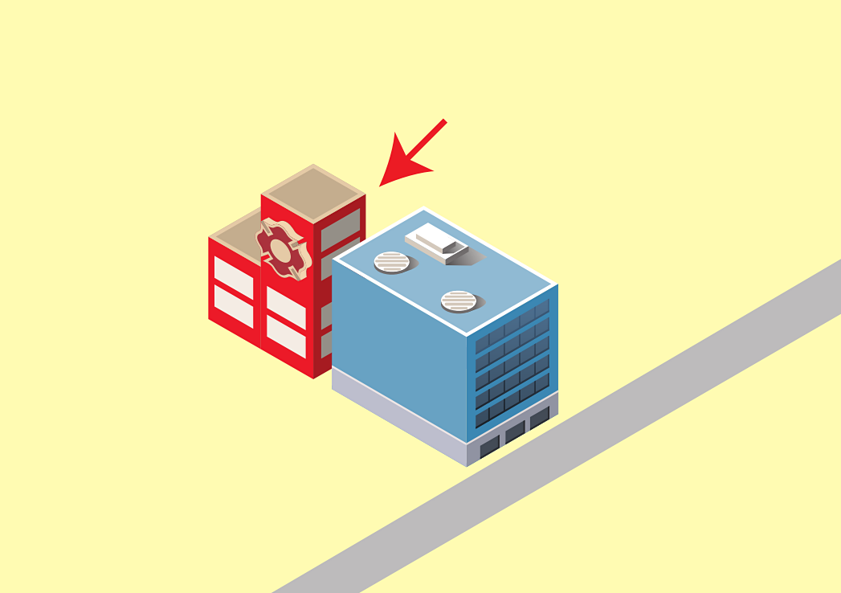
behind

Slide 8

next to

Slide 9
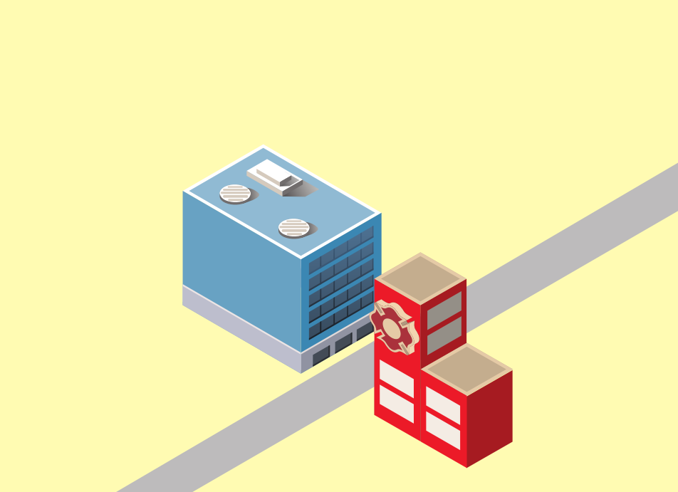
opposite

Slide 10
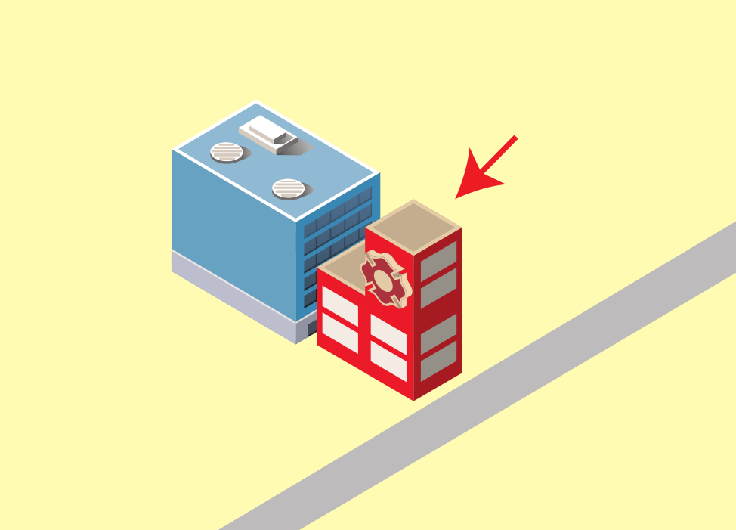
in front of

Slide 11

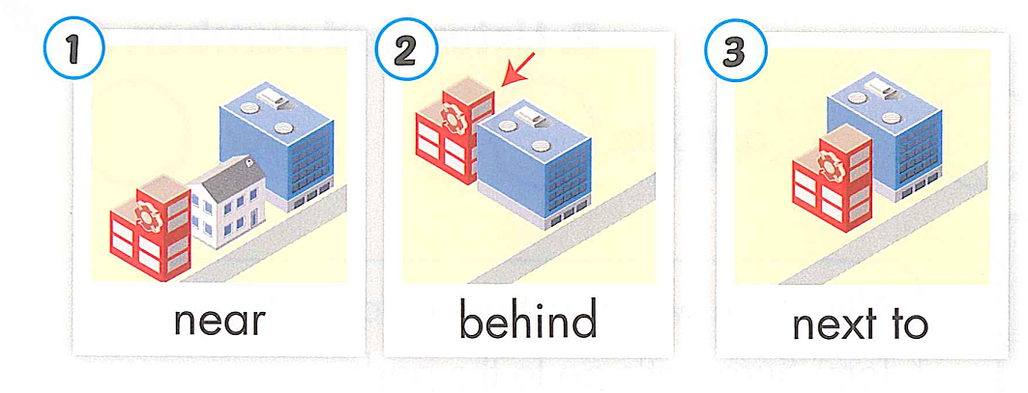
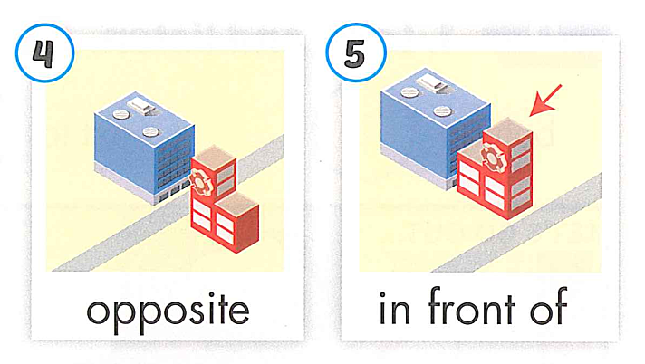

Slide 12

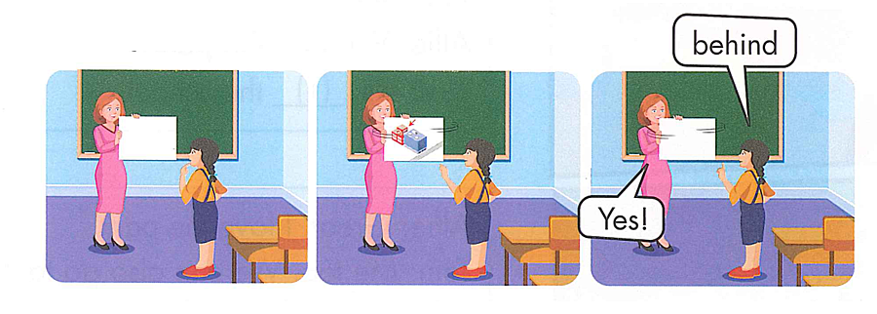

Slide 13
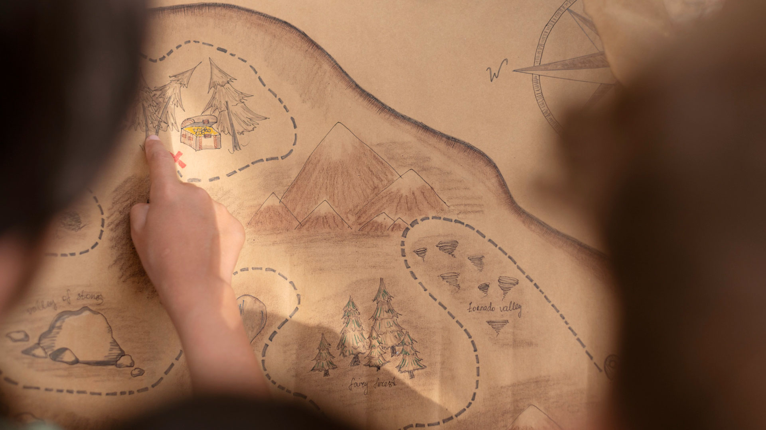
REVIEW
VOCABULARY

Slide 14






Matching picture and words
behind
In front of
Next to
1
2
3
4
5
near
opposite
6
7
8
9
10

Slide 15
03
GRAMMAR

Slide 16

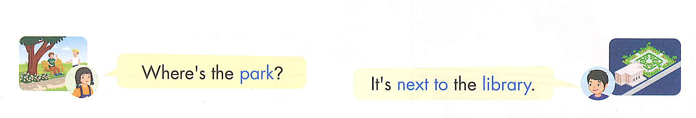

Slide 17
Where’s + the +N ….?
It’s +…….the…..

Slide 18
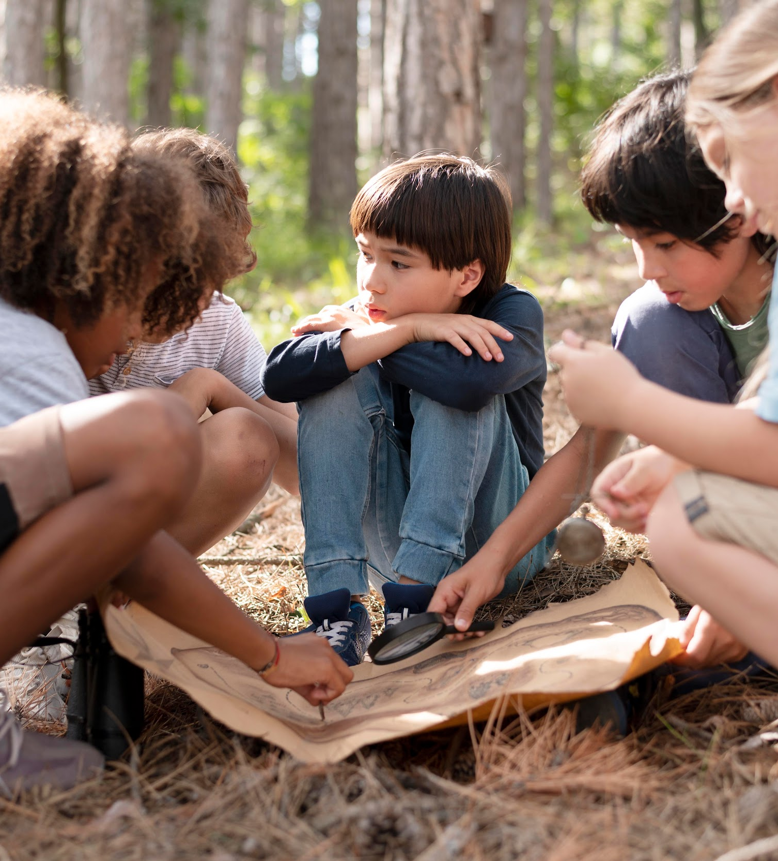
REVIEW GRAMMAR

Slide 19


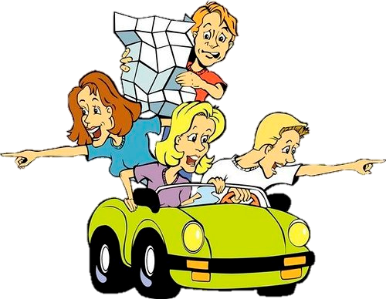
?

Slide 20

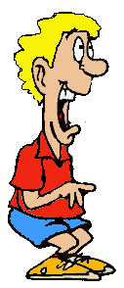
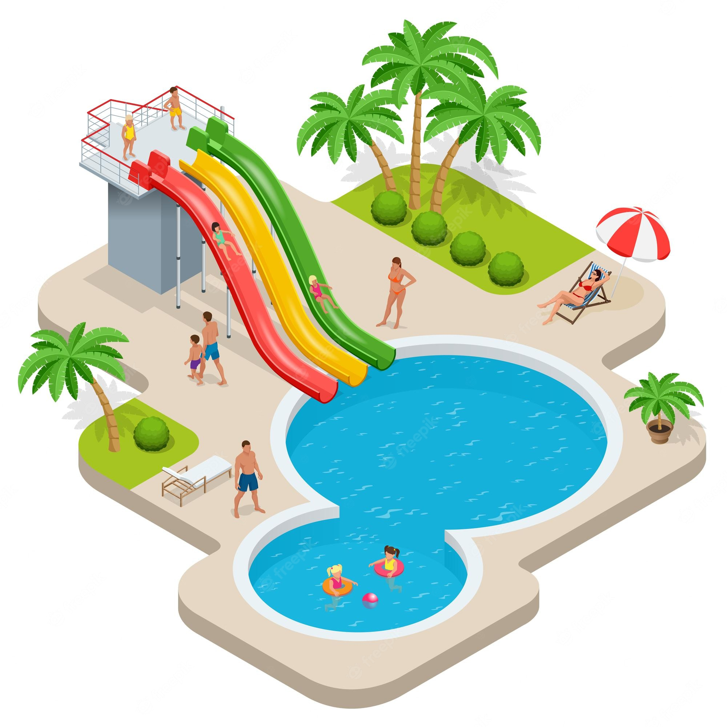
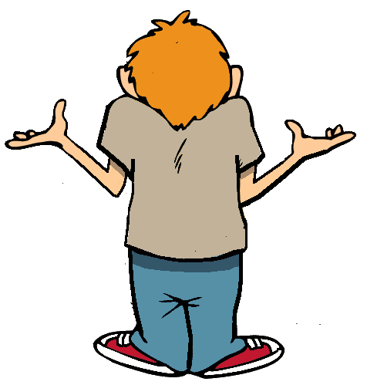
Where’s the library ?

Slide 21
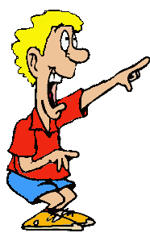
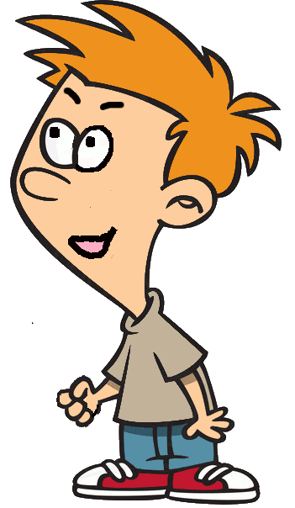
It’s opposite the swimming pool

Slide 22

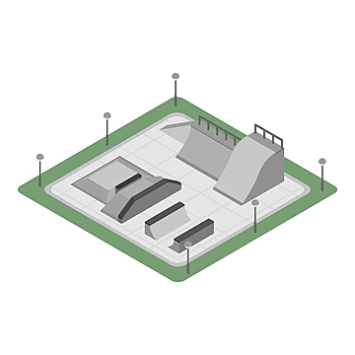

Where’s the market ?

Slide 23
It’s behind the skate park

Slide 24
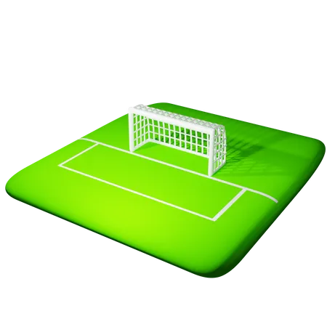
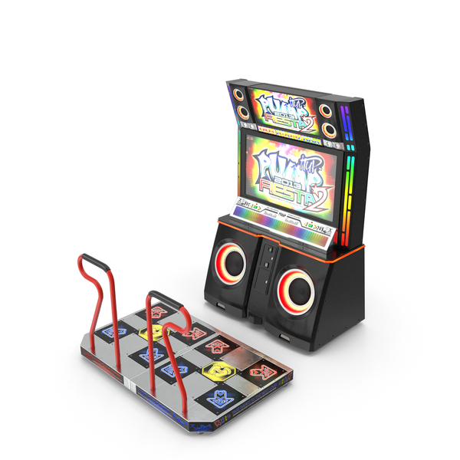
Where’s the soccer field ?

Slide 25
It’s next to the arcade

Slide 26
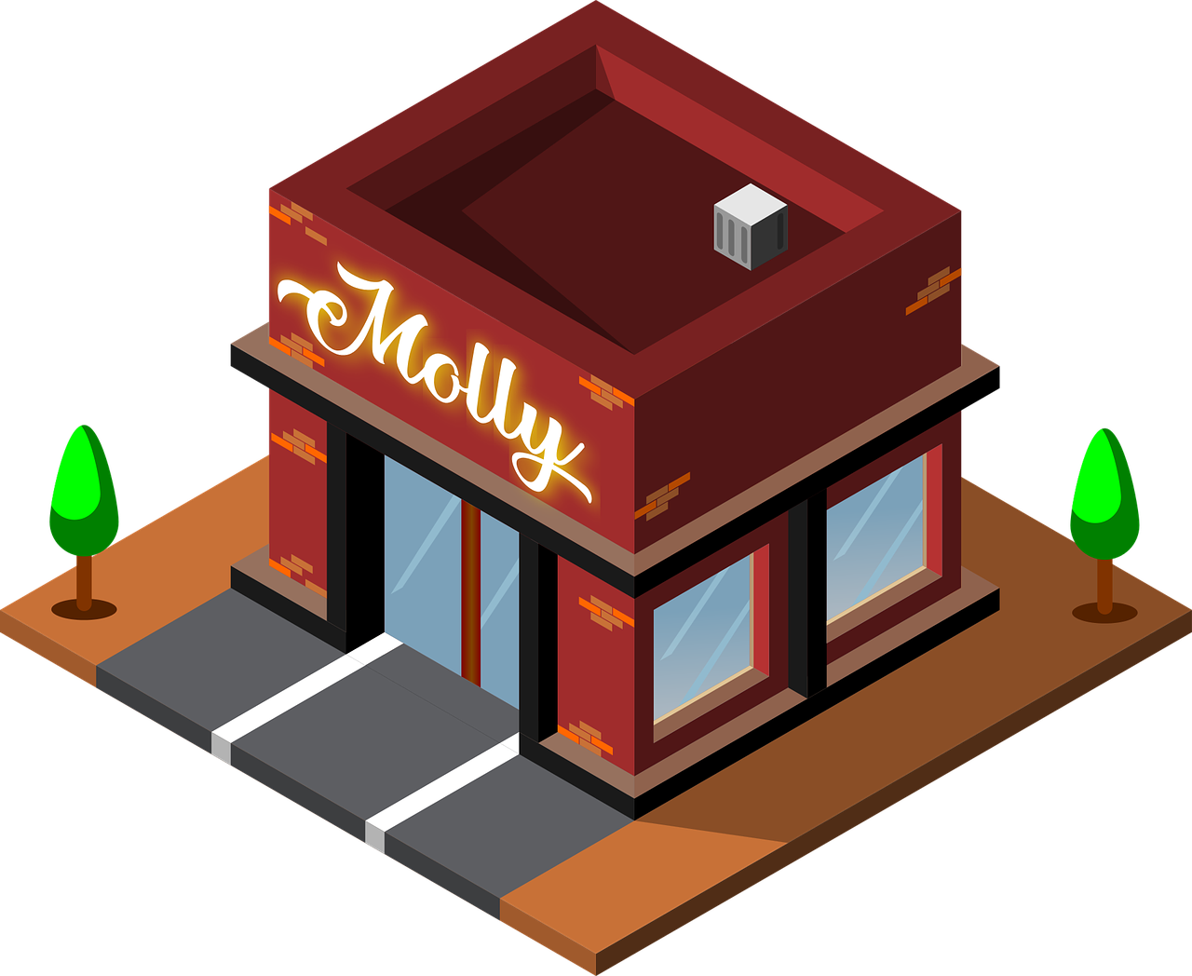
Where’s the water park ?

Slide 27
Where’s the coffee shop ?

Slide 28
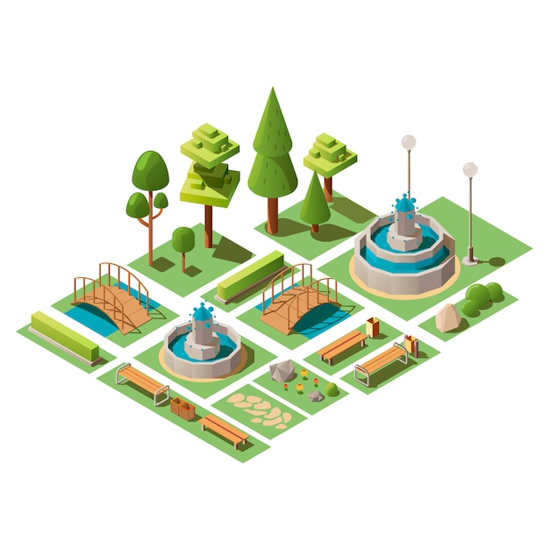
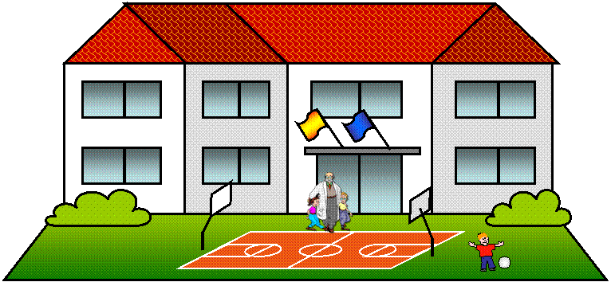
It’s opposite the school

Slide 29
THANK YOU FOR YOUR HELP!
YOU’RE WELCOME!

Slide 30
PRACTICE

Slide 31

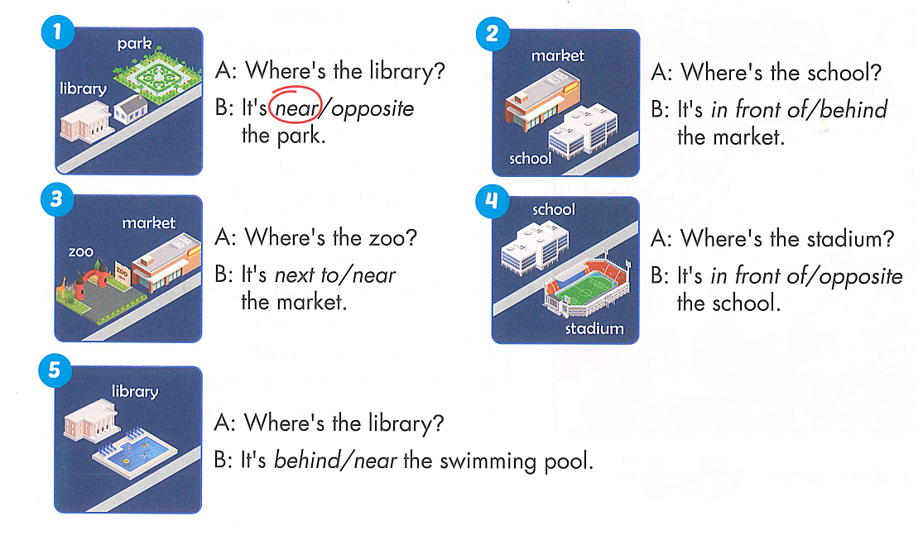

Slide 33
Unit 5: Getting around
Lesson 2
Monday, January 15th, 2024
New words:
near : gần
behind : phía sau
next to : bên cạnh
opposite : đối diện
in front of : phía trước
Structures:
1. Where’s the library?
- It’s next to the park.
2. Where’s the stadium?
- It’s behind the swimming pool.

Slide 34
GOOD BYE

