Slide 1

UNIT 5
GETTING AROUND
LESSON 1.2

Slide 2
Table of contents
01
02
03
Warm Up
Sound
Listening

Slide 3
01
Warm Up

Slide 4
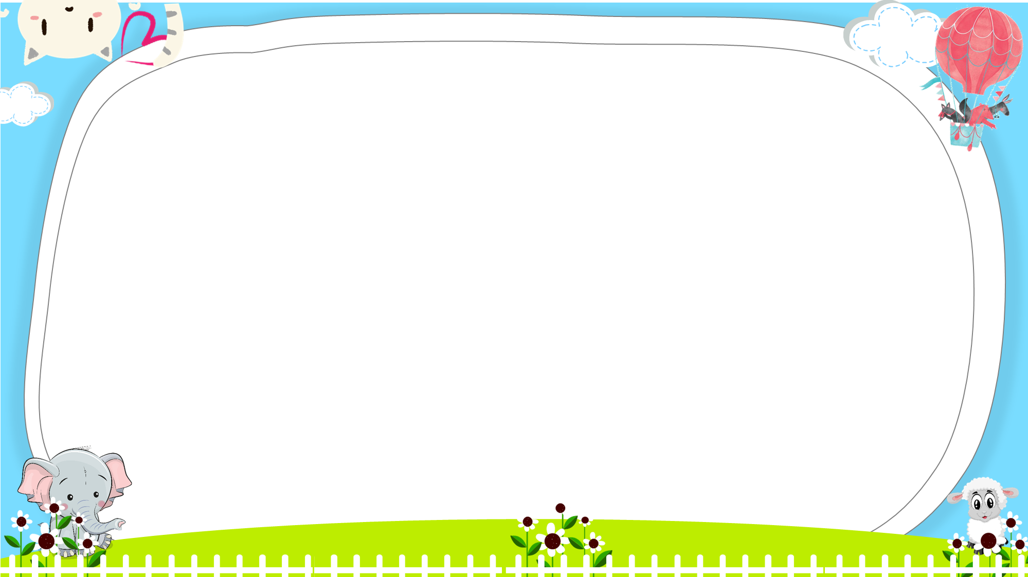






Slide 5




What does that sign mean ?
It means “Turn left”.
a. Yes
b. No

Slide 6

It means “No parking”.
a. Yes
b. No

Slide 7

What does that sign mean ?
It means…..
a. Turn right
b. Turn left

Slide 8
t-d-o-e-n-n-t-r-o-e
a. do enter not
b. do not enter

Slide 9
mean ? / that/ What/ sign /does
a. What does sign
that mean ?
b. What does that
sign mean ?

Slide 10


a. Stop
b. No parking

Slide 11

It means “ stop”
a. No
b. Yes

Slide 12

no p…rki…g
a. a- n
b. o - n

Slide 13



Slide 14
02
Sound

Slide 15
1. Listen and repeat
/g/, /g/, going
/g/, /g/, get

Slide 16
2. Chant
Where are we going?
We’re going around town.
Can we get some ice cream?
Yes, we can!

Slide 17
03
Listening

Slide 18

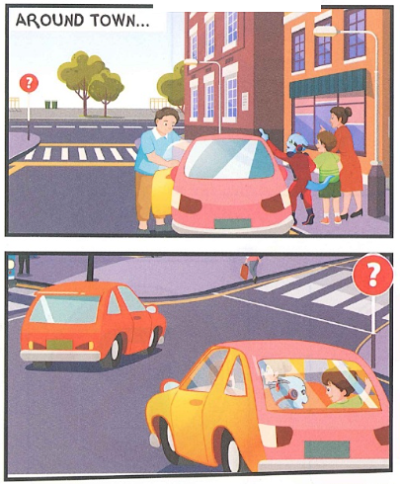
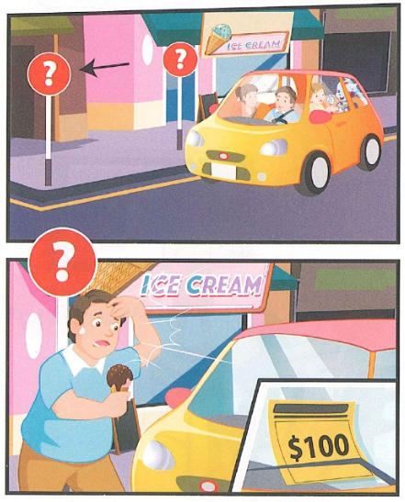

Slide 19
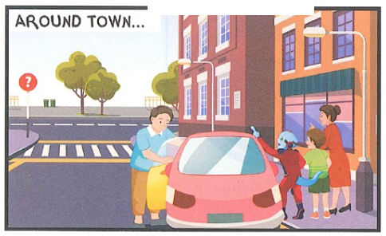

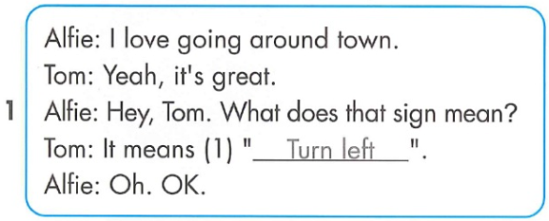

Slide 20
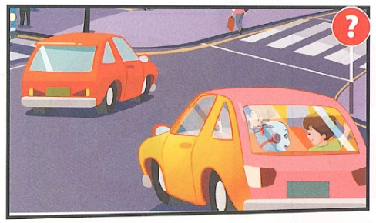

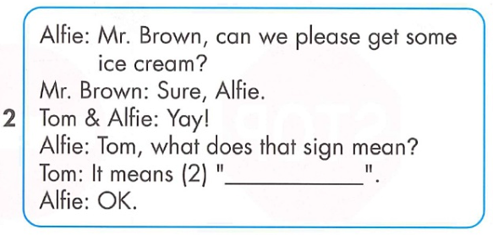
Turn right

Slide 21
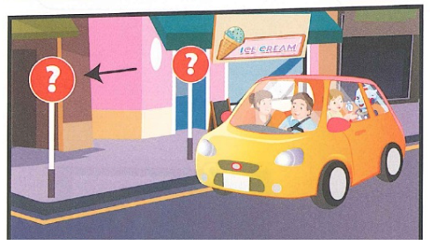
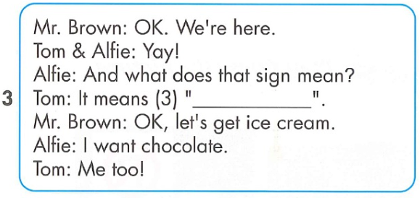
Stop

Slide 22
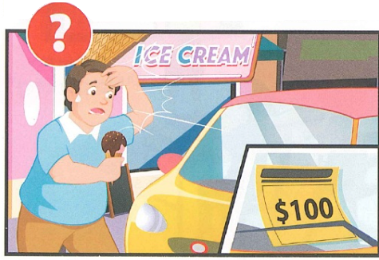
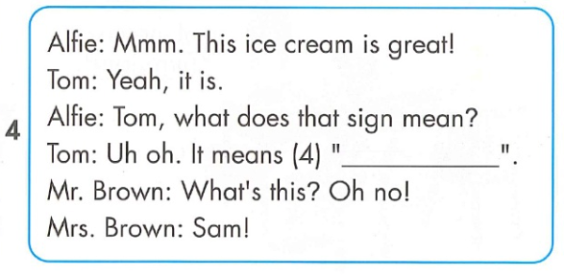
No parking

Slide 23
Review reading

Slide 24
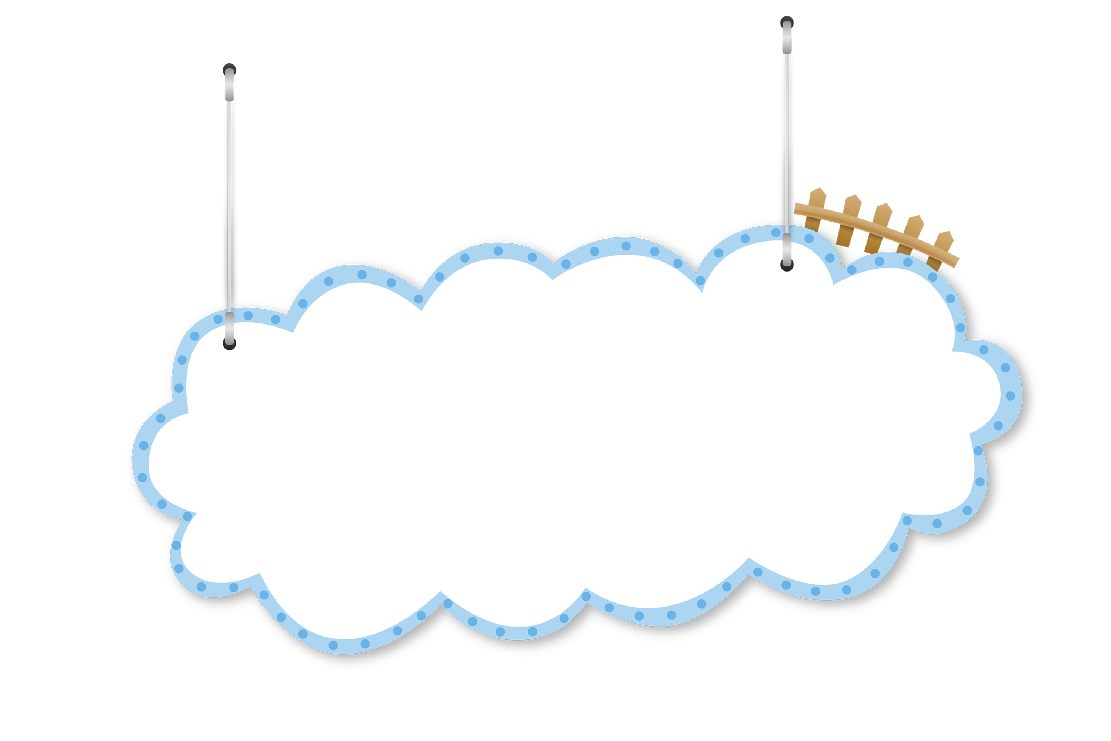
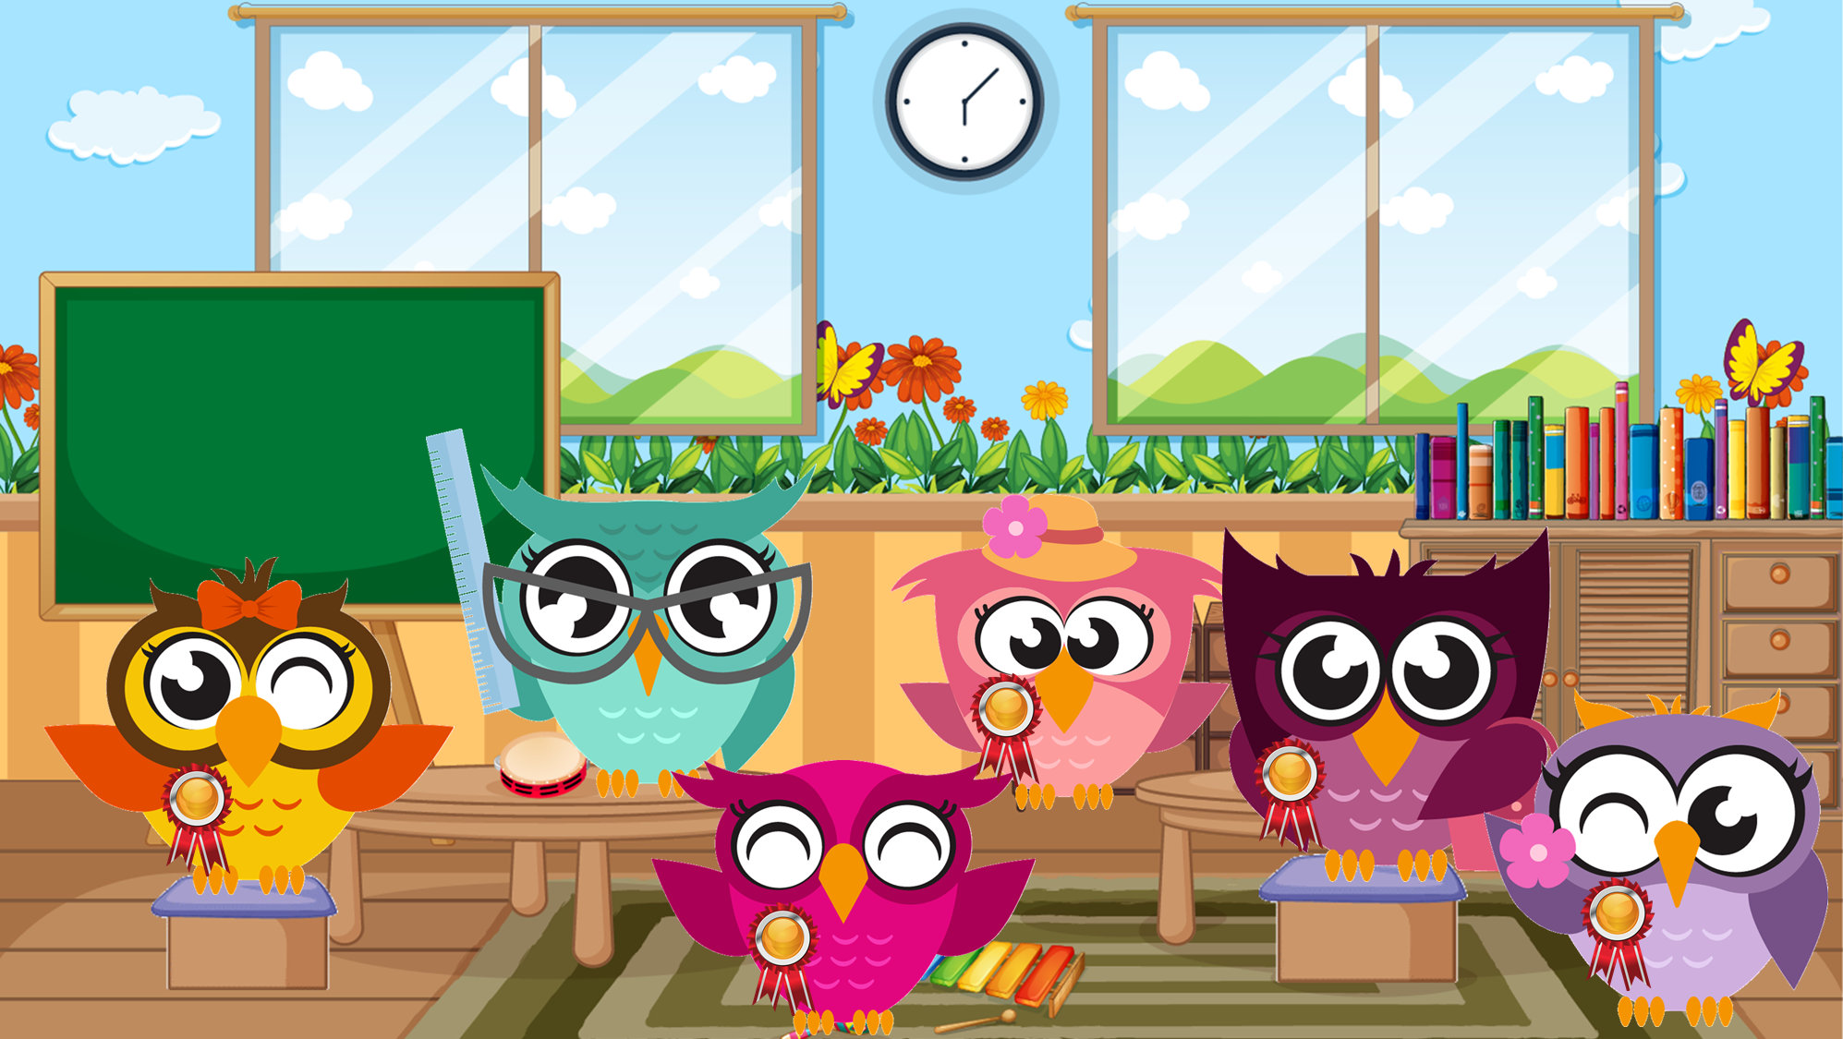
The Owl’s class
game

Slide 25

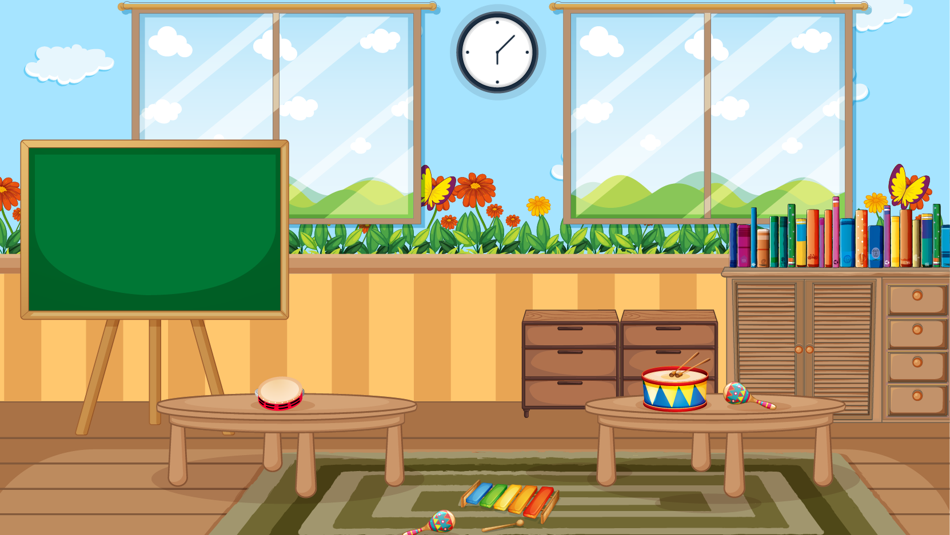


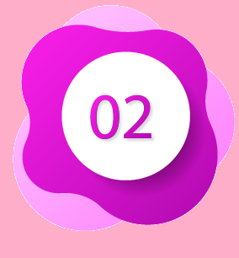











NEXT

Slide 26
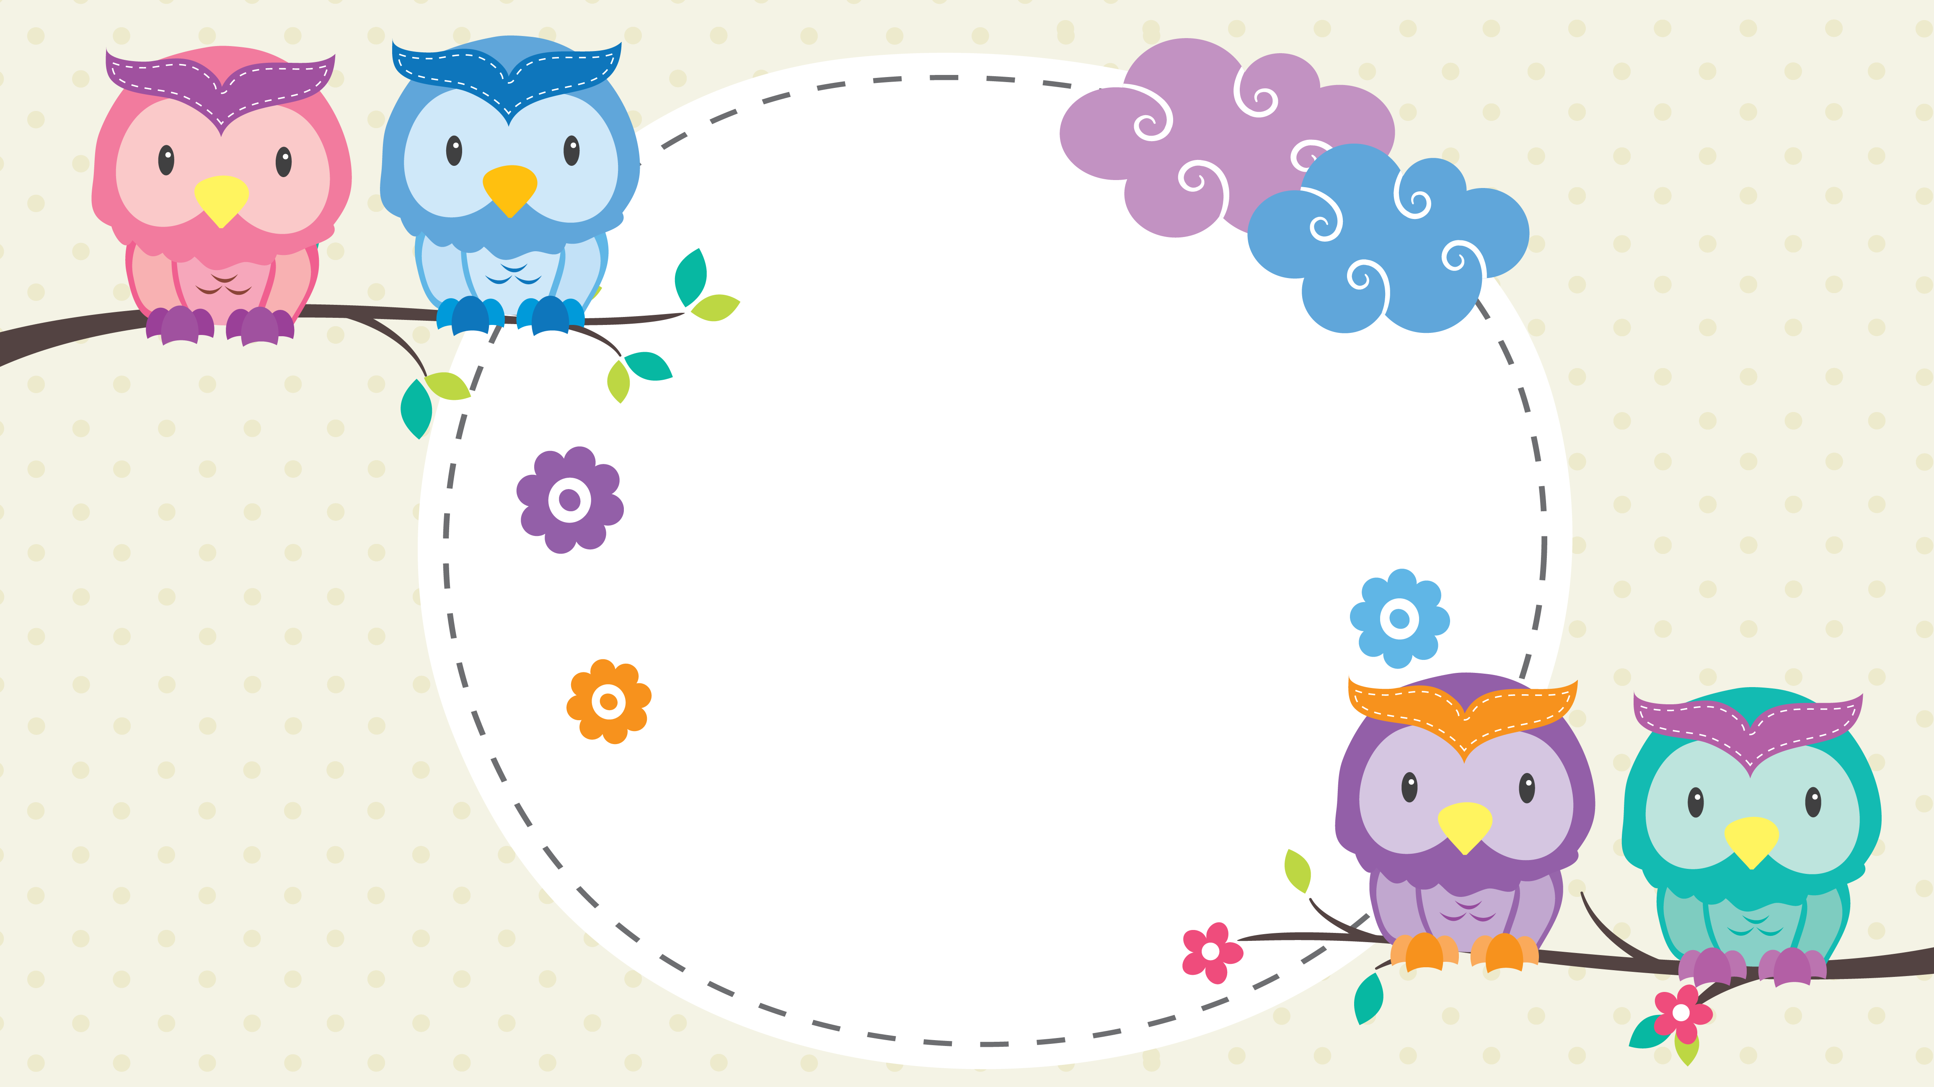

Question 1. How does Tom’s family go to town?
By bus
By car
By train
Key b.

Slide 27
Question 2. How many signs appeared?
5
4
3
Key b.

Slide 28
Question 3. Which sign appeared twice?
Turn left
Stop
No parking
Key no

Slide 29
Question 4. What ice cream does Alfie want?
Strawberry
Chocolate
Banana
Key b.

Slide 30
Question 5. What does that sign mean?
No parking
Stop
Turn left
Key c.

Slide 31

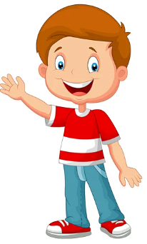
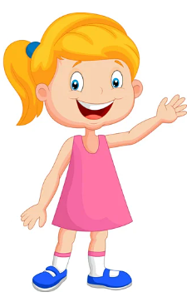

Slide 32
GOOD BYE

