Slide 1
UNIT 5 GETTING AROUND
LESSON 1.3

Slide 2
Table of contents
01
02
03
Warm Up
Speaking
Class Activities

Slide 3
01
Warm Up

Slide 4
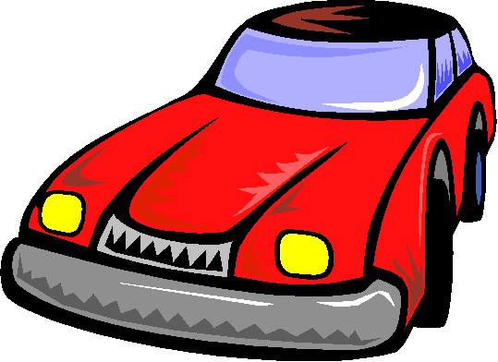
DRIVING TEST

Slide 5
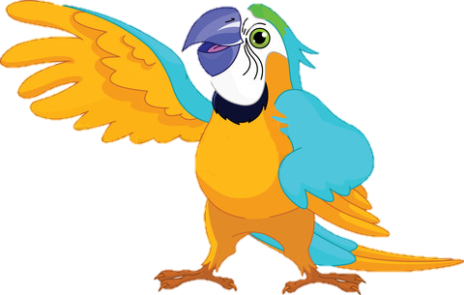
What does the sign mean?
It means……
a. Turn left
b. Do not enter

Slide 6
What does the sign mean?
It means...
a. Turn left
b. Turn right

Slide 7
It means“ stop”
a. Yes
b. No

Slide 8
T_rn r_gh_
a. u-i-t
b. i-t-u

Slide 9
What does the sign mean?
a. It means…
b. Yes, I do

Slide 10
What does the sign mean?
It means…..
a. No parking
b. Stop

Slide 11
What/sign/does/the/mean?
a. What does the sign mean?
b. What the sign does mean?

Slide 12
o/N a/r/p/i/k/g/n
a. No pakirng
b. No parking

Slide 13
____
It means “Stop”
a. Where is it ?
b. What does the sign mean?

Slide 14
02
Speaking

Slide 15
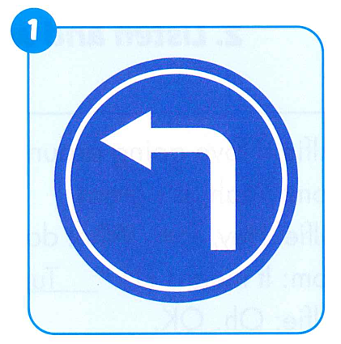
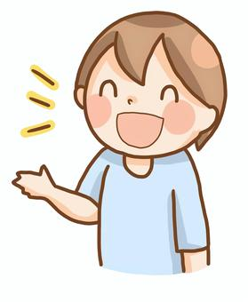
It means
“ Turn left”.

Slide 16
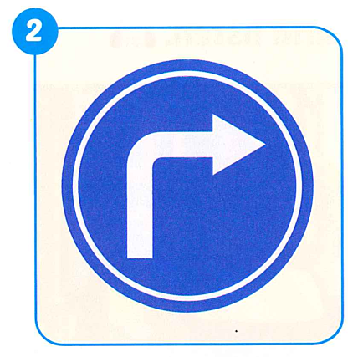
It means
“ Turn right”.

Slide 17
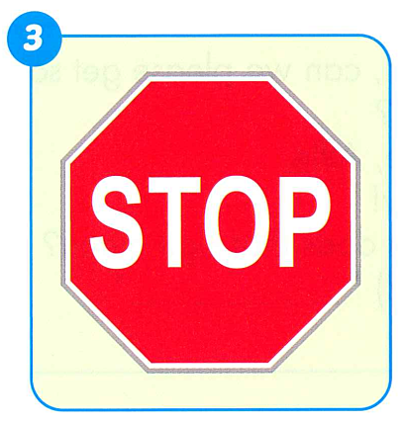
It means
“ Stop”.

Slide 18
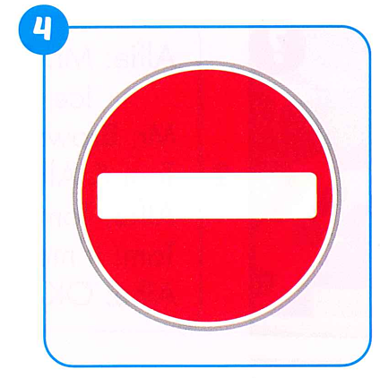
It means
“ Do not enter”.

Slide 19
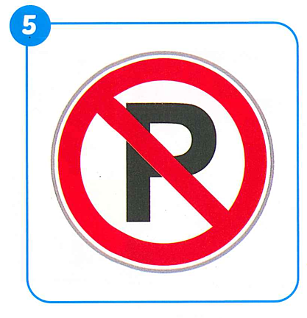
It means
“ No parking”.

Slide 20
Class Activity

Slide 21
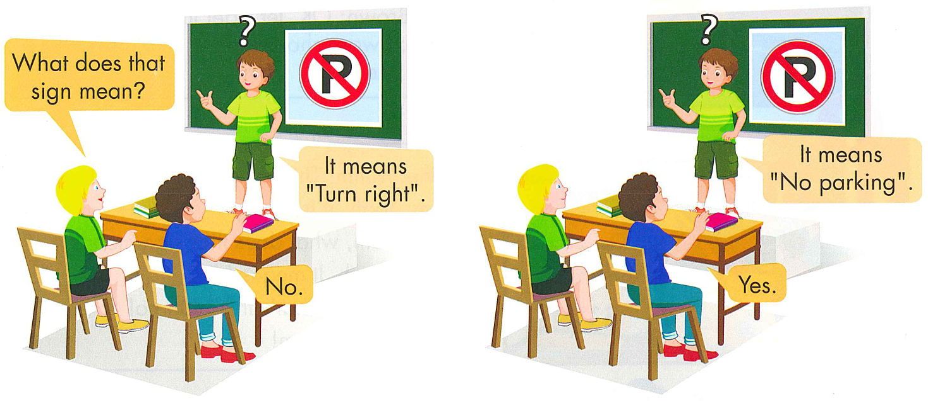

Slide 23
Friday, January 12th, 2024 Unit 5: Getting around Lesson 1
Write:
What does that sign mean?
1. It means turn left.
2.
3.
4.
5.

Slide 24
GOOD BYE

