Slide 1

UNIT 5
GETTING AROUND
LESSON 1.1

Slide 2
Table of contents
01
02
03
Warm Up
Vocabulary
Grammar

Slide 3
01
Warm Up

Slide 4


Slide 5
02
VOCABULARY

Slide 6


stop

Slide 7

do not enter

Slide 8

turn left

Slide 9

turn right

Slide 10

no parking

Slide 11
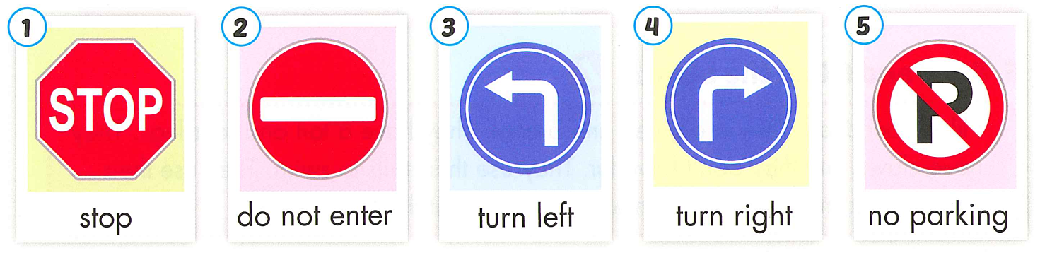

Slide 12

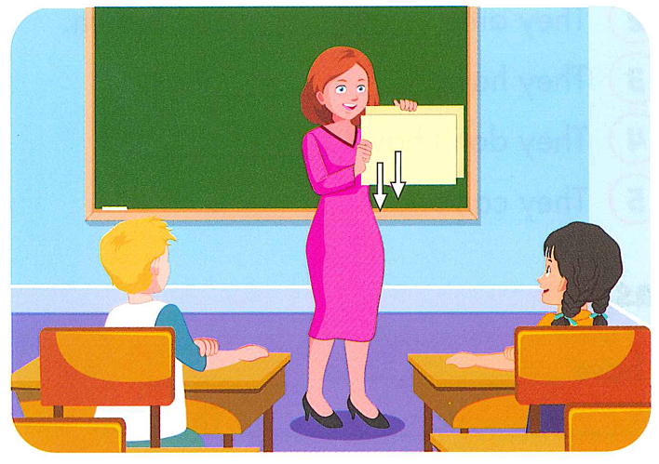
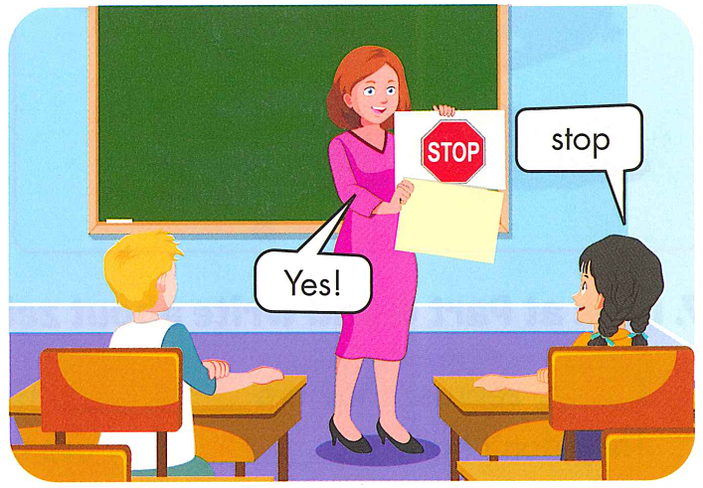

Slide 13
Review
Vocabulary

Slide 14
turn left
Answer

Slide 15

no parking
Answer

Slide 16

Answer
stop

Slide 17
turn right
Answer

Slide 18

Answer
do not enter

Slide 19
03
Grammar

Slide 20

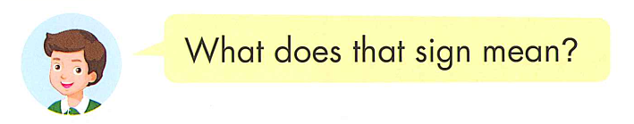
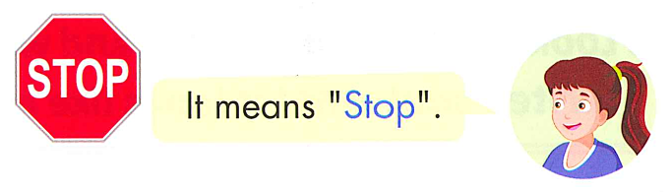

Slide 21
What does the sign mean?
It means……..

Slide 22
Review Grammar

Slide 23
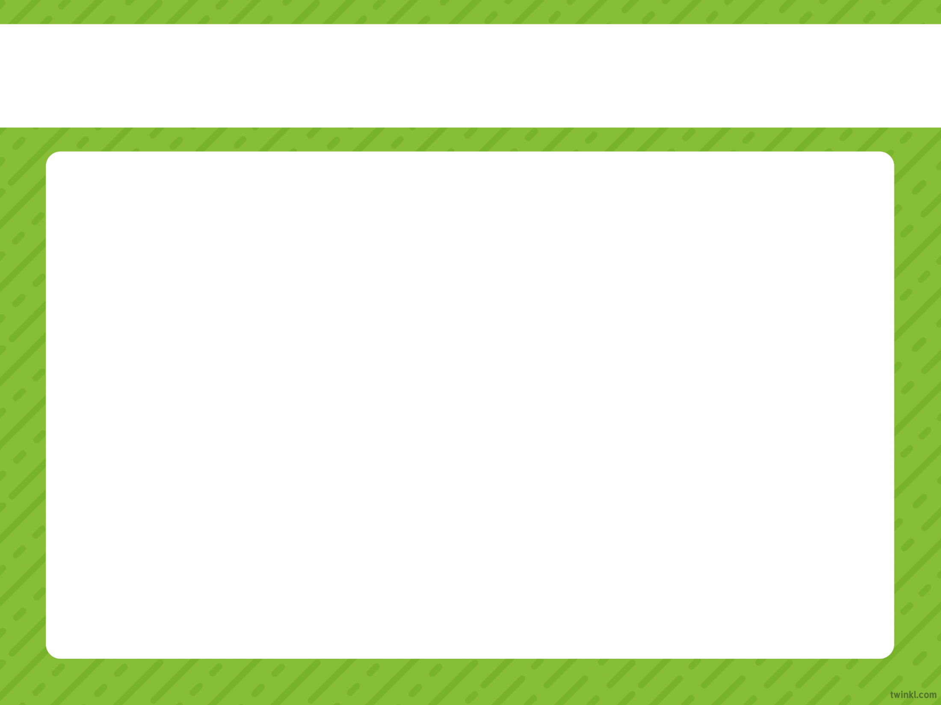


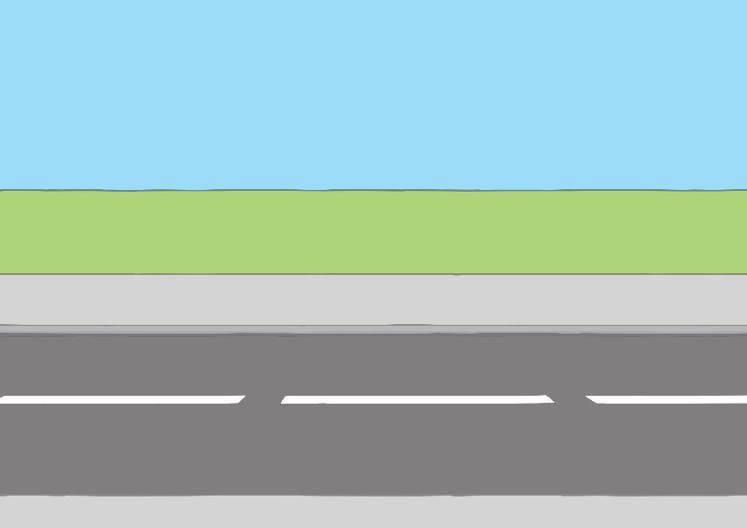

What does the sign mean?
a. It means do not enter.
Incorrect
Try again!
Incorrect
Try again!
b. It means stop.
d. It means turn left.
Incorrect
Try again!
Correct
Well done!
c. It means no parking.
Next

Slide 24
does/mean/the/sign/?/What
Incorrect
Try again!
Incorrect
Try again!
a. What the does sign mean?
b. What sign does the means?
Correct
Well done!
Incorrect
Try again!
c. What does the sign mean?
d. What does sign the means?
Next

Slide 25
What does the sign mean?
Incorrect
Try again!
Incorrect
Try again!
a. It means stop.
b. It means turn left. .
c. It mean turn right.
Incorrect
Try again!
Correct
Well done!
d. It mean no parking .
Next

Slide 26
What does the sing mean?
It is…..
a. Stop.
Correct
Well done!
Incorrect
Try again!
b. Do not enter.
Incorrect
Try again!
c. No parking.
Incorrect
Try again!
d. Turn right.
Next

Slide 27

What does the sign mean?
Correct
Well done!
a. Turn right.
b. Tnur right.
Incorrect
Try again!
c. turn rigth.
Incorrect
Try again!
d. Trnu rghit.
Incorrect
Try again!
Incorrect
Try again!
Next

Slide 28
t…rn l…f…
Incorrect
Try again!
b. u-e-t.
a. u-a-t.
Correct
Well done!
Incorrect
Try again!
c. u-e-c.
d. u-c-t.
Incorrect
Try again!
Next

Slide 29
Practice

Slide 30


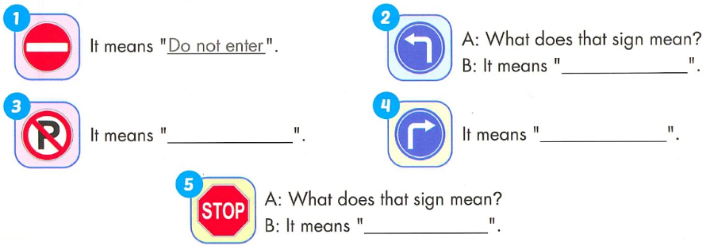
Turn left
No parking
Turn right
Stop

Slide 31
Wednesday, January 10th, 2024
Unit 5: Getting around
New words:
Structures
What does that sign mean?
It means “Stop”.

Slide 32
GOOD BYE

