Slide 1


Slide 2
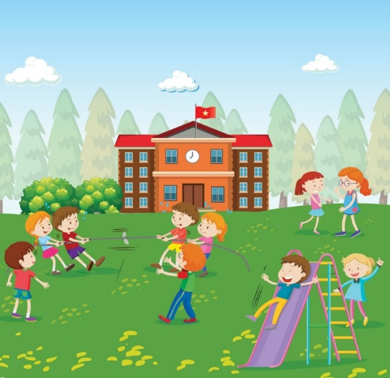
Break time activities
Unit 10
Lesson 2 (4,5,6)

Slide 3
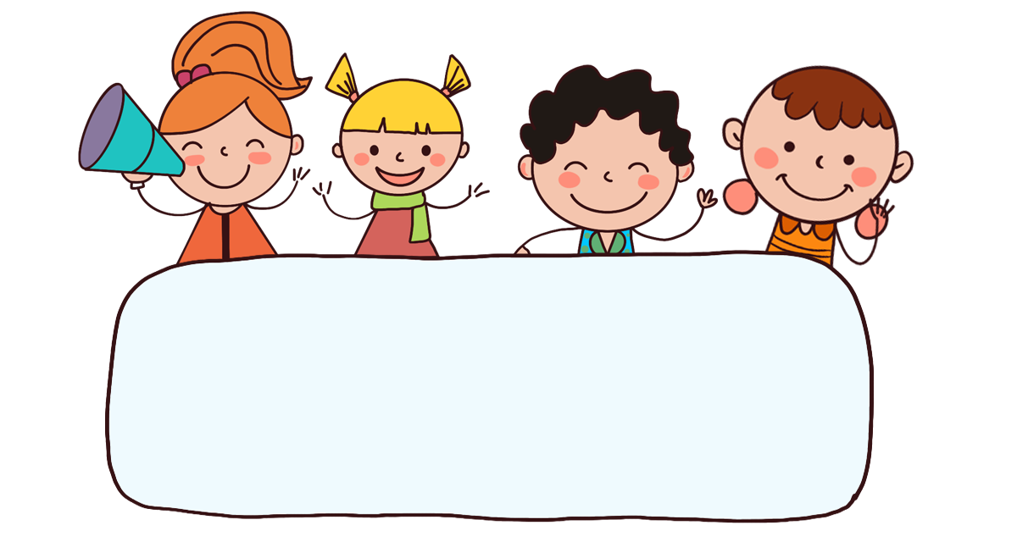
Warm-up

Slide 4
Let’s play!

Slide 5
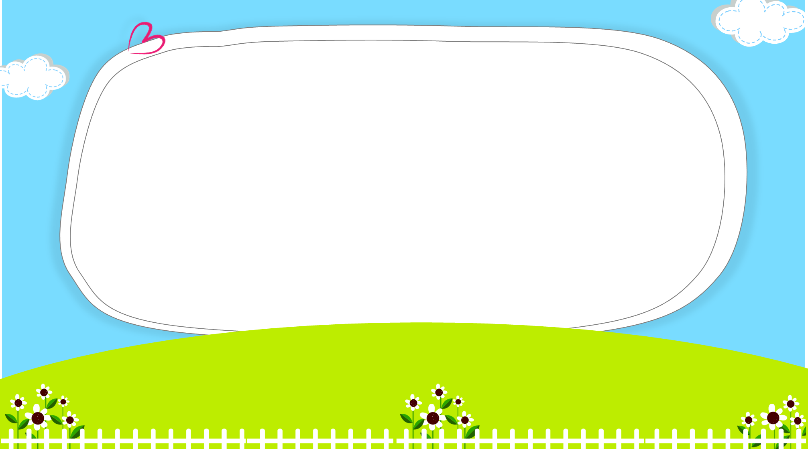



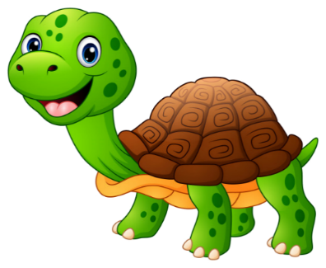
RABBIT
&
TORTOISE

Slide 6
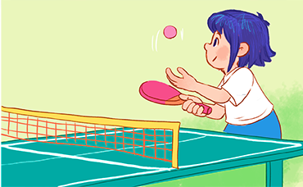

What do you do at break time?
__________________.
A. I play table tennis
B. I play badminton
Click on the rabbit / tortoise to choose.

Slide 7
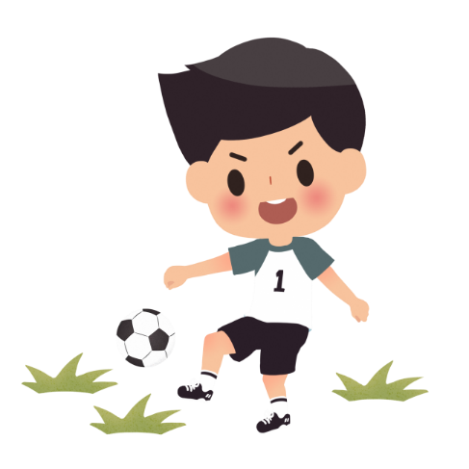
What do you do at break time?
__________________.
A. I play volleyball
B. I play football

Slide 8
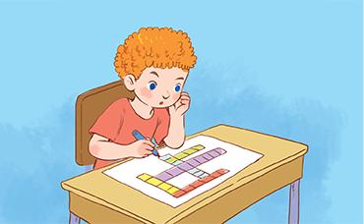
What do you do at break time?
__________________.
A. I do word puzzles
B. I play chess

Slide 9

What do you do ___ break time?
A. at
B. in

Slide 10
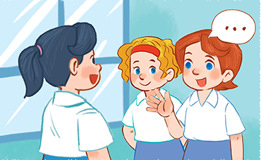
What do you do at break time?
__________________.
A. I play basketball
B. I chat with my friends

Slide 11
What do you do at break time?
I _____ word puzzles.
A. play
B. do

Slide 12
What do you do at break time?
I ________ table tennis.
A. chat
B. play

Slide 13
What do you do at ______?
I chat with my friends.
A. break time
B. footbal

Slide 14


Slide 15

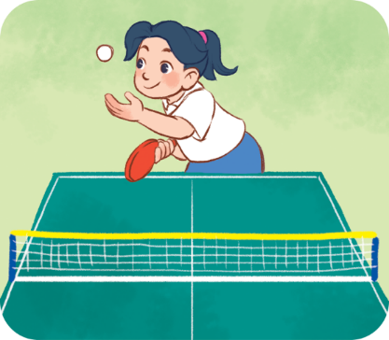
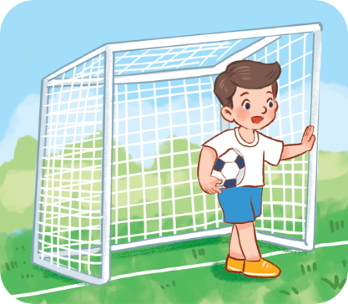
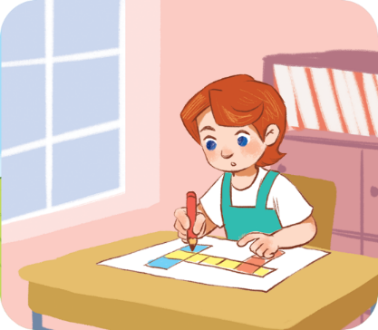
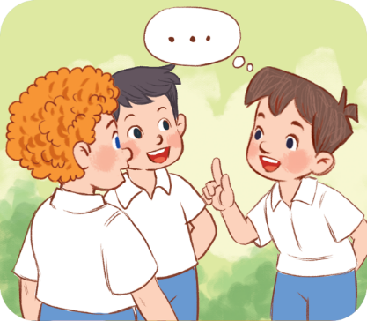



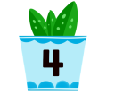
4. Listen and number.
a
b
c
d
2
4
3
1

Slide 16
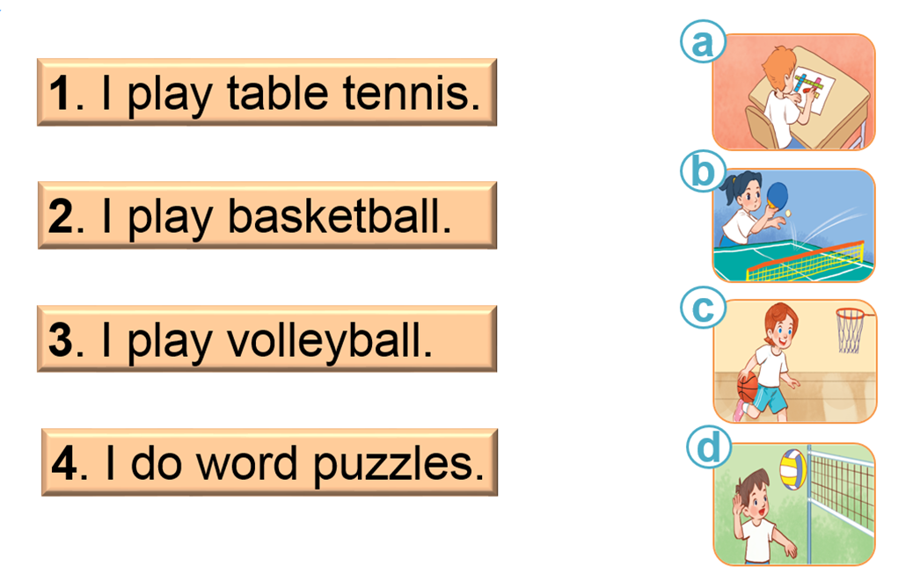
5. Read and match.
1 -b
2 - c
3 - d
4 - a

Slide 17
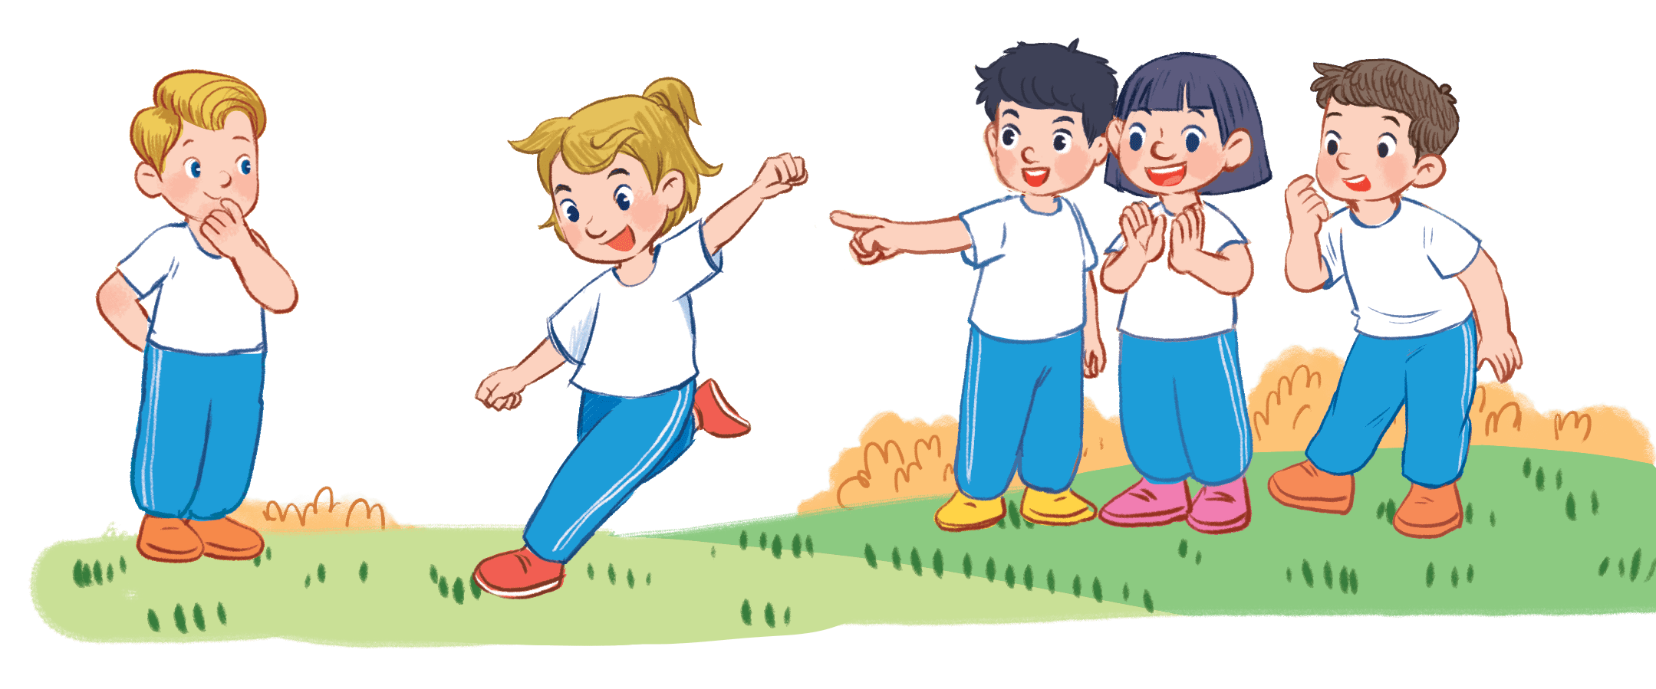
6. Let’s play.
Miming game
play football

Slide 18
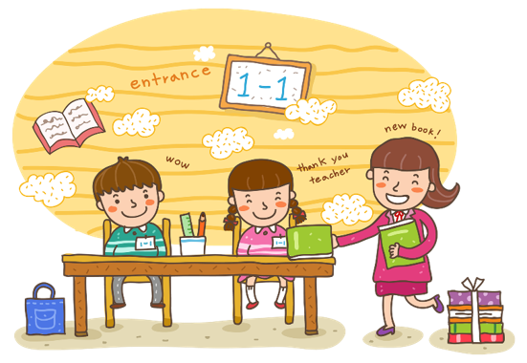
Wrap up

Slide 19


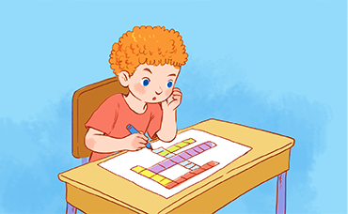
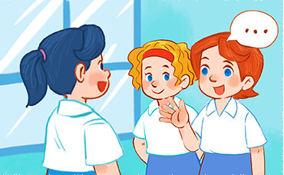
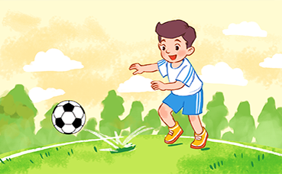
What do you do at break time?
I _________.
do word puzzles
play
table tennis
chat with my friends
play football

Slide 20
Homework
Learn by heart all the new words and the model sentences.
Read again the dialogues in part 1.

Slide 21

Thank you!

